Slide 1

jGRASP Project
Valdosta State University
Fall 2019
Department of Computer Science

Slide 2
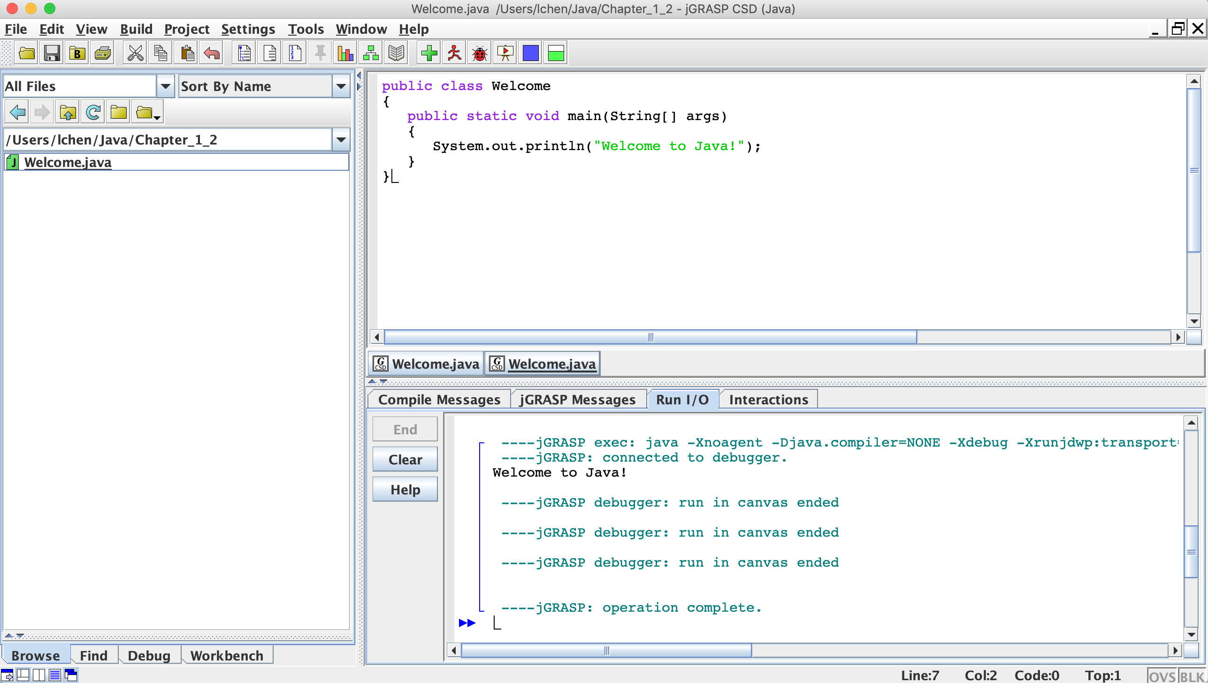
Valdosta State University
1. Create a folder for
a Java Program
2. Create a Java file in
the folder
3. Write the code in
the Java file
Department of Computer Science

Slide 3
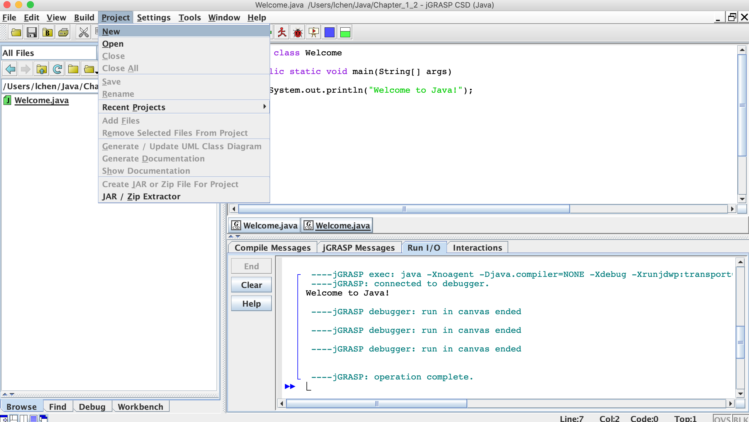
Valdosta State University
Create a project
Department of Computer Science

Slide 4
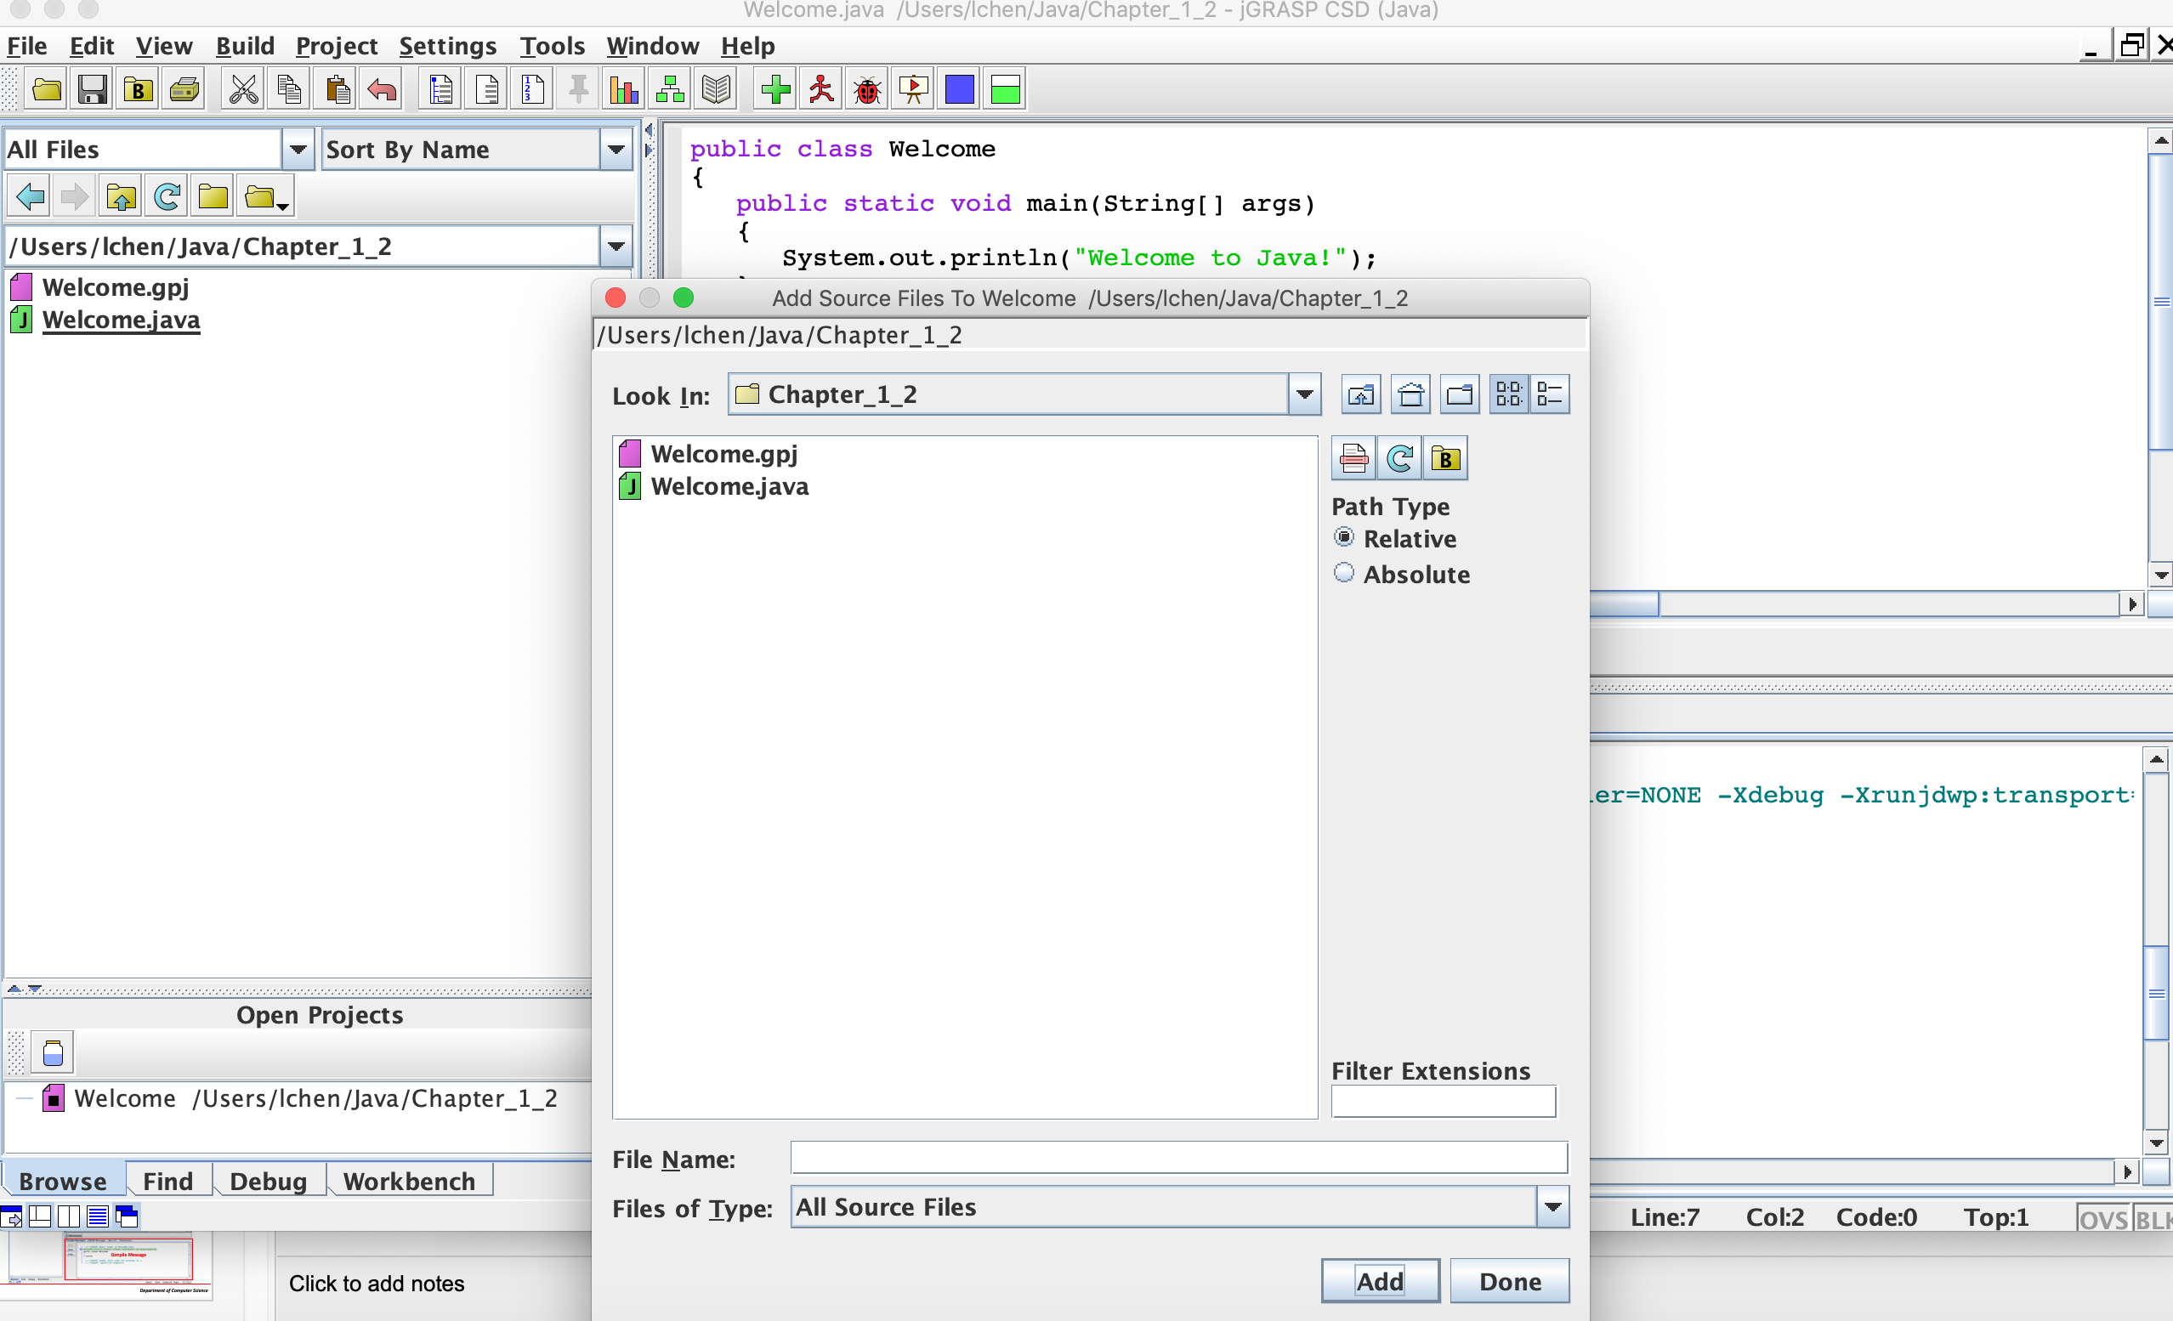
Valdosta State University
Add Java file into the project
Department of Computer Science

Slide 5
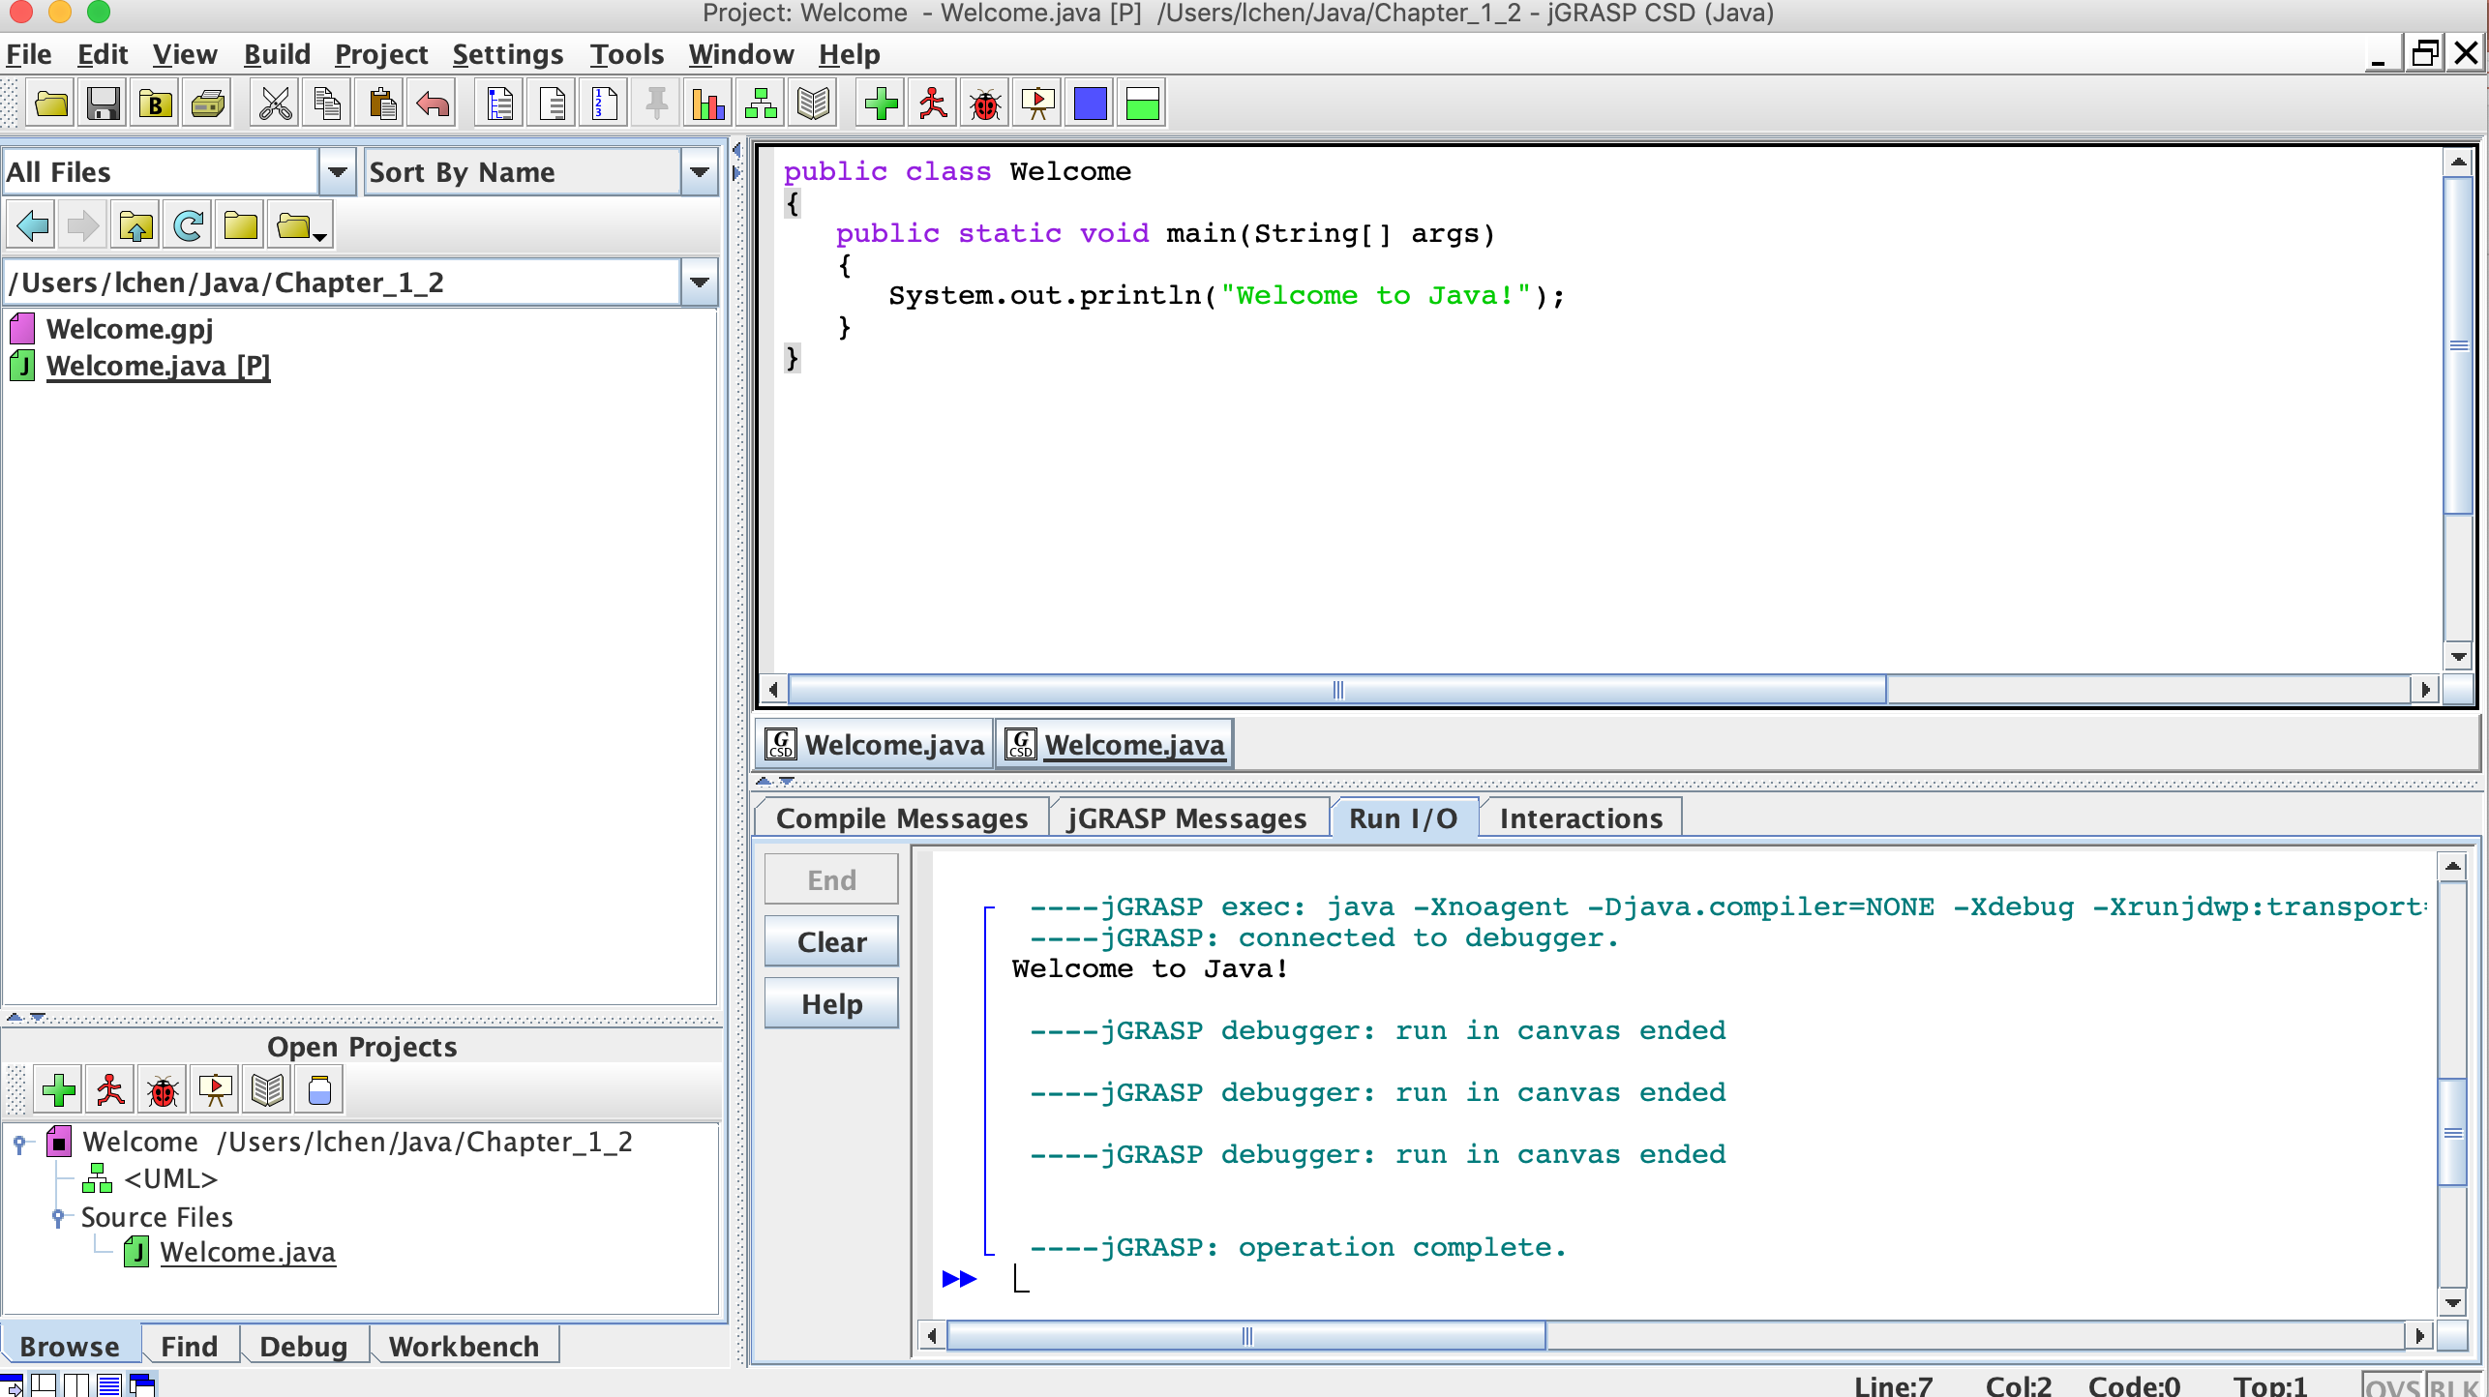
Valdosta State University
Add Java file into the project
Department of Computer Science

Slide 6
Valdosta State University
Generate the documentation
Department of Computer Science

