Slide 1

OCUFLY
Presented by:
Team DEKU

Slide 2
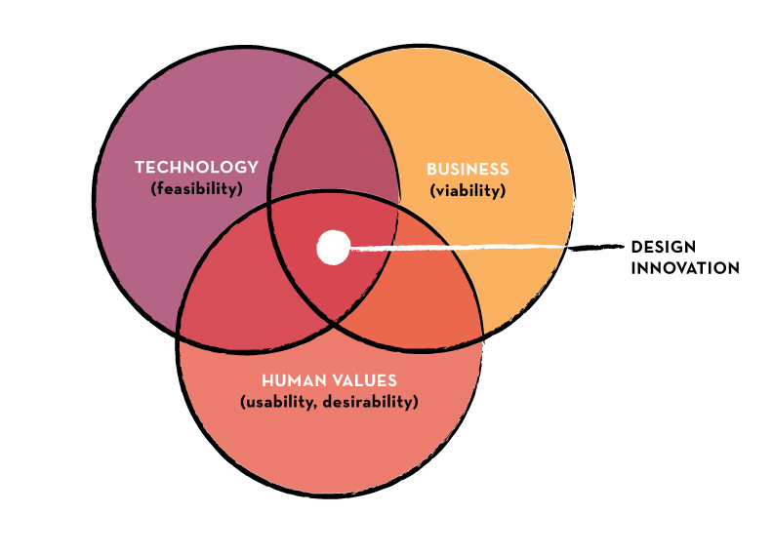
Who We Are…
We are a group of developers who want to see a change in the way emergencies are handled in the 21st century. We wish to bring life saving technology to the heroes who serve us every day. Our goal is to improve their, on the job, performance so that they can provide us with security and safety.

Slide 3

Public Safety
Provide pertinent information to public safety officials
Create a safer environment for the public
Quicker responses to emergencies

Slide 4
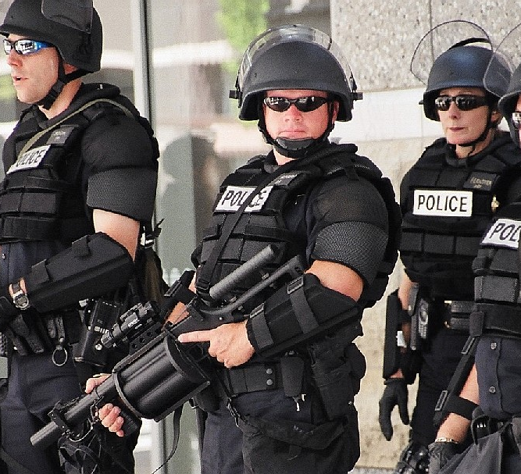
Police
Detect dangerous situations
Scope out potentially dangerous areas before police enter

Slide 5
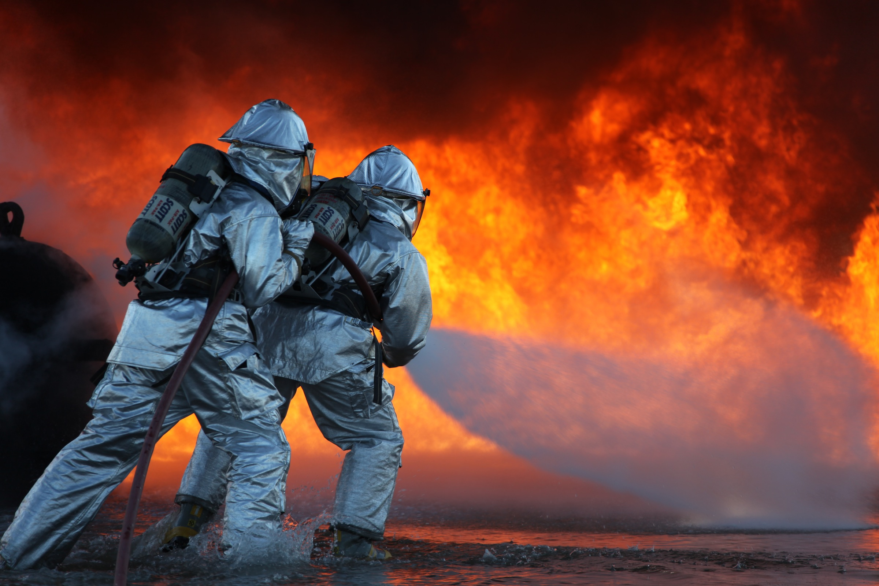
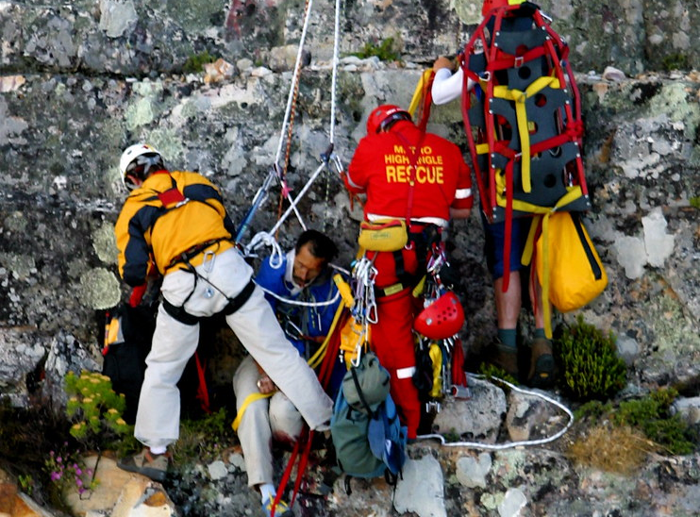
Fire/Rescue
Find victims of wrecks and fires in areas inaccessible to firefighters
Locate missing persons
This Photo by Unknown Author is licensed under CC BY-NC-ND
This Photo by Unknown Author is licensed under CC BY

Slide 6
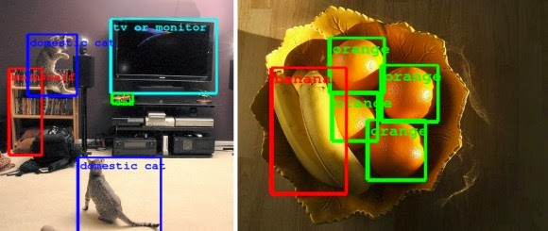
Resources
Python object recognition libraries
Image libraries
This Photo by Unknown Author is licensed under CC BY

Slide 7
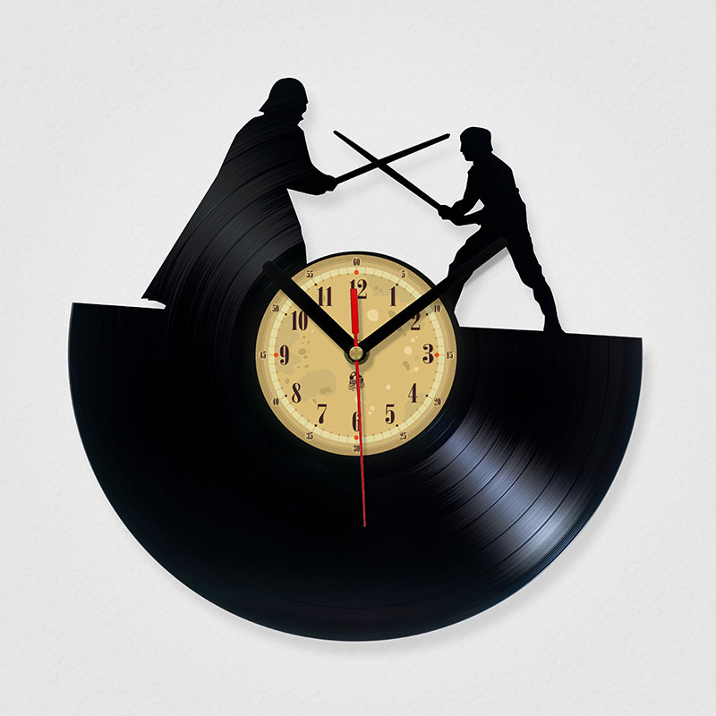
Development Time Frame
We plan on spending 11-13 weeks overall
1 week planning
8-9 weeks in development
1-2 weeks refactoring
1 week final testing

Slide 8
Budget
Personnel Cost: $182, 000
Hardware: $1,300
Misc: $50,000
Total: $233,300

Slide 9
Team DEKU
Product Owner: Joshua Stalvey
Scrum Master: Matthew Hale
Developers: James Faber, Ernest Jackson, Jordan Shellhorse, Tyler Vance, Tianna Vazquez

