Slide 1

Department of Computer Science
Git Tutorial
Spring 2020

Slide 2

Department of Computer Science
Create Github Account
Configuration
Profile
Security
Emails
SSH
Repositories
Organizations

Slide 3
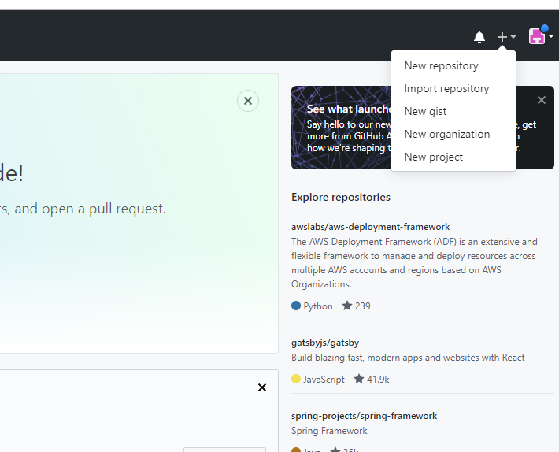
Department of Computer Science
Create a Project Repository
Working on an Individual Project

Slide 4
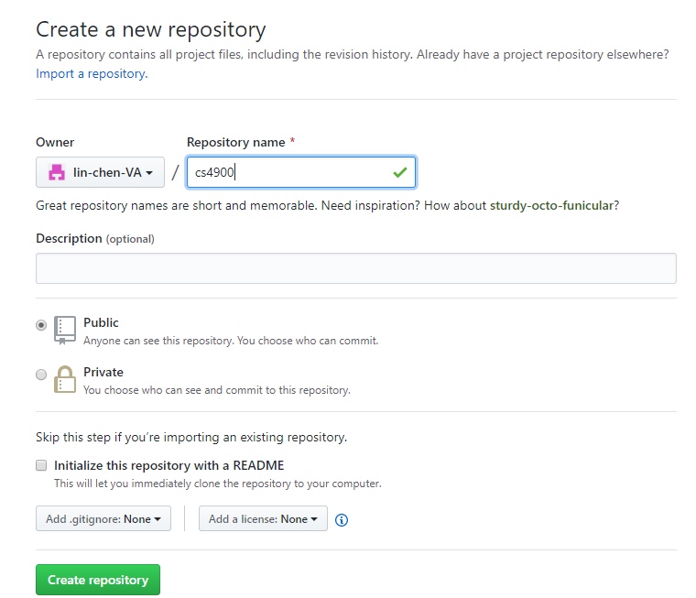
Department of Computer Science
Create a Project Repository
Working on an Individual Project

Slide 5
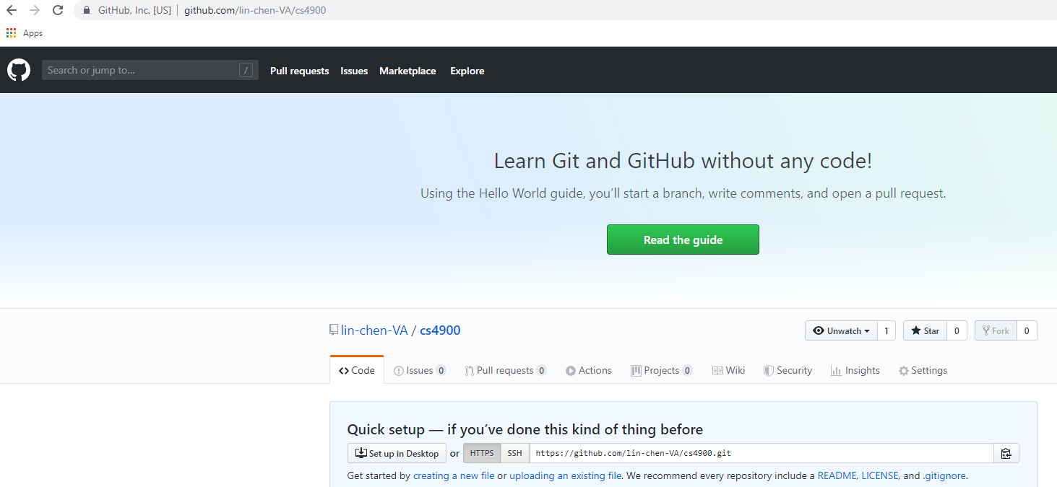
Department of Computer Science
Create a Project Repository
Working on an Individual Project

Slide 6


Department of Computer Science
Deposit the Code to the Repository
name of remote repository
git remote add origin https://github.com/lin-chen-VA/cs4900
/home
Readme
url of remote repository
Project
main.cpp
git remote –v //check the remote repositories
util.h
git push origin master
.git
Working on an Individual Project

Slide 7
Department of Computer Science
Download the Code from the Repository
git clone https://github.com/lin-chen-VA/cs4900
Fetch the Code Generated by Other Developers

Slide 8
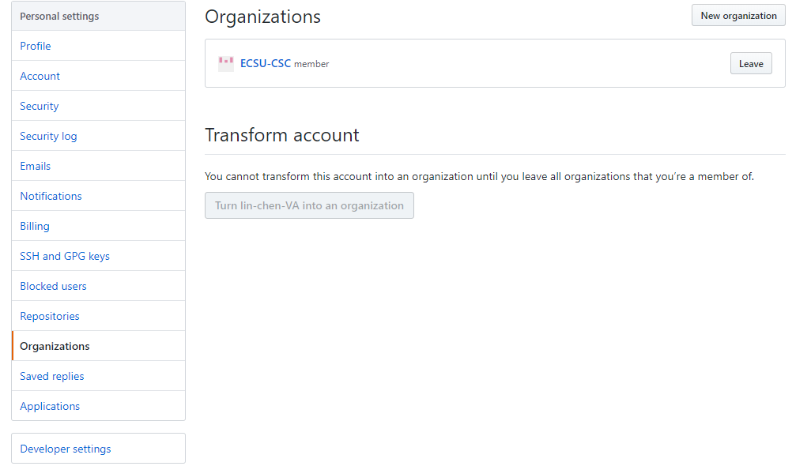
Department of Computer Science
Create an Organization
Team Work

Slide 9
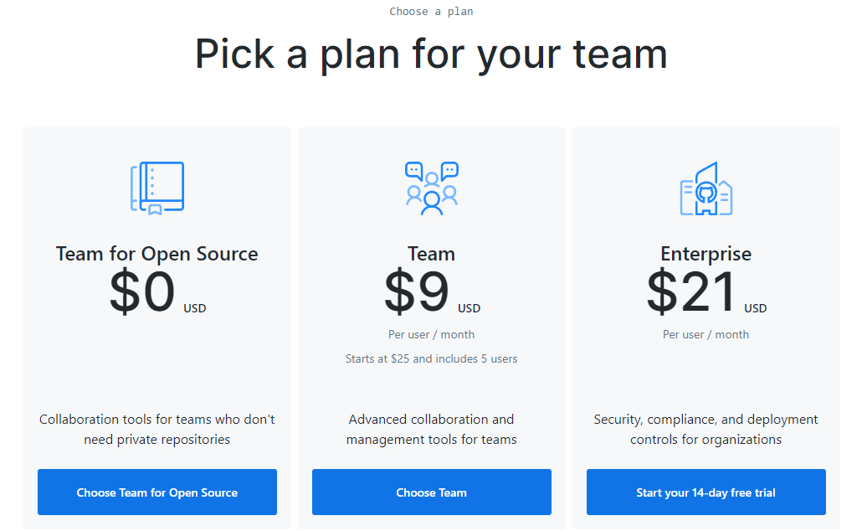
Department of Computer Science
Create an Organization
Team Work

Slide 10
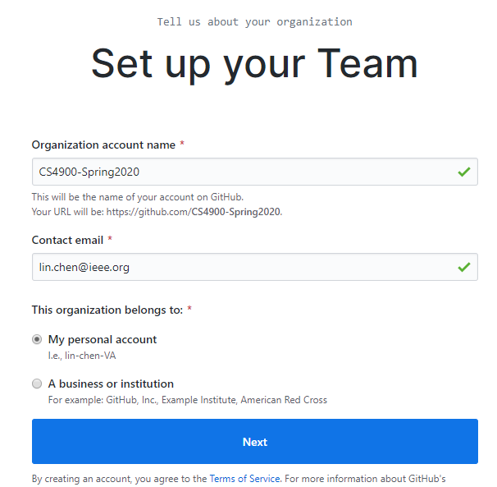
Department of Computer Science
Create an Organization
Team Work

Slide 11
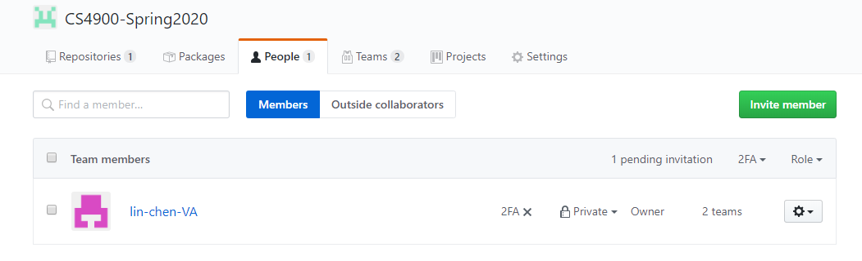
Department of Computer Science
Invite Members for the Organization
Team Work

Slide 12
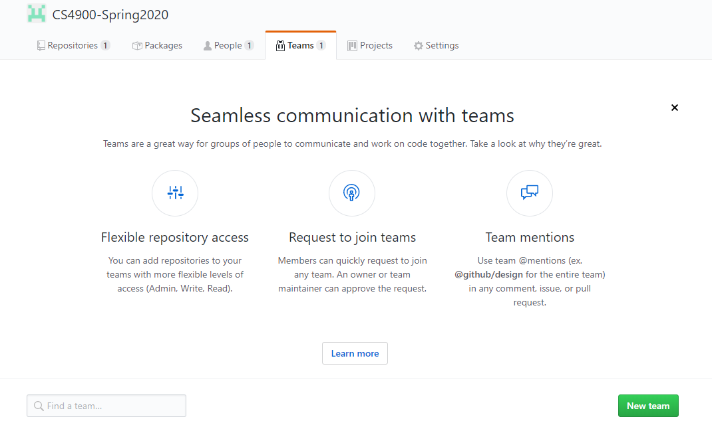
Department of Computer Science
Create Teams for the Organization
Team Work

Slide 13
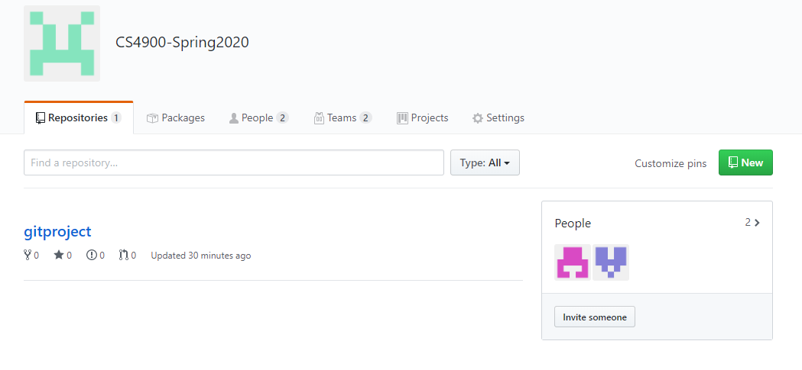
Department of Computer Science
Create Repositories for the Organization
Team Work

Slide 14
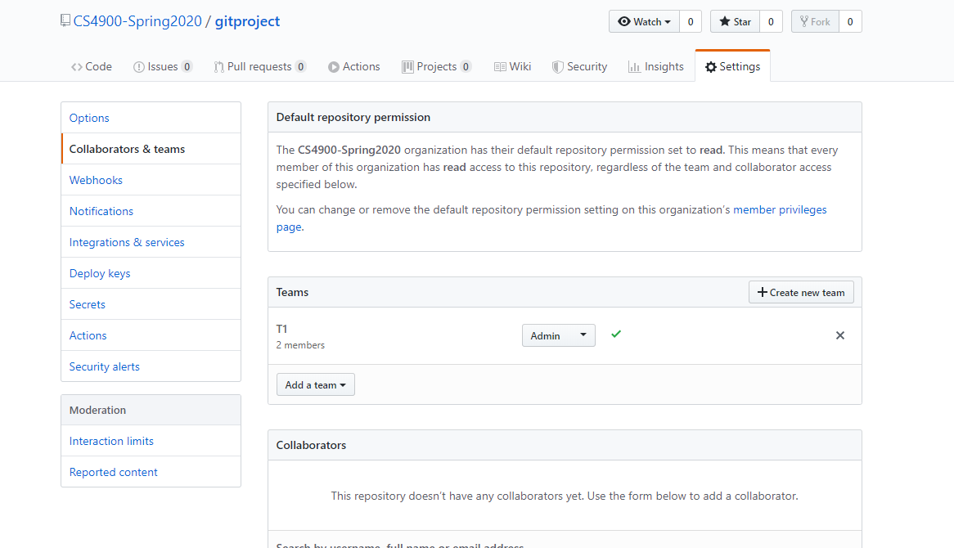
Department of Computer Science
Assign Teams to the Repository
Team Work

Slide 15
Department of Computer Science
Architecture
Organization
Repository_1
Repository_2
Read
Admin
Admin
Team_1
Team_2
Team_3
Team_4
Member_1
Member_2
Member_3
Member_4
Member_5
Team Work

Slide 16
Department of Computer Science
Teamwork
Create an account for your team
Create a organization for your team
Invite your team members into the organization
Create a team and assign all team members into the team
Create a repository “project_1”
Assign the team created to “project_1”

Slide 17
Department of Computer Science
Teamwork
Remote Repository
Programmer A
Programmer B
Programmer C

Slide 18
Department of Computer Science
Teamwork
git clone projectURL
Create a file
git add *
git commit –am “Comment”
git push origin master
Remote Repository
Programmer A
Programmer B
Programmer C
V1

Slide 19
Department of Computer Science
Teamwork
git clone projectURL
Update the file
git add *
git commit –am “Comment”
git push origin master
Remote Repository
Programmer A
Programmer B
Programmer C
V1
V1
V2

Slide 20
Department of Computer Science
Teamwork
Update the file
git add *
git commit -am “Commit”
git fetch origin
git branch –a
git log –graph –all
git merge origin/master
git push origin master
Remote Repository
Programmer A
Programmer B
Programmer C
V1
V2
Merge

