Slide 1
Basic Structures: Sets, Functions, Sequences, Sums, and Matrices
Chapter 2
With Question/Answer Animations

Slide 2
Sets
Section 2.1

Slide 3
Introduction
Sets are one of the basic building blocks for the types of objects considered in discrete mathematics.
Important for counting.
Programming languages have set operations.
Set theory is an important branch of mathematics.
Many different systems of axioms have been used to develop set theory.
Here we are not concerned with a formal set of axioms for set theory. Instead, we will use what is called naïve set theory.

Slide 4
Sets
A set is an unordered collection of objects.
the students in this class
the chairs in this room
The objects in a set are called the elements, or members of the set. A set is said to contain its elements.
The notation a ∈ A denotes that a is an element of the set A.
If a is not a member of A, write a ∉ A

Slide 5
Describing a Set: Roster Method
S = {a,b,c,d}
Order not important
S = {a,b,c,d} = {b,c,a,d}
Each distinct object is either a member or not; listing more than once does not change the set.
S = {a,b,c,d} = {a,b,c,b,c,d}
Elipses (…) may be used to describe a set without listing all of the members when the pattern is clear.
S = {a,b,c,d, ……,z }

Slide 6
Roster Method
List all members between braces
Set of all vowels in the English alphabet:
V = {a,e,i,o,u}
Set of all odd positive integers less than 10:
O = {1,3,5,7,9}
Set of all positive integers less than 100:
S = {1,2,3,……..,99}
Set of all integers less than 0:
S = {…., -3,-2,-1}

Slide 7
Some Important Sets
N = natural numbers = {0,1,2,3….}
Z = integers = {…,-3,-2,-1,0,1,2,3,…}
Z⁺ = positive integers = {1,2,3,…..}
R = set of real numbers
R⁺ = set of positive real numbers
C = set of complex numbers.
Q = set of rational numbers

Slide 8
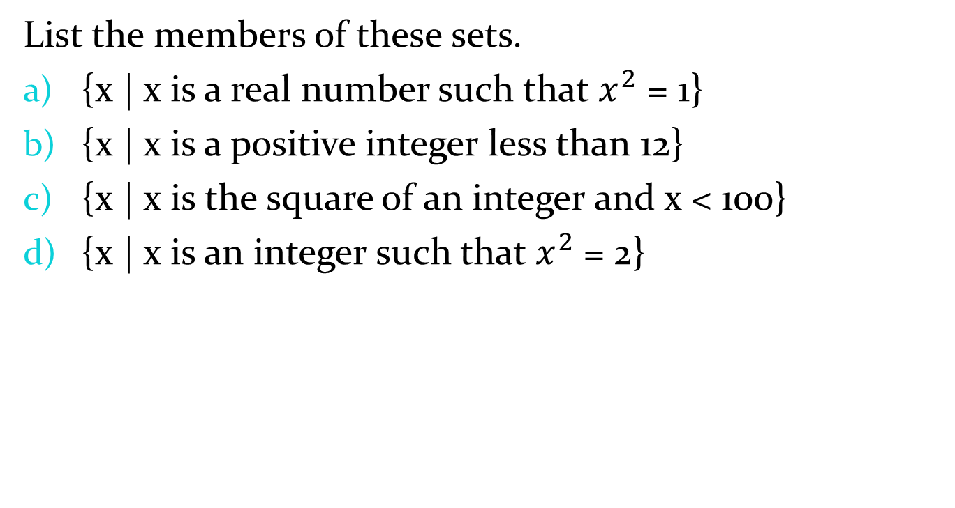
Classroom Exercise
List the members of these sets.
{x | x is a real number such that $x^{2}$ = 1}
{x | x is a positive integer less than 12}
{x | x is the square of an integer and x < 100}
{x | x is an integer such that $x^{2}$= 2}

Slide 9
Set-Builder Notation
Specify the property or properties that all members must satisfy:
S = {x | x is a positive integer less than 100}
O = {x | x is an odd positive integer less than 10}
O = {x ∈ Z⁺ | x is odd and x < 10}
A predicate may be used:
S = {x | P(x)}
Example: S = {x | Prime(x)}
Positive rational numbers:
Q⁺ = {x ∈ R | x = p/q, for some positive integers p,q}

Slide 10
Classroom Exercise
Use set builder notation to give a description of each of
these sets.
{0, 3, 6, 9, 12}
{−3,−2,−1, 0, 1, 2, 3}
{m, n, o, p}

Slide 11
Interval Notation
[a,b] = {x | a ≤ x ≤ b}
[a,b) = {x | a ≤ x < b}
(a,b] = {x | a < x ≤ b}
(a,b) = {x | a < x < b}
closed interval [a,b]
open interval (a,b)

Slide 12
Data Type in Java
Boolean
Integer
Float

Slide 13
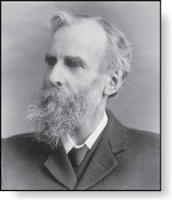
Universal Set and Empty Set
The universal set U is the set containing everything currently under consideration.
Sometimes implicit
Sometimes explicitly stated.
Contents depend on the context.
The empty set is the set with no
elements. Symbolized ∅, but
{} also used.
Venn Diagram
U
V
a e i
o u
Null Set
John Venn (1834-1923)
Cambridge, UK

Slide 14
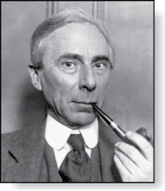
Russell’s Paradox
Let S be the set of all sets which are not members of themselves. A paradox results from trying to answer the question “Is S a member of itself?”
Related Paradox:
Henry is a barber who shaves all people who do not shave themselves. A paradox results from trying to answer the question “Does Henry shave himself?”
Bertrand Russell (1872-1970)
Cambridge, UK
Nobel Prize Winner

Slide 15
Some things to remember
Sets can be elements of sets.
{{1,2,3},a, {b,c}}
{N,Z,Q,R}
The empty set is different from a set containing the empty set.
∅ ≠ { ∅ }

Slide 16
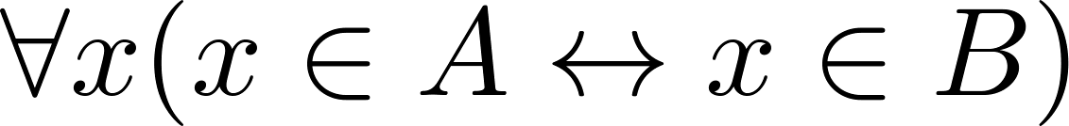
Set Equality
Definition: Two sets are equal if and only if they have the same elements.
Therefore if A and B are sets, then A and B are equal if and only if .
We write A = B if A and B are equal sets.
{1,3,5} = {3, 5, 1}
{1,5,5,5,3,3,1} = {1,3,5}

Slide 17
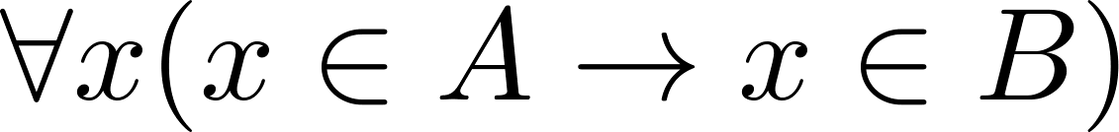
Subsets
Definition: The set A is a subset of B, if and only if every element of A is also an element of B.
The notation A ⊆ B is used to indicate that A is a subset of the set B.
A ⊆ B holds if and only if is true.
Because a ∈ ∅ is always false, ∅ ⊆ S ,for every set S.
Because a ∈ S → a ∈ S, S ⊆ S, for every set S.
A = {1, 2, 3}
B = {1, 2, 3, 4}
A = {1, 2, 3, 4}
B = {1, 2, 3, 4}
A = ∅
B = {1, 2, 3, 4}

Slide 18
Showing a Set is or is not a Subset of Another Set
Showing that A is a Subset of B: To show that A ⊆ B, show that if x belongs to A, then x also belongs to B.
Showing that A is not a Subset of B: To show that A is not a subset of B, A ⊈ B, find an element x ∈ A with x ∉ B. (Such an x is a counterexample to the claim that x ∈ A implies x ∈ B.)
Examples:
The set of all computer science majors at your school is a subset of all students at your school.
The set of integers with squares less than 100 is not a subset of the set of nonnegative integers.

Slide 19
Another look at Equality of Sets
Recall that two sets A and B are equal, denoted by A = B, iff
Using logical equivalences we have that A = B iff
This is equivalent to
A ⊆ B and B ⊆ A

Slide 20
Proper Subsets
Definition: If A ⊆ B, but A ≠B, then we say A is a proper subset of B, denoted by A ⊂ B. If A ⊂ B, then
is true.
Venn Diagram
A = {1, 2, 3}
B = {1, 2, 3, 4}
U
B
A

Slide 21
Classroom Exercise
Determine whether each of these statements is true or
false.
x ∈ {x}
{x} ⊆ {x}
{x} ∈ {x}
{x} ∈ {{x}}
∅ ⊆ {x}
∅ ∈ {x}

Slide 22
Set Cardinality
Definition: If there are exactly n distinct elements in S where n is a nonnegative integer, we say that S is finite. Otherwise it is infinite.
Definition: The cardinality of a finite set A, denoted by |A|, is the number of (distinct) elements of A.
Examples:
|ø| = 0
Let S be the letters of the English alphabet. Then |S| = 26
|{1,2,3}| = 3
|{ø}| = 1
The set of integers is infinite.

Slide 23
Classroom Exercise
What is the cardinality of each of these sets?
∅ 0
{∅} 1
{∅, {∅}} 2
{∅, {∅}, {∅, {∅}}} 3

Slide 24
Power Sets
Definition: The set of all subsets of a set A, denoted P(A), is called the power set of A.
Example: If A = {a,b} then
P(A) = {ø, {a},{b},{a,b}}
If a set has n elements, then the cardinality of the power set is 2ⁿ. (In Chapters 5 and 6, we will discuss different ways to show this.)

Slide 25
Power Sets
Definition: The set of all subsets of a set A, denoted P(A), is called the power set of A.
Example: If A = {a,b} then
P(A) = {ø, {a},{b},{a,b}}
If a set has n elements, then the cardinality of the power set is 2ⁿ. (In Chapters 5 and 6, we will discuss different ways to show this.)

Slide 26
Exercise
Example: If A = {0, 1, 2} then
P(A)

Slide 27
Tuples
The ordered n-tuple (a₁,a₂,…..,a_{n}) is the ordered collection that has a₁ as its first element and a₂ as its second element and so on until a_{n} as its last element.
Two n-tuples are equal if and only if their corresponding elements are equal.
2-tuples are called ordered pairs.
The ordered pairs (a,b) and (c,d) are equal if and only if a = c and b = d.

Slide 28
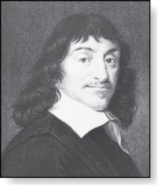
Cartesian Product
René Descartes (1596-1650)
Definition: The Cartesian Product of two sets A and B, denoted by A × B is the set of ordered pairs (a,b) where a ∈ A and b ∈ B .
Example:
A = {a,b} B = {1,2,3}
A × B = {(a,1),(a,2),(a,3), (b,1),(b,2),(b,3)}
Definition: A subset R of the Cartesian product A × B is called a relation from the set A to the set B. (Relations will be covered in depth in Chapter 9. )

Slide 29
Exercise
René Descartes (1596-1650)
Example:
A = {a,b} B = {1,2,3}
B × A =
|A| = m
|B| = n
|B × A| =

Slide 30
Classroom Exercise
Let A = {a, b, c, d} and B = {y, z}. Find
A × B.
B × A.

Slide 31
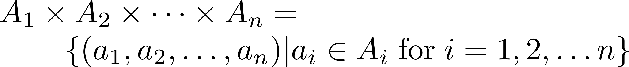
Cartesian Product
Definition: The cartesian products of the sets A₁,A₂,……,A_{n}, denoted by A₁ × A₂ × …… × A_{n} , is the set of ordered n-tuples (a₁,a₂,……,a_{n}) where a_{i} belongs to A_{i} for i = 1, … n.
Example: What is A × B × C where A = {0,1}, B = {1,2} and C = {0,1,2}
Solution: A × B × C = {(0,1,0), (0,1,1), (0,1,2),(0,2,0), (0,2,1), (0,2,2),(1,1,0), (1,1,1), (1,1,2), (1,2,0), (1,2,1), (1,1,2)}

Slide 32
Classroom Exercise
Let A = {1, 2}
A² = A × A
A³ = A × A × A

Slide 33
Relation
Definition: A subset R of the Cartesian product A × B
Example: What are the order pairs in the less than or equal to relation, which contains (a, b) if a <= b, A = {0, 1, 2}, B = {0, 1, 2}

Slide 34
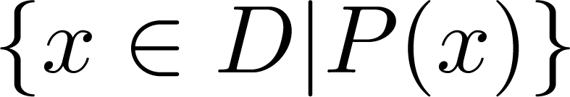
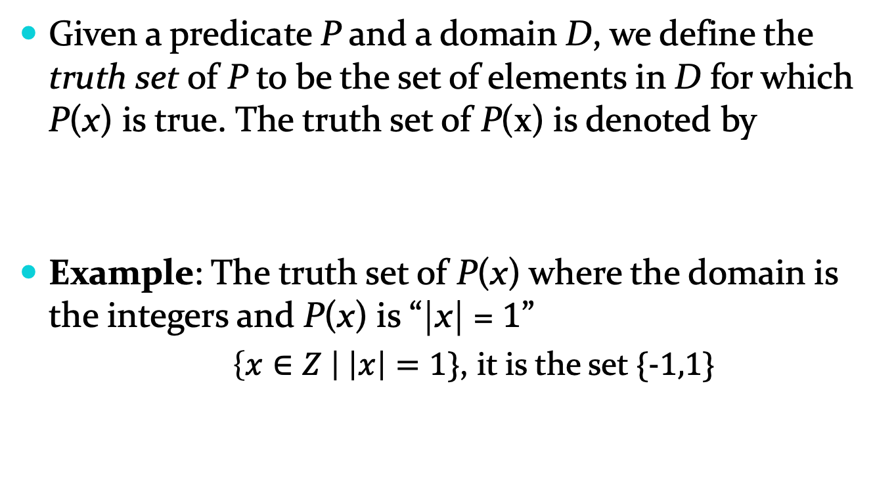
Truth Sets of Quantifiers
Given a predicate P and a domain D, we define the truth set of P to be the set of elements in D for which P(x) is true. The truth set of P(x) is denoted by
Example: The truth set of P(x) where the domain is the integers and P(x) is “|x| = 1”
$\left\{x∈Z \right| \left|x\right|=1\}$, it is the set {-1,1}

Slide 35
Exercise
Example: The truth set of P(x) where the domain is the integers and P(x) is “x² < 10”

Slide 36
Set Operations
Section 2.2

Slide 37
Boolean Algebra
Propositional calculus and set theory are both instances of an algebraic system called a Boolean Algebra. This is discussed in Chapter 12.
The operators in set theory are analogous to the corresponding operator in propositional calculus.
As always there must be a universal set U. All sets are assumed to be subsets of U.

Slide 38
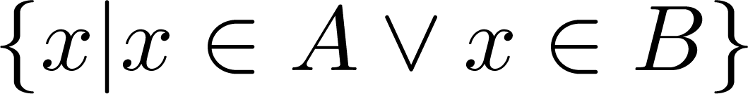
Union
Definition: Let A and B be sets. The union of the sets A and B, denoted by A ∪ B, is the set:
Example: What is {1,2,3} ∪ {3, 4, 5}?
Solution: {1,2,3,4,5}
Venn Diagram for A ∪ B
U
A
B

Slide 39
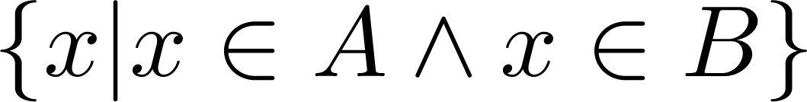
Intersection
Definition: The intersection of sets A and B, denoted by A ∩ B, is
Note if the intersection is empty, then A and B are said to be disjoint.
Example: What is? {1,2,3} ∩ {3,4,5} ?
Solution: {3}
Example:What is?
{1,2,3} ∩ {4,5,6} ?
Solution: ∅
Venn Diagram for A ∩B
U
A
B

Slide 40
Complement
Definition: If A is a set, then the complement of the A (with respect to U), denoted by Ā is the set U - A
Ā = {x ∈ U | x ∉ A}
(The complement of A is sometimes denoted by A^{c} .)
Example: If U is the positive integers less than 100, what is the complement of {x | x > 70}
Solution: {x | x ≤ 70}
Venn Diagram for Complement
U
Ā
A

Slide 41
Difference
Definition: Let A and B be sets. The difference of A and B, denoted by A – B, is the set containing the elements of A that are not in B. The difference of A and B is also called the complement of B with respect to A.
A – B = {x | x ∈ A ∧ x ∉ B} = A ∩‾B
U
Venn Diagram for A − B
A
B

Slide 42
Classroom Exercise
Let A = {a, b, c, d, e} and B = {a, b, c, d, e, f, g, h}.
Find
A ∪ B.
A ∩ B.
A − B.
B − A.

Slide 43
The Cardinality of the Union of Two Sets
Inclusion-Exclusion
|A ∪ B| = |A| + | B| - |A ∩ B|
Example: Let A be the math majors in your class and B be the CS majors. To count the number of students who are either math majors or CS majors, add the number of math majors and the number of CS majors, and subtract the number of joint CS/math majors.
We will return to this principle in Chapter 6 and Chapter 8 where we will derive a formula for the cardinality of the union of n sets, where n is a positive integer.
U
A
B
Venn Diagram for A, B, A ∩ B, A ∪ B

Slide 44
Review Questions
Example: U = {0,1,2,3,4,5,6,7,8,9,10} A = {1,2,3,4,5}, B ={4,5,6,7,8}
A ∪ B
Solution: {1,2,3,4,5,6,7,8}
A ∩ B
Solution: {4,5}
Ā
Solution: {0,6,7,8,9,10}
Solution: {0,1,2,3,9,10}
A – B
Solution: {1,2,3}
B – A
Solution: {6,7,8}

Slide 45

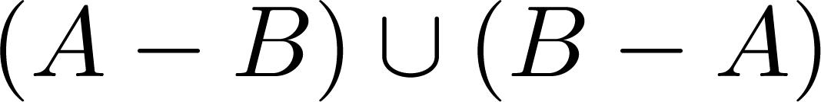
Symmetric Difference (optional)
Definition: The symmetric difference of A and B, denoted by is the set
Example:
U = {0,1,2,3,4,5,6,7,8,9,10}
A = {1,2,3,4,5} B ={4,5,6,7,8}
What is:
Solution: {1,2,3,6,7,8}
U
A
B
Venn Diagram

Slide 46



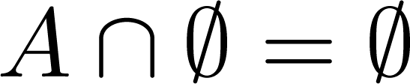


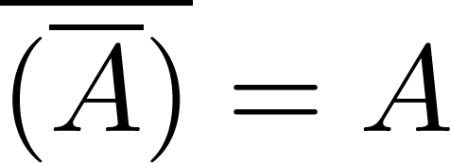
Set Identities
Identity laws
Domination laws
Idempotent laws
Complementation law
Continued on next slide →

Slide 47


Set Identities
Commutative laws
Associative laws
Distributive laws
Continued on next slide →

Slide 48


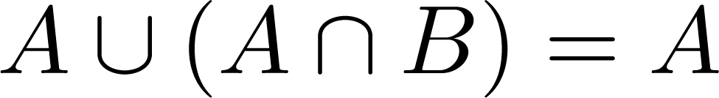
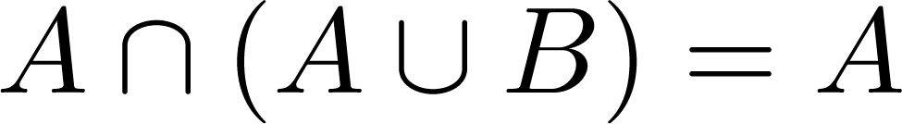

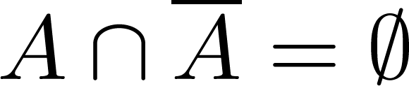
Set Identities
De Morgan’s laws
Absorption laws
Complement laws

Slide 49
Proving Set Identities
Different ways to prove set identities:
Prove that each set (side of the identity) is a subset of the other.
Use set builder notation and propositional logic.
Membership Tables: Verify that elements in the same combination of sets always either belong or do not belong to the same side of the identity. Use 1 to indicate it is in the set and a 0 to indicate that it is not.

Slide 50
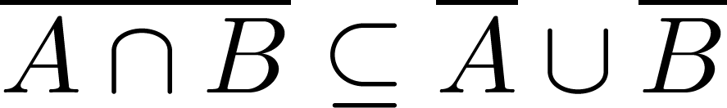

Proof of Second De Morgan Law
Example: Prove that
Solution: We prove this identity by showing that:
1) and
2)
Continued on next slide →

Slide 51
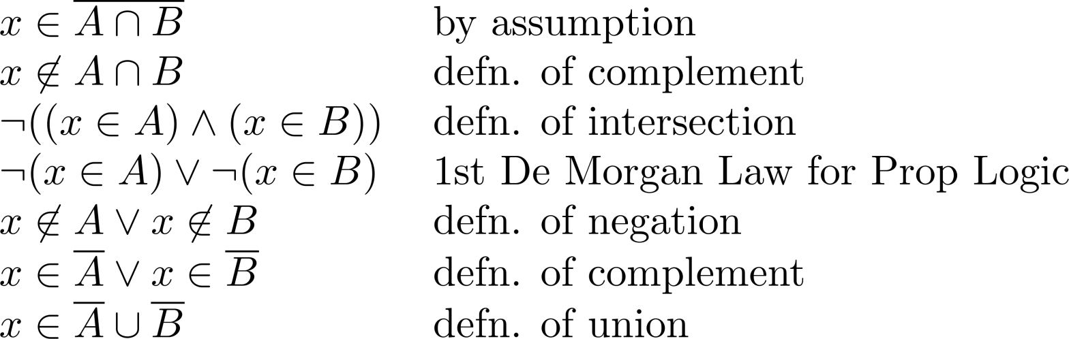
Proof of Second De Morgan Law
These steps show that:
Continued on next slide →

Slide 52
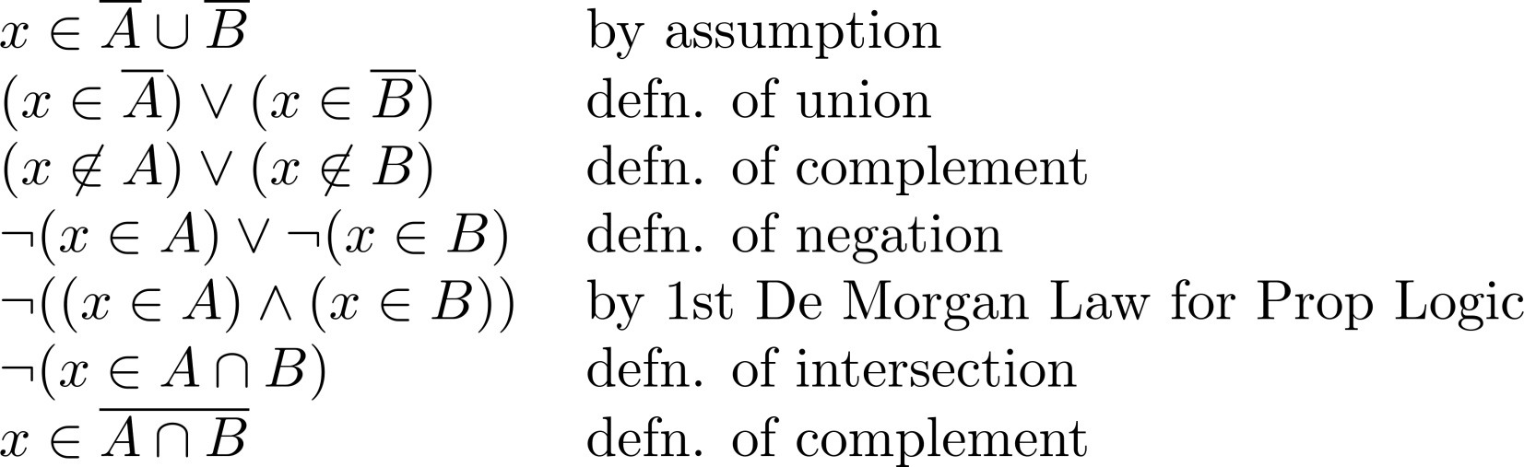
Proof of Second De Morgan Law
These steps show that:

Slide 53
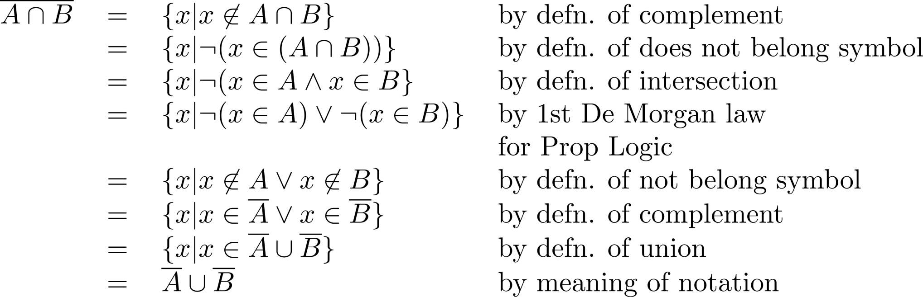
Set-Builder Notation: Second De Morgan Law

Slide 54





Membership Table
Example:
Construct a membership table to show that the distributive law holds.
Solution:
A | B | C
1 | 1 | 1 | 1 | 1 | 1 | 1 | 1
1 | 1 | 0 | 0 | 1 | 1 | 1 | 1
1 | 0 | 1 | 0 | 1 | 1 | 1 | 1
1 | 0 | 0 | 0 | 1 | 1 | 1 | 1
0 | 1 | 1 | 1 | 1 | 1 | 1 | 1
0 | 1 | 0 | 0 | 0 | 1 | 0 | 0
0 | 0 | 1 | 0 | 0 | 0 | 1 | 0
0 | 0 | 0 | 0 | 0 | 0 | 0 | 0

Slide 55
Exercise
Example:
$$\overline{A∪(B∩C)}=(\overline{C}∪\overline{B})∩\overline{A}$$

Slide 56
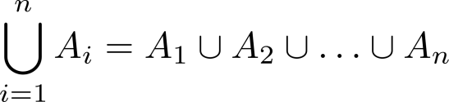
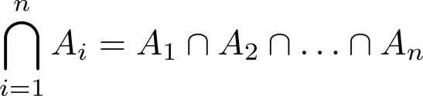
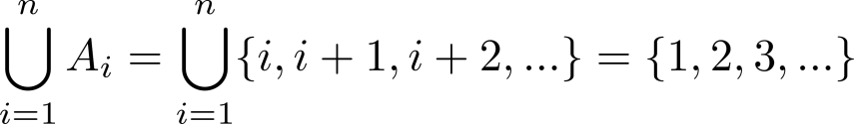
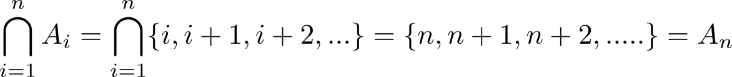
Generalized Unions and Intersections
Let A₁, A₂ ,…, A_{n} be an indexed collection of sets.
We define:
These are well defined, since union and intersection are associative.
For i = 1,2,…, let A_{i} = {i, i + 1, i + 2, ….}. Then,

Slide 57
Functions
Section 2.3

Slide 58
Functions
Definition: Let A and B be nonempty sets. A function f from A to B, denoted f: A → B is an assignment of each element of A to exactly one element of B. We write f(a) = b if b is the unique element of B assigned by the function f to the element a of A.
Functions are sometimes
called mappings or
transformations.
Students
Grades
A
Carlota Rodriguez
B
Sandeep Patel
C
Jalen Williams
D
F
Kathy Scott

Slide 59
Functions
A function f: A → B can also be defined as a subset of A×B (a relation). This subset is restricted to be a relation where no two elements of the relation have the same first element.
Specifically, a function f from A to B contains one, and only one ordered pair (a, b) for every element a∈ A.
and

Slide 60
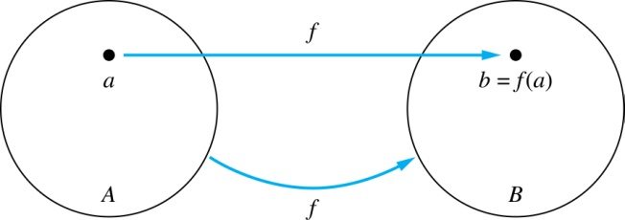
Functions
Given a function f: A → B:
We say f maps A to B or
f is a mapping from A to B.
A is called the domain of f.
B is called the codomain of f.
If f(a) = b,
then b is called the image of a under f.
a is called the preimage of b.
The range of f is the set of all images of points in A under f. We denote it by f(A).
Two functions are equal when they have the same domain, the same codomain and map each element of the domain to the same element of the codomain.

Slide 61
Representing Functions
Functions may be specified in different ways:
An explicit statement of the assignment.
Students and grades example.
A formula.
f(x) = x + 1
A computer program.
A Java program that when given an integer n, produces the nth Fibonacci Number (covered in the next section and also inChapter 5).

Slide 62
Questions
z
A
B
f(a) = ?
The image of d is ?
z
a
x
The domain of f is ?
A
b
y
The codomain of f is ?
B
c
d
z
The preimage of y is ?
b
f(A) = ?
The preimage(s) of z is (are) ?
{a,c,d}

Slide 63
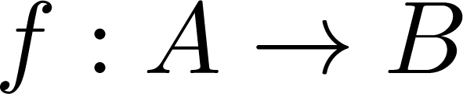
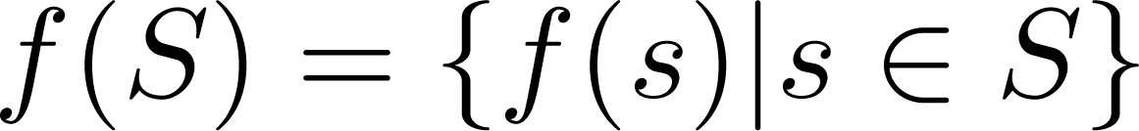
Question on Functions and Sets
If and S is a subset of A, then
A
B
f {a,b,c,} is ?
{y,z}
a
x
f {c,d} is ?
b
{z}
y
c
d
z

Slide 64
Injections
Definition: A function f is said to be one-to-one , or injective, if and only if f(a) = f(b) implies that a = b for all a and b in the domain of f. A function is said to be an injection if it is one-to-one.
A
B
a
x
v
b
y
c
z
d
w

Slide 65

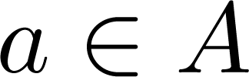
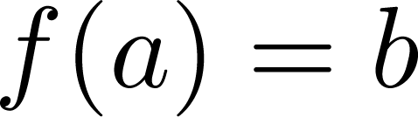
Surjections
Definition: A function f from A to B is called onto or surjective, if and only if for every element there is an element with . A function f is called a surjection if it is onto.
A
B
a
x
b
y
c
z
d

Slide 66
Bijections
Definition: A function f is a one-to-one correspondence, or a bijection, if it is both one-to-one and onto (surjective and injective).
A
B
a
x
b
y
c
d
z
w

Slide 67
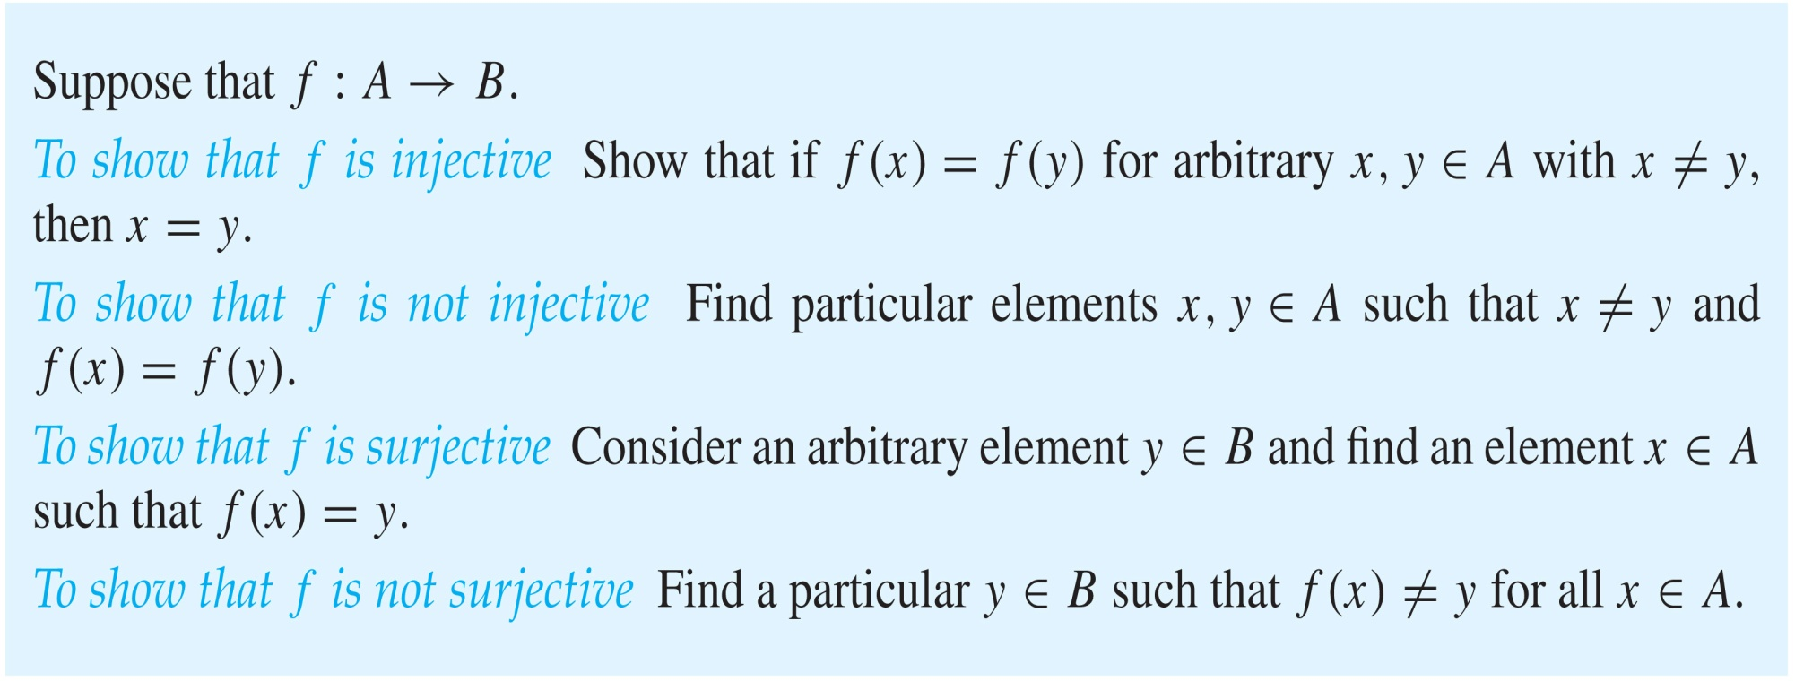
Showing that f is one-to-one or onto

Slide 68
Showing that f is one-to-one or onto
Example 1: Let f be the function from {a,b,c,d} to {1,2,3} defined by f(a) = 3, f(b) = 2, f(c) = 1, and f(d) = 3. Is f an onto function?
Solution: Yes, f is onto since all three elements of the codomain are images of elements in the domain. If the codomain were changed to {1,2,3,4}, f would not be onto.
Example 2: Is the function f(x) = x² from the set of integers onto?
Solution: No, f is not onto because there is no integer x with x² = −1, for example.

Slide 69
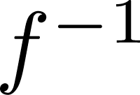
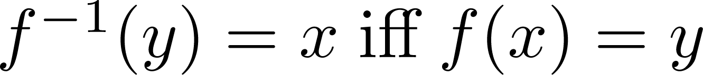
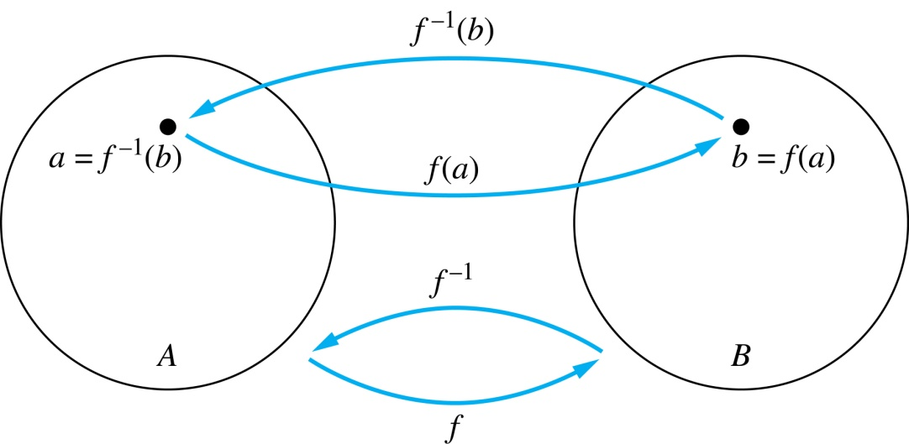
Inverse Functions
Definition: Let f be a bijection from A to B. Then the inverse of f, denoted , is the function from B to A defined as
No inverse exists unless f is a bijection. Why?

Slide 70
Inverse Functions
A
B
A
B
f
a
V
V
a
b
b
W
W
c
c
d
X
X
d
Y
Y

Slide 71
Questions
Example 1: Let f be the function from {a,b,c} to {1,2,3} such that f(a) = 2, f(b) = 3, and f(c) = 1. Is f invertible and if so what is its inverse?
Solution: The function f is invertible because it is a one-to-one correspondence. The inverse function f⁻¹ reverses the correspondence given by f, so f⁻¹ (1) = c, f⁻¹ (2) = a, and f⁻¹ (3) = b.

Slide 72
Questions
Example 2: Let f: Z → Z be such that f(x) = x + 1. Is f invertible, and if so, what is its inverse?
Solution: The function f is invertible because it is a one-to-one correspondence. The inverse function f⁻¹ reverses the correspondence so f⁻¹ (y) = y – 1.

Slide 73
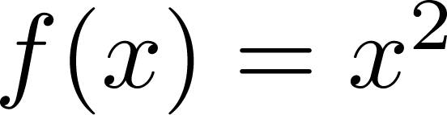
Questions
Example 3: Let f: R → R be such that . Is f invertible, and if so, what is its inverse?
Solution: The function f is not invertible because it is not one-to-one .

Slide 74
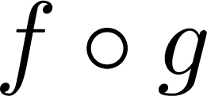
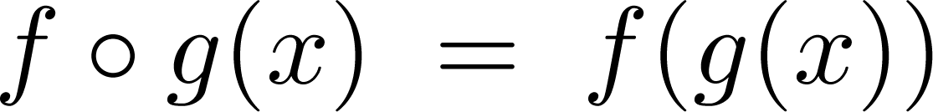
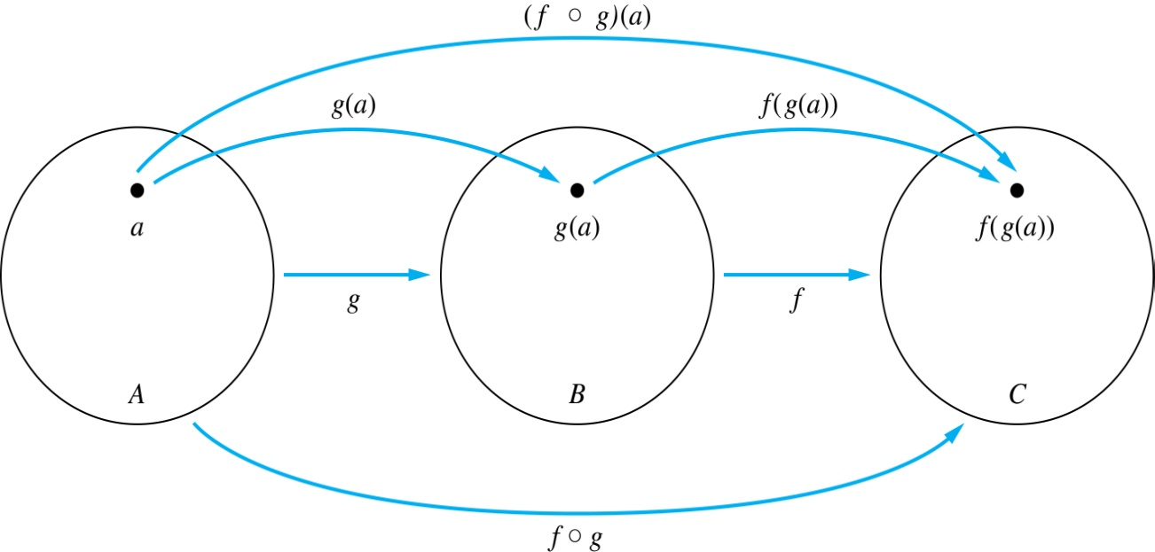
Composition
Definition: Let f: B → C, g: A → B. The composition of f with g, denoted is the function from A to C defined by

Slide 75
Composition
A
g
B
f
C
A
C
V
a
a
h
h
b
i
b
W
i
c
c
X
j
d
d
j
Y

Slide 76
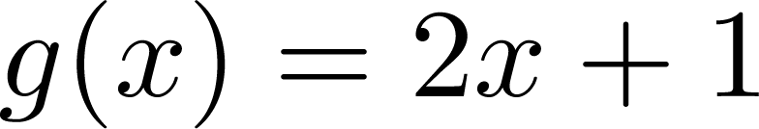
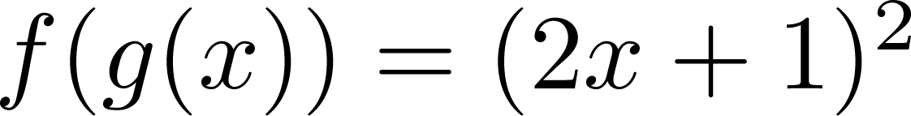
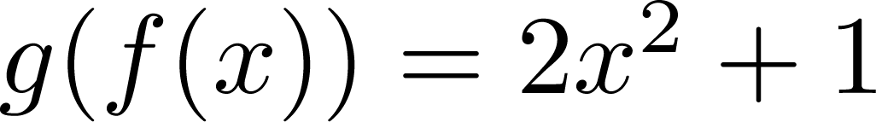
Composition
Example 1: If and , then
and

Slide 77
Composition Questions
Example 2: Let g be the function from the set {a,b,c} to itself such that g(a) = b, g(b) = c, and g(c) = a. Let f be the function from the set {a,b,c} to the set {1,2,3} such that f(a) = 3, f(b) = 2, and f(c) = 1.
What is the composition of f and g, and what is the composition of g and f.
Solution: The composition f∘g is defined by
f∘g (a)= f(g(a)) = f(b) = 2.
f∘g (b)= f(g(b)) = f(c) = 1.
f∘g (c)= f(g(c)) = f(a) = 3.
Note that g∘f is not defined, because the range of f is not a subset of the domain of g.

Slide 78
Composition Questions
Example 2: Let f and g be functions from the set of integers to the set of integers defined by f(x) = 2x + 3 and g(x) = 3x + 2.
What is the composition of f and g, and also the composition of g and f ?
Solution:
f∘g (x)= f(g(x)) = f(3x + 2) = 2(3x + 2) + 3 = 6x + 7
g∘f (x)= g(f(x)) = g(2x + 3) = 3(2x + 3) + 2 = 6x + 11

Slide 79
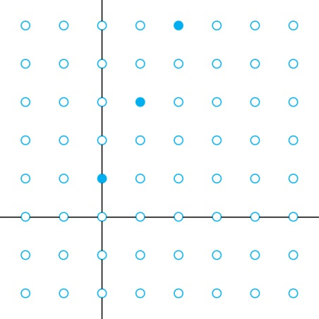
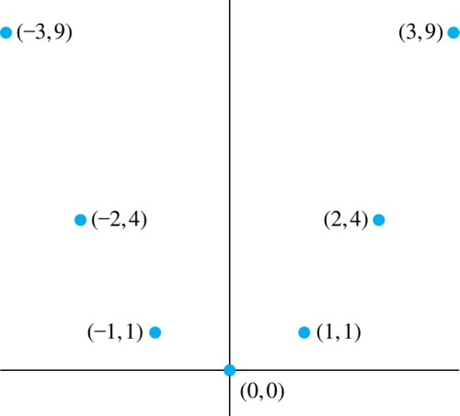
Graphs of Functions
Let f be a function from the set A to the set B. The graph of the function f is the set of ordered pairs {(a,b) | a ∈A and f(a) = b}.
Graph of f(n) = 2n + 1
from Z to Z
Graph of f(x) = x²
from Z to Z

Slide 80
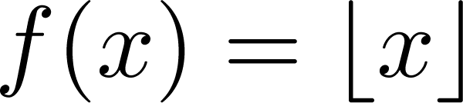
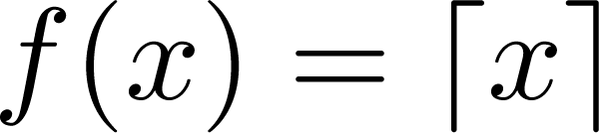
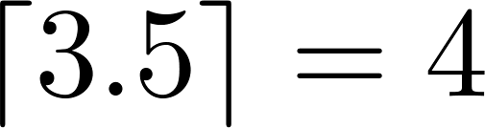
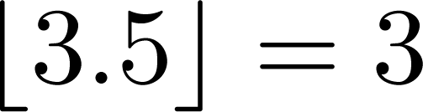
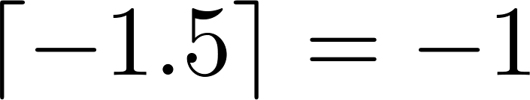
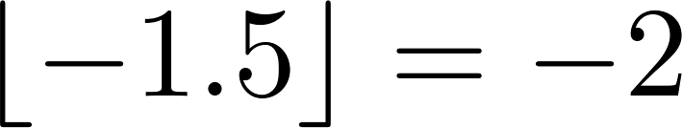
Some Important Functions
The floor function, denoted
is the largest integer less than or equal to x.
The ceiling function, denoted
is the smallest integer greater than or equal to x
Example:

Slide 81
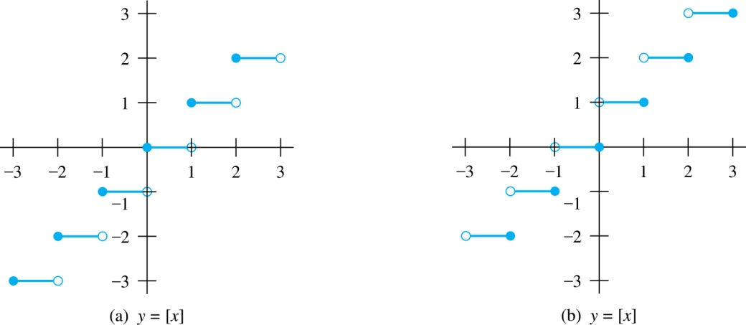
Floor and Ceiling Functions
Graph of (a) Floor and (b) Ceiling Functions

Slide 82

Floor and Ceiling Functions

Slide 83
Proving Properties of Functions
Example: Prove that x is a real number, then
⌊2x⌋= ⌊x⌋ + ⌊x + 1/2⌋
Solution: Let x = n + ε, where n is an integer and 0 ≤ ε< 1.
Case 1: ε < ½
2x = 2n + 2ε and ⌊2x⌋ = 2n, since 0 ≤ 2ε< 1.
⌊x + 1/2⌋ = n, since x + ½ = n + (1/2 + ε ) and 0 ≤ ½ +ε < 1.
Hence, ⌊2x⌋ = 2n and ⌊x⌋ + ⌊x + 1/2⌋ = n + n = 2n.
Case 2: ε ≥ ½
2x = 2n + 2ε = (2n + 1) +(2ε − 1) and ⌊2x⌋ =2n + 1, since 0 ≤ 2 ε - 1< 1.
⌊x + 1/2⌋ = ⌊ n + (1/2 + ε)⌋ = ⌊ n + 1 + (ε – 1/2)⌋ = n + 1 since 0 ≤ ε – 1/2< 1.
Hence, ⌊2x⌋ = 2n + 1 and ⌊x⌋ + ⌊x + 1/2⌋ = n + (n + 1) = 2n + 1.

Slide 84

Factorial Function
Definition: f: N → Z⁺ , denoted by f(n) = n! is the product of the first n positive integers when n is a nonnegative integer.
f(n) = 1 ∙ 2 ∙∙∙ (n – 1) ∙ n, f(0) = 0! = 1
Examples:
^{f(1) = 1! = 1}
^{f(2) = 2! = 1 ∙ 2 = 2}
^{f(6) = 6! = 1 ∙ 2 ∙ 3∙ 4∙ 5} ^{∙ 6 = 720}
f(20) = 2,432,902,008,176,640,000.
Stirling’s Formula:

Slide 85
Sequences and Summations
Section 2.4

Slide 86
Introduction
Sequences are ordered lists of elements.
1, 2, 3, 5, 8
1, 3, 9, 27, 81, …….
Sequences arise throughout mathematics, computer science, and in many other disciplines, ranging from botany to music.
We will introduce the terminology to represent sequences and sums of the terms in the sequences.

Slide 87
Sequences
Definition: A sequence is a function from a subset of the integers (usually either the set {0, 1, 2, 3, 4, …..} or {1, 2, 3, 4, ….} ) to a set S.
The notation a_{n} is used to denote the image of the integer n. We can think of a_{n} as the equivalent of f(n) where f is a function from {0,1,2,…..} to S. We call a_{n} a term of the sequence.

Slide 88



Sequences
Example: Consider the sequence where

Slide 89

Geometric Progression
Definition: A geometric progression is a sequence of the form:
where the initial term a and the common ratio r are real numbers.
Examples:
Let a = 1 and r = −1. Then:
Let a = 2 and r = 5. Then:
Let a = 6 and r = 1/3. Then:

Slide 90
Arithmetic Progression
Definition: A arithmetic progression is a sequence of the form:
where the initial term a and the common difference d are real numbers.
Examples:
Let a = −1 and d = 4:
Let a = 7 and d = −3:
Let a = 1 and d = 2:

Slide 91
Strings
Definition: A string is a finite sequence of characters from a finite set (an alphabet).
Sequences of characters or bits are important in computer science.
The empty string is represented by λ.
The string abcde has length 5.

Slide 92
Recurrence Relations
Definition: A recurrence relation for the sequence {a_{n}} is an equation that expresses a_{n} in terms of one or more of the previous terms of the sequence, namely, a₀, a₁, …, a_{n-1}, for all integers n with n ≥ n₀, where n₀ is a nonnegative integer.
A sequence is called a solution of a recurrence relation if its terms satisfy the recurrence relation.
The initial conditions for a sequence specify the terms that precede the first term where the recurrence relation takes effect.

Slide 93
Questions about Recurrence Relations
Example 1: Let {a_{n}} be a sequence that satisfies the recurrence relation a_{n} = a_{n-1} + 3 for n = 1,2,3,4,…. and suppose that a₀ = 2. What are a₁ , a₂ and a₃?
[Here a₀ = 2 is the initial condition.]
Solution: We see from the recurrence relation that
a₁ = a₀ + 3 = 2 + 3 = 5
a₂ = 5 + 3 = 8
a₃ = 8 + 3 = 11

Slide 94
Classroom Exercise
Define a geometric progression that has an initial term a₀ and a rate r with a recurrence relation.
Solution: recurrence formula: a_{n} = r a_{n-1} , initial condition: a₀ = a.

Slide 95
Questions about Recurrence Relations
Example 2: Let {a_{n}} be a sequence that satisfies the recurrence relation a_{n} = a_{n-1} – a_{n-2} for n = 2,3,4,…. and suppose that a₀ = 3 and a₁ = 5. What are a₂ and a₃?
[Here the initial conditions are a₀ = 3 and a₁ = 5. ]
Solution: We see from the recurrence relation that
a₂ = a₁ - a₀ = 5 – 3 = 2
a₃ = a₂ – a₁ = 2 – 5 = –3

Slide 96
Fibonacci Sequence
Definition: Define the Fibonacci sequence, f₀ ,f₁ ,f₂,…, by:
Initial Conditions: f₀ = 0, f₁ = 1
Recurrence Relation: f_{n} = f_{n-1} + f_{n-2}
Example: Find f₂ ,f₃ ,f₄ , f₅ and f₆ .
Answer:
f₂ = f₁ + f₀ = 1 + 0 = 1,
f₃ = f₂ + f₁ = 1 + 1 = 2,
f₄ = f₃ + f₂ = 2 + 1 = 3,
f₅ = f₄ + f₃ = 3 + 2 = 5,
f₆ = f₅ + f₄ = 5 + 3 = 8.

Slide 97
Solving Recurrence Relations
Finding a formula for the nth term of the sequence generated by a recurrence relation is called solving the recurrence relation.
Such a formula is called a closed formula.
Various methods for solving recurrence relations will be covered in Chapter 8 where recurrence relations will be studied in greater depth.
Here we illustrate by example the method of iteration in which we need to guess the formula. The guess can be proved correct by the method of induction (Chapter 5).

Slide 98
Iterative Solution Example
Method 1: Working upward, forward substitution
Let {a_{n}} be a sequence that satisfies the recurrence relation a_{n} = a_{n-1} + 3 for n = 2,3,4,…. and suppose that a₁ = 2.
a₂ = 2 + 3
a₃ = (2 + 3) + 3 = 2 + 3 ∙ 2
a₄ = (2 + 2 ∙ 3) + 3 = 2 + 3 ∙ 3
.
.
.
a_{n} = a_{n-1} + 3 = (2 + 3 ∙ (n – 2)) + 3 = 2 + 3(n – 1)

Slide 99
Iterative Solution Example
Method 2: Working downward, backward substitution
Let {a_{n}} be a sequence that satisfies the recurrence relation a_{n} = a_{n-1} + 3 for n = 2,3,4,…. and suppose that a₁ = 2.
a_{n} = a_{n-1} + 3
= (a_{n-2} + 3) + 3 = a_{n-2} + 3 ∙ 2
= (a_{n-3} + 3 )+ 3 ∙ 2 = a_{n-3} + 3 ∙ 3
.
.
.
= a₂ + 3(n – 2) = (a₁ + 3) + 3(n – 2) = 2 + 3(n – 1)

Slide 100
Financial Application
Example: Suppose that a person deposits $10,000.00 in a savings account at a bank yielding 11% per year with interest compounded annually. How much will be in the account after 30 years?
Let P_{n} denote the amount in the account after n years. P_{n} satisfies the following recurrence relation:
P_{n} = P_{n-1} + 0.11P_{n-1} = (1.11) P_{n-1}
with the initial condition P₀ = 10,000
Continued on next slide →

Slide 101
Financial Application
P_{n} = P_{n-1} + 0.11P_{n-1} = (1.11) P_{n-1}
with the initial condition P₀ = 10,000
Solution: Forward Substitution
P₁ = (1.11)P₀
P₂ = (1.11)P₁ = (1.11)²P₀
P₃ = (1.11)P₂ = (1.11)³P₀
:
P_{n} = (1.11)P_{n-1} = (1.11)^{n}P₀ = (1.11)^{n} 10,000
P_{n} = (1.11)^{n} 10,000 (Can prove by induction, covered in Chapter 5)
P₃₀ = (1.11)³⁰ 10,000 = $228,992.97

Slide 102
Special Integer Sequences
Given a few terms of a sequence, try to identify the sequence. Conjecture a formula, recurrence relation, or some other rule.
Some questions to ask?
Are there repeated terms of the same value?
Can you obtain a term from the previous term by adding an amount or multiplying by an amount?
Can you obtain a term by combining the previous terms in some way?
Are they cycles among the terms?
Do the terms match those of a well known sequence?

Slide 103
Questions on Special Integer Sequences
Example 1: Find formulae for the sequences with the following first five terms: 1, ½, ¼, 1/8, 1/16
Solution: Note that the denominators are powers of 2. The sequence with a_{n} = 1/2^{n} is a possible match. This is a geometric progression with a = 1 and r = ½.
Example 2: Consider 1,3,5,7,9
Solution: Note that each term is obtained by adding 2 to the previous term. A possible formula is a_{n} = 2n + 1. This is an arithmetic progression with a =1 and d = 2.
Example 3: 1, -1, 1, -1,1
Solution: The terms alternate between 1 and -1. A possible sequence is a_{n} = (−1)^{n} . This is a geometric progression with a = 1 and r = −1.

Slide 104

Useful Sequences

Slide 105




Summations
Sum of the terms
from the sequence
The notation:
represents
The variable j is called the index of summation. It runs through all the integers starting with its lower limit m and ending with its upper limit n.

Slide 106




Summations
More generally for a set S:
Examples:

Slide 107



Product Notation
Product of the terms
from the sequence
The notation:
represents

Slide 108




Geometric Series
Sums of terms of geometric progressions
To compute S_{n} , first multiply both sides of the equality by r and then manipulate the resulting sum as follows:
Proof:
Let
Continued on next slide →

Slide 109






Geometric Series
From previous slide.
Shifting the index of summation with k = j + 1.
Removing k = n + 1 term and
adding k = 0 term.
Substituting S for summation formula
∴
if r ≠1
if r = 1

Slide 110

Some Useful Summation Formulae
Geometric Series: We just proved this.
Later we will prove some of these by induction.
Proof in text
(requires calculus)

