Slide 1
The Foundations: Logic
Chapter 1, Part I: Propositional Logic
With Question/Answer Animations

Slide 2
Propositional Logic
Section 1.1

Slide 3
Propositions
A proposition is a declarative sentence that is either true or false.
Examples of propositions:
The Moon is made of green cheese.
Trenton is the capital of New Jersey.
Toronto is the capital of Canada.
1 + 0 = 1
0 + 0 = 2
Examples that are not propositions.
Sit down!
What time is it?
x + 1 = 2
x + y = z

Slide 4
Propositional Logic
Constructing Propositions
Propositional Variables: p, q, r, s, …
The proposition that is always true is denoted by T and the proposition that is always false is denoted by F.
Compound Propositions; constructed from logical connectives and other propositions
Negation ¬
Conjunction ∧
Disjunction ∨
Implication →
Biconditional ↔
Logical Operators

Slide 5
Compound Propositions: Negation
The negation of a proposition p is denoted by ¬p and has this truth table:
Example: If p denotes “The earth is round.”, then ¬p denotes “It is not the case that the earth is round,” or more simply “The earth is not round.”
not
p | ¬p
T | F
F | T

Slide 6
p: I am a CS student
¬p

Slide 7
Conjunction
and
The conjunction of propositions p and q is denoted by p ∧ q and has this truth table:
Example: If p denotes “I am at home.” and q denotes “It is raining.” then p ∧q denotes “I am at home and it is raining.”
p | q | p ∧ q
T | T | T
T | F | F
F | T | F
F | F | F

Slide 8
p: I am a CS student
q: I am 20 years old
p ∧ q

Slide 9
Disjunction
Inclusive or
The disjunction of propositions p and q is denoted by p ∨q and has this truth table:
Example: If p denotes “I am at home.” and q denotes “It is raining.” then p ∨q denotes “I am at home or it is raining.”
p | q | p ∨q
T | T | T
T | F | T
F | T | T
F | F | F

Slide 10
p: I major CS
q: I major Math
p ∨ q

Slide 11
The Connective Or in English
In English “or” has two distinct meanings.
“Inclusive Or” - In the sentence “Students who have taken CS202 or Math120 may take this class,” we assume that students need to have taken one of the prerequisites, but may have taken both. This is the meaning of disjunction. For p ∨q to be true, either one or both of p and q must be true.
“Exclusive Or” - When reading the sentence “Soup or salad comes with this entrée,” we do not expect to be able to get both soup and salad. This is the meaning of Exclusive Or (Xor). In p ⊕ q , one of p and q must be true, but not both. The truth table for ⊕ is:
p | q | p ⊕q
T | T | F
T | F | T
F | T | T
F | F | F

Slide 12
p: I come from Virginia
q: I come from Georgia
p ⊕ q

Slide 13
Implication
If p and q are propositions, then p →q is a conditional statement or implication which is read as “if p, then q ” and has this truth table:
Example: If p denotes “I am at home.” and q denotes “It is raining.” then p →q denotes “If I am at home then it is raining.”
In p →q , p is the hypothesis (antecedent or premise) and q is the conclusion (or consequence).
p | q | p →q
T | T | T
T | F | F
F | T | T
F | F | T

Slide 14
p: I am21 years old
q: I am allowed to drink
p → q

Slide 15
Understanding Implication
In p →q there does not need to be any connection between the antecedent or the consequent. The “meaning” of p →q depends only on the truth values of p and q.
These implications are perfectly fine, but would not be used in ordinary English.
“If the moon is made of green cheese, then I have more money than Bill Gates. ”
“If the moon is made of green cheese then I’m on welfare.”
“If 1 + 1 = 3, then your grandma wears combat boots.”

Slide 16
Understanding Implication (cont)
One way to view the logical conditional is to think of an obligation or contract.
“If I am elected, then I will lower taxes.”
“If you get 100% on the final, then you will get an A.”
If the politician is elected and does not lower taxes, then the voters can say that he or she has broken the campaign pledge. Something similar holds for the professor. This corresponds to the case where p is true and q is false.

Slide 17
Different Ways of Expressing p →q
if p, then q p implies q
if p, q p only if q
q unless ¬p q when p
q if p q when p
q whenever p p is sufficient for q
q follows from p q is necessary for p
a necessary condition for p is q
a sufficient condition for q is p

Slide 18
Converse, Contrapositive, and Inverse
From p →q we can form new conditional statements .
q →p is the converse of p →q
¬q → ¬ p is the contrapositive of p →q
¬ p → ¬ q is the inverse of p →q

Slide 19
Converse, Contrapositive, and Inverse
Example: Find the converse, inverse, and contrapositive of “It raining is a sufficient condition for my not going to town.”
p: it is raining
q: I am going to town
Solution:
Converse q →p : If I do not go to town, then it is raining.
Inverse ¬ p → ¬ q : If it is not raining, then I will go to town.
Contrapositive ¬q → ¬ p : If I go to town, then it is not raining.

Slide 20
Converse, Contrapositive, and Inverse
“If I am 21 years old, I am allowed to drink”
p:
q:
Converse q →p :
Inverse ¬ p → ¬ q :
Contrapositive ¬q → ¬ p :

Slide 21
Biconditional
If p and q are propositions, then we can form the biconditional proposition p ↔q , read as “p if and only if q .” The biconditional p ↔q denotes the proposition with this truth table:
If p denotes “I am at home.” and q denotes “It is raining.” then p ↔q denotes “I am at home if and only if it is raining.”
p | q | p ↔q
T | T | T
T | F | F
F | T | F
F | F | T

Slide 22
Expressing the Biconditional
Some alternative ways “p if and only if q” is expressed in English:
p is necessary and sufficient for q
if p then q , and conversely
p iff q

Slide 23
Truth Tables For Compound Propositions
Construction of a truth table:
Rows
Need a row for every possible combination of values for the atomic propositions.
Columns
Need a column for the compound proposition (usually at far right)
Need a column for the truth value of each expression that occurs in the compound proposition as it is built up.
This includes the atomic propositions

Slide 24
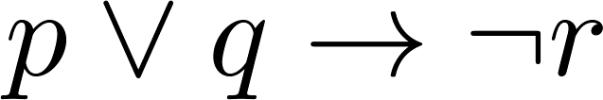
Example Truth Table
Construct a truth table for
p | q | r | ¬r | p ∨ q | p ∨ q → ¬r
T | T | T | F | T | F
T | T | F | T | T | T
T | F | T | F | T | F
T | F | F | T | T | T
F | T | T | F | T | F
F | T | F | T | T | T
F | F | T | F | F | T
F | F | F | T | F | T

Slide 25
Equivalent Propositions
Two propositions are equivalent if they always have the same truth value.
Example: Show using a truth table that the implication is equivalent to the contrapositive.
Solution:
p →q
¬q → ¬ p
p | q | ¬ p | ¬ q | p →q | ¬q → ¬ p
T | T | F | F | T | T
T | F | F | T | F | F
F | T | T | F | T | T
F | F | T | T | T | T

Slide 26
Using a Truth Table to Show Non-Equivalence
Example: Show using truth tables that neither the converse nor inverse of an implication are not equivalent to the implication.
Solution:
p | q | ¬ p | ¬ q | q →p | ¬ p →¬ q
T | T | F | F | T | T
T | F | F | T | F | T
F | T | T | F | T | F
F | F | T | T | T | T

Slide 27
Problem
How many rows are there in a truth table with n propositional variables?
Solution: 2^{n} We will see how to do this in Chapter 6.
Note that this means that with n propositional variables, we can construct 2^{n} distinct (i.e., not equivalent) propositions.

Slide 28
Precedence of Logical Operators
Operator | Precedence
¬ | 1
∧ ∨ | 2 3
→ ↔ | 4 5
p ∨q → ¬r is equivalent to (p ∨q) → ¬r
If the intended meaning is p ∨(q → ¬r )
then parentheses must be used.

Slide 29
Classroom Exercise
Construct a truth table for the composite proposition
p ∨¬ q

Slide 30
Logic and Bit Operations
01 1011 0110
11 0001 1101
OR
11 1011 1111
AND

Slide 31
p | q | (p → q) ∨ (¬p → q)
T | T
T | F
F | T
F | F

Slide 32
Applications of Propositional Logic
Section 1.2

Slide 33
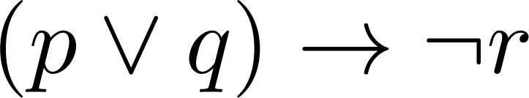
Translating English Sentences
Steps to convert an English sentence to a statement in propositional logic
Identify atomic propositions and represent using propositional variables.
Determine appropriate logical connectives
“If I go to Harry’s or to the country, I will not go shopping.”
p: I go to Harry’s
q: I go to the country.
r: I will go shopping.
If p or q then not r.

Slide 34
Example
Problem: Translate the following sentence into propositional logic:
“You can access the Internet from campus only if you are a computer science major or you are not a freshman.”
One Solution:
a: “You can access the internet from campus”
b: “You are a computer science major”
c: “You are a freshman”
a→ (c ∨ ¬ f )

Slide 35
System Specifications
System and Software engineers take requirements in English and express them in a precise specification language based on logic.
Example: Express in propositional logic:
“The automated reply cannot be sent when the file system is full”
Solution:
p: “The automated reply can be sent”
q: “The file system is full.”
q→ ¬ p

Slide 36
Consistent System Specifications
Definition: A list of propositions is consistent if there is no conflict, in other words, it is possible to assign truth values to the proposition variables so that each proposition is true.
Exercise: Are these specifications consistent?
“The diagnostic message is stored in the buffer or it is retransmitted.”
“The diagnostic message is not stored in the buffer.”
“If the diagnostic message is stored in the buffer, then it is retransmitted.”

Slide 37
Consistent System Specifications
Solution:
p: “The diagnostic message is stored in the buffer.”
q: “The diagnostic message is retransmitted”
p ∨q: “The diagnostic message is stored in the buffer or it is retransmitted.”
¬p: “The diagnostic message is not stored in the buffer.”
p→ q: “If the diagnostic message is stored in the buffer, then it is retransmitted.”
p | q | ¬ p | p →q | p ∨q
T | T | F | T | T
T | F | F | F | T
F | T | T | T | T
F | F | T | T | F

Slide 38
Consistent System Specifications
“The diagnostic message is stored in the buffer or it is retransmitted.”
“The diagnostic message is not stored in the buffer.”
“If the diagnostic message is stored in the buffer, then it is retransmitted.”
“The diagnostic message is not retransmitted”

Slide 39
Boolean Searches
Search Engine

Slide 40
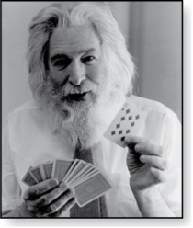
Logic Puzzles
Raymond Smullyan
(Born 1919)
An island has two kinds of inhabitants, knights, who always tell the truth, and knaves, who always lie.
You go to the island and meet A and B.
A says “B is a knight.”
B says “The two of us are of opposite types.”
Example: What are the types of A and B?

Slide 41
Logic Puzzles
Raymond Smullyan
(Born 1919)
Solution:
p: A is a knight
q: B is a knight
A says “B is a knight.”
B says “The two of us are of opposite types.”
p | q | ¬ p | ¬ q
T | T | F | T
T | F | F | F
F | T | T | T
F | F | T | T

Slide 42
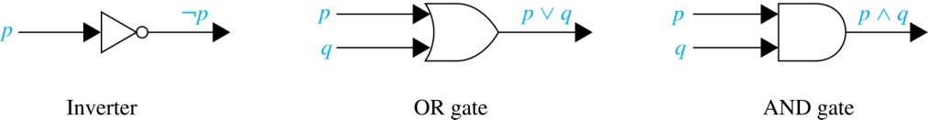
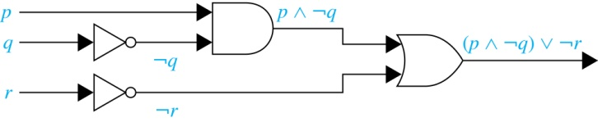
Logic Circuits (Studied in depth in Chapter 12)
Electronic circuits; each input/output signal can be viewed as a 0 or 1.
0 represents False
1 represents True
Complicated circuits are constructed from three basic circuits called gates.
The inverter (NOT gate)takes an input bit and produces the negation of that bit.
The OR gate takes two input bits and produces the value equivalent to the disjunction of the two bits.
The AND gate takes two input bits and produces the value equivalent to the conjunction of the two bits.
More complicated digital circuits can be constructed by combining these basic circuits to produce the desired output given the input signals by building a circuit for each piece of the output expression and then combining them. For example:

Slide 43
Propositional Equivalences
Section 1.3

Slide 44
Tautologies, Contradictions, and Contingencies
A tautology is a proposition which is always true.
Example: p ∨¬p
A contradiction is a proposition which is always false.
Example: p ∧¬p
A contingency is a proposition which is neither a tautology nor a contradiction, such as p
P | ¬p | p ∨¬p | p ∧¬p
T | F | T | F
F | T | T | F

Slide 45
Logically Equivalent
Two compound propositions p and q are logically equivalent if p↔q is a tautology.
We write this as p⇔q or as p≡q where p and q are compound propositions.
Two compound propositions p and q are equivalent if and only if the columns in a truth table giving their truth values agree.
This truth table show ¬p ∨ q is equivalent to p → q.
p | q | ¬p | ¬p ∨ q | p→ q
T | T | F | T | T
T | F | F | F | F
F | T | T | T | T
F | F | T | T | T

Slide 46
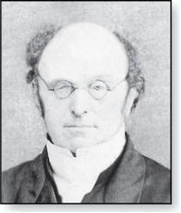
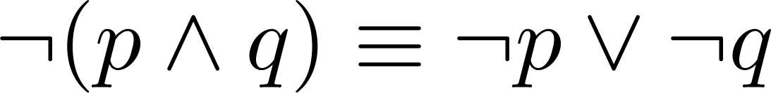
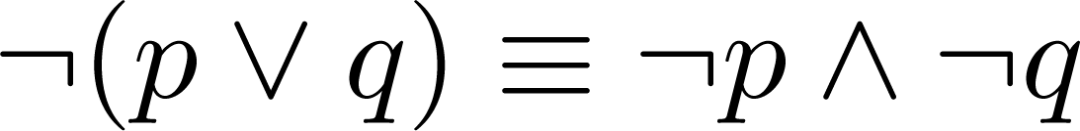
De Morgan’s Laws
Augustus De Morgan
1806-1871
This truth table shows that De Morgan’s Second Law holds.
p | q | ¬p | ¬q | (p∨q) | ¬(p∨q) | ¬p∧¬q
T | T | F | F | T | F | F
T | F | F | T | T | F | F
F | T | T | F | T | F | F
F | F | T | T | F | T | T

Slide 47
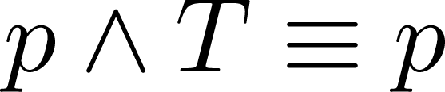
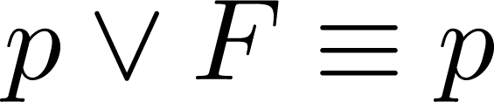
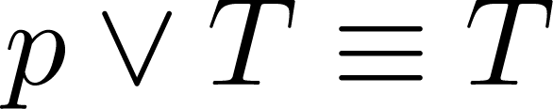
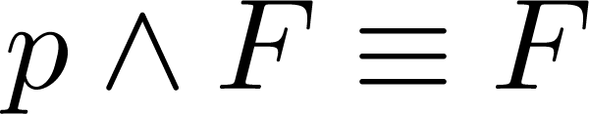
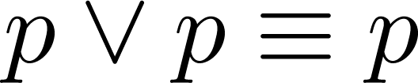
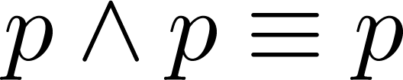
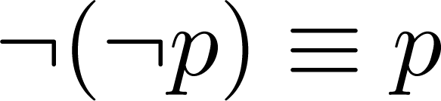
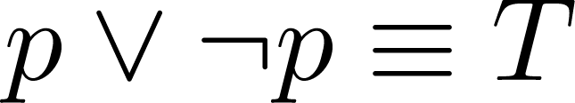
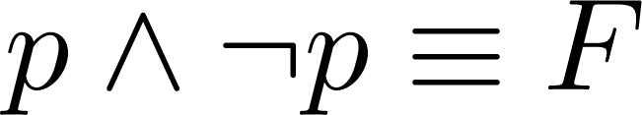
Key Logical Equivalences
Identity Laws: ,
Domination Laws: ,
Idempotent laws: ,
Double Negation Law:
Negation Laws: ,

Slide 48
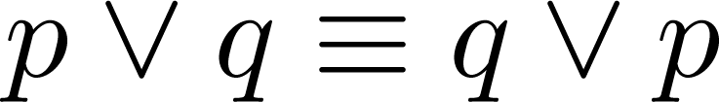
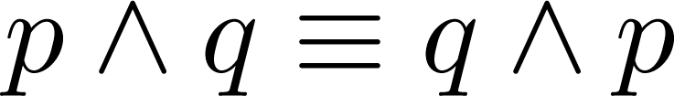
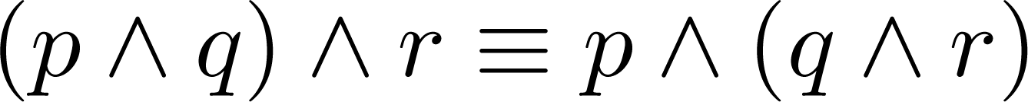
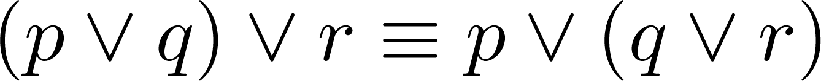
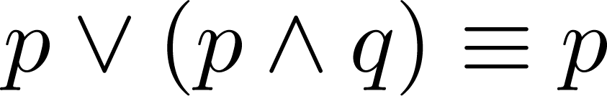
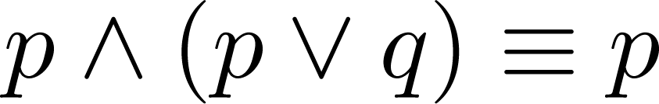
Key Logical Equivalences (cont)
Commutative Laws: ,
Associative Laws:
Distributive Laws:
Absorption Laws:

Slide 49


Exercise
Show Distributive Laws with a Truth Table
$$p∨(q∧r)$$
$$(p∨q)∧(q∨r)$$

Slide 50
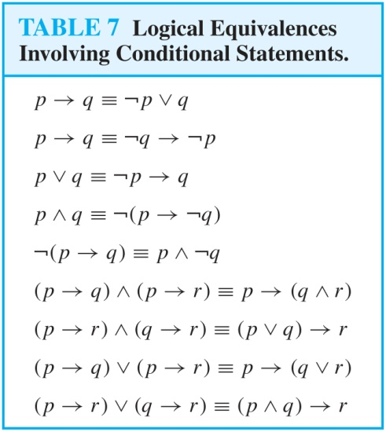
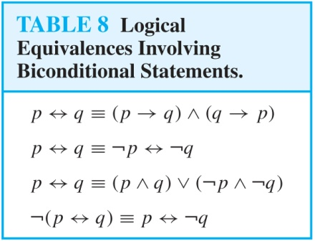
More Logical Equivalences

Slide 51

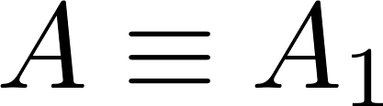
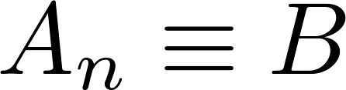
Constructing New Logical Equivalences
We can show that two expressions are logically equivalent by developing a series of logically equivalent statements.
To prove that we produce a series of equivalences beginning with A and ending with B.
Keep in mind that whenever a proposition (represented by a propositional variable) occurs in the equivalences listed earlier, it may be replaced by an arbitrarily complex compound proposition.

Slide 52
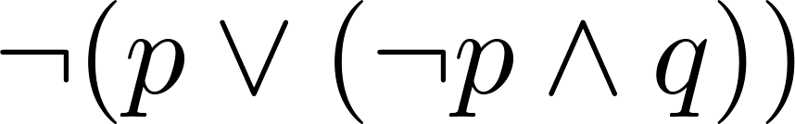
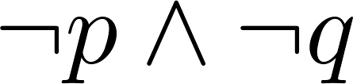
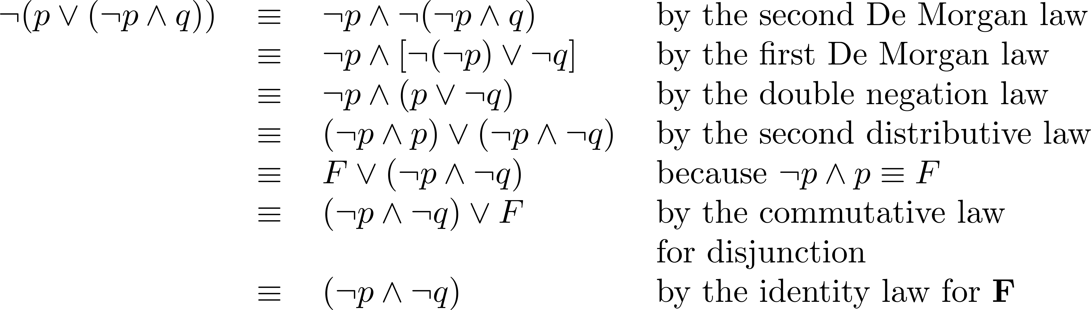
Equivalence Proofs
Example: Show that
is logically equivalent to
Solution:

Slide 53
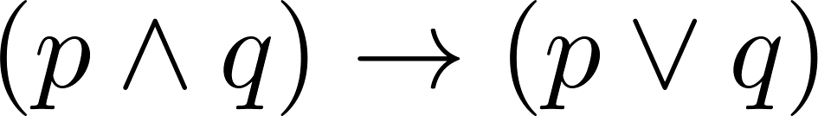
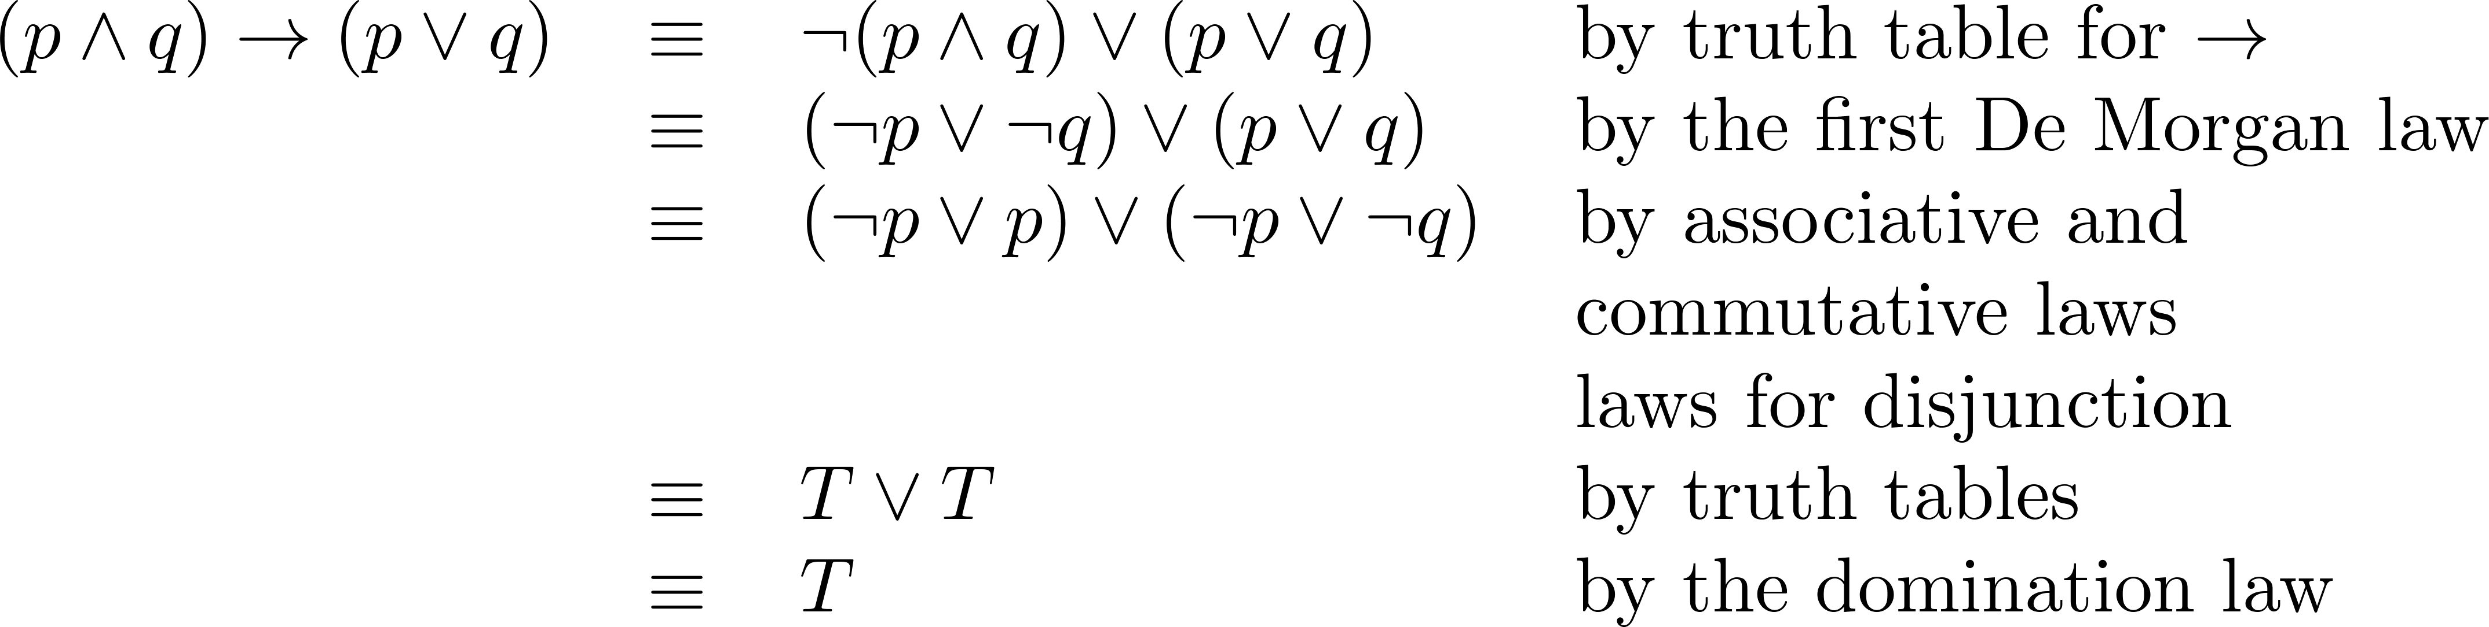
Equivalence Proofs
Example: Show that
is a tautology.
Solution:

Slide 54
Propositional Satisfiability
A compound proposition is satisfiable if there is an assignment of truth values to its variables that make it true. When no such assignments exist, the compound proposition is unsatisfiable.
A compound proposition is unsatisfiable if and only if its negation is a tautology.

Slide 55
Questions on Propositional Satisfiability
Example: Determine the satisfiability of the following compound propositions:
Solution: Satisfiable. Assign T to p, q, and r.
Solution: Satisfiable. Assign T to p and F to q.
Solution: Not satisfiable. Check each possible assignment of truth values to the propositional variables and none will make the proposition true.

Slide 56
Notation
Needed for the next example.

Slide 57

Exercise: show that
$\left(p→q\right)∧(p→r)≡p→(q∧r)$

Slide 58

Exercise: show that
$\left(p→r\right)∧(q→r)≡(p∨q)→r$

Slide 59

Exercise: show that
$¬p→(q→r)≡q→(p∨r)$

Slide 60
Predicates and Quantifiers
Section 1.4

Slide 61

Propositional Logic Not Enough
If we have:
p: “All men are mortal.”
q: “Socrates is a man.”
Does it follow that r: “Socrates is mortal?”
Can’t be represented in propositional logic. Need a language that talks about objects, their properties, and their relations.
Later we’ll see how to draw inferences.
$$p∧q$$

Slide 62
Introducing Predicate Logic
Predicate logic uses the following new features:
Variables: x, y, z
Predicates: P(x), M(x)
Quantifiers (to be covered in a few slides):
Propositional functions are a generalization of propositions.
They contain variables and a predicate, e.g., P(x)
Variables can be replaced by elements from their domain.
P(x): x is greater than 0
P(x) is not a proposition, P(3) is

Slide 63
Propositional Functions
Propositional functions become propositions (and have truth values) when their variables are each replaced by a value from the domain (or bound by a quantifier, as we will see later).
The statement P(x) is said to be the value of the propositional function P at x.
For example, let P(x) denote “x > 0” and the domain be the integers. Then:
P(-3) is false.
P(0) is false.
P(3) is true.
Often the domain is denoted by U. So in this example U is the integers.

Slide 64
Examples of Propositional Functions
Let “x + y = z” be denoted by R(x, y, z) and U (for all three variables) be the integers. Find these truth values:
R(2,-1,5)
Solution: F
R(3,4,7)
Solution: T
R(x, 3, z)
Solution: Not a Proposition
Now let “x - y = z” be denoted by Q(x, y, z), with U as the integers. Find these truth values:
Q(2,-1,3)
Solution: T
Q(3,4,7)
Solution: F
Q(x, 3, z)
Solution: Not a Proposition

Slide 65
Classroom Exercise
Let P(x) be the statement “the word x contains the
letter a.” What are these truth values?
a) P(orange) b) P(lemon)
c) P(true) d) P(false)

Slide 66
Classroom Exercise
P(x): x > 3
P(4)
P(2)

Slide 67
Classroom Exercise
P(x): Computer x is under attack by an intruder
Suppose CS2 and MATH1 are under attack by intruders
P(CS1)
P(MATH1)

Slide 68
Compound Expressions
Connectives from propositional logic carry over to predicate logic.
If P(x) denotes “x > 0,” find these truth values:
P(3) ∨ P(-1) Solution: T
P(3) ∧ P(-1) Solution: F
P(3) → P(-1) Solution: F
P(-1) → P(3) Solution: T
Expressions with variables are not propositions and therefore do not have truth values. For example,
P(3) ∧ P(y)
P(x) → P(y)
When used with quantifiers (to be introduced next), these expressions (propositional functions) become propositions.

Slide 69
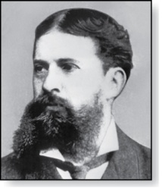
Quantifiers
Charles Peirce (1839-1914)
We need quantifiers to express the meaning of English words including all and some:
“All men are Mortal.”
“Some cats do not have fur.”
The two most important quantifiers are:
Universal Quantifier, “For all,” symbol: ∀
Existential Quantifier, “There exists,” symbol: ∃
We write as in ∀x P(x) and ∃x P(x).
∀x P(x) asserts P(x) is true for every x in the domain.
∃x P(x) asserts P(x) is true for some x in the domain.
The quantifiers are said to bind the variable x in these expressions.

Slide 70
Universal Quantifier
∀x P(x) is read as “For all x, P(x)” or “For every x, P(x)”
Examples:
If P(x) denotes “x > 0” and U is the integers, then ∀x P(x) is false.
If P(x) denotes “x > 0” and U is the positive integers, then ∀x P(x) is true.
If P(x) denotes “x is even” and U is the integers, then ∀ x P(x) is false.

Slide 71
Existential Quantifier
∃x P(x) is read as “For some x, P(x)”, or as “There is an x such that P(x),” or “For at least one x, P(x).”
Examples:
If P(x) denotes “x > 0” and U is the integers, then ∃x P(x) is true. It is also true if U is the positive integers.
If P(x) denotes “x < 0” and U is the positive integers, then ∃x P(x) is false.
If P(x) denotes “x is even” and U is the integers, then ∃x P(x) is true.

Slide 72


Classroom Exercise
P(x): x + 1 > x
$$Domain: all real number x$$
$$∀xP\left(x\right)$$

Slide 73

Classroom Exercise
Q(x): x < 2
$$Domain: all real number x$$
$$∀xQ\left(x\right)$$

Slide 74

Classroom Exercise
P(x): x > 3
$$Domain: all real number x$$
$$∃xP\left(x\right)$$

Slide 75
Uniqueness Quantifier
∃!x P(x) means that P(x) is true for one and only one x in the universe of discourse.
This is commonly expressed in English in the following equivalent ways:
“There is a unique x such that P(x).”
“There is one and only one x such that P(x)”
Examples:
If P(x) denotes “x + 1 = 0” and U is the integers, then ∃!x P(x) is true.
But if P(x) denotes “x > 0,” then ∃!x P(x) is false.
The uniqueness quantifier is not really needed as the restriction that there is a unique x such that P(x) can be expressed as:
∃x (P(x) ∧∀y (P(y) → y =x))

Slide 76
Thinking about Quantifiers
When the domain of discourse is finite, we can think of quantification as looping through the elements of the domain.
To evaluate ∀x P(x) loop through all x in the domain.
If at every step P(x) is true, then ∀x P(x) is true.
If at a step P(x) is false, then ∀x P(x) is false and the loop terminates.
To evaluate ∃x P(x) loop through all x in the domain.
If at some step, P(x) is true, then ∃x P(x) is true and the loop terminates.
If the loop ends without finding an x for which P(x) is true, then ∃x P(x) is false.
Even if the domains are infinite, we can still think of the quantifiers this fashion, but the loops will not terminate in some cases.

Slide 77
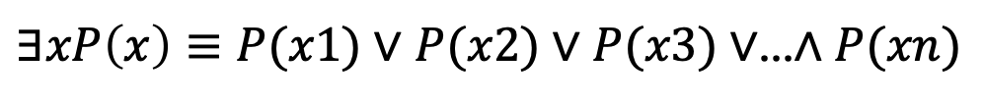
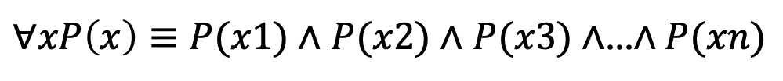
Quantifiers Over Finite Domains
$∀xP\left(x\right)≡P(x1)∧$ $P(x2)∧$ $P(x3)∧$…$∧P(xn)$
$∃xP\left(x\right)≡P(x1)∨$ $P(x2)∨P(x3)∨$…$∧P(xn)$

Slide 78



Classroom Exercise
P(x): x² < 10
$$Domain:x is a positive integer$$
$$∀xP\left(x\right)$$
$$∃xP\left(x\right)$$

Slide 79
Properties of Quantifiers
The truth value of ∃x P(x) and ∀ x P(x) depend on both the propositional function P(x) and on the domain U.
Examples:
If U is the positive integers and P(x) is the statement “x < 2”, then ∃x P(x) is true, but ∀ x P(x) is false.
If U is the negative integers and P(x) is the statement “x < 2”, then both ∃x P(x) and ∀ x P(x) are true.
If U consists of 3, 4, and 5, and P(x) is the statement “x > 2”, then both ∃x P(x) and ∀ x P(x) are true. But if P(x) is the statement “x < 2”, then both ∃x P(x) and ∀ x P(x) are false.

Slide 80
Precedence of Quantifiers
The quantifiers ∀ and ∃ have higher precedence than all the logical operators.
For example, ∀x P(x) ∨ Q(x) means (∀x P(x))∨ Q(x)
∀x (P(x) ∨ Q(x)) means something different.
Unfortunately, often people write ∀x P(x) ∨ Q(x) when they mean ∀ x (P(x) ∨ Q(x)).

Slide 81
Translating from English to Logic
Example 1: Translate the following sentence into predicate logic: “Every student in this class has taken a course in Java.”
Solution:
First decide on the domain U.
Solution 1: If U is all students in this class, define a propositional function J(x) denoting “x has taken a course in Java” and translate as ∀x J(x)
Solution 2: But if U is all people, also define a propositional function S(x) denoting “x is a student in this class” and translate as ∀x (S(x)→ J(x))
∀x (S(x) ∧ J(x)) is not correct. What does it mean?

Slide 82
Translating from English to Logic
Example 2: Translate the following sentence into predicate logic: “Some student in this class has taken a course in Java.”
Solution:
First decide on the domain U.
Solution 1: If U is all students in this class, translate as
∃x J(x)
Solution 2: But if U is all people, then translate as ∃x (S(x) ∧ J(x))
∃x (S(x)→ J(x)) is not correct. What does it mean?

Slide 83
Classroom Exercise
Translate these statements into English, where R(x) is “x
is a rabbit” and H(x) is “x hops” and the domain consists
of all animals.
∀x(R(x) → H(x))
∀x(R(x) ∧ H(x))
∃x(R(x) → H(x))
∃x(R(x) ∧ H(x))

Slide 84
Classroom Exercise
Translate these statements into English, where C(x) is “x
is a comedian” and F(x) is “x is funny” and the domain
consists of all people.
∀x(C(x) → F(x))
∀x(C(x) ∧ F(x))
∃x(C(x) → F(x))
∃x(C(x) ∧ F(x))

Slide 85
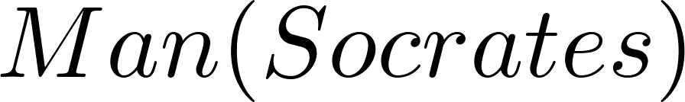
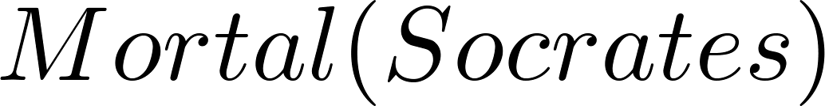
Returning to the Socrates Example
Introduce the propositional functions Man(x) denoting “x is a man” and Mortal(x) denoting “x is mortal.” Specify the domain as all people.
The two premises are:
The conclusion is:
Later we will show how to prove that the conclusion follows from the premises.

Slide 86
Equivalences in Predicate Logic
Statements involving predicates and quantifiers are logically equivalent if and only if they have the same truth value
for every predicate substituted into these statements and
for every domain of discourse used for the variables in the expressions.
The notation S ≡T indicates that S and T are logically equivalent.
Example: ∀x ¬¬S(x) ≡ ∀x S(x)

Slide 87
Thinking about Quantifiers as Conjunctions and Disjunctions
If the domain is finite, a universally quantified proposition is equivalent to a conjunction of propositions without quantifiers and an existentially quantified proposition is equivalent to a disjunction of propositions without quantifiers.
If U consists of the integers 1,2, and 3:
Even if the domains are infinite, you can still think of the quantifiers in this fashion, but the equivalent expressions without quantifiers will be infinitely long.

Slide 88
Negating Quantified Expressions
Consider ∀x J(x)
“Every student in your class has taken a course in Java.”
Here J(x) is “x has taken a course in Java” and
the domain is students in your class.
Negating the original statement gives “It is not the case that every student in your class has taken Java.” This implies that “There is a student in your class who has not taken Java.”
Symbolically ¬∀x J(x) and ∃x ¬J(x) are equivalent

Slide 89
Negating Quantified Expressions (continued)
Now Consider ∃ x J(x)
“There is a student in this class who has taken a course in Java.”
Where J(x) is “x has taken a course in Java.”
Negating the original statement gives “It is not the case that there is a student in this class who has taken Java.” This implies that “Every student in this class has not taken Java”
Symbolically ¬∃ x J(x) and ∀ x ¬J(x) are equivalent

Slide 90
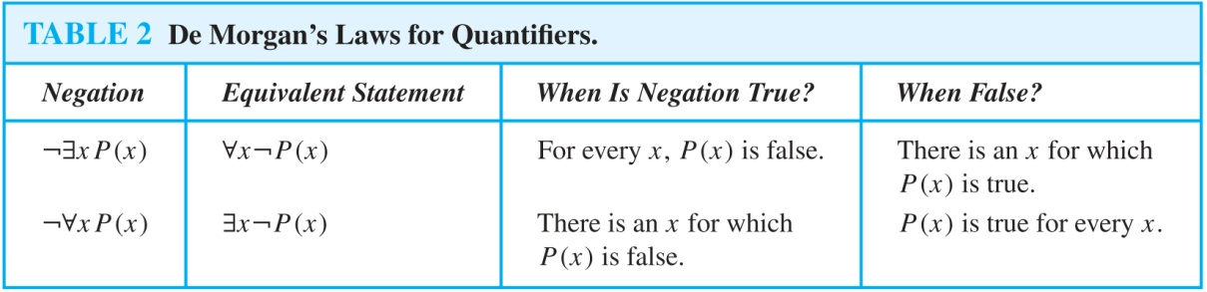
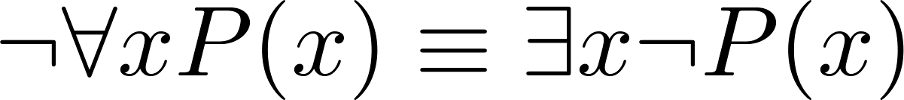
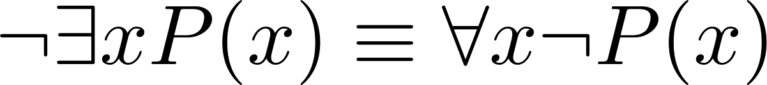
De Morgan’s Laws for Quantifiers
The rules for negating quantifiers are:
The reasoning in the table shows that:
These are important. You will use these.

Slide 91
De Morgan’s Laws for Quantifiers
Show
$$¬∀xP\left(x\right)≡¬\left(P\left(1\right)∧P\left(2\right)∧ …∧P\left(xn\right)\right)≡¬P\left(1\right)∨¬P\left(2\right)…≡∃x¬P(x)$$

Slide 92
Exercise
Negation of the statement “There is an honest politician”

Slide 93
Exercise
Show
$$¬∀x(P\left(x\right)→Q\left(x\right))≡∃x(P\left(x\right)∧¬Q\left(x\right))$$

Slide 94
Exercise
”All lions are fierce”
“Some lions do not drink coffee”
“Some fierce creatures do not drink coffee”
P(x), “x is a lion”
Q(x), “x is fierce”
R(x), “x drinks coffee”

Slide 95
Translation from English to Logic
Examples:
“Some student in this class has visited Mexico.”
Solution: Let M(x) denote “x has visited Mexico” and S(x) denote “x is a student in this class,” and U be all people.
∃x (S(x) ∧ M(x))
“Every student in this class has visited Canada or Mexico.”
Solution: Add C(x) denoting “x has visited Canada.”
∀x (S(x)→ (M(x)∨C(x)))

Slide 96
Some Fun with Translating from English into Logical Expressions
U = {fleegles, snurds, thingamabobs}
F(x): x is a fleegle
S(x): x is a snurd
T(x): x is a thingamabob
Translate “Everything is a fleegle”
Solution: ∀x F(x)

Slide 97
Translation (cont)
U = {fleegles, snurds, thingamabobs}
F(x): x is a fleegle
S(x): x is a snurd
T(x): x is a thingamabob
“Nothing is a snurd.”
Solution: ¬∃x S(x) What is this equivalent to?
Solution: ∀x ¬ S(x)

Slide 98
Translation (cont)
U = {fleegles, snurds, thingamabobs}
F(x): x is a fleegle
S(x): x is a snurd
T(x): x is a thingamabob
“All fleegles are snurds.”
Solution: ∀x (F(x)→ S(x))

Slide 99
Translation (cont)
U = {fleegles, snurds, thingamabobs}
F(x): x is a fleegle
S(x): x is a snurd
T(x): x is a thingamabob
“Some fleegles are thingamabobs.”
Solution: ∃x (F(x) ∧ T(x))

Slide 100
Translation (cont)
U = {fleegles, snurds, thingamabobs}
F(x): x is a fleegle
S(x): x is a snurd
T(x): x is a thingamabob
“No snurd is a thingamabob.”
Solution: ¬∃x (S(x) ∧ T(x)) What is this equivalent to?
Solution: ∀x (¬S(x) ∨ ¬T(x))

Slide 101
Translation (cont)
U = {fleegles, snurds, thingamabobs}
F(x): x is a fleegle
S(x): x is a snurd
T(x): x is a thingamabob
“If any fleegle is a snurd then it is also a thingamabob.”
Solution: ∀x ((F(x) ∧ S(x))→ T(x))

Slide 102
Classroom Exercise
Let C(x) be the statement “x has a cat,” let D(x) be the statement “x has a dog,” and let F(x) be the statement “x has a ferret.” Express each of these statements in terms of C(x), D(x), F(x), quantifiers, and logical connectives. Let the domain consist of all students in your class.
A student in your class has a cat, a dog, and a ferret.
All students in your class have a cat, a dog, or a ferret.
Some student in your class has a cat and a ferret, but not a dog.
No student in your class has a cat, a dog, and a ferret.
For each of the three animals, cats, dogs, and ferrets, there is a student in your class who has this animal as a pet.

Slide 103
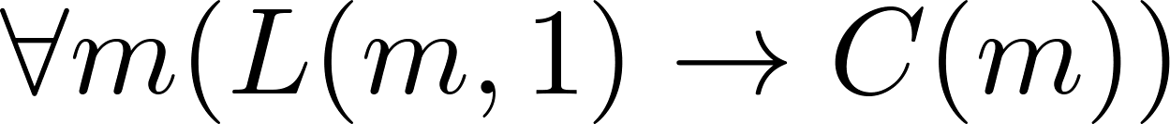
System Specification Example
Predicate logic is used for specifying properties that systems must satisfy.
For example, translate into predicate logic:
“Every mail message larger than one megabyte will be compressed.”
“If a user is active, at least one network link will be available.”
Decide on predicates and domains (left implicit here) for the variables:
Let L(m, y) be “Mail message m is larger than y megabytes.”
Let C(m) denote “Mail message m will be compressed.”
Let A(u) represent “User u is active.”
Let S(n, x) represent “Network link n is state x.
Now we have:

Slide 104
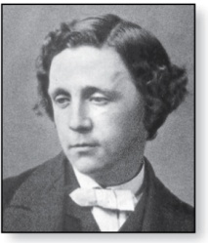
Lewis Carroll Example
Charles Lutwidge Dodgson
(AKA Lewis Caroll)
(1832-1898)
The first two are called premises and the third is called the conclusion.
“All lions are fierce.”
“Some lions do not drink coffee.”
“Some fierce creatures do not drink coffee.”
Here is one way to translate these statements to predicate logic. Let P(x), Q(x), and R(x) be the propositional functions “x is a lion,” “x is fierce,” and “x drinks coffee,” respectively.
∀x (P(x)→ Q(x))
∃x (P(x) ∧ ¬R(x))
∃x (Q(x) ∧ ¬R(x))
Later we will see how to prove that the conclusion follows from the premises.

