Slide 1
Graphs
Chapter 10

Slide 2
Graphs and Graph Models
Section 10.1

Slide 3
Graphs
Definition: A graph G = (V, E) consists of a nonempty set V of vertices (or nodes) and a set E of edges. Each edge has either one or two vertices associated with it, called its endpoints. An edge is said to connect its endpoints.
Remarks:
The graphs we study here are unrelated to graphs of functions studied in Chapter 2.
We have a lot of freedom when we draw a picture of a graph. All that matters is the connections made by the edges, not the particular geometry depicted. For example, the lengths of edges, whether edges cross, how vertices are depicted, and so on, do not matter
A graph with an infinite vertex set is called an infinite graph. A graph with a finite vertex set is called a finite graph. We (following the text) restrict our attention to finite graphs.
Example:
a
b
This is a graph with four vertices and five edges.
d
c

Slide 4
Some Terminology
In a simple graph each edge connects two different vertices and no two edges connect the same pair of vertices.
Multigraphs may have multiple edges connecting the same two vertices. When m different edges connect the vertices u and v, we say that {u,v} is an edge of multiplicity m.
An edge that connects a vertex to itself is called a loop.
A pseudograph may include loops, as well as multiple edges connecting the same pair of vertices.
Example:
This pseudograph has both multiple edges and a loop.
a
b
Remark: There is no standard terminology for graph theory. So, it is crucial that you understand the terminology being used whenever you read material about graphs.
c

Slide 5
Directed Graphs
Definition: An directed graph (or digraph) G = (V, E) consists of a nonempty set V of vertices (or nodes) and a set E of directed edges (or arcs). Each edge is associated with an ordered pair of vertices. The directed edge associated with the ordered pair (u,v) is said to start at u and end at v.
Remark:
Graphs where the end points of an edge are not ordered are said to be undirected graphs.

Slide 6
Directed Graphs (continued)
A simple directed graph has no loops and no multiple edges.
A directed multigraph may have multiple directed edges. When there are m directed edges from the vertex u to the vertex v, we say that (u,v) is an edge of multiplicity m.
Example:
a
b
This is a directed graph with three vertices and four edges.
c
Example:
In this directed multigraph the multiplicity of (a,b) is 1 and the multiplicity of (b,c) is 2.
a
b
c

Slide 7
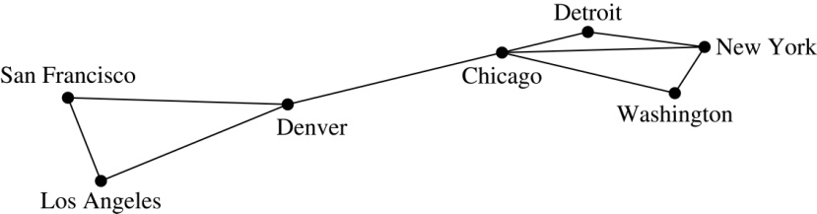
Graph Models: Computer Networks
When we build a graph model, we use the appropriate type of graph to capture the important features of the application.
We illustrate this process using graph models of different types of computer networks. In all these graph models, the vertices represent data centers and the edges represent communication links.
To model a computer network where we are only concerned whether two data centers are connected by a communications link, we use a simple graph. This is the appropriate type of graph when we only care whether two data centers are directly linked (and not how many links there may be) and all communications links work in both directions.

Slide 8
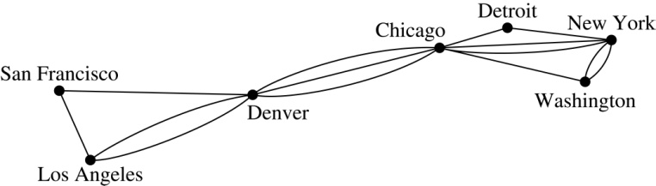
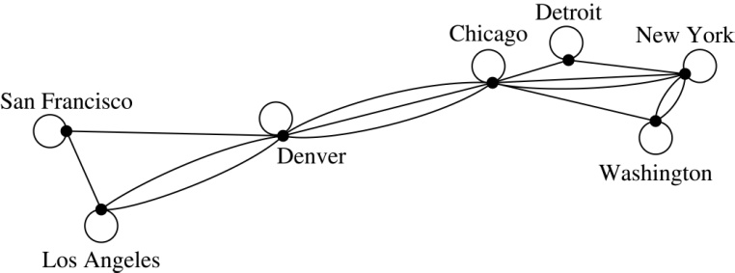
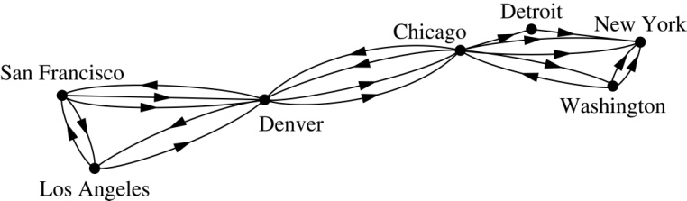
Graph Models: Computer Networks (continued)
To model a computer network where we care about the number of links between data centers, we use a multigraph.
To model a computer network with diagnostic links at data centers, we use a pseudograph, as loops are needed.
To model a network with multiple one-way links, we use a directed multigraph. Note that we could use a directed graph without multiple edges if we only care whether there is at least one link from a data center to another data center.

Slide 9
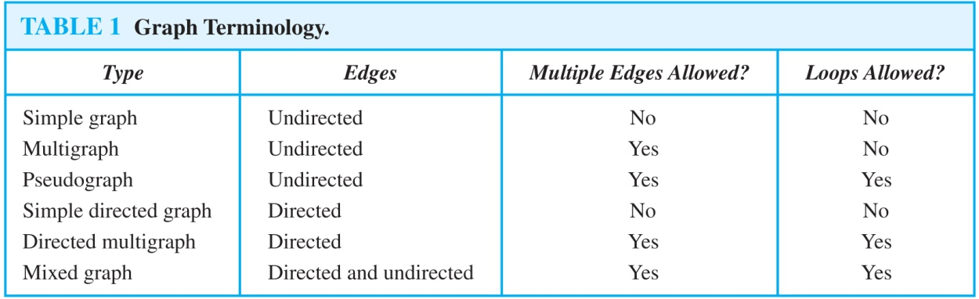
Graph Terminology: Summary
To understand the structure of a graph and to build a graph model, we ask these questions:
Are the edges of the graph undirected or directed (or both)?
If the edges are undirected, are multiple edges present that connect the same pair of vertices? If the edges are directed, are multiple directed edges present?
Are loops present?

Slide 10
Other Applications of Graphs
We will illustrate how graph theory can be used in models of:
Social networks
Communications networks
Information networks
Software design
Transportation networks
Biological networks
It’s a challenge to find a subject to which graph theory has not yet been applied. Can you find an area without applications of graph theory?

Slide 11
Graph Models: Social Networks
Graphs can be used to model social structures based on different kinds of relationships between people or groups.
In a social network, vertices represent individuals or organizations and edges represent relationships between them.
Useful graph models of social networks include:
friendship graphs - undirected graphs where two people are connected if they are friends (in the real world, on Facebook, or in a particular virtual world, and so on.)
collaboration graphs - undirected graphs where two people are connected if they collaborate in a specific way
influence graphs - directed graphs where there is an edge from one person to another if the first person can influence the second person

Slide 12
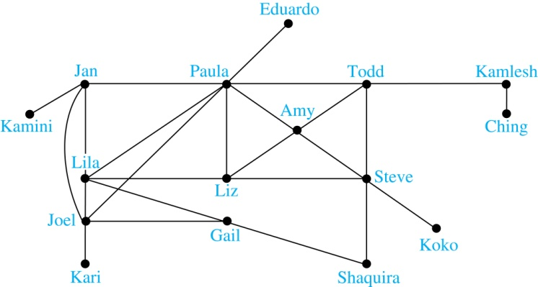
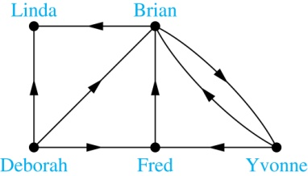
Graph Models: Social Networks (continued)
Example: A friendship graph where two people are connected if they are Facebook friends.
Example: An influence graph
Next Slide: Collaboration Graphs

Slide 13
Examples of Collaboration Graphs
The Hollywood graph models the collaboration of actors in films.
We represent actors by vertices and we connect two vertices if the actors they represent have appeared in the same movie.
We will study the Hollywood Graph in Section 10.4 when we discuss Kevin Bacon numbers.
An academic collaboration graph models the collaboration of researchers who have jointly written a paper in a particular subject.
We represent researchers in a particular academic discipline using vertices.
We connect the vertices representing two researchers in this discipline if they are coauthors of a paper.
We will study the academic collaboration graph for mathematicians when we discuss Erdős numbers in Section 10.4.

Slide 14
Applications to Information Networks
Graphs can be used to model different types of networks that link different types of information.
In a web graph, web pages are represented by vertices and links are represented by directed edges.
A web graph models the web at a particular time.
We will explain how the web graph is used by search engines in Section 11.4.
In a citation network:
Research papers in a particular discipline are represented by vertices.
When a paper cites a second paper as a reference, there is an edge from the vertex representing this paper to the vertex representing the second paper.

Slide 15
Transportation Graphs
Graph models are extensively used in the study of transportation networks.
Airline networks can be modeled using directed multigraphs where
airports are represented by vertices
each flight is represented by a directed edge from the vertex representing the departure airport to the vertex representing the destination airport
Road networks can be modeled using graphs where
vertices represent intersections and edges represent roads.
undirected edges represent two-way roads and directed edges represent one-way roads.

Slide 16
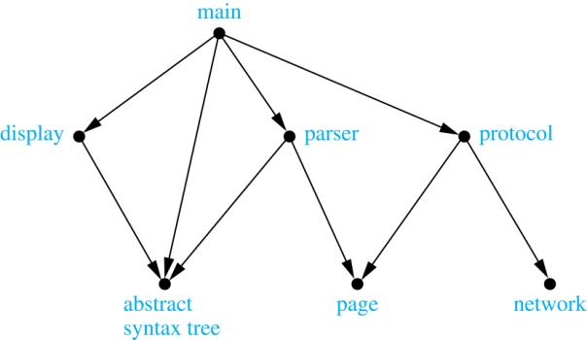
Software Design Applications
Graph models are extensively used in software design. We will introduce two such models here; one representing the dependency between the modules of a software application and the other representing restrictions in the execution of statements in computer programs.
When a top-down approach is used to design software, the system is divided into modules, each performing a specific task.
We use a module dependency graph to represent the dependency between these modules. These dependencies need to be understood before coding can be done.
In a module dependency graph vertices represent software modules and there is an edge from one module to another if the second module depends on the first.
Example: The dependencies between the seven modules in the design of a web browser are represented by this module dependency graph.

Slide 17
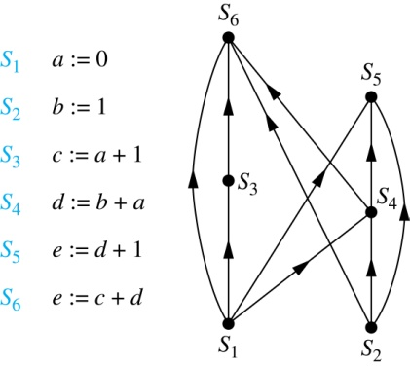
Software Design Applications (continued)
We can use a directed graph called a precedence graph to represent which statements must have already been executed before we execute each statement.
Vertices represent statements in a computer program
There is a directed edge from a vertex to a second vertex if the second vertex cannot be executed before the first
Example: This precedence graph shows which statements must already have been executed before we can execute each of the six statements in the program.

Slide 18
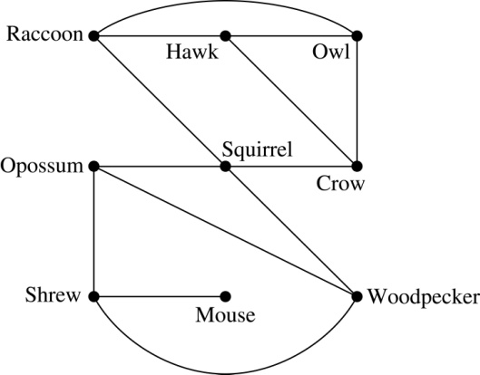
Biological Applications
Graph models are used extensively in many areas of the biological science. We will describe two such models, one to ecology and the other to molecular biology.
Niche overlap graphs model competition between species in an ecosystem
Vertices represent species and an edge connects two vertices when they represent species who compete for food resources.
Example: This is the niche overlap graph for a forest ecosystem with nine species.

Slide 19
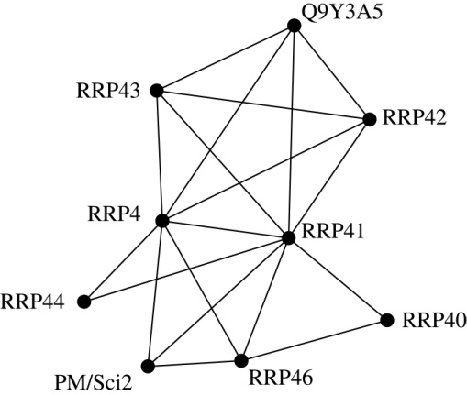
Biological Applications (continued)
We can model the interaction of proteins in a cell using a protein interaction network.
In a protein interaction graph, vertices represent proteins and vertices are connected by an edge if the proteins they represent interact.
Protein interaction graphs can be huge and can contain more than 100,000 vertices, each representing a different protein, and more than 1,000,000 edges, each representing an interaction between proteins
Protein interaction graphs are often split into smaller graphs, called modules, which represent the interactions between proteins involved in a particular function.
Example: This is a module of the protein interaction graph of proteins that degrade RNA in a human cell.

Slide 20
Graph Terminology and Special Types of Graphs
Section 10.2

Slide 21

Basic Terminology
Definition 1. Two vertices u, v in an undirected graph G are called adjacent (or neighbors) in G if there is an edge e between u and v. Such an edge e is called incident with the vertices u and v and e is said to connect u and v.
Definition 2. The set of all neighbors of a vertex v of G = (V, E), denoted by N(v), is called the neighborhood of v. If A is a subset of V, we denote by N(A) the set of all vertices in G that are adjacent to at least one vertex in A. So,
Definition 3. The degree of a vertex in a undirected graph is the number of edges incident with it, except that a loop at a vertex contributes two to the degree of that vertex. The degree of the vertex v is denoted by deg(v).

Slide 22
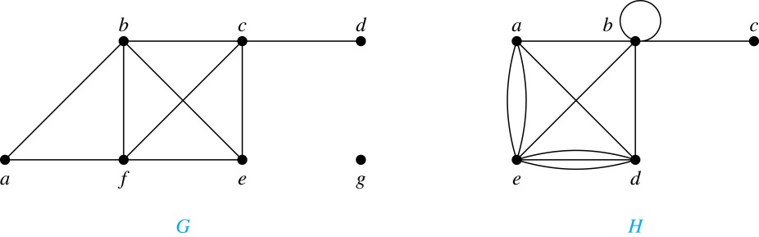
Degrees and Neighborhoods of Vertices
Example: What are the degrees and neighborhoods of the vertices in the graphs G and H?
Solution:
G: deg(a) = 2, deg(b) = deg(c) = deg(f ) = 4, deg(d ) = 1,
deg(e) = 3, deg(g) = 0.
N(a) = {b, f }, N(b) = {a, c, e, f }, N(c) = {b, d, e, f }, N(d) = {c},
N(e) = {b, c , f }, N(f) = {a, b, c, e}, N(g) = ∅ .
H: deg(a) = 4, deg(b) = deg(e) = 6, deg(c) = 1, deg(d) = 5.
N(a) = {b, d, e}, N(b) = {a, b, c, d, e}, N(c) = {b},
N(d) = {a, b, e}, N(e) = {a, b ,d}.

Slide 23
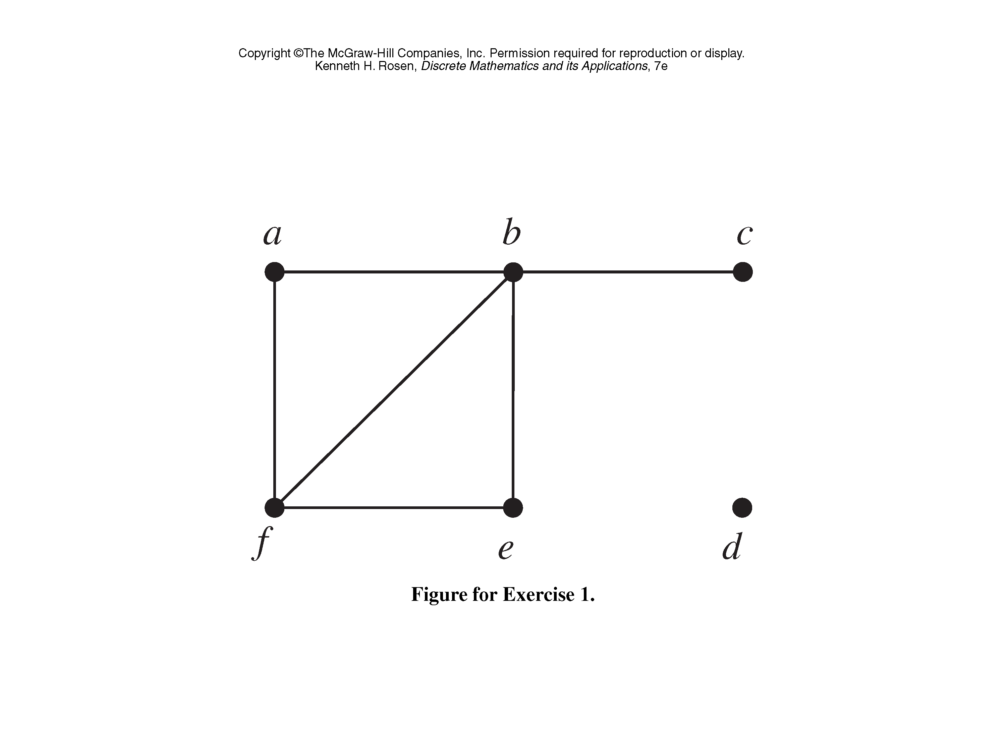
Classroom Exercise
Find the number of vertices, the number of edges, and the degree of each vertex in the given undirected graph. Identify all isolated (degree is zero) and pendant vertices (degree is one).

Slide 24
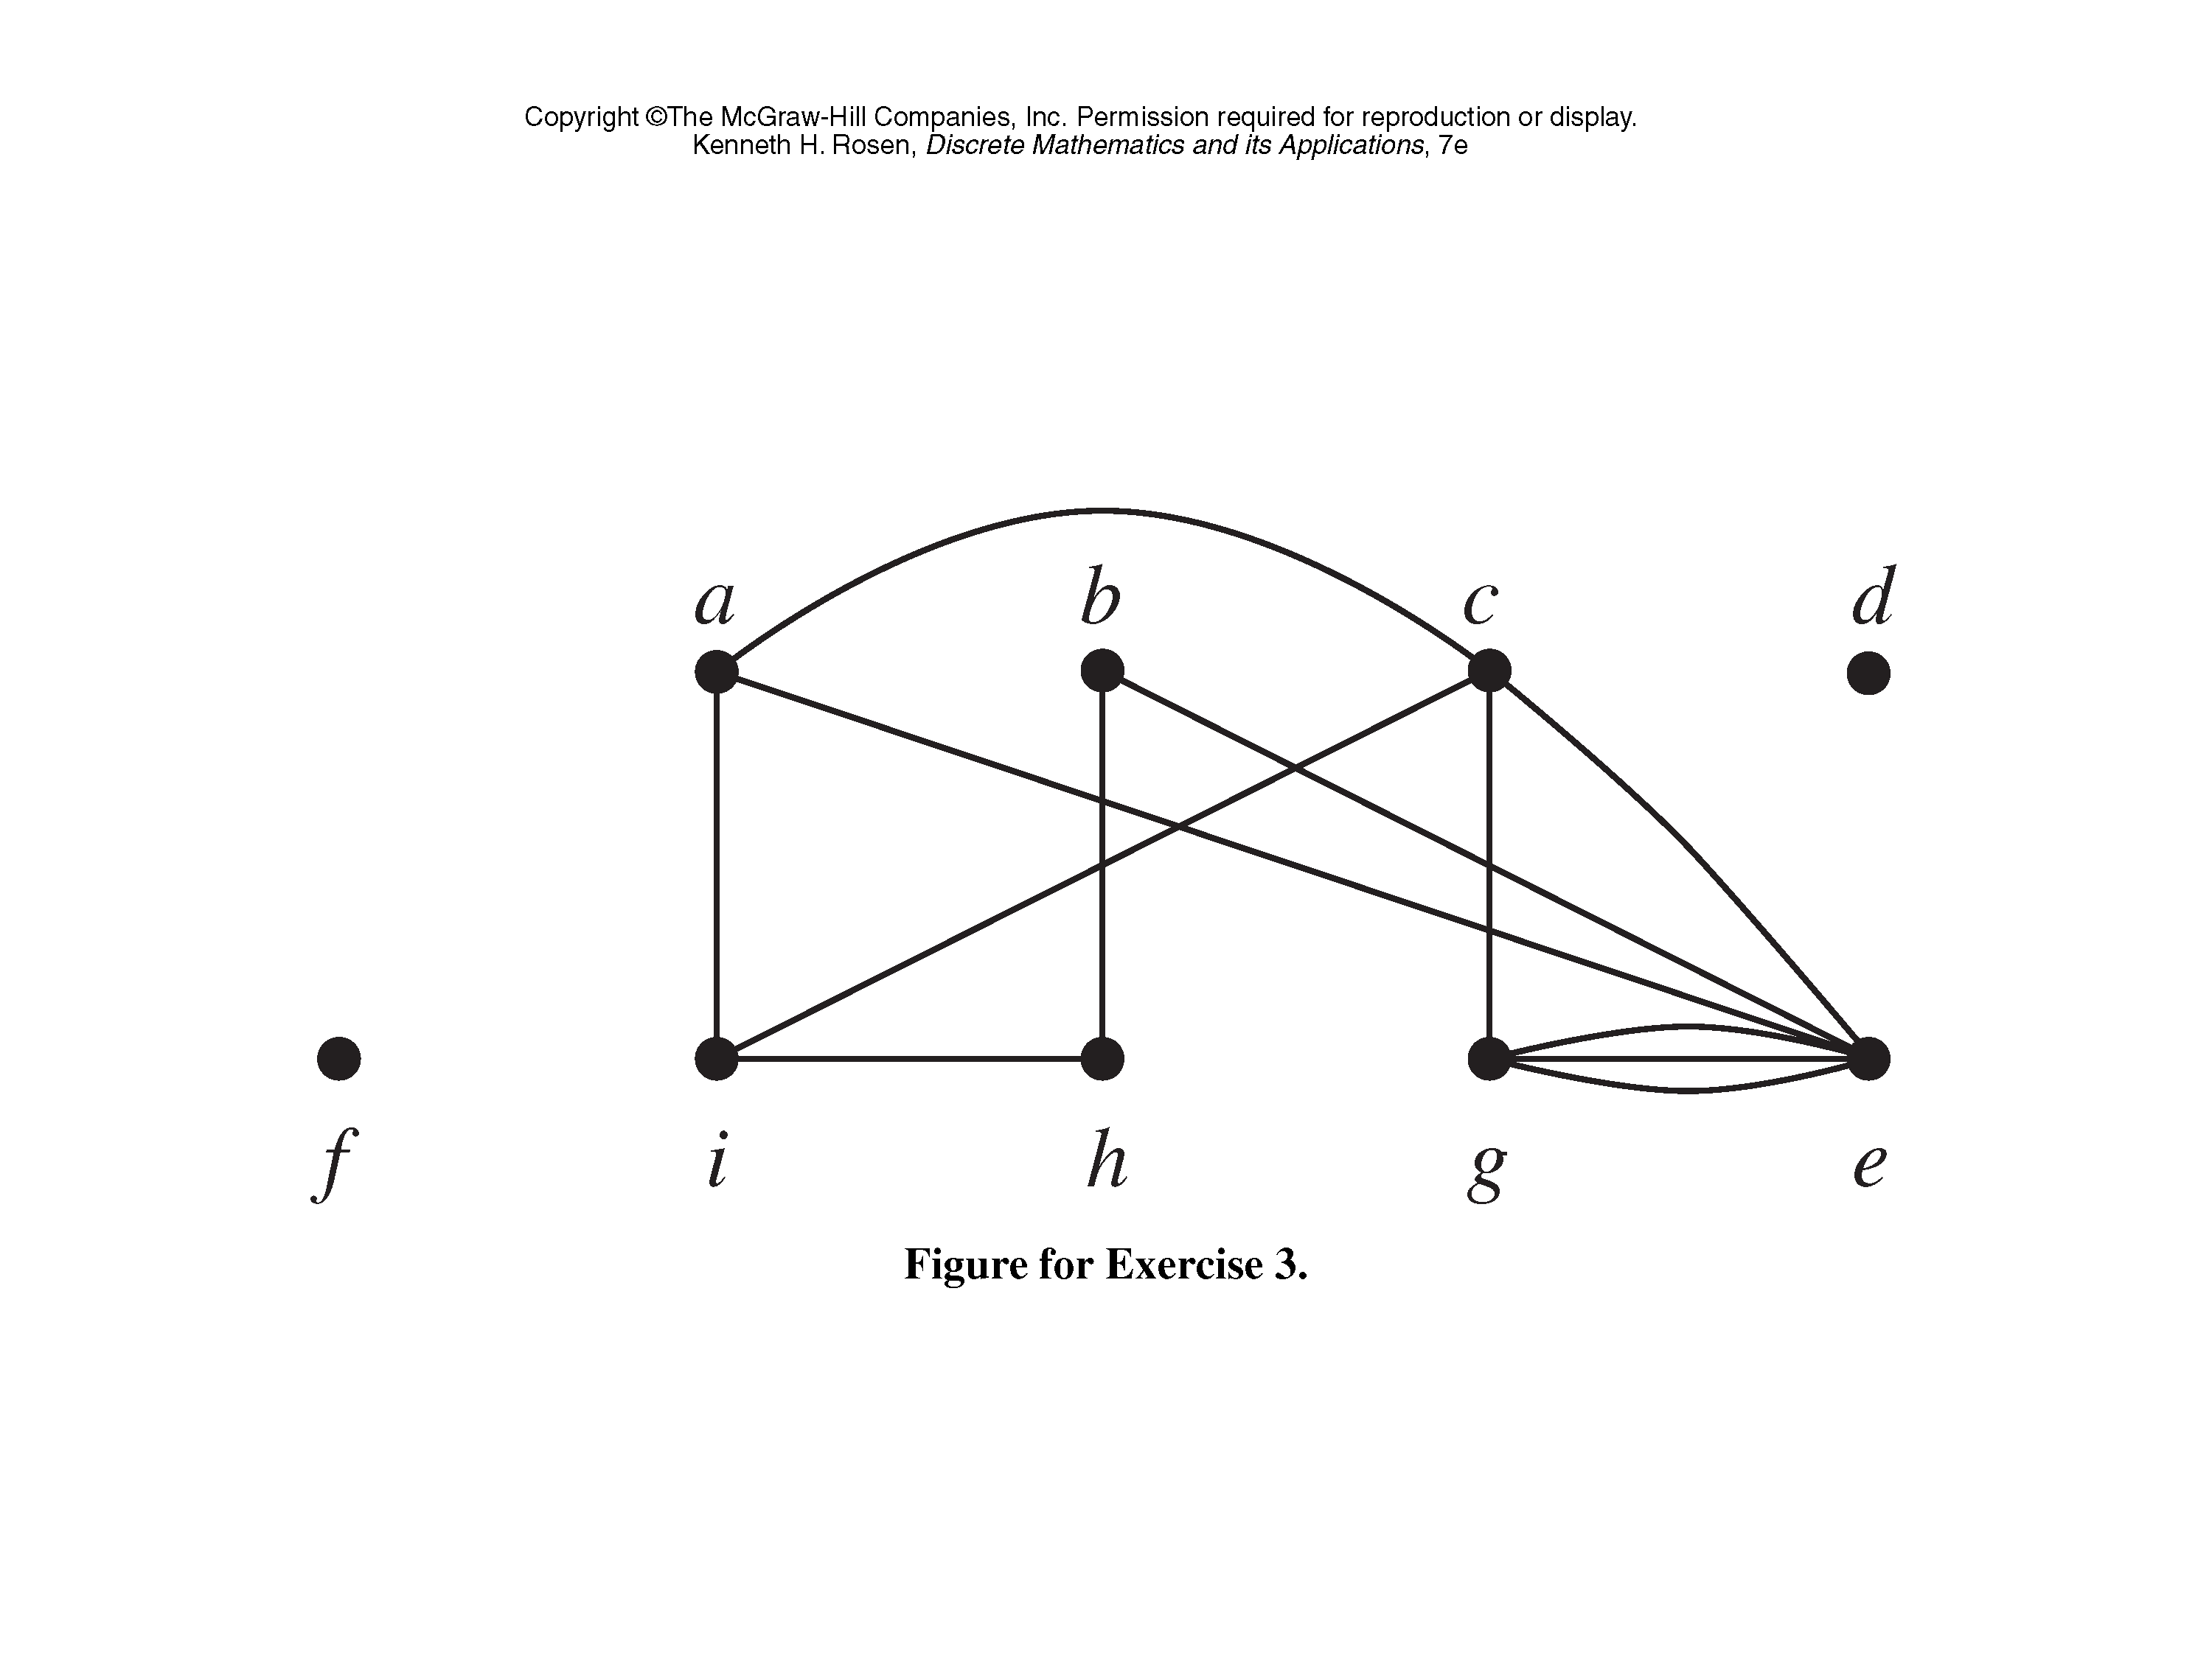
Classroom Exercise
Find the number of vertices, the number of edges, and the degree of each vertex in the given undirected graph. Identify all isolated and pendant vertices.

Slide 25
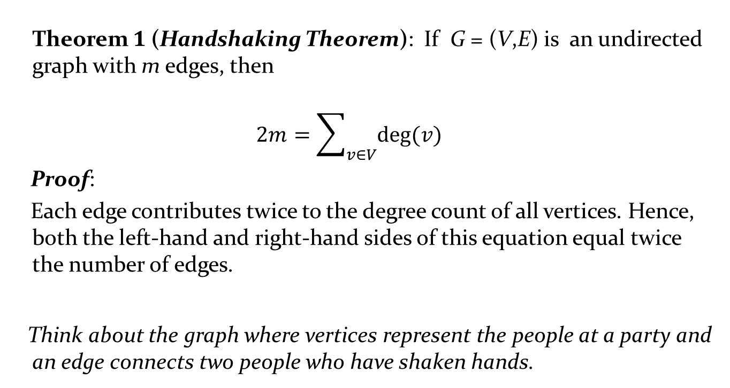
Degrees of Vertices
Theorem 1 (Handshaking Theorem): If G = (V,E) is an undirected graph with m edges, then
$$2m=\sum_{v∈V}{deg⁡(v)}$$
Proof:
Each edge contributes twice to the degree count of all vertices. Hence, both the left-hand and right-hand sides of this equation equal twice the number of edges.
Think about the graph where vertices represent the people at a party and an edge connects two people who have shaken hands.

Slide 26
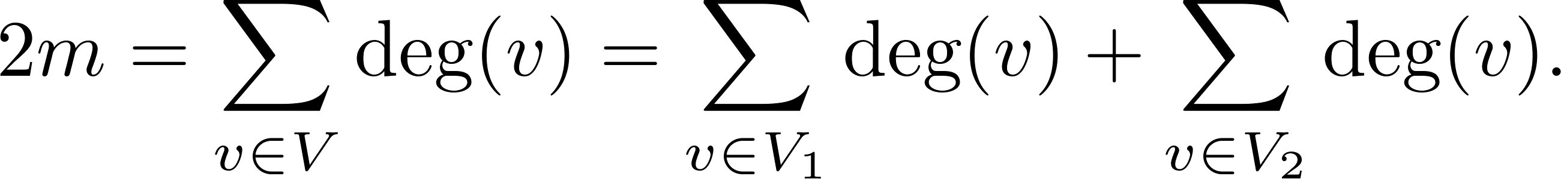
Degree of Vertices (continued)
Theorem 2: An undirected graph has an even number of vertices of odd degree.
Proof: Let V₁ be the vertices of even degree and V₂ be the vertices of odd degree in an undirected graph G = (V, E) with m edges. Then
even
This sum must be even because 2m is even and the sum of the degrees of the vertices of even degrees is also even. Because this is the sum of the degrees of all vertices of odd degree in the graph, there must be an even number of such vertices.
must be even since deg(v) is even for each v ∈ V₁

Slide 27
Handshaking Theorem
We now give two examples illustrating the usefulness of the handshaking theorem.
Example: How many edges are there in a graph with 10 vertices of degree six?
Solution: Because the sum of the degrees of the vertices is 6 ⋅ 10 = 60, the handshaking theorem tells us that 2m = 60. So the number of edges m = 30.
Example: If a graph has 5 vertices, can each vertex have degree 3?
Solution: This is not possible by the handshaking theorem, because the sum of the degrees of the vertices 3 ⋅ 5 = 15 is odd.

Slide 28
Directed Graphs
Recall the definition of a directed graph.
Definition: An directed graph G = (V, E) consists of V, a nonempty set of vertices (or nodes), and E, a set of directed edges or arcs. Each edge is an ordered pair of vertices. The directed edge (u,v) is said to start at u and end at v.
Definition: Let (u,v) be an edge in G. Then u is the initial vertex of this edge and is adjacent to v and v is the terminal (or end) vertex of this edge and is adjacent from u. The initial and terminal vertices of a loop are the same.

Slide 29
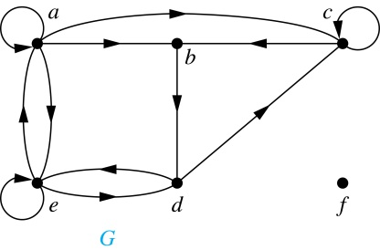
Directed Graphs (continued)
Definition: The in-degree of a vertex v, denoted deg⁻(v), is the number of edges which terminate at v. The out-degree of v, denoted deg⁺(v), is the number of edges with v as their initial vertex. Note that a loop at a vertex contributes 1 to both the in-degree and the out-degree of the vertex.
Example: In the graph G we have
deg⁻(a) = 2, deg⁻(b) = 2, deg⁻(c) = 3, deg⁻(d) = 2,
deg⁻(e) = 3, deg⁻(f) = 0.
deg⁺(a) = 4, deg⁺(b) = 1, deg⁺(c) = 2, deg⁺(d) = 2,
deg⁺ (e) = 3, deg⁺(f) = 0.

Slide 30
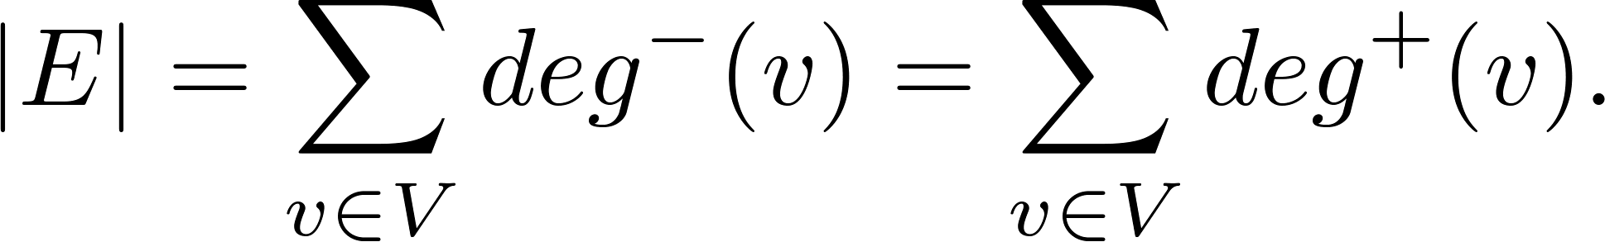
Directed Graphs (continued)
Theorem 3: Let G = (V, E) be a graph with directed edges. Then:
Proof: The first sum counts the number of outgoing edges over all vertices and the second sum counts the number of incoming edges over all vertices. It follows that both sums equal the number of edges in the graph.

Slide 31
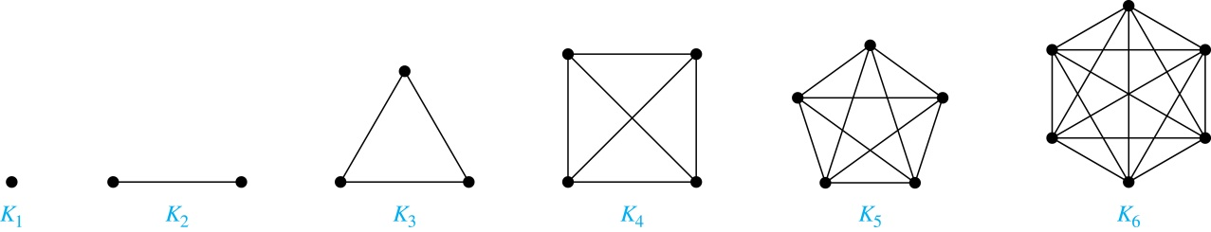
Special Types of Simple Graphs: Complete Graphs
A complete graph on n vertices, denoted by K_{n}, is the simple graph that contains exactly one edge between each pair of distinct vertices.

Slide 32
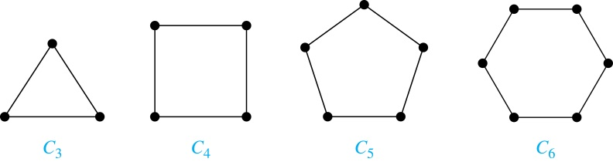
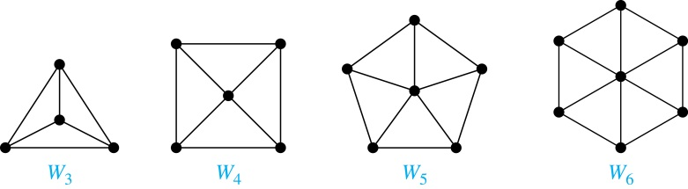
Special Types of Simple Graphs: Cycles and Wheels
A cycle C_{n} for n ≥ 3 consists of n vertices v₁, v₂ ,⋯ , v_{n}, and edges {v₁, v₂}, {v₂, v₃} ,⋯ , {v_{n-1}, v_{n}}, {v_{n}, v₁}.
A wheel W_{n} is obtained by adding an additional vertex to a cycle C_{n} for n ≥ 3 and connecting this new vertex to each of the n vertices in C_{n} by new edges.

Slide 33
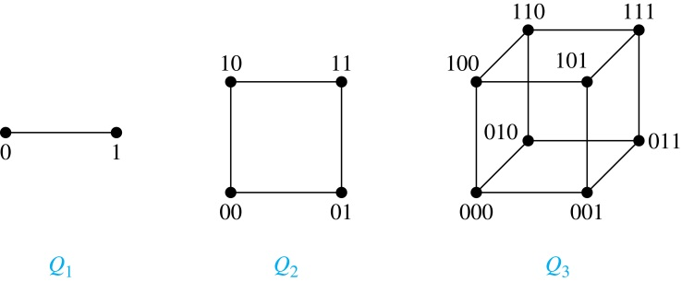
Special Types of Simple Graphs: n-Cubes
An n-dimensional hypercube, or n-cube, Q_{n}, is a graph with 2^{n} vertices representing all bit strings of length n, where there is an edge between two vertices that differ in exactly one bit position.

Slide 34
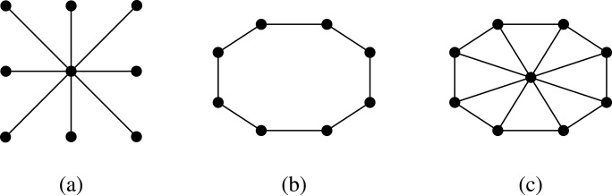
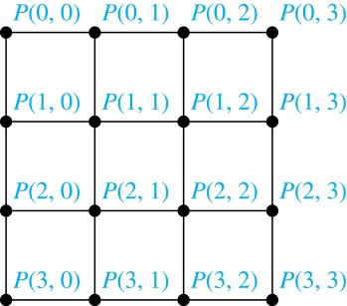
Special Types of Graphs and Computer Network Architecture
Various special graphs play an important role in the design of computer networks.
Some local area networks use a star topology, which is a complete bipartite graph K_{1,n} ,as shown in (a). All devices are connected to a central control device.
Other local networks are based on a ring topology, where each device is connected to exactly two others using C_{n} ,as illustrated in (b). Messages may be sent around the ring.
Others, as illustrated in (c), use a W_{n} – based topology, combining the features of a star topology and a ring topology.
Various special graphs also play a role in parallel processing where processors need to be interconnected as one processor may need the output generated by another.
The n-dimensional hypercube, or n-cube, Q_{n}, is a common way to connect processors in parallel, e.g., Intel Hypercube.
Another common method is the mesh network, illustrated here for 16 processors.

Slide 35
Bipartite Graphs
Definition: A simple graph G is bipartite if V can be partitioned into two disjoint subsets V₁ and V₂ such that every edge connects a vertex in V₁ and a vertex in V₂. In other words, there are no edges which connect two vertices in V₁ or in V₂.
It is not hard to show that an equivalent definition of a bipartite graph is a graph where it is possible to color the vertices red or blue so that no two adjacent vertices are the same color.
Theorem 4. A simple graph is bipartite if and only if it is possible to assign one of two different colors to each vertex of the graph so that no two adjacent vertices are assigned the same color.

Slide 36
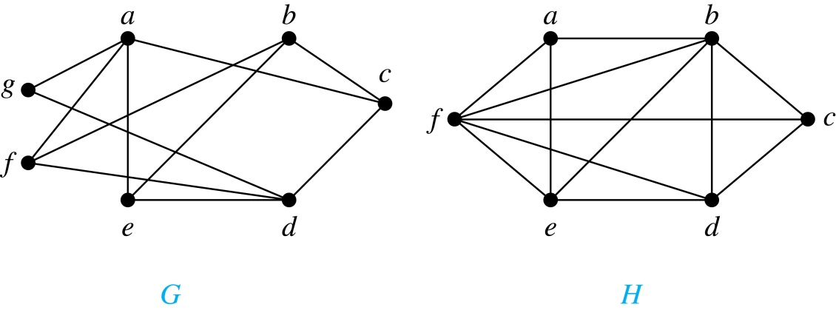
Bipartite Graphs
H is not bipartite
since if we color a red, then the adjacent vertices f and b must both be blue.
G is bipartite

Slide 37
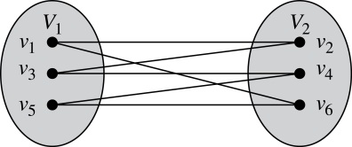
Bipartite Graphs (continued)
Example: Show that C₆ is bipartite.
Solution: We can partition the vertex set into V₁ = {v₁, v₃, v₅} and V₂ = {v₂, v₄, v₆} so that every edge of C₆ connects a vertex in V₁ and V₂ .
Example: Show that C₃ is not bipartite.
Solution: If we divide the vertex set of C₃ into two nonempty sets, one of the two must contain two vertices. But in C₃ every vertex is connected to every other vertex. Therefore, the two vertices in the same partition are connected. Hence, C₃ is not bipartite.

Slide 38
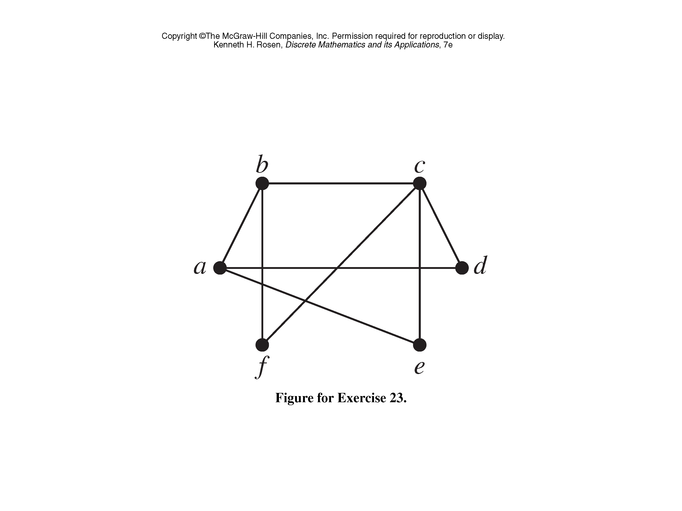
Classroom Exercise
Determine whether the graph is bipartite.

Slide 39
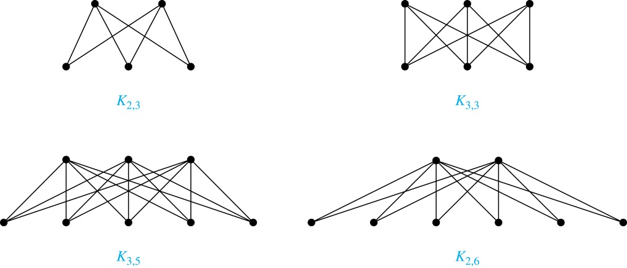
Complete Bipartite Graphs
Definition: A complete bipartite graph K_{m,n} is a graph that has its vertex set partitioned into two subsets V₁ of size m and V₂ of size n such that there is an edge from every vertex in V₁ to every vertex in V₂.
Example: We display four complete bipartite graphs here.

Slide 40
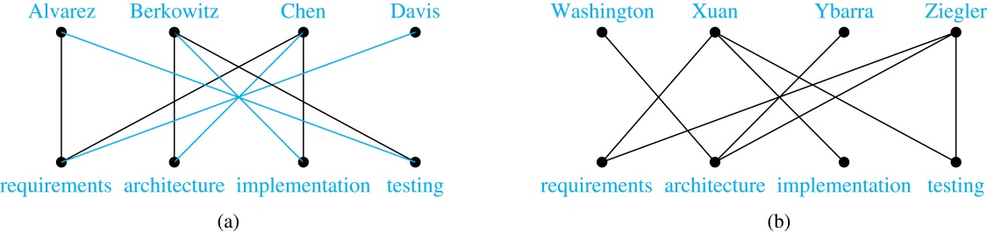
Bipartite Graphs and Matching
Bipartite graphs are used to model applications that involve matching the elements of one set to elements in another, for example:
Job assignments - vertices represent the jobs and the employees, edges link employees with those jobs they have been trained to do. A common goal is to match jobs to employees so that the most jobs are done.
Marriage - vertices represent the men and the women and edges link a a man and a woman if they are an acceptable spouse. We may wish to find the largest number of possible marriages.
See the text for more about matching in bipartite graphs.

Slide 41
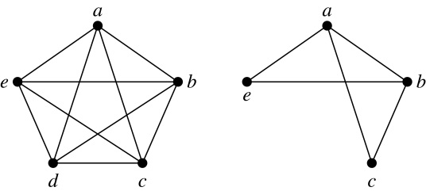
New Graphs from Old
Definition: A subgraph of a graph G = (V,E) is a graph (W,F), where W ⊂ V and F ⊂ E. A subgraph H of G is a proper subgraph of G if H ≠ G.
Example: Here we show K₅ and one of its subgraphs.
Definition: Let G = (V, E) be a simple graph. The subgraph induced by a subset W of the vertex set V is the graph (W,F), where the edge set F contains an edge in E if and only if both endpoints are in W.
Example: Here we show K₅ and the subgraph induced by W = {a,b,c,e}.

Slide 42
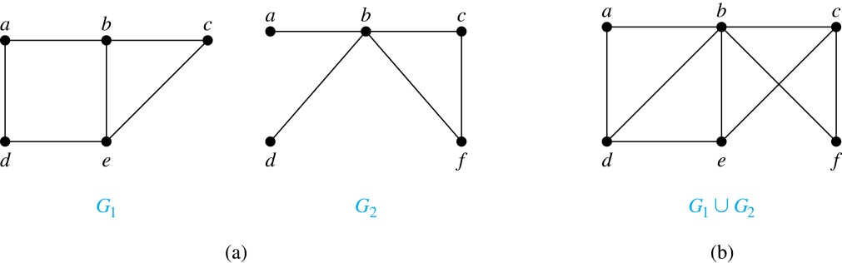
New Graphs from Old (continued)
Definition: The union of two simple graphs G₁ = (V₁, E₁) and G₂ = (V₂, E₂) is the simple graph with vertex set V₁ ⋃ V₂ and edge set E₁ ⋃ E₂. The union of G₁ and G₂ is denoted by G₁ ⋃ G₂.
Example:

Slide 43
Representing Graphs and Graph Isomorphism
Section 10.3

Slide 44
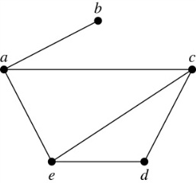
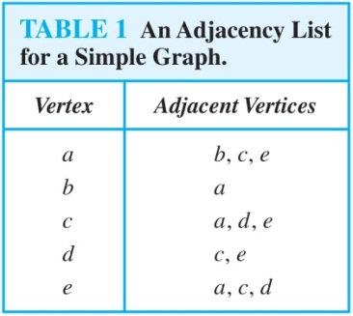
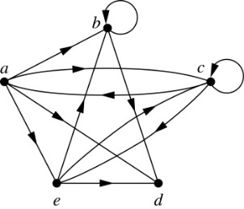
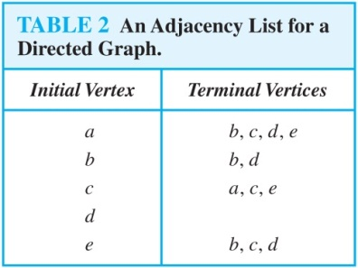
Representing Graphs: Adjacency Lists
Definition: An adjacency list can be used to represent a graph with no multiple edges by specifying the vertices that are adjacent to each vertex of the graph.
Example:
Example:

Slide 45
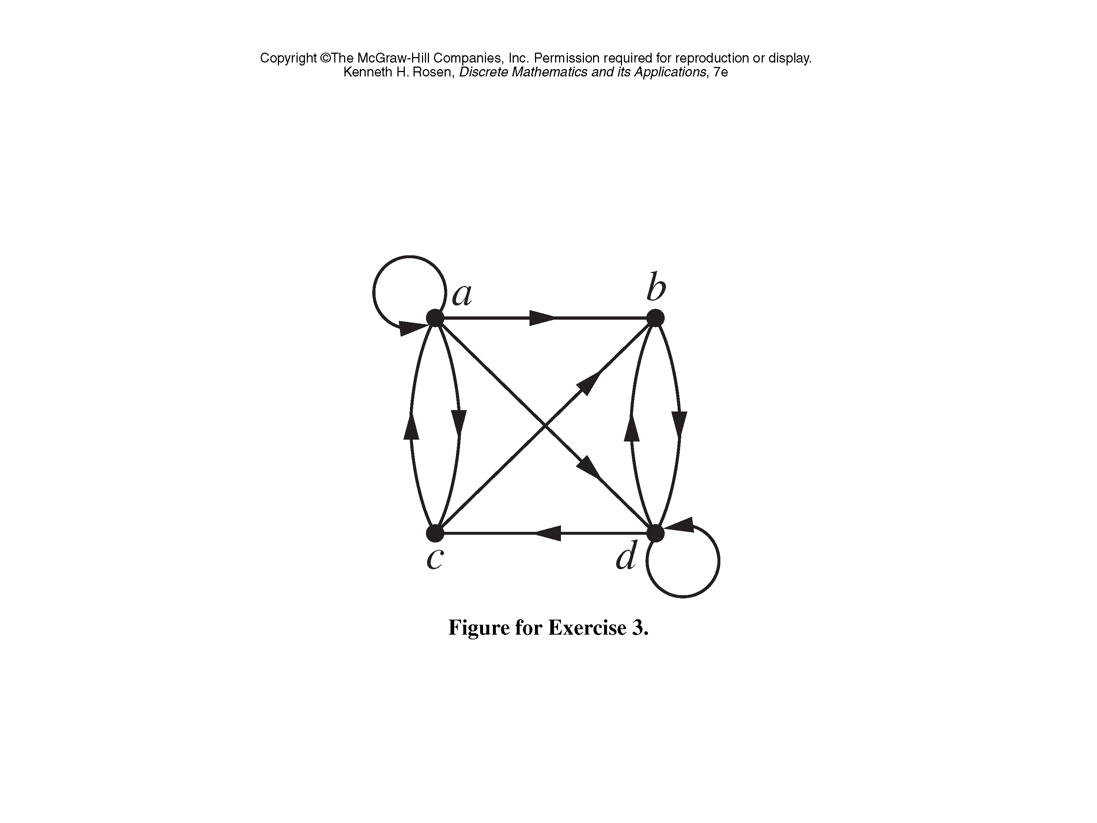
Classroom Exercise
Use an adjacency list to represent the given graph.

Slide 46
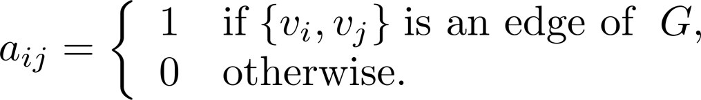
Representation of Graphs: Adjacency Matrices
Definition: Suppose that G = (V, E) is a simple graph where |V| = n. Arbitrarily list the vertices of G as v₁, v₂, … , v_{n}. The adjacency matrix A_{G} of G, with respect to the listing of vertices, is the n × n zero-one matrix with 1 as its (i, j)th entry when v_{i} and v_{j} are adjacent, and 0 as its (i, j)th entry when they are not adjacent.
In other words, if the graphs adjacency matrix is A_{G} = [a_{ij}], then

Slide 47
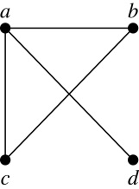
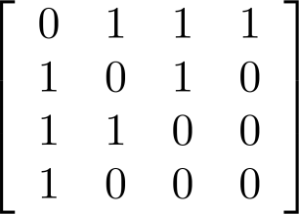
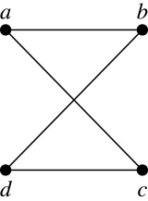
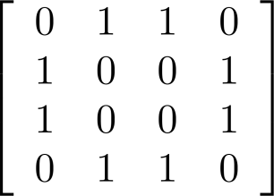
Adjacency Matrices (continued)
Example:
When a graph is sparse, that is, it has few edges relatively to the total number of possible edges, it is much more efficient to represent the graph using an adjacency list than an adjacency matrix. But for a dense graph, which includes a high percentage of possible edges, an adjacency matrix is preferable.
The ordering of
vertices is a, b, c, d.
The ordering of
vertices is a, b, c, d.
Note: The adjacency matrix of a simple graph is symmetric, i.e., a_{ij} = a_{ji}
Also, since there are no loops, each diagonal entry a_{ii} for i = 1, 2, 3, …, n, is 0.

Slide 48
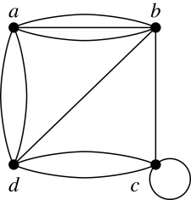
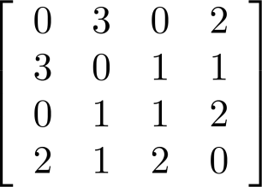
Adjacency Matrices (continued)
Adjacency matrices can also be used to represent graphs with loops and multiple edges.
A loop at the vertex v_{i} is represented by a 1 at the (i, j)th position of the matrix.
When multiple edges connect the same pair of vertices v_{i} and v_{j}, (or if multiple loops are present at the same vertex), the (i, j)th entry equals the number of edges connecting the pair of vertices.
Example: We give the adjacency matrix of the pseudograph shown here using the ordering of vertices a, b, c, d.

Slide 49
Adjacency Matrices (continued)
Adjacency matrices can also be used to represent directed graphs. The matrix for a directed graph G = (V, E) has a 1 in its (i, j)th position if there is an edge from v_{i} to v_{j}, where v₁, v₂, … v_{n} is a list of the vertices.
In other words, if the graphs adjacency matrix is A_{G} = [a_{ij}], then
The adjacency matrix for a directed graph does not have to be symmetric, because there may not be an edge from v_{i} to v_{j}, when there is an edge from v_{j} to v_{i}.
To represent directed multigraphs, the value of a_{ij} is the number of edges connecting v_{i} to v_{j}.

Slide 50
Classroom Exercise
Use an adjacency matrix to represent the given graph.

Slide 51
Adjacency List v.s. Adjacency Matrix
Memory
Adjacency list, memory O(cn)
Adjacency matrix, memory O(n^2)
Check if two nodes are neighbor nodes
Adjacency list, Find a node, search the neighbor list
Adjacency matrix, find the neighbor node by index

Slide 52
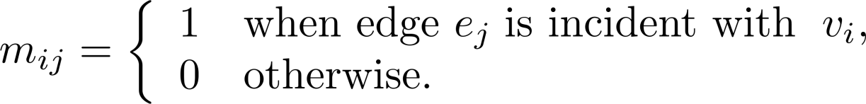
Representation of Graphs: Incidence Matrices
Definition: Let G = (V, E) be an undirected graph with vertices where v₁, v₂, … v_{n} and edges e₁, e₂, … e_{m}. The incidence matrix with respect to the ordering of V and E is the n × m matrix M = [m_{ij}], where

Slide 53
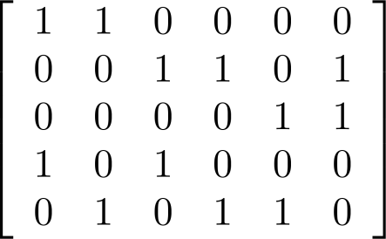
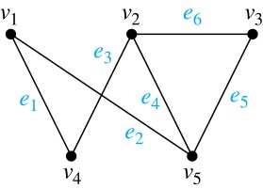
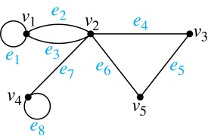
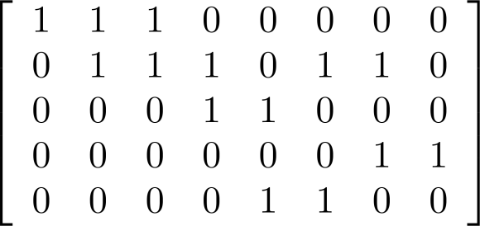
Incidence Matrices (continued)
Example: Simple Graph and Incidence Matrix
The rows going from top to bottom represent v₁ through v₅ and the columns going from left to right represent e₁ through e₆.
Example: Pseudograph and Incidence Matrix
The rows going from top to bottom represent v₁ through v₅ and the columns going from left to right represent e₁ through e₈.

Slide 54
Isomorphism of Graphs
Definition: The simple graphs G₁ = (V₁, E₁) and G₂ = (V₂, E₂) are isomorphic if there is a one-to-one and onto function f from V₁ to V₂ with the property that a and b are adjacent in G₁ if and only if f(a) and f(b) are adjacent in G₂ , for all a and b in V₁ . Such a function f is called an isomorphism. Two simple graphs that are not isomorphic are called nonisomorphic.

Slide 55
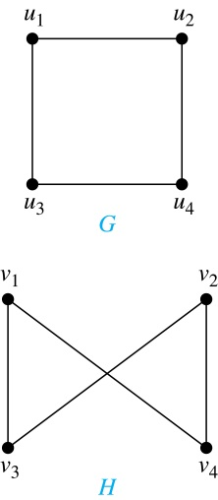
Isomorphism of Graphs (cont.)
Example: Show that the graphs G =(V, E) and H = (W, F) are isomorphic.
Solution: The function f with f(u₁) = v₁,
f(u₂) = v₄, f(u₃) = v₃, and f(u₄) = v₂ is a
one-to-one correspondence between V and W. Note that adjacent vertices in G are u₁ and u₂, u₁ and u₃, u₂ and u₄, and u₃ and u₄. Each of the pairs f(u₁) = v₁ and f(u₂) = v₄, f(u₁) = v₁ and f(u₃) = v₃ , f(u₂) = v₄ and f(u₄) = v₂ , and f(u₃) = v₃ and f(u₄) = v₂ consists of two adjacent vertices in H.

Slide 56
Isomorphism of Graphs (cont.)
It is difficult to determine whether two simple graphs are isomorphic using brute force because there are n! possible one-to-one correspondences between the vertex sets of two simple graphs with n vertices.
The best algorithms for determining weather two graphs are isomorphic have exponential worst case complexity in terms of the number of vertices of the graphs.
Sometimes it is not hard to show that two graphs are not isomorphic. We can do so by finding a property, preserved by isomorphism, that only one of the two graphs has. Such a property is called graph invariant.
There are many different useful graph invariants that can be used to distinguish nonisomorphic graphs, such as the number of vertices, number of edges, and degree sequence (list of the degrees of the vertices in nonincreasing order). We will encounter others in later sections of this chapter.

Slide 57
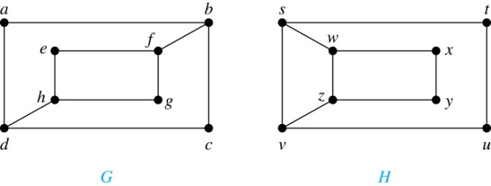

Isomorphism of Graphs (cont.)
Example: Determine whether these two graphs are isomorphic.
Solution: Both graphs have eight vertices and ten edges.
They also both have four vertices of degree two and four of degree three.
However, G and H are not isomorphic. Note that since deg(a) = 2 in G, a must correspond to t, u, x, or y in H, because these are the vertices of degree 2. But each of these vertices is adjacent to another vertex of degree two in H, which is not true for a in G.
Alternatively, note that the subgraphs of G and H made up of vertices of
degree three and the edges connecting them must be isomorphic.
But the subgraphs, as shown at the right, are not isomorphic.

Slide 58

Isomorphism of Graphs (cont.)
Example: Determine whether these two graphs are isomorphic.
Solution: Both graphs have six vertices and seven edges.
They also both have four vertices of degree two and two of degree three.
The subgraphs of G and H consisting of all the vertices of degree two and the edges connecting them are isomorphic. So, it is reasonable to try to find an isomorphism f.
We define an injection f from the vertices of G to the vertices of H that preserves the degree of vertices. We will determine whether it is an isomorphism.
The function f with f(u₁) = v₆, f(u₂) = v₃, f(u₃) = v₄, and f(u₄) = v₅ , f(u₅) = v₁, and f(u₆) = v₂ is a one-to-one correspondence between G and H. Showing that this correspondence preserves edges is straightforward, so we will omit the details here. Because f is an isomorphism, it follows that G and H are isomorphic graphs.
See the text for an illustration of how adjacency matrices can be used for this verification.

Slide 59
Algorithms for Graph Isomorphism
The best algorithms known for determining whether two graphs are isomorphic have exponential worst-case time complexity (in the number of vertices of the graphs).
However, there are algorithms with linear average-case time complexity.
You can use a public domain program called NAUTY to determine in less than a second whether two graphs with as many as 100 vertices are isomoprhic.
Graph isomorphism is a problem of special interest because it is one of a few NP problems not known to be either tractable or NP-complete (see Section 3.3).

Slide 60
Applications of Graph Isomorphism
The question whether graphs are isomorphic plays an important role in applications of graph theory. For example,
chemists use molecular graphs to model chemical compounds. Vertices represent atoms and edges represent chemical bonds. When a new compound is synthesized, a database of molecular graphs is checked to determine whether the graph representing the new compound is isomorphic to the graph of a compound that this already known.
Electronic circuits are modeled as graphs in which the vertices represent components and the edges represent connections between them. Graph isomorphism is the basis for
the verification that a particular layout of a circuit corresponds to the design’s original schematics.
determining whether a chip from one vendor includes the intellectual property of another vendor.

Slide 61
Connectivity
Section 10.4

Slide 62
Paths
Informal Definition: A path is a sequence of edges that begins at a vertex of a graph and travels from vertex to vertex along edges of the graph. As the path travels along its edges, it visits the vertices along this path, that is, the endpoints of these.
Applications: Numerous problems can be modeled with paths formed by traveling along edges of graphs such as:
determining whether a message can be sent between two computers.
efficiently planning routes for mail delivery.

Slide 63
Paths
Definition: Let n be a nonnegative integer and G an undirected graph. A path of length n from u to v in G is a sequence of n edges e₁, … , e_{n} of G for which there exists a sequence x₀ = u, x₁, …, x_{n-1}, x_{n} = v of vertices such that e_{i} has, for i = 1, …, n, the endpoints x_{i-1} and x_{i}.
When the graph is simple, we denote this path by its vertex sequence x₀, x₁, … , x_{n}(since listing the vertices uniquely determines the path).
The path is a circuit if it begins and ends at the same vertex (u = v) and has length greater than zero.
The path or circuit is said to pass through the vertices x₁, x₂, … , x_{n-1} and traverse the edges e₁, … , e_{n}.
A path or circuit is simple if it does not contain the same edge more than once.
This terminology is readily extended to directed graphs. (see text)

Slide 64

Paths (continued)
Example: In the simple graph here:
a, d, c, f, e is a simple path of length 4.
d, e, c, a is not a path because e is not connected to c.
b, c, f, e, b is a circuit of length 4.
a, b, e, d, a, b is a path of length 5, but it is not a simple path.

Slide 65

Degrees of Separation
Example: Paths in Acquaintanceship Graphs. In an acquaintanceship graph there is a path between two people if there is a chain of people linking these people, where two people adjacent in the chain know one another. In this graph there is a chain of six people linking Kamini and Ching.
Some have speculated that almost every pair of people in the world are linked by a small chain of no more than six, or maybe even, five people. The play Six Degrees of Separation by John Guare is based on this notion.

Slide 66

Connectedness in Undirected Graphs
Definition: An undirected graph is called connected if there is a path between every pair of vertices. An undirected graph that is not connected is called disconnected. We say that we disconnect a graph when we remove vertices or edges, or both, to produce a disconnected subgraph.
Example: G₁ is connected because there is a path between any pair of its vertices, as can be easily seen. However G₂ is not connected because there is no path between vertices a and f, for example.

Slide 67

Connected Components
Definition: A connected component of a graph G is a connected subgraph of G that is not a proper subgraph of another connected subgraph of G. A graph G that is not connected has two or more connected components that are disjoint and have G as their union.
Example: The graph H is the union of three disjoint subgraphs H₁, H₂, and H₃, none of which are proper subgraphs of a larger connected subgraph of G.These three subgraphs are the connected components of H.

Slide 68
Connectedness in Directed Graphs
Definition: A directed graph is strongly connected if there is a path from a to b and a path from b to a whenever a and b are vertices in the graph.
Definition: A directed graph is weakly connected if there is a path between every two vertices in the underlying undirected graph, which is the undirected graph obtained by ignoring the directions of the edges of the directed graph.

Slide 69

Connectedness in Directed Graphs (continued)
Example: G is strongly connected because there is a path between any two vertices in the directed graph. Hence, G is also weakly connected. The graph H is not strongly connected, since there is no directed path from a to b, but it is weakly connected.

Slide 70
Definition: The subgraphs of a directed graph G that are strongly connected but not contained in larger strongly connected subgraphs, that is, the maximal strongly connected subgraphs, are called the strongly connected components or strong components of G.
Example (continued): The graph H has three strongly connected components, consisting of the vertex a; the vertex e; and the subgraph consisting of the vertices b, c, d and edges (b,c), (c,d), and (d,b).

Slide 71
Counting Paths between Vertices
We can use the adjacency matrix of a graph to find the number of paths between two vertices in the graph.
Theorem: Let G be a graph with adjacency matrix A with respect to the ordering v₁, … , v_{n} of vertices (with directed or undirected edges, multiple edges and loops allowed). The number of different paths of length r from v_{i} to v_{j}, where r >0 is a positive integer, equals the (i,j)th entry of A^{r}.
Proof by mathematical induction:
Basis Step: By definition of the adjacency matrix, the number of paths from v_{i} to v_{j} of length 1 is the (i,j)th entry of A.
Inductive Step: For the inductive hypothesis, we assume that that the (i,j)th entry of A^{r} is the number of different paths of length r from v_{i} to v_{j}.
Because A^{r+1} = A^{r} A, the (i,j)th entry of A^{r+1} equals b_{i1}a_{1j} + b_{i2}a_{2j} + ⋯ + b_{in}a_{nj}, where b_{ik} is the (i,k)th entry of A^{r}. By the inductive hypothesis, b_{ik} is the number of paths of length r from v_{i} to v_{k}.
A path of length r + 1 from v_{i} to v_{j} is made up of a path of length r from v_{i} to some v_{k} , and an edge from v_{k} to v_{j}. By the product rule for counting, the number of such paths is the product of the number of paths of length r from v_{i} to v_{k} (i.e., b_{ik} ) and the number of edges from from v_{k} to v_{j} (i.e, a_{kj}). The sum over all possible intermediate vertices v_{k} is b_{i1}a_{1j} + b_{i2}a_{2j} + ⋯ + b_{in}a_{nj} .

Slide 72


Counting Paths between Vertices (continued)
Example: How many paths of length four are there from a to d in the graph G.
Solution: The adjacency matrix of G (ordering the vertices as a, b, c, d) is given above. Hence the number of paths of length four from a to d is the (1, 4)th entry of A⁴ . The eight paths are as:
adjacency matrix of G
G
A =
A⁴ =
a, b, a, b, d a, b, a, c, d
a, b, d, b, d a, b, d, c, d
a, c, a, b, d a, c, a, c, d
a, c, d, b, d a, c, d, c, d

Slide 73
Euler and Hamiltonian Graphs
Section 10.5

Slide 74



Euler Paths and Circuits
Leonard Euler (1707-1783)
The town of Kӧnigsberg, Prussia (now Kalingrad, Russia) was divided into four sections by the branches of the Pregel river. In the 18th century seven bridges connected these regions.
People wondered whether it was possible to follow a path that crosses each bridge exactly once and returns to the starting point.
The Swiss mathematician Leonard Euler proved that no such path exists. This result is often considered to be the first theorem ever proved in graph theory.
Multigraph Model of the Bridges of Kӧnigsberg
The 7 Bridges of Kӧnigsberg

Slide 75

Euler Paths and Circuits (continued)
Definition: An Euler circuit in a graph G is a simple circuit containing every edge of G. An Euler path in G is a simple path containing every edge of G.
Euler circuit: pass each edge once, may pass a vertex more than once, stop as the same vertex
Euler path: pass each edge once, may not stop as the same vertex
Example: Which of the undirected graphs G₁, G₂, and G₃ has a Euler circuit? Of those that do not, which has an Euler path?
Solution: The graph G₁ has an Euler circuit (e.g., a, e, c, d, e, b, a). But, as can easily be verified by inspection, neither G₂ nor G₃ has an Euler circuit. Note that G₃ has an Euler path (e.g., a, c, d, e, b, d, a, b), but there is no Euler path in G₂, which can be verified by inspection.

Slide 76
Necessary Conditions for Euler Circuits and Paths
An Euler circuit begins with a vertex a and continues with an edge incident with a, say {a, b}. The edge {a, b} contributes one to deg(a).
Each time the circuit passes through a vertex it contributes two to the vertex’s degree.
Finally, the circuit terminates where it started, contributing one to deg(a). Therefore deg(a) must be even.
We conclude that the degree of every other vertex must also be even.
By the same reasoning, we see that the initial vertex and the final vertex of an Euler path have odd degree, while every other vertex has even degree. So, a graph with an Euler path has exactly two vertices of odd degree.
In the next slide we will show that these necessary conditions are also sufficient conditions.

Slide 77

Sufficient Conditions for Euler Circuits and Paths
Suppose that G is a connected multigraph with ≥ 2 vertices, all of even degree. Let x₀ = a be a vertex of even degree. Choose an edge {x₀, x₁} incident with a and proceed to build a simple path {x₀, x₁}, {x₁, x₂}, …, {x_{n-1}, x_{n}} by adding edges one by one until another edge can not be added.
The path begins at a with an edge of the form {a, x}; we show that it must terminate at a with an edge of the form {y, a}. Since each vertex has an even degree, there must be an even number of edges incident with this vertex. Hence, every time we enter a vertex other than a, we can leave it. Therefore, the path can only end at a.
If all of the edges have been used, an Euler circuit has been constructed. Otherwise, consider the subgraph H obtained from G by deleting the edges already used.
We illustrate this idea in the graph G here. We begin at a and choose the edges {a, f}, {f, c}, {c, b}, and {b, a} in succession.
In the example H consists of the vertices c, d, e.

Slide 78
Sufficient Conditions for Euler Circuits and Paths (continued)
Because G is connected, H must have at least one vertex in common with the circuit that has been deleted.
Every vertex in H must have even degree because all the vertices in G have even degree and for each vertex, pairs of edges incident with this vertex have been deleted. Beginning with the shared vertex construct a path ending in the same vertex (as was done before). Then splice this new circuit into the original circuit.
Continue this process until all edges have been used. This produces an Euler circuit. Since every edge is included and no edge is included more than once.
Similar reasoning can be used to show that a graph with exactly two vertices of odd degree must have an Euler path connecting these two vertices of odd degree
In the example, the vertex is c.
In the example, we end up with the circuit a, f, c, d, e, c, b, a.

Slide 79


Classroom Exercise
Determine whether the given graph has an Euler circuit. Construct such a circuit when one exists. If no Euler circuit exists, determine whether the graph has an Euler path and construct such a path if one exists.

Slide 80

Classroom Exercise
Determine whether the given graph has an Euler circuit. Construct such a circuit when one exists. If no Euler circuit exists, determine whether the graph has an Euler path and construct such a path if one exists.

Slide 81
Algorithm for Constructing an Euler Circuits
In our proof we developed this algorithms for constructing a Euler circuit in a graph with no vertices of odd degree.
procedure Euler(G: connected multigraph with all vertices of even degree)
circuit := a circuit in G beginning at an arbitrarily chosen vertex with edges
successively added to form a path that returns to this vertex.
H := G with the edges of this circuit removed
while H has edges
subciruit := a circuit in H beginning at a vertex in H that also is
an endpoint of an edge in circuit.
H := H with edges of subciruit and all isolated vertices removed
circuit := circuit with subcircuit inserted at the appropriate vertex.
return circuit{circuit is an Euler circuit}

Slide 82
Necessary and Sufficient Conditions for Euler Circuits and Paths (continued)
Theorem: A connected multigraph with at least two vertices has an Euler circuit if and only if each of its vertices has an even degree and it has an Euler path if and only if it has exactly two vertices of odd degree.
Example: Two of the vertices in the multigraph model of the Kӧnigsberg bridge problem have odd degree. Hence, there is no Euler circuit in this multigraph and it is impossible to start at a given point, cross each bridge exactly once, and return to the starting point.

Slide 83

Euler Circuits and Paths
Example:
G₁ contains exactly two vertices of odd degree (b and d). Hence it has an Euler path, e.g., d, a, b, c, d, b.
G₂ has exactly two vertices of odd degree (b and d). Hence it has an Euler path, e.g., b, a, g, f, e, d, c, g, b, c, f, d.
G₃ has six vertices of odd degree. Hence, it does not have an Euler path.

Slide 84
Applications of Euler Paths and Circuits
Euler paths and circuits can be used to solve many practical problems such as finding a path or circuit that traverses each
street in a neighborhood,
road in a transportation network,
connection in a utility grid,
link in a communications network.
Other applications are found in the
layout of circuits,
network multicasting,
molecular biology, where Euler paths are used in the sequencing of DNA.

Slide 85



Hamilton Paths and Circuits
William Rowan Hamilton (1805- 1865)
Euler paths and circuits contained every edge only once. Now we look at paths and circuits that contain every vertex exactly once.
William Hamilton invented the Icosian puzzle in 1857. It consisted of a wooden dodecahedron (with 12 regular pentagons as faces), illustrated in (a), with a peg at each vertex, labeled with the names of different cities. String was used to used to plot a circuit visiting 20 cities exactly once
The graph form of the puzzle is given in (b).
The solution (a Hamilton circuit) is given here.

Slide 86
Hamilton Paths and Circuits
Definition: A simple path in a graph G that passes through every vertex exactly once is called a Hamilton path, and a simple circuit in a graph G that passes through every vertex exactly once is called a Hamilton circuit.
That is, a simple path x₀, x₁, …, x_{n-1}, x_{n} in the graph G = (V, E) is called a Hamilton path if V = {x₀, x₁, … , x_{n-1,} x_{n} } and x_{i} ≠ x_{j} for 0≤ i < j ≤ n, and the simple circuit x₀, x₁, …, x_{n-1}, x_{n}, x₀ (with n > 0) is a Hamilton circuit if x₀, x₁, … , x_{n-1}, x_{n} is a Hamilton path.

Slide 87

Hamilton Paths and Circuits (continued)
Example: Which of these simple graphs has a Hamilton circuit or, if not, a Hamilton path?
Solution: G₁ has a Hamilton circuit: a, b, c, d, e, a.
G₂ does not have a Hamilton circuit (Why?), but does have a Hamilton path : a, b, c, d.
G₃ does not have a Hamilton circuit, or a Hamilton path. Why?

Slide 88


Necessary Conditions for Hamilton Circuits
Gabriel Andrew Dirac
(1925-1984)
Unlike for an Euler circuit, no simple necessary and sufficient conditions are known for the existence of a Hamiton circuit.
However, there are some useful necessary conditions. We describe two of these now.
Dirac’s Theorem: If G is a simple graph with n ≥ 3 vertices such that the degree of every vertex in G is ≥ n/2, then G has a Hamilton circuit.
Ore’s Theorem: If G is a simple graph with n ≥ 3 vertices such that deg(u) + deg(v) ≥ n for every pair of nonadjacent vertices, then G has a Hamilton circuit.
Øysten Ore
(1899-1968)

Slide 89
Applications of Hamilton Paths and Circuits
Applications that ask for a path or a circuit that visits each intersection of a city, each place pipelines intersect in a utility grid, or each node in a communications network exactly once, can be solved by finding a Hamilton path in the appropriate graph.
The famous traveling salesperson problem (TSP) asks for the shortest route a traveling salesperson should take to visit a set of cities. This problem reduces to finding a Hamilton circuit such that the total sum of the weights of its edges is as small as possible.
A family of binary codes, known as Gray codes, which minimize the effect of transmission errors, correspond to Hamilton circuits in the n-cube Q_{n}. (See the text for details.)

