Slide 1
Discrete Probability
Chapter 7
With Question/Answer Animations

Slide 2
An Introduction to Discrete Probability
Section 7.1

Slide 3

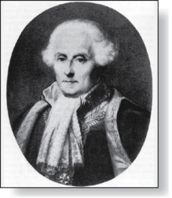
Probability of an Event
Pierre-Simon Laplace
(1749-1827)
We first study Pierre-Simon Laplace’s classical theory of probability, which he introduced in the 18th century, when he analyzed games of chance.
We first define these key terms:
An experiment is a procedure that yields one of a given set of possible outcomes.
The sample space of the experiment is the set of possible outcomes.
An event is a subset of the sample space.

Slide 4
Probability of an Event
Pierre-Simon Laplace
(1749-1827)
Here is how Laplace defined the probability of an event:
Definition: If S is a finite sample space of equally likely outcomes, and E is an event, that is, a subset of S, then the probability of E is p(E) = |E|/|S|.
For every event E, we have 0 ≤ p(E) ≤ 1. This follows directly from the definition because 0 ≤ p(E) = |E|/|S| ≤ |S|/|S| ≤ 1, since 0 ≤ |E| ≤ |S|.
Roll a dice, the probability of having a odd number.

Slide 5
Applying Laplace’s Definition
Example: An urn contains four blue balls and five red balls. What is the probability that a ball chosen from the urn is blue?
Solution: The probability that the ball is chosen is 4/9 since there are nine possible outcomes, and four of these produce a blue ball.
Example: What is the probability that when two dice are rolled, the sum of the numbers on the two dice is 7?
Solution: By the product rule there are 6² = 36 possible outcomes. Six of these sum to 7. Hence, the probability of obtaining a 7 is 6/36 = 1/6.

Slide 6
Classroom Exercise
What is the probability that a card selected at random from a standard deck of 52 cards is an ace?

Slide 7
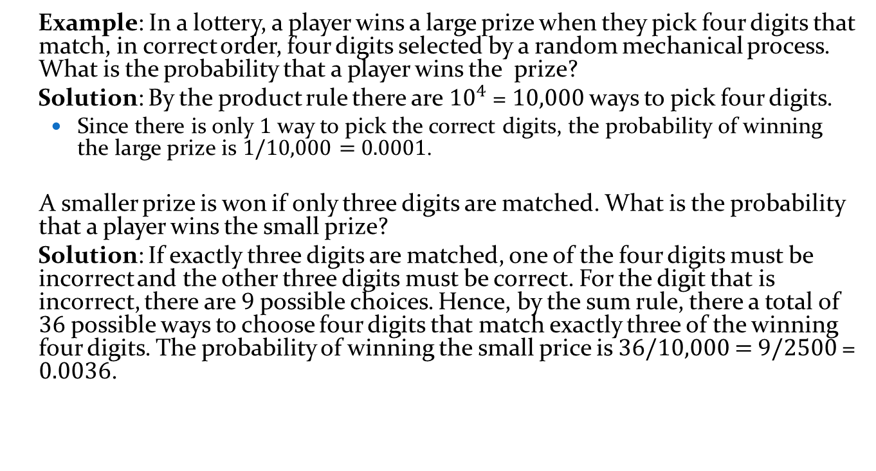
Applying Laplace’s Definition
Example: In a lottery, a player wins a large prize when they pick four digits that match, in correct order, four digits selected by a random mechanical process. What is the probability that a player wins the prize?
Solution: By the product rule there are ${10}^{4}$ = 10,000 ways to pick four digits.
Since there is only 1 way to pick the correct digits, the probability of winning the large prize is 1/10,000 = 0.0001.
A smaller prize is won if only three digits are matched. What is the probability that a player wins the small prize?
Solution: If exactly three digits are matched, one of the four digits must be incorrect and the other three digits must be correct. For the digit that is incorrect, there are 9 possible choices. Hence, by the sum rule, there a total of 36 possible ways to choose four digits that match exactly three of the winning four digits. The probability of winning the small price is 36/10,000 = 9/2500 = 0.0036.

Slide 8
Applying Laplace’s Definition
Example: There are many lotteries that award prizes to people who correctly choose a set of six numbers out of the first n positive integers, where n is usually between 30 and 60. What is the probability that a person picks the correct six numbers out of 40?
Solution: The number of ways to choose six numbers out of 40 is
C(40,6) = 40!/(34!6!) = 3,838,380.
Hence, the probability of picking a winning combination is 1/ 3,838,380 ≈ 0.00000026.
Can you work out the probability of winning the lottery with the biggest prize where you live?

Slide 9
Example: Find the probability that a hand of five cards in poker contains four cards of one kind

Slide 10
Example: What is the probability that a poker hand contains a full house, that is, three of one kind and two of another kind?

Slide 11
Applying Laplace’s Definition
Example: What is the probability that the numbers 11, 4, 17, 39, and 23 are drawn in that order from a bin with 50 balls labeled with the numbers 1,2, …, 50 if
The ball selected is not returned to the bin.
The ball selected is returned to the bin before the next ball is selected.
Solution: Use the product rule in each case.
a) Sampling without replacement: The probability is 1/254,251,200 since there are 50 ∙49 ∙48 ∙47 ∙46 = 254,251,200 ways to choose the five balls.
b) Sampling with replacement: The probability is 1/50⁵ = 1/312,500,000 since 50⁵ = 312,500,000.

Slide 12
Classroom Exercise
Find the probability of winning a lottery by selecting the correct six integers, where the order in which these integers are selected does not matter, from the positive integers not exceeding 50.

Slide 13

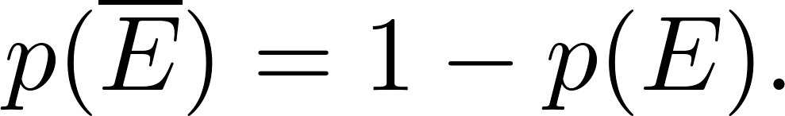
The Probability of Complements and Unions of Events
Theorem 1: Let E be an event in sample space S. The probability of the event = S − E, the complementary event of E, is given by
Proof: Using the fact that | | = |S| − |E|,

Slide 14
The Probability of Complements and Unions of Events
Example: A sequence of 10 bits is chosen randomly. What is the probability that at least one of these bits is 0?
Solution: Let E be the event that at least one of the 10 bits is 0. Then is the event that all of the bits are 1s. The size of the sample space S is 2¹⁰. Hence,

Slide 15
Classroom Exercise
What is the probability that a ﬁve-card poker hand contains at least one ace?

Slide 16
Classroom Exercise
What is the probability that a fair die never comes up an even number when it is rolled six times?

Slide 17
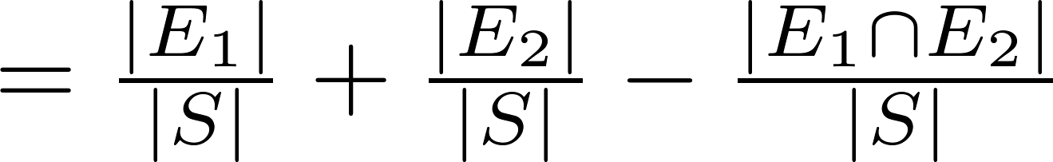
The Probability of Complements and Unions of Events
Theorem 2: Let E₁ and E₂ be events in the sample space S. Then
Proof: Given the inclusion-exclusion formula from Section 2.2, |A ∪ B| = |A| + | B| − |A ∩ B|, it follows that

Slide 18
The Probability of Complements and Unions of Events
Example: What is the probability that a positive integer selected at random from the set of positive integers not exceeding 100 is divisible by either 2 or 5?
Solution: Let E₁ be the event that the integer is divisible by 2 and E₂ be the event that it is divisible 5? Then the event that the integer is divisible by 2 or 5 is E₁ ∪ E₂ and E₁ ∩ E₂ is the event that it is divisible by 2 and 5.
It follows that:
p(E₁ ∪ E₂) = p(E₁) + p(E₂) – p(E₁ ∩ E₂)
= 50/100 + 20/100 − 10/100 = 3/5.

Slide 19
Monty Hall Puzzle
1
2
3
Example: You are asked to select one of the three doors to open. There is a large prize behind one of the doors and if you select that door, you win the prize. After you select a door, the game show host opens one of the other doors (which he knows is not the winning door). The prize is not behind the door and he gives you the opportunity to switch your selection. Should you switch?
Solution: You should switch. The probability that your initial pick is correct is 1/3. This is the same whether or not you switch doors. But since the game show host always opens a door that does not have the prize, if you switch the probability of winning will be 2/3, because you win if your initial pick was not the correct door and the probability your initial pick was wrong is 2/3.
(This is a notoriously confusing problem that has been the subject of much discussion . Do a web search to see why!)

