Slide 1

Valdosta State University
Review
Fall 2020
Department of Computer Science

Slide 2
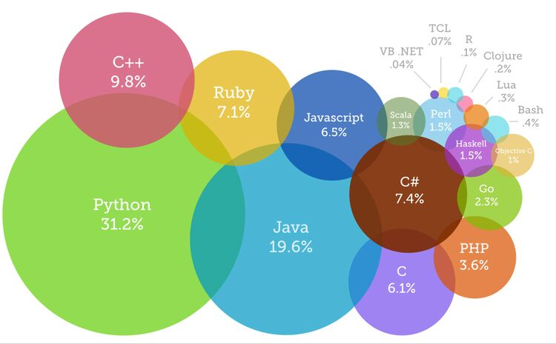
Valdosta State University
The Most Popular Programming Languages of 2019
https://www.devsaran.com/blog/10-best-programming-languages-2019-you-should-know
Department of Computer Science

Slide 3
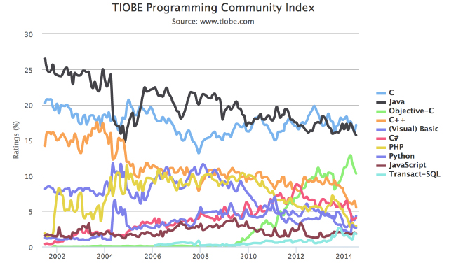
Valdosta State University
Language Trends
https://zeroturnaround.com/rebellabs/a-short-history-of-nearly-everything-java/
Department of Computer Science

Slide 4
Valdosta State University
Learning Path
Bioinformatics
High Performance
Computing
Data Science
Application
Artificial Intelligence
Web Programming
Image Processing
Simulation
Coding
Java
Department of Computer Science

Slide 5
Valdosta State University
Edit code, compile, execute
Source Code
bytecodes
Java Virtual Machine (JVM)
.java
.class
Execute
Text Editor
javac
java
Department of Computer Science

Slide 6
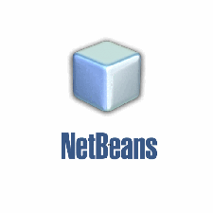






Valdosta State University
Integrated Development Environment (IDE)
open source
Yes
Yes
Yes
Git
No
Yes
No
Department of Computer Science

Slide 7
Valdosta State University
Terms
JVM, Java Virtual Machine
JRE, Java Runtime Environment
JDK, Java Development Kit
JSE, Java Standard Edition
JavaME, Java Mobile Edition
JavaEE, Java Enterprise Edition
Department of Computer Science

Slide 8
Valdosta State University
Java Resources
Reddit, https://www.reddit.com/r/java/
Oracle, https://docs.oracle.com/javase/tutorial/
Books
Think in Java
Effective Java
Department of Computer Science

