Slide 1
Counting
Chapter 6
With Question/Answer Animations

Slide 2
The Basics of Counting
Section 6.1

Slide 3
Basic Counting Principles: The Product Rule
The Product Rule: A procedure can be broken down into a sequence of two tasks. There are n₁ ways to do the first task and n₂ ways to do the second task. Then there are n₁∙n₂ ways to do the procedure.

Slide 4
Basic Counting Principles: The Product Rule
Example: How many bit strings of length seven are there?
Solution: Since each of the seven bits is either a 0 or a 1, the answer is 2⁷ = 128.
1/0

Slide 5
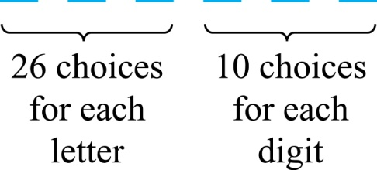
The Product Rule
Example: How many different license plates can be made if each plate contains a sequence of three uppercase English letters followed by three digits?
Solution: By the product rule,
there are 26 ∙ 26 ∙ 26 ∙ 10 ∙ 10 ∙ 10 = 17,576,000 different possible license plates.

Slide 6
Counting Functions
Counting Functions: How many functions are there from a set with m elements to a set with n elements?
Solution: Since a function represents a choice of one of the n elements of the codomain for each of the m elements in the domain, the product rule tells us that there are n ∙ n ∙ ∙ ∙ n = n^{m} such functions.
Counting One-to-One Functions: How many one-to-one functions are there from a set with m elements to one with n elements?
Solution: Suppose the elements in the domain are a₁, a₂,…, a_{m}. There are n ways to choose the value of a₁ and n−1 ways to choose a₂, etc. The product rule tells us that there are n(n−1) (n−2)∙∙∙(n−m +1) such functions.

Slide 7
Telephone Numbering Plan
Example: The North American numbering plan (NANP) specifies that a telephone number consists of 10 digits, consisting of a three-digit area code, a three-digit office code, and a four-digit station code. There are some restrictions on the digits.
Let X denote a digit from 0 through 9.
Let N denote a digit from 2 through 9.
Let Y denote a digit that is 0 or 1.
In the old plan (in use in the 1960s) the format was NYX-NNX-XXXX.
In the new plan, the format is NXX-NXX-XXXX.
How many different telephone numbers are possible under the old plan and the new plan?
Solution: Use the Product Rule.
There are 8 ∙2 ∙10 = 160 area codes with the format NYX.
There are 8 ∙10 ∙10 = 800 area codes with the format NXX.
There are 8 ∙8 ∙10 = 640 office codes with the format NNX.
There are 10 ∙10 ∙10 ∙10 = 10,000 station codes with the format XXXX.
Number of old plan telephone numbers: 160 ∙640 ∙10,000 = 1,024,000,000.
Number of new plan telephone numbers: 800 ∙800 ∙10,000 = 6,400,000,000.

Slide 8
Counting Subsets of a Finite Set
Counting Subsets of a Finite Set: Use the product rule to show that the number of different subsets of a finite set S is 2^{|S|}. (In Section 5.1, mathematical induction was used to prove this same result.)
Solution: When the elements of S are listed in an arbitrary order, there is a one-to-one correspondence between subsets of S and bit strings of length |S|. When the ith element is in the subset, the bit string has a 1 in the ith position and a 0 otherwise.
By the product rule, there are 2^{|S|} such bit strings, and therefore 2^{|S|} subsets.

Slide 9
Product Rule in Terms of Sets
If A₁, A₂, … , A_{m} are finite sets, then the number of elements in the Cartesian product of these sets is the product of the number of elements of each set.
The task of choosing an element in the Cartesian product A₁ ⨉ A₂ ⨉ ∙∙∙ ⨉ A_{m} is done by choosing an element in A₁, an element in A₂ , …, and an element in A_{m}.
By the product rule, it follows that:
|A₁ ⨉ A₂ ⨉ ∙∙∙ ⨉ A_{m} |= |A₁| ∙ |A₂| ∙ ∙∙∙ ∙ |A_{m}|.

Slide 10
Classroom Exercise
How many different three-letter initials can people have?

Slide 11
DNA and Genomes
A gene is a segment of a DNA molecule that encodes a particular protein and the entirety of genetic information of an organism is called its genome.
DNA molecules consist of two strands of blocks known as nucleotides. Each nucleotide is composed of bases: adenine (A), cytosine (C), guanine (G), or thymine (T).
The DNA of bacteria has between 10⁵ and 10⁷ links (one of the four bases). Mammals have between 10⁸ and 10¹⁰ links. So, by the product rule there are at least 4¹⁰⁵ different sequences of bases in the DNA of bacteria and 4¹⁰⁸ different sequences of bases in the DNA of mammals.
The human genome includes approximately 23,000 genes, each with 1,000 or more links.
Biologists, mathematicians, and computer scientists all work on determining the DNA sequence (genome) of different organisms.

Slide 12
Basic Counting Principles: The Sum Rule
The Sum Rule: If a task can be done either in one of n₁ ways or in one of n₂ ways to do the second task, where none of the set of n₁ ways is the same as any of the n₂ ways, then there are n₁ + n₂ ways to do the task.
Example: The mathematics department must choose either a student or a faculty member as a representative for a university committee. How many choices are there for this representative if there are 37 members of the mathematics faculty and 83 mathematics majors and no one is both a faculty member and a student.
Solution: By the sum rule it follows that there are 37 + 83 = 120 possible ways to pick a representative.

Slide 13
The Sum Rule in terms of sets.
The sum rule can be phrased in terms of sets.
|A ∪ B|= |A| + |B| as long as A and B are disjoint sets.
Or more generally,
The case where the sets have elements in common will be discussed when we consider the subtraction rule and taken up fully in Chapter 8.
|A₁ ∪ A₂ ∪ ∙∙∙ ∪ A_{m} |= |A₁| + |A₂| + ∙∙∙ + |A_{m}|
when A_{i} ∩ A_{j} = ∅ for all i, j.

Slide 14
Combining the Sum and Product Rule
Example: Suppose statement labels in a programming language can be either a single letter or a letter followed by a digit. Find the number of possible labels.
Solution: Use the product rule.
26 + 26 ∙ 10 = 286

Slide 15
Counting Passwords
Combining the sum and product rule allows us to solve more complex problems.
Example: Each user on a computer system has a password, which is six to eight characters long, where each character is an uppercase letter or a digit. Each password must contain at least one digit. How many possible passwords are there?
Solution: Let P be the total number of passwords, and let P₆, P₇, and P₈ be the passwords of length 6, 7, and 8.
By the sum rule P = P₆ + P₇ +P₈.
To find each of P₆, P₇, and P₈ , we find the number of passwords of the specified length composed of letters and digits and subtract the number composed only of letters. We find that:
P₆ = 36⁶ − 26⁶ =2,176,782,336 − 308,915,776 =1,867,866,560.
P₇ = 36⁷ − 26⁷ =
78,364,164,096 − 8,031,810,176 = 70,332,353,920.
P₈ = 36⁸ − 26⁸ =
2,821,109,907,456 − 208,827,064,576 =2,612,282,842,880.
Consequently, P = P₆ + P₇ +P₈ = 2,684,483,063,360.

Slide 16
Classroom Exercise
How many strings are there of lowercase letters of length four or less, not counting the empty string?

Slide 17
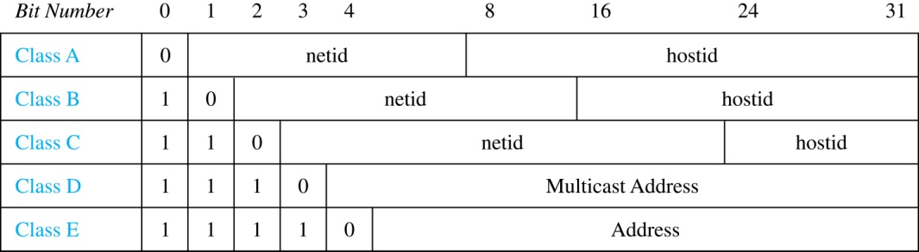
Internet Addresses
Version 4 of the Internet Protocol (IPv4) uses 32 bits.
Class A Addresses: used for the largest networks, a 0,followed by a 7-bit netid and a 24-bit hostid.
Class B Addresses: used for the medium-sized networks, a 10,followed by a 14-bit netid and a 16-bit hostid.
Class C Addresses: used for the smallest networks, a 110,followed by a 21-bit netid and a 8-bit hostid.
Neither Class D nor Class E addresses are assigned as the address of a computer on the internet. Only Classes A, B, and C are available.
1111111 is not available as the netid of a Class A network.
Hostids consisting of all 0s and all 1s are not available in any network.

Slide 18
Counting Internet Addresses
Example: How many different IPv4 addresses are available for computers on the internet?
Solution: Use both the sum and the product rule. Let x be the number of available addresses, and let x_{A}, x_{B}, and x_{C} denote the number of addresses for the respective classes.
To find, x_{A}: 2⁷ − 1 = 127 netids. 2²⁴ − 2 = 16,777,214 hostids.
x_{A} = 127∙ 16,777,214 = 2,130,706,178.
To find, x_{B}: 2¹⁴ = 16,384 netids. 2¹⁶ − 2 = 16,534 hostids.
x_{B} = 16,384 ∙ 16, 534 = 1,073,709,056.
To find, x_{C}: 2²¹ = 2,097,152 netids. 2⁸ − 2 = 254 hostids.
x_{C} = 2,097,152 ∙ 254 = 532,676,608.
Hence, the total number of available IPv4 addresses is
x = x_{A} + x_{B} + x_{C}
= 2,130,706,178 + 1,073,709,056 + 532,676,608
= 3, 737,091,842.
Not Enough Today !!
The newer IPv6 protocol solves the problem of too few addresses.

Slide 19
Basic Counting Principles: Subtraction Rule
Subtraction Rule: If a task can be done either in one of n₁ ways or in one of n₂ ways, then the total number of ways to do the task is n₁ + n₂ minus the number of ways to do the task that are common to the two different ways.
Also known as, the principle of inclusion-exclusion:

Slide 20
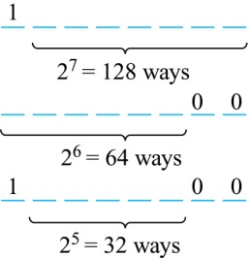
Counting Bit Strings
Example: How many bit strings of length eight either start with a 1 bit or end with the two bits 00?
Solution: Use the subtraction rule.
Number of bit strings of length eight that start with a 1 bit: 2⁷ = 128
Number of bit strings of length eight that start with bits 00: 2⁶ = 64
Number of bit strings of length eight that start with a 1 bit and end with bits 00 : 2⁵ = 32
Hence, the number is 128 + 64 − 32 = 160.

Slide 21
Classroom Exercise
How many strings of three decimal digits do not contain the same digit three times?

Slide 22
The Pigeonhole Principle
Section 6.2

Slide 23
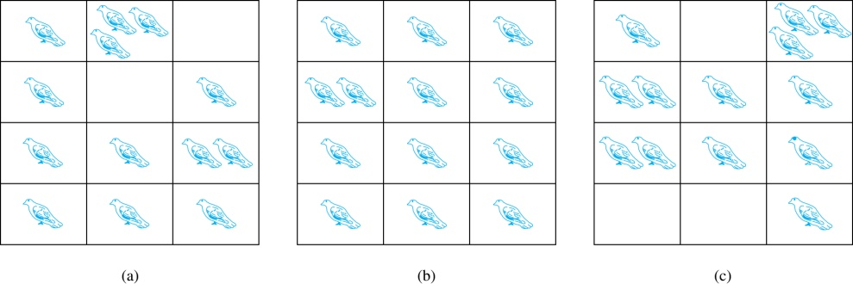
The Pigeonhole Principle
If a flock of 20 pigeons roosts in a set of 19 pigeonholes, one of the pigeonholes must have more than 1 pigeon.
Pigeonhole Principle: If k is a positive integer and k + 1 objects are placed into k boxes, then at least one box contains two or more objects.
Proof: We use a proof by contraposition. Suppose none of the k boxes has more than one object. Then the total number of objects would be at most k. This contradicts the statement that we have k + 1 objects.

Slide 24
The Pigeonhole Principle
Corollary 1: A function f from a set with k + 1 elements to a set with k elements is not one-to-one.
Proof: Use the pigeonhole principle.
Create a box for each element y in the codomain of f .
Put in the box for y all of the elements x from the domain such that f(x) = y.
Because there are k + 1 elements and only k boxes, at least one box has two or more elements.
Hence, f can’t be one-to-one.

Slide 25
Pigeonhole Principle
Example: Among any group of 367 people, there must be at least two with the same birthday, because there are only 366 possible birthdays.
Example (optional): Show that for every integer n there is a multiple of n that has only 0s and 1s in its decimal expansion.
Solution: Let n be a positive integer. Consider the n + 1 integers 1, 11, 111, …., 11…1 (where the last has n + 1 1s). There are n possible remainders when an integer is divided by n. By the pigeonhole principle, when each of the n + 1 integers is divided by n, at least two must have the same remainder. Subtract the smaller from the larger and the result is a multiple of n that has only 0s and 1s in its decimal expansion.

Slide 26
Classroom Exercise
What is the minimum number of students, each of whom comes from one of the 50 states, who must be enrolled in a university to guarantee that there are at least 100 who come from the same state?

Slide 27
Permutations and Combinations
Section 6.3

Slide 28
Permutations
Definition: A permutation of a set of distinct objects is an ordered arrangement of these objects. An ordered arrangement of r elements of a set is called an r-permuation.
Example: Let S = {1,2,3}.
The ordered arrangement 3,1,2 is a permutation of S.
The ordered arrangement 3,2 is a 2-permutation of S.
The number of r-permuatations of a set with n elements is denoted by P(n,r).
The 2-permutations of S = {1,2,3} are 1,2; 1,3; 2,1; 2,3; 3,1; and 3,2. Hence, P(3,2) = 6.

Slide 29
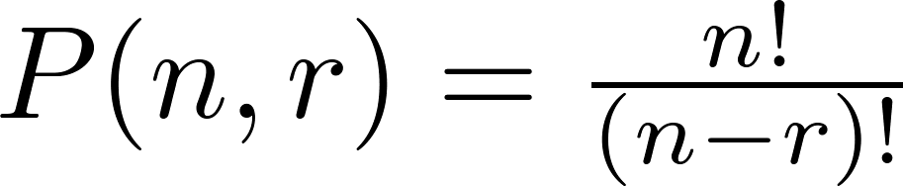
A Formula for the Number of Permutations
Theorem 1: If n is a positive integer and r is an integer with 1 ≤ r ≤ n, then there are
P(n, r) = n(n − 1)(n − 2) ∙∙∙ (n − r + 1)
r-permutations of a set with n distinct elements.
Proof: Use the product rule. The first element can be chosen in n ways. The second in n − 1 ways, and so on until there are (n − ( r − 1)) ways to choose the last element.
Note that P(n,0) = 1, since there is only one way to order zero elements.
Corollary 1: If n and r are integers with 1 ≤ r ≤ n, then

Slide 30
Solving Counting Problems by Counting Permutations
Example: How many ways are there to select a first-prize winner, a second prize winner, and a third-prize winner from 100 different people who have entered a contest?
Solution:
P(100,3) = 100 ∙ 99 ∙ 98 = 970,200

Slide 31
Classroom Exercise
In how many different orders can ﬁve runners ﬁnish a race if no ties are allowed?

Slide 32
Solving Counting Problems by Counting Permutations (continued)
Example: Suppose that a saleswoman has to visit eight different cities. She must begin her trip in a specified city, but she can visit the other seven cities in any order she wishes. How many possible orders can the saleswoman use when visiting these cities?
Solution: The first city is chosen, and the rest are ordered arbitrarily. Hence the orders are:
7! = 7 ∙ 6 ∙ 5 ∙ 4 ∙ 3 ∙ 2 ∙ 1 = 5040
If she wants to find the tour with the shortest path that visits all the cities, she must consider 5040 paths!

Slide 33
Solving Counting Problems by Counting Permutations (continued)
Example: How many permutations of the letters ABCDEFGH contain the string ABC ?
Solution: We solve this problem by counting the permutations of six objects, ABC, D, E, F, G, and H.
6! = 6 ∙ 5 ∙ 4 ∙ 3 ∙ 2 ∙ 1 = 720

Slide 34

Combinations
Definition: An r-combination of elements of a set is an unordered selection of r elements from the set. Thus, an r-combination is simply a subset of the set with r elements.
The number of r-combinations of a set with n distinct elements is denoted by C(n, r). The notation is also used and is called a binomial coefficient. (We will see the notation again in the binomial theorem in Section 6.4.)
Example: Let S be the set {a, b, c, d}. Then {a, c, d} is a 3-combination from S. It is the same as {d, c, a} since the order listed does not matter.
C(4,2) = 6 because the 2-combinations of {a, b, c, d} are the six subsets {a, b}, {a, c}, {a, d}, {b, c}, {b, d}, and {c, d}.

Slide 35
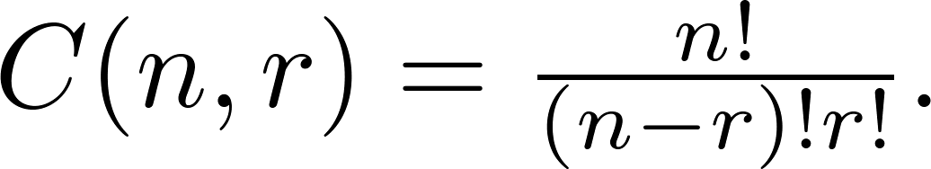
Combinations
Theorem 2: The number of r-combinations of a set with n elements, where n ≥ r ≥ 0, equals
Proof: By the product rule P(n, r) = C(n,r) ∙ P(r,r). Therefore,

Slide 36
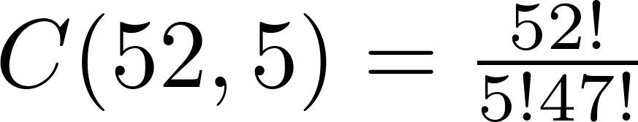
Combinations
Example: How many poker hands of five cards can be dealt from a standard deck of 52 cards? Also, how many ways are there to select 47 cards from a deck of 52 cards?
Solution: Since the order in which the cards are dealt does not matter, the number of five card hands is:
The different ways to select 47 cards from 52 is
This is a special case of a general result. →

Slide 37
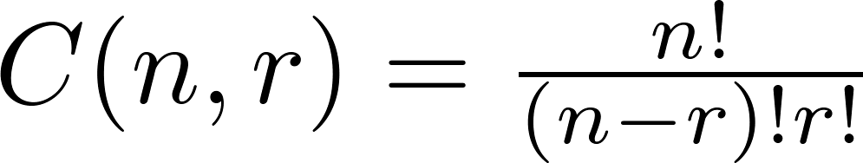
Combinations
Corollary 2: Let n and r be nonnegative integers with r ≤ n. Then C(n, r) = C(n, n − r).
Proof: From Theorem 2, it follows that
and
Hence, C(n, r) = C(n, n − r).
This result can be proved without using algebraic manipulation. →

Slide 38
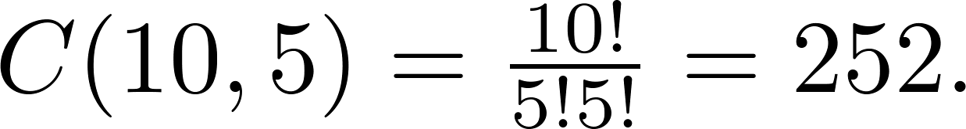
Combinations
Example: How many ways are there to select five players from a 10-member tennis team to make a trip to a match at another school.
Solution: By Theorem 2, the number of combinations is
Example: A group of 30 people have been trained as astronauts to go on the first mission to Mars. How many ways are there to select a crew of six people to go on this mission?
Solution: By Theorem 2, the number of possible crews is

Slide 39
Classroom Exercise
Seven women and nine men are on the faculty in the mathematics department at a school. How many ways are there to select a committee of ﬁve members of the department if at least one woman must be on the committee?

