Slide 1

Elizabeth City State University
ECSU Research Week 2017
Web crawling to Match miRNA ID to expression
Rayshawn Walker, Hirendranath Banerjee, Lin Chen
04.04.2017

Slide 2
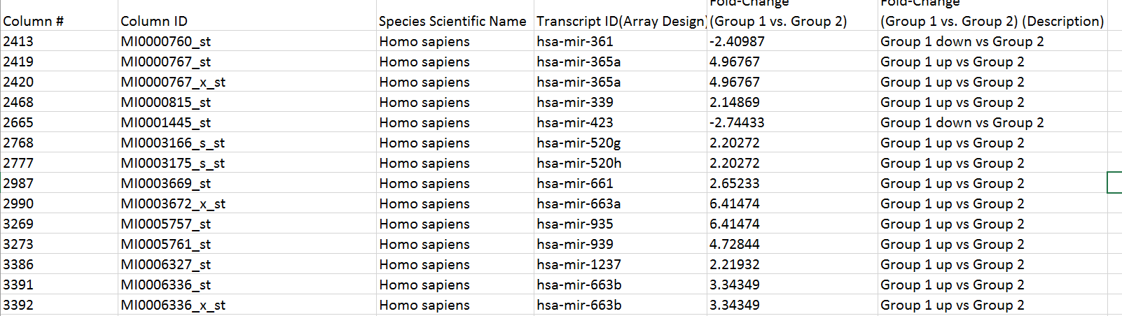
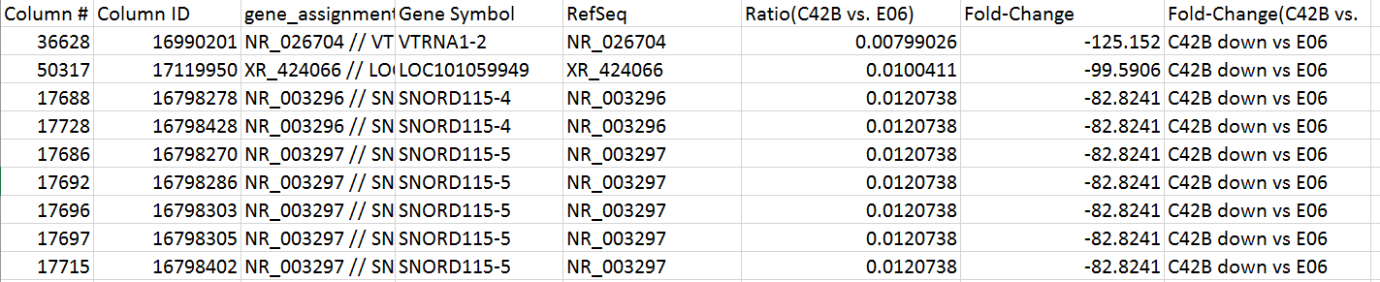
Elizabeth City State University
Problem Description
Match miRNA ID to representative transcript
miRNA.csv
Expression.csv

Slide 3
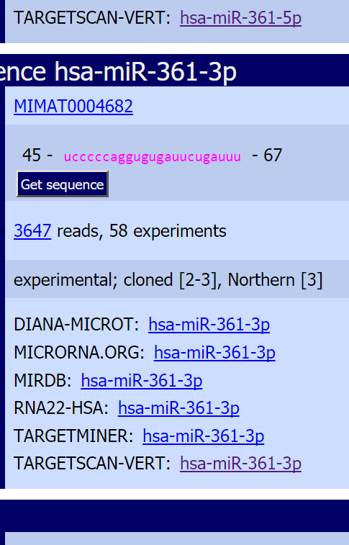
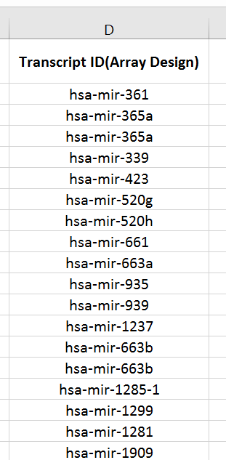
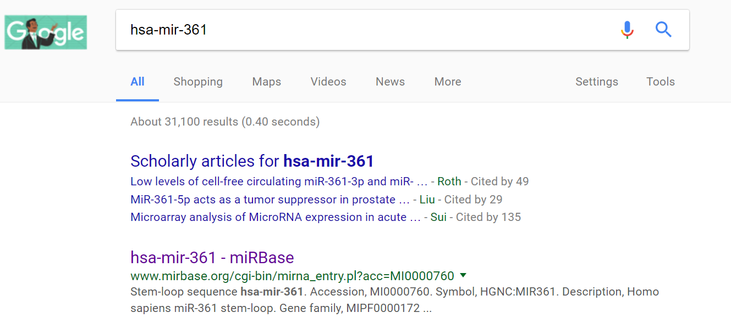
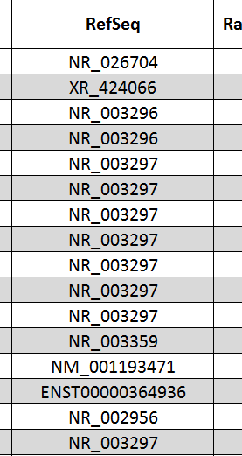
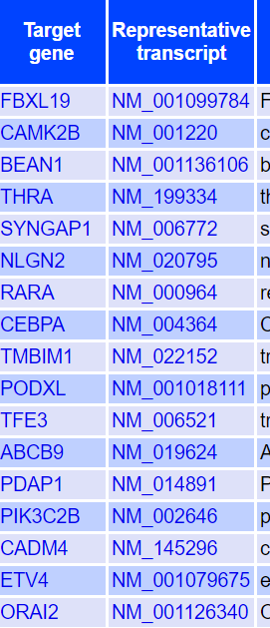
Elizabeth City State University
Manual Procedure
Google
mirbase.org
miRNA.csv
Matching
targetscan.org
Expression.csv

Slide 4
Elizabeth City State University
Complexity
O(n^3)
miRNA.csv
urls at miRbase.org
targetscan.org
Expression.csv
35344 records
<5 records
>100 records
2180 records
Search times = 35344*100*2180 ≈ 10 ^ 9
Real matching time
3 mins * 35344 = 1767.2 hours

Slide 5
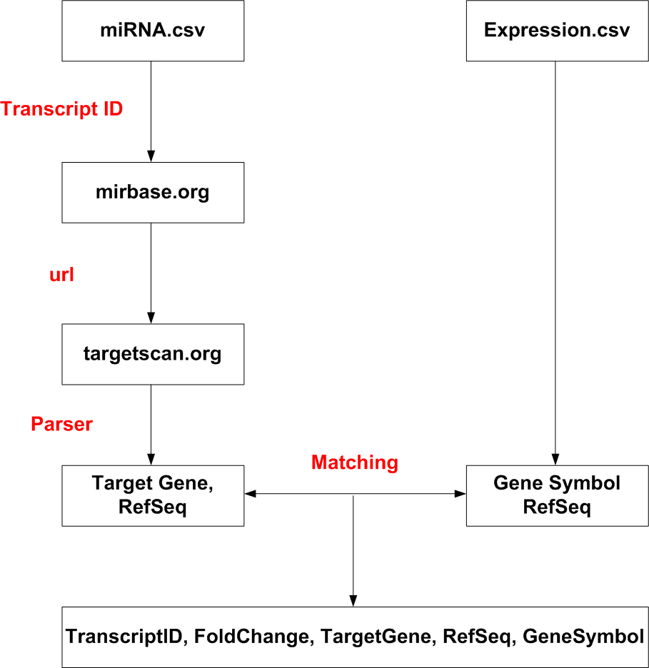
Elizabeth City State University
Web Crawler
Python
urllib2
fetch webpage for each url
Beautifulsoup
parse webpages
re
match strings

Slide 6
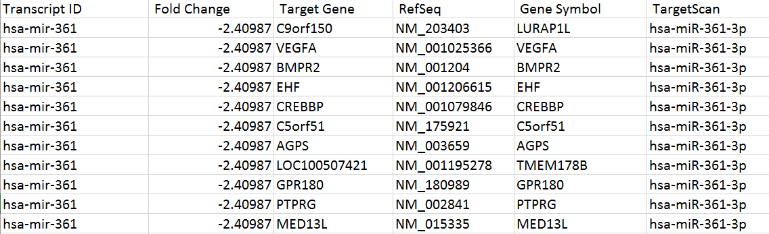
Elizabeth City State University
Results
miRNA.csv
targetscan.org
mirbase.org
12941 records found
Expression.csv

Slide 7
Elizabeth City State University
?

