Slide 1
Arduino Course

Slide 2
Part 1
Introduction To Embedded system

Slide 3
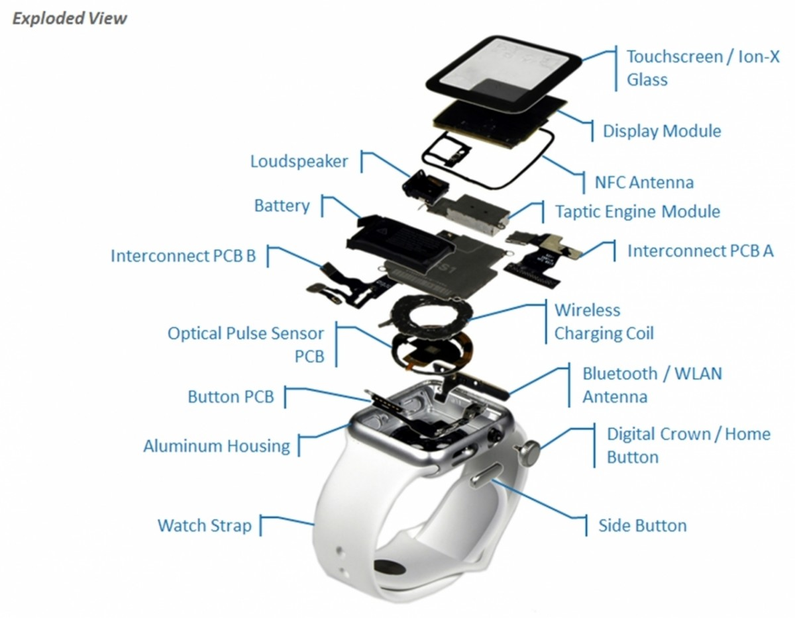
System
What System mean
Example
is an arrangement in which all its unit assemble work together according to a set of rules.
defined as a way of working, organizing or doing one or many tasks according to a fixed plan.
in a system, all its subcomponents depend on each other.

Slide 4
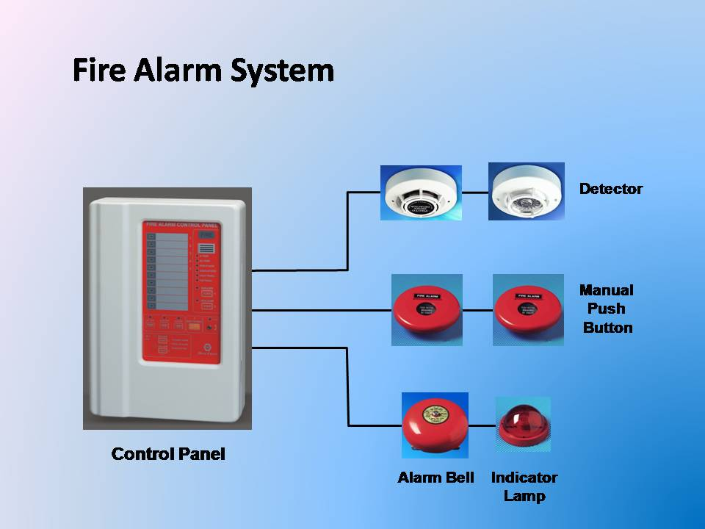
Embedded System
Definition
Example
Embedded means something that is attached to another thing.
a computer hardware system having software embedded in it
An embedded system can be an independent system or it can be a part of a large system.
An embedded system is a microcontroller or microprocessor based system which is designed to perform a specific task.

Slide 5
Embedded system Component
Hardware
Software
RTOS

Slide 6
Embedded System Characteristics
Single Function
Tightly constrained
Size, Speed, Power ,Cost
Reactive and Real time
Microprocessors based
Memory
Connected
Connected peripherals to connect input and output devices.
HW-SW systems
Software is used for more features and flexibility. Hardware is used for performance and security.

Slide 7
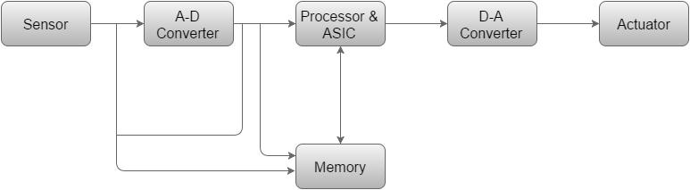
Basic Structure of Embedded System

Slide 8
Basic Structure of Embedded system
Sensor − It measures the physical quantity and converts it to an electrical signal which can be read by an observer or by any electronic instrument like an A2D converter. A sensor stores the measured quantity to the memory.
A-D Converter − An analog-to-digital converter converts the analog signal sent by the sensor into a digital signal.
Processor & ASICs − Processors process the data to measure the output and store it to the memory.
D-A Converter − A digital-to-analog converter converts the digital data fed by the processor to analog data
Actuator − An actuator compares the output given by the D-A Converter to the actual (expected) output stored in it and stores the approved output.

Slide 9
Microprocessor VS Microcontroller
Microprocessor
Microcontroller
multitasking in nature. Can perform multiple tasks at a time.
RAM, ROM, I/O Ports, and Timers can be added externally and can vary in numbers.
Single task oriented.
RAM, ROM, I/O Ports, and Timers cannot be added externally. These components are to be embedded together on a chip and are fixed in numbers.

Slide 10
Arduino Environment
Arduino board
8-bit microcontroller
USB programming interface
Software IDE
Compiler
Debugger
Shields
Unique functionalities
Easy to attach
I/O pins
Simulator
Good libraries provided

Slide 11
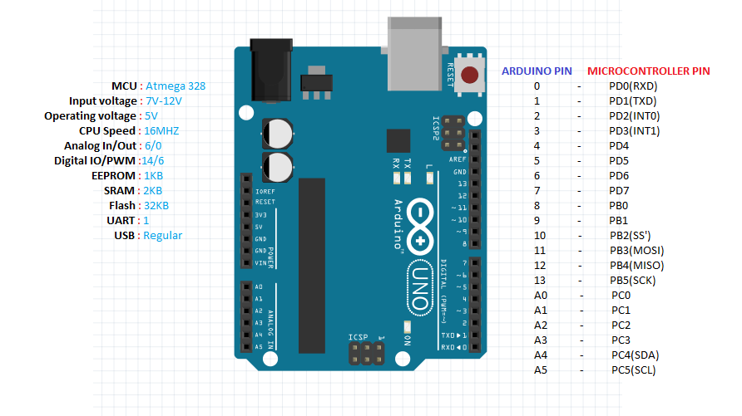
Arduino Board

Slide 12
Microcontroller
ATmega328
Write your code into
ATmega16U2
To communication with USB
Operating voltage → 5V
Input Voltage →7-12V
Digital I/O pins → 14 pins → 0:13
Analog input pins → 6 pins → A0:A5
Flash Memory → 32KB
Clock speed → 16MHz

Slide 13
Arduino Pins
Pins are wires connected to the micro controller
Pins are the interface of micro controller
Pins voltages are controlled by a sketch
Pins voltages can be read by a sketch
Output pins
Voltages is determined by sketch
Other components can be controlled through outputs
Input pins
Input pins are controlled by other component
Arduino read the voltage on the pin allow it to respond to events

Slide 14
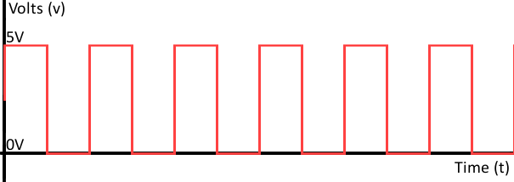
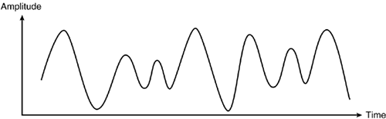
Analog Vs Digital
Digital
Analog
Can be only Two Value 0volt or 5Volt
Arduino Has 14 Digital Input / Output Pins
Can be any Value from 0Volt to 5Volt
Arduino Has 6 Analog Input Pins

Slide 15
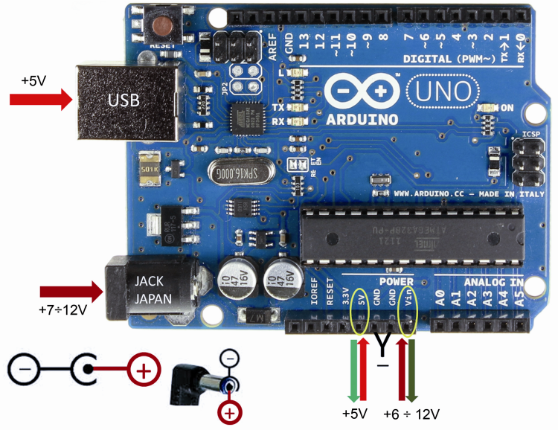
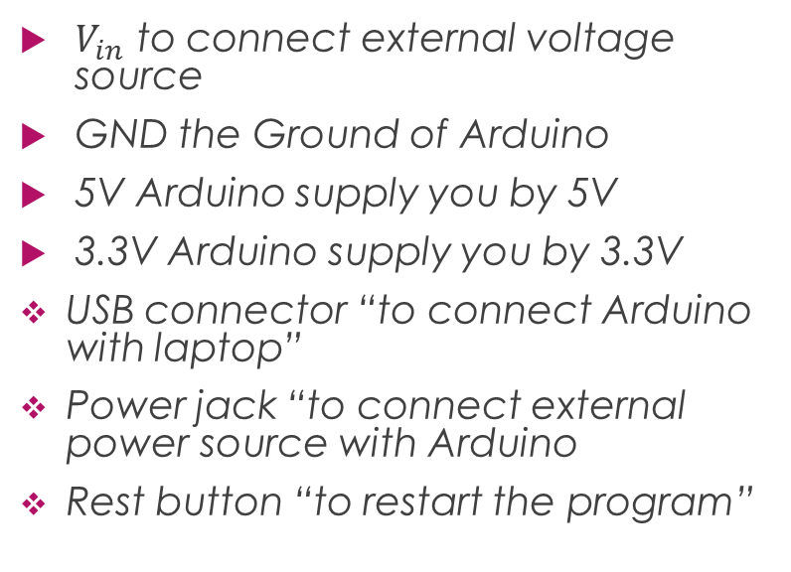
Power
$V_{in}$ to connect external voltage source
GND the Ground of Arduino
5V Arduino supply you by 5V
3.3V Arduino supply you by 3.3V
USB connector “to connect Arduino with laptop”
Power jack “to connect external power source with Arduino
Rest button “to restart the program”

Slide 16
Software
Firmware
Application code
Low level code support the main function
USB interface, power modes , reset
Come with Arduino
We write this code

Slide 17
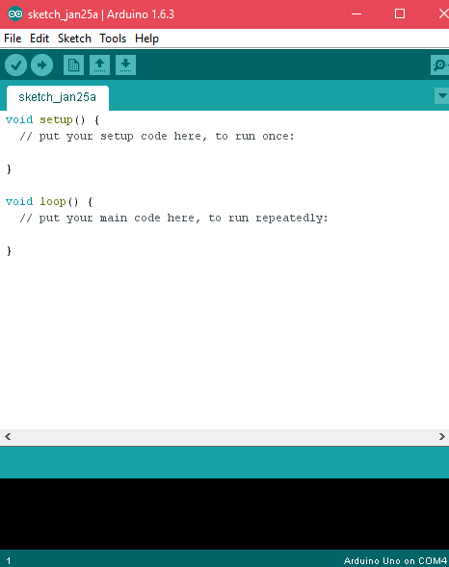
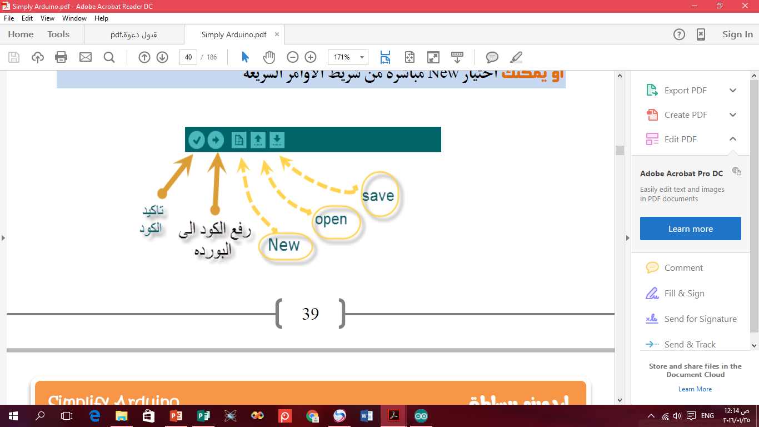
Arduino IDE

Slide 18
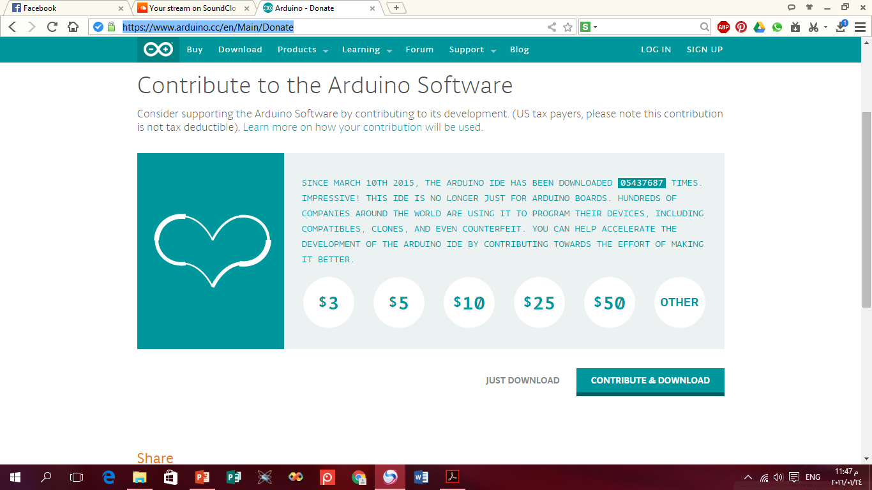
Setup the Arduino IDE
Download the IDE https://www.arduino.cc/en/Main/Donate

Slide 19
Setup the Arduino IDE
Install Arduino app on your PC
Connect the Board to your PC using USB cable
Install USB and other drivers
Launch the Arduino app
Select your Arduino board “Tools >>board>> Arduino UNO
Select serial port “Tools >>port>>COM’X’”
Write your code

Slide 20
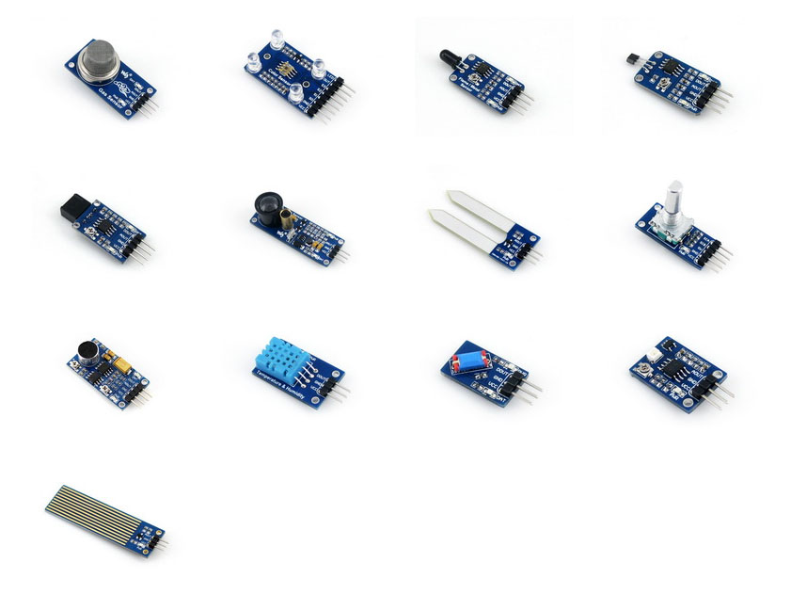
Sensors
How bright is it ?
How loud is it?
How humid is it?
How distance is it ?
Is the button being pressed?
Is there motion ?

Slide 21
Sensors
Allow the microcontroller receive info. From the environments
Perform operation based on the state of environment
Microcontroller sense voltage only
Sensors logic must convert an environmental effect into voltage

Slide 22
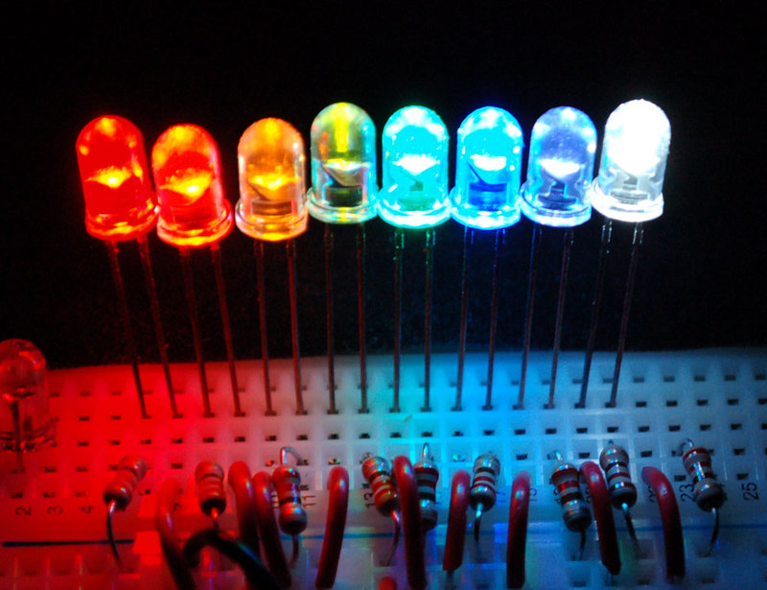
Actuators
Devices that cause something to happen in the physical word
Visual → LEDs , LCDs
Audio → Buzzer , Speaker
Motion → Motors , valves

Slide 23
Actuators
Digital Actuators
Analog Actuators
They only control the power
Even complicated actuators can be controlled via power
Many actuators need an analog voltage for complete control
Arduino can’t generate analog outputs
DAC will convert digital numbers to analog voltage
Most microcontrollers don’t have DAC
Can by one attached

Slide 24
Part 2
Introduction To Computer Programming

Slide 25
Setup () Function
Use for primary order
Start by powering Arduino
void setup ()
{ arguments
}

Slide 26
Loop() function
Work as long as Arduino work
Start after setup function end
The main code written in it
void loop()
{
Arguments
}

Slide 27
Basics symbol
Operation | Symbol
Every line of code must ended by it | ; “semi Colom”
Group line of code Every function must be start and ended by it | { } Curly bracket
To write comments between it | /*…….*/

Slide 28
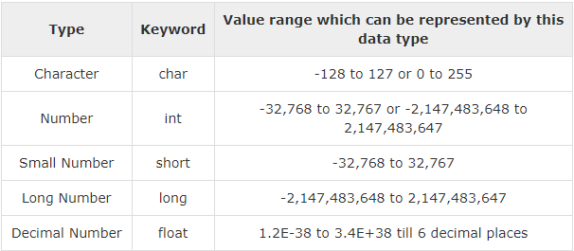
Variables
Variables Name Conditions
Data Types Size
A sequence of visible character
Must start with a non-numerical character
No C language keywords

Slide 29
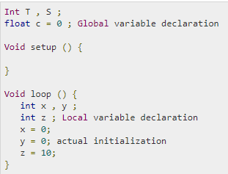
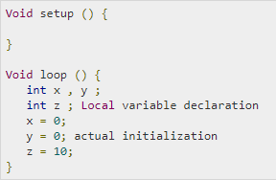
Variable Scope
Local Variable
Formal Parameter
Global Variables
Variables that are declared inside a function or block are local variables. They can be used only by the statements that are inside that function or block of code.
can be declared. In the definition of function parameters
Global variables are defined outside of all the functions, usually at the top of the program.

Slide 30
C – operator
Arithmetic Operators
Comparison Operators
Boolean Operators
Bitwise Operators
Compound Operators

Slide 31
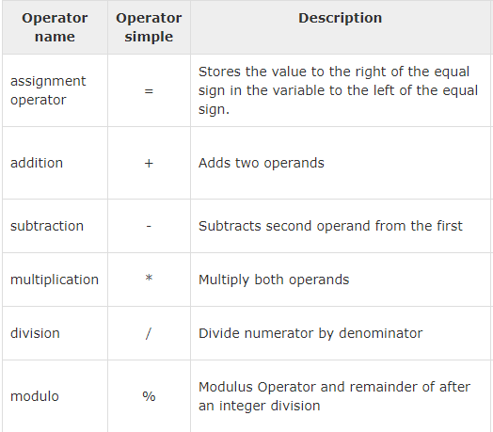
Arithmetic Operators

Slide 32
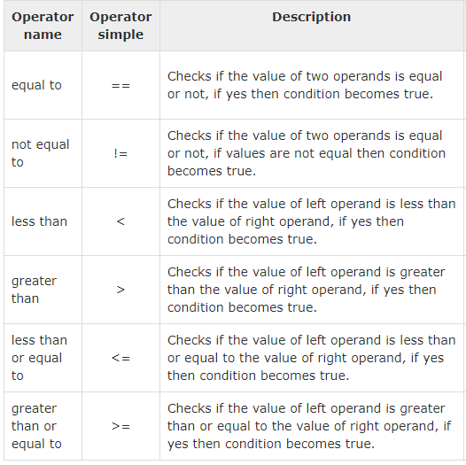
Comparison Operators

Slide 33
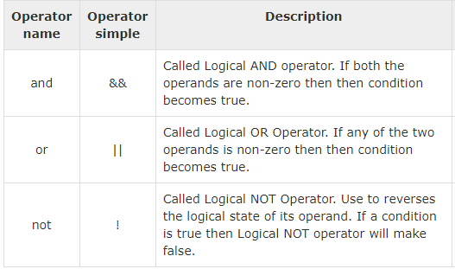
Boolean Operators

Slide 34
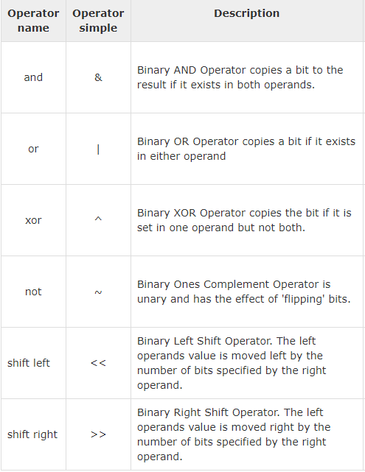
Bitwise Operators

Slide 35
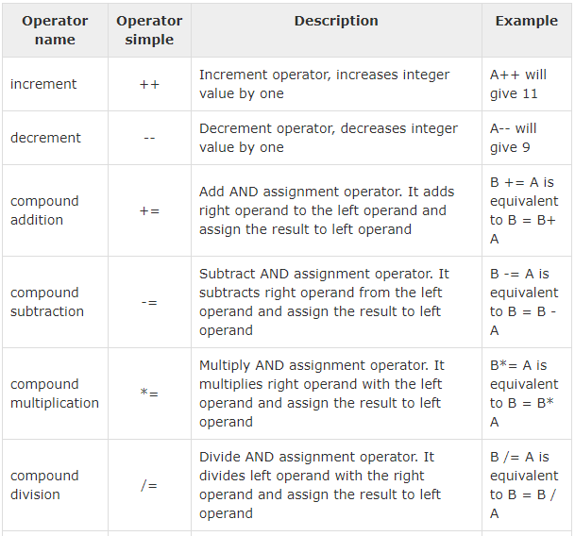
Compound Operators

Slide 36
Control Statements
If statements
If-else Statements
If-else if – else statement
Switch statement

Slide 37
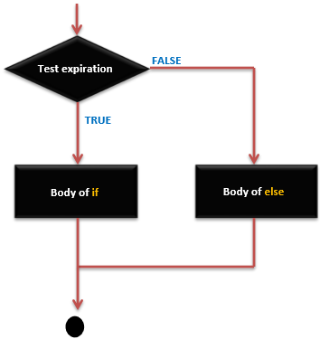
If statement
if( expression )
{
Statement 1
}
else
{ statement 2
}

Slide 38
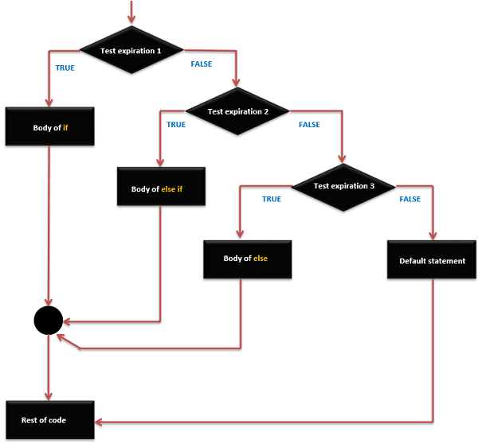
If –else if - else
if( expression1 )
{
Statement 1
}
If else (expression2 )
{ statement 2
}
else
{ statement3 }

Slide 39
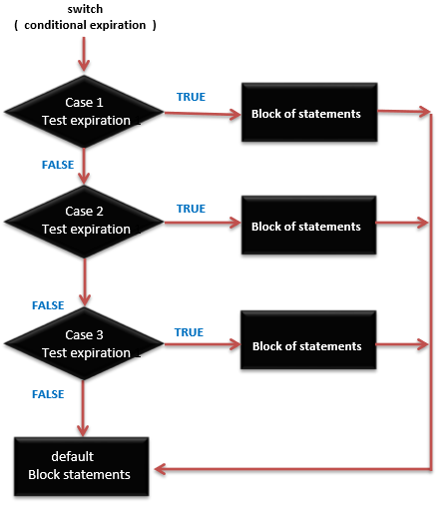
Switch statement
switch (expression )
{
case ‘const_expr1’ : stat1
break ;
case ‘const_expr2’ : stat2
break ;
default : stat3
}
Compere each case with expression and operate the case equal to expression
Default → operating when no case is matching
Break → use to stop operation
,

Slide 40
Loop Statements
For Loop
While Loop
Do-while loop
Nested Loop
Infinite Loop

Slide 41
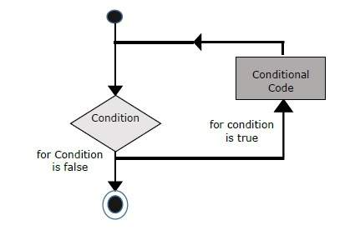
For statement
for ( expr1; expr2; expr3; )
{ statement }
expr1→ initialization
expr2→ termination
expr3→ step

Slide 42
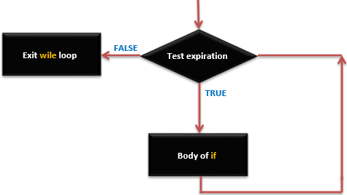
While Loop
while (expression) {
Statements
}

Slide 43
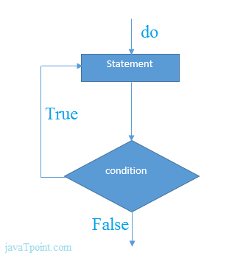

Do-while Loop

Slide 44
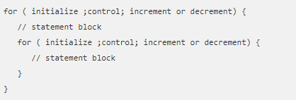
Nested Loop
use one loop inside another loop.

Slide 45
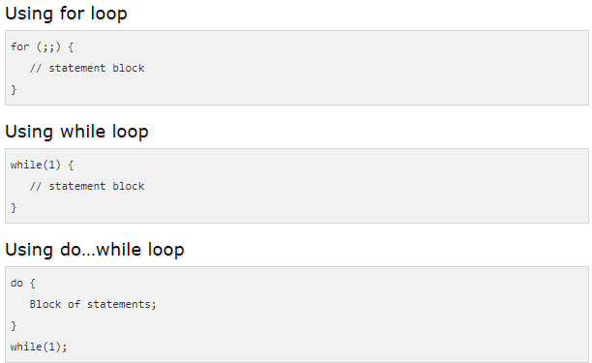
Infinite Loop

Slide 46
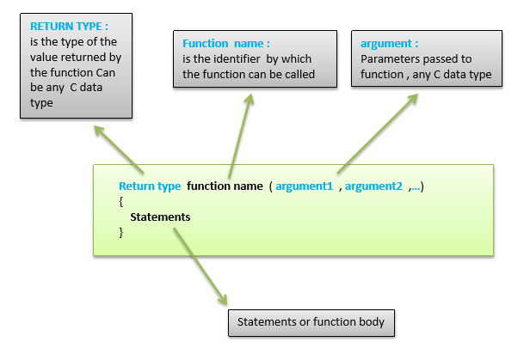
Functions

Slide 47
Part 3
Arduino C

Slide 48
Pin mode function
These function allow access to the pins
Set a pin to act as an INPUT or OUTOUT
pinMode( pin , mode )
Pin
Is the number of the pin “0:13 for digital
analog” “A0:A5 for analog pins
Mode
Is the I/O mode the pin is set to “INPUT” “OUTPUT”

Slide 49
Digital output function
Assign the state of an output pin
Assign either LOW or HIGH
digitalWrite(pin , Value)
Value
HIGH
LOW

Slide 50
Digital input function
Returns the state of an input pin
Returns either LOW or HIGH
digitalRead(pin)

Slide 51
Analog input function
Returns the state of an analog pin
Returns an integer number from 0 to 1023
0 for 0Volt 1023 for 5Volts
analogRead(pin)

Slide 52
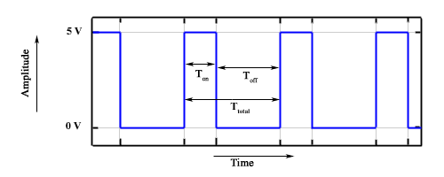


Pulse Width Modulation
On-Time − Duration of time signal is high.
Off-Time − Duration of time signal is low.
Period − It is represented as the sum of on-time and off-time of PWM signal.
Duty Cycle − It is represented as the percentage of time signal that remains on during the period of the PWM signal.

Slide 53
Analog Output Function
writes an analog value (PWM wave) to a pin
this function works on pins 3, 5, 6, 9, 10, and 11.
Values from 0 to 255
0 mean Zero Volt
255 mean 5 Volt
analogWrite(pin,value)

Slide 54
Delay function
Pauses the program for milliseconds
Useful for human interaction
delay(m sec)

Slide 55
Delay Microseconds()
The same function of normal “delay” but
Normal delay measure in mille second
This function measure in micro second
delayMicroseconds(time);

Slide 56
pulse In()
We use this function to calculate time from Arduino call it to end of code
Frist argument is the pin number
Second argument is the pulse level we want to detect
pulseIn (Pin, State);

Slide 57
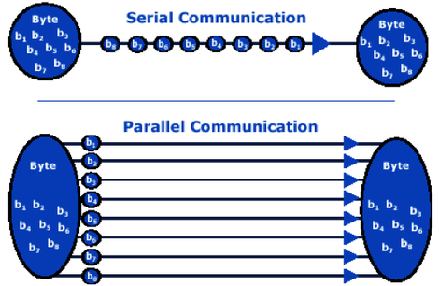
Communication

Slide 58
serial communication
Used for communication between the Arduino board and a computer or other devices.
All Arduino boards have at least one serial port
It communicates on digital pins 0 (RX) and 1 (TX) as well as with the computer via USB.
Thus, if you use these functions, you cannot also use pins 0 and 1 for digital input or output.

Slide 59
Serial functions
Serial . begin(Baud Rate)
To start communication with other devices
Sets the data rate in bits per second (baud) for serial data transmission
Serial . print(Value, Format)
To show data received from Arduino on serial monitor on your PC .
Format is optional Parameter [BIN, OCT, HEX, DEC]
Printed Data shown in the same line

Slide 60
Serial Communication
Serial.available()
Get the number of bytes available for reading from the serial port.
Data Returned stored in Serial Buffer Register
Serial.read()
Reads incoming serial data
Return Data

Slide 61
Part 4
Sensors and Actuators

Slide 62
Basic Electronic Component
LED
LDR
Button
Potentiometer
Buzzer

Slide 63
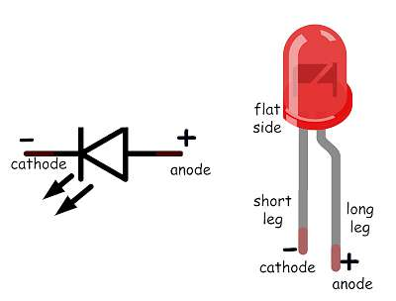
LED
Two terminal “ anode + the long terminal cathode – the short terminal “
Current only flow in one direction + to –
Anode – cathode voltage must be above threshold
LEDs have a maximum current limit
Don’t connect LEDs directly with power supply

Slide 64
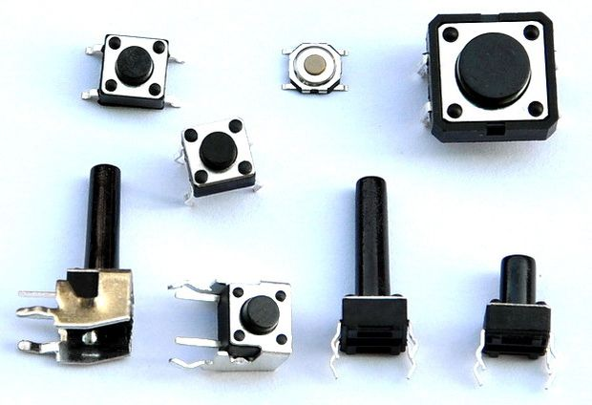
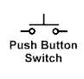
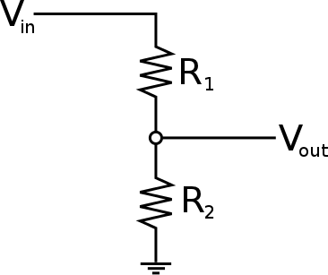
Push button
Closing switch complete circuit
Voltage on both terminal is identical when switch is closed

Slide 65
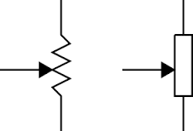
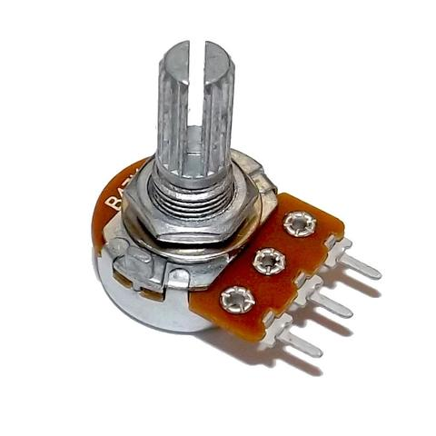
Potentiometer
A potentiometer, informally a pot, is a three-terminal resistor with a sliding or rotating contact that forms an adjustable voltage divider. If only two terminals are used, one end and the wiper, it acts as a variable resistor or rheostat.

Slide 66
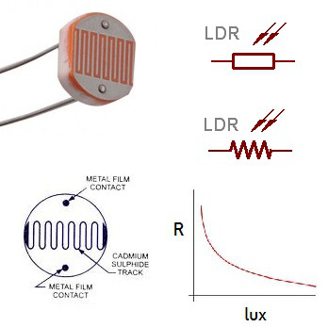
Light Depended Resistor “ LDR”
Two terminal device
Analog sensor
In darkness resistance increase
In brightness resistance decrease

Slide 67

Buzzer
Two input :- signal / ground
Produces a sound when applying voltage

Slide 68
Most Important Modules
Liquid Crystal Display (LCD)
Ultrasonic HC-SR04
Relay Module
H-Bridge
Bluetooth Module HC-05

Slide 69
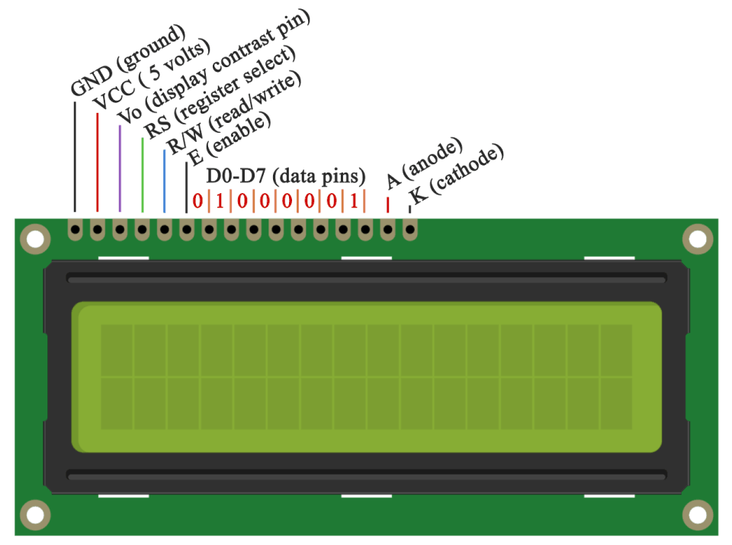
Liquid Crystal Display
Has it’s own Library to use with Arduino
Need variable resistor to control display contrast
Use Parallel interface

Slide 70
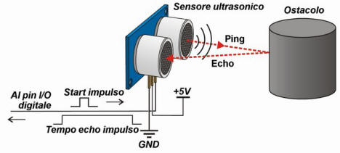
Ultrasonic
4 terminal device
Vcc → 5V
GND → 0V
Trig → output
Echo→ input
To calculate distance in cm use the following equation
Time in micro second /58 = distance in cm

Slide 71
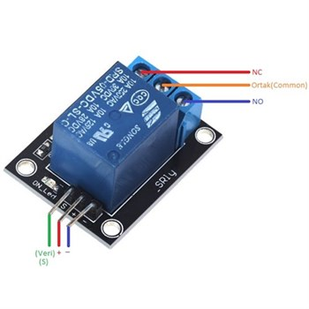
Relay Module
Use to Control High Power Devices
Digital Control
NC → Normally Open
NO → Normally Close

Slide 72
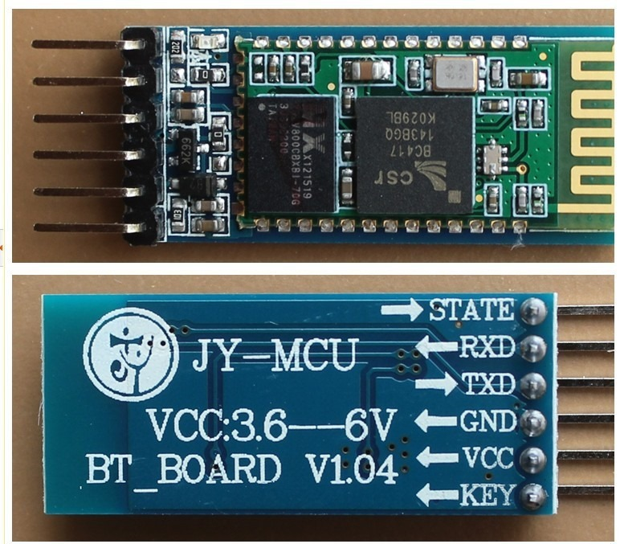
Bluetooth Module
Use Serial Communication
TX in Bluetooth connected to RX with Arduino and Vise Versa

Slide 73
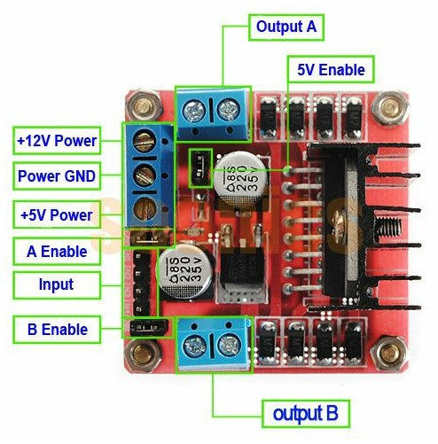
H-Bridge
Each motor has two control Line
Can control both direction and speed
Need external power source

Slide 74
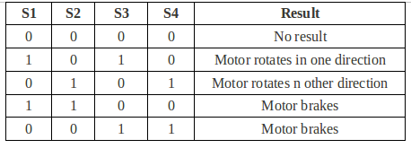
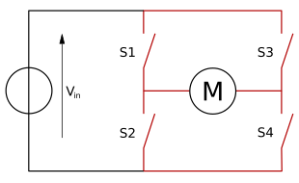
H-bridge truth table

Slide 75
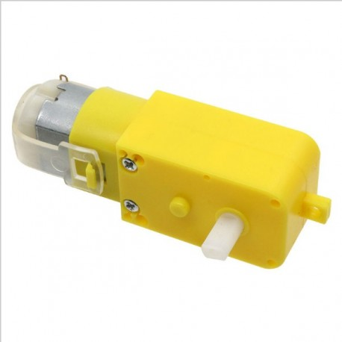
DC-Motors
Need H-bridge to control
Never Connect directly with Arduino

Slide 76
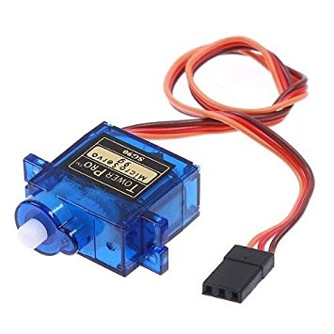
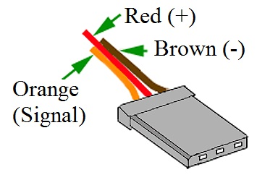
Servo Motor
You can control in it’s angle
Use PWM to control
Only 180 degree rotate

Slide 77
Part 5
QUESTIONS?

