Slide 1
SASS Workshop
Speaker: Kyle Lin

Slide 2
Agenda
Overview
Syntax
Sass/CSS Design Pattern
Naming Rule
Implement

Slide 3

Overview

Slide 4
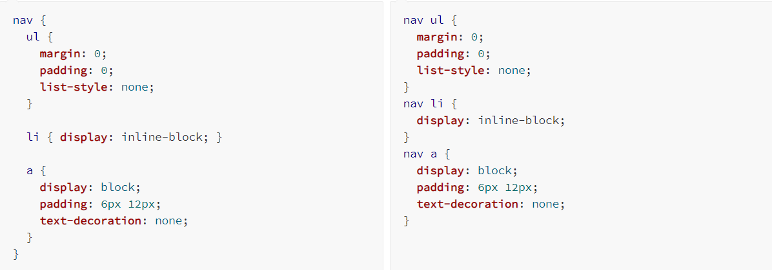
What is Sass
CSS preprocessor
Manage CSS
Support two Syntaxes(SCSS, Sass)

Slide 5
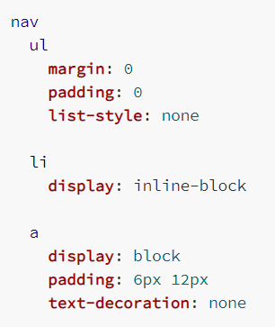
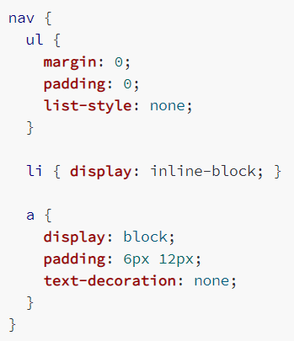
Sass
SCSS

Slide 6

Syntax

Slide 7
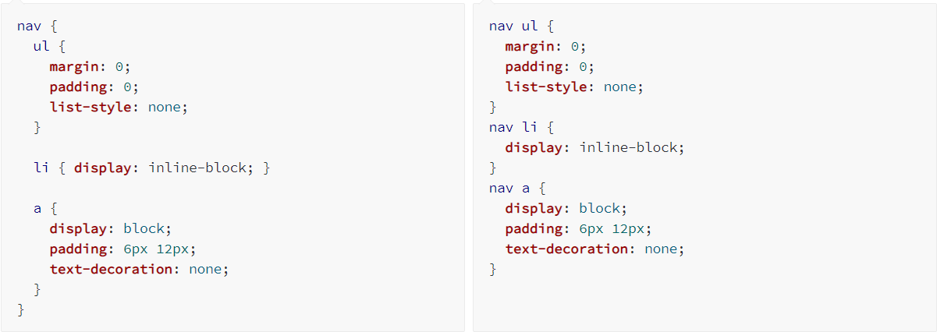
Nesting

Slide 8


Partials

Slide 9
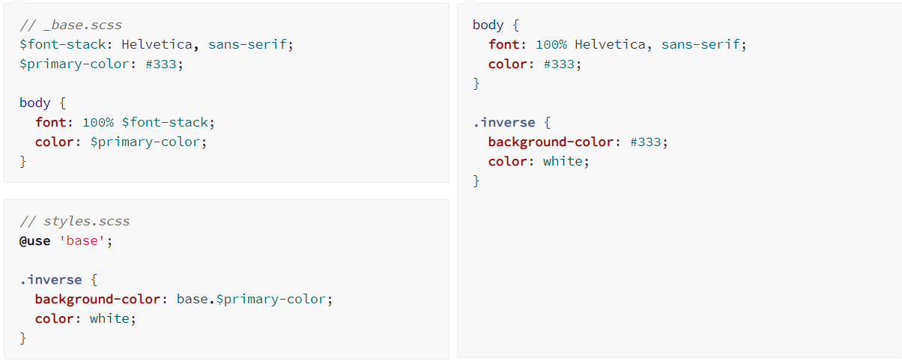
Modules

Slide 10
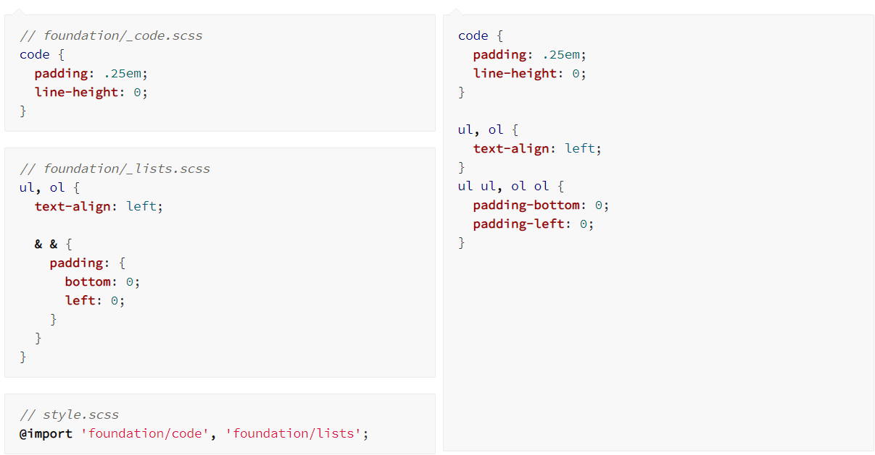
@import

Slide 11
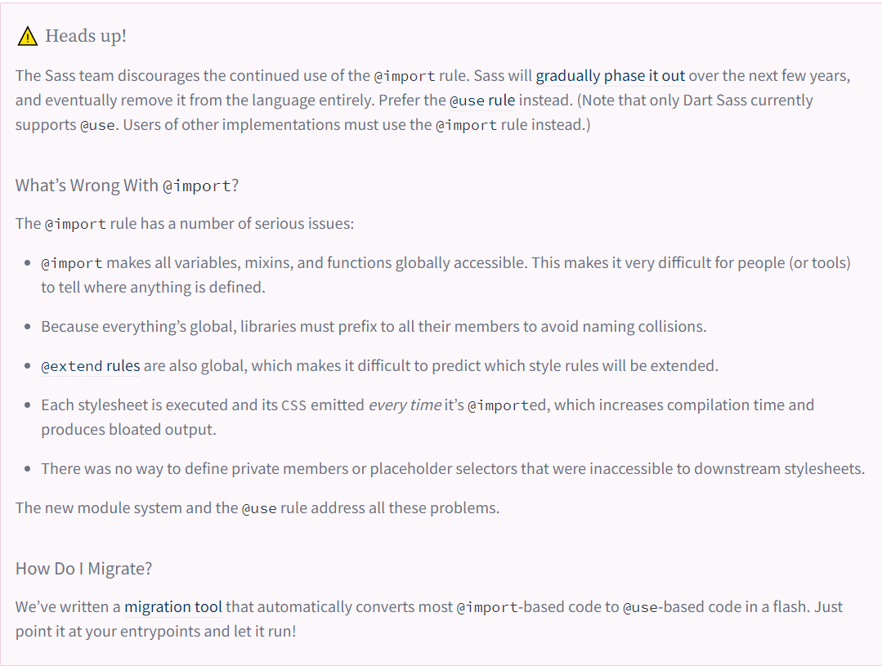

Slide 12
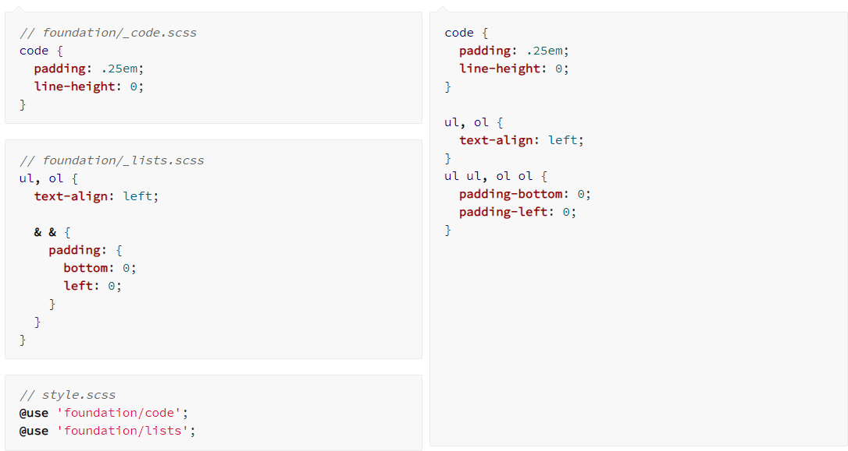
@use

Slide 13
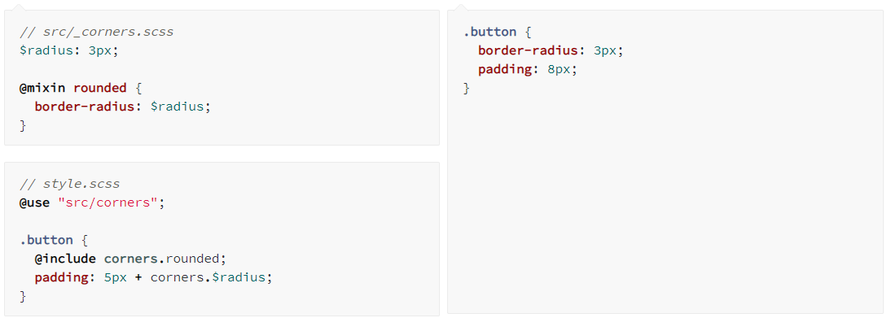

Slide 14
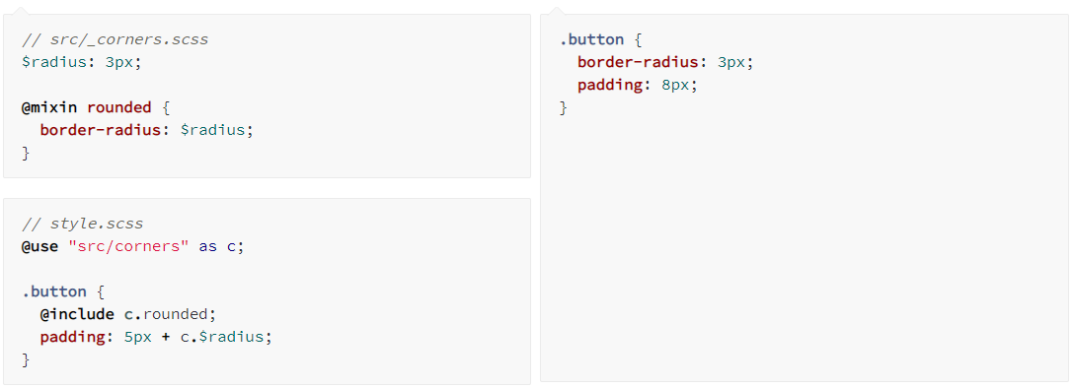

Slide 15
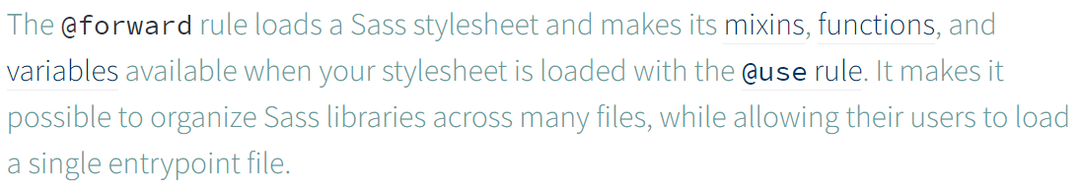
@forward

Slide 16
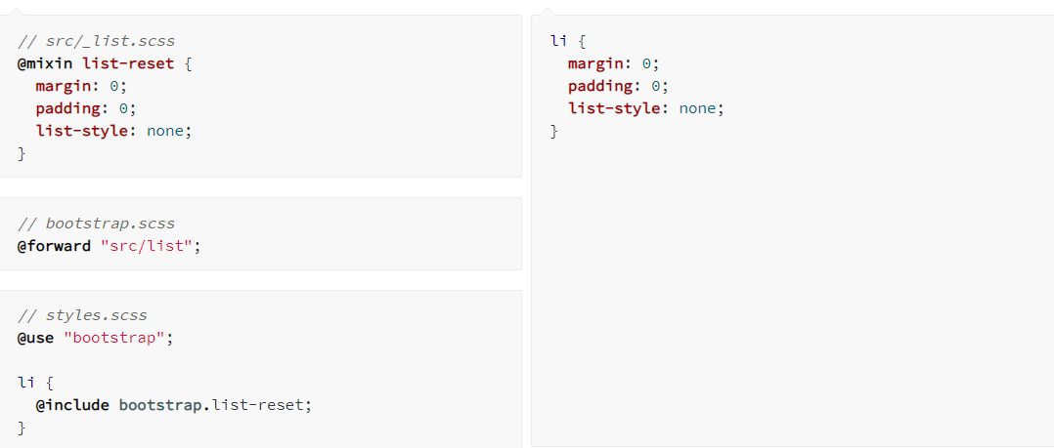

Slide 17
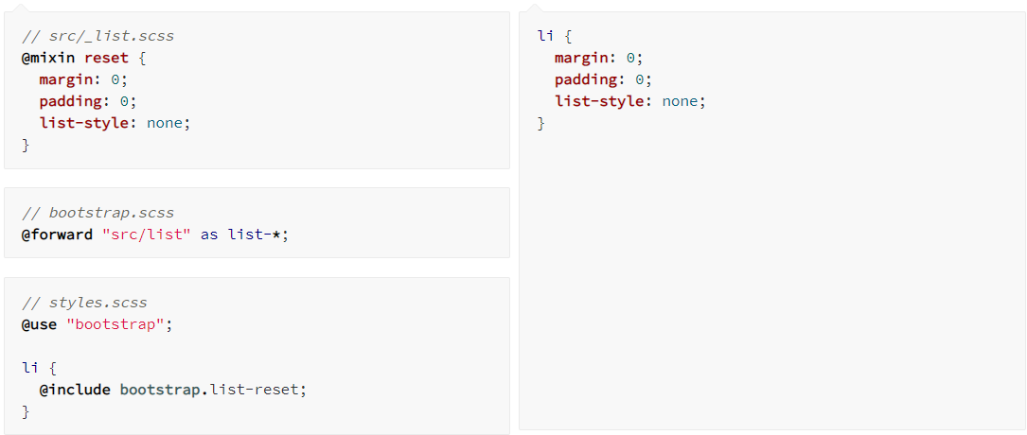

Slide 18
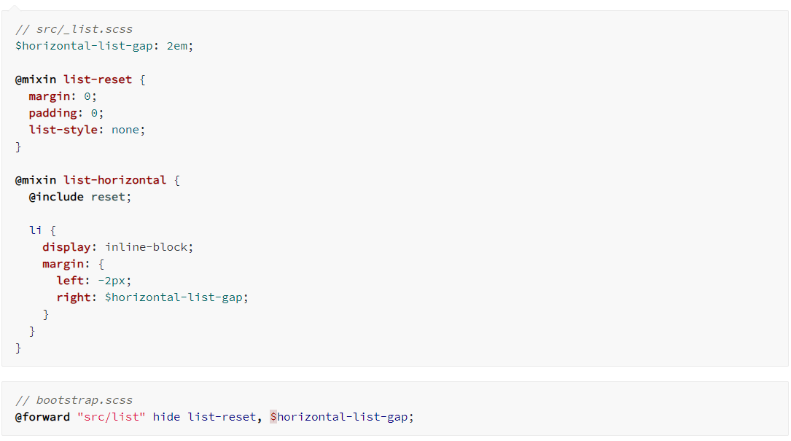

Slide 19
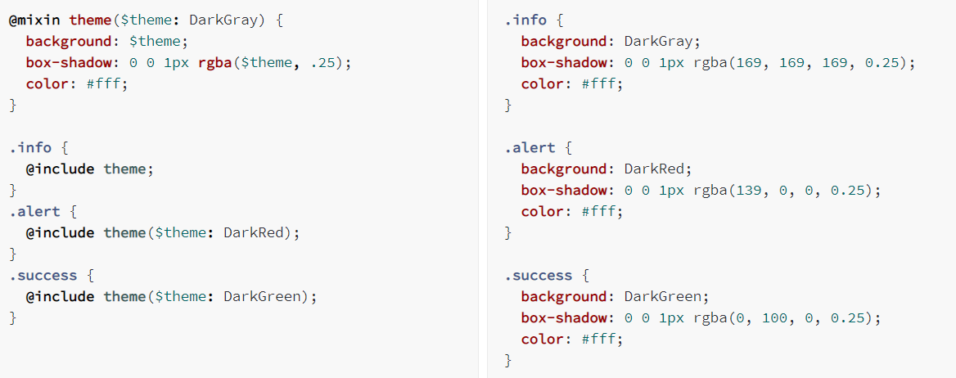
Mixins
It helps keep your Sass very DRY

Slide 20
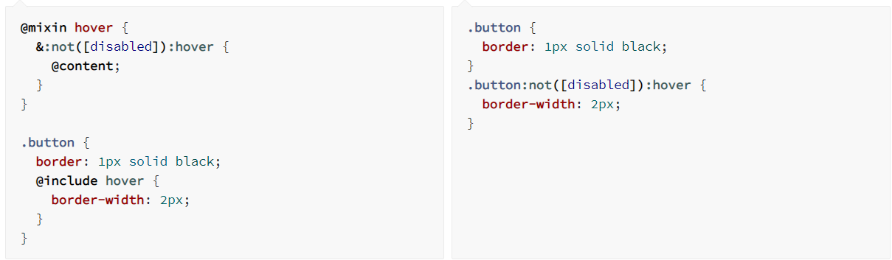
@Content

Slide 21
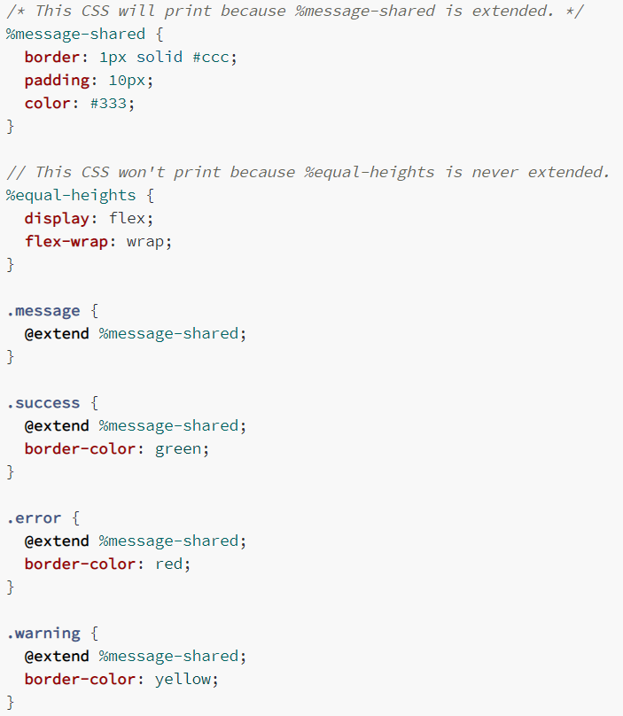
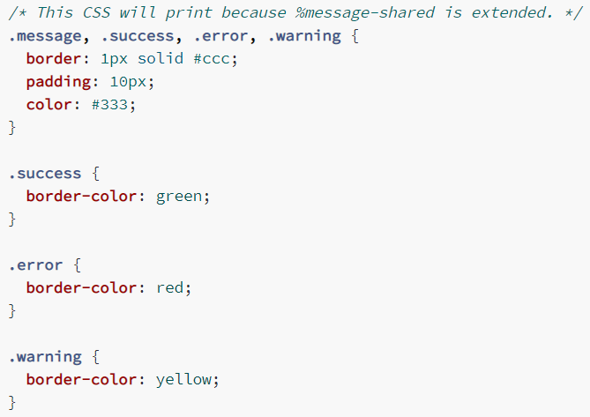
Extend/Inheritance

Slide 22
Mixins || Extend/Inheritance

Slide 23

Sass/CSS Design Pattern

Slide 24
Sass/CSS Design Pattern
Separate structure and skin.
Separate container and content.

Slide 25


Separate structure and skin

Slide 26


Slide 27
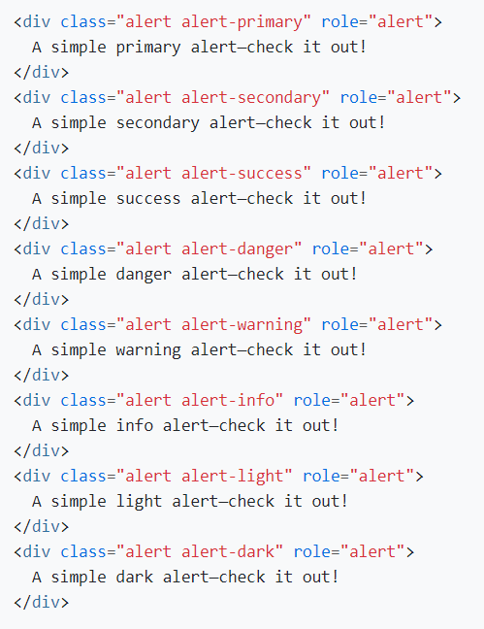
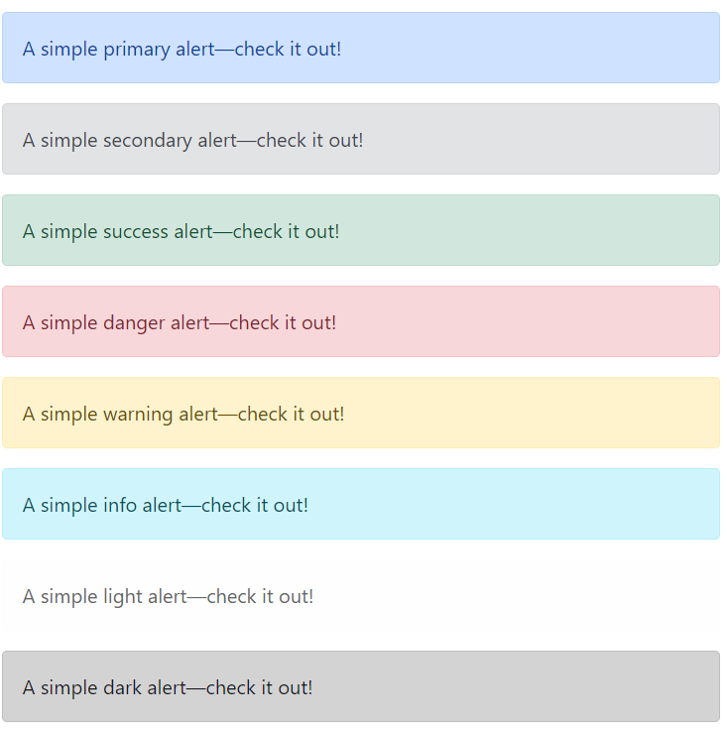
structure
skin

Slide 28


Skin
.alert-primary {
color: #084298;
background-color: #cfe2ff;
border-color: #b6d4fe;
}
Structure
.alert {
position: relative;
padding: 1rem 1rem;
margin-bottom: 1rem;
border: 1px solid transparent;
border-radius: 0.25rem;
}
Skin
.alert-secondary {
color: #41464b;
background-color: #e2e3e5;
border-color: #d3d6d8;
}

Slide 29
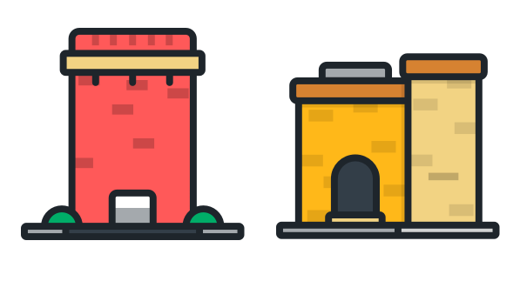
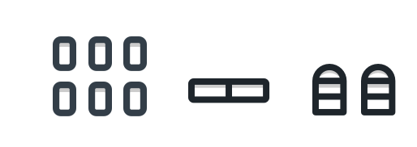
Separate container and content

Slide 30


||

Slide 31
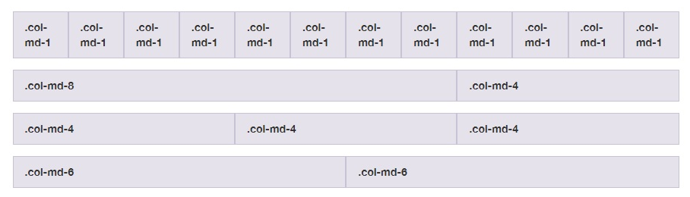
Grid System

Slide 32
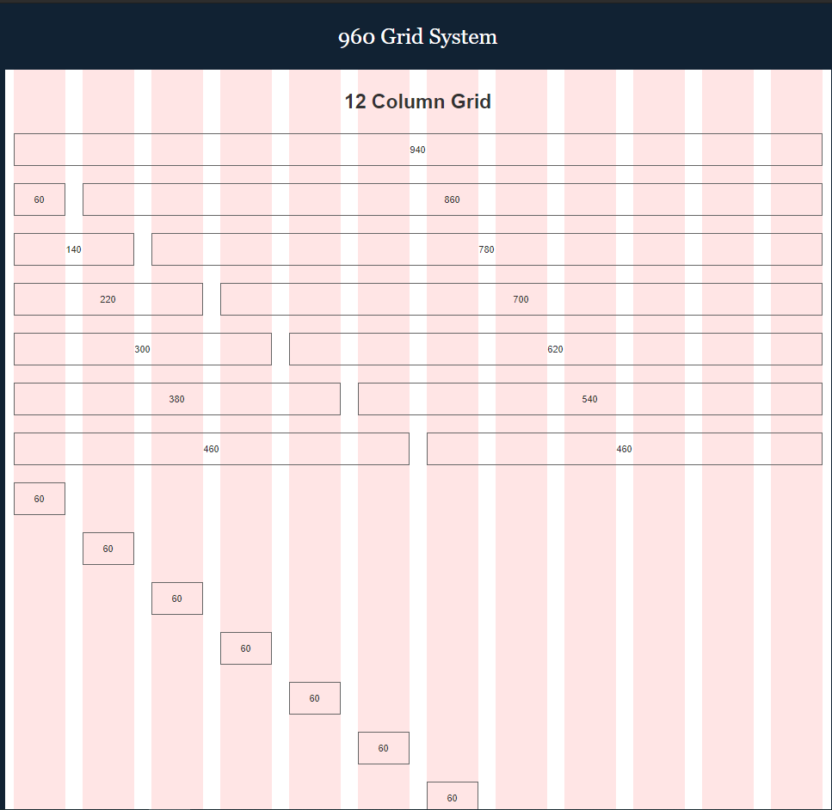

Slide 33
SMACSS
Base Rules
Layout Rules
Module Rules
State Rules
Theme Rules

Slide 34
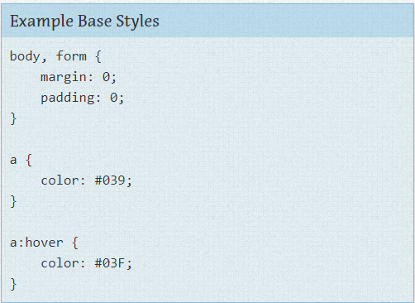
Base Rules
CSS reset
Website base style

Slide 35
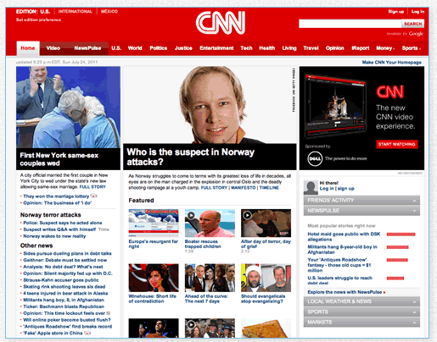
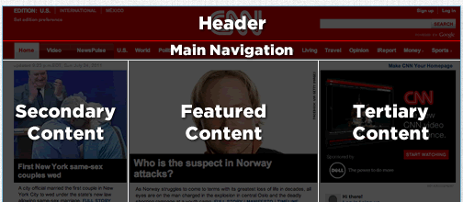
Layout Rules

Slide 36
Module Rules
Module is a more discrete component of the page. It is your navigation bars and your carousels and your dialogs and your widgets and so on.
Modules sit inside Layout components. Modules can sometimes sit within other Modules

Slide 37
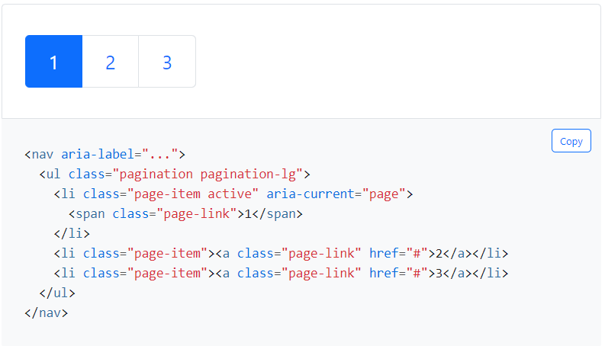
State Rules

Slide 38

Naming Rule

Slide 39
BEM
B = Block
E = Element
M = Modifier
Block__Element--Modifier

Slide 40
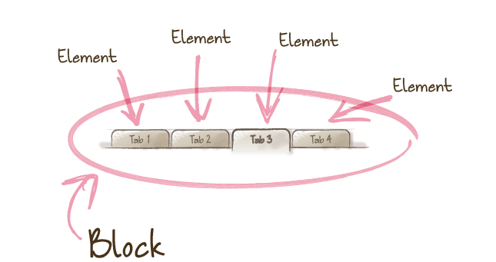


Slide 41
Demo

