Slide 1
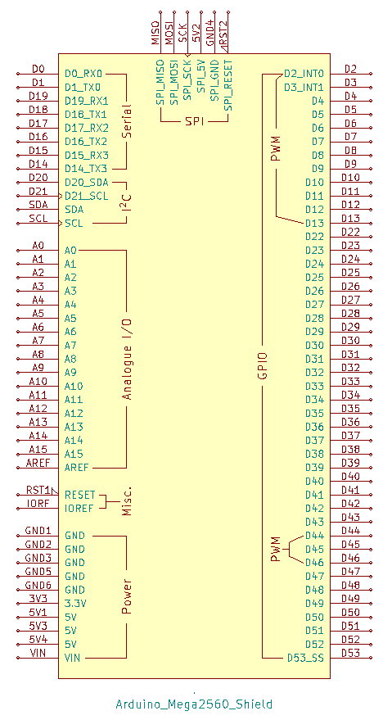
Electrical wiring diagram
Button arm up
Button arm down
Button Stop
Motor controller 1
24V BLDC motor 1
Joystick
PWM speed control
36V
Hall sensor
Hall sensor
GND
3 phase power
Power wires
Analog X
Analog Y
Motor controller 2
24V BLDC motor 2
5V
GND
PWM speed control
36V
Hall sensor
Hall sensor
GND
3 phase power
Power wires
Linear actuator controller
Linear actuator
Signal 1
Signal 2
12V signal
Power wires
12V
GND
GND
5V OUT
5V
Power Distribution
36V battery
36V/12V Buck converter
36V
36V OUT
12V OUT

