Slide 1
Main menu
-Name
-Diff
-Opt
-Exit

Slide 2
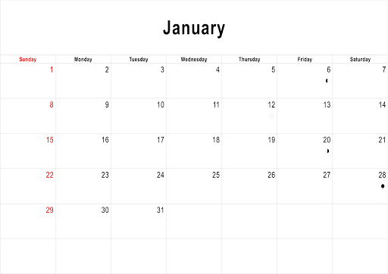

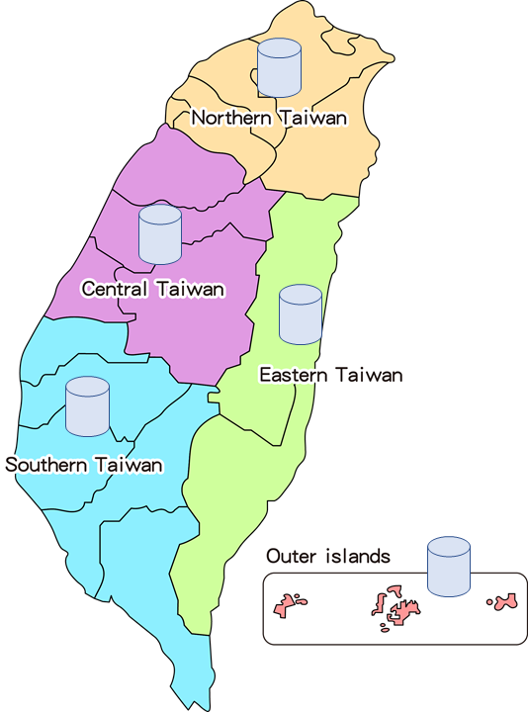
Opt:
-Publicize(price:xx)
-Solicit votes(price:xx)
-Bribery(price:xx)
-Cyberwarfare(price:xx)
*-Special Event

Slide 3
Publicize
-Area:
-Main point view: Random(1/3)
-flyer or advertising board?
-Date:

Slide 4
Solicit votes
-Area:
-Main point view: Random(1/3)
-Date:

Slide 5
Cyberwarfare
-Area:
-Main point view: Random(1/3)
-Social Media?
-Date:

Slide 6
Bribery
-Area:
-How much?
-Date:

Slide 7
Special Event
Choose which side?
Point view
News media focus?

Slide 8
Hidden Info.
media darling
Young supporters rate:
middle aged supporters rate:
elder supporters rate:
Negative Point:
Area supporters:

Slide 9
presidential candidates debate
3 times
Game: Find flaws

Slide 10
Results

