Slide 1
INT 222
Internet I - Internet Fundamentals
Sunny Shi
sunny.shi@senecacolleg.ca
Office: T2094

Slide 2
Outline
Client-Side Validation

Slide 3
Validate HTML with JavaScript
External JavaScript file
  <script type="text/javascript" src="myjavascriptfile.js"></script>

Slide 4
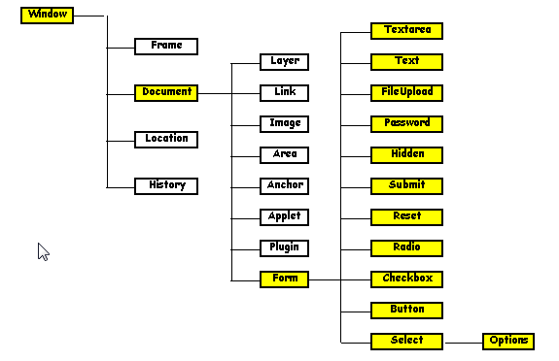
Object Hierarchy

Slide 5
Advantages of Client-Side Validation
Saves time and bandwidth.
Fast. Gives users immediate feedback without having to wait for the page to load. If something's wrong, the alarm is triggered upon submission of the form.
Gives more options to point out to the user where they've gone wrong in filling out the form.
You can safely display only one error at a time and focus on the wrong field, to help ensure that the user correctly fills in all the details as required.
Still need server-side validation.
Client and server-side validation complement each other, and as such, they really shouldn't be used independently.

Slide 6
Client-Side Validation Approaches
Display the errors one by one, focusing on the offending field.
  Makes revising and successfully submitting the form much easier for the user
Display all errors simultaneously, server-side validation style.

Slide 7
Client-Side Validation Guidelines
Presence or Absence Test
  To determine whether the required fields left empty.
Value Test
  To determine if a field has a specific value or code.
Range Test
  To determine if a value entered is within a specific range (inclusive or exclusive)

Slide 8
Client-Side Validation Guidelines
Reasonableness Test
  To determine if a value entered is reasonable based on other information supplied or information available to us. This test needs to be review periodically.
Check Digit Test
  To determine if for example, a credit card number or a Driver's license number is valid.
Consistency Test MULTIPLE FIELD(s)
  To determine if a value entered is consistent with other information entered.

Slide 9
What to check?
valid e-mail address?
valid date?
text in a numeric field?

Slide 10
What to check?
a field contains
  a numeric value
  an alphabetic value
  an alphabetic - Upper case
  an alphabetic - Lower case

Slide 11
What to check?
a filed is
  Positive
  Negative
  Zero

Slide 12
Examples
Text Box: all digits
  function validateMyForm(frm1)
  {
  if (parseInt(frm1.phone.value) != frm1.phone.value)
  {
  alert('Please re-enter, numbers only');
  frm1.phone.focus();
  frm1.phone.select();
  return false;
  }
  return true;
  }
test_javaScript_validate_phoneNumber.html

Slide 13
Examples
Text Box:
  at least one alphabetic letter (‘a’-’z’, ‘A’-’Z’)
  Check no input
  Check all blanks
  At least one alphabetic letter
  var inputValue = document.form1.name.value;
test_javaScript_validate_text_3.html

Slide 14
Examples
TextArea:
  presence
  Not blanks,
  Not only New Line,
  Not only Carriage
if (document.form1.comments.value.length == 0)
test_javaScript_validate_textArea_2.html

Slide 15
Examples
Radio Button:
  must select one
  if (eval("document.form1.specialty[i].checked") == true)
test_javaScript_validate_radio.html

Slide 16
Examples
CheckBox:
  At least check one
  Check all of the above
  Check none of the above
  If checked one item, deselect the “check none of the above”
  if (document.form1.system_type[i].checked == true)
test_javaScript_validate_checkbox.html

Slide 17
Examples
Menu Selection (Select):
  Require to select one item
  if (document.form1.plans.selectedIndex == -1)
test_javaScript_validate_select.html

Slide 18
Examples
Button:
E.g., calculation
Do calculation
Price changed, recalculate price, do not submit.
Example:
  test_javaScript_validate_button_calculation.html

Slide 19
Examples
Hidden:
document.form1.jsEnabled.value = "yes";
<input type='hidden' name='jsEnabled' value='no' />
test_javaScript_validate_hidden.html

Slide 20
Examples
File Upload:
  File name has no blanks
  if (document.form1.filename.value.length == 0) { /* check length */
  if (document.form1.filename.value.indexOf(invalid) != -1) /* check if spaces are included */
  <p> <input type='file' name='filename' /> </p>

Slide 21
Multiple Validation Rules
<head> section, <script>
  function validateName()
  { code1; }
  function validatePhone()
  { code2; }
  /////////////////////////////
  function validateAll()
  {
  if (validateName() && validatePhone())
  { return true; }
  else
  { return false; }
  } // function validateAll()
<body> section
  <form name="form1" method = "post"
  action='https://cs.senecac.on.ca/~int222/cgi-bin/echo-c.cgi'
  onsubmit="return validateAll()">

Slide 22
Thank you!

