Slide 1
INT 222
Internet I - Internet Fundamentals
Sunny Shi
sunny.shi@senecacolleg.ca
Office: T2094

Slide 2
Outline
HTML5 New Features
<audio>
<video>
<canvas>

Slide 3
<audio>
Current, no standard for playing audio files on a web page.
Most audio files are played through a plug-in (like flash). However, different browsers may have different plug-ins.
HTML5 specifies a standard way to embed an audio file on a web page: - the <audio> element.
IE 9, Firefox, Opera, Chrome, and Safari support <audio>
IE8 and earlier versions, do not support <audio>.
<audio controls="controls">
<source src="horse.ogg" type="audio/ogg">
<source src="horse.mp3" type="audio/mpeg">
Your browser does not support the audio element.
</audio>
Test_audio.html

Slide 4
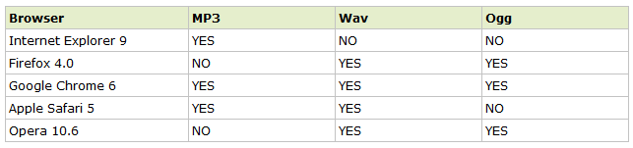
Audio Formats and Browser Support

Slide 5
<video>
<video width="320" height="240" controls="controls">
<source src="movie.mp4" type="video/mp4">
<source src="movie.ogg" type="video/ogg">
<source src="movie.webm" type="video/webm">
<object data="movie.mp4" width="320" height="240">
<embed src="movie.swf" width="320" height="240">
</object>
</video>
Test_video.html

Slide 6
<canvas>
<canvas> - an element to give you a drawing space in JavaScript on your Web pages.
It can let you add images or graphs to tool tips or just create dynamic graphs on your Web pages, built on the fly.
The <canvas> element is only a container for graphics. You must use a script to actually draw the graphics.
Canvas has several methods for drawing paths, boxes, circles, characters, and adding images.
Test_canvas.html

Slide 7
Create a Canvas
A canvas is a rectangular area on an HTML page, and it is specified with the <canvas> element.
By default, the <canvas> element has no border and no content.
<canvas id="myCanvas" width="200" height="100"></canvas>
Always specify an id attribute (to be referred to in a script), and a width and height attribute to define the size of the canvas.
You can have multiple <canvas> elements on one HTML page.

Slide 8
Create a Canvas
add a border to the canvas:
<canvas id="myCanvas" width="200" height="100"
style="border:1px solid #000000;">
</canvas>

Slide 9
Draw onto the Canvas
All drawing on the canvas must be done inside a JavaScript.
<script>
var c=document.getElementById("myCanvas");
var ctx=c.getContext("2d");
ctx.fillStyle="#FF0000";
ctx.fillRect(0,0,150,75);
</script>

Slide 10
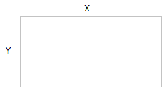
Canvas Coordinates
The canvas is a two-dimensional grid.
The upper-left corner, coordinate (0,0)
ctx.fillRect(0,0,150,75)
  Start at the upper-left corner (0,0) and draw a 150x75 pixels rectangle.

Slide 11
Canvas - Paths
Draw straight lines on a canvas:
moveTo(x,y): the starting point of the line
lineTo(x,y): the ending point of the line
To actually draw the line, use stroke().
var c=document.getElementById("myCanvas");
var ctx=c.getContext("2d");
ctx.moveTo(0,0);
ctx.lineTo(300,150);
ctx.stroke();

Slide 12
Canvas – draw a circle
arc(x,y,r,start,stop)
x, y: coordinate
Start: starting angle (e.g. 0)
Stop: stopping angle (e.g., 2 * Matho.PI)
To actually draw the circle, use stroke() or fill().

Slide 13
Canvas - Text
Draw text on a canvas:
font - defines the font properties for text
fillText(text,x,y) - Draws "filled" text on the canvas
var c=document.getElementById("myCanvas");
var ctx=c.getContext("2d");
ctx.font="30px Arial";
ctx.fillText("Hello World",10,50);

Slide 14
Canvas - Text
strokeText(text,x,y) - Draws text on the canvas (no fill)
var c=document.getElementById("myCanvas");
var ctx=c.getContext("2d");
ctx.font="30px Arial";
ctx.strokeText("Hello World",10,50);

Slide 15
Canvas - Gradients
Gradients can be used to fill rectangles, circles, lines, text, etc.
Shapes on the canvas are not limited to solid colors.
Two types of gradients:
createLinearGradient(x,y,x1,y1) - Creates a linear gradient
createRadialGradient(x,y,r,x1,y1,r1) - Creates a radial/circular gradient
Once we have a gradient object, we must add two or more color stops.
The addColorStop() method specifies the color stops, and its position along the gradient.
Gradient positions can be anywhere between 0 to 1.
Set the fillStyle or strokeStyle property to the gradient, and then draw the shape, like a rectangle, text, or a line.

Slide 16
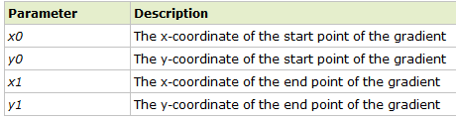
Canvas - Gradients
context.createLinearGradient(x0,y0,x1,y1);
Creates a linear gradient object.
The gradient can be used to fill rectangles, circles, lines, text, etc.
Tip: Use the addColorStop() method to specify different colors, and where to position the colors in the gradient object.

Slide 17
Canvas - Gradients
// Create gradient
var grd=ctx.createLinearGradient(0,0,200,0);
grd.addColorStop(0.5,"red");
grd.addColorStop(0.6,"green");
// Fill with gradient
ctx.fillStyle=grd;
ctx.fillRect(10,10,150,80);

Slide 18
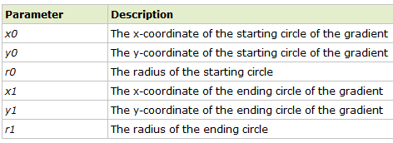
Canvas - Gradients
context.createRadialGradient(x0,y0,r0,x1,y1,r1);
var grd=ctx.createRadialGradient(75,50,5,90,60,100);
creates a radial/circular gradient object.
The gradient can be used to fill rectangles, circles, lines, text, etc.
Use addColorStop() to specify different colors, and where to position the colors in the gradient object.

Slide 19
Canvas - Image
Draw an image, canvas, or video onto the canvas.
Can also draw parts of an image, and/or increase/reduce the image size
Position the image on the canvas:
  context.drawImage(img,x,y);
Position the image, and specify width and height of the image:
  context.drawImage(img,x,y,width,height);
Clip the image and position the clipped part on the canvas:
  context.drawImage(img,sx,sy,swidth,sheight,x,y,width,height);

Slide 20
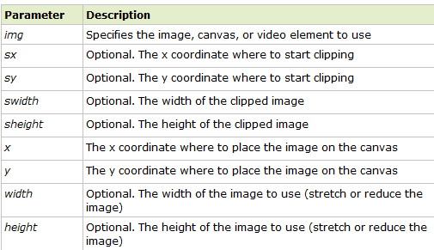
Property Values

Slide 21
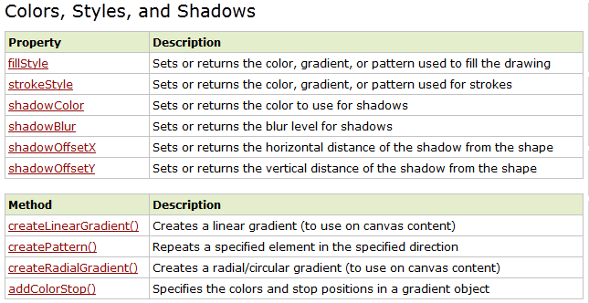
Canvas Reference http://www.w3schools.com/tags/ref_canvas.asp

Slide 22
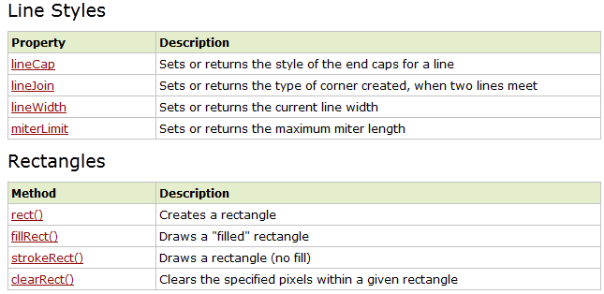
Canvas Reference

Slide 23
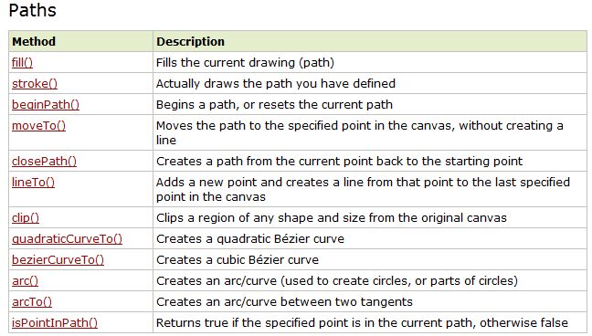
Canvas Reference

Slide 24
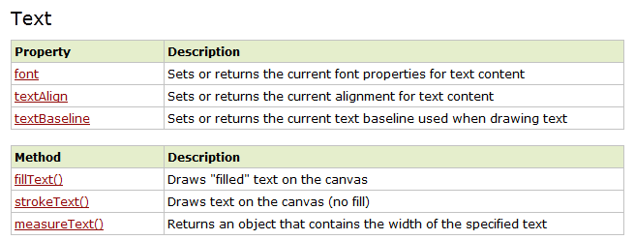

Canvas Reference

Slide 25
Thank you!

