Slide 1
INT 222
Internet I - Internet Fundamentals
-Sunny Shi
sunny.shi@senecacollege.ca

Slide 2
Outline
Image Mapping
Table

Slide 3
Image Mapping
Image -> image map,
- one or more links apply to different regions of the image
- click on different parts of the image -> activate different hyperlinks

Slide 4
Make an Image Map
1 image ->1 to more smaller pieces,
Put link tags around each piece of image
1 link <-> 1 piece of image.

Slide 5
Make an Image Map
Active areas are described by their pixel co-ordinates with 0,0 being the top left corner.
Put the image in your page using a normal image tag,
except add the attribute usemap="#name_of_map", e.g.,
<img src= "sccs222.jpg" width="400" height="166" border = "2" usemap="#cs_imgmap" />
You can have more than one image map in the same page as long as they've got different names.
(0,0)

Slide 6
Image Map Example
<img src= "sccs222.jpg" width=“400" height=“166" border = "2" usemap="#cs_imgmap" />
<map name = "cs_imgmap">
<area shape = "rect" coords = "0,0, 200, 166" href = "http://cs.senecac.on.ca" alt = "1st rect"/>
<area shape = "rect" coords = “200, 0, 400, 166" href = "http://www.yahoo.com" alt = "2nd rect" />
</map>
imagemap.html, imagemap2.html

Slide 7
Area Tag
Put <area> tag for each active area
Attributes for tag <area>:
- shape: rect (rectangle), circle, poly (polygon).
- coords: coordinates of this shape. Start from upper left corner “0,0”. Each number is separated by commas,
  * Rectangle: “x1, y1, x2, y2” coordinates of upper-left and lower-right corners
  * Circle: “x,y, r”, coordinate of circle center and the radius of the circle in pixels.
  * Polygon: “x1,y1, x2, y2, x3, y3,…”, coordinates of each point
- href: like the href in a regular link tag.
- alt: alternative label
<area shape = "rect" coords = "0,0, 200, 166" href = "http://cs.senecac.on.ca" alt = “area rect"/>
<area shape = “circle" coords = “150,260, 130" href = "http://cs.senecac.on.ca" alt = “area circle"/>
<area shape = “poly" coords = "0,0, 50, 60, 150, 230, 100, 366" href =
"http://cs.senecac.on.ca" alt = “area polygon"/>

Slide 8
Tools for Creating Images & Image Maps
X-Map: Free Html Map Editor used for determining image coordinates
http://www.carlosag.net/Tools/XMap/
mapedit used for determining image coordinates
http://www.boutell.com/
Paint Shop Pro used for image creation
http://www.corel.com/servlet/Satellite/us/en/Product/1184951547051#versionTabview=tab1&tabview=tab0
Gif Construction used for image creation and animation
http://www.mindworkshop.com/
Truespace Graphics used for image creation and animation
http://www.caligari.com/

Slide 9
Table
tables are supposed to structure tabular data, and not for web page layouts. Make web page layouts using CSS.
Layout table: sometimes must be used when no equivalent CSS construct is available.

Slide 10
Table Tags
<table>: defines the table, all table tags must be inside <table> </table>.
<caption>: defines the caption of a table.
<th>: defines a table header.
<tr>: defines a table row.
<td>: defines a data cell, which must be enclosed in <tr> tags.

Slide 11
Grades for Course INT222
<caption>
Student ID | Student Name | Grade
1234598 | Tom | 87
3242345 | Helen | 92
3847987 | Kelly | 78
<th>
<tr>
<td>

Slide 12
Table Attributes - border
<table border='value'>: value is the thickness of the table border in pixels.
By default, the table has no borders,
- the border attribute is absent
- <table border = “0”>
Notes:
800 * 600
< 760 pixel
1024 * 768 =➔

Slide 13
Table Attributes - cellspacing
<table cellspacing='value'>: value is the amount of space (in pixels) inserted between individual cells in a table.
By default, a table will have a cell spacing of two pixels.
- <table cellspacing=‘2'>
Notes:
800 * 600
< 760 pixel
1024 * 768

Slide 14
Table Attributes – cellpadding
<table cellpadding='value'>: value is the amount of space (in pixels) between the border of the cell and the content of the cell.
By default, a table will have a cell padding of one pixel.
- <table cellpadding=‘1'>

Slide 15
Table Attributes - width
This attribute specifies the desired width of the entire table in pixels, or as a percentage of the available horizontal space of the parent element.
<table width='value'>: value can be an absolute width in pixels, or a percentage of document width.
The width='value' may also appear on either the <th....> tag or the <td....> tag to describe the width of the cell, again in either absolute width in pixels, or a percentage of table.
?
<th width = "60" >Name </th>
<td width = “30”> Wendy </td>
<th width = “30" >Name </th>
<td width = “60”> Wendy </td>

Slide 16
Table Attributes - align
<table align = “value” >, it controls whether the table is aligned to the left, the right or centered within the document.
- value ='left‘ (default), 'center‘, or 'right'.
<caption align = “value”>, it controls whether the caption appears above or below the table.
- value='top‘ (default), or 'bottom‘.
<tr align =“value”>
<th align = “value”>
<td align = “value”>
- it controls whether the text inside the table cell(s) is aligned to the left/right/center of the cell.
- value ='left‘, 'center‘, or 'right'.
If the align is used on the <tr>, the alignment used on the <tr> will be used on the <th> or the <td> unless otherwise specified on the
<th> or the <td>.

Slide 17
Table Attributes - valign
<tr valign =“value”>
<th valign = “value”>
<td valign = “value”>
- it controls whether the text inside the table cell(s) is aligned to the top/ bottom/ vertically centered of the cell.
- value =‘top‘ , ‘middle‘, ‘bottom‘, or ‘baseline’.

Slide 18
Table Attributes - nowrap
<th nowrap = “value”>
<td nowrap = “value”>
- value = 'nowrap'.
- the lines within this cell cannot be broken to fit the width of the cell.
Be cautious when using this attribute as it can result in excessively wide cells.

Slide 19
Table Attributes -colspan
<th colspan = “value”>
<td colspan = “value”>
- value: positive integer, specifies how many columns of the table this cell should span.
- By default value ='1'.

Slide 20
Table Attributes - rowspan
<th rowspan = “value”>
<td rowspan = “value”>
- value: positive integer, specifies how many rows of the table this cell should span.
- By default value ='1'.

Slide 21
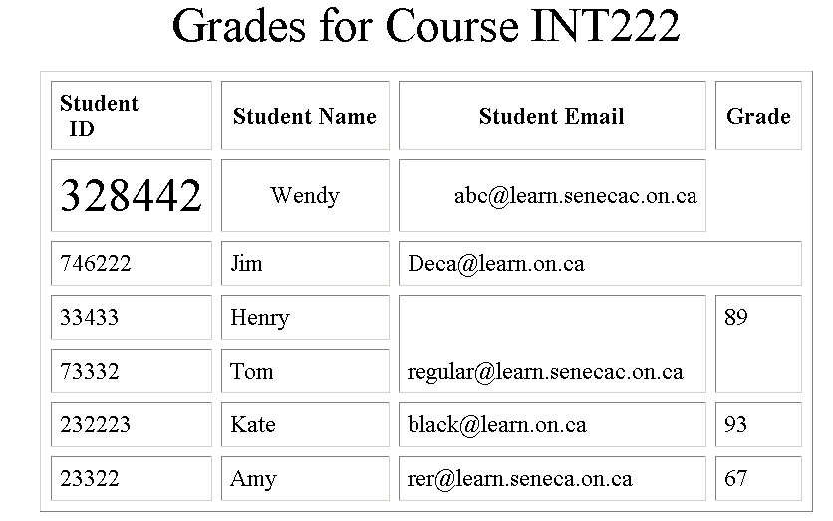
Table.html

Slide 22
Thank you!

