Slide 1
INT 222
Internet I - Internet Fundamentals
-Sunny Shi
sunny.shi@senecacollege.ca

Slide 2
Outline
CSS Styling
Backgrounds
Text

Slide 3
Background
- Properties
background_image:
  background-image:url(image.jpg);
    where image.jpg may be a relative or absolute path
background-color: can still be used, and will provide colour where the image is not displayed
background-position:
  Values: left top (default), right, bottom, center, center
background-repeat:
  Values: repeat (default), repeat-x, repeat-y, no-repeat
background-attachment:
  Value: fixed, scroll (default)
Shorthand property:
body{ background: url("../img/seneca_logo.gif") no-repeat
grey right top;}
Bg.html, bg.css

Slide 4
CSS3 Backgrounds
Property “background-size”: specifies the size of the background image.
Before CSS3, the background image size was determined by the actual size of the image.
In CSS3 it is possible to specify the size of the background image, which allows us to re-use background images in different contexts.
You can specify the size in pixels or in percentages.
If you specify the size as a percentage, the size is relative to the width and height of the parent element.

Slide 5
CSS3 Backgrounds
Resize a background image:
body {
background:url(../img/seneca_logo.gif);
background-size: 80px 60px;
-moz-background-size:80px 60px; /* Firefox 3.6 */
background-repeat: no-repeat;
padding-top: 40px;
}
Bg_new.html

Slide 6
CSS3 Background
Stretch the background image to completely fill the content area:
p {
background:url(../img/seneca_logo.gif);
background-size: 100% 100%;
-moz-background-size:100% 100%; /* Firefox 3.6 */
background-repeat: no-repeat;
padding-top: 40px;
Bg_new_100.html

Slide 7

CSS3 Background
Property “background-origin”:
Specifies the positioning area of the background images.
The background image can be placed within the content-box, padding-box, or border-box area.
Bg_new_origin.html

Slide 8
Support Browsers
Firefox 3.6 and earlier does not support the background-origin property, and requires the prefix -moz- to support the background-size property.
Safari 4 requires the prefix -webkit- to support the new background properties.
Internet Explorer 9, Firefox 4, Chrome, Safari 5 and Opera support the new background properties.

Slide 9
Formatting Text font-family
A font family or a font face is the typeface that will be applied by a web browser to some text.
The font family can use a specific named font, but the actual appearance will depend on the browser and the fonts installed on the system.
E.g., a default installation of I.E. always displays serif and Times as Times New Roman, and sans-serif and Helvetica as Arial.
A font-family (or face in HTML) consists of a set of related fonts, grouped as font families

Slide 10
Formatting Text font-family
<!-- font.html -->
<!DOCTYPE html>
<html lang="EN">
<head>
<title> FONT </title>
<meta charset="UTF-8">
<style type="text/css">
p.serif{font-family: "Times New Roman", Times, serif;}
p.sansserif{font-family: Arial, Helvetica, sans-serif;}
/* if Arial is not available, choose Helvetica, … */
p {background-color: grey;}
</style>
</head>
<body>
<h1> CSS font-family </h1>
<p class="serif"> This is a paragraph, shown in the
Times New Roman font. </p>
<p class="sansserif"> this is a paragraph, shown in the
Arial font. </p>
</body>
</html>

Slide 11
Formatting Text font-family
The web browser will only be able to apply a font if it is available on the system on which it operates, which is not always the case.
So, list in preferential order font families to use when rendering text.
The font list is separated by commas.
To avoid unexpected results, the last font family on the font list should be one of the five generic families which are by default always available in HTML and CSS.

Slide 12
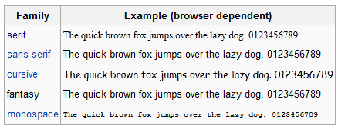
Generic Font Family

Slide 13
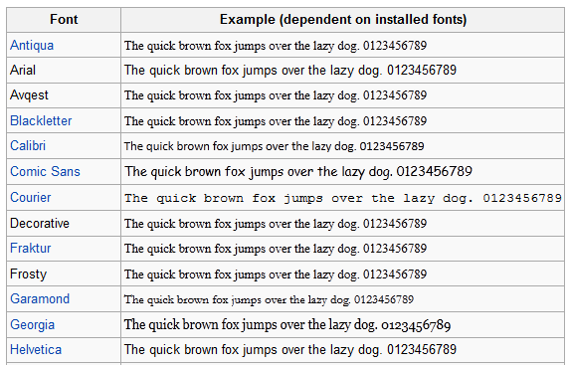
Generic Font

Slide 14
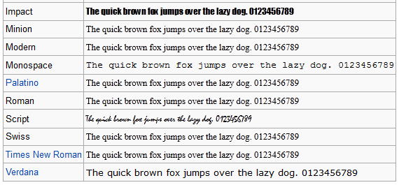
Generic Font (Cont’d)

Slide 15
Formatting Text font-size
Font size for different elements
  h1 {font-size:250%} –size relative to regular size (scales well)
  p {font-size: 20pt} –actual size in points,
  div{font-size:20px} –actual size in pixels,
  {font-size: smaller} – smaller than regular size, default medium
  {font-size: 1.5em} – size relative to regular size (scales well)

Slide 16
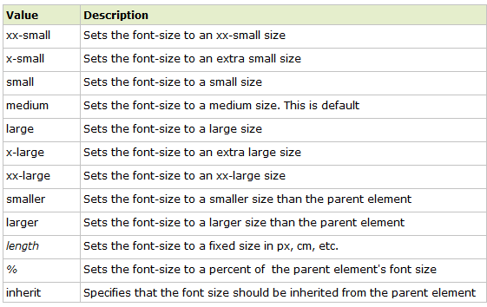
Font-size:
Property values

Slide 17
Units in CSS
em:
The "em" is a scalable unit that is used in web document media.
1 em = the current font-size, e.g., 12pt
Ems are scalable in nature, so 2em = 24pt,
Ems are becoming increasingly popular in web documents due to scalability and their mobile-device-friendly nature.
em stands for "M", the letter M being the widest character in a font.

Slide 18
Units in CSS
px:
Pixels are fixed-size units that are used in screen media.
One pixel = one dot on the computer screen (the smallest division of your screen's resolution).
It does not scale upward for visually-impaired readers or downward to fit mobile devices.

Slide 19
Units in CSS
pt:
Points are traditionally used in print media
One point = 1/72 of an inch.
Points are fixed-size units and cannot scale in size.

Slide 20
Units in CSS
%:
The percent unit is much like the "em" unit.
Current font-size = 100% (i.e. 12pt = 100%).
While using the percent unit, the text remains fully scalable for mobile devices and for accessibility.
1 em = 12pt = 16px = 100%

Slide 21
Formatting Text other text properties
{font-weight: bold} or “lighter”, “normal”, “bolder”
{font-weight:700} or 100, 200, 300, 400(normal), 500,600, 700 (bold), 800, 900
{font-style:italic} or “normal”, “oblique”
{line-height:1.5} =150%
{text-align: center} – or “left”(normal), “right”, “justify”
{text-indent:4em}-first-line indent, can use %, pt, px
{text-indent: -4em} –hanging indent

Slide 22
Formatting Text other text properties
{text-decoration:underline} or “overline”, “line-through”, “blink”, “none”
{text-transform: capitalize} or “uppercase”, “lowercase”, “none”
{font-variant:small-caps} or “normal”
Shorthand:
  h2 {font:italic small-caps bolder 20pt/28pt "Lucida","Arial"; text-decoration:underline; text-align:right; color:red; background-color:silver;}
font-2.html, text.html

Slide 23
CSS3 Text Effect
Text shadow:
  Specify horizontal shadow, the vertical shadow, the blur distance, and the color of the shadow.
  h1
  {
  text-shadow: 5px 5px 5px #FF0000;
  }
text_css3.html

Slide 24
CSS3 Text Effect
CSS3 word wrapping
If a word is too long to fit within an area, it expands outside
In Css3, the word-wrap property allows to force the text to wrap
Even if it means splitting it in the middle of a word.
text_css3.html

Slide 25
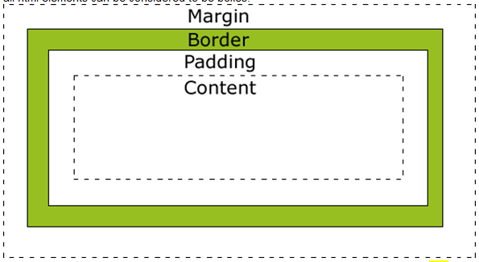
CSS Box Model
All elements can be considered to be box.

Slide 26
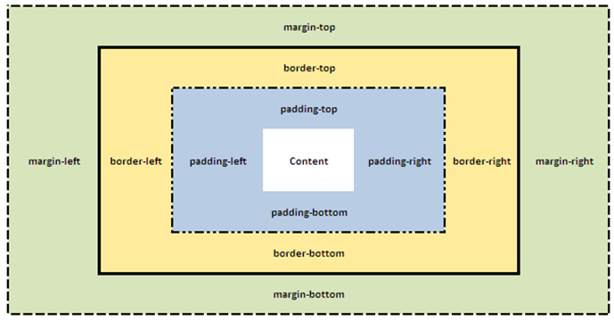
CSS Box Model

Slide 27
Thank you!

