Slide 1
INT 222
Internet I - Internet Fundamentals
-Sunny Shi
sunny.shi@senecacollege.ca

Slide 2
Outline
CSS Box Model
CSS margins
CSS borders
CSS3
Positioning

Slide 3
Web Safe Colors & Web Smart Colors
colours can be specified in several ways:
  colour name - eg. red
  red-green-blue decimal numbers, 0 to 255 - eg. rgb(173,253,36)
  hex value - eg. #13FD24 - this is the most commonly used method
some old monitors display only 256 colours, and 40 are reserved for the browser and the OS:
  the 216 remaining colours are called "web-safe colours", and many web designers stick to these
easy way to determine if a colour is web-safe:
  use the hex digits 00, 33, 66, 99, CC, or FF for each colour pair
    eg. #00FF33 is a web-safe colour
    eg. #00FF25 is not a web-safe colour, because 25 isn't in the above list
web-smart colours degrade gracefully on old monitors, and provide 4096 colours:
  use the hex digits 00, 11, 22, 33, 44, 55, 66, 77, 88, 99, AA, BB, CC, DD, EE, or FF for each colour pair
    eg. #11DD22 is a web-smart colour
    eg. #11DD25 is not a web-smart colour, because 25 isn't in the above list
4096 color wheel:
  http://www.ficml.org/jemimap/style/color/wheel.html

Slide 4
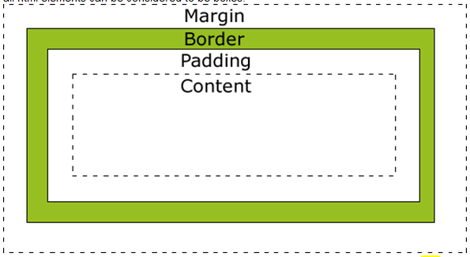
CSS Box Model
All elements can be considered to be box.

Slide 5
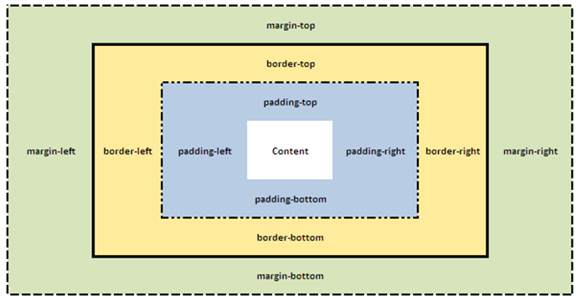
CSS Box Model
Shorthand order: CLOCKWISE:
top -> right-> bottom→ left

Slide 6
CSS Margins
CSS Margins define the white space around an HTML element's border.
Possible values:
  auto: The browser calculates a margin
  Length: Specifies a margin in px, pt, cm, etc. Default value is 0px
  %: Specifies a margin in percent of the width of the containing element
CSS Property | Description
margin | Applies to all sides
margin:6px; /* short cut */ | Applies a margin to all sides of an element
margin-top | Applies a margin to the top of an element
margin-right | Applies a margin to the right of an element
margin-bottom | Applies a margin to the bottom of an element
margin-left | Applies a margin to the left of an element
Margin.html

Slide 7
The margin property can have from one to four values.
margin:25px 50px 75px 100px;
  top margin is 25px
  right margin is 50px
  bottom margin is 75px
  left margin is 100px
margin:25px 50px 75px;
  top margin is 25px
  right and left margins are 50px
  bottom margin is 75px
margin:25px 50px;
  top and bottom margins are 25px
  right and left margins are 50px
margin:25px;
  all four margins are 25px

Slide 8
CSS Border
set the color, style and width of the borders around an element.
None of the border properties will have ANY effect unless the border-style property is set! Properties:
Border-style.html

Slide 9
Property border-style Values
none: Defines no border
dotted: Defines a dotted border
dashed: Defines a dashed border
solid: Defines a solid border
double: Defines two borders. The width of the two borders are the same as the border-width value
groove: Defines a 3D grooved border. The effect depends on the border-color value
ridge: Defines a 3D ridged border. The effect depends on the border-color value
inset: Defines a 3D inset border. The effect depends on the border-color value
outset: Defines a 3D outset border. The effect depends on the border-color value

Slide 10
Property border-width Values
The border-width property is used to set the width of the border.
The width is set in pixels, or one of the three pre-defined values: thin, medium, or thick.
Note: The "border-width" property does not work if it is used alone. Use the "border-style" property to set the borders first.

Slide 11
HTML5 <mark> tag
Highlight parts of a text.
  <p>Do not forget to buy <mark>milk</mark> today.</p>
Border-width.html

Slide 12
border-color
set the color of the border.
The color can be set by:
  name - specify a color name, like "red"
  RGB - specify a RGB value, like "rgb(255,0,0)"
  Hex - specify a hex value, like "#ff0000"
You can also set the border color to "transparent".
Note: The "border-color" property does not work if it is used alone. Use the "border-style" property to set the borders first.
Border-color.html

Slide 13
Border Individual Sides
Specify different borders for different sides.
  p {
  border-top-style:dotted;
  border-right-style:solid;
  border-bottom-style:dotted;
  border-left-style:solid;
  }

Slide 14
The border-style property can have from one to four values.
border-style:dotted solid double dashed;
  top border is dotted
  right border is solid
  bottom border is double
  left border is dashed
border-style:dotted solid double;
  top border is dotted
  right and left borders are solid
  bottom border is double
border-style:dotted solid;
  top and bottom borders are dotted
  right and left borders are solid
border-style:dotted;
  all four borders are dotted
It also works with border-width and border-color.

Slide 15
Border Shorthand property
shorthand property: specify all the individual border properties in one property.
The border property is a shorthand for the following individual border properties:
  border-width
  border-style (required)
  border-color
border:5px solid red;
Border-short.html

Slide 16
CSS3 Rounded Corners
Property: border-radius
div
{
border:2px solid #a1a1a1;
padding:10px 40px;
background:grey;
width:300px;
border-radius:25px;
-moz-border-radius:25px; /* Firefox 3.6 and earlier */
}

Slide 17
CSS3 Rounded Corners
border-radius:2em;
is equivalent to:
border-top-left-radius:2em;
border-top-right-radius:2em;
border-bottom-right-radius:2em;
border-bottom-left-radius:2em;
The border-radius property is supported in
IE9+, Firefox 4+, Chrome, Safari 5+, and Opera.

Slide 18
CSS3 Box Shadow
Property: box-shadow
-moz-box-shadow: 10px 10px 5px #888888; /* Firefox 3.6 and earlier */
box-shadow: 10px 10px 5px blue;

Slide 19
Centering Page Content
to horizontally center page content,
  use a "div" to contain the entire page content
  use CSS to center the "div“
eg. {width:800px; margin:auto} - browser will automatically calculate the left and right margins to be equal
Center.html

Slide 20
Positioning
property: position
a browser renders html statements in the order that they are in the html file - this is called normal flow
CSS positioning can be used to position elements precisely

Slide 21
Positioning
Values for property: position
  absolute - position precisely within the containing element
  relative - position precisely relative to normal flow
  fixed - position precisely within the browser window, and does not move when the page is scrolled
  static - position using normal flow (default)
Values for Properties: "left", "right", "top", and "bottom" can be given offsets in px or %
<div> tags, with various classes, are used to create the different divisions of the document.
position.html
Position_relative.html

Slide 22
Positioning
what if the text takes more than the allotted space?
use the property "overflow" to specify an action:
eg. {overflow:scroll} - include scroll bars
eg. {overflow:auto} - scroll if required
eg. {overflow:hidden} - hide overflow
eg. {overflow:visible} - default
position.html

Slide 23
Positioning
graphics and titles can be positioned in a similar fashion:
Position_graphic.html

Slide 24
Padding
Property- "padding“: be used to pad around inside edges of divisions.
note that the padding must be subtracted from the width and height to maintain the "div" sizes
{padding:5px} - pads by 5 pixels on top, right, bottom, left.
{padding:5px 10px} - pads by 5 on top & bottom, 10 on right & left
{padding:5px 10px 15px} - pads by 5 on top, 10 on right, 15 on bottom, 10 on left (assumes same as right)
{padding:5px 10px 15px 20px} - pads by 5 on top, 10 on right, 15 on bottom, 20 on left
using styles for padding articles, article headings, and horizontal rules.
Position_graphic.html

Slide 25
Thank you!

