Slide 1
INT 222
Internet I - Internet Fundamentals
-Sunny Shi
sunny.shi@senecacollege.ca

Slide 2
Outline
CSS lists
CSS tables
CSS hyperlinks
HTML5 new tags

Slide 3
CSS Lists
Set different list item markers for ordered lists
Set different list item markers for unordered lists
Set an image as the list item marker
ul.circle {list-style-type:circle}
ul.square {list-style-type:square}
ol.upper-roman {list-style-type:upper-roman}
ol.lower-alpha {list-style-type:lower-alpha}

Slide 4
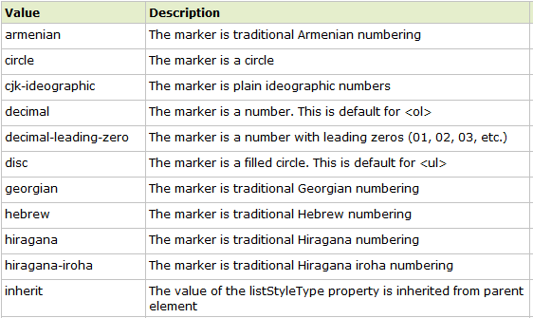
Property: list-style-type Values

Slide 5
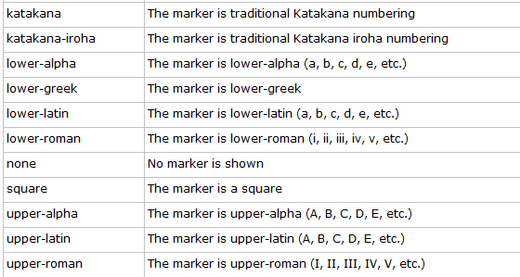
Property Values
Css_list.html

Slide 6
Property: list-style-image
ul
{
list-style-image:url('sqpurple.gif');
}
ul_img_all_browser.html

Slide 7
Table Formatting
CSS properties:
  margin, padding, width, height, text-align, vertical-align, background-color, background-image, border
formatting the entire table:
  table {margin: auto; width: 80%}
  table {border: dotted}
  table {background-color: yellow}

Slide 8
Border Collapse
Property: border-collapse sets whether the table borders are collapsed into a single border or separated.
E.g.:
    table
    {
    border-collapse:collapse;
    }
    table,th, td
    {
    border: 1px solid black;
    }

Slide 9
Formatting Table Cells
td {border: 4px inset #4400FF}
td {padding:10px 20px}
td {background-color: aqua}
td {height: 100px; width: 400px}
using "text-align" and "vertical-align"
Css_table.html

Slide 10
Table Sections
<thead> - group the first one or more rows of a table for formatting
<tbody> - group the middle rows of a table for formatting
<tfoot> - group the last one or more rows of a table for formatting
Table_section.html

Slide 11
Styling Links
Properties:
  color, font-family, background
Links are styled differently depending on what state they are in.
The four links states are:
  a:link - a normal, unvisited link
  a:visited - a link the user has visited
  a:hover - a link when the user mouses over it
  a:active - a link the moment it is clicked
NOTE: When setting the style for several link states,
  a:hover MUST come after a:link and a:visited
  a:active MUST come after a:hover
Css_link.html

Slide 12
CSS – display property
defines how a certain HTML element should be displayed.
p.inline
{
display:inline;
}
Css_display.html

Slide 13
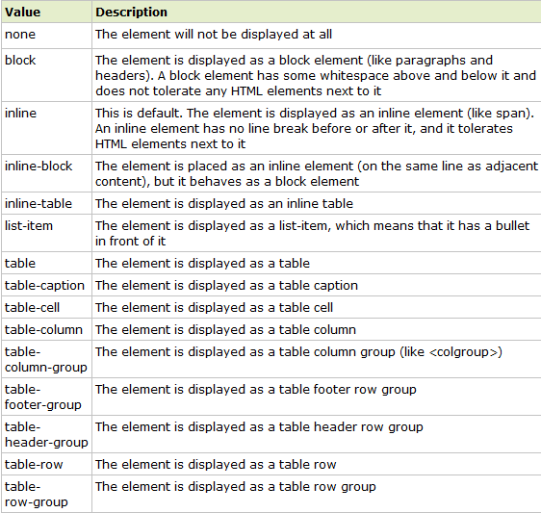
display property values

Slide 14
HTML5 new tags -
<article>
Defines an article.
Specifies independent, self-contained content.
An article should make sense on its own and it should be possible to distribute it independently from the rest of the site.
Potential sources for the <article> element:
  Forum post
  Blog post
  News story
  Comment
New_tags.html

Slide 15
HTML5 new tags -
<aside>
Defines content aside from the page content
Defines some content aside from the content it is placed in.
The aside content should be related to the surrounding content.
The <aside> content could be placed as a sidebar in an article.
New_tags.html

Slide 16
HTML5 new tags - <header>
Defines a header for a document or section
The <header> tag specifies a header for a document or section.
The <header> element should be used as a container for introductory content or set of navigational links.
You can have several <header> elements in one document.
Note: A <header> tag cannot be placed within a <footer>, <address> or another <header>
New_tags.html

Slide 17
HTML5 new tags - <hgroup>
Groups heading (<h1> to <h6>) elements
The <hgroup> element is used to group a set of <h1> to <h6> elements, when a heading has multiple levels (subheadings).
New_tags.html

Slide 18
HTML5 new tags - <section>
Defines a section in a document
Such as chapters, headers, footers, or any other sections of the document.
New_tags.html

Slide 19
HTML5 new tags - <footer>
Defines a footer for a document or section
A <footer> element should contain information about its containing element.
A footer typically contains the author of the document, copyright information, links to terms of use, contact information, etc.
You can have several <footer> elements in one document.
New_tags.html

Slide 20
Thank you!

