Slide 1
INT 222
Internet I - Internet Fundamentals
-Sunny Shi
Office: T2094
sunny.shi@senecacollege.ca

Slide 2
Outline
Introduction to CGI
The Process of CGI

Slide 3

What are CGI scripts
Client Side
Server Side
Server response
Web Server
…….
Web Browser
HTTP request
pages
scripts
programs
Multimedia files

Slide 4
Introduction to CGI
Normal Web browsing (static):
- Server response the file requested by the client
CGI (dynamic):
-the file the client requested is executed as a program
- the result (output) of the program is sent back to the client.
- This function is called the Common Gateway Interface or CGI.
- The programs are called CGI scripts.

Slide 5
Introduction to CGI
CGI is NOT a programming language.
It's simply a protocol that is used to communicate between web pages and a program.
Common: Suggests that CGI can be used by many languages and interact with many different types of systems.
Gateway: Suggests that CGI offer "access" to files, databases and really anything available on a server.
Interface: Suggests that CGI provides a well-defined implementation "protocol".

Slide 6
Introduction to CGI
A CGI script is simply a program that is called by the web server, in response to some action by a web visitor.
CGI programs may be written in any programming language that can
- read STDIN,
- write to STDOUT
- read environment variables.
Almost any programming language including Shell scripting can handle those.

Slide 7
Common Languages for CGI
PERL (Practical Extraction and Reporting Language),
PHP (originally derived from Personal Home Page Tools - now stands for Hypertext Preprocessor)
C language
C++, VB (ASP & ASP.net) and Java

Slide 8
The CGI Process
A client requests a URL corresponding to a CGI program using a method (get or post).
The method of the request is the first thing the CGI needs to identify.
- using a form to capture the data, you can choose the method get or post.

Slide 9
The CGI Process
Environment variables play a major role in communicating information between the client and the server.
environment variables:
REQUEST_METHOD,
QUERY_STRING,
CONTENT_LENGTH,
PATH_INFO

Slide 10
Environment Variables
Determine:
  how you get the information,
  what it is,
  where to get it and
  the locations that may be required for processing the data.

Slide 11
The CGI Process
GET Method
The GET method uses the QUERY_STRING to store the information being passed to the CGI.
Any information being passed will be part of the URL and you will in fact see it as part of the URL.
The part of the URL following the question mark (?) is automatically chopped and placed in the QUERY_STRING.

Slide 12
The CGI Process
POST Method
The POST method uses the standard input (STDIN) stream to pass the information.
The CONTENT_LENGTH is set to the number of URL-encoded bytes being sent to the STDIN.
Better to deal with large amounts of data, because the STDIN buffer has an unlimited capacity where as the GET method is limited to 256 characters.

Slide 13
GET is not secure.
Since the data is passed through as part of the URL, it'll show up in the web server's logfile (complete with all the data). Server logfiles are often readable by other users on the system.
URL history is also saved in the browser and can be viewed by anyone with access to the computer.
Do not use GET, use POST method instead, to send private or other sensitive information, e.g., password, credit card information.

Slide 14
The CGI Process
What CGI passes:
- Ordered pair: name=value
- Pair1&pair2
- CGI decoding hexadecimal encoding in order for the CGI script to use the information.
URL encoding:
- Alphanumeric characters are sent as themselves;
- spaces are converted to plus signs (+);
- other characters — like tabs, quotes, etc. — are converted to "%HH" — a percent sign and two hexadecimal digits representing the ASCII code of the character.

Slide 15
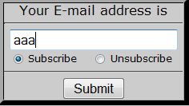
The CGI Process Example
email=aaa&what=add&submit=+Submit+
While the information is decoded, the CGI script will carry out the function it was intended to perform.

Slide 16
Questions
1. Where is the CGI script code located ?
In files in the CGI-BIN directory on the serve
2. Where is the CGI script code executed ?
On the server.

Slide 17
Create CGI Scripts
Confirm ISP offers CGI hosting
Write and edit CGI programs (scripts)
Upload the CGI scripts to web server as plain text (ASCII) files, not binary.
move it to cgi-bin (or public_html directory — wherever your ISP has told you to put your CGI programs)

Slide 18
Modify permission for CGI scripts
chmod 755 filename
- Owner - Read, Write, and Execute (binary: 111)
- Group - Read and Execute (binary: 101)
- Other - Read and Execute (binary: 101)

Slide 19
Where to use CGI
With CGI, you can write scripts that create interactive, user-driven applications.
provide users with all types of information, collect their comments, and respond to them.
a wide range of applications:
- surveys
- search tools
- quizzes
- games
- guestbooks

Slide 20
Remarks about CGI
While a client requests a URL corresponding to a CGI program, the server will execute it in real-time.
This is equivalent to allowing anyone on the web to execute programs on your system.
ISP's and Webmasters are always concerned about allowing the use of this feature on their servers. Allowing or prohibiting the use of CGI is a configuration feature for any web server.

Slide 21
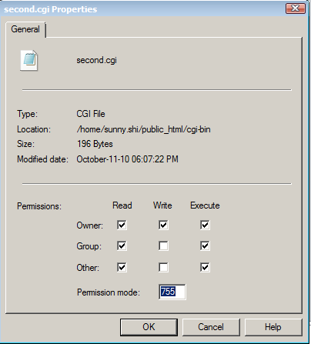
Example
https://scs.senecac.on.ca/~sunny.shi/cgi-bin/second.cgi

Slide 22
Thank you!

