Slide 1
JUnit 4

Slide 2
JUnit
JUnit is a java framework written by Erich Gamma and Kent Beck.
It is used to implement unit tests in java.
There are suitable frameworks for other programming languages such as C# (NUnit)，JavaScript (JSUnit) …

Slide 3
JUnit 3.8 vs JUnit 4
JUnit 3.8 | JUnit 4
naming conventions | annotation
GUI is available | omitted GUI
*The older version is still compatible in JUnit 4

Slide 4
JUnit 3.8
import junit.framework.TestCase;
public class TestGCD extends TestCase {
GCD gcd = null;
public void testGCD(){
gcd = new GCD();
assertEquals(5, gcd.getGCD(10,5));
}
}

Slide 5
JUnit 4
import static org.junit.Assert.*;
import org.junit.Test;
public class TestGCD {
GCD gcd = null;
@Test
public void CheckGCD(){
gcd = new GCD();
assertEquals(5, gcd.getGCD(10,5));
}
}

Slide 6
Test Fixture
Common set of objects want to be used
in two or more test cases.
Avoid duplicating the code
Created and destroyed by setUp()
and tearDown()

Slide 7
JUnit 3.8
public class testFixture extends TestCase{
Calculate calculate = null;
public void setUp() throws Exception {calculate = new Calculate();}
public void tearDown() throws Exception {calculate = null;}
public void testAdd() {assertEquals(30,calculate.Addition(10,20)); }
public void testSub() {assertEquals(-10, calculate.Subtraction(10,20));}
}
1
4
3
6
2
5

Slide 8
JUnit 4
public class testFixture {
Calculate calculate = null;
@Before
public void initialize() throws Exception {calculate = new Calculate();}
@After
public void cleanObject() throws Exception {calculate = null;}
@Test
public void Add() {assertEquals(30,calculate.Addition(10,20));}
@Test
public void Sub() {assertEquals(10,calculate.Subtraction(10,20));}
}

Slide 9
Testing Exceptions
JUnit 3.8
public void testDivisionByZero() {
try {
calculate.division(1,0);
fail(“Did’t catch the expected exception !");
}
catch (ArithmeticException success) { assertNotNull(success.getMessage());
}
}
JUnit 4
@Test(expected=ArithmeticException.class)
public void testDivByZero(){
calculate.division(1,0);
}

Slide 10
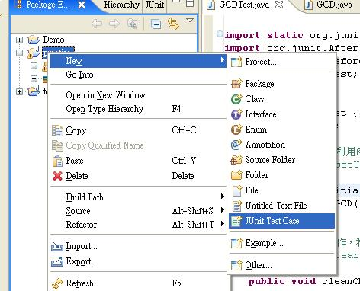
JUnit in Eclipse

Slide 11
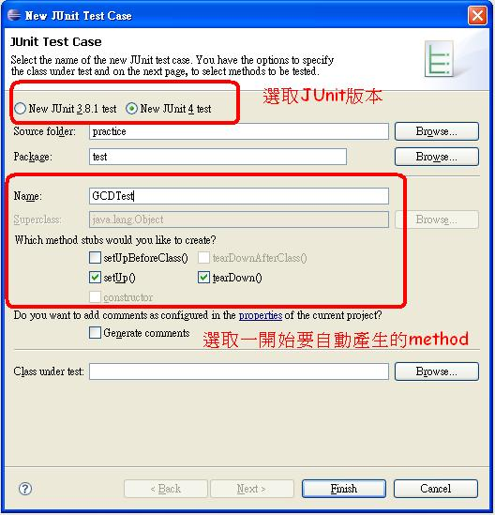
JUnit in Eclipse(Cont.)

Slide 12
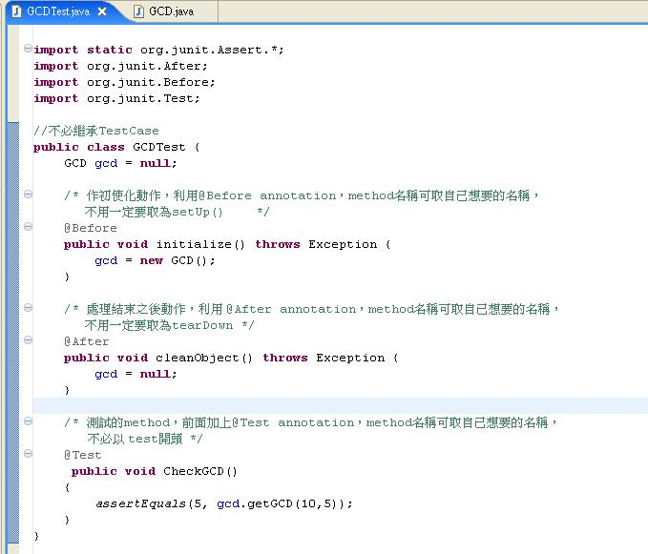
JUnit in Eclipse(Cont.)

Slide 13
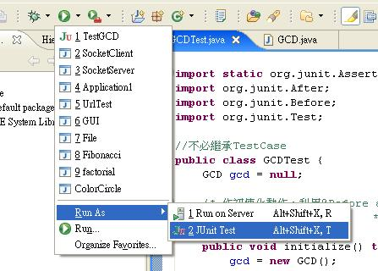
JUnit in Eclipse(Cont.)

Slide 14
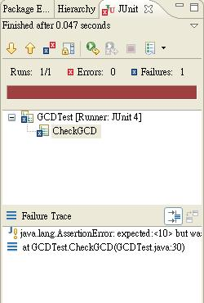
JUnit in Eclipse(Cont.)

Slide 15
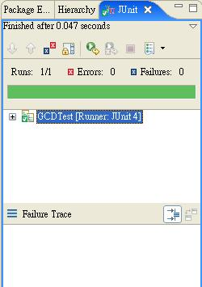
JUnit in Eclipse(Cont.)

Slide 16
References
http://junit.sourceforge.net/doc/faq/faq.htm#overview_1
http://www.ibm.com/developerworks/tw/library/j-junit4.html
http://caterpillar.onlyfun.net/Gossip/
JUnit/JUnitGossip.html

