Slide 1
CKY Parser
₀Book ₁ the ₂ flight ₃ through ₄ Houston₅
S, VP, Verb,
Nominal,
Noun
None
NP
Det
Nominal,
Noun
Speech and Language Processing - Jurafsky and Martin

Slide 2
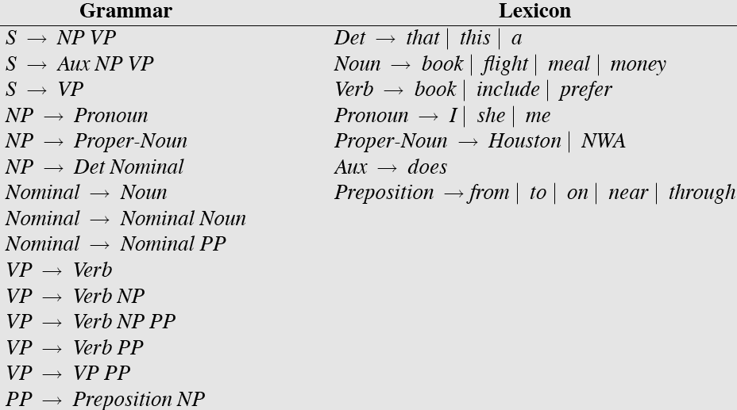
Sample L1 Grammar
Speech and Language Processing - Jurafsky and Martin

Slide 3
CKY Parser
₀Book ₁ the ₂ flight ₃ through ₄ Houston₅
S, VP, Verb,
Nominal,
Noun
VP
None
NP
Det
Nominal,
Noun
Speech and Language Processing - Jurafsky and Martin

Slide 4
CKY Parser
₀Book ₁ the ₂ flight ₃ through ₄ Houston₅
S, VP, Verb,
Nominal,
Noun
S
VP
None
NP
Det
Nominal,
Noun
Speech and Language Processing - Jurafsky and Martin

Slide 5
CKY Parser
₀Book ₁ the ₂ flight ₃ through ₄ Houston₅
S, VP, Verb,
Nominal,
Noun
S
VP
None
NP
Det
Nominal,
Noun
Speech and Language Processing - Jurafsky and Martin

Slide 6
CKY Parser
₀Book ₁ the ₂ flight ₃ through ₄ Houston₅
S, VP, Verb,
Nominal,
Noun
S
VP
None
None
NP
Det
None
Nominal,
Noun
None
Prep
Speech and Language Processing - Jurafsky and Martin

Slide 7
CKY Parser
₀Book ₁ the ₂ flight ₃ through ₄ Houston₅
S, VP, Verb,
Nominal,
Noun
S
VP
None
None
NP
Det
None
Nominal,
Noun
None
Prep
PP
NP
ProperNoun
Speech and Language Processing - Jurafsky and Martin

Slide 8
CKY Parser
₀Book ₁ the ₂ flight ₃ through ₄ Houston₅
S, VP, Verb,
Nominal,
Noun
S
VP
None
None
NP
Det
None
Nominal,
Noun
None
Nominal
Prep
PP
NP
ProperNoun
Speech and Language Processing - Jurafsky and Martin

Slide 9
CKY Parser
₀Book ₁ the ₂ flight ₃ through ₄ Houston₅
S, VP, Verb,
Nominal,
Noun
S
VP
None
None
NP
NP
Det
None
Nominal,
Noun
None
Nominal
Prep
PP
NP
ProperNoun
Speech and Language Processing - Jurafsky and Martin

Slide 10
CKY Parser
₀Book ₁ the ₂ flight ₃ through ₄ Houston₅
S, VP, Verb,
Nominal,
Noun
S
VP
None
None
VP
NP
NP
Det
None
Nominal,
Noun
None
Nominal
Prep
PP
NP
ProperNoun
Speech and Language Processing - Jurafsky and Martin

Slide 11
CKY Parser
₀Book ₁ the ₂ flight ₃ through ₄ Houston₅
S, VP, Verb,
Nominal,
Noun
S
VP
None
None
S
VP
NP
NP
Det
None
Nominal,
Noun
None
Nominal
Prep
PP
NP
ProperNoun
Speech and Language Processing - Jurafsky and Martin

Slide 12
CKY Parser
₀Book ₁ the ₂ flight ₃ through ₄ Houston₅
S, VP, Verb,
Nominal,
Noun
S
VP
VP
None
None
S
VP
NP
NP
Det
None
Nominal,
Noun
None
Nominal
Prep
PP
NP
ProperNoun
Speech and Language Processing - Jurafsky and Martin

Slide 13
CKY Parser
₀Book ₁ the ₂ flight ₃ through ₄ Houston₅
S, VP, Verb,
Nominal,
Noun
S
S
VP
VP
None
None
S
VP
NP
NP
Det
None
Nominal,
Noun
None
Nominal
Prep
PP
NP
ProperNoun
Speech and Language Processing - Jurafsky and Martin

Slide 14
CKY Parsing
Is that really a parser?
Speech and Language Processing - Jurafsky and Martin

Slide 15
CKY Parser
₀Book ₁ the ₂ flight ₃ through ₄ Houston₅
Parse
Tree
#1
S, VP, Verb,
Nominal,
Noun
S
S
VP
VP
None
None
S
VP
NP
NP
Det
None
Nominal,
Noun
None
Nominal
Prep
PP
NP
ProperNoun
Speech and Language Processing - Jurafsky and Martin

Slide 16
CKY Parser
₀Book ₁ the ₂ flight ₃ through ₄ Houston₅
Parse
Tree
#2
S, VP, Verb,
Nominal,
Noun
S
S
VP
VP
None
None
S
VP
NP
NP
Det
None
Nominal,
Noun
None
Nominal
Prep
PP
NP
ProperNoun
Speech and Language Processing - Jurafsky and Martin

