Slide 1



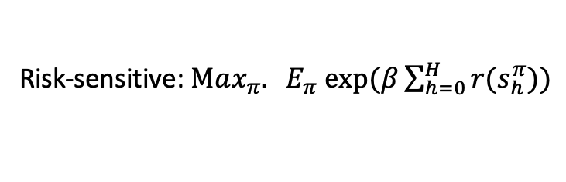

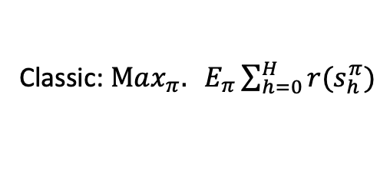




A toy example – travel on a circle
Agent’s action:
Left/right/stay
State-transition:
Agent’s action + random perturbation $ε$
Objective:
Collect as many reward as possible
…
…
Classic: $Max_{π}. E_{π}\sum_{h=0}^{H}{r(s_{h}^{π})}$
$$−10$$
$$5$$
$$−10$$
$$0$$
$$2$$
$$0$$
…
…
Risk-sensitive: $Max_{π}. E_{π} exp⁡(β\sum_{h=0}^{H}{r(s_{h}^{π}))}$
High risk, high reward
low risk, low reward

Slide 2
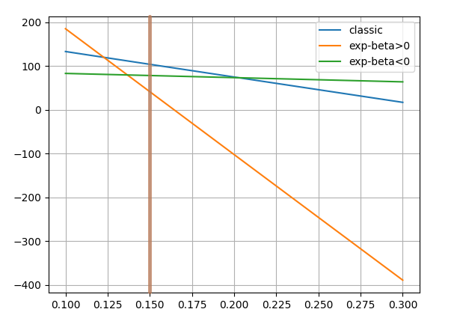


Numerical simulation result
Reward list:
[0,-10,5,-10,0,1,1,0, 0,0,-1,2,-1,0]
Three different objective functions:
Classic (Risk Neutral)
Risk-averse (beta < 0)
Risk-seeking (beta > 0)
Implementation: calculate the optimal policy for the
three different objectives under $ε_{0}= .15$, then calculate
The performance for different $ε=.1,.15,.2,…,.3$
Algorithm for finding the optimal policy: Dynamical programming
High risk
Low risk
Medium risk
$$ε$$

Slide 3
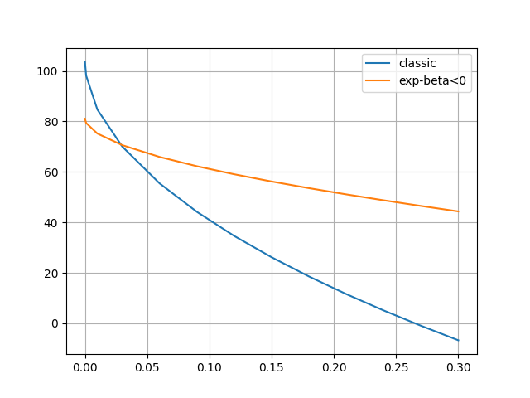
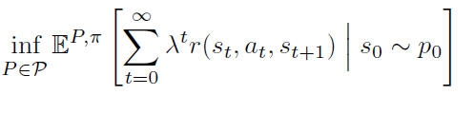



Robustness
Criteria for testing robustness
where the ambiguity set is chosen as:
Note that at different nodes the perturbation error
can be different in this choice of ambiguity set
$$f\left(π\right)$$
$$f\left(π\right)=$$
$$δ$$

Slide 4
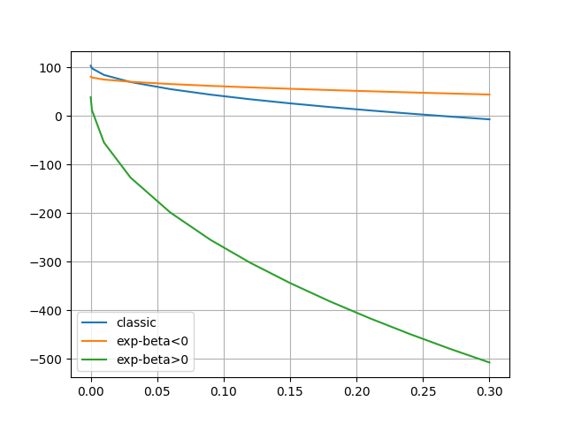


Additional figure (with risk seeking):
$$f\left(π\right)$$
$$δ$$

