Slide 1
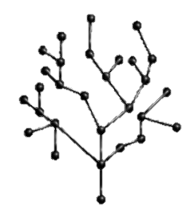
Trees
Mohammed Brahimi

Slide 2
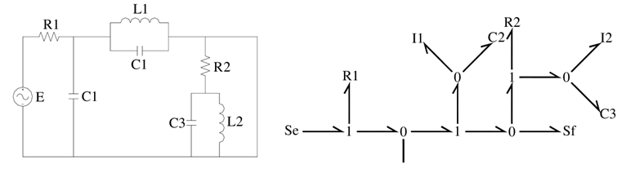
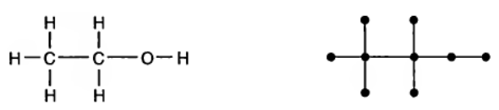
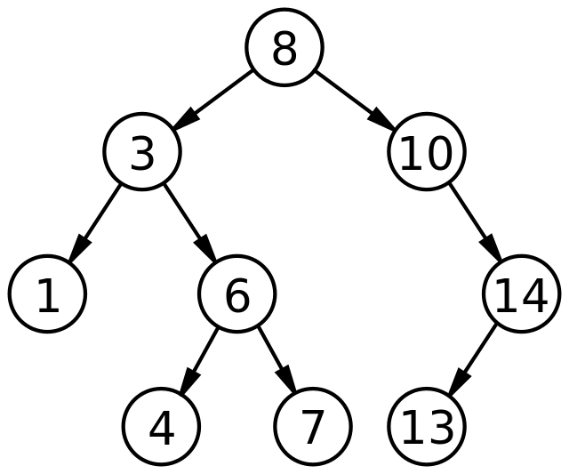
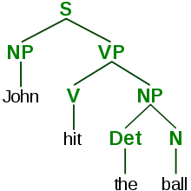
Applications of Trees
Electrical Networks - Gustav Robert Kirchhoff, 1840
Gustav Robert Kirchhoff made significant contributions to the field of electrical networks.
He developed models and analyzed interconnected circuits using tree structures.
Molecular Enumeration - Arthur Cayley, 1870
Arthur Cayley's work focused on enumerating molecules using tree representations.
Trees were used to model and analyze properties of molecules.
More Recent Applications
Computer Science: Trees are fundamental in algorithms, data structures, and search techniques.
Decision Making: Tree-based decision models provide optimal choices in various scenarios.
Linguistics: Syntax trees enable the analysis of language syntax and hierarchical relationships.
Gas Pipeline System Design: Trees are used to optimize network design and routing.

Slide 3
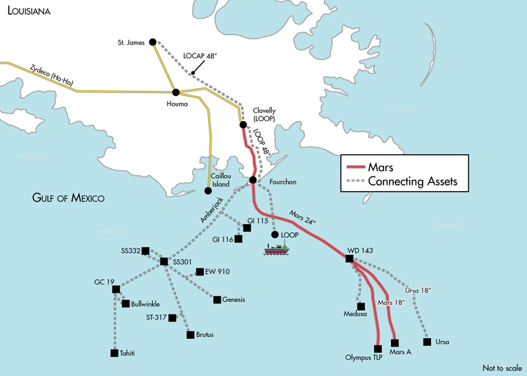
Applications of Trees - Pipeline Distribution System
Oil or gas pipeline distribution systems are a key example of artificial trees.
Economic Consideration:
The construction cost of such networks can be exceedingly high.
Adopting a tree structure can help minimize unnecessary edges, optimizing the network design.
Employing a tree structure can lead to substantial cost reductions, rendering it the most cost-effective design for the network.

Slide 4
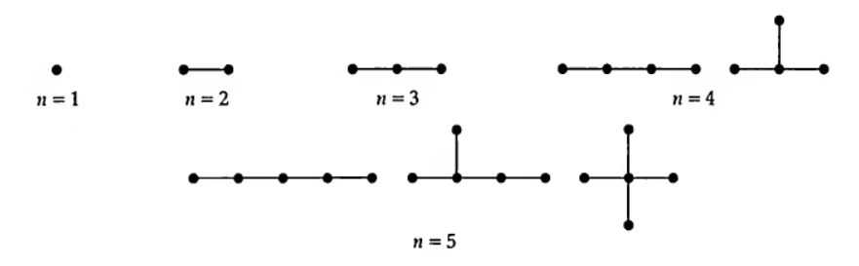
Mathematical properties of tree
Definition
A tree is a connected graph that has no cycles (acyclic).
The number of vertices is called the order of tree.
The number of edges is called the size of tree.

Slide 5
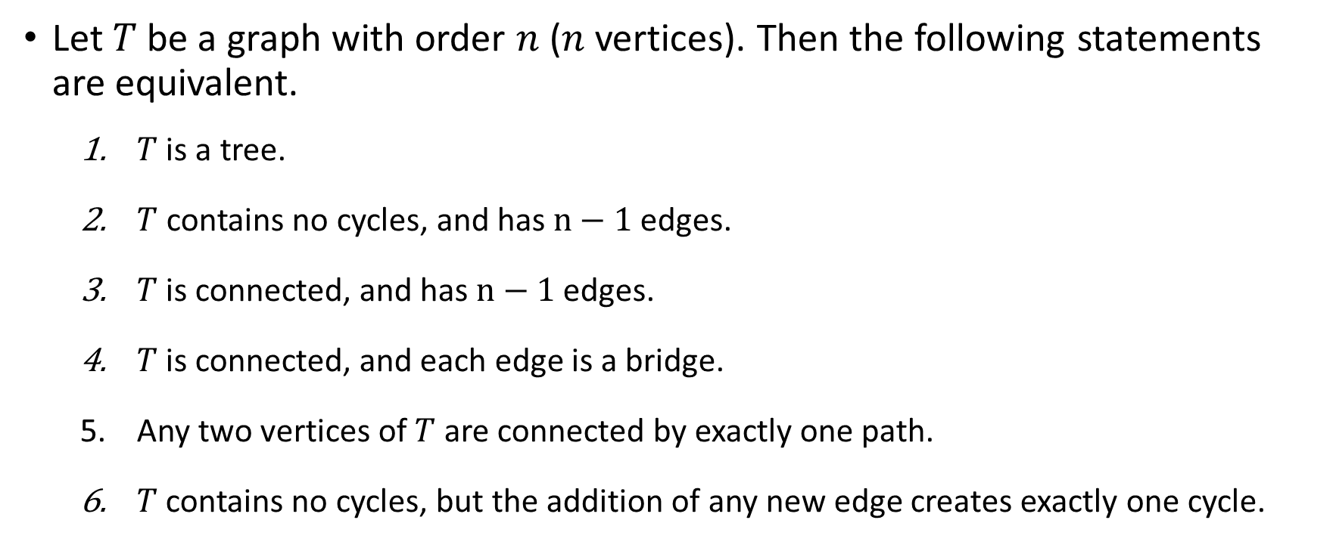
Theorem 1: Equivalent definitions of a Tree
Let $T$ be a graph with order $n$($n$ vertices). Then the following statements are equivalent.
$T$ is a tree.
$T$contains no cycles, and has $n−1$edges.
$T$ is connected, and has $n−1$edges.
$T$ is connected, and each edge is a bridge.
Any two vertices of $T$ are connected by exactly one path.
$T$ contains no cycles, but the addition of any new edge creates exactly one cycle.

Slide 6
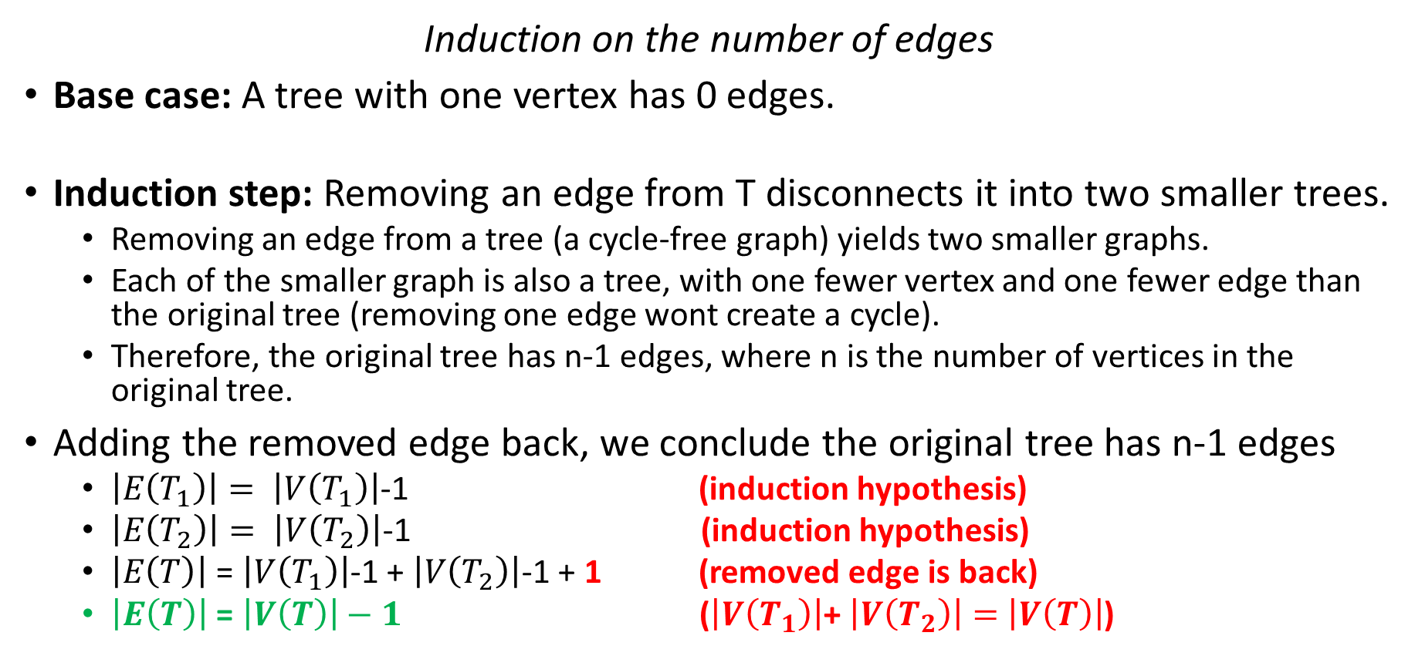
Proof (1➔2): 𝑇 is a tree ➔ 𝑇 contains no cycles, and has n−1 edges.
Induction on the number of edges
Base case: A tree with one vertex has 0 edges.
Induction step: Removing an edge from T disconnects it into two smaller trees.
Removing an edge from a tree (a cycle-free graph) yields two smaller graphs.
Each of the smaller graph is also a tree, with one fewer vertex and one fewer edge than the original tree (removing one edge wont create a cycle).
Therefore, the original tree has n-1 edges, where n is the number of vertices in the original tree.
Adding the removed edge back, we conclude the original tree has n-1 edges
$\left|E\left(T_{1}\right)\right|= \left|V\left(T_{1}\right)\right|$-1 (induction hypothesis)
$\left|E\left(T_{2}\right)\right|= \left|V\left(T_{2}\right)\right|$-1 (induction hypothesis)
$\left|E\left(T\right)\right|$ = $\left|V\left(T_{1}\right)\right|$-1 + $\left|V\left(T_{2}\right)\right|$-1 + 1 (removed edge is back)
$\left|E\left(T\right)\right|$ = $\left|V\left(T\right)\right|−1$ ($\left|V\left(T_{1}\right)\right|$+ $\left|V\left(T_{2}\right)\right|=$ $\left|V\left(T\right)\right|$)

Slide 7
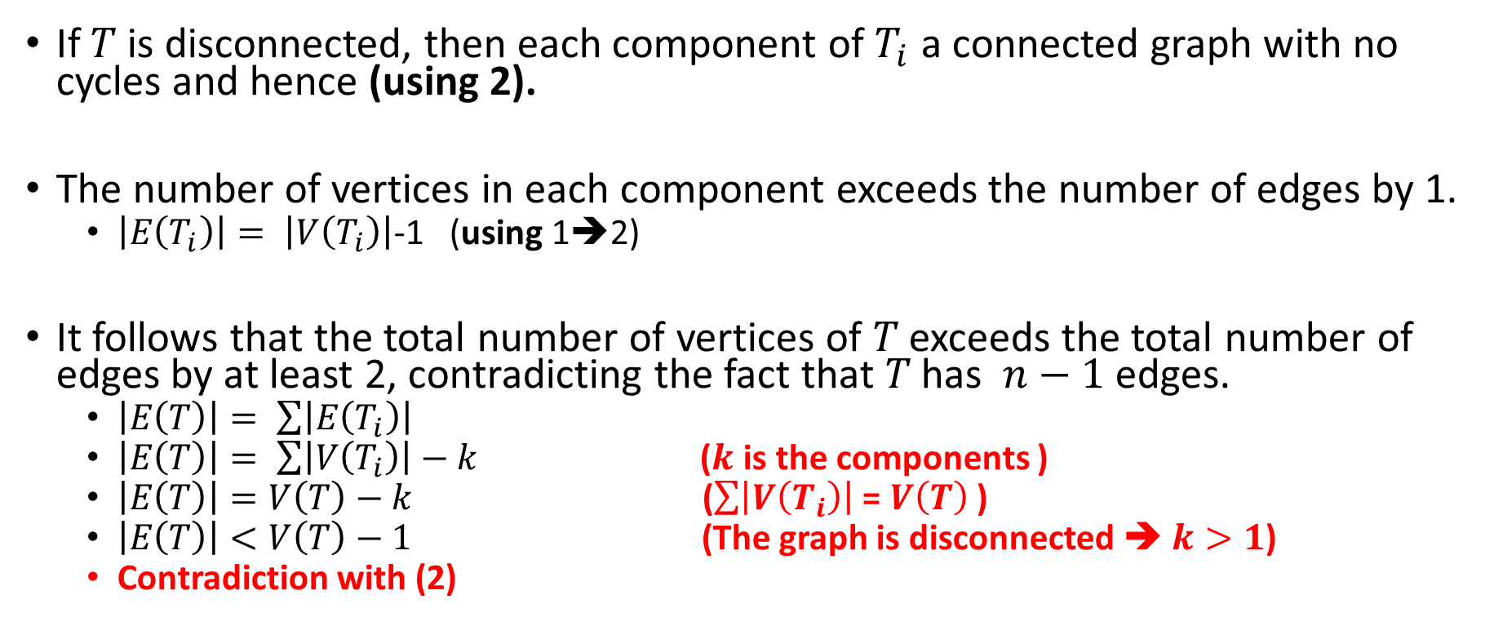
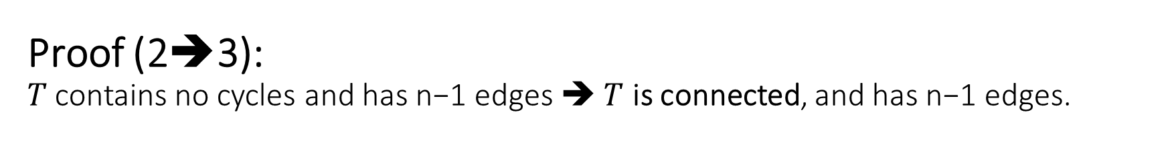
Proof (2➔3): 𝑇 contains no cycles and has n−1 edges ➔ $T$ is connected, and has n−1 edges.
If 𝑇 is disconnected, then each component of $T_{i}$ a connected graph with no cycles and hence (using 2).
The number of vertices in each component exceeds the number of edges by 1.
$\left|E\left(T_{i}\right)\right|= \left|V\left(T_{i}\right)\right|$-1 (using 1➔2)
It follows that the total number of vertices of 𝑇 exceeds the total number of edges by at least 2, contradicting the fact that 𝑇 has $n−1$edges.
$\left|E\left(T\right)\right|= \sum{\left|E\left(T_{i}\right)\right|}$
$\left|E\left(T\right)\right|= \sum{\left|V\left(T_{i}\right)\right|}−k$ ($k$ is the components )
$\left|E\left(T\right)\right|=V\left(T\right)−k$ ($\sum{\left|V\left(T_{i}\right)\right|}$ = $V\left(T\right)$ )
$\left|E\left(T\right)\right|<V\left(T\right)−1$ (The graph is disconnected ➔ $k>1$)
Contradiction with (2)

Slide 8

Proof (3➔4): 𝑇 is connected, and has n−1 edges ➔ 𝑇 is connected, and each edge is a bridge.
The removal of any edge results in a graph with $n$ vertices and $n –2$edges, which must be disconnected by THEOREM 2 in Week8 Connectivity in graphs ($k=1$).
THEOREM 2
Let G be a simple graph on n vertices. If $G$ has $k$ components, then the number m of edges of G satisfies:
$$n−k ≤m ≤ \frac{(n−k)(n−k+1)}{2}$$

Slide 9


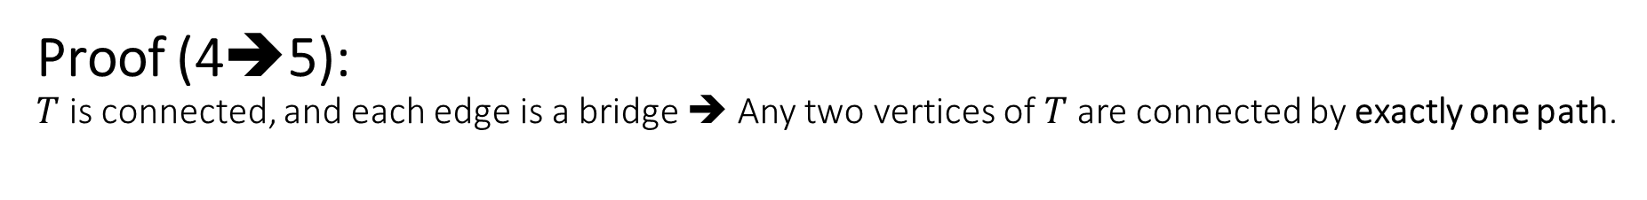






Proof (4➔5): $T$ is connected, and each edge is a bridge ➔ Any two vertices of $T$ are connected by exactly one path.
Since $T$ connected, each pair of vertices is connected by at least one path.
Assume that a given pair of vertices is connected by two paths
Then these paths contain a cycle, contradicting the fact that each edge is a bridge (Cycle cannot contain a bridge).

Slide 10


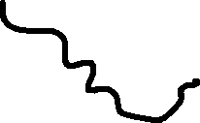
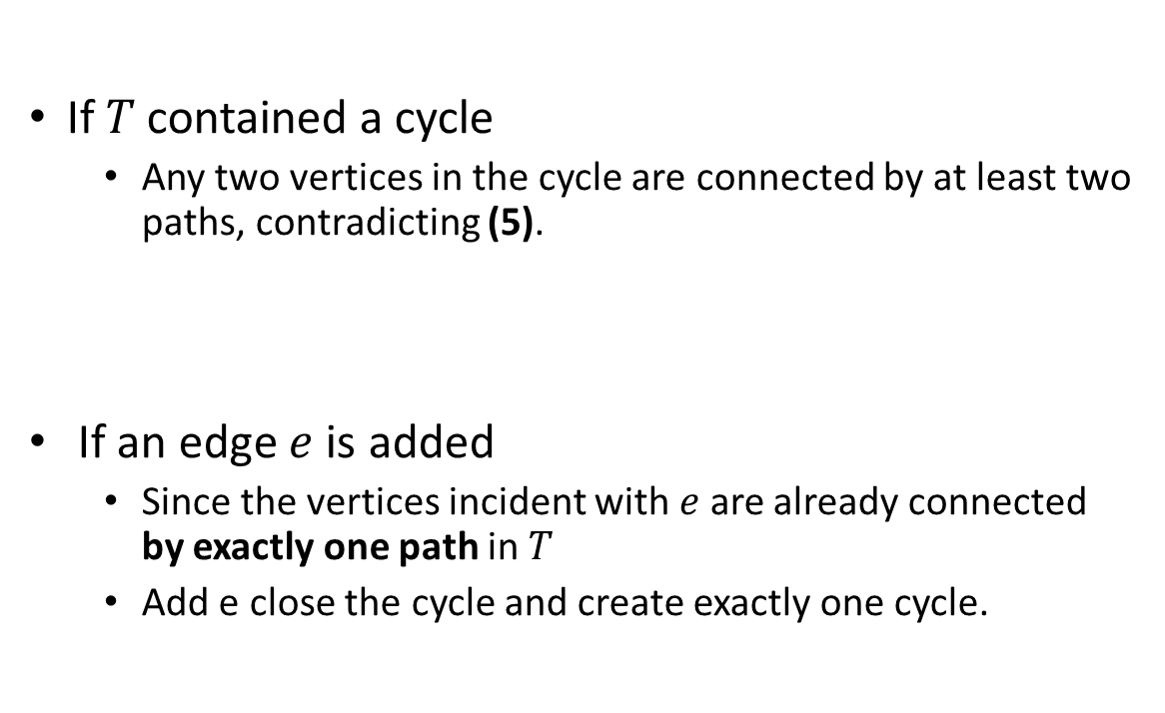






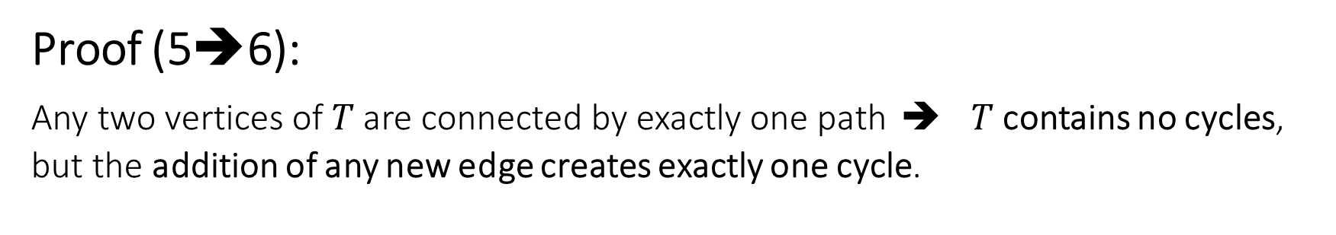
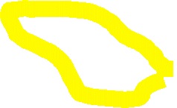
Proof (5➔6): Any two vertices of 𝑇 are connected by exactly one path ➔ $T$ contains no cycles, but the addition of any new edge creates exactly one cycle.
If 𝑇 contained a cycle
Any two vertices in the cycle are connected by at least two paths, contradicting (5).
If an edge $e$ is added
Since the vertices incident with $e$ are already connected by exactly one path in $T$
Add e close the cycle and create exactly one cycle.

Slide 11
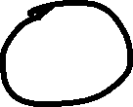
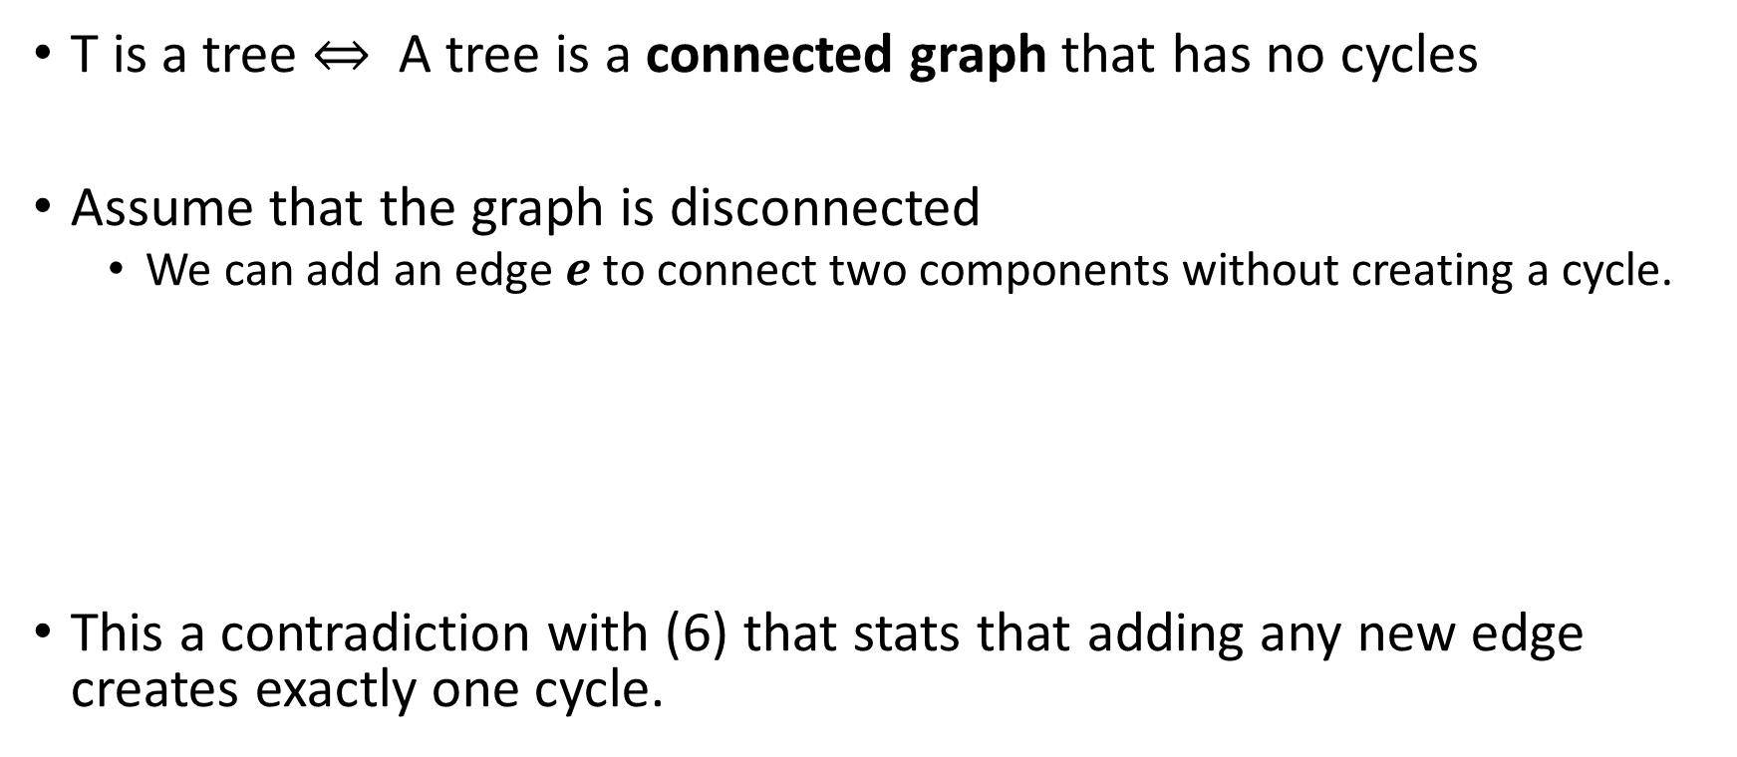
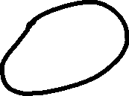
Proof (6➔1): 𝑇 contains no cycles, but the addition of any new edge creates exactly one cycle ➔ 𝑇 is a tree.
T is a tree $⇔$ A tree is a connected graph that has no cycles
Assume that the graph is disconnected
We can add an edge $e$ to connect two components without creating a cycle.
This a contradiction with (6) that stats that adding any new edge creates exactly one cycle.

Slide 12
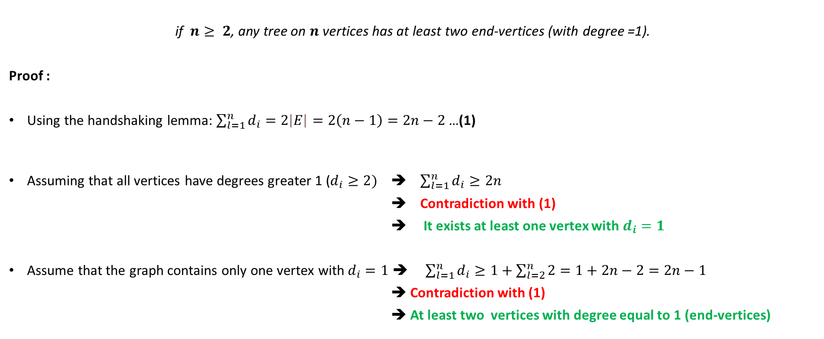
Theorem 2:
if $n≥ 2$, any tree on $n$ vertices has at least two end-vertices (with degree =1).
Proof :
Using the handshaking lemma: $\sum_{l=1}^{n}{d_{i}}=2\left|E\right|=2\left(n−1\right)=2n−2$ …(1)
Assuming that all vertices have degrees greater 1 ($d_{i}≥2)$ ➔ $\sum_{l=1}^{n}{d_{i}}≥2n$
➔ Contradiction with (1)
➔ It exists at least one vertex with $d_{i}=1$
Assume that the graph contains only one vertex with$d_{i}=1$ ➔ $\sum_{l=1}^{n}{d_{i}}≥1+\sum_{l=2}^{n}{2}=1+2n−2=2n−1$
➔ Contradiction with (1)
➔ At least two vertices with degree equal to 1 (end-vertices)

Slide 13
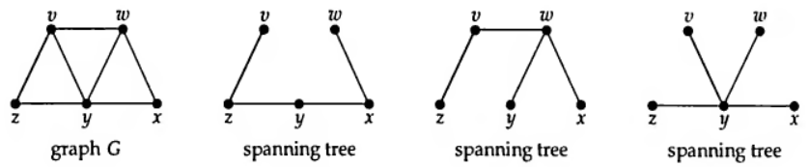
Spanning Trees
Definition
Let G be a connected graph. Then a spanning tree in G is a subgraph of G that includes every vertex and is also a tree.
The number of spanning trees in a graph can be very large
The Petersen graph has 2000 labelled spanning trees.

Slide 14
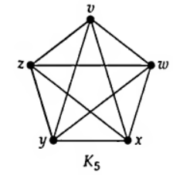
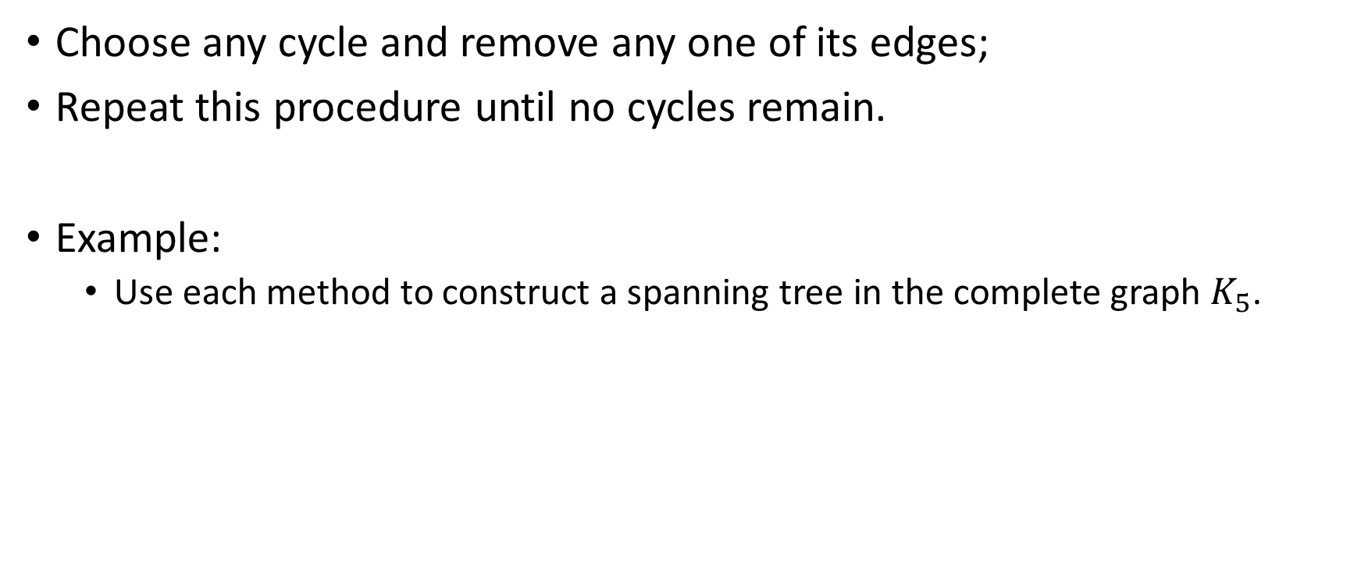
Constructing a spanning tree
Choose any cycle and remove any one of its edges;
Repeat this procedure until no cycles remain.
Example:
Use each method to construct a spanning tree in the complete graph $K_{5}$.

Slide 15
THEOREM 3
If T is any spanning tree Of a connected graph G, then
Each cutset of G has an edge in common With T;
Each cycle of G has an edge in common With the complement of T .

Slide 16
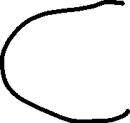

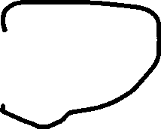




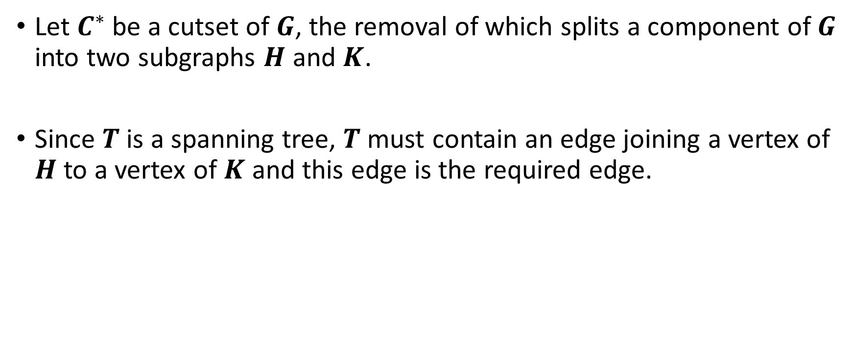
Proof of (1): Each cutset of G has an edge in common With T
Let $C^{∗}$be a cutset of $G$, the removal of which splits a component of $G$ into two subgraphs $H$ and $K$.
Since $T$ is a spanning tree, $T$ must contain an edge joining a vertex of $H$ to a vertex of $K$ and this edge is the required edge.

Slide 17

Proof of (2): Each cycle of G has an edge in common With the complement of T .
Let $C$ a cycle of $G$ having no edge in common with the complement of T.
Then $C$ must be contained in $T$, which is a contradiction.

Slide 18
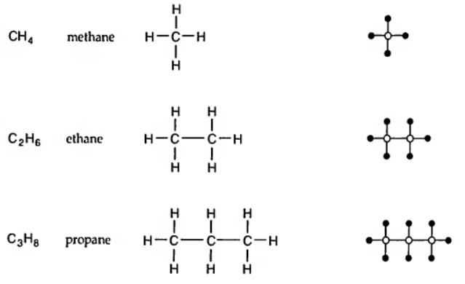
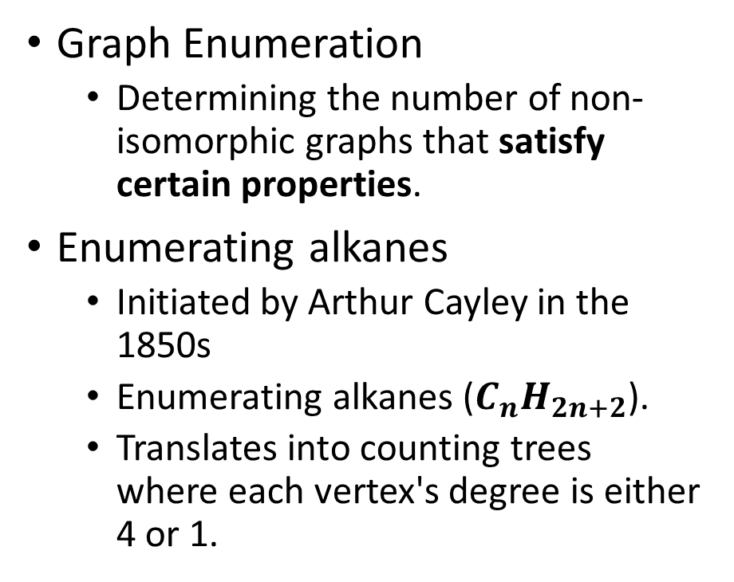
Counting trees
Graph Enumeration
Determining the number of non-isomorphic graphs that satisfy certain properties.
Enumerating alkanes
Initiated by Arthur Cayley in the 1850s
Enumerating alkanes ($C_{n}H_{2n+2}$).
Translates into counting trees where each vertex's degree is either 4 or 1.

Slide 19


Counting chemical molecules
The chemical formula $C_{4}H_{10} (n=4)$.

Slide 20

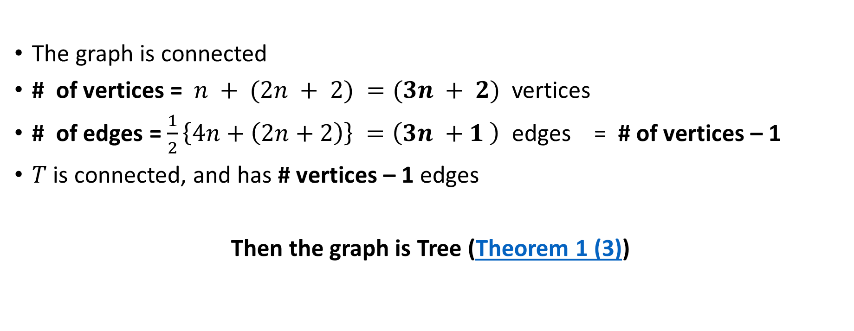
How many different molecules are there with $C_{n}H_{2n+2}$?
The graph is connected
# of vertices = $n + (2n + 2) =(3n + 2)$vertices
# of edges = $\frac{1}{2}\left\{4n+\left(2n+2\right)\right\} =\left(3n +1 \right)$ edges = # of vertices – 1
$T$ is connected, and has # vertices – 1 edges
Then the graph is Tree (Theorem 1 (3))

Slide 21
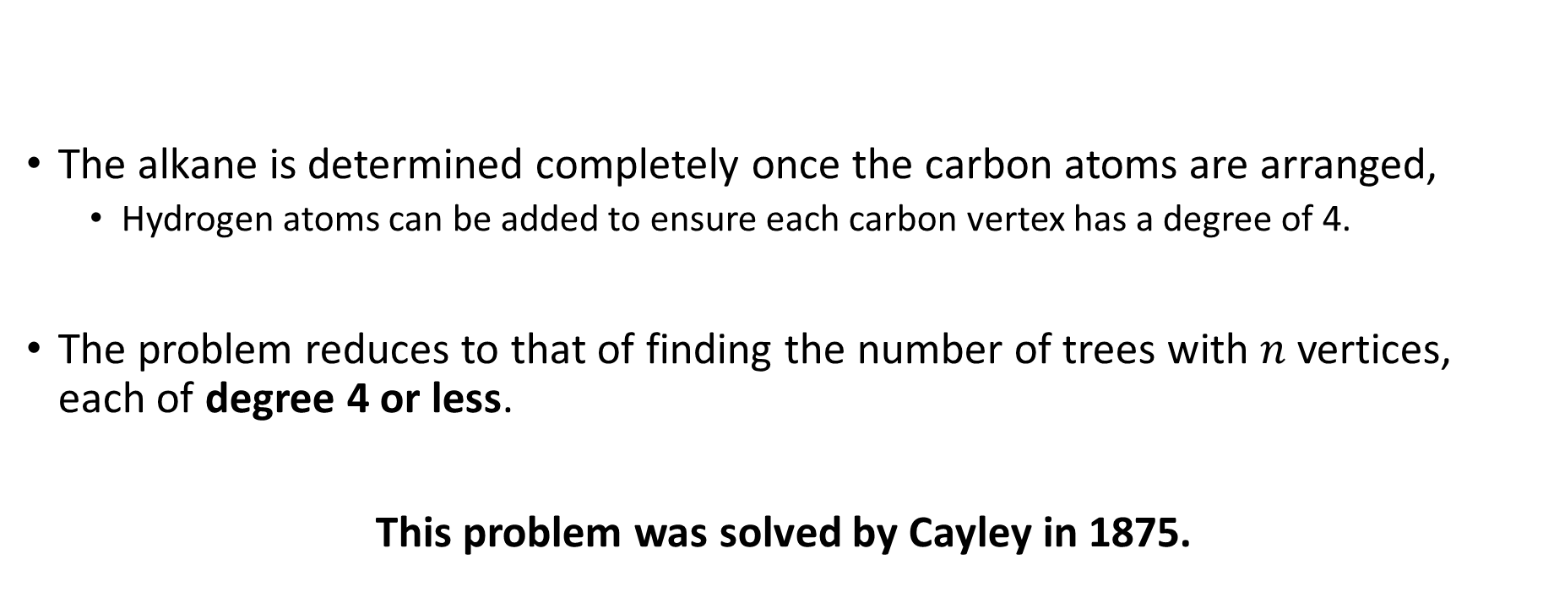
How many different molecules are there with $C_{n}H_{2n+2}$?
The alkane is determined completely once the carbon atoms are arranged,
Hydrogen atoms can be added to ensure each carbon vertex has a degree of 4.
The problem reduces to that of finding the number of trees with $n$ vertices, each of degree 4 or less.
This problem was solved by Cayley in 1875.

Slide 22


Counting chemical molecules
The chemical formula $C_{4}H_{10} (n=4)$.

Slide 23



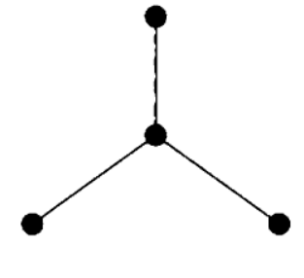
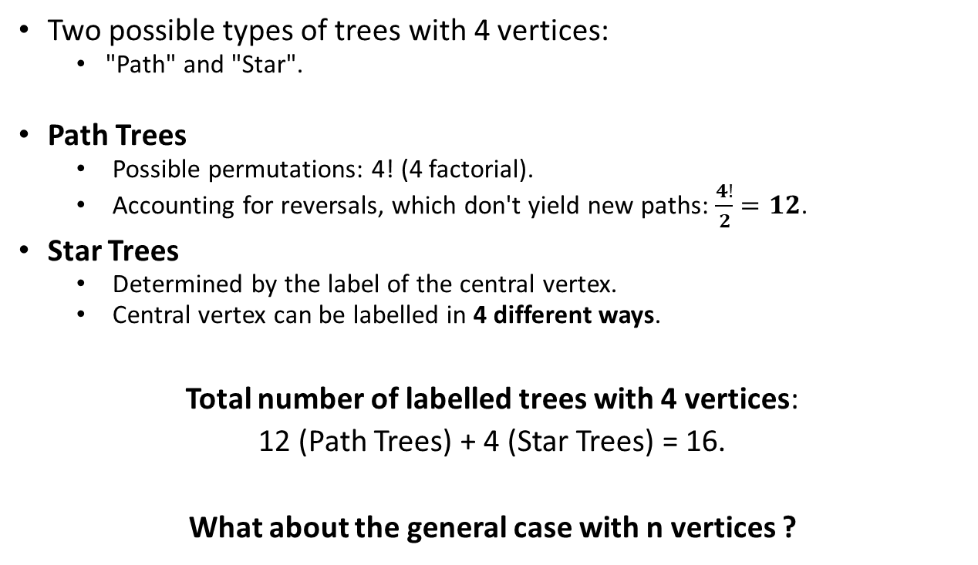
Counting Labelled trees
Two possible types of trees with 4 vertices:
"Path" and "Star".
Path Trees
Possible permutations: 4! (4 factorial).
Accounting for reversals, which don't yield new paths: $\frac{4!}{2}=12$.
Star Trees
Determined by the label of the central vertex.
Central vertex can be labelled in 4 different ways.
Total number of labelled trees with 4 vertices:
12 (Path Trees) + 4 (Star Trees) = 16.
What about the general case with n vertices ?

Slide 24
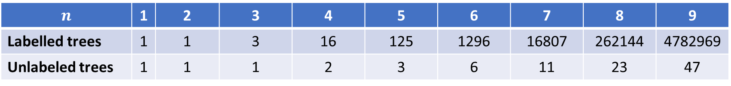

THEOREM 4 (Cayley, 1889)
There are $n^{n−2}$ distinct labelled trees with n vertices.
Counting unlabelled trees, where vertices aren't distinct, is more complex than counting labelled ones, lacking a simple formula like Cayley's.
$$n$$ | 1 | 2 | 3 | 4 | 5 | 6 | 7 | 8 | 9
Labelled trees | 1 | 1 | 3 | 16 | 125 | 1296 | 16807 | 262144 | 4782969
Unlabeled trees | 1 | 1 | 1 | 2 | 3 | 6 | 11 | 23 | 47

Slide 25



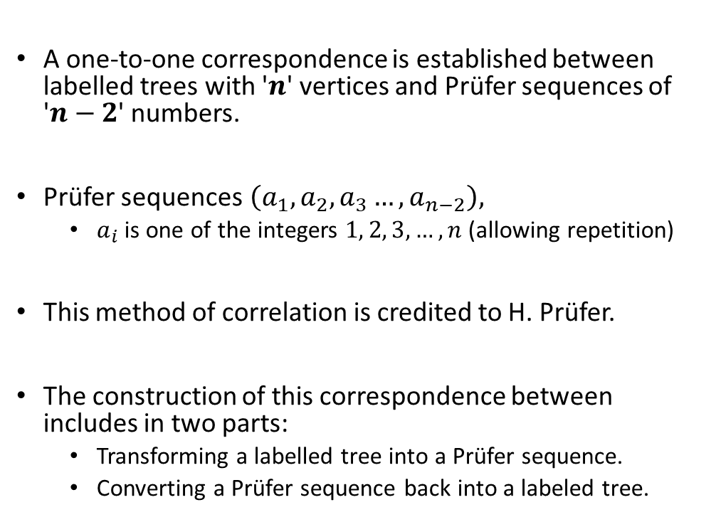



First proof: Proving the Count of Labelled Trees via Prüfer Sequences
A one-to-one correspondence is established between labelled trees with '$n$' vertices and Prüfer sequences of '$n−2$' numbers.
Prüfer sequences$\left(a_{1},a_{2},a_{3}…, a_{n−2}\right),$
$a_{i}$ is one of the integers $1, 2, 3, …, n$(allowing repetition)
This method of correlation is credited to H. Prüfer.
The construction of this correspondence between includes in two parts:
Transforming a labelled tree into a Prüfer sequence.
Converting a Prüfer sequence back into a labeled tree.
$$T_{1}$$
$${Seq}_{1}$$
$$T_{2}$$
$${Seq}_{2}$$
. . .
. . .
$$T_{N}$$
$${Seq}_{N}$$

Slide 26
Construction of a Prufer Sequence from a Labelled Tree
Step 1
Identify vertices of degree 1 and select the one with the smallest label.
Step 2
Put the label of the vertex adjacent to the vertex of Step 1 in the next position in the Prüfer sequence.
Step 3
Remove the chosen vertex from Step 1 and its incident edge, resulting in a smaller tree.
Repeat Steps 1-3
Continue the process with the remaining tree until only two vertices are left.
Stop
The process ends when only two vertices remain.
The resulting Prüfer sequence has now been constructed.

Slide 27
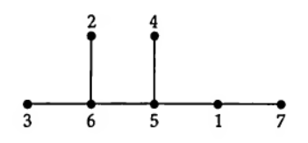
Example
Step1
Identify vertices of degree 1 and select the one with the smallest label.
Step 2
Put the label of the vertex adjacent to the vertex of Step 1 in the next position in the Prüfer sequence.
(6,?,?,?,?)
Step 3
Remove the chosen vertex from Step 1 and its incident edge, resulting in a smaller tree.

Slide 28
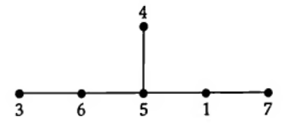
Example
Step1
Identify vertices of degree 1 and select the one with the smallest label.
Step 2
Put the label of the vertex adjacent to the vertex of Step 1 in the next position in the Prüfer sequence.
(6,6,?,?,?)
Step 3
Remove the chosen vertex from Step 1 and its incident edge, resulting in a smaller tree.

Slide 29
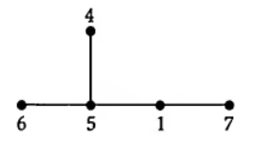
Example
Step1
Identify vertices of degree 1 and select the one with the smallest label.
Step 2
Put the label of the vertex adjacent to the vertex of Step 1 in the next position in the Prüfer sequence.
(6,6,5,?,?)
Step 3
Remove the chosen vertex from Step 1 and its incident edge, resulting in a smaller tree.

Slide 30

Example
Step1
Identify vertices of degree 1 and select the one with the smallest label.
Step 2
Put the label of the vertex adjacent to the vertex of Step 1 in the next position in the Prüfer sequence.
(6,6,5,5,?)
Step 3
Remove the chosen vertex from Step 1 and its incident edge, resulting in a smaller tree.

Slide 31
Example
Step1
Identify vertices of degree 1 and select the one with the smallest label.
Step 2
Put the label of the vertex adjacent to the vertex of Step 1 in the next position in the Prüfer sequence.
(6,6,5,5,1)
Step 3
Remove the chosen vertex from Step 1 and its incident edge, resulting in a smaller tree.

Slide 32
Example
Stop
The process ends when only two vertices remain.
The resulting Prüfer sequence has now been constructed.
(6,6,5,5,1)

Slide 33
Example
(6,6,5,5,1)

Slide 34
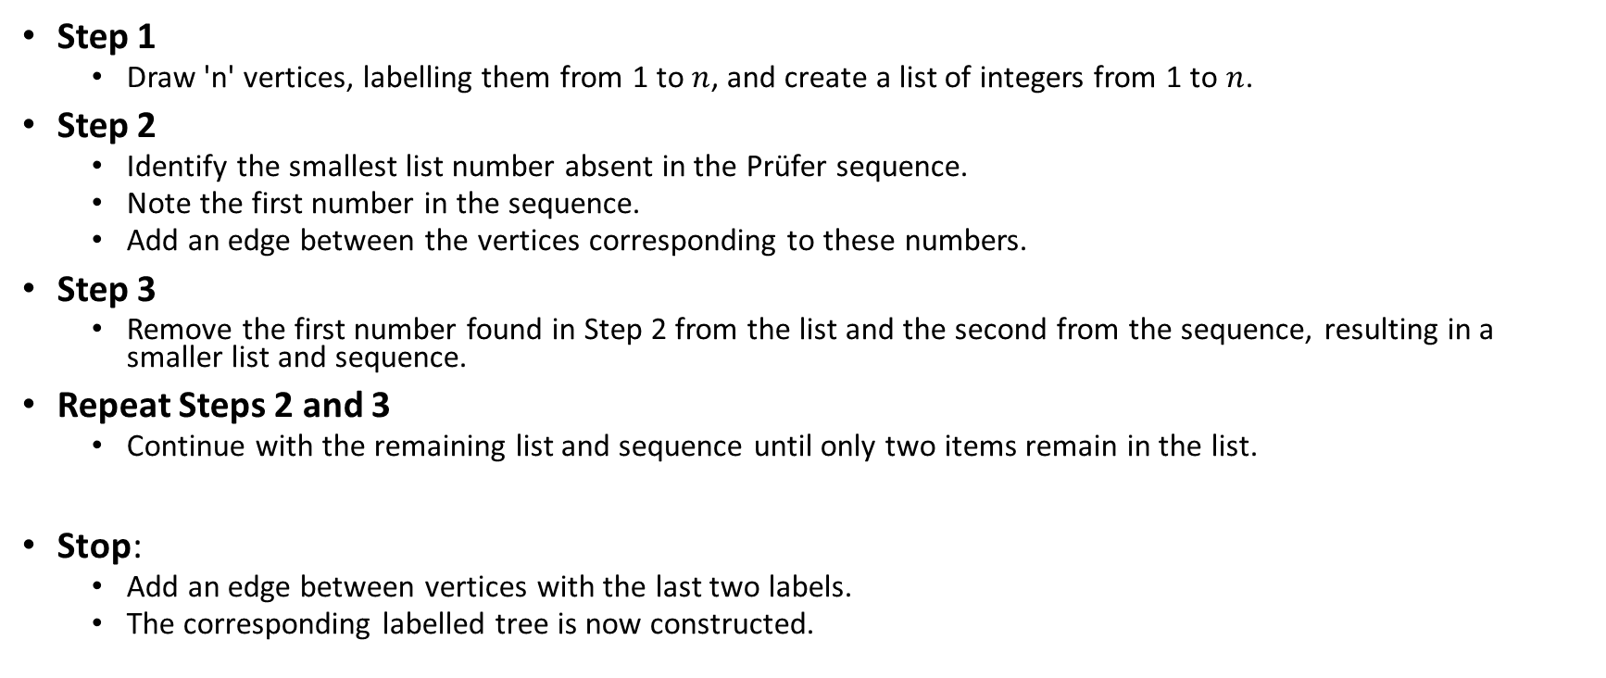
Constructing a Labeled Tree from a Prüfer Sequence
Step 1
Draw 'n' vertices, labelling them from 1 to $n$, and create a list of integers from 1 to $n$.
Step 2
Identify the smallest list number absent in the Prüfer sequence.
Note the first number in the sequence.
Add an edge between the vertices corresponding to these numbers.
Step 3
Remove the first number found in Step 2 from the list and the second from the sequence, resulting in a smaller list and sequence.
Repeat Steps 2 and 3
Continue with the remaining list and sequence until only two items remain in the list.
Stop:
Add an edge between vertices with the last two labels.
The corresponding labelled tree is now constructed.

Slide 35
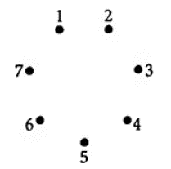
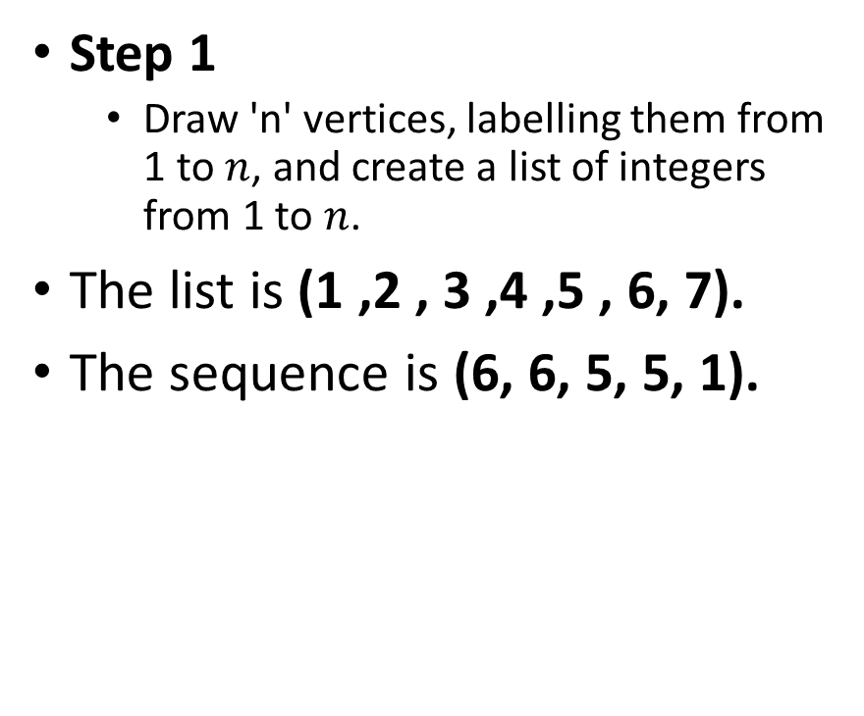
Example
Step 1
Draw 'n' vertices, labelling them from 1 to $n$, and create a list of integers from 1 to $n$.
The list is (1 ,2 , 3 ,4 ,5 , 6, 7).
The sequence is (6, 6, 5, 5, 1).

Slide 36
Example
Step 1
The list is (1 , 2 , 3 ,4 ,5 , 6, 7).
The sequence is (6, 6, 5, 5, 1).
Step 2
The smallest list number absent in the Prüfer sequence is 2.
The first number in the sequence is 6.
Add an edge between the vertices 2 and 6.
Step 3
Remove the first number found in Step 2 from the list and the second from the sequence, resulting in a smaller list and sequence.

Slide 37
Example
Step 1
The list is (1 ,3 , 4 ,5 , 6, 7).
The sequence is (6, 5, 5, 1).
Step 2
The smallest list number absent in the Prüfer sequence is 3.
The first number in the sequence is 6.
Add an edge between the vertices 3 and 6.
Step 3
Remove the first number found in Step 2 from the list and the second from the sequence, resulting in a smaller list and sequence.

Slide 38
Example
Step 1
The list is (1 , 4 ,5 , 6, 7).
The sequence is (5, 5, 1).
Step 2
The smallest list number absent in the Prüfer sequence is 4.
The first number in the sequence is 5.
Add an edge between the vertices 4 and 5.
Step 3
Remove the first number found in Step 2 from the list and the second from the sequence, resulting in a smaller list and sequence.

Slide 39
Example
Step 1
The list is (1 ,5 , 6, 7).
The sequence is (5, 1).
Step 2
The smallest list number absent in the Prüfer sequence is 6.
The first number in the sequence is 5.
Add an edge between the vertices 6 and 5.
Step 3
Remove the first number found in Step 2 from the list and the second from the sequence, resulting in a smaller list and sequence.

Slide 40
Example
Step 1
The list is (1 , 5, 7).
The sequence is (1).
Step 2
The smallest list number absent in the Prüfer sequence is 5.
The first number in the sequence is 1.
Add an edge between the vertices 5 and 1.
Step 3
Remove the first number found in Step 2 from the list and the second from the sequence, resulting in a smaller list and sequence.

Slide 41
Example
The list is (1 , 7).
The sequence is (1).
.
Stop:
Add an edge between vertices with the last two labels.
The corresponding labelled tree is now constructed.

Slide 42
Example
(6,6,5,5,1)

Slide 43

Enumerating Prüfer sequence
Prüfer sequences$\left(a_{1},a_{2},a_{3}…, a_{n−2}\right),$
$a_{i}$ is one of the integers $1, 2, 3, …, n$(allowing repetition)
$n×n×n$ $×$ … $×n$ ($n−2$ times)
$n^{n−2}$

Slide 44
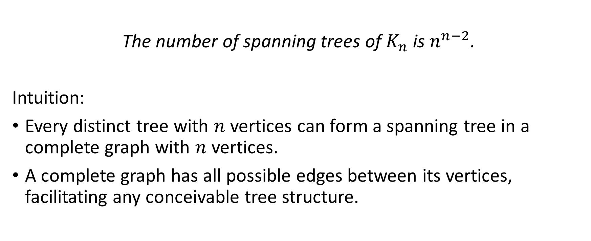
COROLLARY 1: Spanning Trees in Complete Graphs
The number of spanning trees of $K_{n}$ is $n^{n−2}$.
Intuition:
Every distinct tree with $n$ vertices can form a spanning tree in a complete graph with $n$ vertices.
A complete graph has all possible edges between its vertices, facilitating any conceivable tree structure.

Slide 45
Conclusion
Trees are fundamental structures, having the minimum required edges for connectivity.
Removing any single edge disrupts the tree's connectivity.
Adding an edge creates a cycle, transitioning the tree into a cyclic graph.
Graph enumeration can be complex due to diverse configurations.
Labelling vertices simplifies the problem, making counting labelled trees easier.
Counting labelling trees is solved by Cayley's formula:

Slide 46
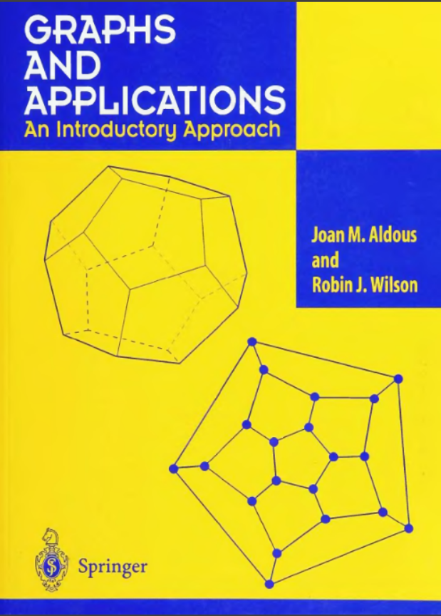
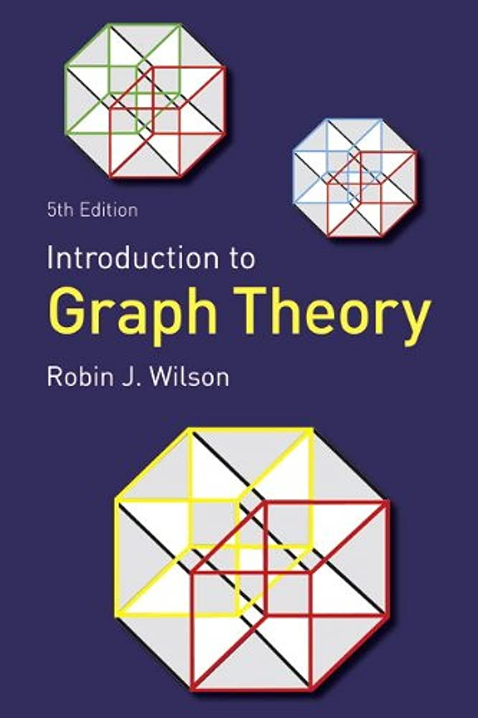
References

