Slide 1
San Francisco Salary Analysis 2011 - 2014
Present by Lina Ma

Slide 2
Data Collection and Cleaning
1

Slide 3
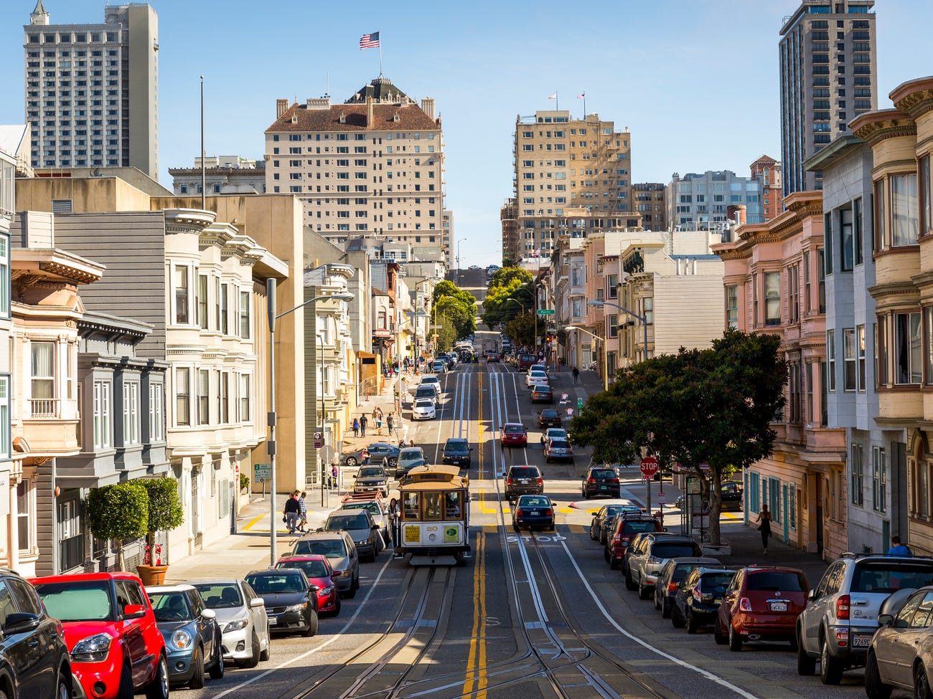
Data Sources
https://www.kaggle.com/kaggle/sf-salaries
https://transparentcalifornia.com/salaries/all/
I’ve collected data from 2 websites, Kaggle and Transparent California, I use the data from Transparent California to verify the accuracy of the data from Kaggle.

Slide 4
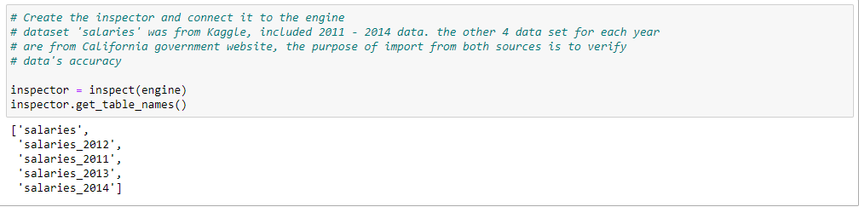
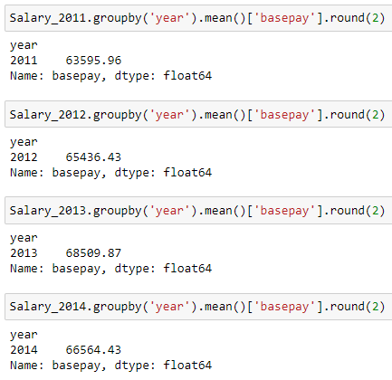
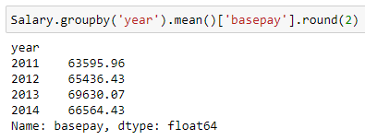
Data Compare and Clean up
From Kaggle:
From Transparent California:
After the comparison, the data from Kaggle and Transparent California give the same results, from here, the data analysis and virtualization will be based on Kaggle’s dataset.

Slide 5
Data Analysis
2

Slide 6
Questions we will cover:
Analysis via SQL
How much San Francisco’s major get paid?
What are the salaries for chief job levels?
What are the salaries for senior job levels?
What are the salaries for junior job levels?
What are the salaries for assistants type of jobs?
What are the average salaries by employees?
What are the average salaries by job titles?
Are there any jobs are data related?
Analysis via Jupyter
How many employees earn over $100,000 annually and what are their job titles?
How many employees earn less than $100,000 annually and what are their job titles?
Who are top 10 employees who switched jobs the most in 4 years?
What are the average pay for fulltime employee vs parttime employees?

Slide 7
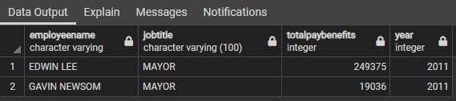
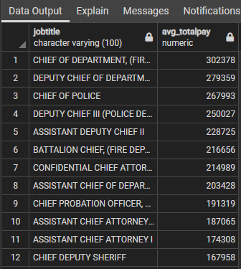
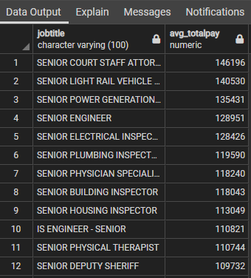
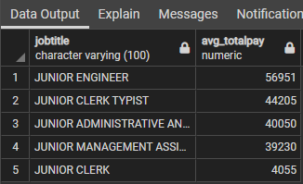
Analysis via SQL Results
How much San Francisco’s major get paid?
What are the salaries for chief job levels?
What are the salaries for senior job levels?
What are the salaries for junior job levels?

Slide 8
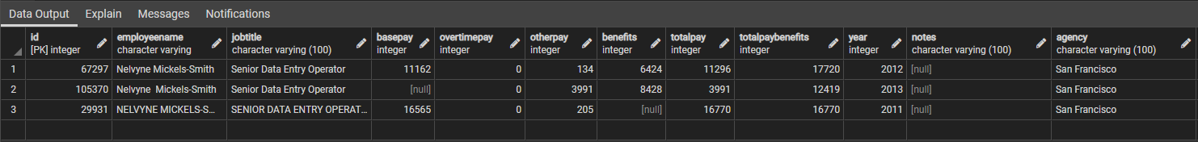
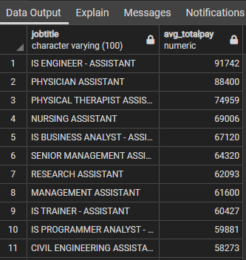
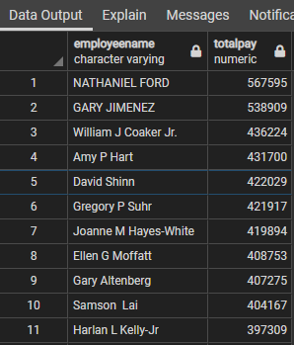
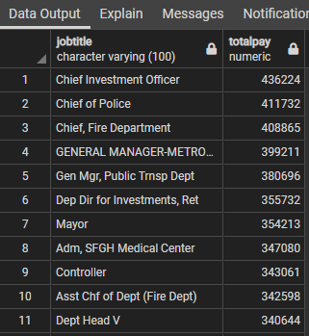
Analysis via SQL Results
Are there any jobs are data related?
What are the salaries for assistants type of jobs?
What are the average salaries by employees?
What are the average salaries by job titles?

Slide 9
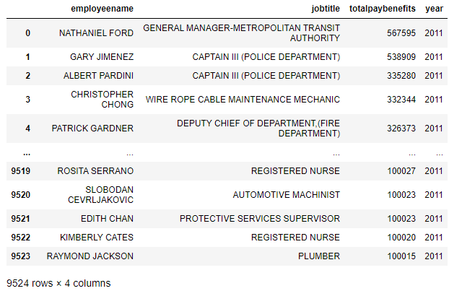
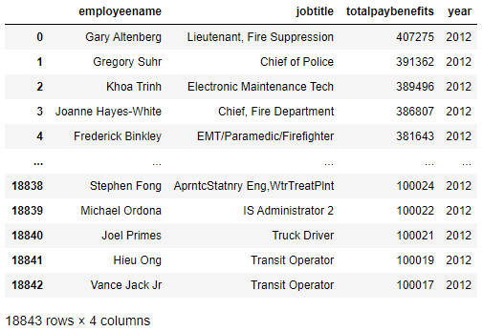
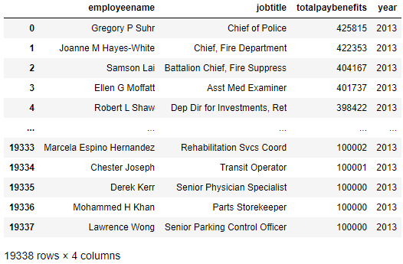
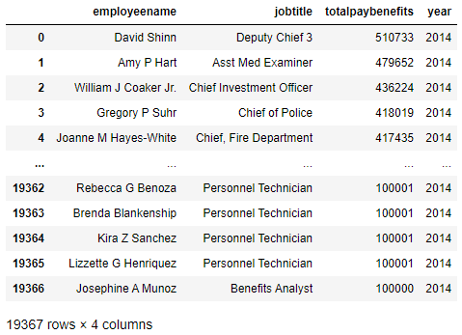
Analysis via Jupyter Results
How many employees earn over $100,000 annually and what are their job titles?

Slide 10
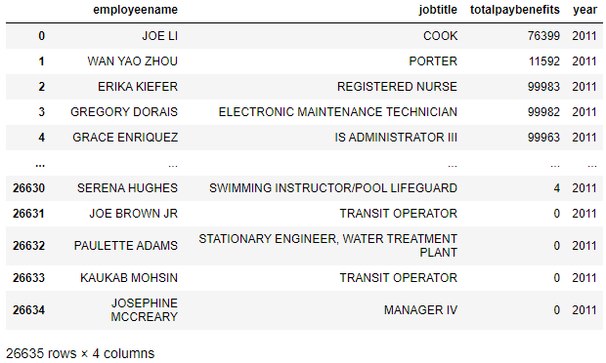
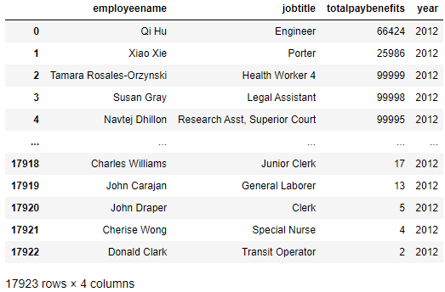
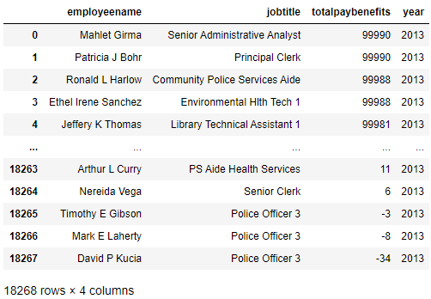
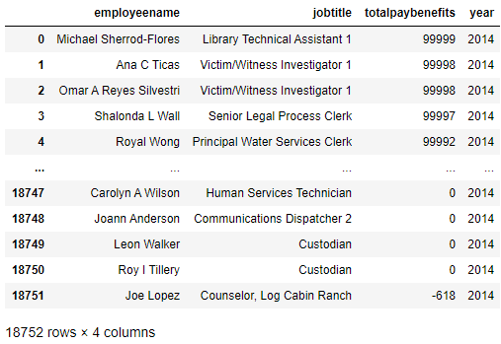
Analysis via Jupyter Results
How many employees earn less than $100,000 annually and what are their job titles?

Slide 11

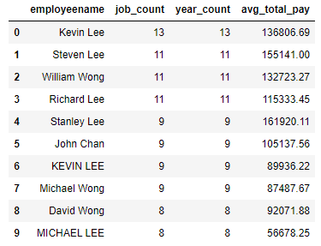

Analysis via Jupyter Results
Who are top 10 employees who switched jobs the most in 4 years?
What are the average pay for fulltime employee vs parttime employees?

Slide 12
Data Visualization
3

Slide 13
Questions we will cover:
What is the average salary with benefits by year? Show it in a DataFrame and a line chart
What are the top 10 job titles that have the highest salary?
Which 10 employees have the highest average pay in SF?
What are the top 10 most needed jobs in City of San Francisco

Slide 14
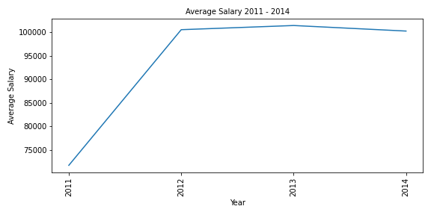
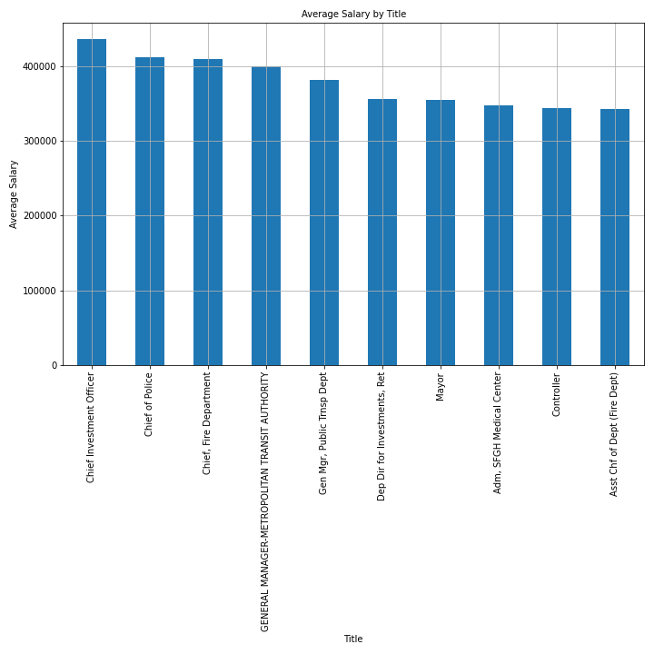
Visualization via Jupyter Results
What is the average salary with benefits by year? Show it in a DataFrame and a line chart
What are the top 10 job titles that have the highest salary?

Slide 15
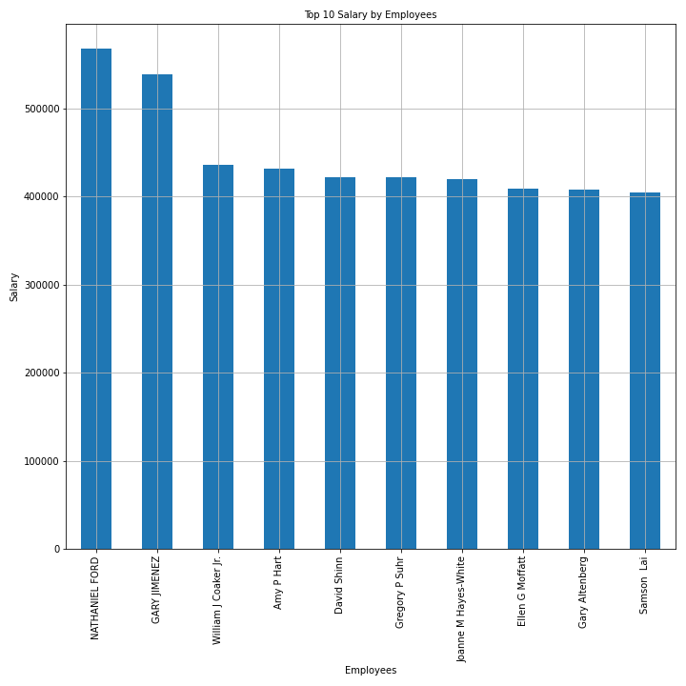
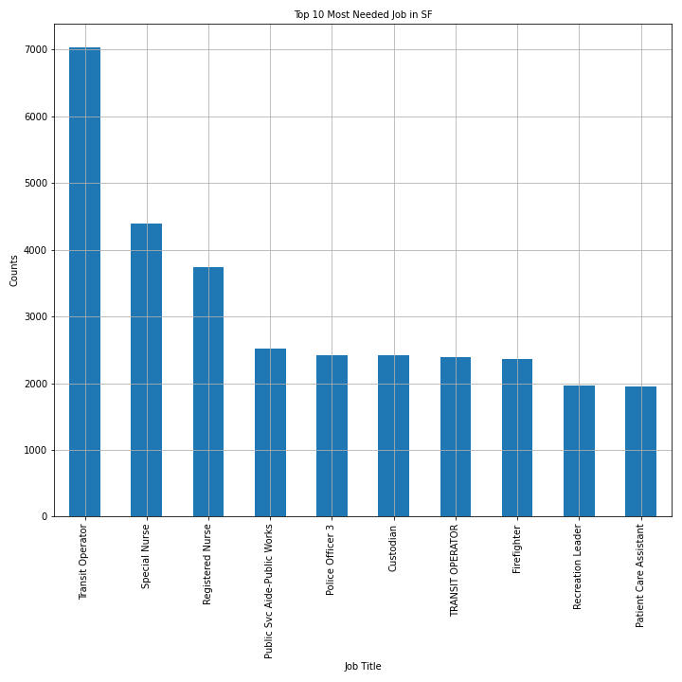
Visualization via Jupyter Results
Which 10 employees have the highest average pay in SF?
What are the top 10 most needed jobs in City of San Francisco

Slide 16
Conclusion

Slide 17
In the same year, there are 2 majors in San Francisco, one major was paid 10 times more than the other, it may be a data error, or the job titles were not accurate. Also, there are maybe missing data because no data about major’s salary from 2012 – 2014.
158 out of 205 chief level positions get paid more than $100K annually, the average pay is $152K
Only 19% of the senior level positions get paid more than $100K annually, the average pay is $72K
No Junior level position get paid more than $100K, the average pay is $23K
Almost 1% assistants work for city of SF paid more than $100K, the average pay is 53K
Highest paid employee’s salary is $537K, Highest paid job title is Chief Investment Officer, the salary is $436K
Data related jobs are all data entry type of work, no data analysis/science
Benefits made big part of the total pay, after comparing the high pay (over 100K) of every year, due to 2011 data missing benefits data, the number of high paid positions is only 40% compare to 2012 – 2014
There may some duplicate data with same employee name, but different positions, 4-5 employees switched more than 10 jobs in 4 years, seems like an error
The most needed jobs are: Transit Operator, Special/Registered Nurses, Police Officer, and Custodian, etc.

Slide 18
Thanks!

