Slide 1

World Happiness Data Analysis
Present by Lina Ma

Slide 2
Data came from the Gallup World Poll. The rankings are based on answers to the main life evaluation question asked in the poll. It is called the Cantril ladder: it asks respondents to think of a ladder, with the best possible life for them being a 10, and the worst possible life being a 0. The typical annual sample is 1,000 people. If a country had surveys in each year, then the sample size would be 3,000 people.
The main purpose of this data analysis is to find out:
What score range have the majority of the countries
The data is from 2015 - 2020, what are the overall trend in past 5 years
What are the top 5 countries having the highest happiness score from 2015 - 2020
What's the correlation between the six factors- levels of GDP, life expectancy, generosity, social support, freedom, and corruption
What's the correlation between the happiness score with each factors
Regression test to see the R square score between 2 factors that are highly related
How many countries are in the survey, and how many regions are these countries belong to
Are all the countries have the same scores?

Slide 3
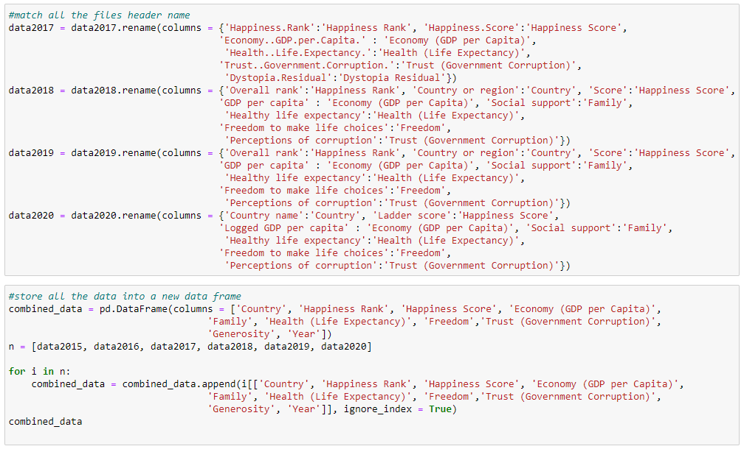
Data Collection and Cleaning
Data Source: https://worldhappiness.report/

Slide 4
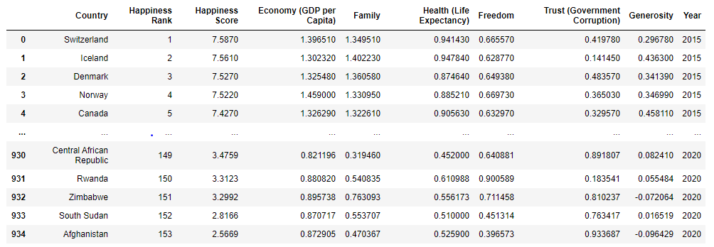

Slide 5
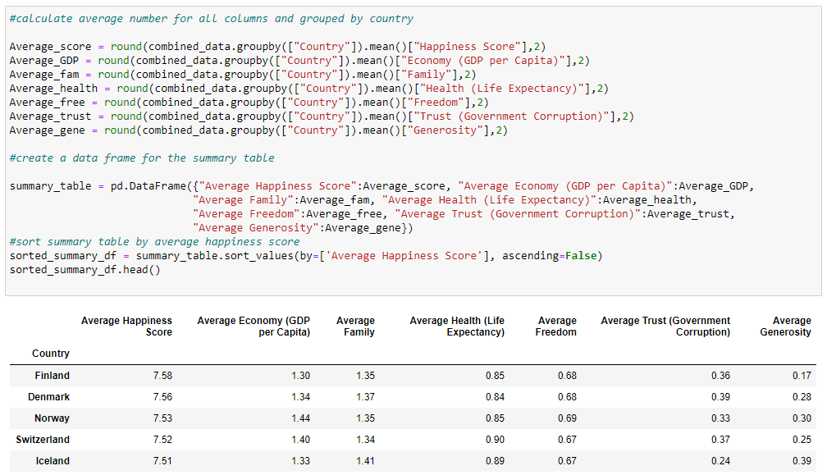
Data Review

Slide 6
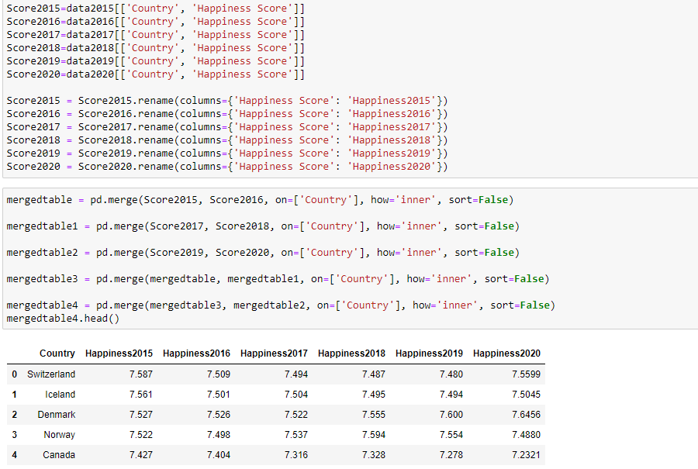

Slide 7
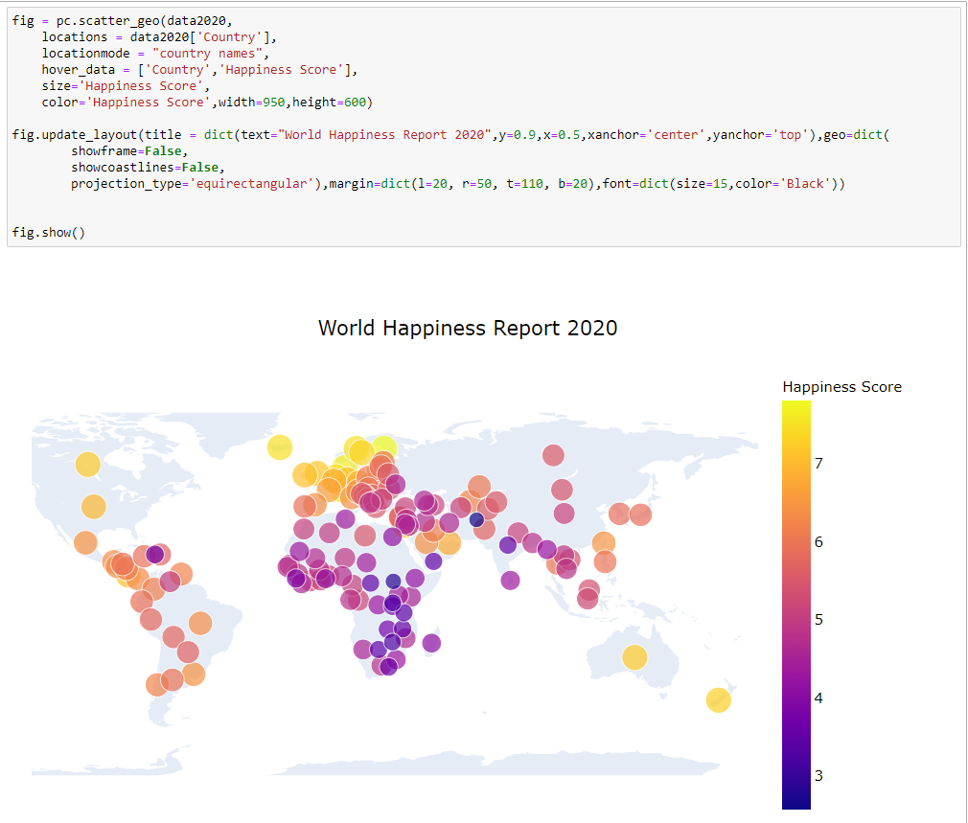
MAP

Slide 8
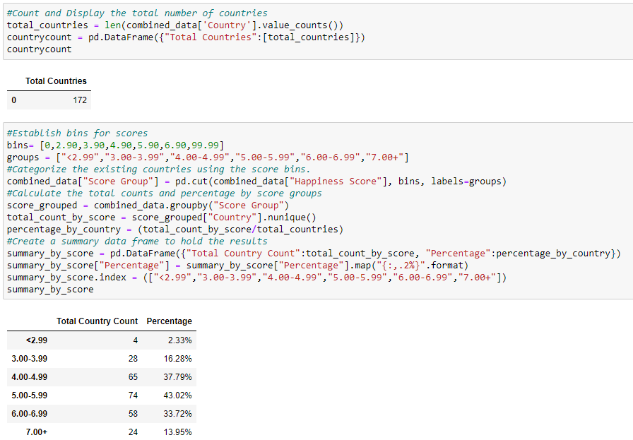
Data Statistics

Slide 9
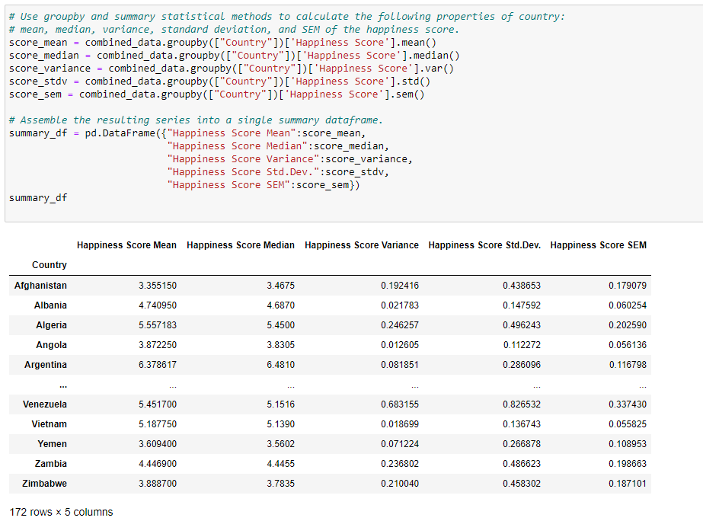

Slide 10
Data Visualization

Slide 11
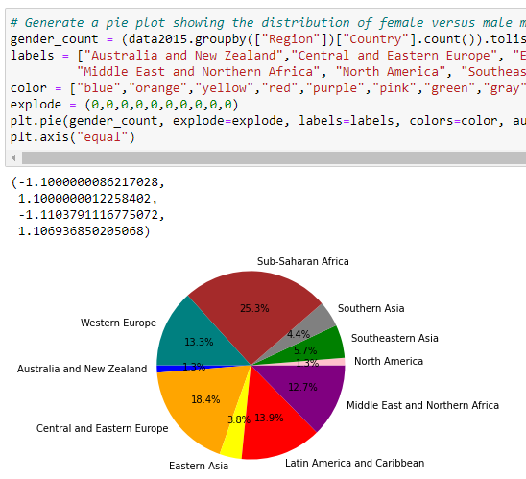
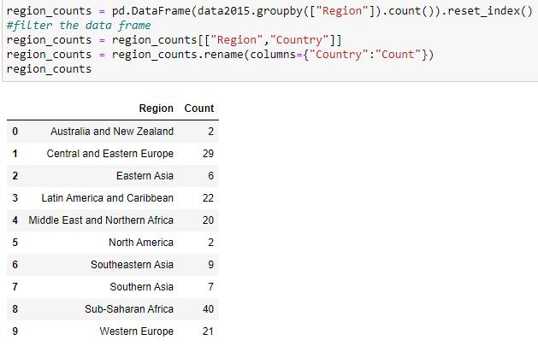

Slide 12
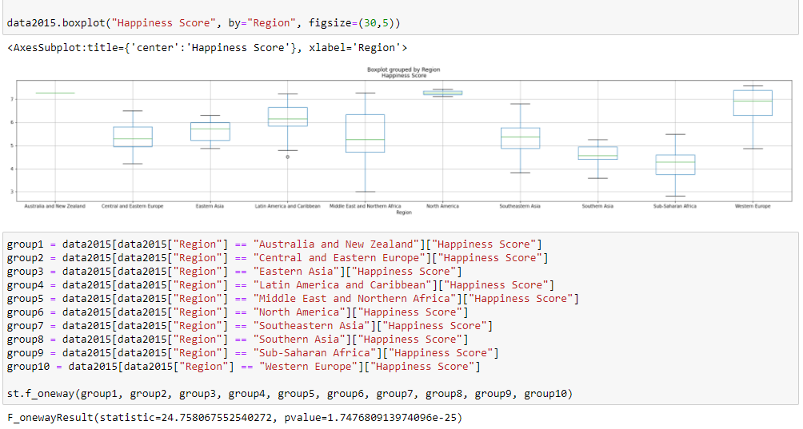

Slide 13
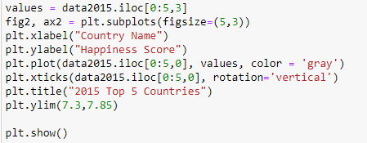
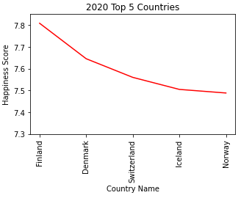
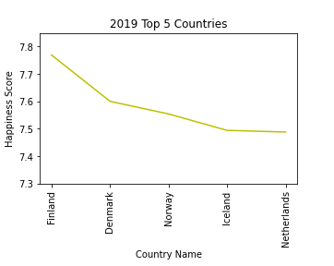
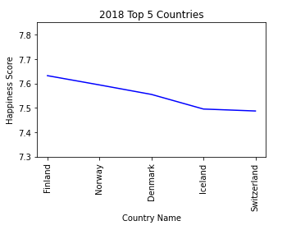
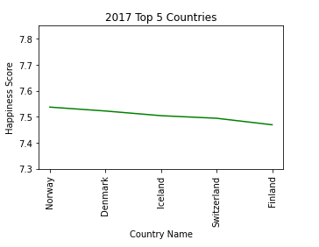
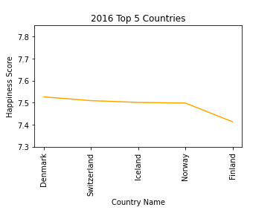
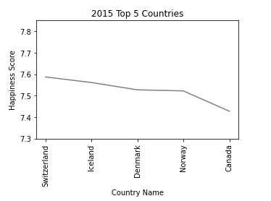

Slide 14
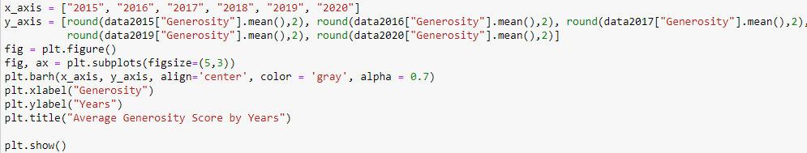
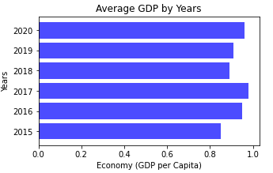
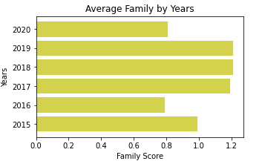
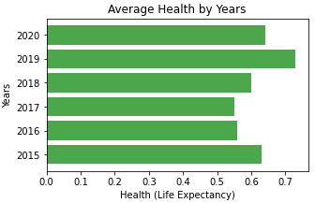
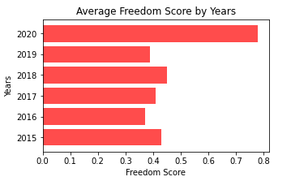
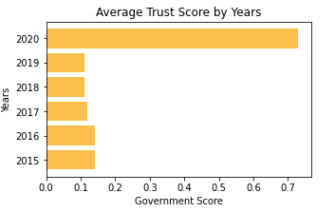
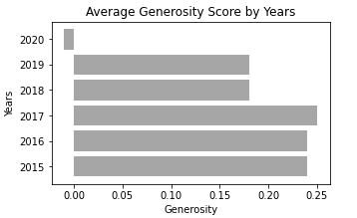

Slide 15
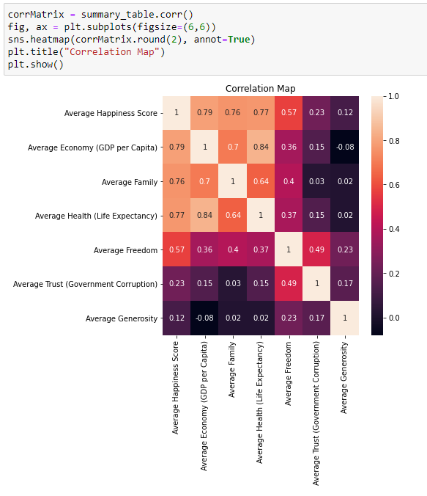
Correlations Matrix

Slide 16
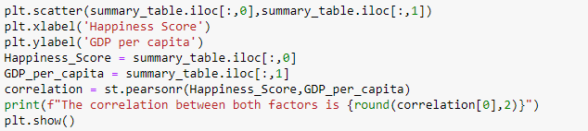
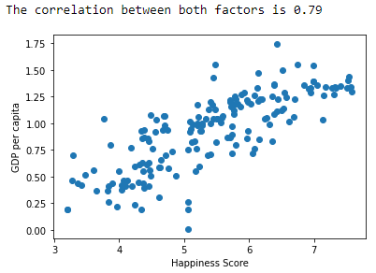
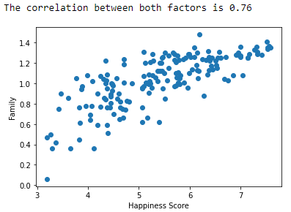
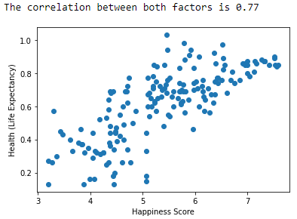
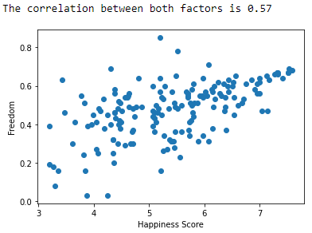
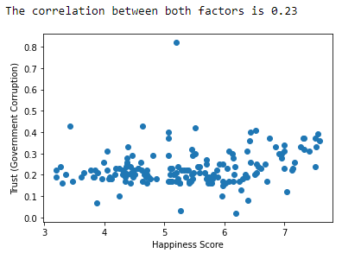
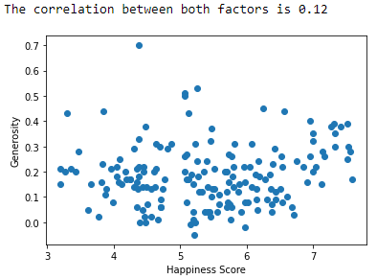

Slide 17
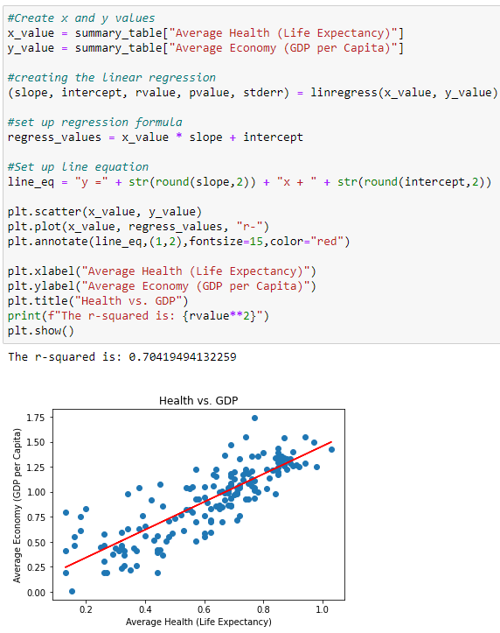
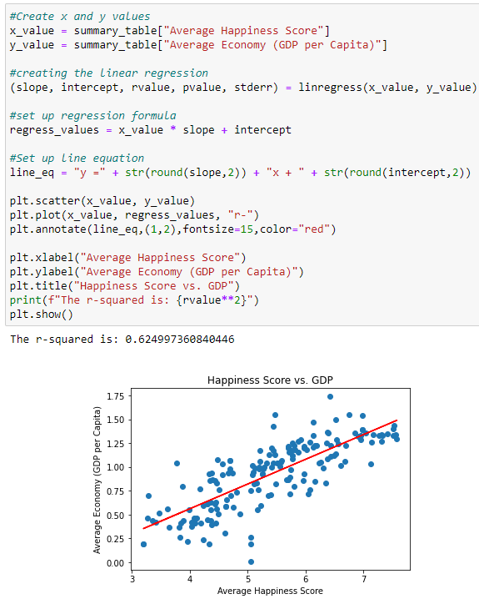
Regression test

Slide 18
Conclusions
The majority (43%) of the countries fall into 5-5.99 score group.
Overall trend from 2015 – 2020, the score was going up.
Denmark, Norway, Swizerland, Iceland made it to the top 5 list every year from 2015 – 2020.
Economy (GDP) is highly related to Health (Life Expectancy).
Overall score is highly related to GDP, Family, Health, has small relation to Government Corruption and Generosity.
All 10 regions have different overall scores

Slide 19
Thanks!
😒
😉
😋
😂
😸
😭
Any questions?
🎃

