Slide 1

Shaml+
A User-Centered
Digital System for
External Child Visits
Graduation Project Defense | HCI3502T
Umm Al-Qura University - College of Computing
BSc in Human-Computer Interaction
Team Members
Sham Khalid Aldossari, Hajar Abdulaziz Alharthi, Lina Abdullah Alasmari, Eshraq Osama Faqeha

Slide 2
OPENING
Storyline & Time Plan
Project Context
Research & Analysis
Design Solution
Evaluation
Conclusion
Problem, motivation, users
Current state, findings, personas
Architecture, apps, dashboard
Usability testing and iteration
Results, limitations, future work
01
02
03
04
05
Shaml+ | Graduation Project
2

Slide 3


01
Project Context
Why Shaml+ matters and what problem it solves

Slide 4
CONTEXT
Project Overview
Core idea
Main goal
Product scope
A connected digital ecosystem for managing external child visits in separated-family cases.
Reduce confusion, repeated follow-up, emotional stress, and administrative fragmentation.
Parent app, child app, admin dashboard, smartwatch interface, and unified design system.
Parents
Child
Request, confirm, track, communicate
Prepare emotionally, understand visit
Shaml+
Ecosystem
Admin / Staff
Smartwatch
Manage visits, requests, data
Quick reminder, mood check, help
Shaml+ | Graduation Project
4

Slide 5
CONTEXT
Problem & Motivation
Current external visitation is more than an appointment. It is a sensitive family experience that needs coordination, privacy, emotional readiness, and reliable status visibility.
Fragmented channels
Unclear visit status
Najiz, Excel/cloud files, calls, messages, and manual follow-up create repeated work.
Parents may not know if a request is pending, confirmed, changed, or completed.
Child emotional stress
Data & safety risks
Children may feel anxious when plans are unclear or preparation is weak.
Similar names, unclear judgment times, missing health or medication details can affect accuracy and safety.
Design challenge
How can we make a legal/social-service workflow feel clear, safe, and emotionally supportive without exposing sensitive family information?
Shaml+ | Graduation Project
5

Slide 6
CONTEXT
Target Users & Main Needs
Parents
Children
Admins / Supervisors
Clear visit information, status transparency, safe communication, reminders, and support services.
Simple language, emotional reassurance, visit preparation, rewards, and child-friendly guidance.
Fast overview, accurate case details, controlled actions, searchable records, and reliable notifications.
Trust & privacy
Status clarity
Child readiness
Operational accuracy
The solution must serve all roles without treating the child as only a passive part of the process.
Shaml+ | Graduation Project
6

Slide 7
02
Research & Current-State Analysis
Evidence used to define the design direction

Slide 8
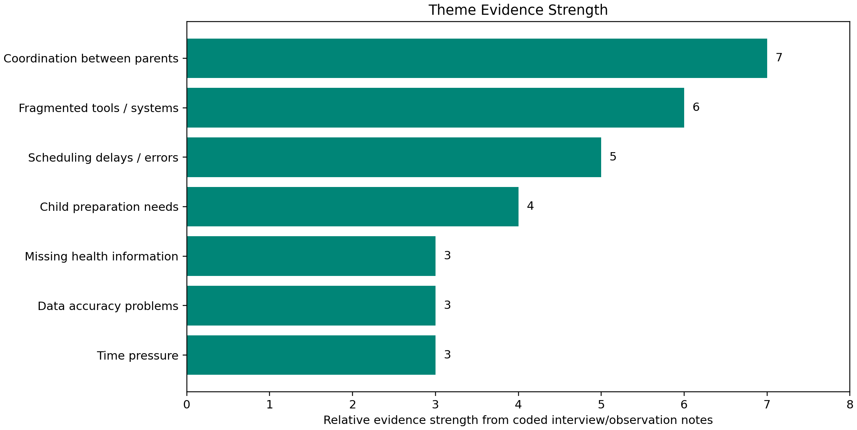
RESEARCH
Research Evidence & Study Boundaries
Field evidence
Document evidence
Comparative review
One semi-structured interview with a Shaml-related social worker / family visit coordinator.
Al-Mawaddah Impact Story 2024 and Shaml Center service indicators.
Existing service and appointment platforms used to identify UX gaps.
The research is transparent: parents and children were not directly interviewed in this phase.
Personas are inferred design representations, not direct participants.
Findings are preliminary and should be validated with more staff and parent participants.
Theme evidence helped translate qualitative findings into requirements, not claim statistical saturation.
Shaml+ | Graduation Project
8

Slide 9
RESEARCH
Current Journey: Where the Friction Happens
Judgment received
Case notification
Case study
Scheduling
Coordination
Visit execution
Follow-up
Uncertainty
Pressure
Concern
Stress
Tension
Risk
Frustration
Main insight
Emotional dimension
Opportunity
The problem is not only scheduling; it includes parent conflict, child preparation, missing safety information, and data accuracy.
The journey must reduce pressure and uncertainty, not only complete a task.
Create one trusted source of information with guided, role-based experiences.
Shaml+ | Graduation Project
9

Slide 10
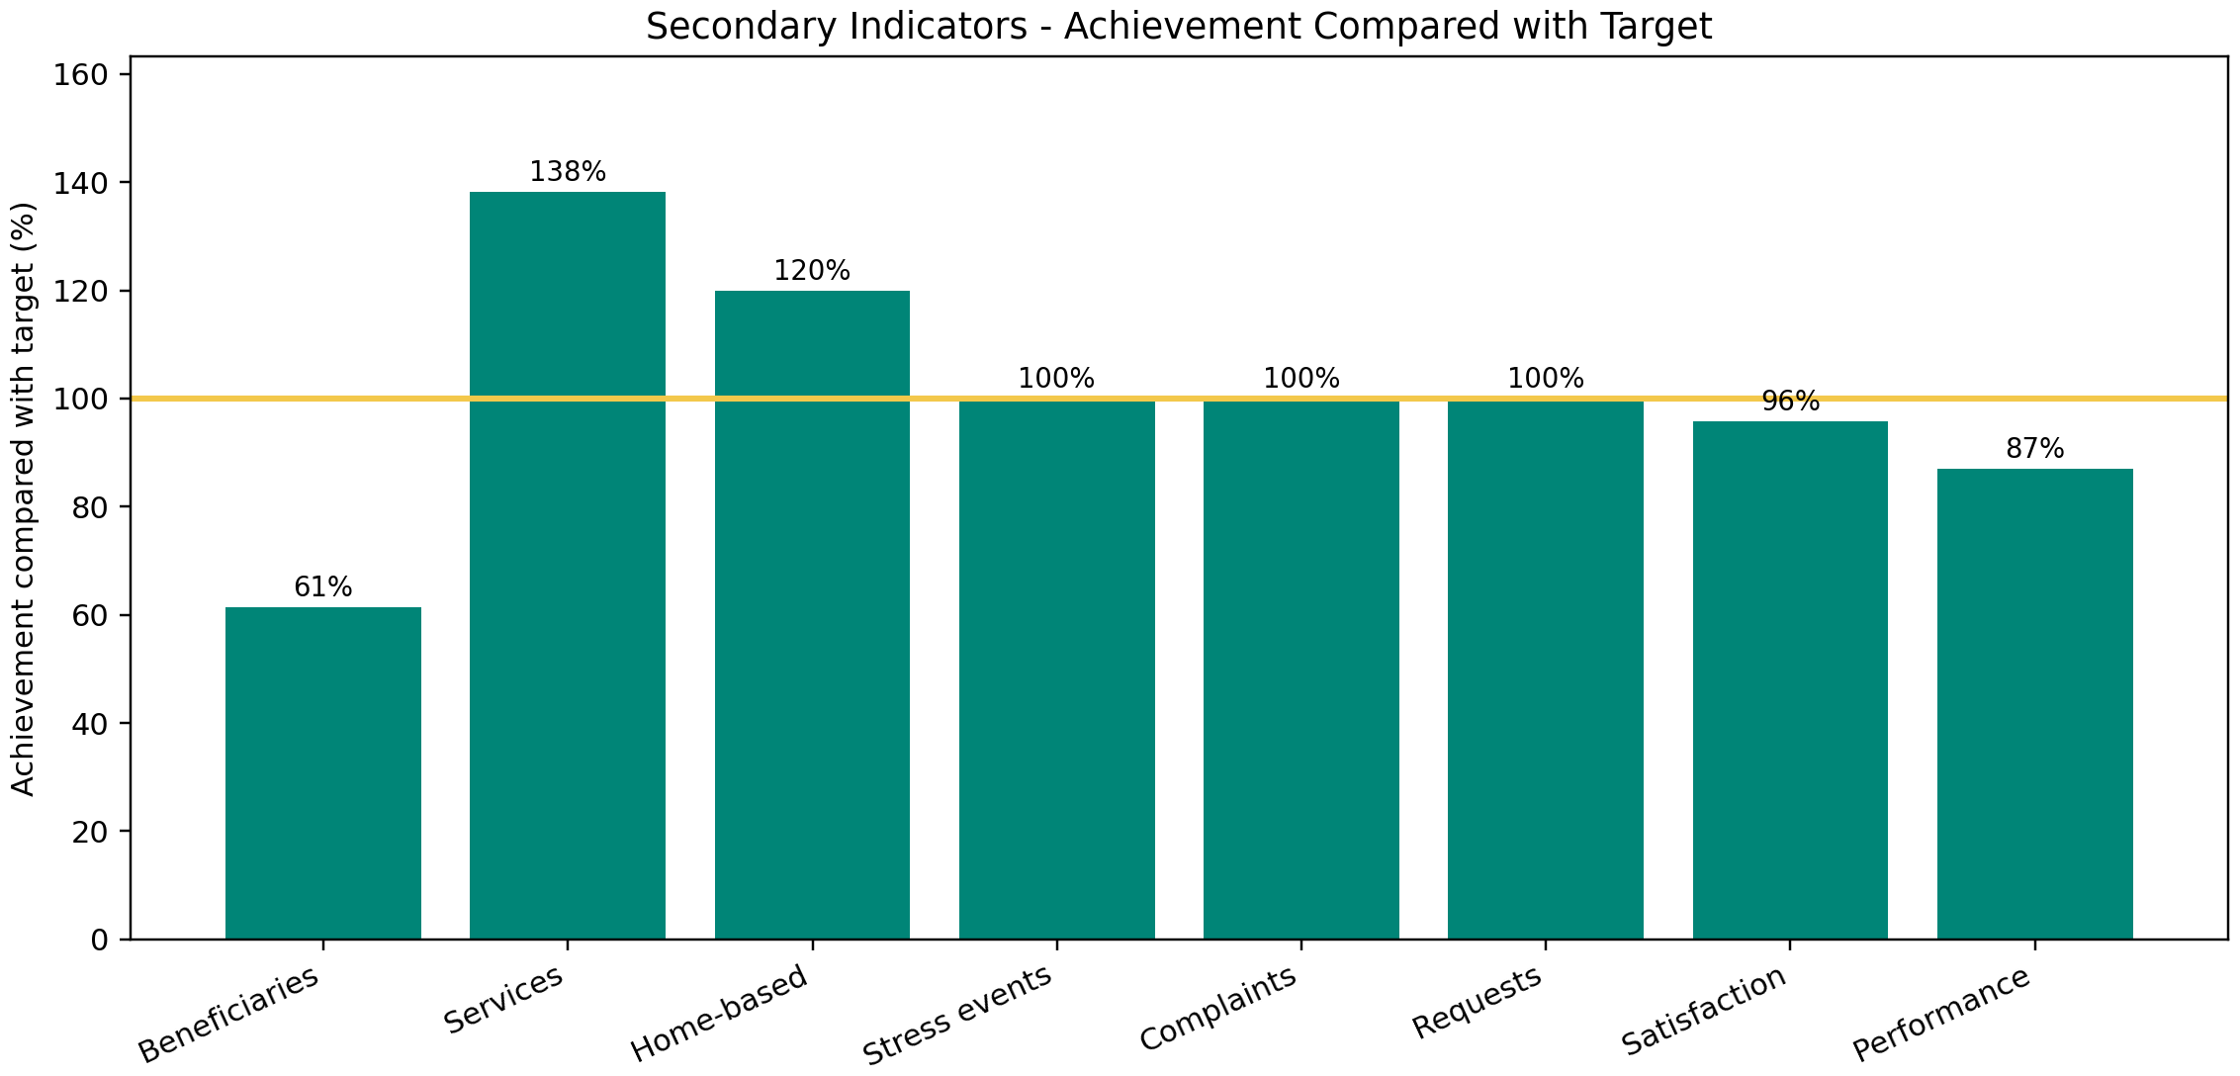
RESEARCH
Secondary Indicators: Why the Service Needs Better Digital Support
16,587 services provided
Services exceeded the target, showing repeated service interactions and the need for organized records.
100% complaint/request response
The system should make response status visible to users, not only handled internally.
67% satisfaction vs 70% target
The service is strong, but UX can improve clarity, tracking, and emotional support.
Secondary quantitative indicators were used as supporting evidence, not project survey results.
Shaml+ | Graduation Project
10

Slide 11
RESEARCH
Persona-Driven Design Decisions
Sara - Mother / caregiver
Khalid - Father / co-parent
Needs confirmation, reminders, safe communication
Needs simple scheduling and transparent rules
Omar - Child / indirect user
Maha - Staff / coordinator
Needs predictability, calm preparation, simple language
Needs dashboard, case IDs, validation, activity logs
Personas are used as design representations derived from research evidence, not as direct interview participants.
Shaml+ | Graduation Project
11

Slide 12
03
Design Solution
How Shaml+ translates research into a multi-platform system

Slide 13
SOLUTION
Proposed Solution: One Coordinated Ecosystem
Parent App
Child App
Request visit, track status, messages, services
Preparation, feelings, rewards, guidance
Shaml+
Unified Flow
Admin Dashboard
Smartwatch
Manage visits, cases, reports, notifications
Reminder, mood check, quick help
Shared functions: case IDs • status chips • notifications • health notes • activity logs • role-based visibility
Shaml+ | Graduation Project
13

Slide 14
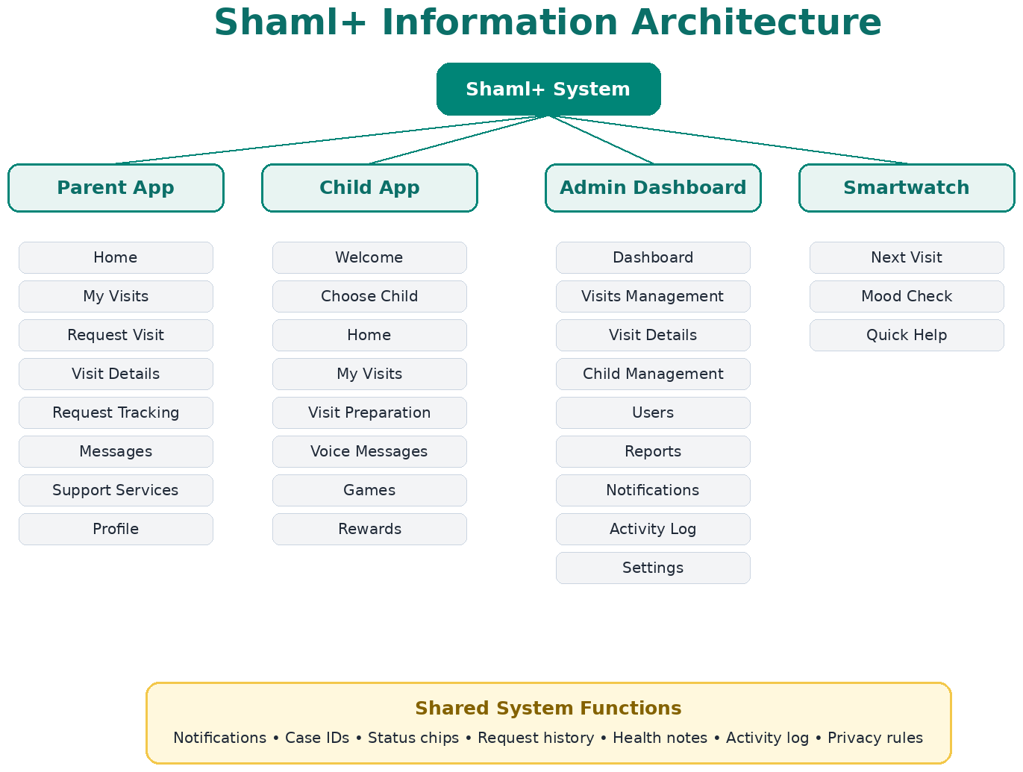
SOLUTION
Information Architecture
The IA organizes three connected experiences plus shared system functions, instead of treating the prototype as separate screens.
Shaml+ | Graduation Project
14

Slide 15
SOLUTION
Design System & Color Rationale
Teal
Gold
White / Gray
Represents trust, safety, official service identity, and calm guidance.
Adds warmth, optimism, family support, and human reassurance.
Keeps the interface clean, readable, and low-stress for sensitive situations.
Trust
Warmth
Clarity
Calm background
Rounded cards reduce visual sharpness and support a friendly tone.
Status chips and clear labels improve visibility of system status.
Consistent navigation across roles lowers cognitive load.
Child screens use friendly visuals, rewards, and simple interaction cues.
Shaml+ | Graduation Project
15

Slide 16
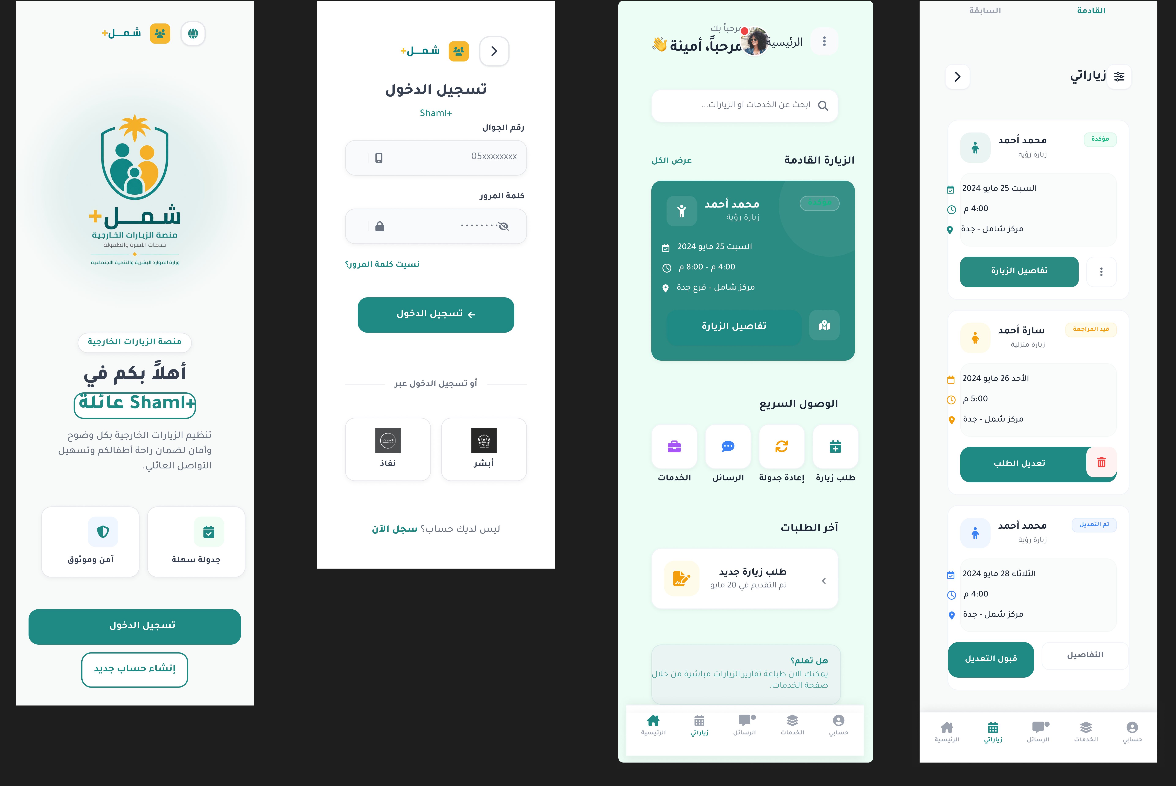
SOLUTION
Parent Mobile App: Clear Visit Management
Main tasks
Login, home, my visits, request visit, visit details, request tracking, messages, notifications, services, profile.
UX value
Parents can see what happens next instead of relying on repeated calls and messages.
Sensitive communication
Private messaging, status explanations, and confirmation cards reduce uncertainty and direct conflict.
Open Figma
Shaml+ | Graduation Project
16

Slide 17
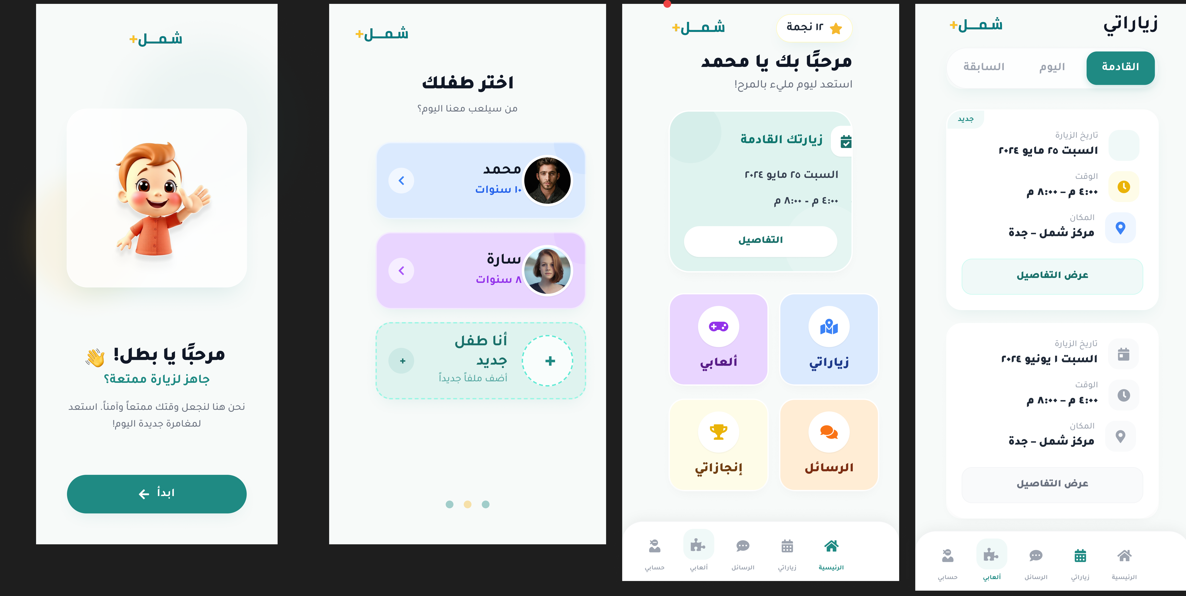
SOLUTION
Child Mobile App: Emotional Preparation
Design intent
Make the visit more predictable, less stressful, and easier to understand for the child.
Key features
Welcome flow, profile selection, upcoming visit, preparation, emotions, voice messages, games, achievements.
Usability focus
Use bigger text, simpler emotion wording, clearer clickable items, and motivating rewards.
Open Figma
Shaml+ | Graduation Project
17

Slide 18
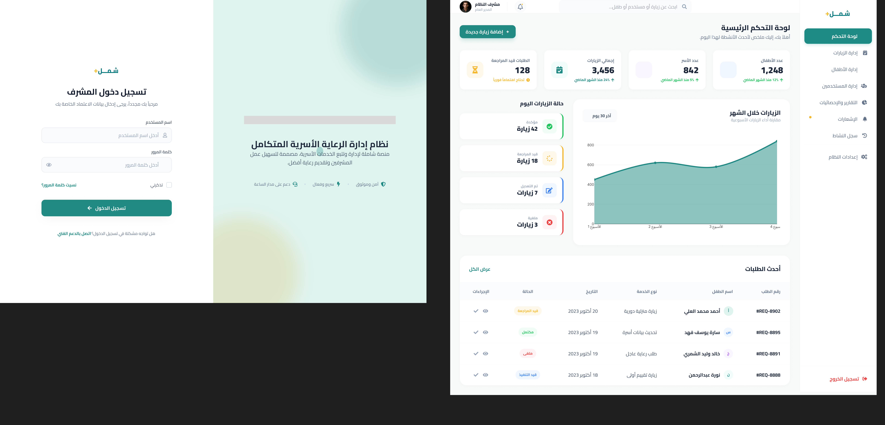
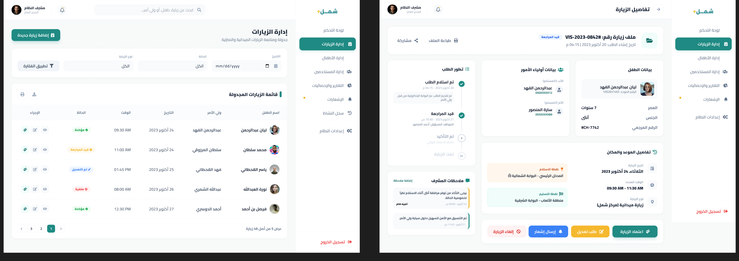
SOLUTION
Admin Dashboard: Operational Control
Main tasks
Dashboard statistics, visit management, visit details, notifications, system pages, search and filtering.
Operational accuracy
Case IDs, status chips, filters, activity logs, and validated details reduce errors and repeated manual work.
Next improvements
Add assigned specialist, visit start/end time, case links, and official holiday settings.
Open Figma
Shaml+ | Graduation Project
18

Slide 19
04
Evaluation & Iteration
How usability testing improved the design direction

Slide 20
EVALUATION
Usability Testing Design
Method
Participants
Scope
Role-based prototype walkthroughs in Figma.
P1/P2 parent perspectives, C1/C2 child perspectives, A1/A2 admin perspectives.
Prototype clarity, task flow, labels, status feedback, and screen comprehension.
Task completion
Clarity
Trust
Friction
Can users complete the role task?
Are buttons, labels, states understood?
Does the interface feel official and safe?
Where do users hesitate or need explanation?
Testing focused on design usability, not final implementation, performance, security, or real back-end integration.
Shaml+ | Graduation Project
21

Slide 21
EVALUATION
Usability Results: What Worked & What Needed Improvement
Repeated improvement themes
Parent app
Successful with minor to moderate clarity issues. Ease ratings: 8/10 and 8.5/10.
Chat destination unclear
Who is in the conversation?
Child app
Status labels need explanation
What happens next?
Successful and suitable for children, with clearer guidance and larger text needed.
Request form feels long
Can it be step-by-step?
Admin dashboard
Child preparation items unclear
Successful for operational use; requested more detail in notifications and visit records.
Clickable or informational?
Admin notifications need details
Start/end time, case link, holidays
Shaml+ | Graduation Project
22

Slide 22
EVALUATION
Iteration 2: Prioritized Improvement Plan
Priority 1
Priority 2
Clarify chat participants, add status explanations, add View Details in notifications.
Split visit request into steps, show available slots, explain child-note sharing.
Priority 3
Priority 4
Increase small text, simplify child emotion wording, add checklist behavior and reward feedback.
Add official admin login, specialist assignment, case links, and holiday settings.
The main improvement direction is not a full redesign; it is stronger microcopy, clearer states, and more complete operational context.
Shaml+ | Graduation Project
23

Slide 23
05
HCI Principles, Ethics & Impact
Why the design is appropriate for a sensitive family-service context

Slide 24
HCI
HCI Principles Applied in Shaml+
Visibility of system status
Match with real world
Error prevention
Visit cards, request tracking, status chips, dashboard statistics.
Simple Arabic wording and familiar appointment patterns.
Case IDs, structured forms, health notes, validation, review steps.
Recognition rather than recall
Consistency
Help & guidance
Reminders, request history, saved details, child profiles.
Repeated cards, navigation, buttons, and status components.
Support services, preparation, instructions, quick help.
Shaml+ | Graduation Project
25

Slide 25
HCI
Ethics, Accessibility & Safety
Ethical safeguards
No private family names, legal case IDs, or identifiable beneficiary details are included.
Children are represented indirectly in the research phase to avoid unnecessary emotional exposure.
Privacy-aware microcopy explains who can see messages, notes, and visit details.
Design avoids dark patterns and persuasive pressure in sensitive decisions.
Accessibility responses
Simple wording for stressed users.
Larger text and clearer cues for children.
Calm colors and low visual noise.
Role-based visibility and activity logs for accountability.
Important principle
In a family-visitation system, usability is also emotional safety: users need clarity, reassurance, and controlled information sharing.
Shaml+ | Graduation Project
26

Slide 26
CONCLUSION
Conclusion: Shaml+ Project Contribution
Unified experience
Child-centered support
Connects parent, child, admin, and smartwatch flows around the same visit lifecycle.
Adds preparation, mood, rewards, and simple guidance instead of focusing only on parent/admin workflows.
Operational clarity
Evidence-based design
Improves status visibility, case tracking, and staff decision support.
Research findings, journey analysis, and usability testing guide each iteration.
Shaml+ turns a fragmented, stressful external visitation process into a guided, role-based digital journey.
Shaml+ | Graduation Project
27

Slide 27

Thank You
Questions & Discussion
Shaml+ - A User-Centered Digital System for External Child Visits

