Slide 1
MercerOS Automated Testing Training
00.1_Software Installation
Dec 01 2017
Webber.ling@mercer.com, Shanghai

Slide 2
Software required
Visual Studio Code or WebStorm
JDK
NodeJS (6.3)
Git (optional)
SourceTree (optional)
AutoIT (optional)
IDE
Platform
Version control
Third-party support
Note: NodeJS has to be version 6.3, others free to use latest version

Slide 3
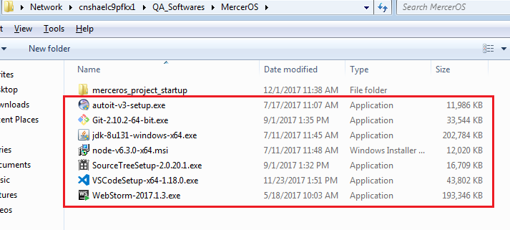
Software required
\\cnshaelc9pfkx1\QA_Softwares\MercerOS
Or
  https://code.visualstudio.com/
  https://www.jetbrains.com/webstorm/
  http://www.oracle.com/technetwork/java/javase/downloads/index.html
  ……

Slide 4

www.mercer.com.au

