Slide 1
MercerOS Automated Testing Training
00.2_Setup Sample Project
Dec 08 2017
Webber.ling@mercer.com, Shanghai

Slide 2
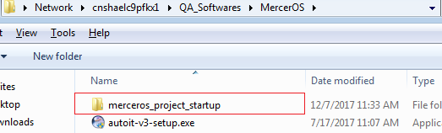
Step – 1: copy the project to local
\\cnshaelc9pfkx1\QA_Softwares\MercerOS\merceros_project_startup

Slide 3
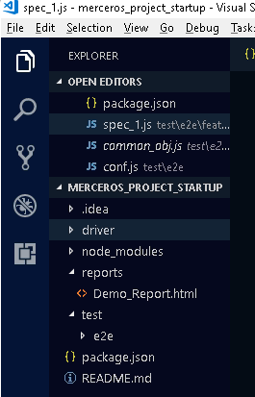
Step – 2: open the project folder in VSCode
VSCode: File -> Open Folder….

Slide 4
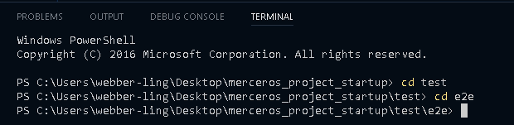
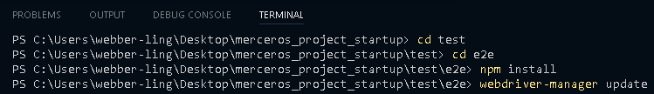
Step – 3: install components
Go to “View -> Integrated Terminal” to launch the terminal window
Run below commands to go into the test/e2e folder
Run npm install and webdriver-manager update to install components

Slide 5

www.mercer.com.au

