Slide 1
MercerOS Automated Testing Training
00.3_AutoIT
Jan 31 2018
Webber.ling@mercer.com, Shanghai

Slide 2
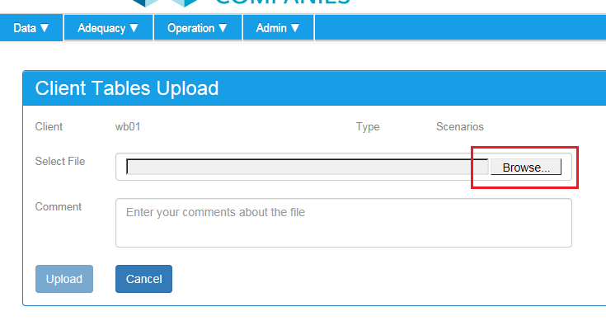
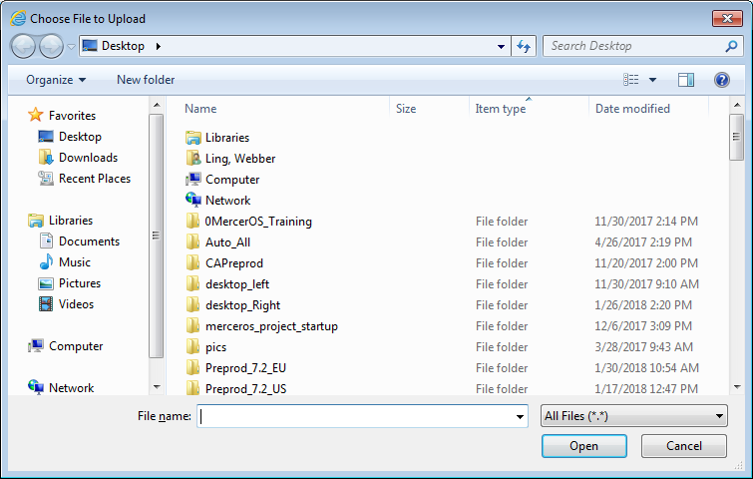
Why need AutoIT & its limitation
To deal with objects that cannot be handled by webdriver
But limited to simple UI operations because of its limited capbility

Slide 3
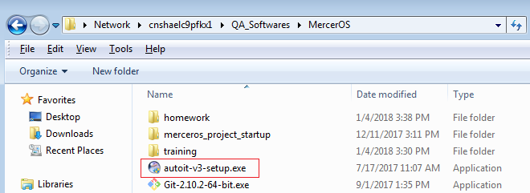
AutoIT installation
\\cnshaelc9pfkx1\QA_Softwares\MercerOS

Slide 4
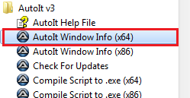
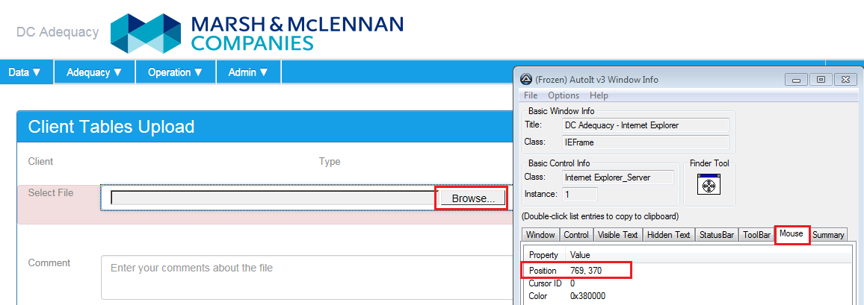
AutoIT Object Identifer

Slide 5

www.mercer.com.au

