Slide 1
MercerOS Automated Testing Training
01_Overview
Dec 01 2017
Webber.ling@mercer.com, Shanghai

Slide 2
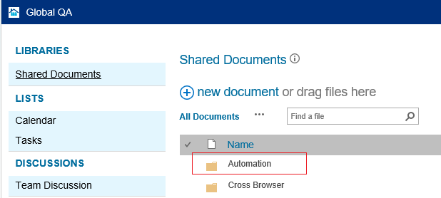
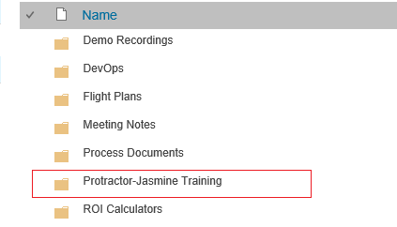
Where to get all the training materials
http://teamsites-west.mercer.com/sites/Global_QA/Shared%20Documents/Forms/AllItems.aspx

Slide 3
Topics
Visual Studio Code basis
Protractor-Jasmine basis
Jasmine syntax
Framework folder structure overview
Conf.js walkthrough
Result & output
Gherkin script introduction

Slide 4
Visual Studio Code basis

Slide 5
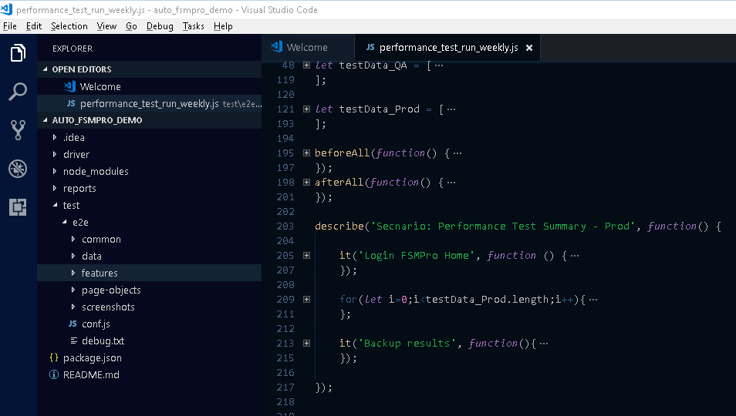
Visual Studio Code

Slide 6
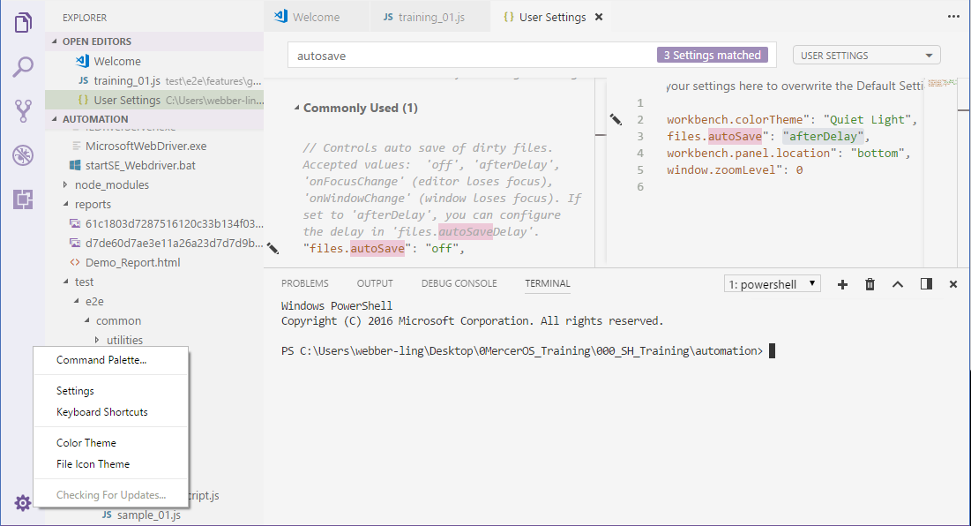
Visual Studio Code
AutoSave

Slide 7
Protractor-Jasmine

Slide 8
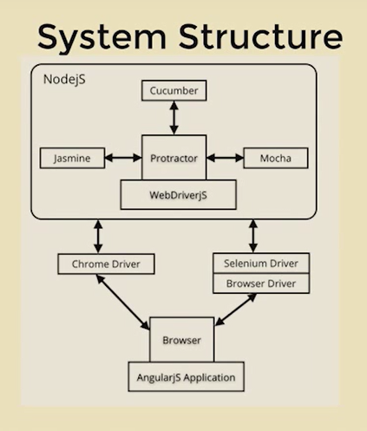
Protractor-Jasmine
Protractor
  a node.js program
  An e2e test framework for Angular and AngularJS applications.
  runs tests against application running in real browser, interacting with it as a user would.
Jasmine
  a testing framework for JavaScript
  protractor uses Jasmine for its test syntax (describe, it, expect, etc.)
asynchronous

Slide 9
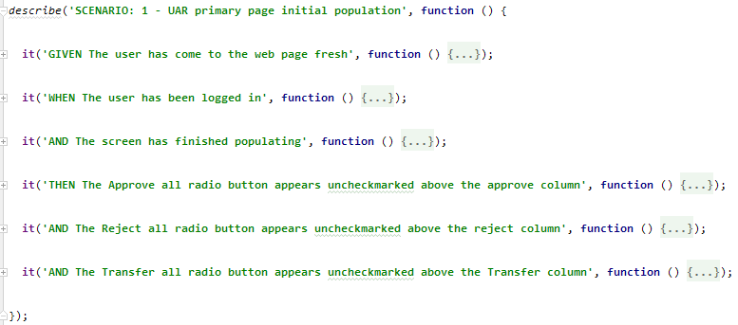
Protractor-Jasmine Syntax
Protractor-Jasmine tutorial
  http://www.protractortest.org/#/tutorial
describe - it

Slide 10
Framework structure

Slide 11
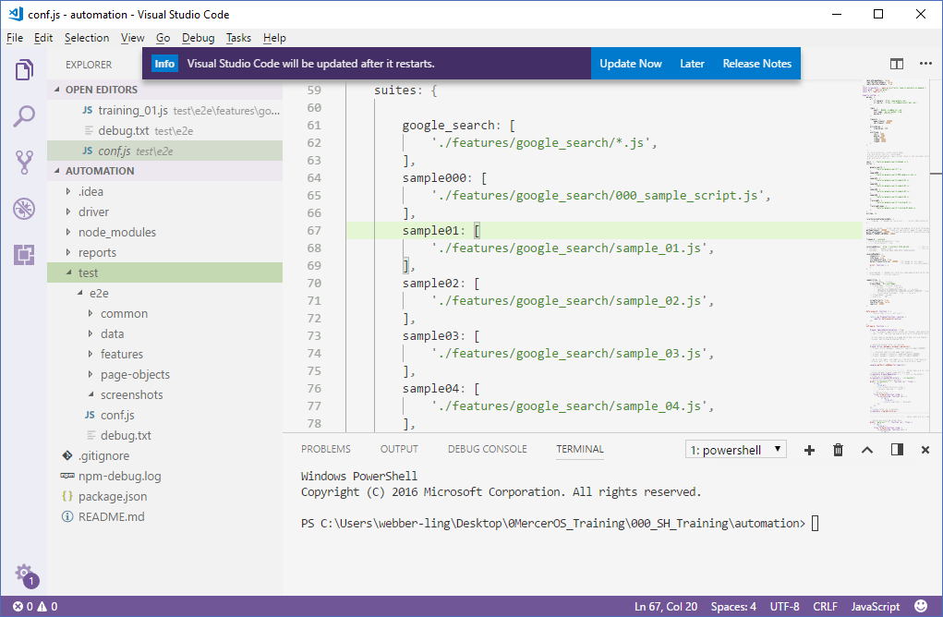
Framework structure

Slide 12
Framework Structure
root folders: node_modules, reports, test
root files: pacakage.jason, README.md
test – e2e folder in detail:
  common
  data
  doc
  features
  page-objects
  screenshots
  conf.js

Slide 13
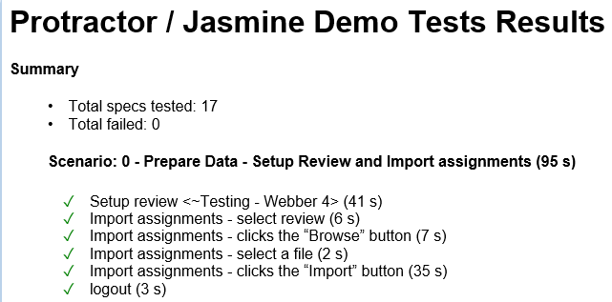
Framework Structure – root folders
node_modules
  Libraries, e.g. protractor, fstream, xlsx, etc
reports
  Html file of execution reports
test
  Test suite, objects, feature files, custom libraries, data, screen captures, configurations

Slide 14
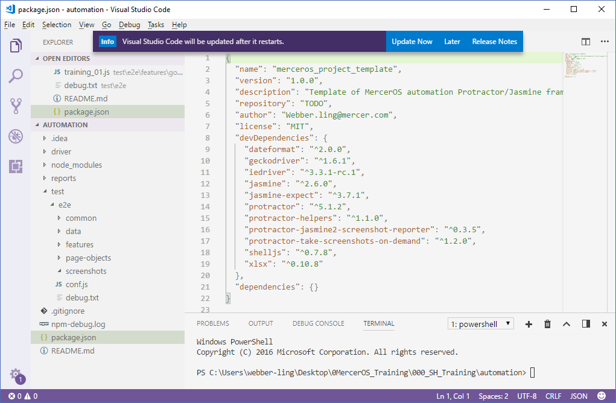
Framework Structure – root files
package.jason
  basic project info, external modules
  modules listed in dependencies will be installed by “npm install”
README.md

Slide 15
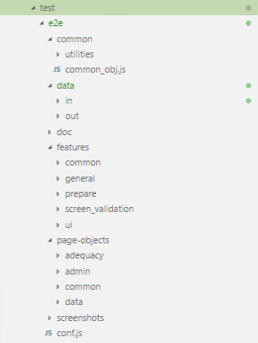
Framework Structure => test - e2e folder
user-customized libraries, third-party support files, e.g. autoit executable exe, util_timer.js, util_xlsx.js
basic common object functions, e.g. click, set text, select dropdown, etc.
data input/output
documents
feature files
object repositories
user-customized screen captures
Test settings, e.g. browser, test suites, timeout, etc.

Slide 16
conf.js

Slide 17
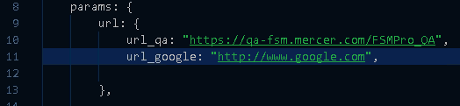
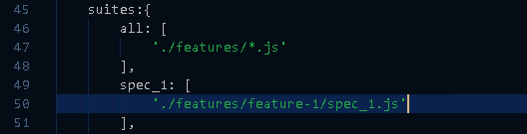
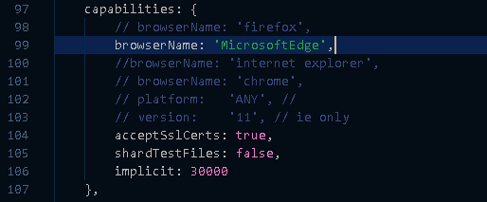
conf.js
Define global parameters
Define test suite
Define browser

Slide 18
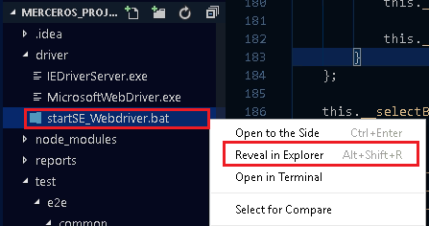
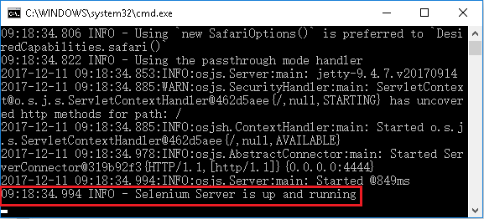
Sample Script Overview – sample script walkthrough – run & result
Start Selenium Server

Slide 19
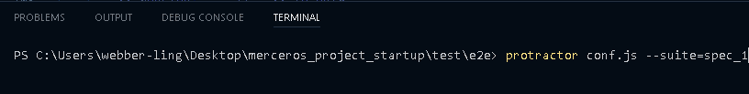
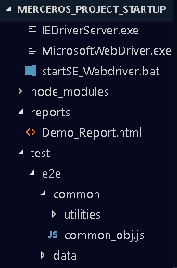
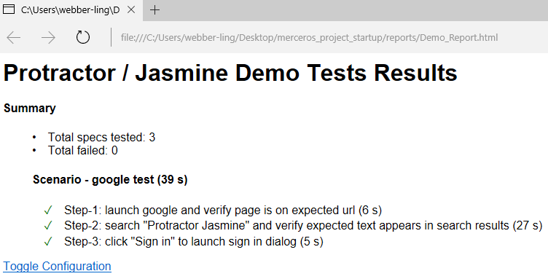
Sample Script Overview – sample script walkthrough – run & result
run command in terminal window: protractor conf.js --suite=spec_1
Demo_Report.html in “reports” folder

Slide 20
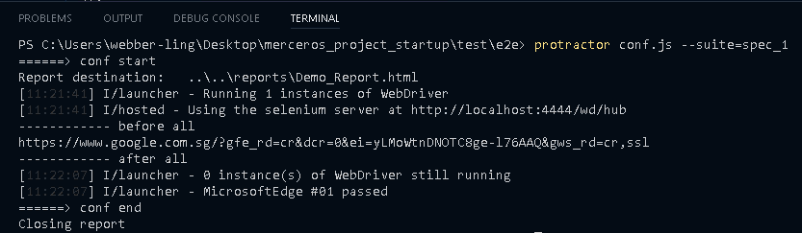
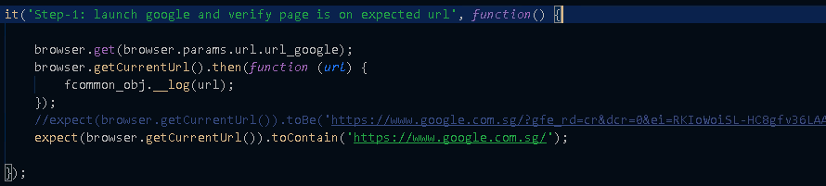
Sample Script Overview – sample script walkthrough – terminal output

Slide 21
Gherkin script introduction

Slide 22
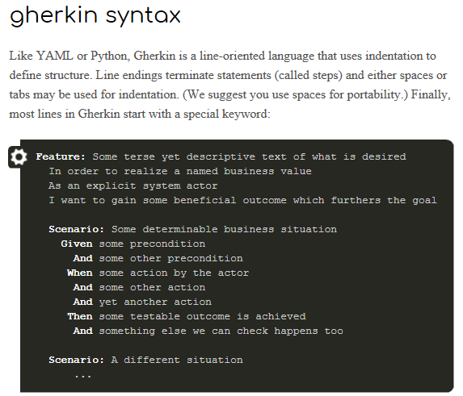
Gherkin script introduction

Slide 23
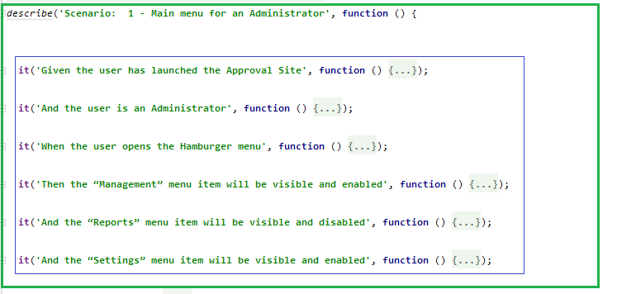
Gherkin script introduction

Slide 24
Homework

Slide 25
Homework
Setup the environments with all tools installed
Setup your own project using start-up project
Able to run sample test
Write a gherkin scripts of one test case from your own project
Due date….

Slide 26

www.mercer.com.au

