Slide 1
MercerOS Automated Testing Training
02_Working with objects
Dec 08 2017
Webber.ling@mercer.com, Shanghai

Slide 2
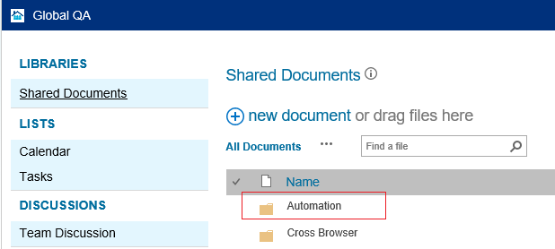
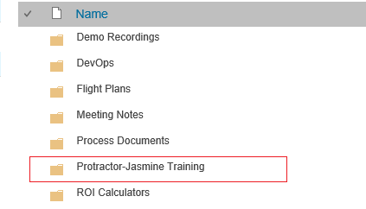
Where to get all the training materials
http://teamsites-west.mercer.com/sites/Global_QA/Shared%20Documents/Forms/AllItems.aspx

Slide 3
Topics
Object identifier
  id
  name
  class
  regular expression
  cssContainingText
  tagName
  table
  multiple instance
  object hierarchy
Methods
  click
  sendKeys
  dropdown select
    byOption
    byValue
    byIndex
  getText
  getAttribute
  getCssValue
  getLocation/getSize
  table

Slide 4
Object identifier

Slide 5
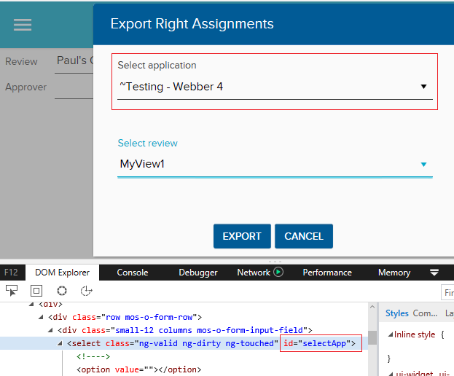

Object Identifier – CSS - id

Slide 6
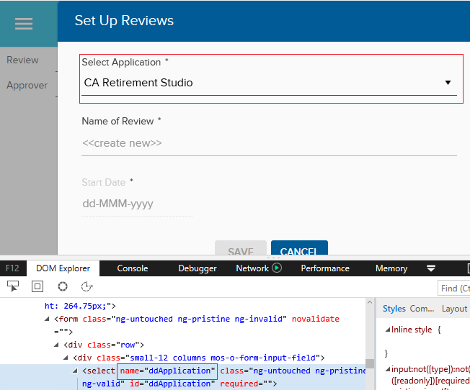
Object Identifier – CSS - name

Slide 7
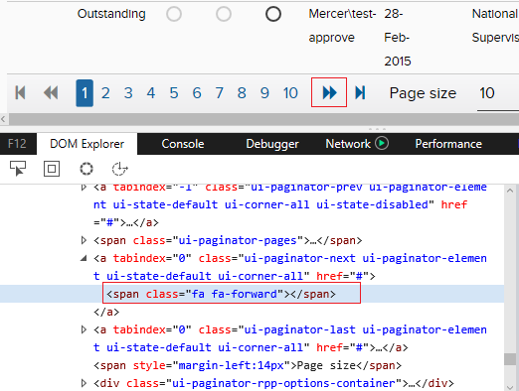
Object Identifier – CSS - class
element.all(…..).first()
element.all(…..).last()
element.all(…..).get(i)

Slide 8
Object Identifier – CSS – partial match
css start syntax: [attribute^=value]
css end syntax: [attribute$=value]
css contains syntax: [attribute*=value]
id=ctl00_FSMMasterContentPlaceholder_monitorUserControl_FundingLevel

Slide 9
Object Identifier – CSS – partial match + dynamic value
id=ctl00_FSMMasterContentPlaceholder_monitorUserControl_FundingLevel
Exact match
End with
Contains
Start with

Slide 10
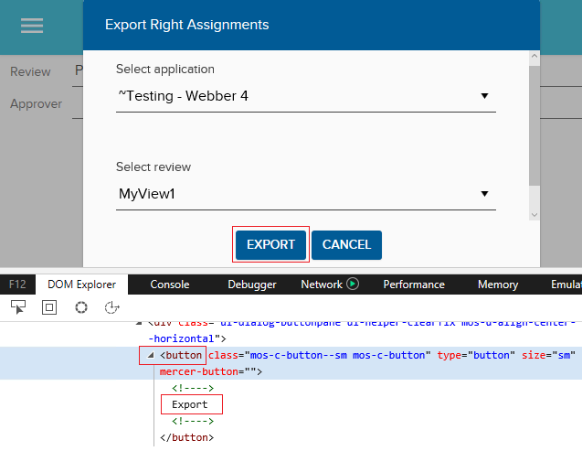
Object Identifier – CSS – cssContainingText (tag)

Slide 11
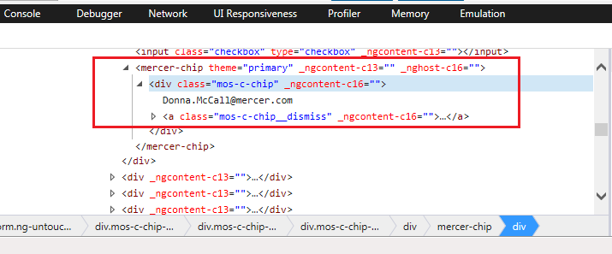
Object Identifier – CSS – cssContainingText (class)

Slide 12
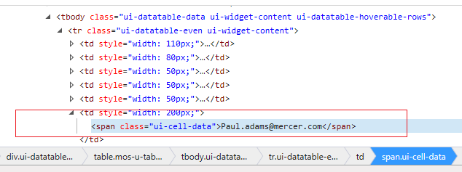
Object Identifier – CSS – cssContainingText (class)

Slide 13
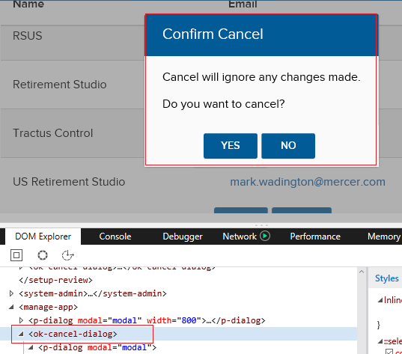
Object Identifier – tagName

Slide 14
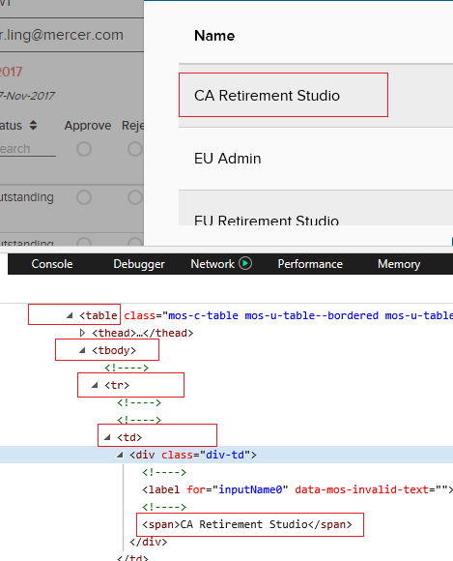
Object Identifier – table

Slide 15
Object Identifier – work with multiple object instances
element.all(…..).first()
element.all(…..).last()
element.all(…..).get(i)

Slide 16
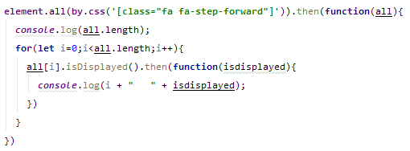
Object Identifier – work with multiple object instances
By default, it will use the first one that matches the identifier
Terminal will report error if expected object is NOT the first instance
Write code to find the “Visible” object which is the expected one

Slide 17
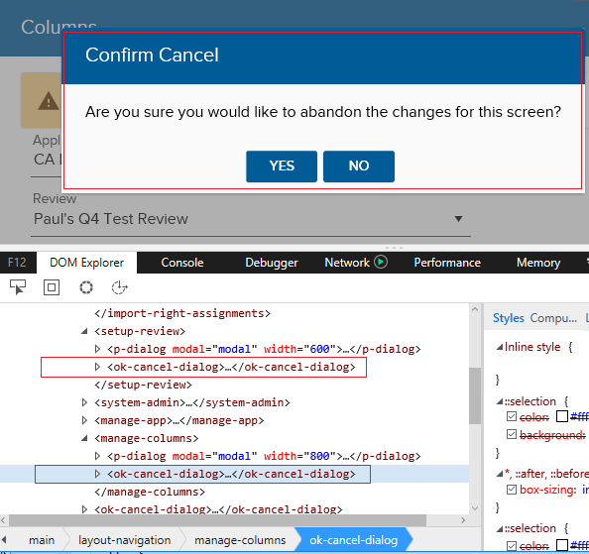
Object Identifier – object hierarchy
Multiple instances of object with different parent

Slide 18
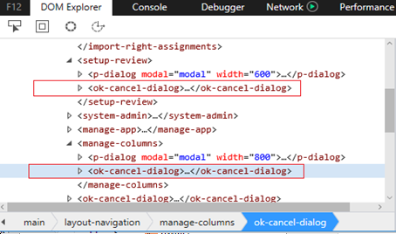
Object Identifier – object hierarchy

Slide 19
Methods

Slide 20
Frequently used web element methods
Name | Description
clear() | If this element is a text entry element, this will clear the value
click() | Click this element.
sendKeys(keysToSend) | Use this method to simulate typing into an element, which may set its value
getText() | Get the visible (not hidden by CSS) innerText of this element, including sub-elements
isDisaplyed() | Is this element displayed or not
isEnabled() | Is this element currently enabled or not
isSelected() | Dertermine whether or not this element is selected or not
getAtrribute(name) | Get the value of the given attribute of the element
getCssValue(propertyName) | Get the value of a given CSS property
getLocation() | Where on the page is the top left-hand corner of the rendered element
getSize() | What is the width and geight of the rendered element
getTagName() | Get the tag name of this element

Slide 21
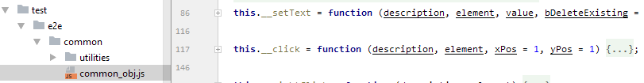
Methods – click()
Always use __click in common_obj.js

Slide 22
Methods – sendKeys
Always use __setText in common_obj.js

Slide 23
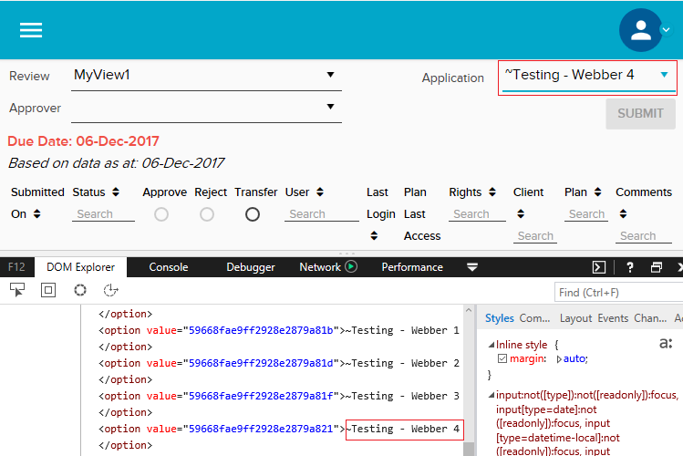
Methods – select dropdown – by option

Slide 24
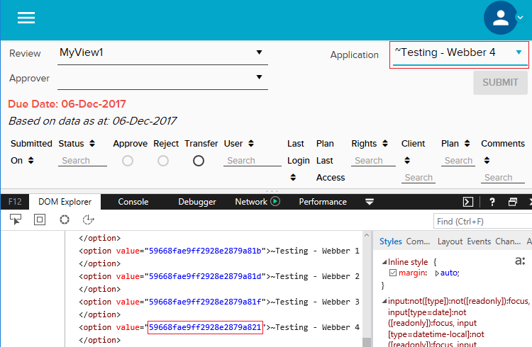
Methods – select dropdown – by value

Slide 25
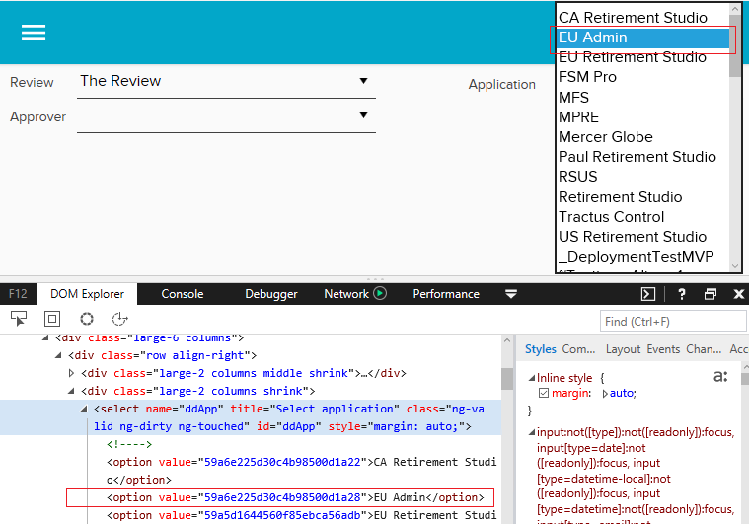
Methods – select dropdown – by index
Index starts from 0

Slide 26
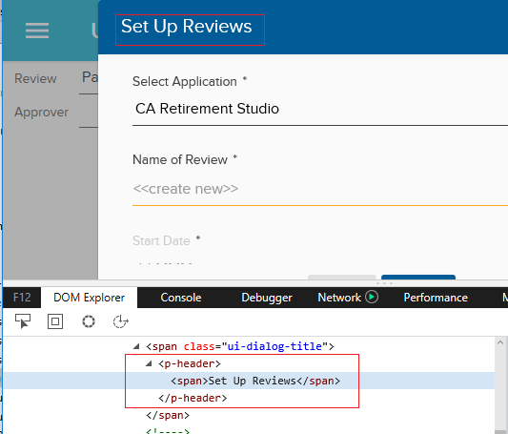

Methods – getText

Slide 27
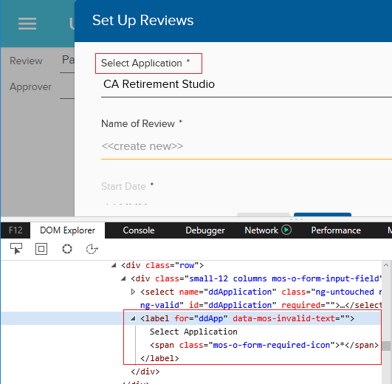
Methods – getText

Slide 28
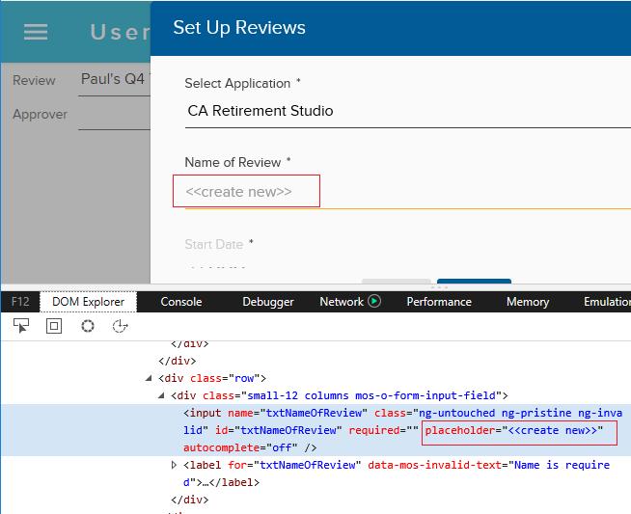

Methods – getAttribute

Slide 29

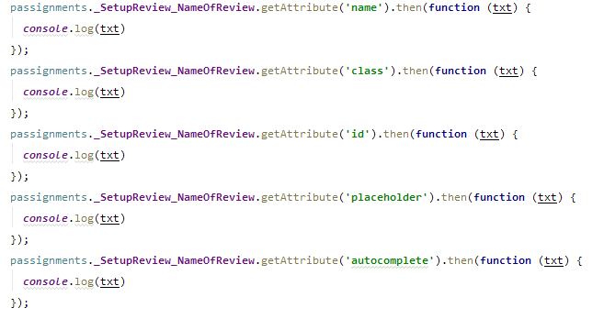
Methods – getAttribute

Slide 30
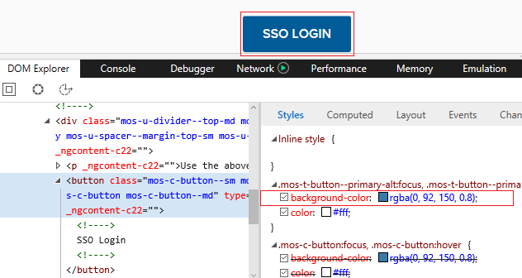

Methods – getCssValue

Slide 31
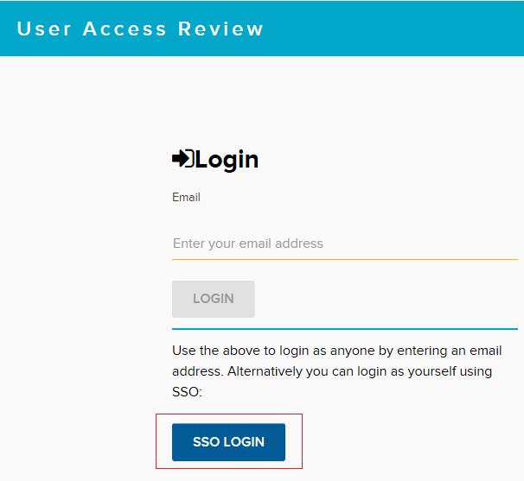


Methods – getLocation/getSize

Slide 32
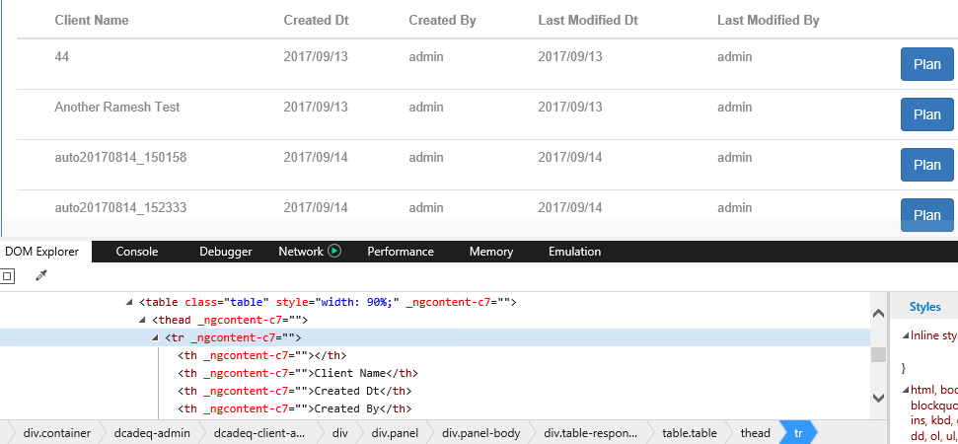
Methods – table

Slide 33
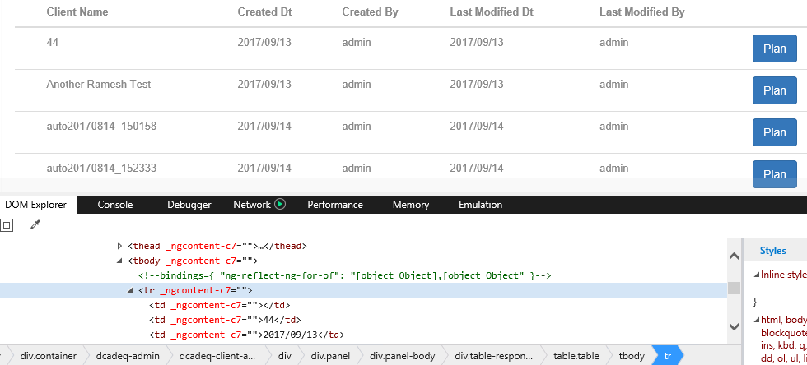
Methods – table

Slide 34
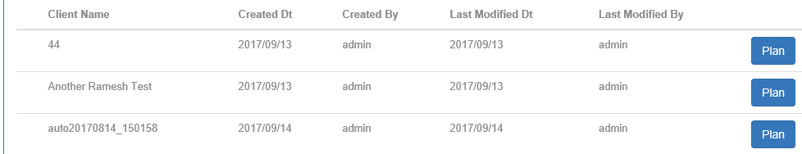
Methods – table

Slide 35

www.mercer.com.au

