Slide 1
MercerOS Automated Testing Training
03_Others
Dec 06 2017
Webber.ling@mercer.com, Shanghai

Slide 2
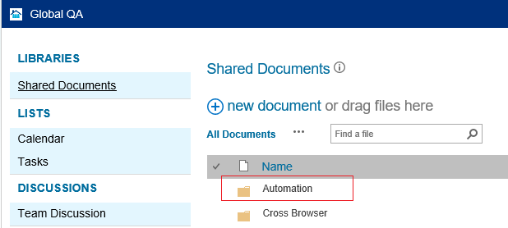
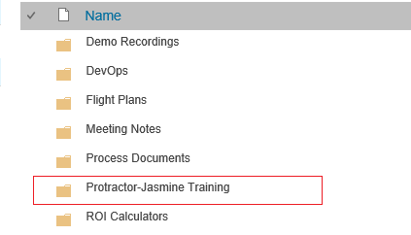
Where to get all the training materials
http://teamsites-west.mercer.com/sites/Global_QA/Shared%20Documents/Forms/AllItems.aspx

Slide 3
Topics
Global parameters
Keyboard
Test Data
Promise
Loop
Switch/Case
Number/String comparison
Date time
Special characters
Throw error
ExpectedConditions

Slide 4
Global Parameters

Slide 5
Global Parameters
params
suites
timeout
capabilities
beforeLaunch / onPrepare / afterLaunch
sauchLab

Slide 6
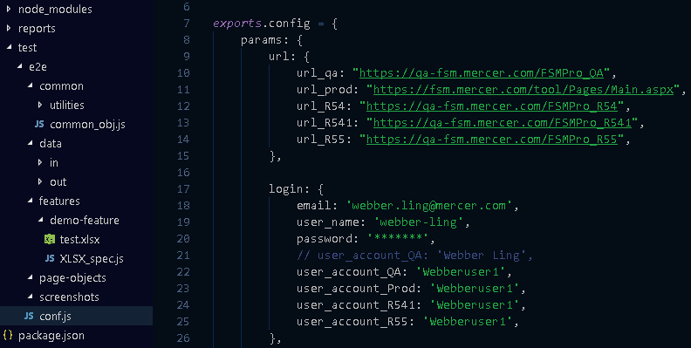
Global Parameters
Define parameters in conf.js
Use parameters in script

Slide 7
Keyboard

Slide 8
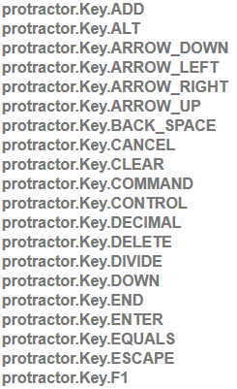
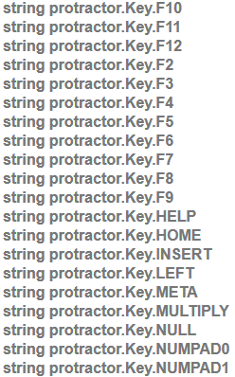
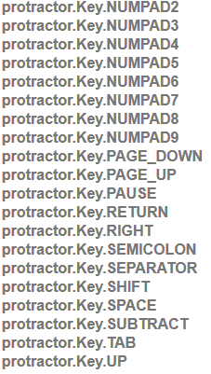
Keyboard

Slide 9
Test Data

Slide 10
Test Data
Declare before use
Use const (if it will not be changed), use let (if it will change)
Temp variable
Local variable
Global variable (refer to Global Parameters)
Jason file
Excel file

Slide 11
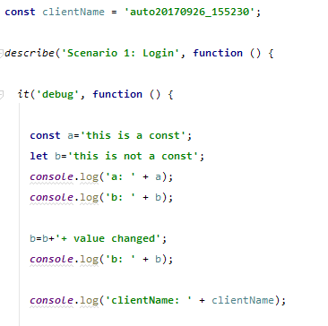
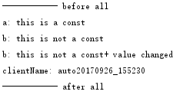
Test Data – temp/local variable

Slide 12
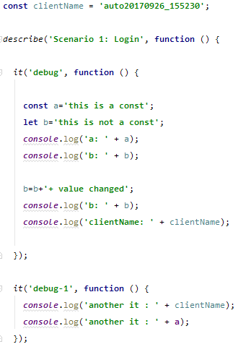
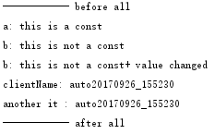
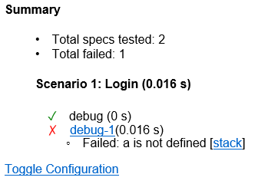
Test Data – temp/local variable

Slide 13

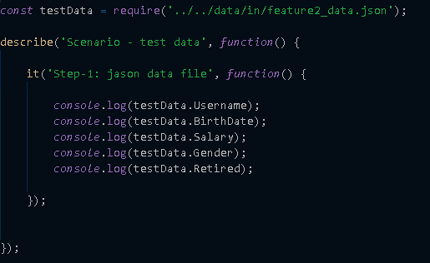
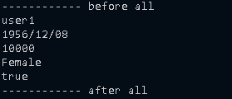
Test Data – json file

Slide 14
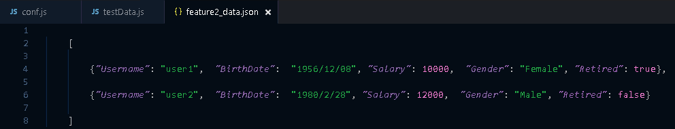
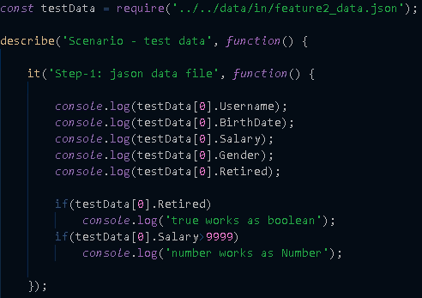
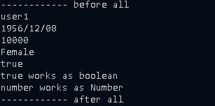
Test Data – json file – array

Slide 15

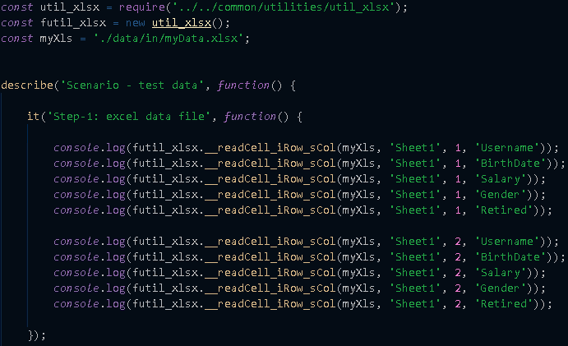
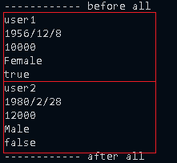
Test Data – excel file – read by column name

Slide 16
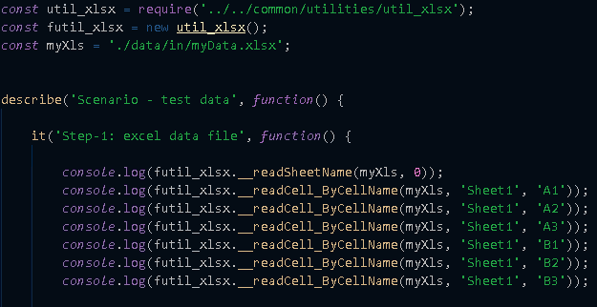
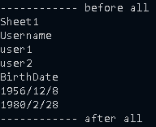
Test Data – excel file – read by cell name

Slide 17
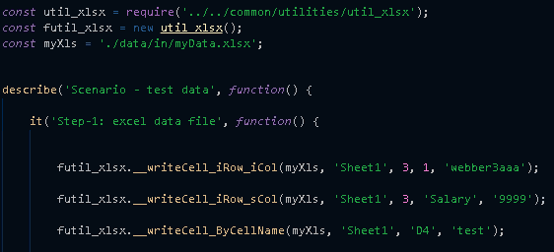
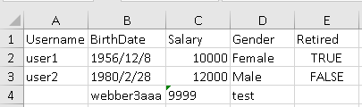
Test Data – excel file – write

Slide 18
Promise

Slide 19

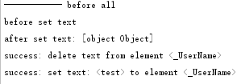
Promise
Protractor runs asynchronously
Protractor takes care to synchronize the test steps
All actions return promises to be executed sometime in the future
Write your test in a synchronous matter
They will be executed asynchronously at the right time

Slide 20




Promise
What we used to do
Now, change your mind

Slide 21
Loop

Slide 22
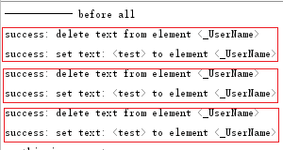

Loop
Regular loop
Runtime counts loop

Slide 23
Switch/Case

Slide 24

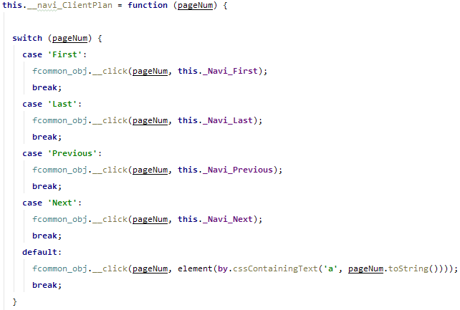
Switch/Case

Slide 25
Number/String Comparison

Slide 26


Number/String comparison

Slide 27
Date Time format

Slide 28





Date Time format
https://www.npmjs.com/package/dateformat

Slide 29
Special characters

Slide 30

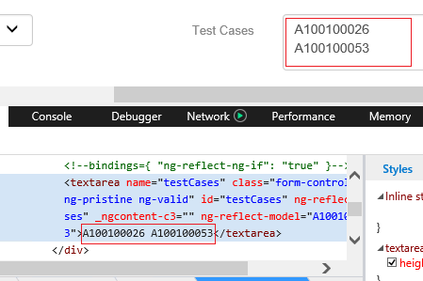
Special characters
Quotes and double quotes
Line break, \r\n

Slide 31
Throw Error

Slide 32
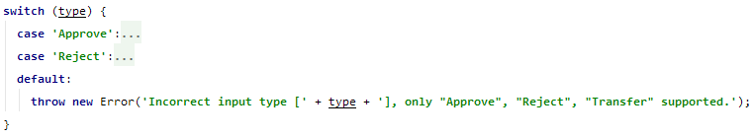
Throw Error
Intentionally throw error in the script
Output will report error with rest of steps NOT affected

Slide 33
ExpectedConditions

Slide 34
ExpectedConditions
object
time out
message

Slide 35

www.mercer.com.au

