Slide 1
MercerOS Automated Testing Training
04_Return & Recursive & Filter & Class & Best Practice
Dec 18 2017
Webber.ling@mercer.com, Shanghai

Slide 2
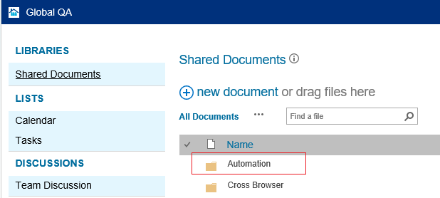
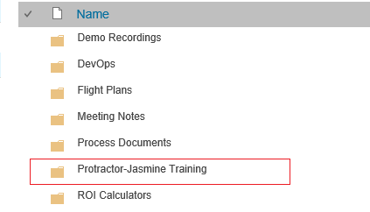
Where to get all the training materials
http://teamsites-west.mercer.com/sites/Global_QA/Shared%20Documents/Forms/AllItems.aspx

Slide 3
Topics
Return
  Return single value
  Return a list
  Return from function
Recursive
Page Class
  Members
  Functions
  Setup a page class from scratch
Best Practice
  Project organization & naming conversion
    page-object
    feature

Slide 4
Return Value

Slide 5
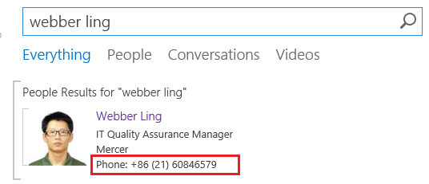
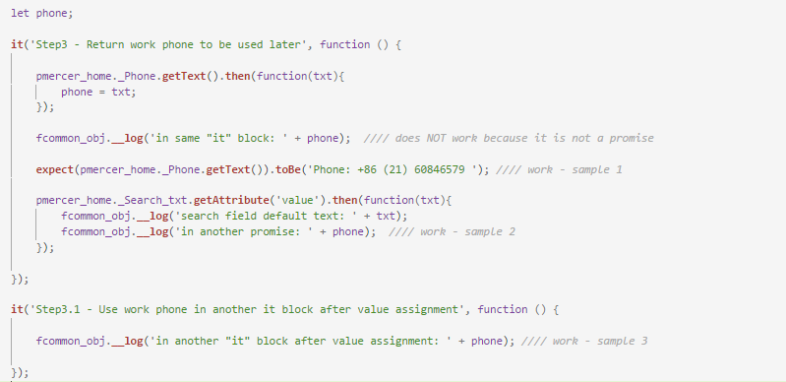
Return – single value

Slide 6
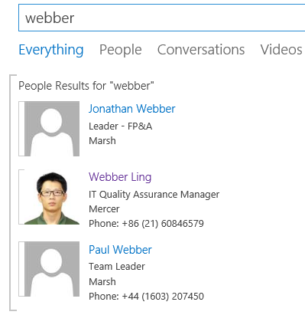
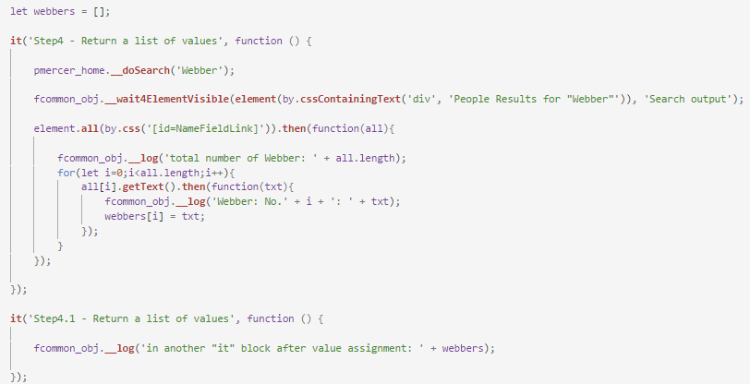
Return – List

Slide 7
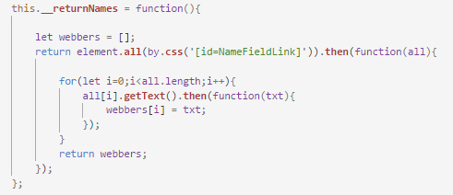
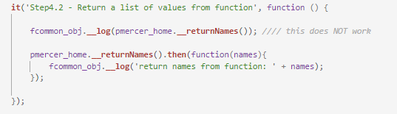
Return – from function

Slide 8
Filter

Slide 9
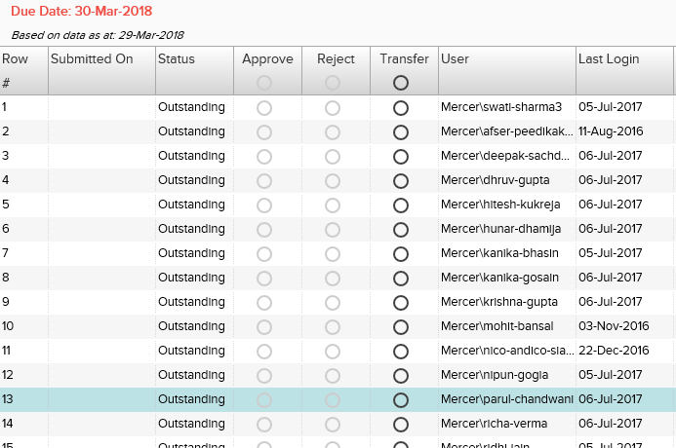
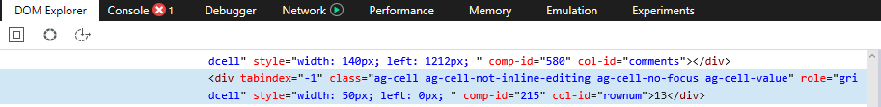
Filter – filter out element(s) meet search condition

Slide 10
Filter – filter out element(s) meet search condition
passignments._ApporvalGrid.all(by.css('[col-id=rownum]')).filter(function(el, index){
return el.getText().then(function(txt){
return txt==='13';
});
}).first().click();
passignments._ApporvalGrid.all(by.css('[col-id=rownum]')).filter(function(el, index){
return el.getText().then(function(txt){
return txt==='13';
});
}).first().isDisplayed().then(function(displayed){
fcommon_obj.__log(displayed);
});

Slide 11
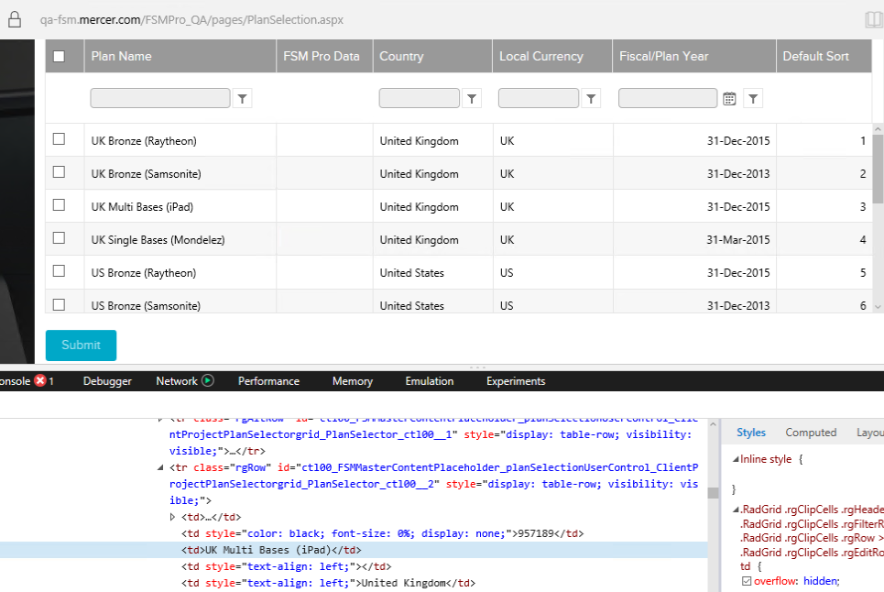
Filter – filter out element(s) meet search condition - Table
fcommon_obj.__ElementScrollIntoView($$(‘tr td’).filter(function (elem, index) {
return elem.getText().then(function (text) {
return text === ‘UK Multi Bases (iPad)’;
});
}).first());

Slide 12
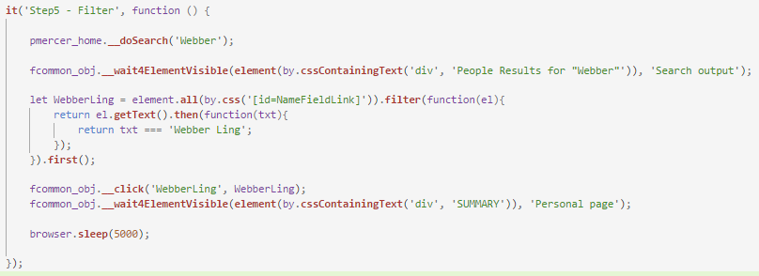
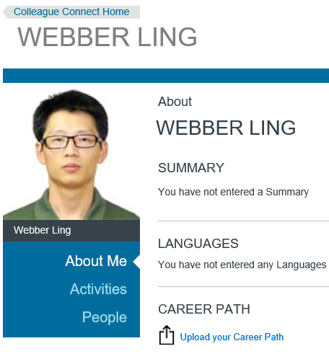
Filter – sample: Mercer site search

Slide 13
Recursive

Slide 14
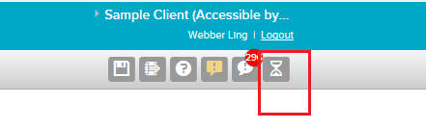
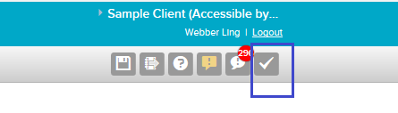
Recursive – sample (MPRE)
this.__runTillComplete = function (el, totalCount, currentCount) {
let self = this;
if (currentCount < totalCount) {
return el.isPresent().then(function (present) {
if (!present) {
fcommon_obj.__log('loop in process: ' + currentCount);
//// steps inside the loop - start
browser.driver.navigate().refresh();
pcommon_page.__wait4Loading(null, true);
//// steps inside the loop - end
self.__runTillComplete(el, totalCount, currentCount + 1);
}
else
fcommon_obj.__log('loop completed:' + currentCount);
})
}
else {
fcommon_obj.__log('loop reach to max: ' + totalCount);
throw new Error('Function __runTillComplete failed because condition NOT meet in time');
}
};

Slide 15
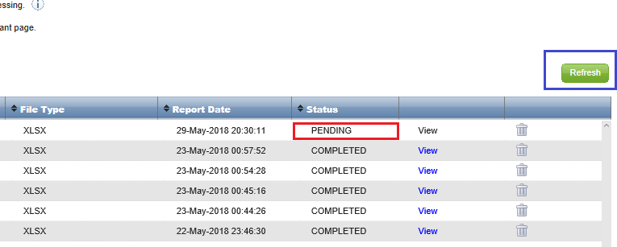
Recursive – sample (Gold+)

Slide 16
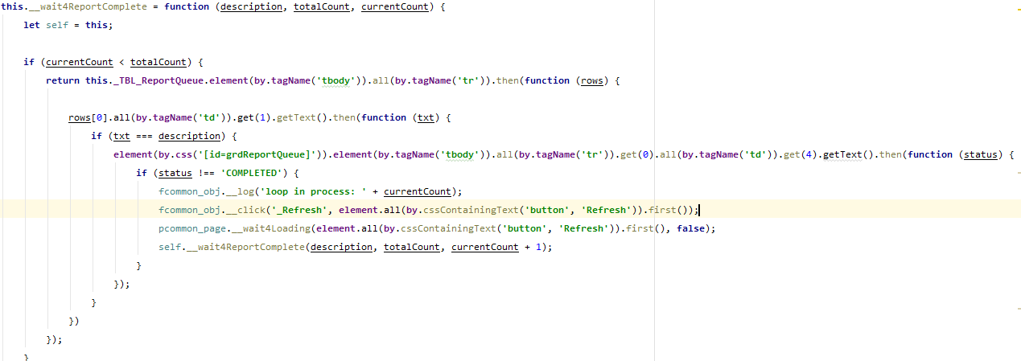
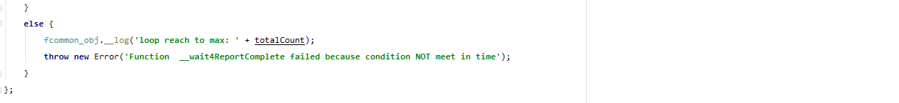
Recursive – sample (Gold+)

Slide 17
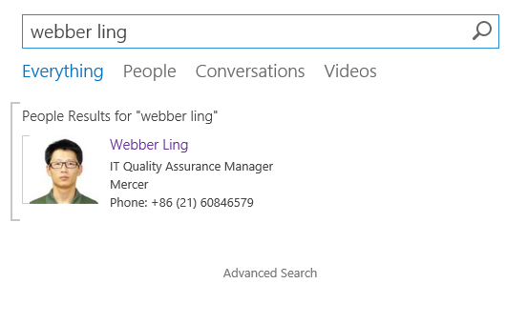
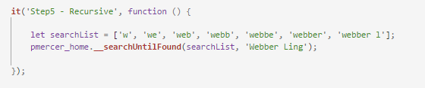
Recursive – sample (Mercer search)

Slide 18
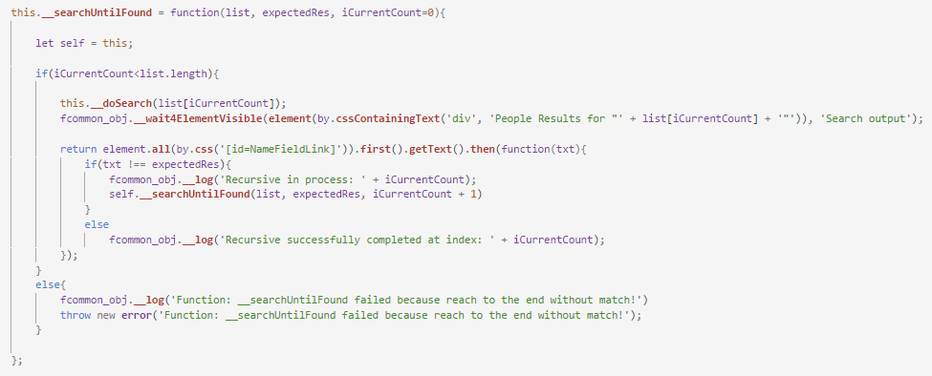
Recursive – sample (Mercer search)

Slide 19
Page Class

Slide 20
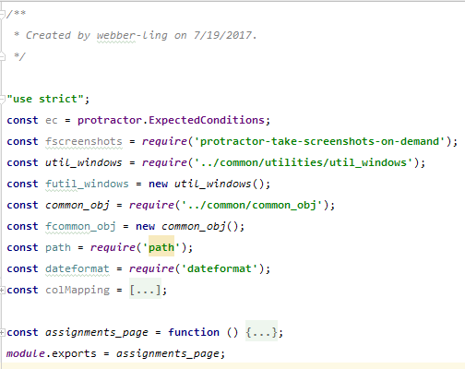
Page Class – structure
A typical page class
Class description
Modules
Local variables
Class definition

Slide 21
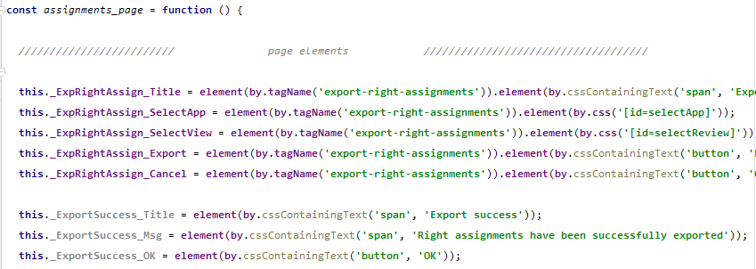
Page Class – members
Class members

Slide 22
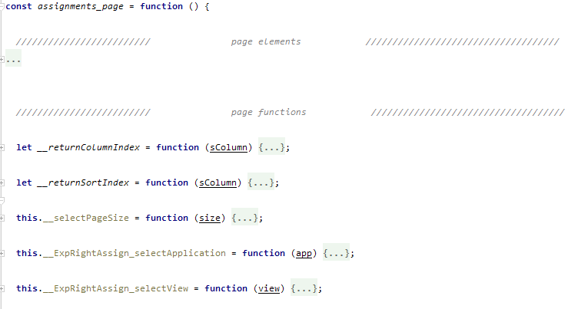
Page Class – functions
Class functions
Private
Exposed

Slide 23

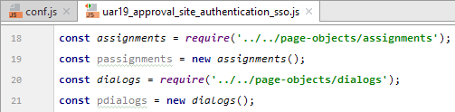
Page Class – import page object
Exported in page class definition
Import from the test script
Call members/functions using the page object

Slide 24
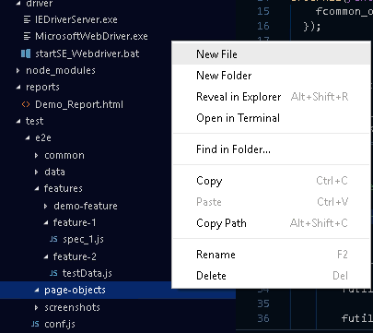
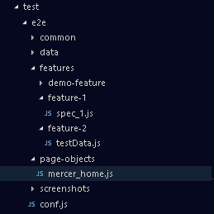
Page Class – setup from scratch
Add a js file in “page-objects” folder

Slide 25
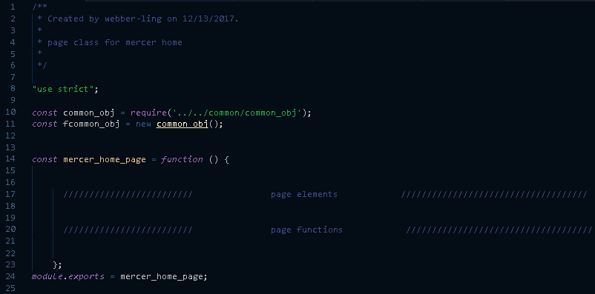
Page Class – setup from scratch
Add description/header for the class
Import common modules to be used
Define a blank page class

Slide 26
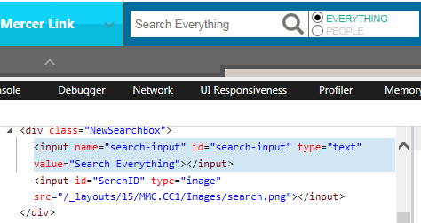

Page Class – setup from scratch
Add page objects

Slide 27
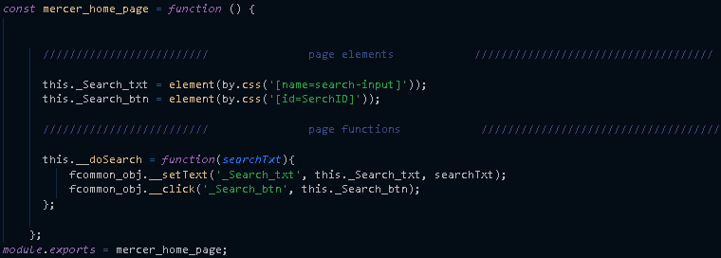
Page Class – setup from scratch
Add page functions

Slide 28
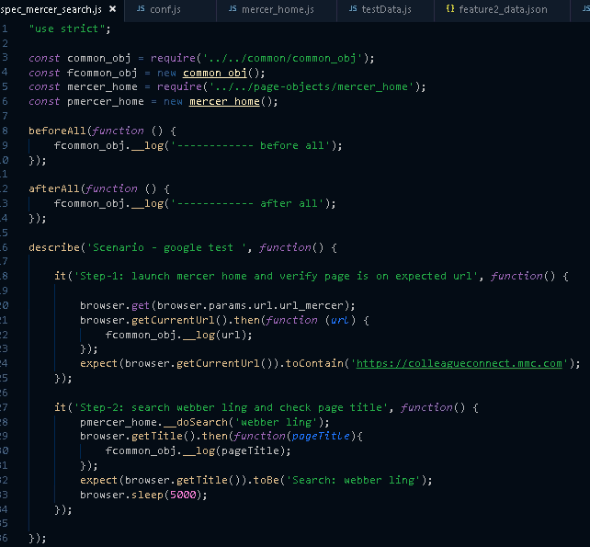
Page Class – setup from scratch

Slide 29
Best Practice

Slide 30
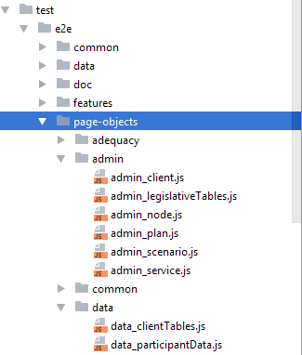
Best Practice – page-objects
Add subfolders to make them well-organized if there are many pages
Use the category name + underscore + page name
Create common page class for cross page elements/functions

Slide 31
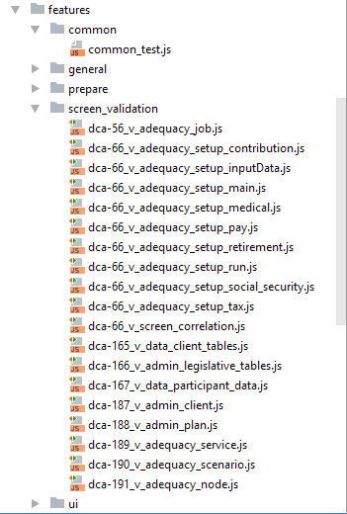
Best Practice – features
Add subfolders to make them well-organized if there are many features
Use the category name + underscore + feature name
Create common test class frequently used functions that interacts with multiple pages

Slide 32
Best Practice – others
Always “use strict”
Use const and let, avoid of using var
Use by.css wherever possible, avoid of using xpath
Use fcommon_obj functions, avoid of using click, sendKeys, etc
Use common_test functions if possible
Use expect to do verification instead of customized verification code

Slide 33
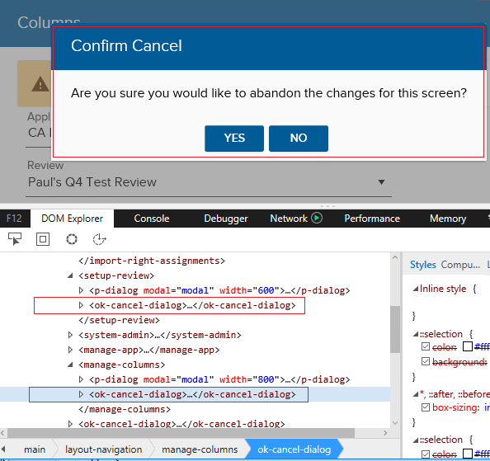
Best Practice – others – multiple instance of object
Multiple instances of object with different parent

Slide 34
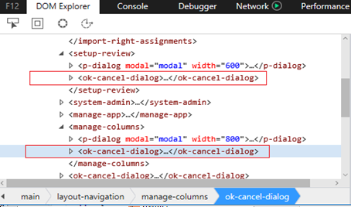
Best Practice – others – multiple instance of object

Slide 35
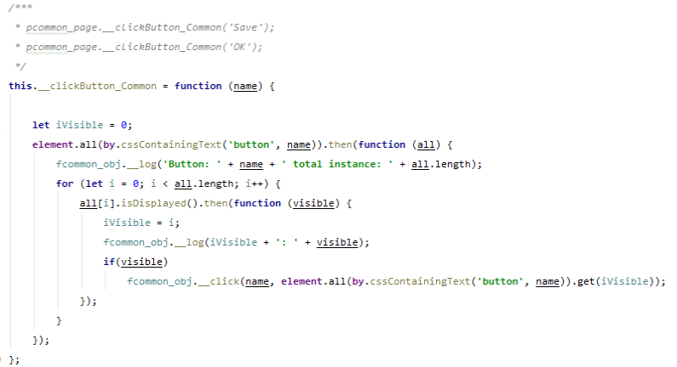
Best Practice – others – multiple instance of object

Slide 36
Debug

Slide 37
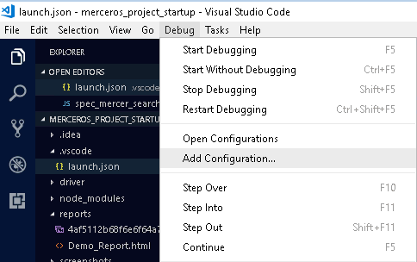
Debug
Go to menu “Debug -> Add Configuration…”

Slide 38
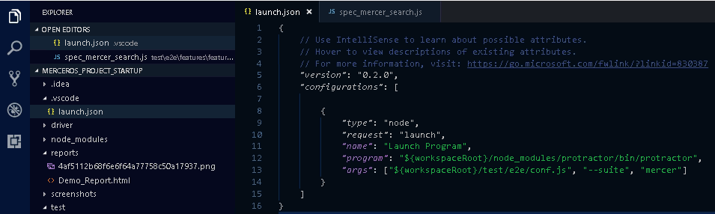
Debug
It creates launch.json automatically
Code your parameters as below

Slide 39
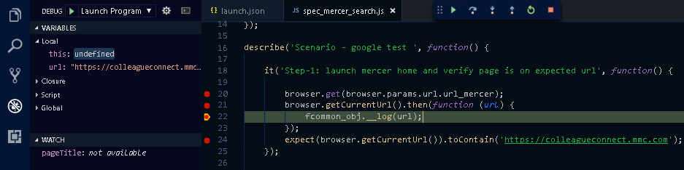
Debug
F5 to start debugging

Slide 40
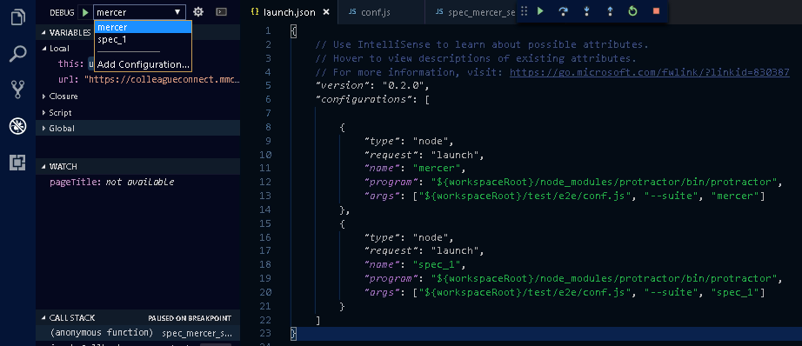
Debug
Multiple debug configurations

Slide 41

www.mercer.com.au

