Slide 1
MercerOS Automated Testing Training
05_AutoIT & Data Driven
Nov 18 2018
Webber.ling@mercer.com, Shanghai

Slide 2
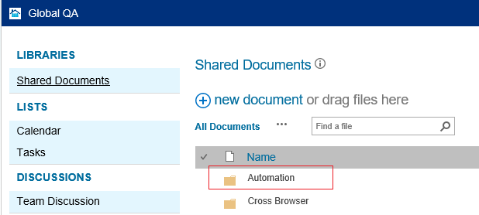
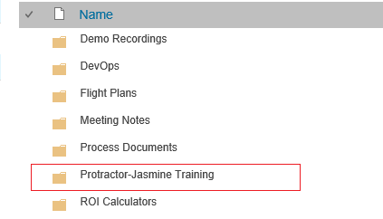
Where to get all the training materials
http://teamsites-west.mercer.com/sites/Global_QA/Shared%20Documents/Forms/AllItems.aspx

Slide 3
Topics
AutoIT
  When to use it
  How to use it
  Call AutoIT in Protractor
Data Driven
  Inside “it”
  Outside “it”
  Multiple “it”
  Call function
  Call script with multiple AutoIT exe

Slide 4
AutoIT

Slide 5
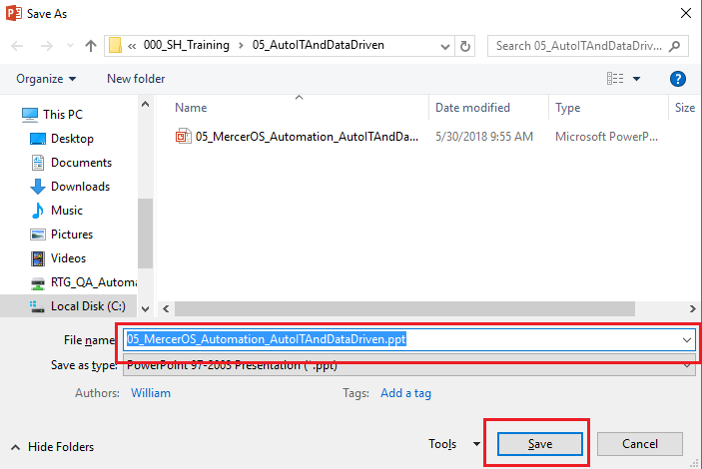
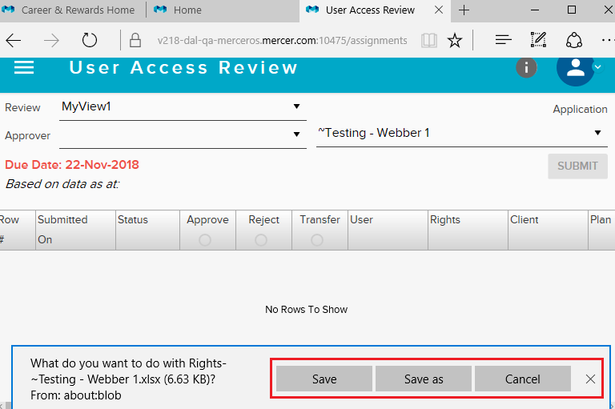
AutoIT – When
Protractor ➔ webdriverJS ➔ Browser

Slide 6
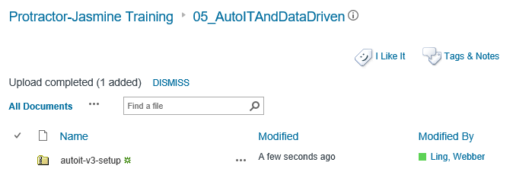
AutoIT – How
Install AutoIT from Global QA site
Install AutoIT from internet
https://www.autoitscript.com/site/autoit/downloads/

Slide 7
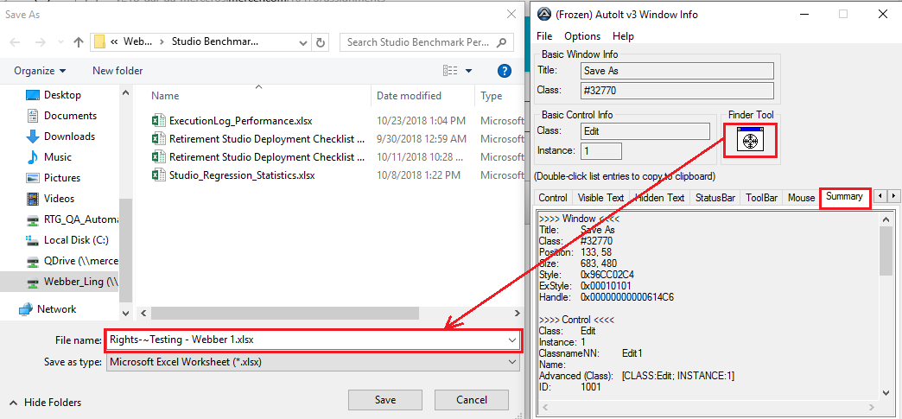
AutoIT – How
Identify object

Slide 8
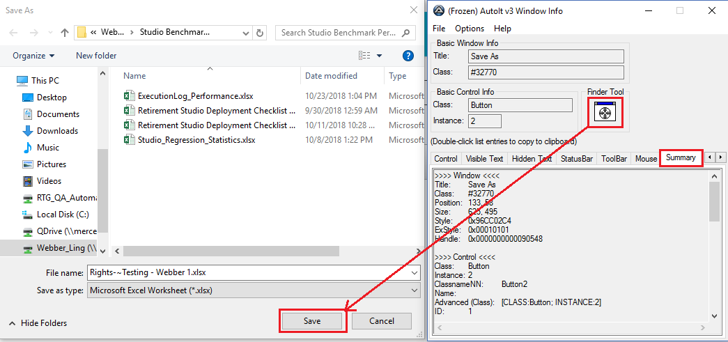
AutoIT – How
Identify object

Slide 9
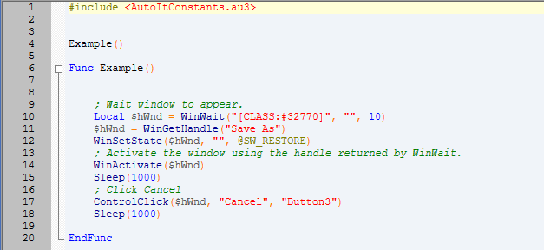
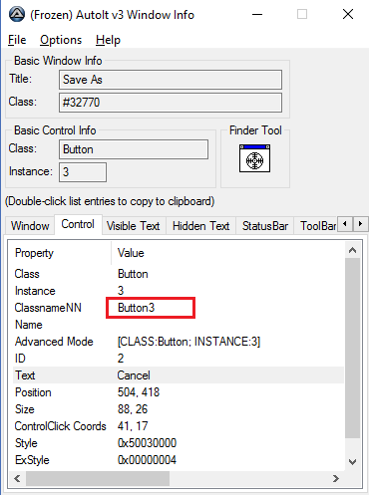
AutoIT – How
Code script to handle object – based on control ID

Slide 10
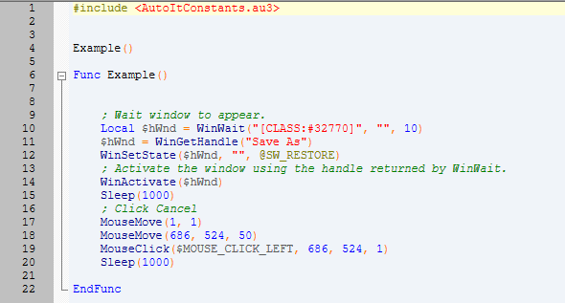
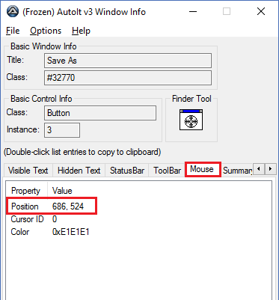
AutoIT – How
Code script to handle object – based on screen position

Slide 11
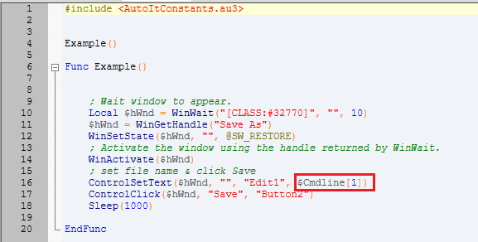
AutoIT – How
Code script to handle object – using parameters

Slide 12
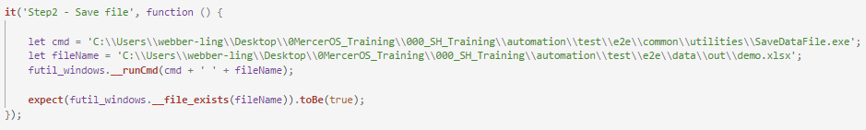
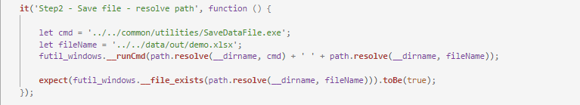
AutoIT – Protractor
Use AutoIT in Protractor – using local path (not recommended)
Use AutoIT in Protractor – using resolved path (recommended)

Slide 13
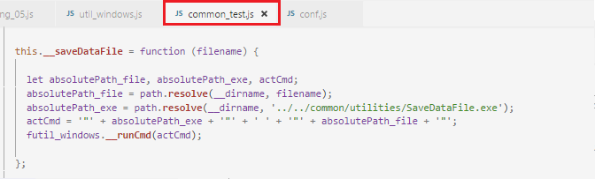
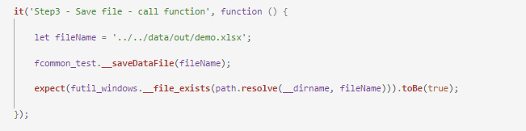
AutoIT – Protractor
Use AutoIT in Protractor – call function in common test (highly recommended)

Slide 14
Data Driven

Slide 15
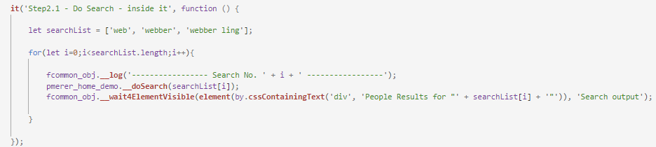
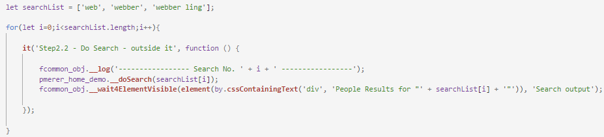
Data Driven – inside “it” & outside “it”
Data driven inside “it”
Data driven outside “it”

Slide 16
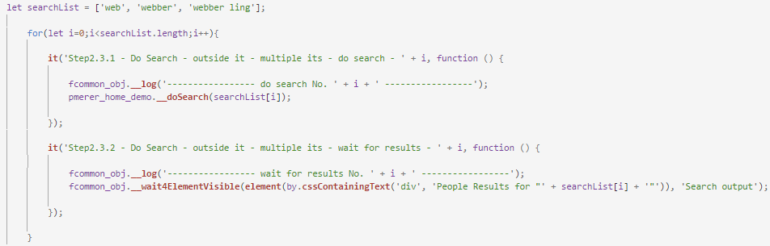
Data Driven – multiple “it”
Data driven multiple “it”

Slide 17
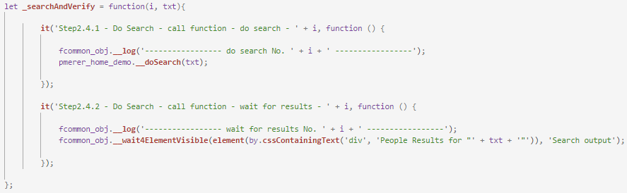

Data Driven – call function
Data driven call function

Slide 18
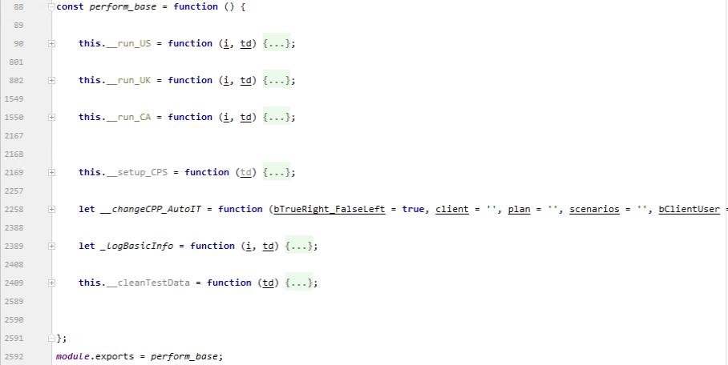
Data Driven – call scripts
Why – lots of repeatable and complex test steps

Slide 19
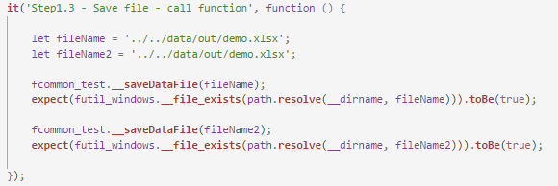
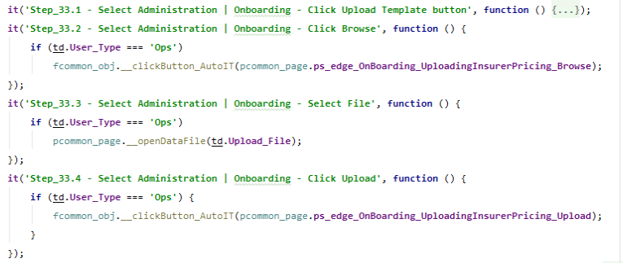
Data Driven – call scripts
Why – multiple AutoIT exe used

Slide 20
Data Driven – call scripts
How
  Create a new test script and define it as a Class
  Code repeatable test steps/functions
  Export the repeatable test script class
  Import the class into test script which is going to call them
  Call the repeatable steps as function

Slide 21

www.mercer.com.au

