Slide 1

“House Price Prediction for King County Seattle”
Presented by-
Radhika KASU
Reshma Kapadnis
Lina MI

Slide 2

DATA MINING
The gathering of information from pre-existing data stored in a database to identify pattern and relationships within the databasets through the use of advance statistical methods.
How we mine the data?
1. Exploring data.
2. Building the model and its validation.
3. Applying the model to the new data.

Slide 3
PROJECT DESCRIPTION
Introduction- Real estate properties are attractive option for safe investment especially for a common person. The direction of changes of the future economy is hard to predict because of international economic direction. Also real estate is investment which does not decline in value rapidly.
Project topic- Predicting house price sales in kings county, USA using different algorithms.
Goal- To determine the best algorithm fit for the prediction.

Slide 4
Dataset
This dataset contains house sale prices for King County, which includes Seattle. It includes homes sold between May 2014 and May 2015
19 house features plus the price and the id columns, along with 21613 observations.
Constraints
Location specific
Time frame(one year)

Slide 5
DATASET DETAILS
Location:
https://www.kaggle.com/harlfoxem/housesalesprediction
Total observations : 21613 observations
Total house features : 19 plus price and id
Dependent variable : Price
Independent variable : 19 features

Slide 6
Steps in Data Mining
Load Libraries and dataset
Data Cleaning
Data Transformation
Training and Testing dataset
Regression Model

Slide 7
Data Cleaning:
Definition: This is the process of amending or removing data in database that is incorrect, incomplete, improperly formatted , or duplicated
Steps of Data cleaning:
1. Exploring raw data.
2. Tidying data.
3. Preparing data for analysis.

Slide 8
DATA PREPROCESSING:
1. Loading the dataset into the R studio. Check if there are missing values in the dataset
The result above shows that there is no missing data in the dataset

Slide 9
Preprocessing:
1. ‘Date’ variable: the type of this variable is factor which is not suitable for data analysis, so I convert it as following: first it is converted into date type in R, and then the date type is transferred to numeric type, since the sale date in the dataset is between May 2014 and May 2015, the variable of sale date is expressed as number of days to the earliest date in the dataset:
>date_tem<-substr(house_data$date,1,8)
> date_tem<-as.Date(date_tem,format = "%Y%m%d")
> date_num<-as.numeric(date_tem-min(date_tem))
>house_data$date<-date_num

Slide 10
2. ‘ID’ variable: in the dataset, observations with exactly same ID number are found, it means that the same house was sold more than one times during the period of May 2014 and May 2015. These duplicated IDs are apparently not useful for the analysis, so the duplicated IDs are removed and only the observations of the houses which were sold at latest time are kept.

Slide 11
3. ‘yr_renovated’ variable: since for newly built houses and old houses which have never been renovated since they were built, the values of this variable are same, this condition definitely can not reflect the real features of properties. I convert it the variable of ‘nyrs_since_last_renovate’, which reflects the number of years since last renovate to 2015, namely 2015-yr_renovated, if the value of yr_renovated is zero, then 2015-yr_built.

Slide 12
4. Variables of ‘lat’ and ‘long’: since feature of ‘zipcode’ has indicated the location of house, variable ‘lat’ and ‘long’ which are latitude of house and longitude of house respectively are not necessary for data analysis. Therefore these two variables were not included in the final dataset, furthermore, zipcode attribute should be factor type instead of numeric type.

Slide 13
Exploring Raw data:
A. Understand the structure of data
B. Look at data.
C. Visualize data

Slide 14
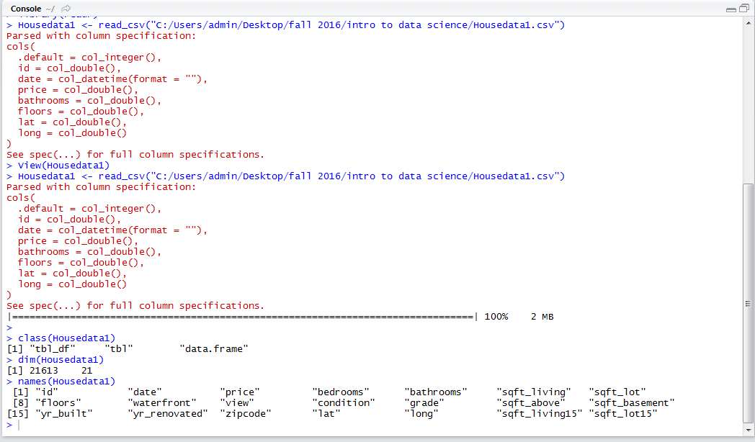
Understand the structure of data:

Slide 15
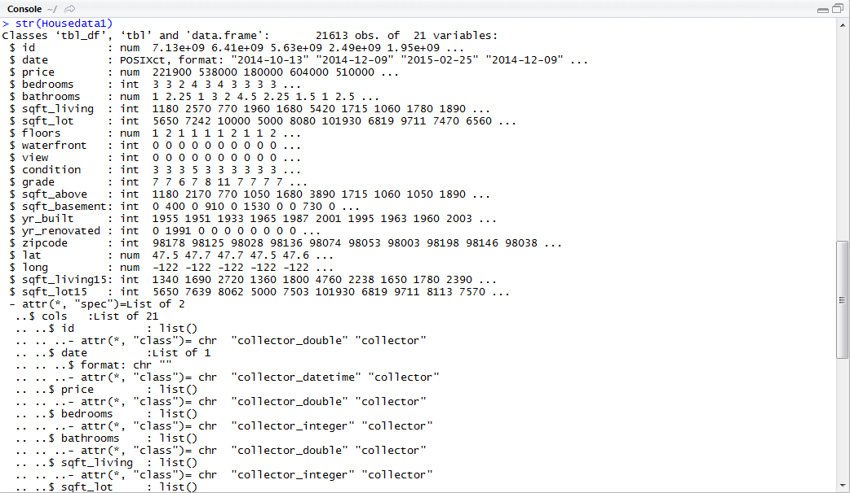

Slide 16
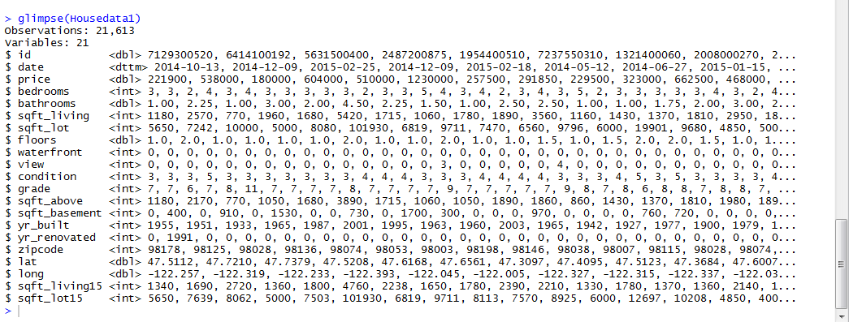

Slide 17
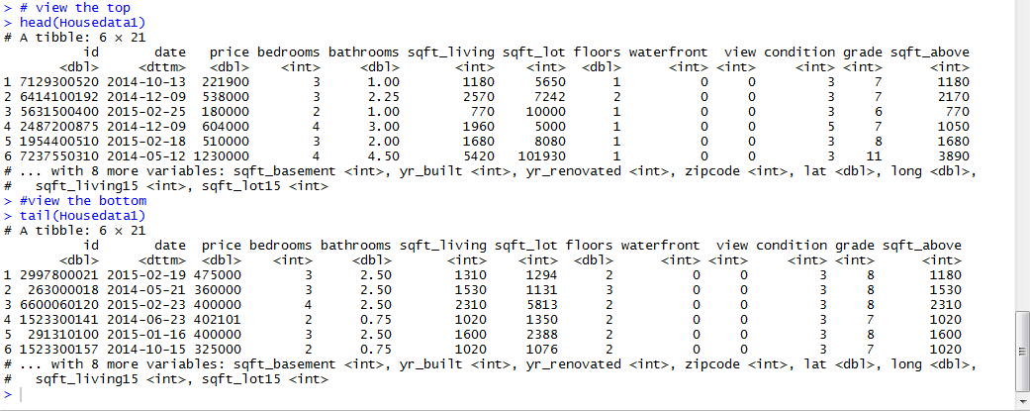
Look at data:

Slide 18
Implementation of algorithms:
1.Random Forest Algoritham:
Definition
Collection of unpruned CARTs
Rule to combine individual tree decisions
• Purpose: Improve prediction accuracy

Slide 19
1. Splitting preprocessed dataset into training dataset and testing dataset

Slide 20
2. Fitting the model with Random Forest

Slide 23
3. Predicting prices of houses in testing dataset using the Random Forest Model

Slide 24
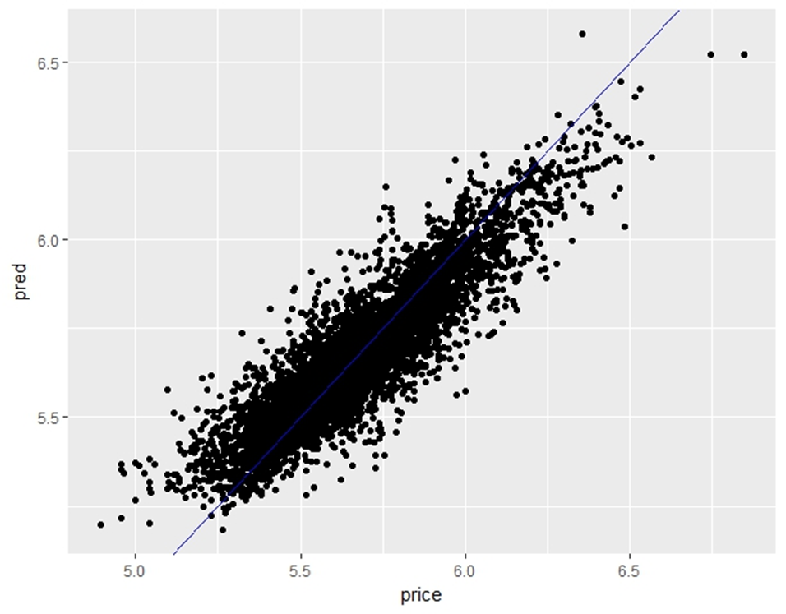

Slide 25
Multiple linear Regression Algorithm:
Multiple Linear Regression
Most common form of linear regression.
Used to explain relationship between one dependent and two or more independent variables.
Equation
Y = a+b₁X₁ +b₂X₂ + +b k_{X}
where Y is the dependent (Outcome) variable, and the variables X1….,X k are the explanatory (predictive) variables. The constants b1……….,b k are the regression coefficients and a is regression constant or intercept.
In this dependent variable decided by independent variables
Dependent: Price is the only variable which is dependent , Which changes according to the independent variable.
Independent Variable : We took 19 different variables……..
List : Number of bedrooms, Number of bathrooms, sqft of living, Sqft of loft, floors, waterfront , view, condition ,grade, sqft above, sqft basement, year built, year renovated, zip_code , lat , long sqft living15, sqft lot 15
Total = 17

Slide 26
TRAINING AND TESTING DATA
Training Dataset- Training Dataset is a set of data which is used to discover potentially predictive relationships.
indexes = sample(1:nrow(HouseDataSet), size = 0.3*nrow(HouseDataSet))
Train_data = HouseDataSet[-indexes,] #Train dataset 70%
dim(Train_data)
Test Dataset – Test dataset is a set of data used to access the strength and utility of a predictive relationship.
Test_data = HouseDataSet[indexes,] #Test dataset 30%
dim(Test_data)

Slide 27
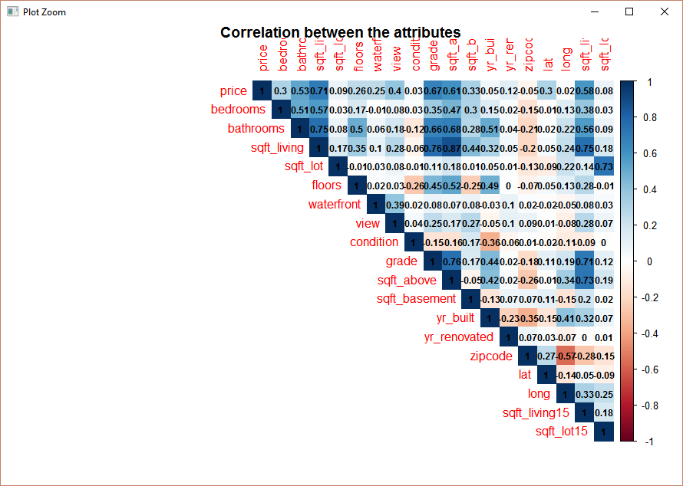
Correlation:
Attribute_Corr <-cor(Train_data[3:21],method="pearson")
View(Attribute_Corr)

Slide 28
CHECKING LINEARITY
Simple linear regression model that describes the relationship between two variables x and y can be expressed by the following equation
Linear models make some strong assumptions concerning the data structure:
Independence of each data points
Correct distribution of the residuals
Correct specification of the variance structure
Linear relationship between the response and the linear predictor

Slide 29
FITTING A MODEL
We tried making 7 models to check for the linear relationship between dependent and independent variables. We found the Housemodel_1 as the fittest model for our predictive model.
R Code:
Housemodel_i1<- lm(log(price) ~ bedrooms+bathrooms+sqft_living+floors+waterfront+view+condition+grade+sqft_above+yr_built+yr_renovated+lat+long+sqft_living15+ sqft_lot15, data = Train_data)
summary(Housemodel_i1) # Multiple R-Squared : 0.7684

Slide 30
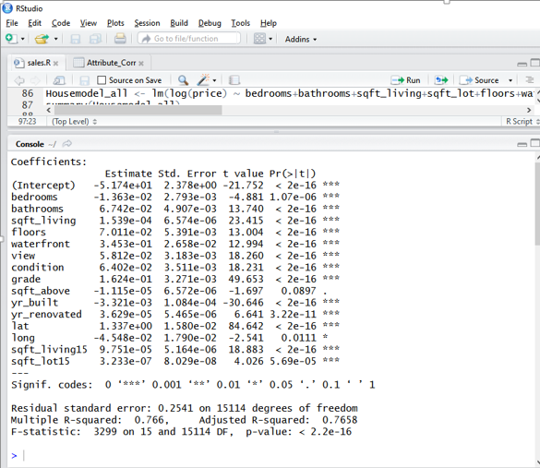

Slide 31
PREDICTING THE NEW PRICE
We applied the predict() to predict the new price of the house using the best fitted linear model.
Equation
Y = a+b₁X₁ +b₂X₂ + +b k_{X}
where Y is the dependent (Outcome) variable, and the variables X1….,X k are the explanatory (predictive) variables. The constants b1……….,b k are the regression coefficients and a is regression constant or intercept
pred <- predict(Housemodel_i1,Test_data)
summary(pred)
View(pred)
View(cbind("ID"=Test_data$id,"Orginal Price"=Test_data$price,"New predicted price"=exp(pred)))

Slide 32
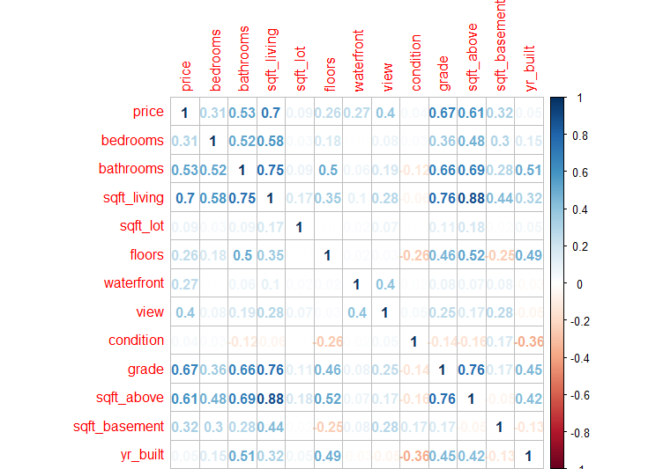
Correlation:
Housecor<- cor(Housedata[3:15])
cor(Housedata[3:15],method="pearson")

Slide 33
DETERMINING PRICE RMSE OF VARIOUS MODELS USING CARET PACKAGE
The caret package (short for _C_lassification _A_nd _RE_gression _T_raining) is
a set of functions that attempt to streamline the process for creating predictive models. The package
contains tools for:
data splitting
pre-processing
feature selection
model tuning using resampling
variable importance estimation
as well as other functionality.
There are many different modeling functions in R. Some have different syntax for model training and/or
prediction. The package started off as a way to provide a uniform interface the functions themselves, as
well as a way to standardize common tasks (such parameter tuning and variable importance).

Slide 34
1. Set the “id” attribute to Null as it is not required.
2. Since we are predicting prices, Price attribute will be our target variable.
3.. We check the correlation of various attributes with target variable “Price”. We need to plot the
correlation between the variables. Once we get how strong the pairs are associated we can ignore
the variables which have least effect on the price. For this we will use ggcorr to get the

Slide 35
4. We can see from below plot that attributes
bedrooms,bathrooms,sqft_living,view,grade,sqft_above,sqft_basement,lat,sqft_living15
display strong correlation with Price (Correlation >0.3).
5. Date,sqft_lot,floors,waterfront,condition,yr_built,yr_renovated,zip code,long,sqft_lot15
attributes have least effect on Price. (Correlation < 0.3).
We then look for multicollinearity effect between
bedrooms,bathrooms,sqft_living,view,grade,sqft_above,sqft_basement,lat,sqft_living15 .
6.. This can be checked by calculating VIF factor and if it is close to 4 then the attribute which
displays better correlation with Price will be retained and the other can be ignored.

Slide 39
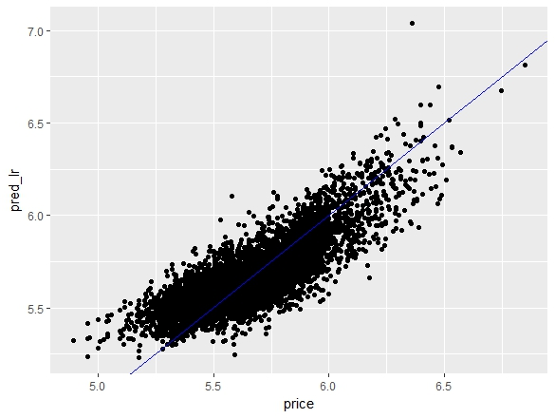
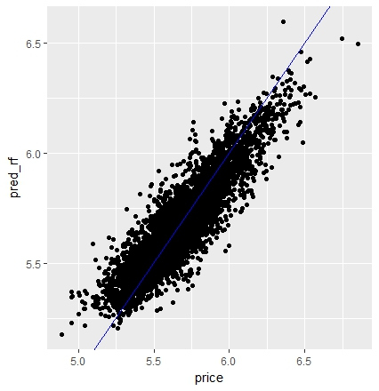
Results Comparison

Slide 40
Results Comparison
Linear Regression: RMSE_lr=0.1324297
Random Forest: RMSE_rf=0.09962464

Slide 41
Challenges:
1.It was very difficult to clean data which suits for every model.
2.Calculating RMSE value with considering different attributes each algorithm considers and then compare them.

Slide 42
Conclusion:
King County house dataset is chosen as target dataset
Linear Regression model and Random Forest model are selected to analyze the dataset and give the prediction on the house prices.
Many attributes are transform into more reasonable type in the preprocessing process, such as the attributes ‘date’, ‘yr_renovated’, the duplicated the observations with same ID are eliminated, and the target variable ‘price’ are taken logarithm to get the normal distribution of ‘price’.
complex correlations among the attributes and target variable ‘price’.
the results from both models show that the predictions made by two models are fair good.
the random forest model gave a little bit better result compared with linear regression.
It can also be seen from the prediction results of both models that the preprocessing on dataset and model parameters selection are successful.

Slide 43
REFERENCES
Kaggle.com
Data Mining –concepts, Models & Techniques.
R Data Mining -Yanchang Zhao

Slide 44
THANK YOU

