Slide 1
PREDICTION OF CHENNAI RESTAURANTS USING ZOMATO DATASET

Slide 2
INTRODUCTION
Chennai is the capital of Indian state of Tamil Nadu. It is a part of the city of Delhi’s 11 districts. It is one of the largest cultural, economic and educational centers of south India.
According to the 2011 Indian census, it is the sixth-most populous city and fourth-most populous urban agglomeration in India.
The city together with the adjoining regions constitutes the Chennai Metropolitan Area, which is the 36th-largest urban area by population in the world.
The Chennai Metropolitan Area is one of the largest municipal economies of India. More than one-third of India's automobile industry being based in the city. Home to the Tamil film industry, Chennai is also known as a major film production center.
Chennai is one of the 100 Indian cities to be developed as a smart city under the Smart Cities Mission. Tamils form the majority of Chennai's population. English is spoken largely by white-collar workers,[204] often mixed into Tamil.
Chennai, along with Bengaluru, Mumbai and Delhi, is one of the few Indian cities that are home to a diverse population of ethno-religious communities.
Due to its diverse culture there lots of varieties in food items. National Geographic mentioned Chennai as the only South Asian city to feature in its 2015 "Top 10 food cities" list.
There are many restaurants in Chennai city out of which each belonging to different categories like South Indian , North Indian , Chinese , Italian , European , Pan Asian , Japanese , Mediterranean etc.

Slide 3
OBJECTIVES
Questions that can be asked using the above mentioned datasets
Which places have the best restaurant in Chennai?
What places are have average restaurants in Chennai?
Which place are suitable for edible person in Chennai city?
Which place are not suitable for edible person in Chennai city?

Slide 4
DATA
Following are the data we need for the project :
Chennai restaurants data that contains list Locality, Resturant name,Rating along with their latitude and longitude.
Data source : Zomato kaggel dataset : https://www.kaggle.com/shrutimehta/zomato-restaurants-data
Description : This data set contains the required information. And we will use this data set to explore various locality of Chennai.
Nearby places in each locality of Chennai.
Data source : Fousquare API : https://developer.foursquare.com/
Description : By using this api we will get all the venues in each neighborhood.

Slide 5
PREDICTION PROCESS
Collect the Chennai city from Zomato Kaggle dataset
Using Foursquare API we will find all venues for for each neighborhood
Filter out all venues that are nearby by locality.
Using aggregative rating for each restaurants to find the best places
Visualize the ranking of neighborhoods using folium library(python)

Slide 6
RESULTS

Slide 7
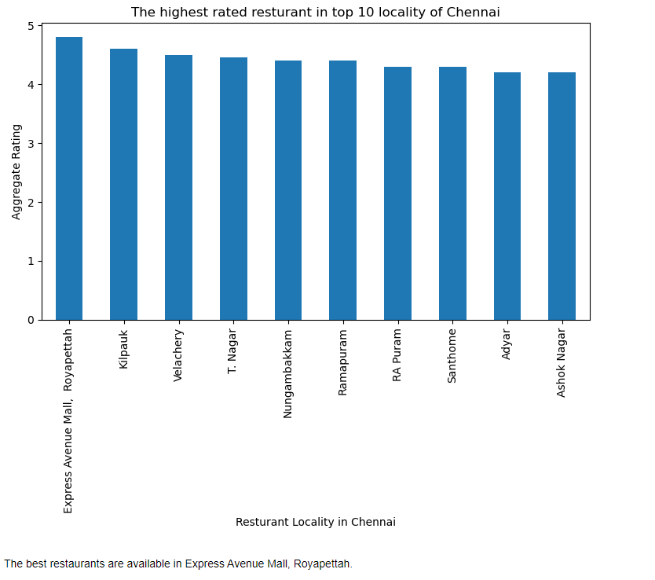


Slide 8
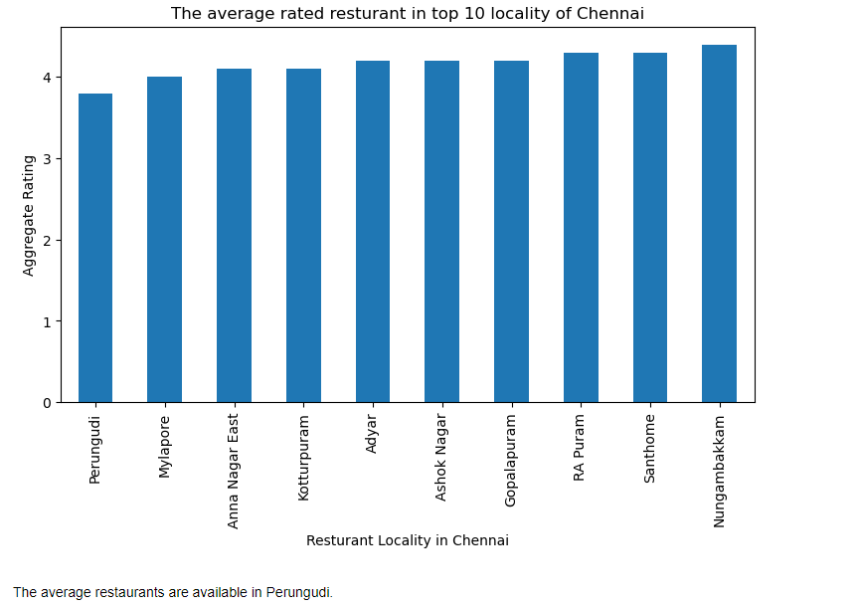

Slide 9
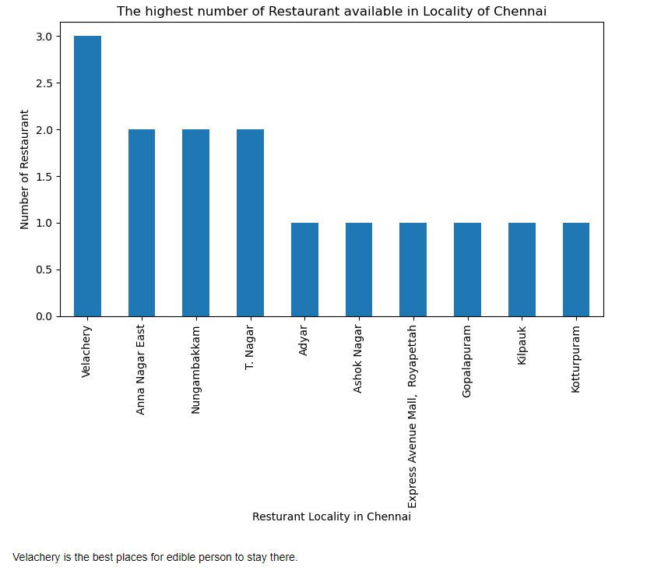

Slide 10
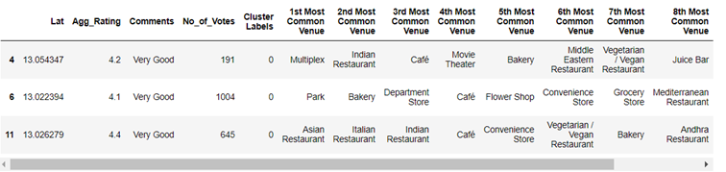
CLUSTER 1

Slide 11
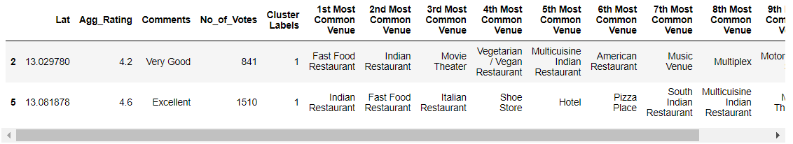
CLUSTER 2

Slide 12
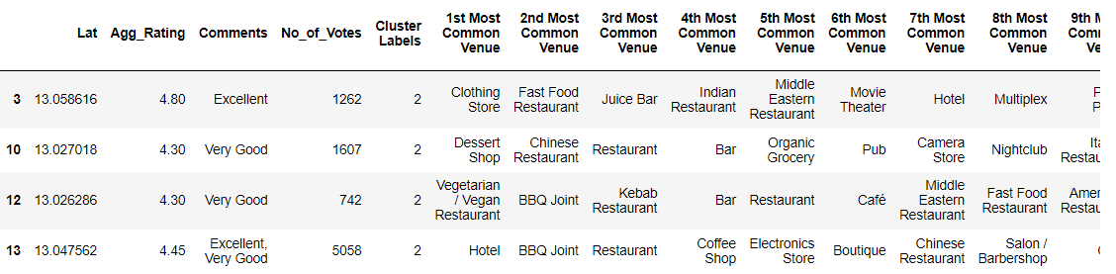
CLUSTER 3

Slide 13
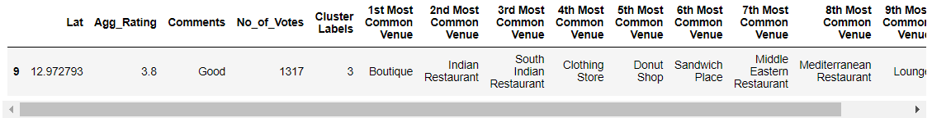
CLUSTER 4

Slide 14
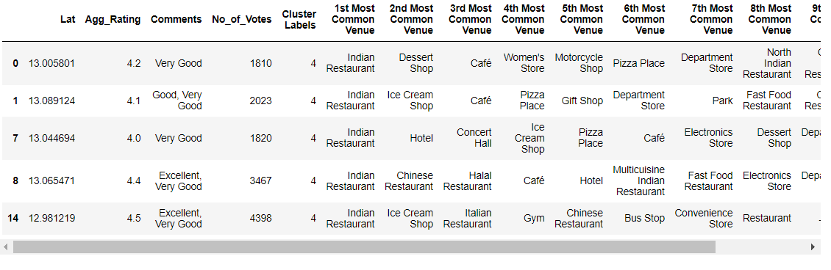
CLUSTER 5

Slide 15
CONCLUSION
The best restaurants are available in Express Avenue Mall, Royapettah.
The average restaurants are available in Perungudi.
Velachery is the best places for edible person to stay there.
The venues in all Chennai Locality
#### Cluster 1: It is most recommended for Indian Restaurants. #### Cluster 2: It is most recommended for Hotels and nightclub. #### Cluster 3 and Cluster 5: It is most recommended for Fast food. #### Cluster 4: It is most recommended for the cafe and pizza

