Slide 1
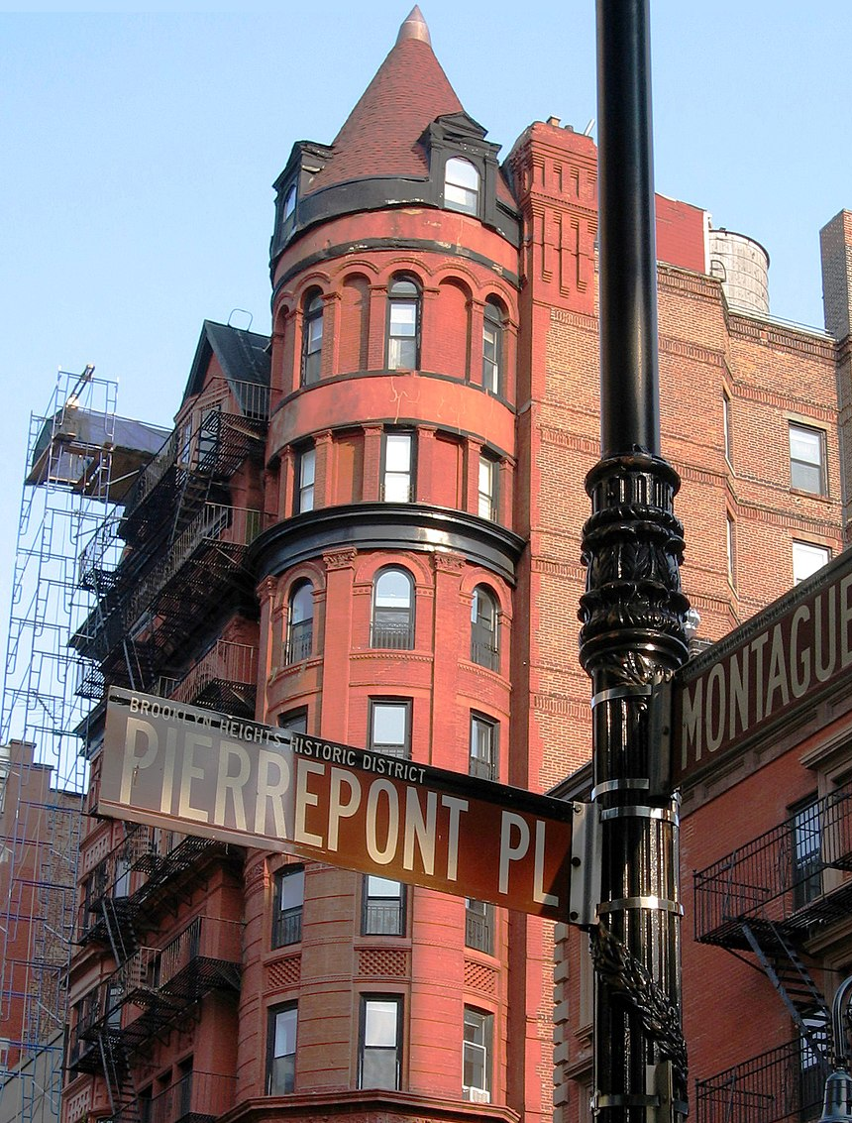
Finding a quiet place to live in NYC
Elena Pavlov NYC Data Science Academy
Notes:
I don’t live in Brooklyn, 311 data is zip code based, re prices are neighborhood based, I could quickly find only zip-neighborhood correspondence for Brooklyn.

Slide 2
Research Proposal
To find quiet and affordable neighborhoods in Brooklyn.
Stakeholders - low income seniors and families with children looking into moving into a new neighborhood and not realizing how noisy it could be. - builders/city looking to build a senior housing, nursing homes in a quiet area (for this part we need to compare with land and property values – further research needed).
There are high noise/high rent, high noise/low rent, low noise/high rent, and low noise/low rent neighborhoods.
We will try to pinpoint neighborhoods with lowest noise complaints and where rent is cheap.
We will try to determine if there is a negative correlation between noise pollution areas and rent prices.

Slide 3
Background Information
NYC 311 Database with records of all non emergency complains, which include different types of noise (residential, commercial, park, street etc.), street conditions, homelessness, etc, 220 different categories in total.
Median rent prices by neighborhood from www.streeteasy.com.

Slide 4
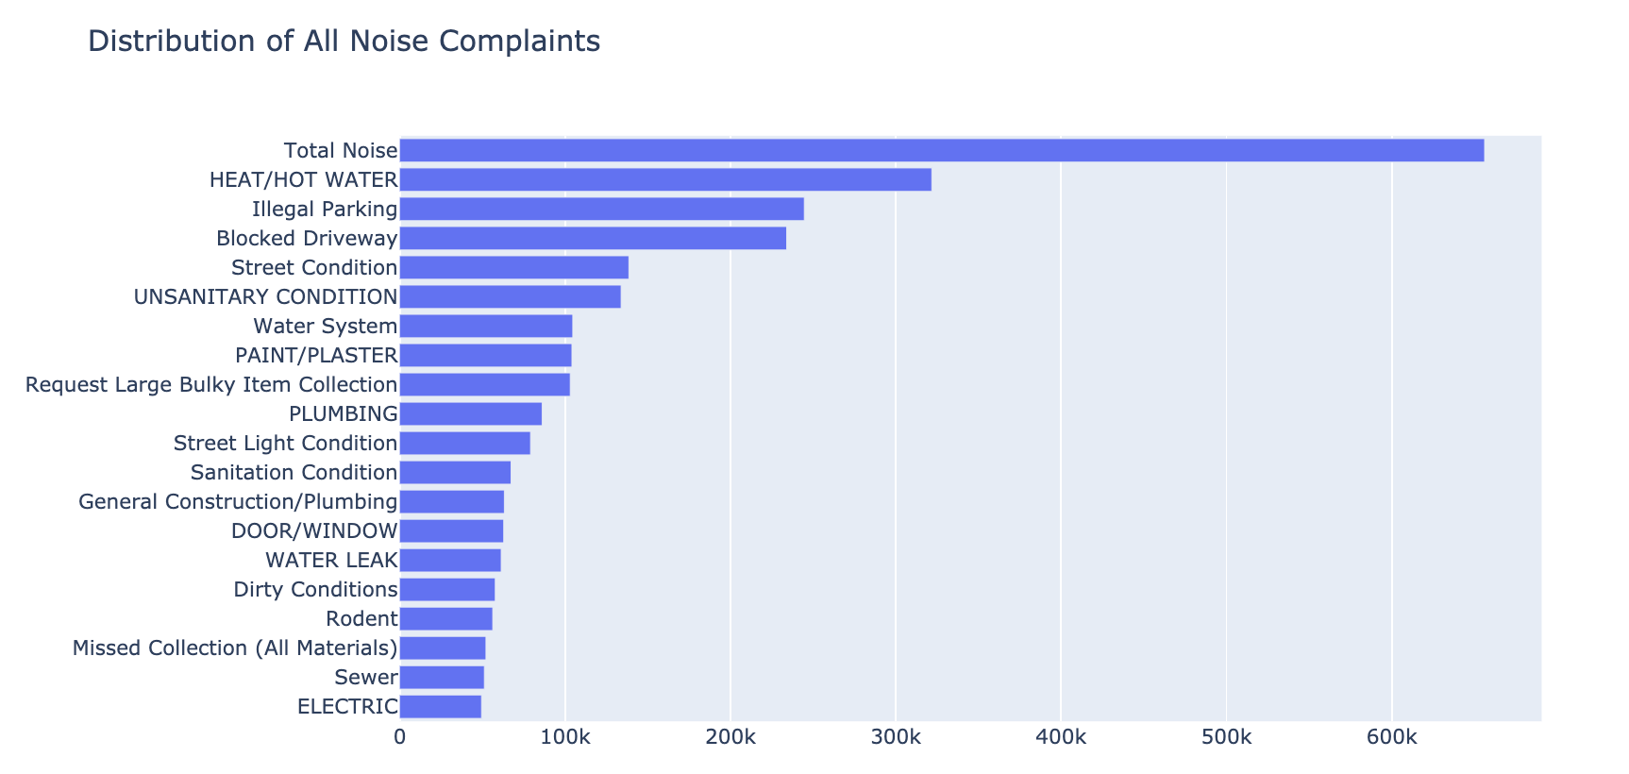
Most common complaints in the city

Slide 5
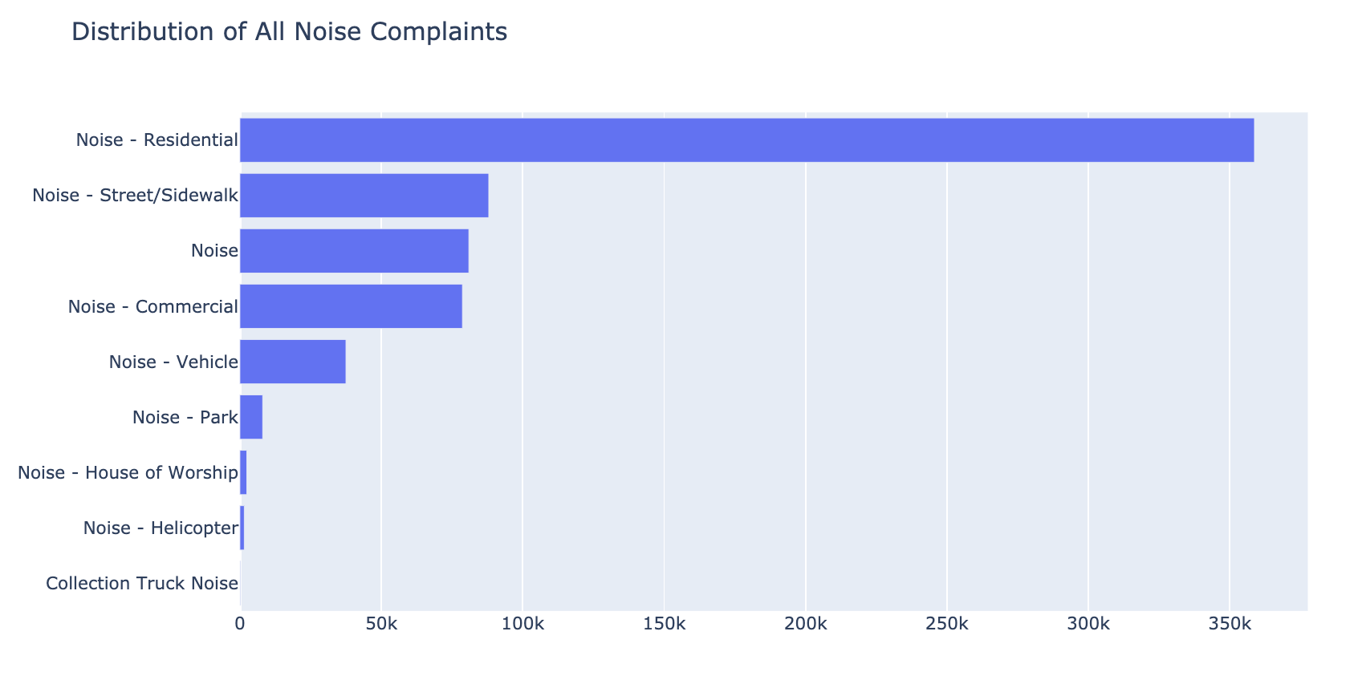
Where all the noise is coming from?

Slide 6
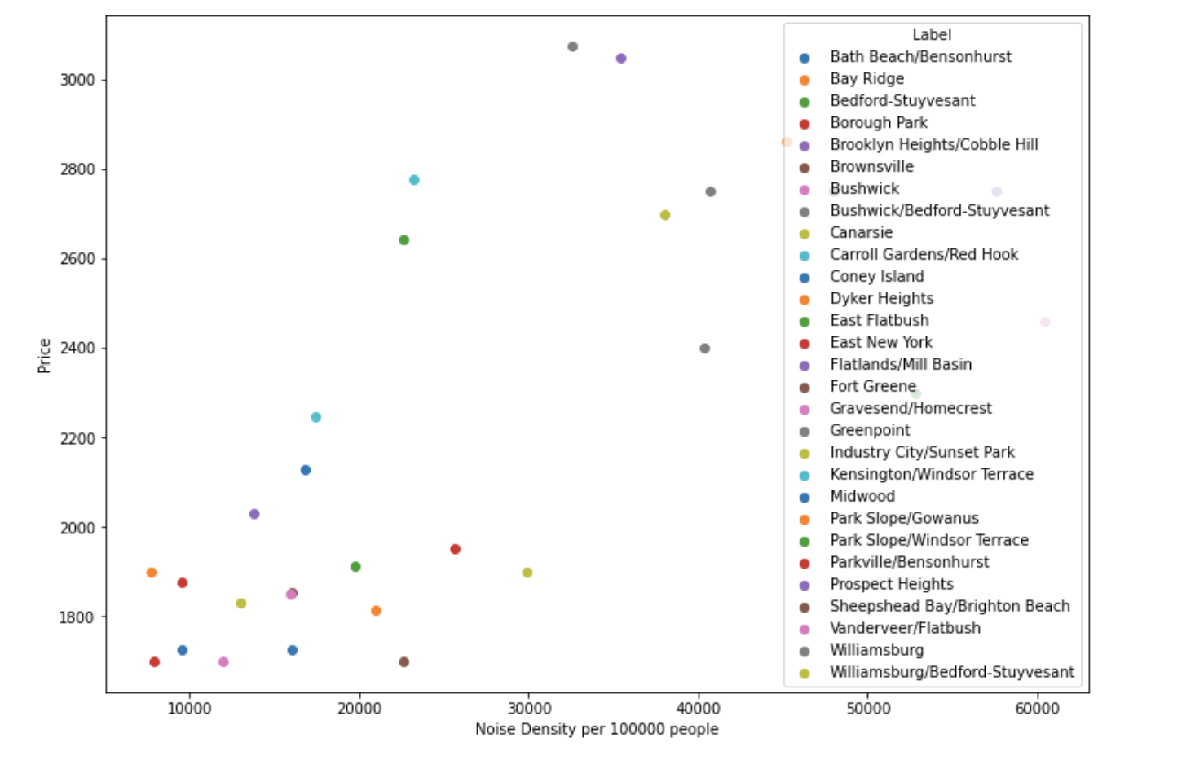

Slide 7
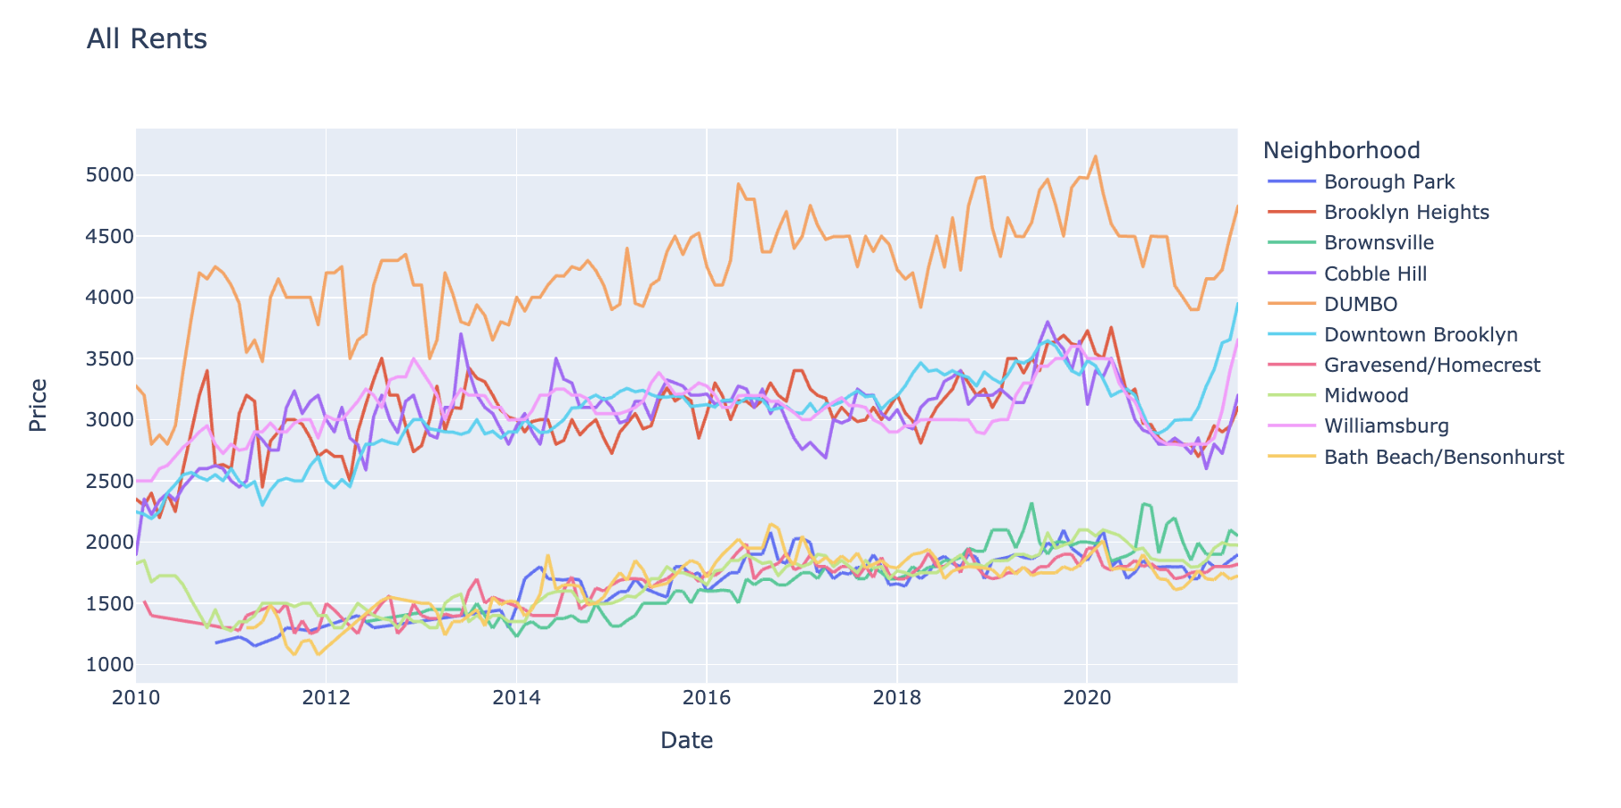
Top and Bottom 5 Medium Rents

Slide 8
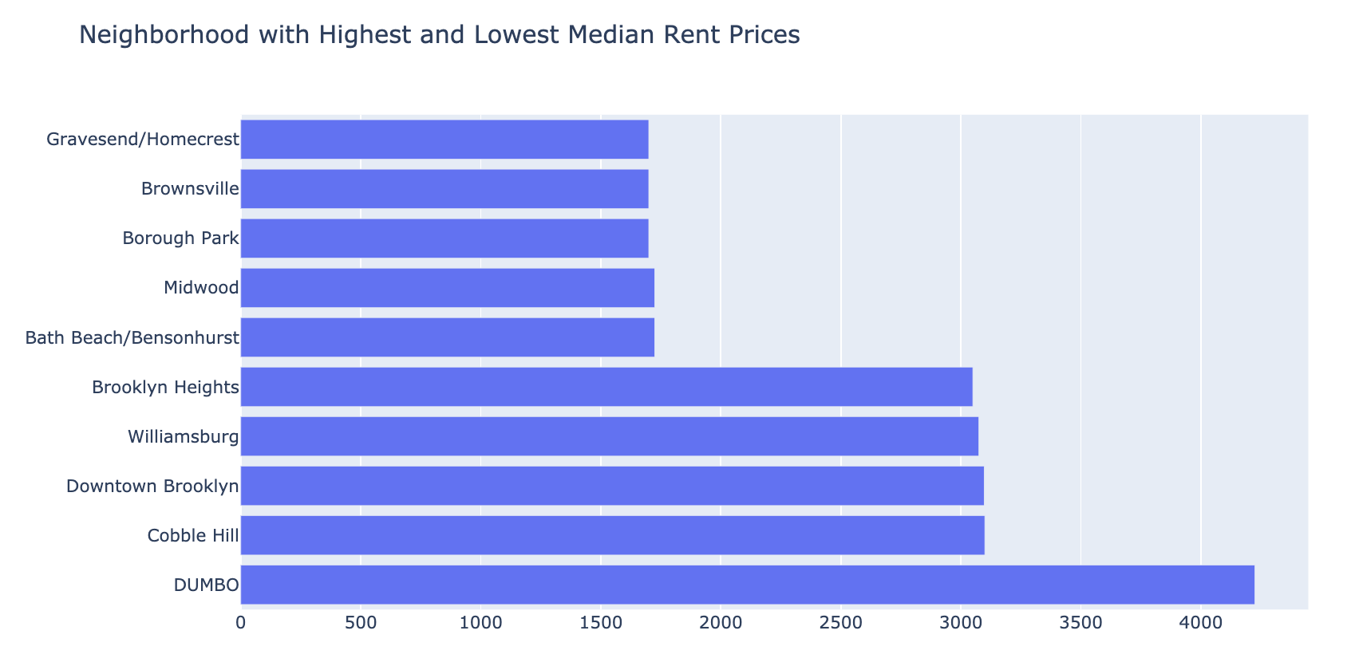
Top and Bottom 5 Median Rents over 2010 - 2021
Notes:
DUMBO is an outlier

Slide 9
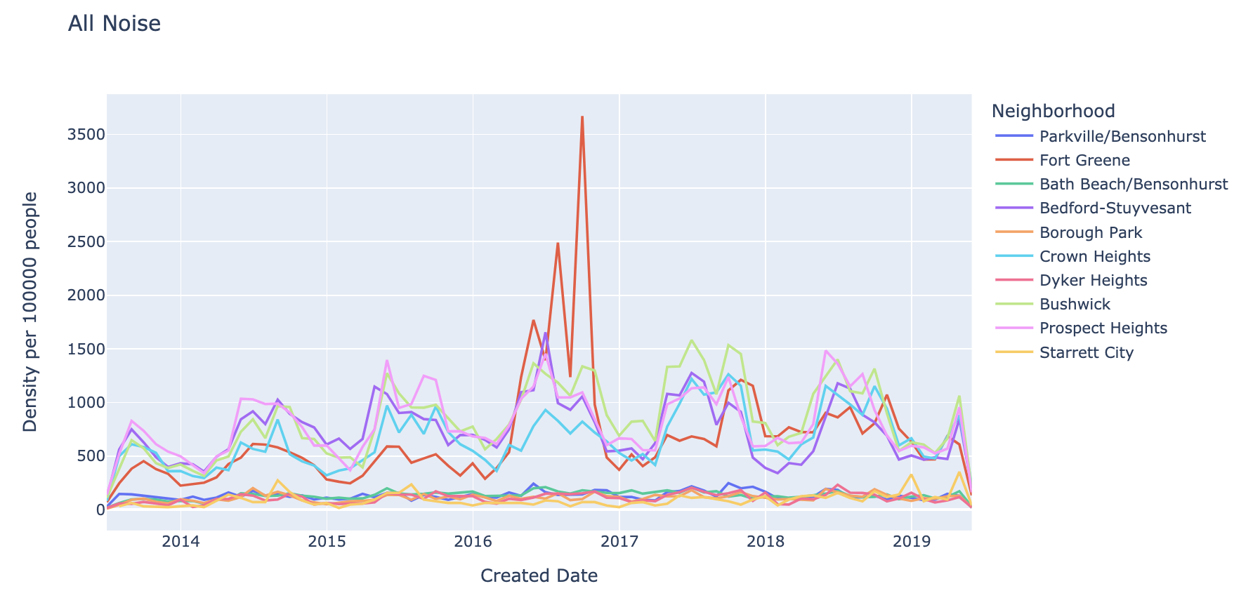
Top and Bottom 5 By Noise Pollution

Slide 10
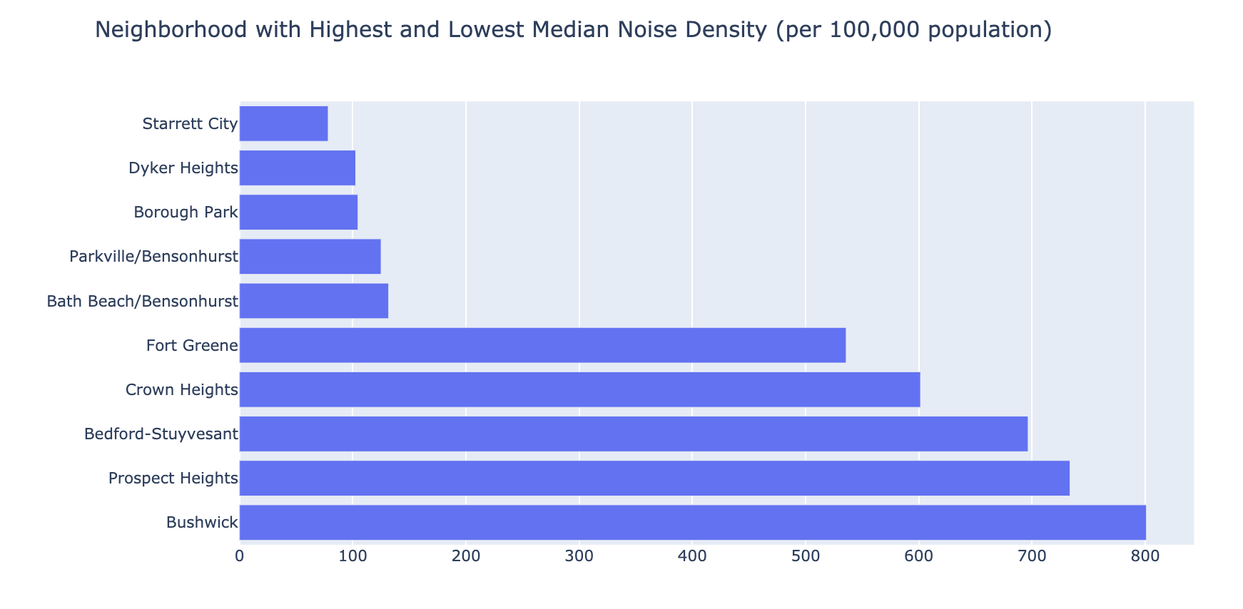
Top and Bottom 5 By Noise Pollution

Slide 11
Conclusions
Not all cheap neighborhoods are noise free.
Some of the noisiest neighborhoods are the most expensive.
I looked at the bottom 5 in both sets and identified 'Borough Park’ and 'Bath Beach/Bensonhurst’ as very affordable and very low noise level neighborhoods. If I were looking to rent, with noise pollution being a key factor in rental location, I would definitely further researched “Borough Park’ as an area closest to Manhattan.
If selection is increased to the bottom 10, the following new names appear: 'Canarsie', 'Vanderveer/Flatbush', 'Gravesend/Homecrest’.
I did not find any correlation between level of noise and rent prices in this research.
Noise pollution in NYC is an issue which varies from neighborhood to neighborhood and needs to be further researched.

Slide 12
Future research
Analyze more neighborhoods in other boroughs.
Can we find correlations with other types of complaints?
Add interactive map where users can select a type of complaint and the map will show color coded inofrmation.
I only had time to do this analysis for Noise related issues, but would be interesting to see other complaints.
Identify the source of noise by correlation with business, entertainment, restaurants and bars.

Slide 13
Limitations
Zip codes do not correspond to neighborhoods, one zip code can belong to 2 neighborhoods. I found a mapping that is used by real estate professionals, but it is not exact.

Slide 14
Resources
https://data.cityofnewyork.us/Social-Services/311-Service-Requests-from-2010-to-Present/erm2-nwe9/data - NYC 311 database
https://streeteasy.com/blog/data-dashboard/?agg=Total&metric=Inventory&type=Rentals&bedrooms=Any%20Bedrooms&property=Any%20Property%20Type&minDate=2010-01-01&maxDate=2021-08-01&area=Flatiron,Brooklyn%20Heights – rent prices by neighborhood 2010 to current
http://www.brooklynproperty.com/Brooklyn/ZipCodes.htm# - postal code to neighborhood name mapping
https://www.newyork-demographics.com/zip_codes_by_population - NY State population by zip code

Slide 15
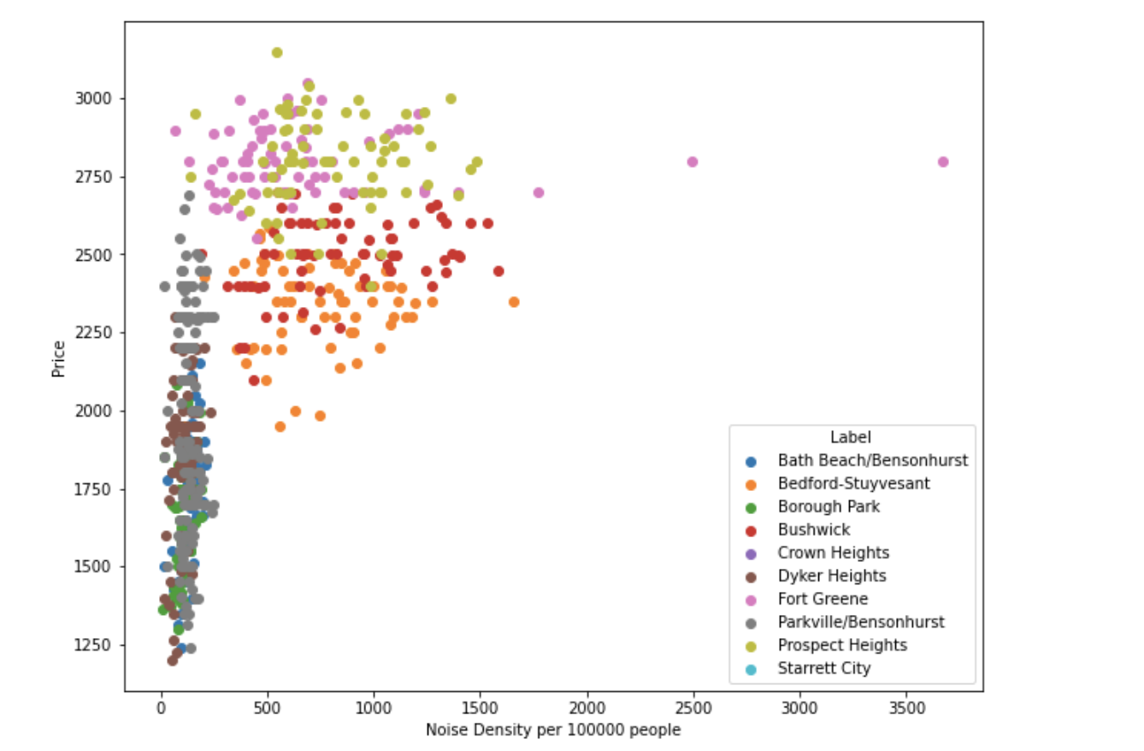

Slide 16
Found neighborhoods with highest and lowest noise condition
I was looking for negative correlation between different complaints and rent prices
While I did not find any correlations, looking at the data I found neighborhoods in Brooklyn where I would prefer not to live
Because I started having insomnia quite recently and street sounds play big role it it.
NB – I don’t live in Brooklyn and do not know any other details about these neighborhoods that might affect their prices.

