Slide 1

HTML Based Web Development (BLOG)

Slide 2
Introduction
A blogging system is an online platform that allows users to create, manage, and share written content with a wider audience. It provides tools for writing blog posts, uploading media, organizing content, and interacting with readers through comments or feedback. Whether for personal use, education, or business, blogging systems make it easy to publish and maintain content on the web without needing advanced technical skills.

Slide 3
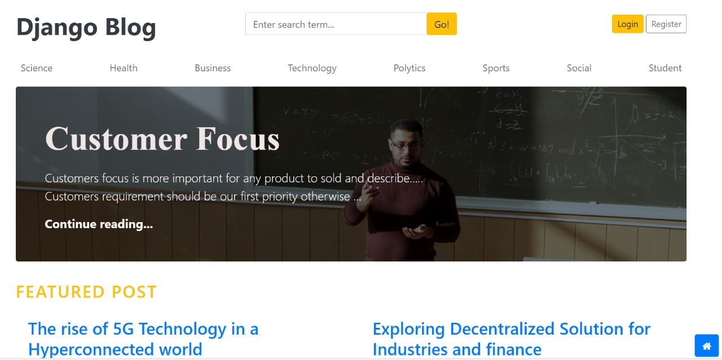
Home Page :

Slide 4
Objective
To provide a clean and simple interface for writing and editing blog posts.
To enable users to register, log in, and manage their own blogs.
To support adding images, videos, and other media to blog posts.
To categorize and organize posts using tags or categories.
To allow readers to view, comment on, and share blog posts.
To ensure the system is secure, responsive, and easy to navigate.

Slide 5
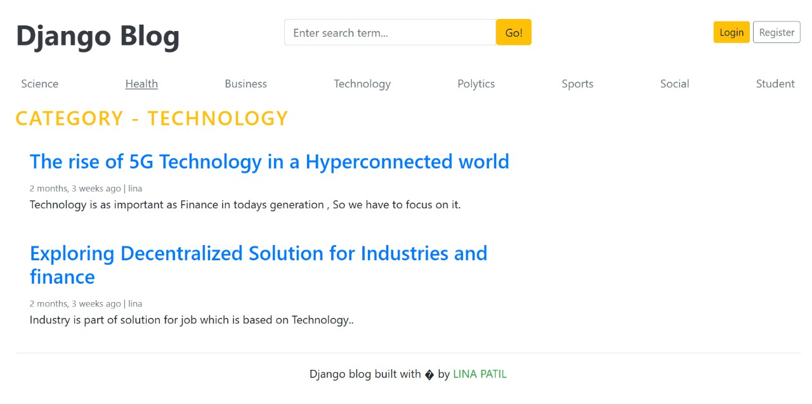
Category Page :

Slide 6
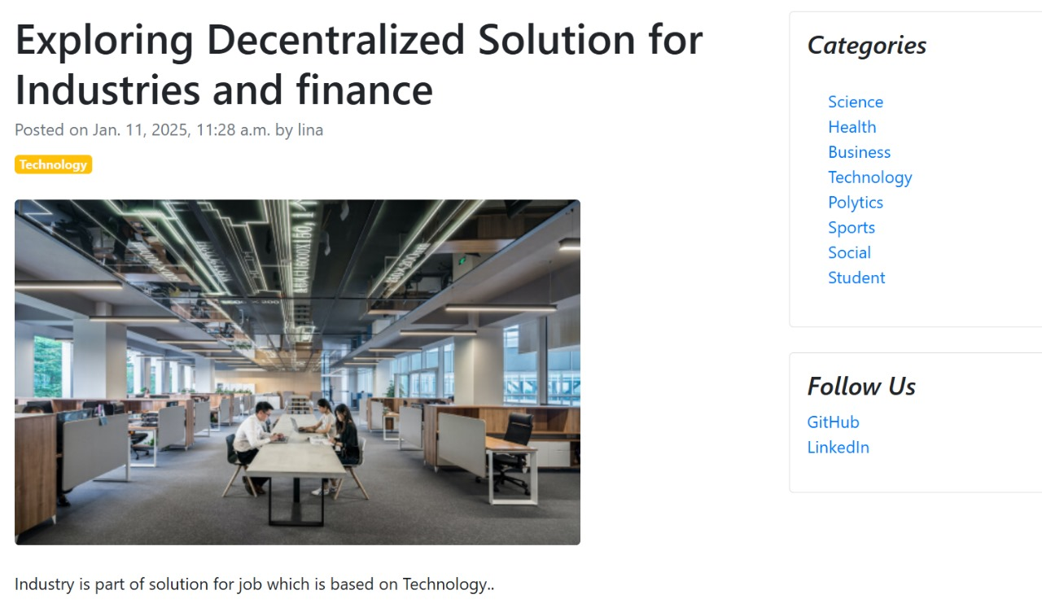
Blog Page :

Slide 7
Problem Definition
Many people want to share their thoughts, ideas, or knowledge online, but they may not have the technical skills to create and manage a website. There is a need for a simple and user-friendly blogging platform that allows users to easily write, publish, and manage their blog posts without requiring coding knowledge. The system should also support features like media uploads, post organization, and user interaction.

Slide 8
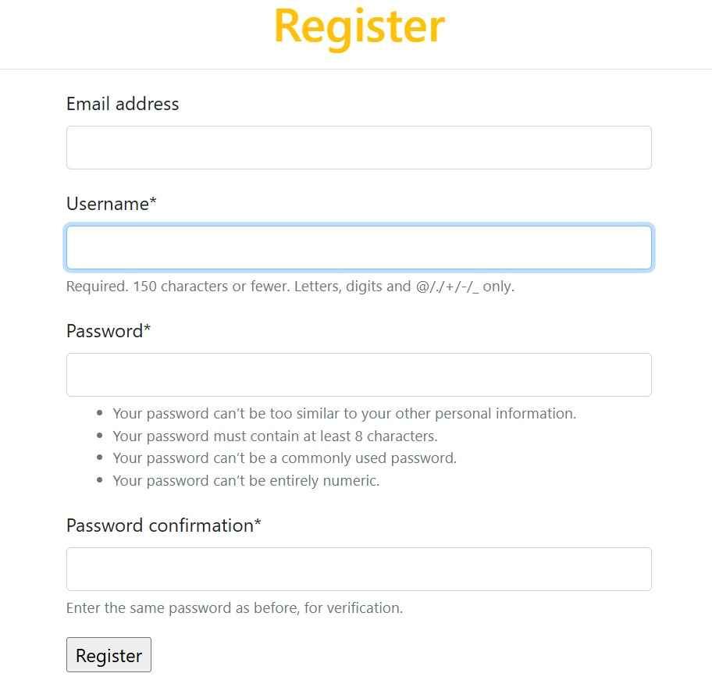
User Registration Page :

Slide 9
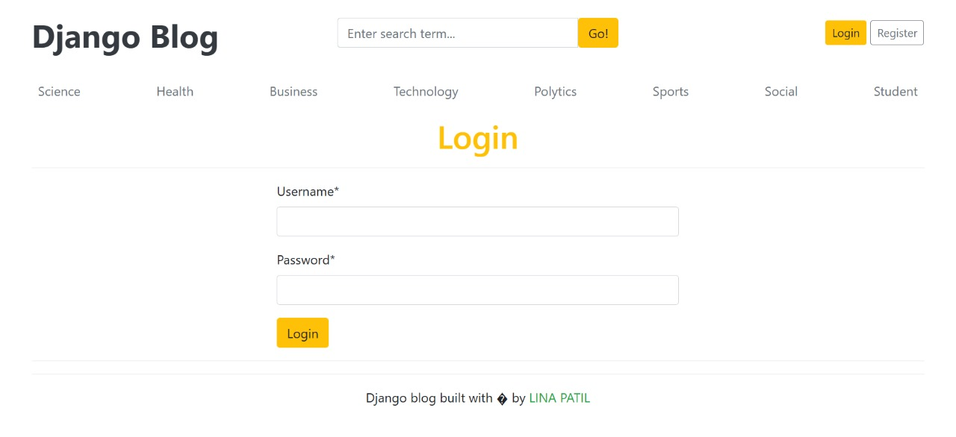
User Login Page :

Slide 10
Project Scope
This project includes the development of a full-fledged blogging website that features:
User registration and authenticationBlog
creation, editing, and deletion
Categorization and tagging of blogs
Commenting system for user interaction
Admin panel for managing users and content
Responsive design for desktop and mobile views
The platform is scalable and can be expanded in the future to include features like blog analytics, subscription models, or integration with social media platforms.

Slide 11
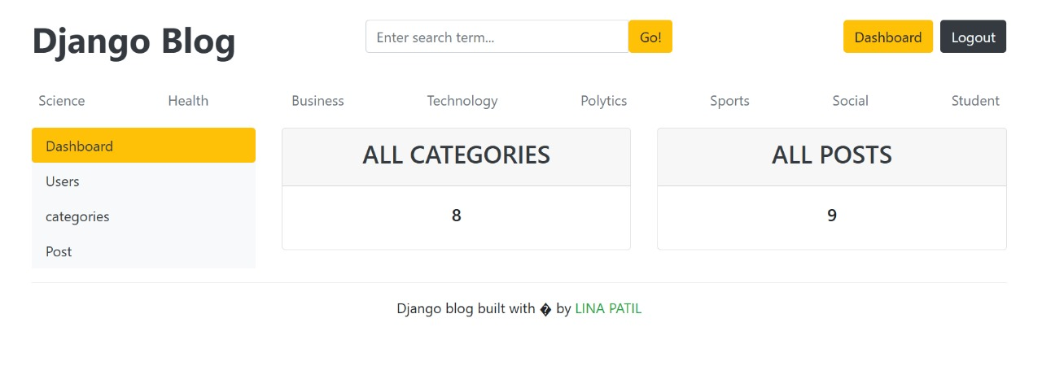
Dashboard :

Slide 12
User Modules:
User can signup
User can login
User can upload multiple images
User can choose image from database
User can add information
User can add comment
User can select any categories

Slide 13
Admin Modules:
Admin can resume user ID
Admin can see all pages
Admin can maintain all records of user
Admin can maintain all site
Admin can access and process all request
Admin can delete/select/update user
Admin provide all information related to any topic

Slide 14
Data Flow Diagram(DFD)
Level 0 – Context Level DFD
[User] ---> [Blogging System] ---> [Blog Posts, Comments, Responses]

Slide 15
Level 1 DFD – Detailed Process Flow
+------------------------+
| User |
+------------------------+
|
v
+------------------------------+
| 1. User Authentication |
+------------------------------+
|
+--------------+-----------------+
| |
v v
+----------------------+ +-------------------------+
| View Dashboard | | View/Create Post |
+----------------------+ +-------------------------+
| |
v v
+----------------+ +------------------------+
| Post to DB | | Fetch from DB |
+----------------+ +------------------------+
| |
v v
+------------------------+ +----------------------+
| Comment System |<-->| Display Posts |
+------------------------+ +----------------------+

Slide 16
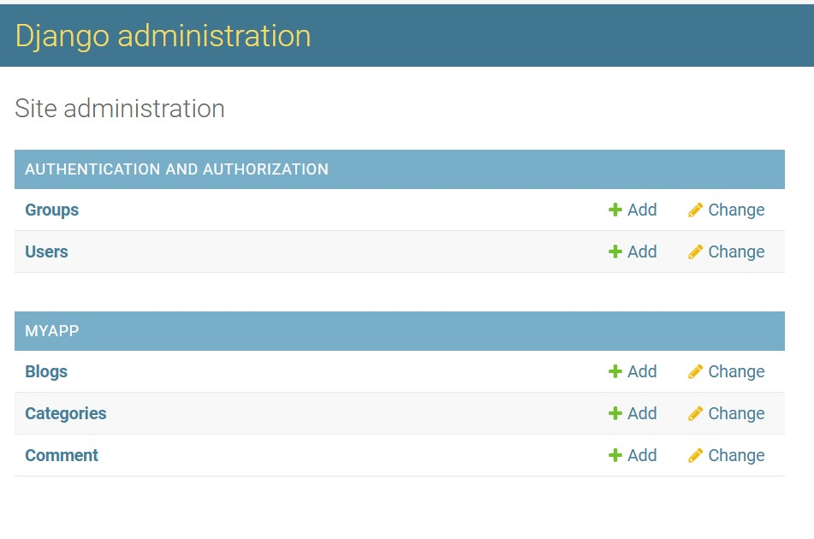
Database :

Slide 17
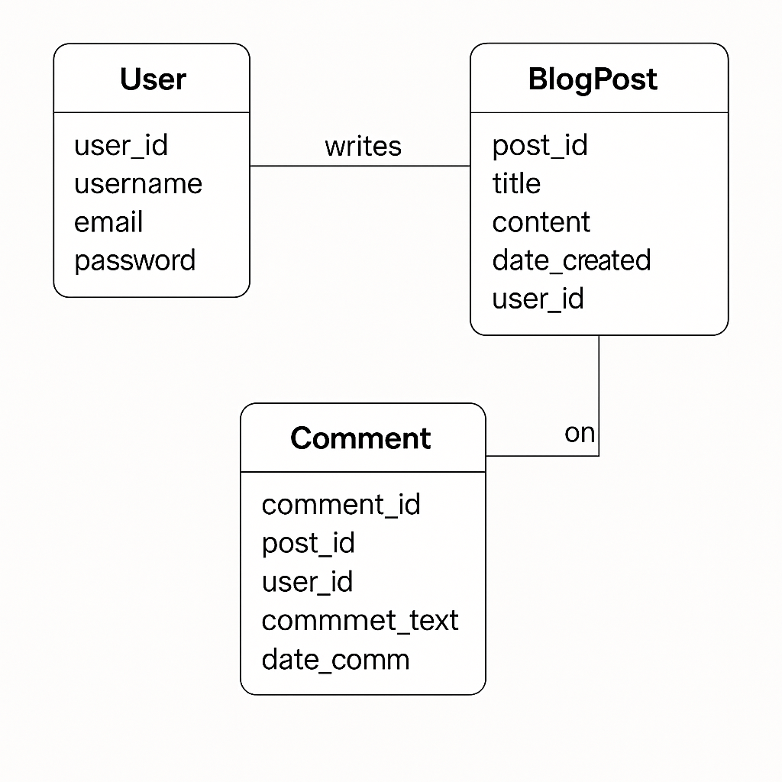
ER diagram :

Slide 18
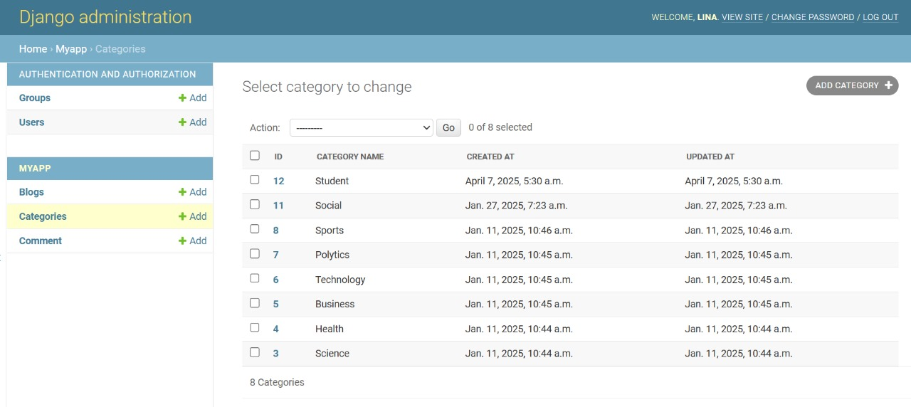
All database :

Slide 19
Need of The System
To provide an easy way for users to create and publish blog posts.
To allow user registration and secure login.
To manage and organize blog content efficiently.
To support media uploads (images, videos, etc.) in posts.
To make the website responsive and accessible on all devices.
To enable readers to comment and interact with blog posts.
To ensure the platform is safe and protects user data.
To allow sharing of posts on social media and other platforms.

Slide 20
Purpose
The purpose of this blogging website is to provide users with an interactive platform where they can create, publish, and manage blog posts on various topics. It enables both individual expression and community interaction through content sharing, commenting, and tagging. The platform is designed to be user-friendly, visually appealing, and adaptable to different content types like articles, images, and videos.

Slide 21
SOFTWARE USED
PYTHON INTERPRETER
PYCHARM IDE (INTEGRATED DEVELOPMENT ENVIRONMENT)
DJANGO FRAMEWORK
CHROME OR ANY OTHER BROWSER

Slide 22
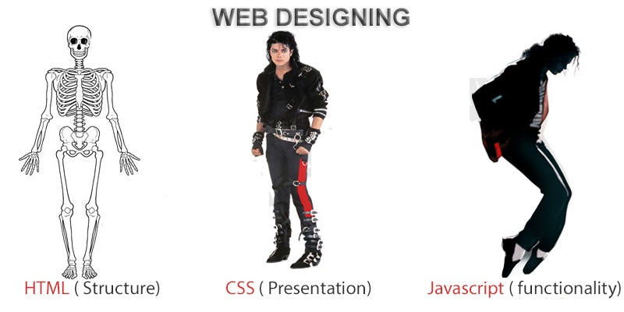
FRONTEND (LANGUAGE USED)
HTML (HYPERTEXT MARKUP LANGUAGE)
CSS (CASCADING STYLE SHEET)
BOOTSTRAP (FRAMEWORK OF HTML,CSS AND JS)

Slide 23

BACKEND
PYTHON DJANGO
SQLITE (DATABASE)

Slide 24
Directory Structure
/Blog_Project/
/myproject
├── /static/ # CSS, JS, images
├── /templates/ # HTML templates
├── /app/
│ ├── models.py # Database models
│ ├── routes.py # URL routing
│ ├── views.py # Business logic
│ └──urls.py
└── run.py # Entry point
/myvenv #enviroment setup

Slide 25
FUTURE SCOPE
The future of blog websites is bright, with continued growth and evolution. Blogging remains a powerful way to build authority, connect with audiences, and generate leads, especially when combined with social media and multimedia content. AI-driven content creation tools and advanced SEO practices are also shaping the future of blogging. Blogging is a digital powerhouse that continues to shape the online landscape. Many bloggers are successfully turning their hobby into a full-time career, leveraging their expertise and online presence to build a strong following and generate income, says a post on Indeed [17]. the future of blog websites is bright and dynamic, with new technologies, trends, and opportunities constantly emerging. By embracing these changes, focusing on high-quality content, and prioritizing user experience, bloggers can continue to thrive and build a successful online presence.

Slide 26
CONCLUSION
The blogging website project was successfully developed to provide users with a streamlined, user-friendly platform for sharing content online. The system fulfills its core objectives, including user registration, blog creation, content management, and interaction through comments. This platform not only serves as a content-sharing tool but also fosters community engagement and digital expression.

Slide 27
Thank You ..

