Slide 1

JobConnect
Team Nexus:
Aila, Tej, Lina, Selma
July 7th, ‘24

Slide 2


THE IDEA
The job market can be extremely difficult to navigate, whether you are seeking employment or seeking employees…
JobConnect helps make the market seem not so intimidating!
JobConnect is an innovative platform that that bridges the gap between job seekers and employers by enabling:
Job seekers showcase profiles
Employers search, filter, and save candidates to streamline hiring.
Overall, ensuring the perfect match between talent and opportunity!

Slide 3

WHO NEEDS IT?
The platform serves two primary user groups:
Job Seekers
Suitable for recent graduates, mid-career professionals, and executives
create detailed profiles
showcase skills, experience + career aspirations
Employers
For companies of all sizes, from startups to multinationals
Efficient and effective talent discovery and hiring
Robust search and filtering tools to match job requirements

Slide 4
WHY SHOULD YOU INVEST IN JOBCONNECT?
Investing in JobConnect means supporting a platform that not only promises substantial returns but also makes a meaningful impact on the job market
MARKET DEMAND
INNOVATIVE FEATURES
REVENUE MODEL
Advanced search algorithms and personalized recommendation
Stands out from traditional job platforms
Focuses on matching right talent with right opportunities
Enhances hiring experience for both job seekers and employers
Multiple revenue streams
Premium subscriptions for job seekers
Paid job postings for employers
Targeted advertising
Ensures financial stability and growth potential
Evolving job market demands specialized platforms
JobConnect caters to both job seekers and employers
User-friendly and efficient solution

Slide 5
Use Case 1: Job Seeker
Register
Create Profile
Search Jobs
Find Job Posting
Upload Resume
Submit Application
Receive Email Confirmation
End: Track Application

Slide 6
Use Case 2: Job Offerer
Register
Create Profile
Post Job Opening
Receive Applications
Filter Applications
Select Candidates
Update Candidates
End: Extend Job Offers

Slide 7
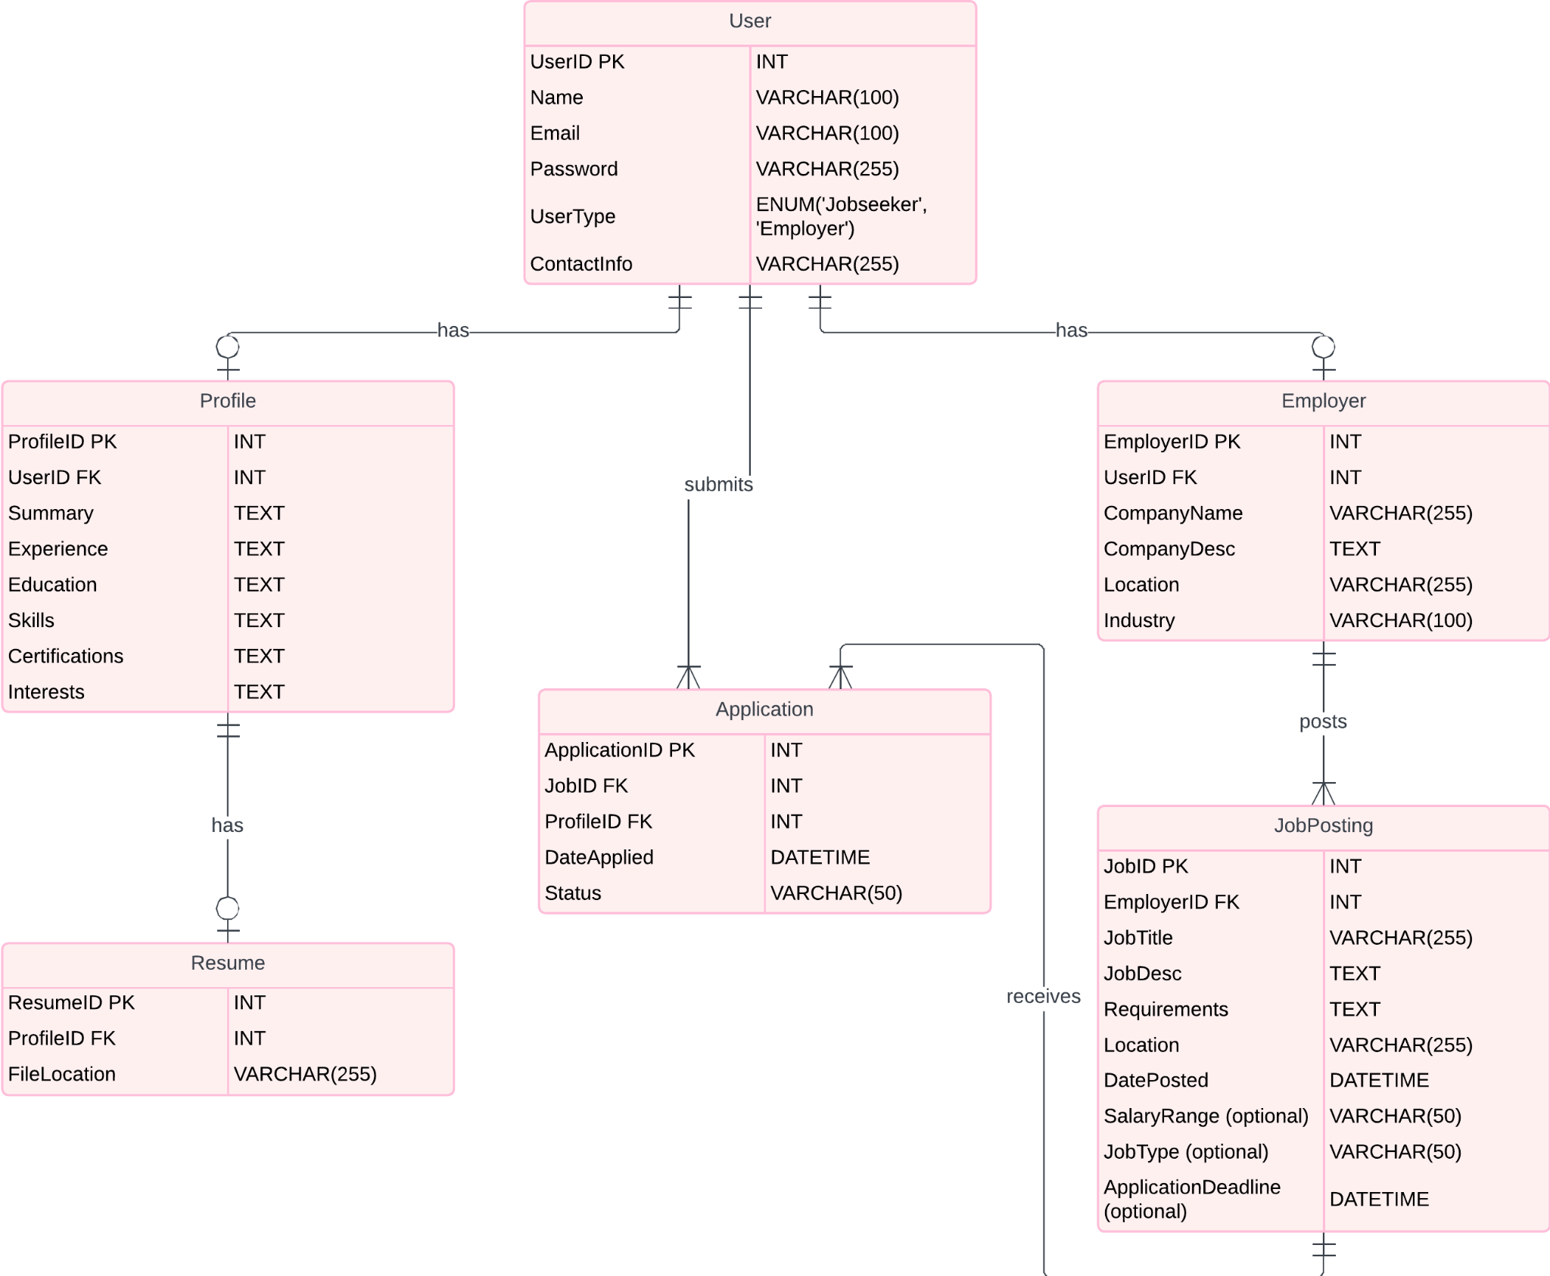
The Data

Slide 8






The Stack
My
FrontEnd:
Framework: Next.js / React
Styling: CSS
Database:
MySQL
Backend:
Framework: Flask
Repository:
Github
Git for version control system

Slide 9
Member Roles
Aila
Lina
Frontend
Database
Selma
Tej
Backend
Integration

Slide 10
Q&A

