Slide 1


Lina Rojas
<Date>

Slide 2

Outline
Executive Summary
Introduction
Methodology
Results
Conclusion
Appendix

Slide 3
Executive Summary
Summary of methodologies
  Data collection with the SpaceX REST API and web scraping (Wikipedia)
  Data wrangling to create the landing outcome label
  Exploratory data analysis with SQL and data visualization
  Interactive visual analytics with Folium and Plotly Dash
  Predictive analysis with classification models (Logistic Regression, SVM, Decision Tree, KNN)
Summary of all results
  Launch success improved steadily over time, especially after 2013
  KSC LC-39A had the most successful launches of any site
  Orbits like ES-L1, GEO, HEO and SSO had the highest success rates
  Launch sites are close to coastlines and far from cities
  All models reached 83.3% test accuracy. Decision Trees had the highest validation accuracy
  The model’s main weakness is false positives: they predicted some failed landings as successful

Slide 4
Introduction
Project background
  SpaceY, a new rocket company founded by billionaire industrialist Allon Musk, wants to compete with SpaceX
  SpaceX advertises Falcon 9 launches for about $62 million, while other providers charge $165 million or more.
  Most of SpaceX’s savings come from reusing the first stage of the rocket
  If we can predict whether the first stage will land successfully, we can estimate the cost of a launch.
Problems we want to find answers
  Can we predict whether the Falcon 9 first stage will land successfully, using a machine learning model trained on past launch data?
  Which factors (payload mass, orbit type, launch site, flight number) affect landing success?
  Which launch sites have the highest success rates, and where are they located?
  How has landing success changed over time?

Slide 5

Section 1

Slide 6
Methodology
Executive Summary
Summary of methodologies
  Data collection with the SpaceX REST API and web scraping (Wikipedia)
  Data wrangling to create the landing outcome label
  Exploratory data analysis with SQL and data visualization
  Interactive visual analytics with Folium and Plotly Dash
  Predictive analysis with classification models (Logistic Regression, SVM, Decision Tree, KNN)
Summary of all results
  Launch success improved steadily over time, especially after 2013
  KSC LC-39A had the most successful launches of any site
  Orbits like ES-L1, GEO, HEO and SSO had the highest success rates
  Lauch sites are close to coastlines and far from cities
  All models predicted landing outcomes with 83.3% accuracy on the test set

Slide 7
Data Collection
Launch data was collected from two sources:
  SpaceX REST API (api.spacexdata.com/v4/)
  Web scraping of Falcon 9 launch records
The API provided launch details: rocket, payload, launch site, landing specifications, date and outcome
Both datasets were cleaned and filtered to Falcon 9 launches

Slide 8
Data Collection – SpaceX API
Request Rocket Launch data
Spacex API
Parse JSON
Json_normalize
Keep Important features
Rockets,payloads, launchpad, cores, date
Build launch_dict
Lists into pd.DataFrame
Filter and export
Falcon 9, save CSV
Look up IDs
e.g. /rockets+str(ID)
Check request
200 status
Sent a GET request to /v4/launches/past and parsed the JSON response and with .json() and json_normalized into a DataFrame
Rocket, launchpad, payload and core columns held only IDs, so helper functions (getBoosterVerssion, getLaunchSite, getPayloadData, getCoreData) requested each ID from its own endpoint.
Combined the results into a dictionary, converted it to a DataFrame, filtered to Falcon 9 and replaced missing payload mass with the mean.
GitHub notebook:

Slide 9
Data Collection - Scraping
Request the Wikipedia page
requests.get() on Falcon 9 URL
Parse the HTML
Create a BeautifulSoup object
Extract column names
From the table header cells
Find the launch tables
soup.find_all('table')
Parse the table rows
Fill launch_dict row by row
Create DataFrame and export
pd.DataFrame(), then to_csv()
Falcon 9 launch records were scraped from Wikipedia with BeautifulSoup, parsed from HTML tables into a dictionary, and converted into a pandas DataFrame saved as CSV.
GitHub notebook:

Slide 10
Data Wrangling
Load data
dataset_part_1.csv
Explore data
Data types,% missing values
Count sites and orbits
values_counts per category
Inspect landing outcomes
e.g. True ASDS, False Ocean
Create Class Label
0= failed, 1 = landed
Export data
dataset_part_2.csv
Explore data types and missing values
Counted launches per site and orbit type
Labeled landings: 1=success, 0=failure
Overall success rate: ~67%
Saved as dataset_part_2.csv
GitHub notebook:

Slide 11
EDA with Data Visualization
Chart | Purpose
Scatter: Flight number vs. Launch site | Does experience improve success at each site?
Scatter: Payload mass vs. launch site | Do heavier payloads affect success by site?
Bar: Success rate by orbit type | Which orbits have the highest success rate?
Scatter: orbit vs. flight number/payload | How do orbit, experience and payload related to success?
Line: Yearly success rate | How has success changed over time?
GitHub notebook:

Slide 12
EDA with SQL
Loaded the SpaceX dataset into a SQLite database (to_sql) and created a clean table without null dates
Explored launch sites and payloads: unique sites, sites starting with “CCA,” and total/average payload mass (DISTINCT, LIKE, SUM, AVG)
Analyzed landing and mission outcomes: first ground pad success, drone ship successes by payload range, and success vs. failure counts (MIN, COUNT, GROUP BY)
Ran advanced queries: boosters with maximum payload (subquery), 2015 drone ship failures by month (CASE, substr), and landing outcomes ranked from 2010 to 2017 (ORDER BY)
GitHub notebook:

Slide 13
Build an Interactive Map with Folium
Markers: labeled the NASA Johnson Space Center and each launch site, so locations are easy to identify
Circles: highlighted the area around each launch site, with a popup showing the site name
Marker clusters: grouped launch outcomes at each site, using green markers for successful landings and red for failed ones, so success rates can be compared visually
Lines: measured the distance from launch sites to nearby features (coastline, city, highway, railway) to study how close sites are to infrastructure and populated areas
GitHub notebook:

Slide 14
Build a Dashboard with Plotly Dash
Launch site dropdown: select all sites or a single site to filter every chart on the dashboard
Pie chart: shows total successful launches by site, or the success vs. failure split for a selected site, to compare site performance
Payload range slider: filters launches by payload mass (0–10,000 kg) to see how payload affects outcomes
Scatter plot (payload vs. launch outcome): colored by booster version, showing the correlation between payload, booster type and mission success
GitHub Python File:
Notes:
Questions:
Which site has the largest successful launches?
The launch site with the largest successful launches is KSC LC-39A with 10 successful launches
Which site has the highest launch success rate?
KSC LC-39A has the highest launch success rate with 76.9% of the launches
Which payload range(s) had the highest launch success rate?
The payload with the highest launch success rate is 6k -8 k (100%)
Which payload range(s) have the lowest launch success rate?
The payload with the lowest launch success is 2k-4k with 40%
Which F9 Booster version (V1.0, V1.1, FT, B4,B5, etc.) has the highest launch success rate?
Booster version with highest success rate: V1.0

Slide 15
Predictive Analysis (Classification)
Load data: loaded the dataset, the features (X) and the target, landing outcome (Y = Class)
Preprocess: standardized X with StandardScaler
Split: divided the data into training (80%) and test (20%) sets with train_test_split
Train and tune: trained Logistic Regression, SVM, Decision Tree and KNN, finding each model’s best hyperparameters with GridSearchCV (10-fold cross-validation)
Evaluate: compared accuracy on the test set and plotted confusion matrices to check true/false positives and negatives
Select: chose the model with the best accuracy
Load data:
Features (X), outcome (Y= Class)
Preprocess:
StandardScaler (X)
Split:
training (80%) test (20%)
Train and tune:
LR, SVM, Decision Tree, and KNN
Evaluate:
Accuracy and confusion matrices
Select:
Chose the mode
GitHub notebook:

Slide 16
Results
Exploratory data analysis results
Interactive analytics demo in screenshots
Predictive analysis results

Slide 17

Section 2

Slide 18
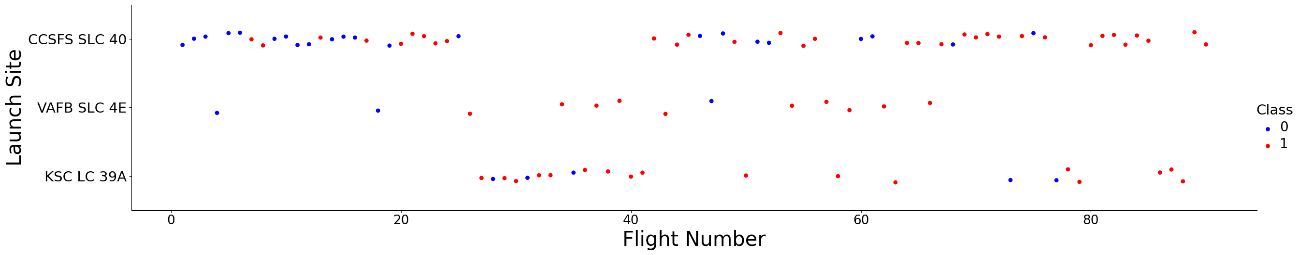
Flight Number vs. Launch Site
CCAFS SLC 40 has the most launches, including most of the early ones.
Early flights show many failures, mostly at CCAFS SLC 40
Success becomes more frequent as the flight number increases, at all sites
VAFB SLC 4E has the fewest launches, and KSC LC 39A was only used for later flights

Slide 19
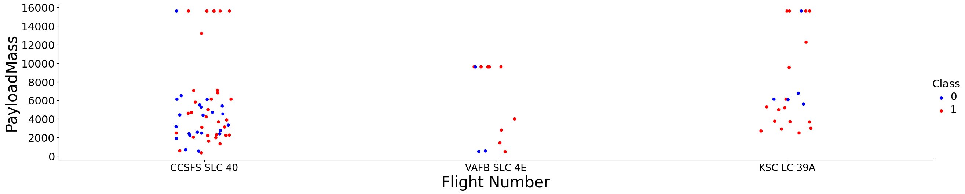
Payload vs. Launch Site
Most launches carry payloads under 7,000 kg
VAFB SLC 4E has no launches with heavy payloads (over 10,000 Kg)
Failures launches with payloads over 10,000 Kg
Failure cluster ay low payloads at CCAFS SLC 40

Slide 20
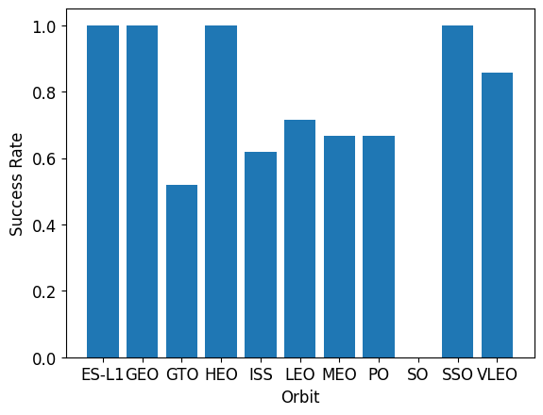
Success Rate vs. Orbit Type
ES-L1, GEO, HEO and SSO have 100% success rate
GTO has one of the lowest success rate (about 50%)
SO has 0% success
The 100% orbits have very few launches, so their rates are less reliable than those of orbits with many launches like GTO, ISS or VLEO

Slide 21
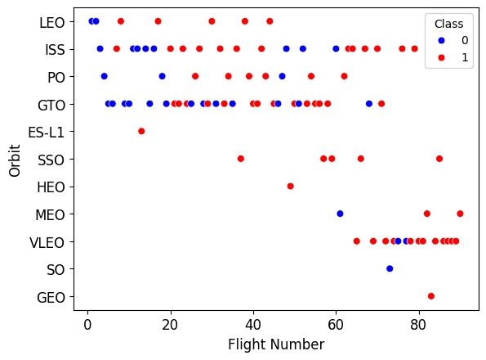
Flight Number vs. Orbit Type
In LEO, success seems related to the number of flights: early flights failed more, later ones mostly succeeded.
In GTO, there’s no clear relationship between flight number and success.
Overall, success becomes more common as the flight number increases, which reflects SpaceX’s improvement over time

Slide 22
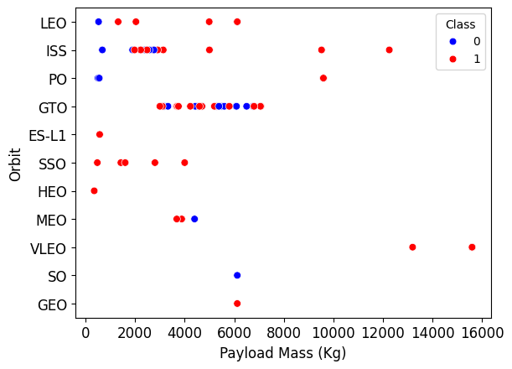
Payload vs. Orbit Type
With heavy payloads, successful landings are more common for Polar, LEO and ISS orbit
GTO launches carry mid-range payloads (about 3,000 – 7,000 Kg)
VLEO launches carry heavy payloads (about 13,000 – 15,000 Kg), and most were successful.

Slide 23
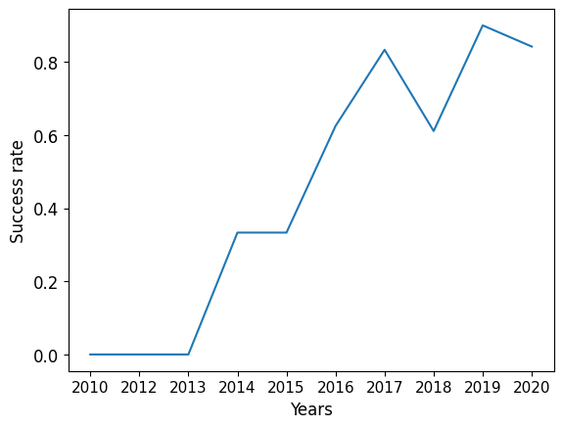
Launch Success Yearly Trend
Landing success rose from 0% before 2013 to about 90% by 2019, showing SpaceX’s steady improvement in booster recovery.

Slide 24
All Launch Site Names
Launch Site
CCAFS LC-40
VAFB SLC-4E
KSC LC-39A
CCAFS SLC-40
SELECT DISTINCT Launch_Site FROM SPACEXTBL;
Using DISTINCT, we found four launch sites: CCAFS LC-40, CCAFS SLC-40, KSC LC-39A and VAFB SLC-4E.

Slide 25
Launch Site Names Begin with 'CCA'
Using LIKE ‘CCA%’ with LIMIT 5, we displayed 5 launches from Cape Canaveral Sites
SELECT * FROM SPACEXTBL WHERE Launch_Site LIKE ‘CCA%’ LIMIT 5;
Date | Booster_Version | Launch_Site | Payload mass | Orbit | Landing_Outcome
2010-06-04 | F9 v1.0 B0003 | CCAFS LC-40 | 0 | LEO | Failure (parachute)
2010-12-08 | F9 v1.0 B0004 | CCAFS LC-40 | 0 | LEO (ISS) | Failure (parachute)
2012-05-22 | F9 v1.0 B0005 | CCAFS LC-40 | 525 | LEO (ISS) | No attempt
2012-10-08 | F9 v1.0 B0006 | CCAFS LC-40 | 500 | LEO (ISS) | No attempt
2013-03-01 | F9 v1.0 B0007 | CCAFS LC-40 | 677 | LEO (ISS) | No attempt

Slide 26
Total Payload Mass
SELECT SUM(PAYLOAD_MASS_KG) AS total_payload_mass_kg FROM SPACEXTBL WHERE Customer=‘NASA (CRS)’;
Using SUM, boosters launched for NASA (CRS)
Total Payload Mass (Kg): 45.596

Slide 27
Average Payload Mass by F9 v1.1
Using AVG, booster version F9 v1.1 carried an
Average Payload Mass: 2928.4 Kg
SELECT AVG(PAYLOAD_MASS_KG) AS ave_payload_mass_kg FROM SPACEXTBL WHERE Booster_Version=‘F9 v1.1’;

Slide 28
First Successful Ground Landing Date
Using MIN(Date);
Date First Successful Landing: 2015-12-22
SELECT MIN(Date),Landing_Outcome FROM SPACEXTBL WHERE Landing_Outcome LIKE =‘Success%’;

Slide 29
Successful Drone Ship Landing with Payload between 4000 and 6000
Booster Version
F9 FT B1022
F9 FT B1026
F9 FT B1021.2
F9 FT B1031.2
Four boosters landed successfully on a drone ship with payloads in that range: F9 FT B1022, B1026, B1021.2 and B1031,2
SELECT Booster_Version FROM SPACEXTBL WHERE Landing_Outcome = ’Success (drone ship) AND PAYLOAD_MASS_KG BETWEEN 4000 AND 6000;

Slide 30
Total Number of Successful and Failure Mission Outcomes
Using SUM and CASE WHEN, almost all missions were successful (100 successes and 3 failures
Total Success | Total Failure
38 | 3
SELECT SUM(CASE WHEN Landing_Outcome=‘Success’ THEN 1 ELSE 0) AS Total_success, SUM(CASE WHEN Landing_Outcome=‘Failure’ THEN 1 ELSE 0) AS Total_Failure FROM SPACEXTBL

Slide 31
Boosters Carried Maximum Payload
Booster Version
F9 B5 B1048.4
F9 B5 B1049.4
F9 B5 B1051.3
F9 B5 B1056.4
F9 B5 B1048.5
F9 B5 B1051.4
F9 B5 B1049.5
F9 B5 B1060.2
F9 B5 B1058.3
F9 B5 B1051.6
F9 B5 B1060.3
F9 B5 B1049.7
Using subquery with MAX, we found the boosters that carried the maximum payload of 15,600 Kg all F9 B5 versions
SELECT Booster_Version, PAYLOAD_MASS_KG_ FROM SPACEXTBL WHERE PAYLOAD_MASS_KG_= (SELECT MAX(PAYLOAD_MASS_KG_) FROM SPACEXTBL);

Slide 32
2015 Launch Records
Month | Landing_Outcome | Booster_Version | Launch_Site
January | Failure (drone ship) | F9 v1.1 B1012 | CCAFS LC-40
April | Failure (drone ship) | F9 v1.1 B1015 | CCAFS LC-40
In 2015, there were two drone ship landing failures, in January and April, both F9 v1.1 boosters launched from CCAFS LC-40
SELECT CASE SUBSTR(Date,6,2) WHEN '01' THEN 'January' WHEN '04' THEN 'April' END AS Month, Landing_Outcome, Booster_Version, Launch_Site FROM SPACEXTBL WHERE Landing_Outcome = "Failure (drone ship)" AND SUBSTR(Date,0,5)='2015';

Slide 33
Rank Landing Outcomes Between 2010-06-04 and 2017-03-20
Landing_Outcome | Outcome_count
No attempt | 10
Success (drone ship) | 5
Failure (drone ship) | 5
Success (ground pad) | 3
Controlled (ocean) | 3
Uncontrolled (ocean) | 2
Failure (parachute) | 2
Precluded (drone ship) | 1
“No attempt” was the most common outcome, followed by Success (drone ship) and Failure (drone ship), tied
SELECT Landing_Outcome, COUNT(*) AS outcome_count FROM SPACEXTBL WHERE Date BETWEEN '2010-06-04' AND '2017-03-20' GROUP BY Landing_Outcome ORDER BY outcome_count DESC;

Slide 34

Section 3

Slide 35
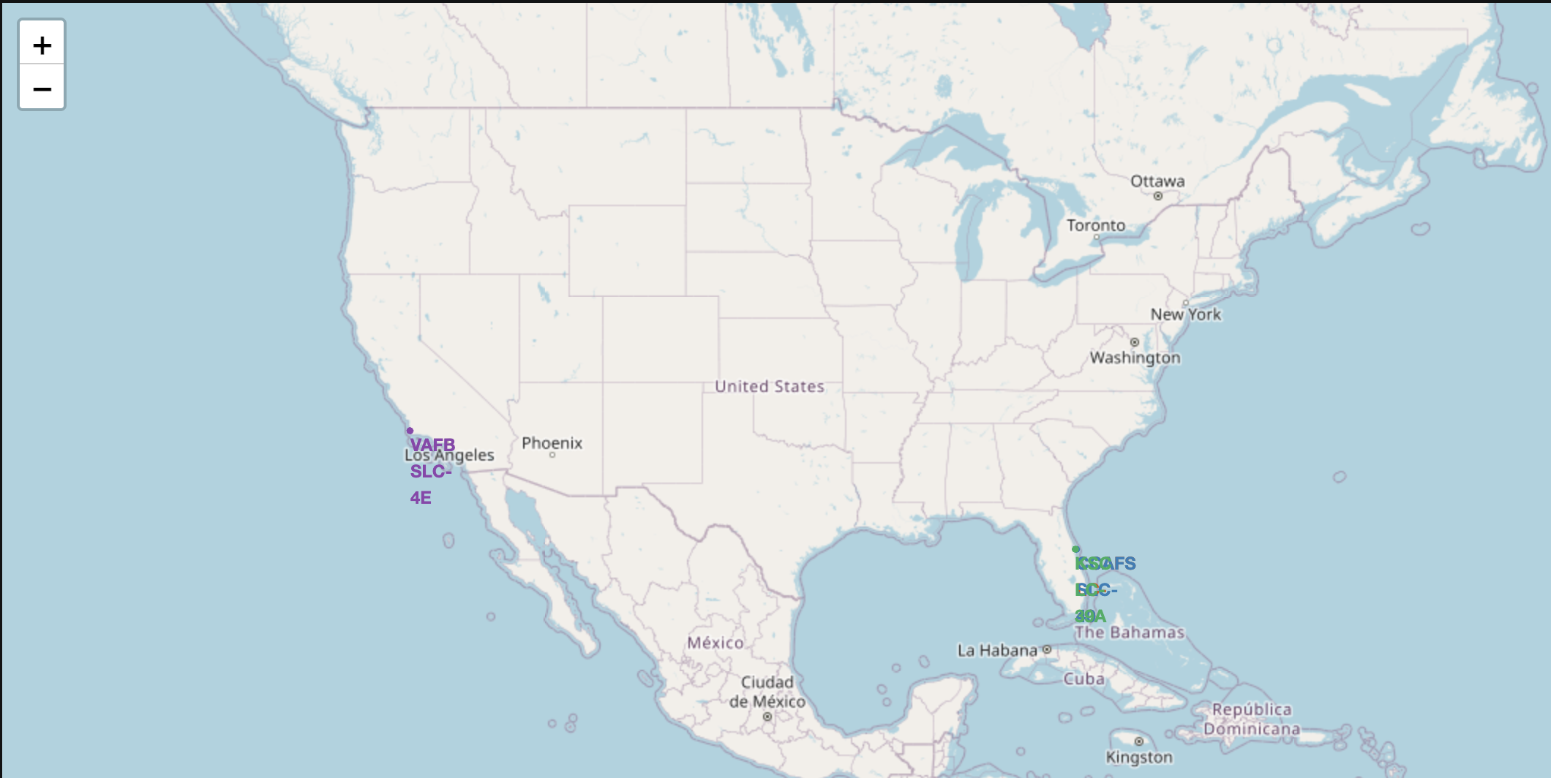
SpaceX Launch Sites Across the US
All launches sites are close to the coast: 3 in Florida and 1 in California.
The sites are in the south of the US, as close to the equator as possible, which helps rockets use Earth’s rotation to save fuel

Slide 36
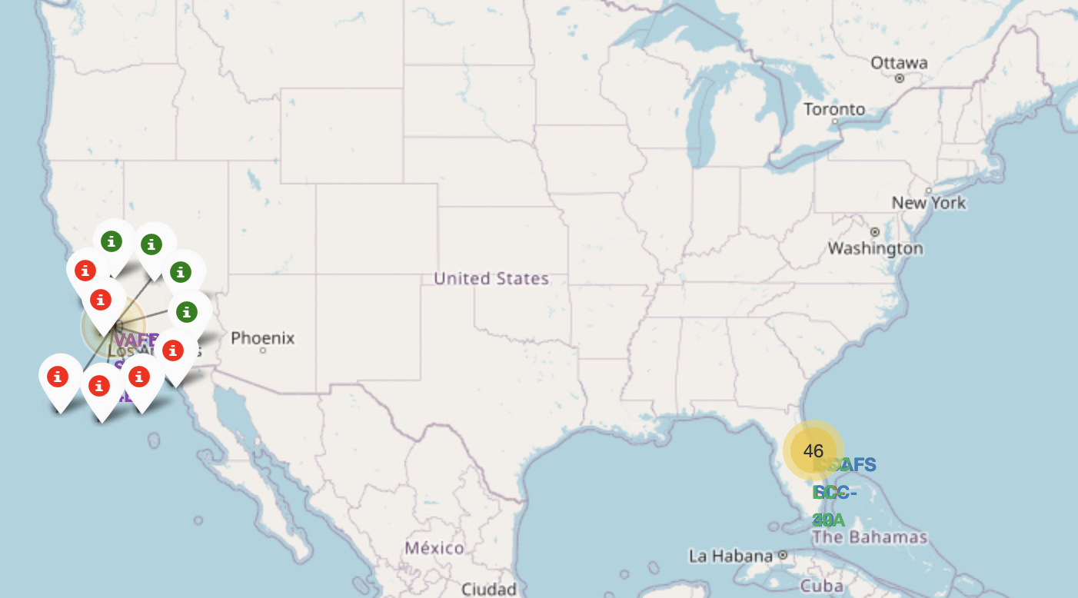
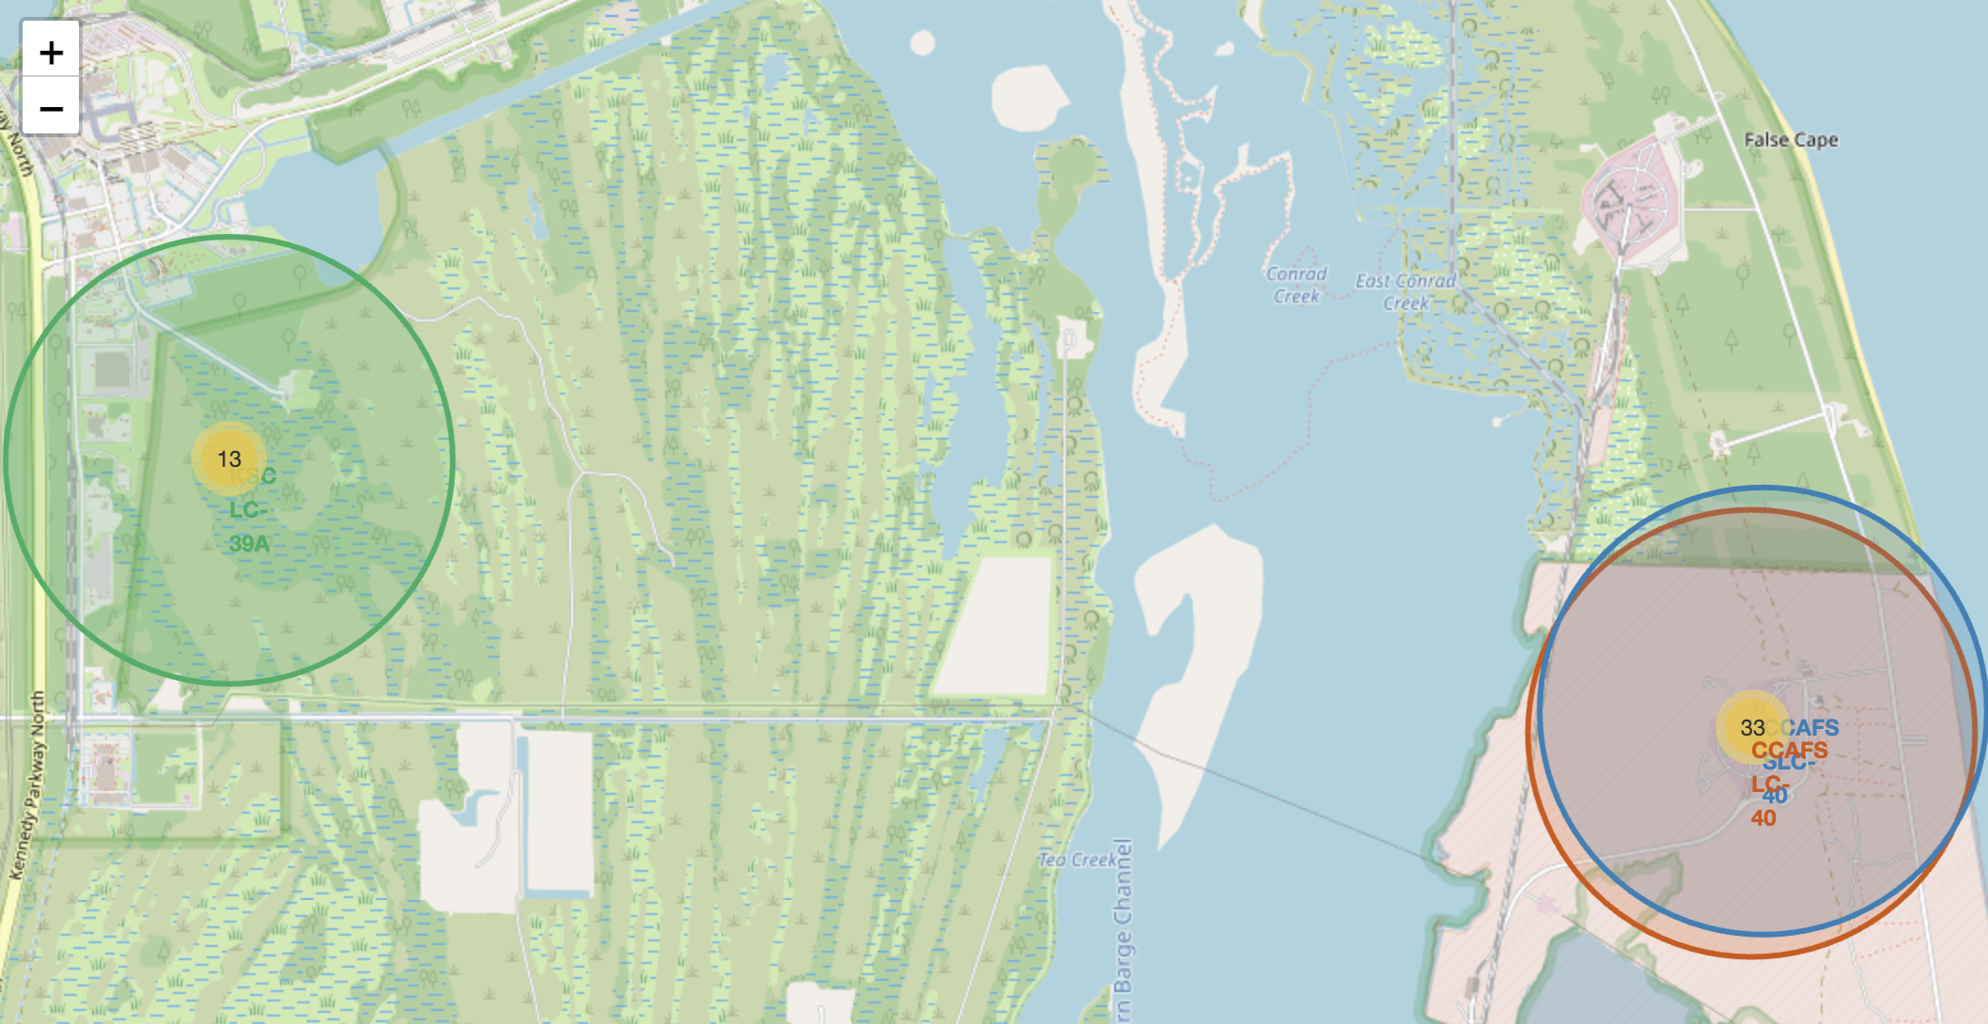
Launch Outcomes by Site: Success vs. Failure
Green markers show successful landings and red markers show failures
KSC LC-39A has the highest share of successful landings
CCAFS LC-40 has the most launches but also many failures.

Slide 37
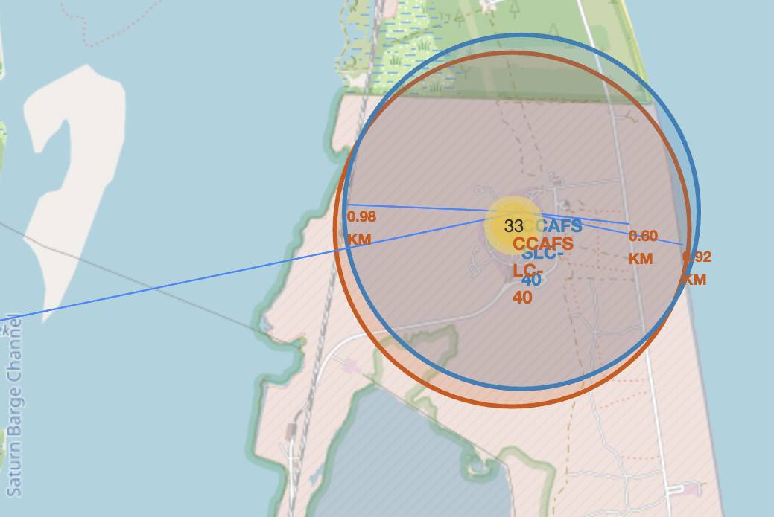
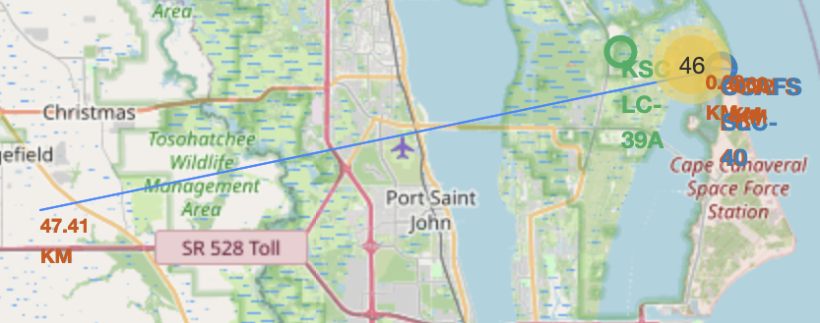
Launch Site Proximity
Launch sites are very close to the coastline (under 1 km) and to railways and highways. This helps with transporting rockets and equipment.
Launch sites are far from cities, keeping populated areas safe in case of an accident

Slide 38

Section 4

Slide 39
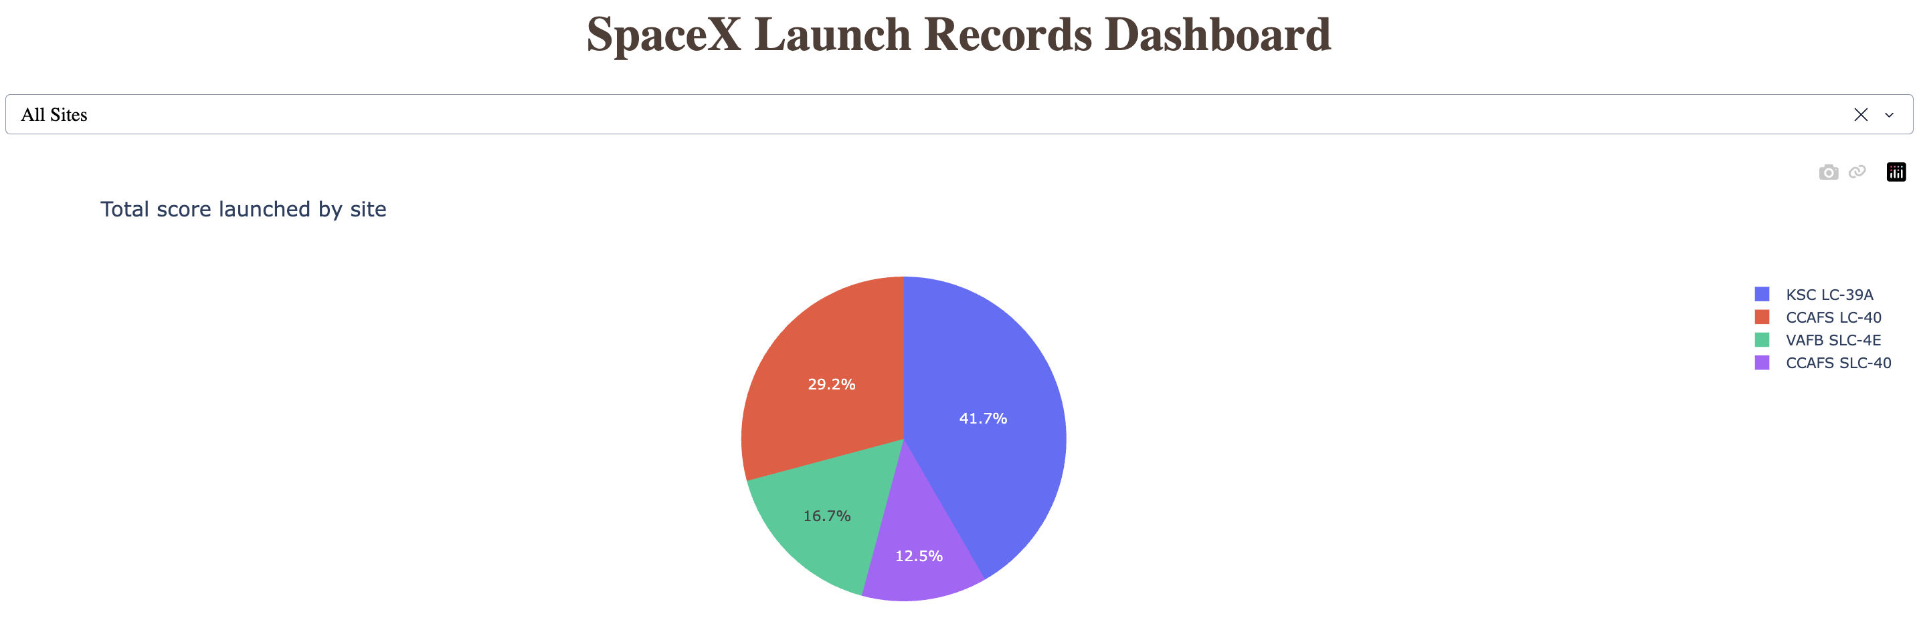
Total Successful Launches by Site
KSC LC-39A has the largest share of successful launches (about 42%)
CCAFS LC-40 follows with about 29%
VAFB SLC-4E and CCAFS SLC-40 have the smallest shares, partly because they had fewer launches

Slide 40
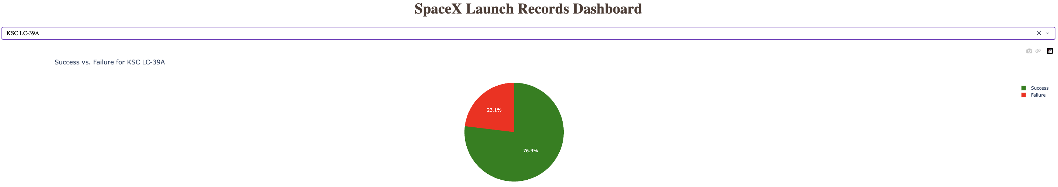
Launch Success Ratio for KSC LC-39A
KSC LC-39A has the highest success ratio of all sites: about 77% success and 23% failure
Out of 13 launches, 10 landed successfully

Slide 41
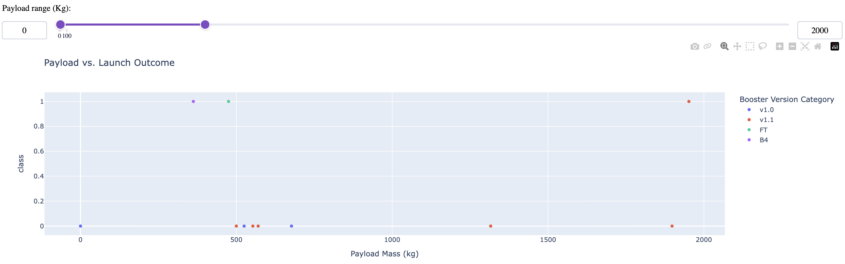
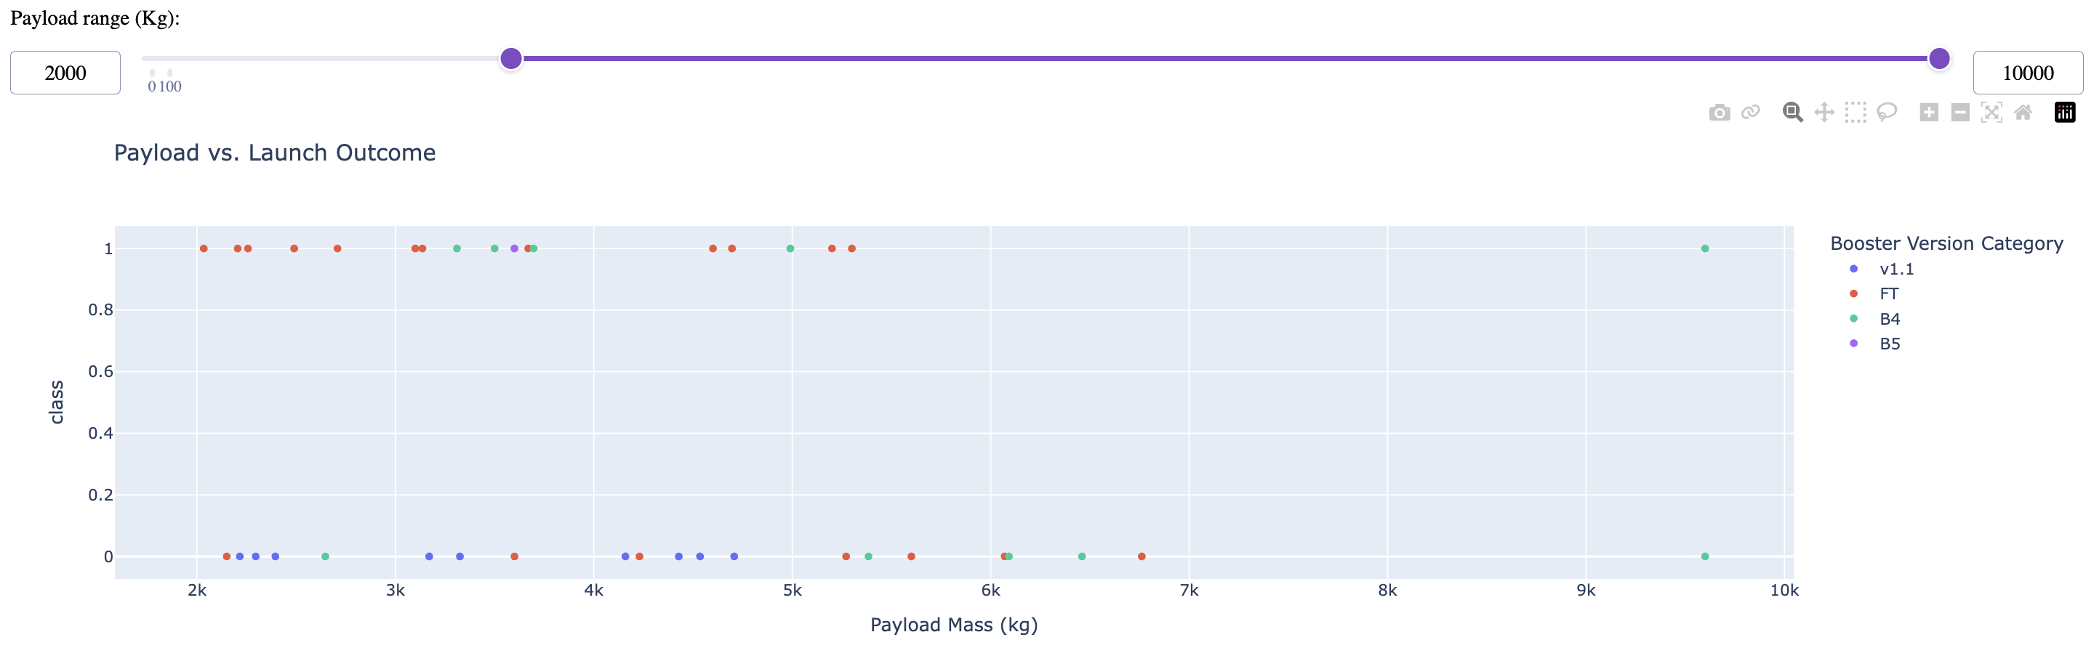
Payload vs. Launch Outcome for All Sites
Replace <Dashboard screenshot 3> title with an appropriate title
Show screenshots of Payload vs. Launch Outcome scatter plot for all sites, with different payload selected in the range slider
Explain the important elements and findings on the screenshot, such as which payload range or booster version have the largest success rate, etc.

Slide 42

Section 5

Slide 43
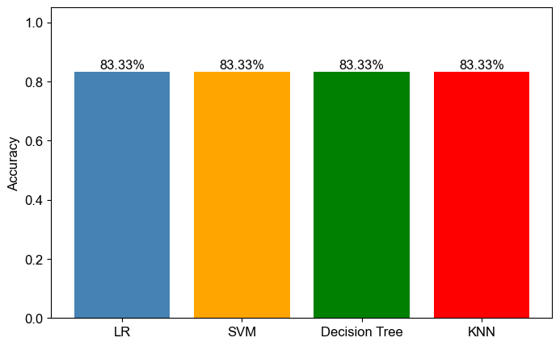
Classification Accuracy
All models achieved the same test accuracy (83.3%) due to the small test set. Based on validation accuracy, Decision Tree performed best

Slide 44
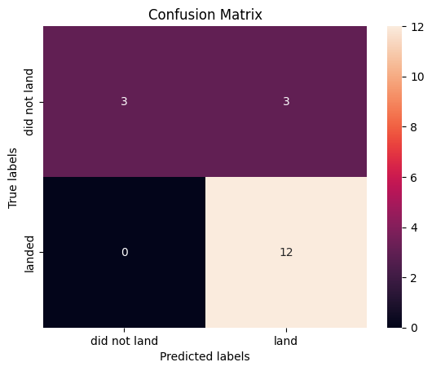
Confusion Matrix
All the models showed the same confusion matrix due to the small test set. The models predict successful landing, but its main problem is false positive: it predicted 3 failed landings as successful.

Slide 45
Conclusions
Launch success has improved significantly over time, from no successful landing before 2013 to about 90% by 2019
KSC LC-39A is the most successful launch site, with the highest share of successful launches and a success ratio of about 77%.
Orbits like ES-L1, GEO, HEO and SSO had a 100% success rate, though some have very few launches
Launches with payloads between about 2,000 and 5,500 Kg had the highest success rate, and the FT booster performed best
Launch sites are located near the coast and the equator, close to transport routed and far from cities.
All classification models reached 83.3% test accuracy, and decision tree had the highest validation accuracy. The models can help SpaceY predict first stage landings and estimate launch costs

Slide 46


