Slide 1
Blockchain (Bitcoin)
Four ideas
Hash chaining – Unalterable history
Public key cryptography – Signatures
Addition/Subtraction – General ledger
Notarization – Proof of validity

Slide 2
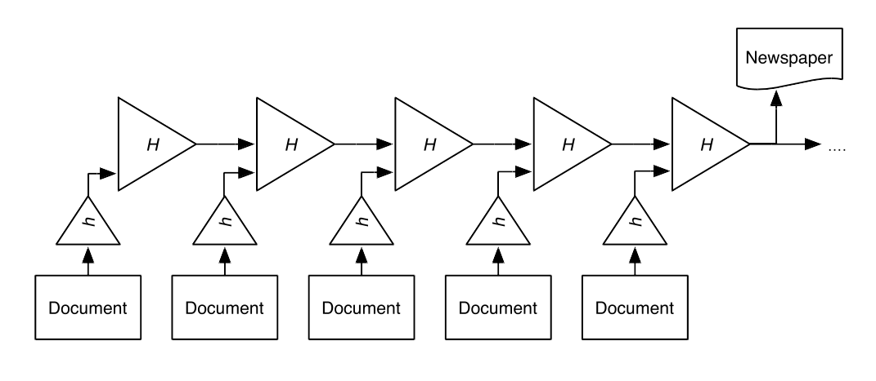
Hash chaining

Slide 3
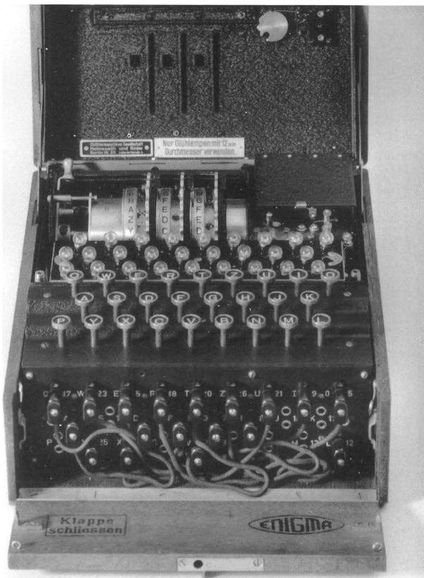
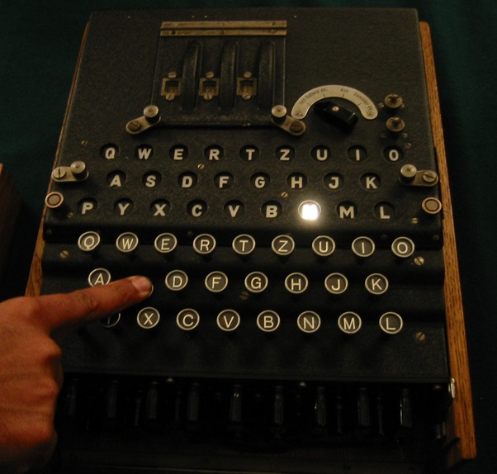
Enigma machine

Slide 4
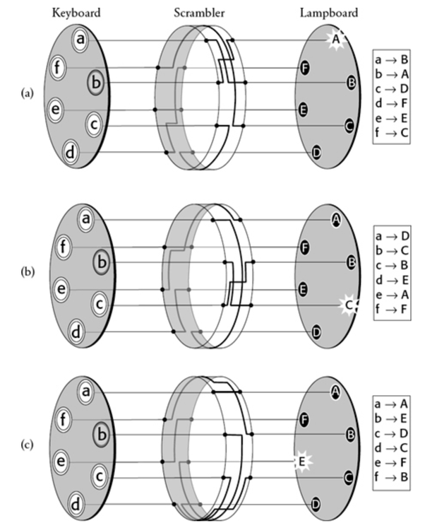
Enigma rotors

Slide 5
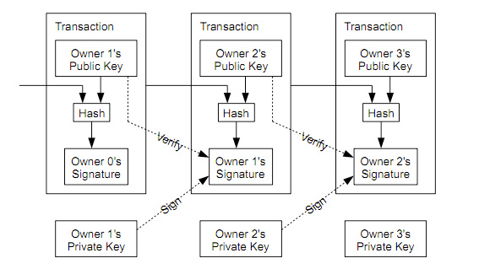
Transaction Hash chaining

Slide 6
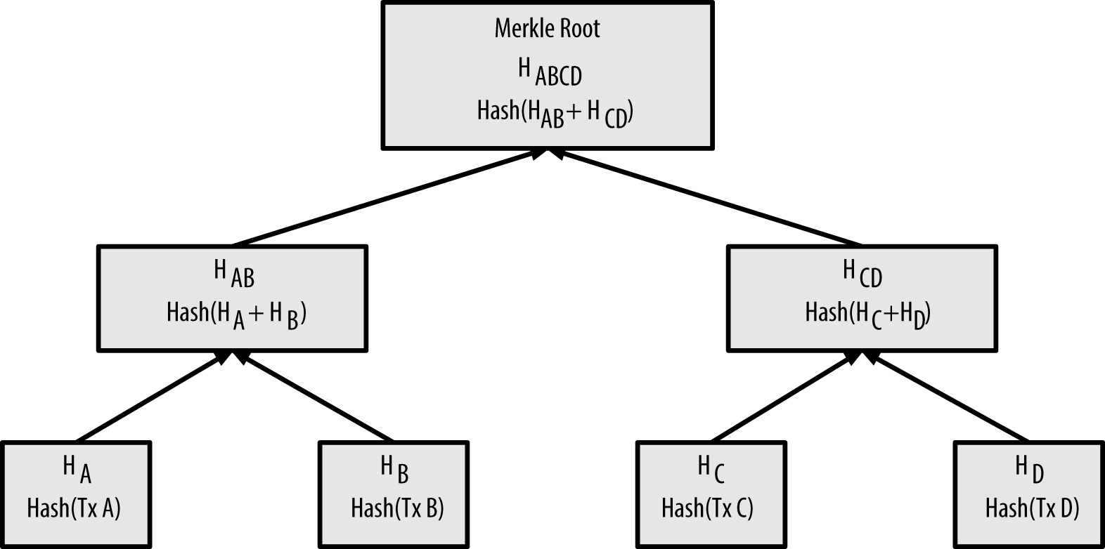
Hash tree – Merkle tree

Slide 7
Blockchain (Bitcoin)
Four ideas
Hash chaining – Unalterable history
Public key cryptography – Signatures
Addition/Subtraction – General ledger
Notarization – Proof of validity

Slide 8
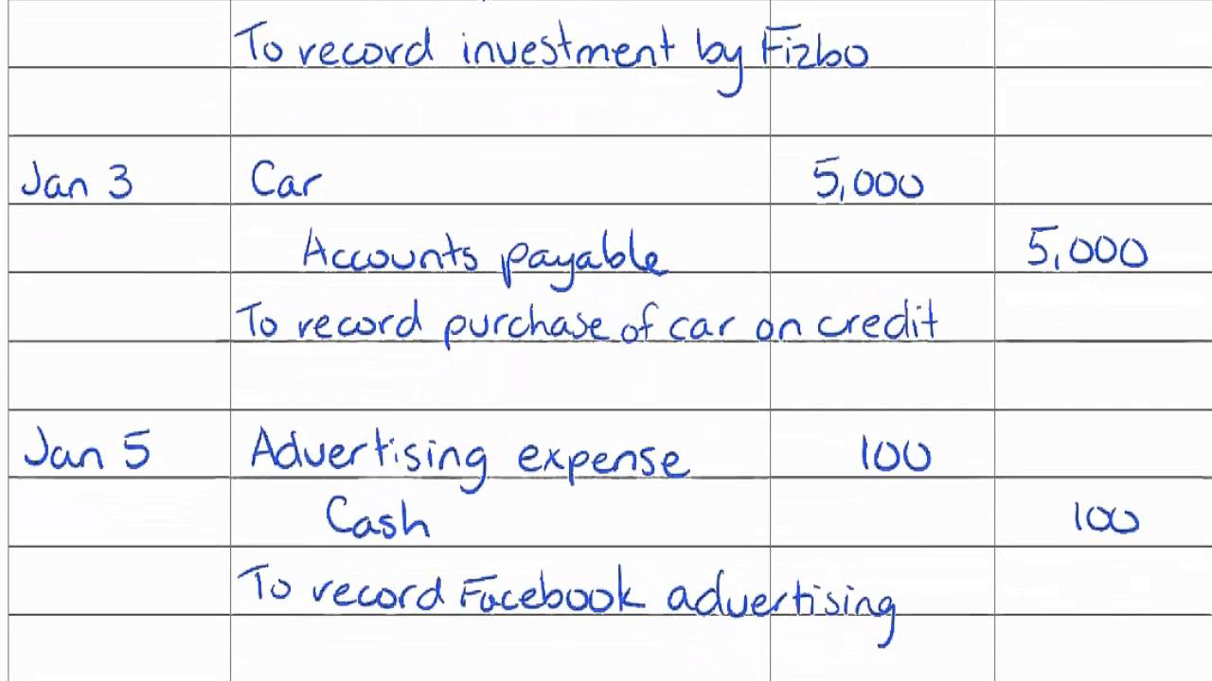
General Ledger

Slide 9
Blockchain (Bitcoin)
Four ideas
Hash chaining – Unalterable history
Public key cryptography – Signatures
Addition/Subtraction – General ledger
Notarization – Proof of validity

Slide 10
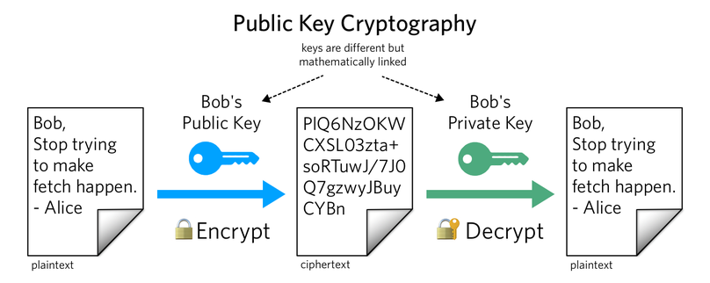
Plaintext - Cryptext

Slide 11
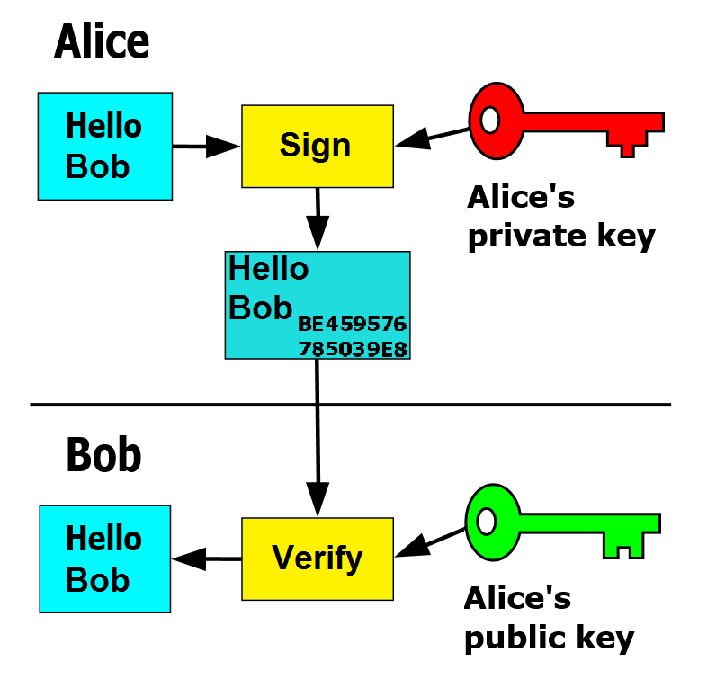
Public Key Signatures

Slide 12
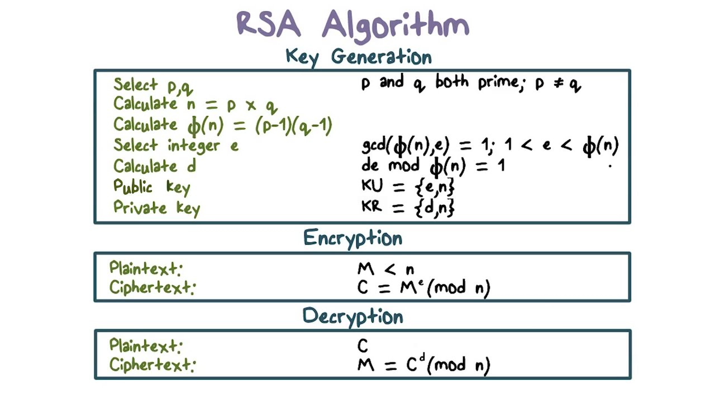
Rivest Shamir Adleman - 1977

Slide 13
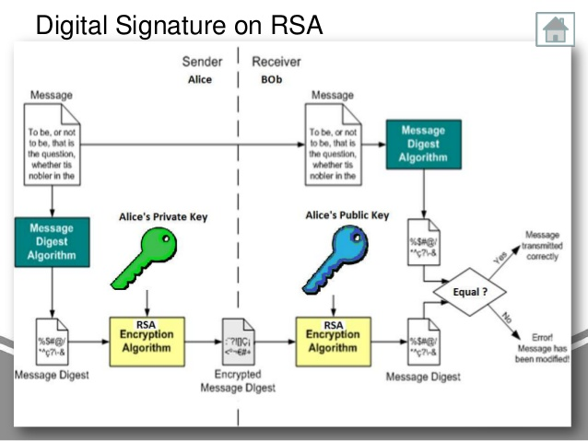

Slide 14
Transaction Hash chaining

Slide 15
Blockchain (Bitcoin)
Four ideas
Hash chaining – Unalterable history
Public key cryptography – Signatures
Addition/Subtraction – General ledger
Notarization – Proof of validity

Slide 16
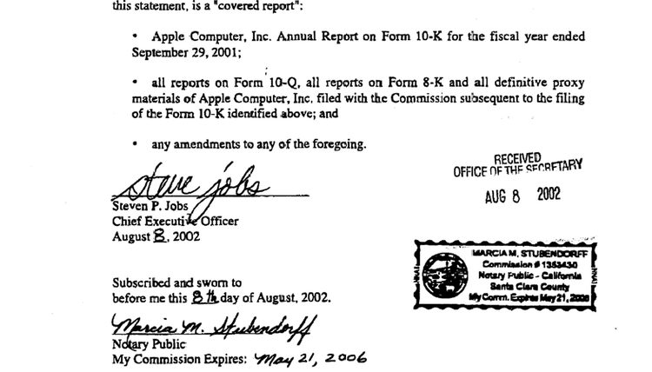
Notarization

Slide 17
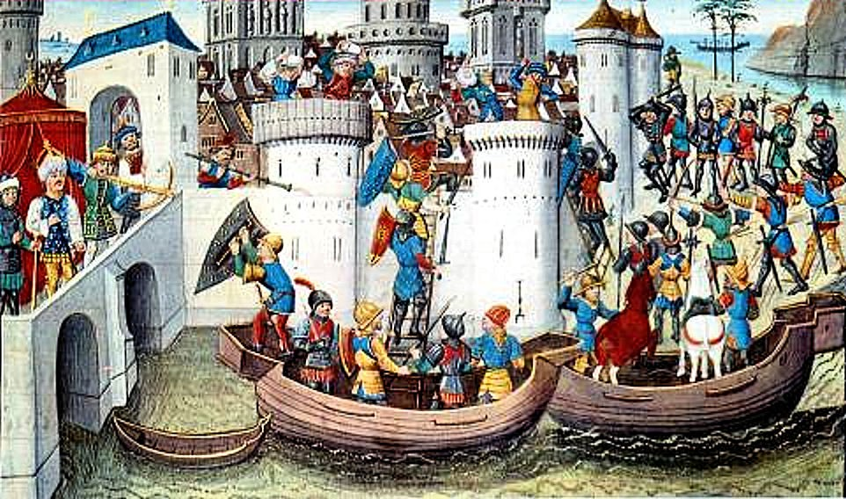
Byzantine Generals

Slide 18
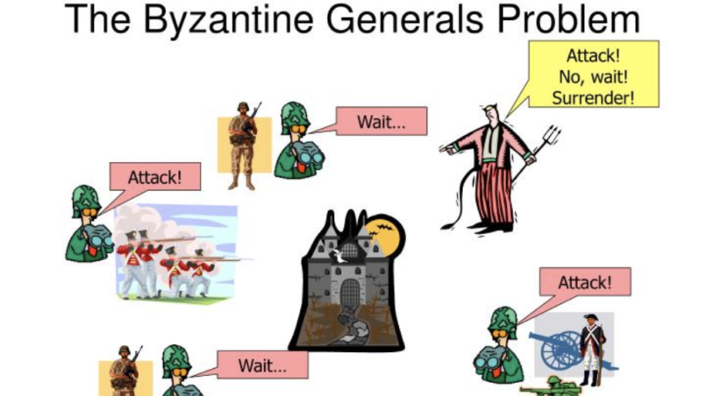

Slide 19
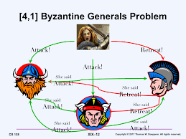

Slide 20
Solution: Chained Notarizations!

Slide 21
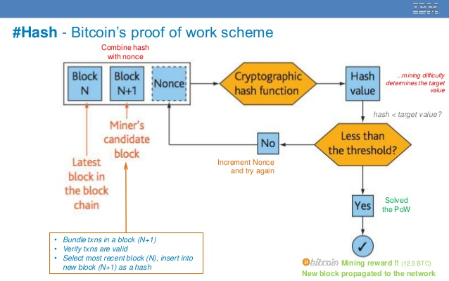

Slide 22
Blockchain (Bitcoin)
Four ideas + Reward
Hash chaining – Unalterable history
Public key cryptography – Signatures
Addition/Subtraction – General ledger
Notarization – Proof of validity
Proof of work – Mining

Slide 23
Bitcoin is Evil ! ! !!!!
Vast waste of electricity!
Strongly deflationary!
  Today GDP=100 BTC=100
  Tomorrow GDP=105 BTC=100
  Don’t spend! Wait till tomorrow!
Not Enough BTC for world population
  21 Million BTC total

Slide 24
Phew. Now Lets go Crazy!
Addition, Subtraction...
  Multiplication, division, if-then-else, loops…
  General programming!
  Ethereum – smart legal contracts
  DAO – Decentralized Autonomous Organizations
Proof of Work...
  Proof of Stake
  Gossip Protocols

Slide 25
Lets Go Crazy!
Uneraseable, uncorruptible database
  Append-only logs
  Git – dat:// – IPFS
  Log structured merge tree (LSM)
Authenticated identity
  Banking, voting, UBI … and social interaction
Identity hiding
  Financial, medical records
  Journalism, secret organizations
  Crime

Slide 26
Lets Go Crazy!
Singleton (centralized) blockchain...
  Decentralization
  Distributed Hash Table
  LSM, Secure Scuttlebutt
Not just money, contracts!
  Chat, email, social media, file sharing
  Not just music, but science data! Or web pages!
  Identity, Liquid democracy, UBI, Value flows, ERP

Slide 27
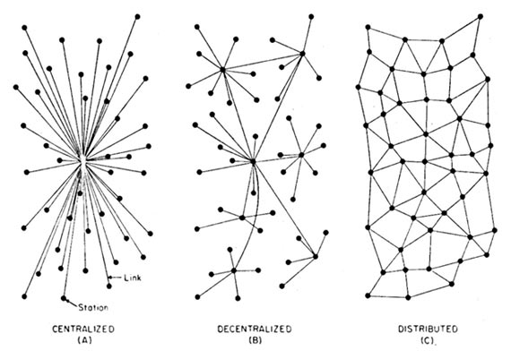
Decentralized Social Media
Centralized Federated Decentralized

