Slide 1


SAFEST PATH FINDING ALGORITHMS ON STREET HARASSMENT PREVENTION

Slide 2






Presentation of the team
Lina Ballesteros
Author
Camilo Córdoba
Author
Andrea Serna
Literature review
Mauricio Toro
Data preparation
https://github.com/linasofi13/StreetHarassmentProyect_2022-2

Slide 3
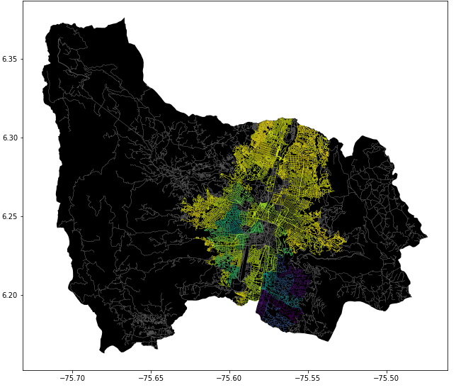
Problem Statement
Shortest path algorithm
Streets
of Medellín, Origin and Destination
Three paths that reduce both the risk of harassment and distance

Slide 4
Solution Algorithm
Dijkstra’s Algorithm
Streets
of Medellín, Origin and Destination
A path that reduces both distance and harassment

Slide 5
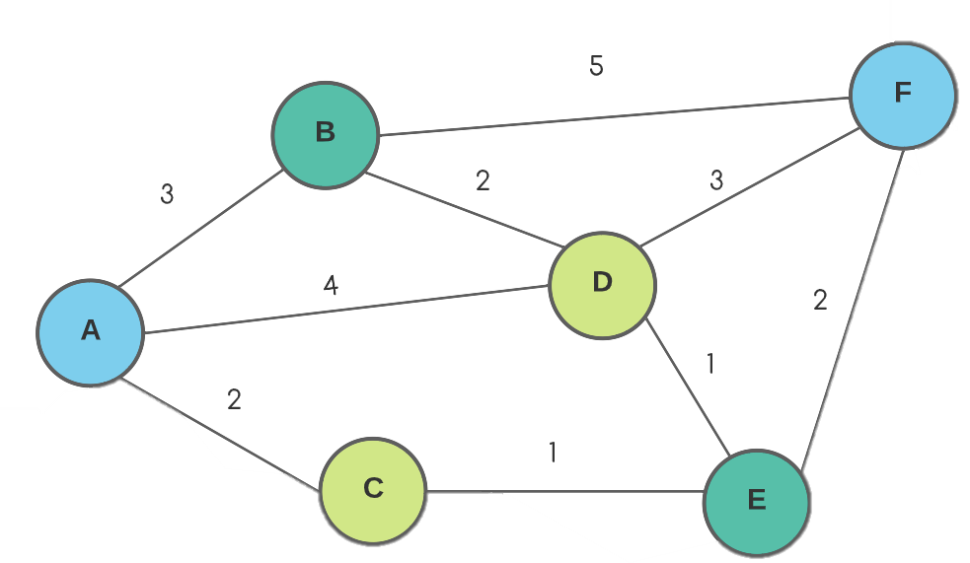

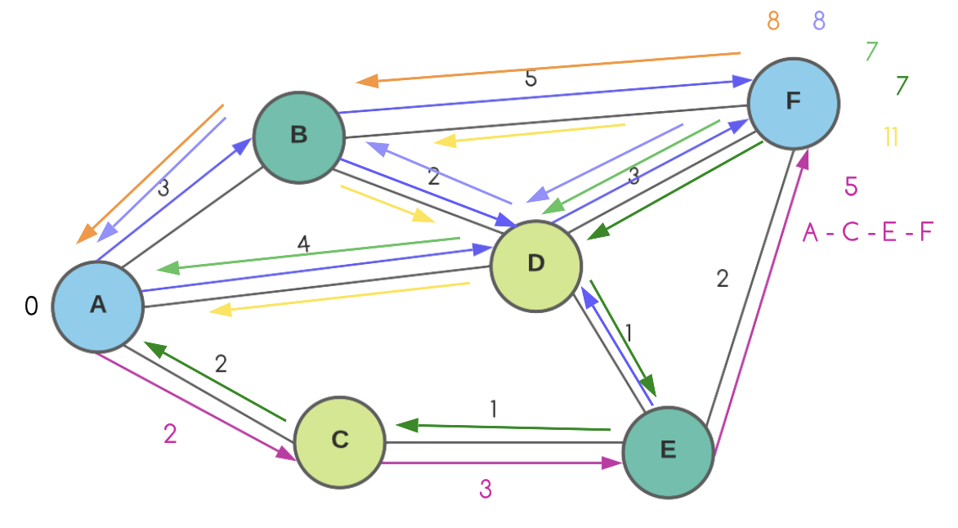
Explanation of the algorithm
Dijkstra’s Algorithm Dijkstra’s Algorithm implementation for the shortest and safest path from A to F. The algorithm checks for the path with the minor total cost from the origin node to the final node. In this case is the path with a cost of 5.

