Slide 1

Structured Approach to Data Analytics Project on Quitting Smoking
By Lina Sutkevičienė, student of Data Analytics at Turing College
2022.10.27

Slide 2
Contents
Ask phase
Prepare phase
Process phase
Analyze
Conclusions
Recommendations

Slide 3
1. Ask phase
Problem
Quit smoking
Questions:
1. What would initiate me to quit smoking?
2. At that circumstances the need for a smoke is the most common?
3. What motivates me to quit smoking?

Slide 4
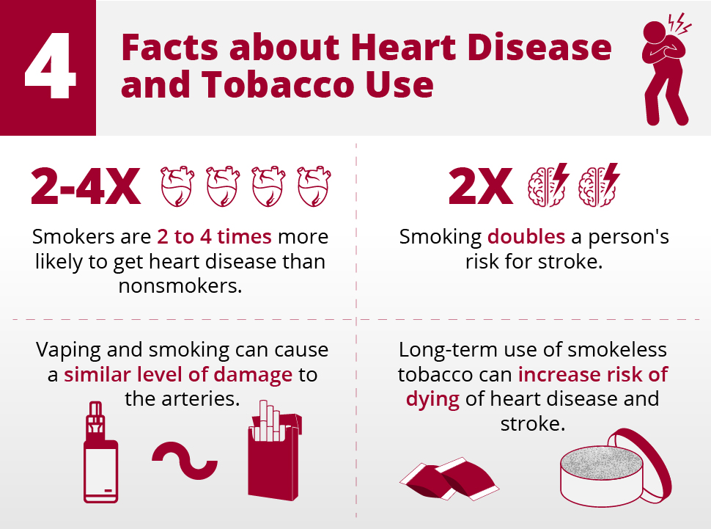

Slide 5
2. Prepare phase 1. How the data was collected? 2. Does my data ROCC? 3. What things I included into my data and how I arranged them?

Slide 6
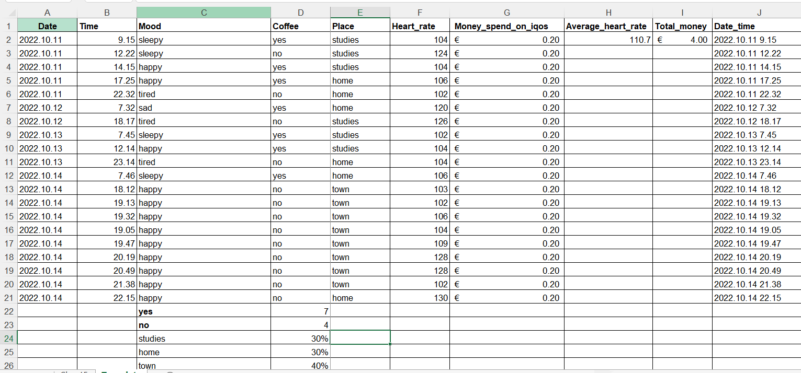
3. Process phase I cleaned and formatted my data

Slide 7
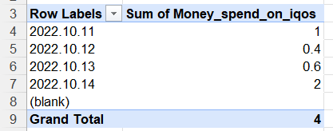
4. Analyze Pivot table 1: for day and money spend on Iqos that day.

Slide 8
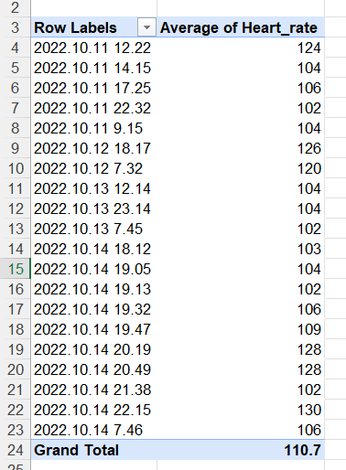
Pivot table 2: Average heart rate

Slide 9
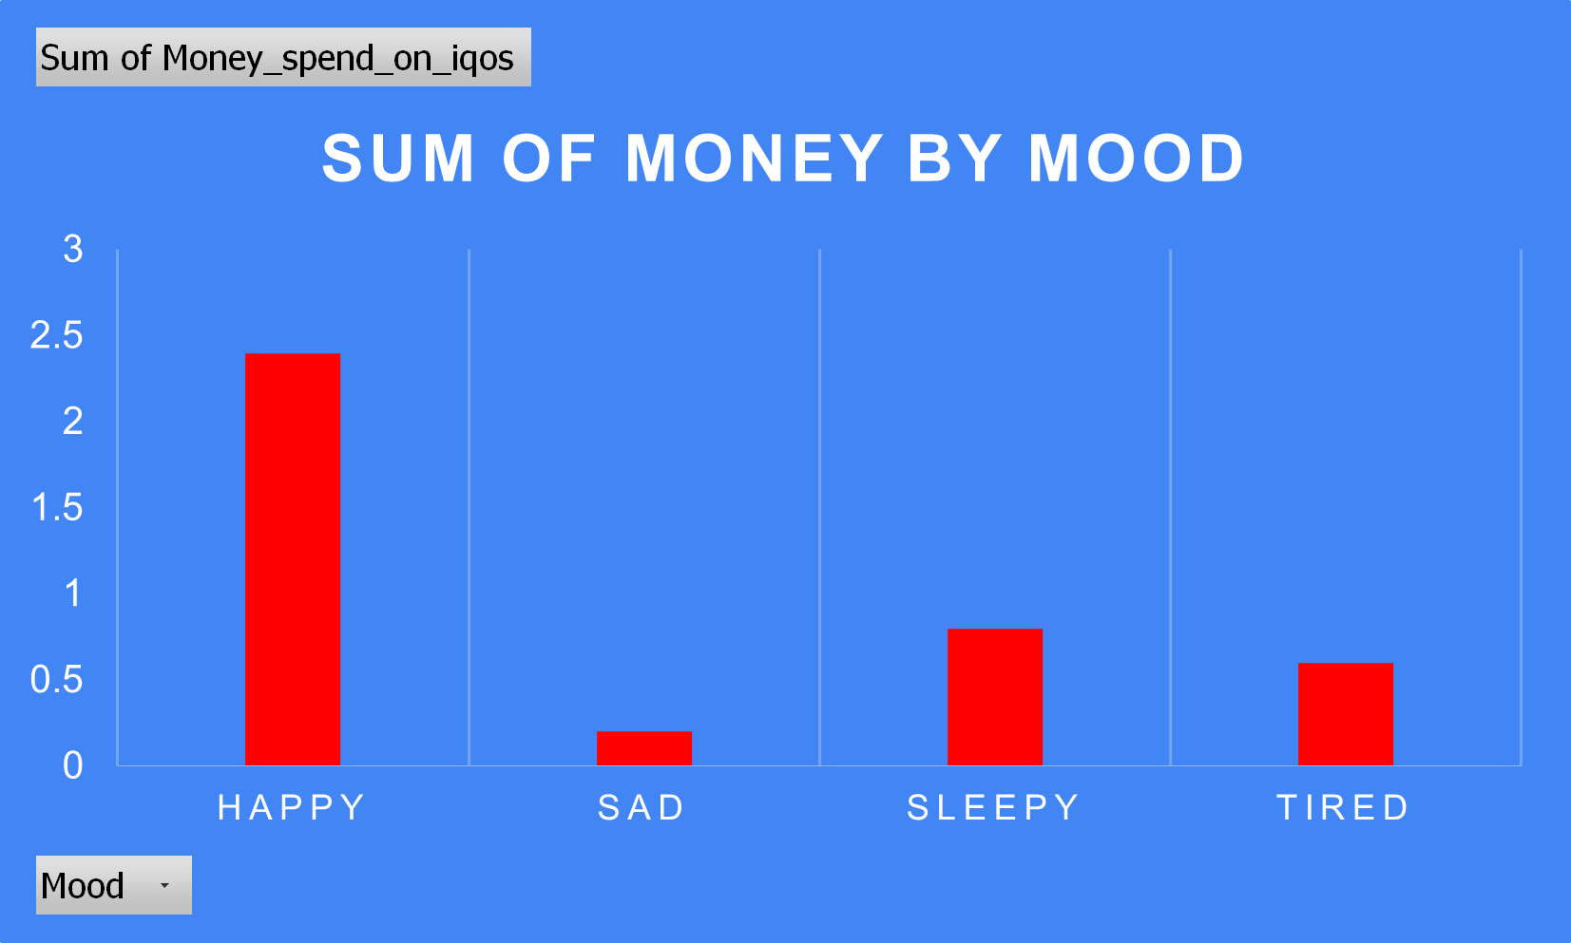
Chart 1: Sum of money by mood

Slide 10
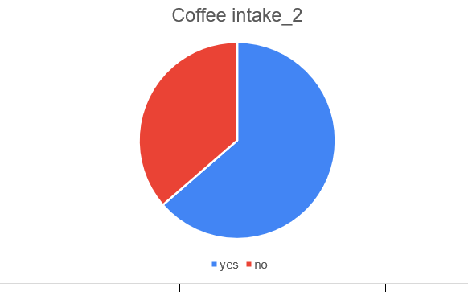
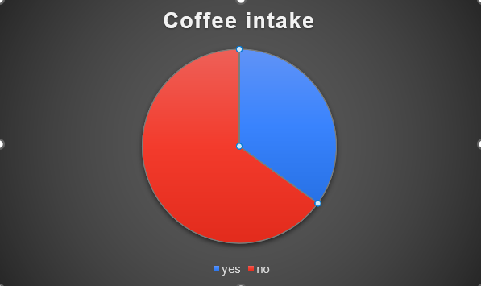
Chart 2: Coffee intake while smoking When going out: No going out:

Slide 11
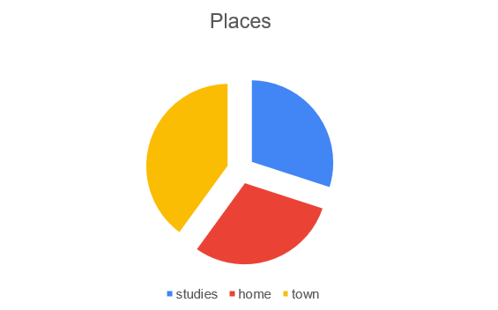
Chart 3: Places where I smoke

Slide 12
CONCLUSIONS 1. Smoking is expensive 2. Smoking is harmful 3. Going out leads to smoke more for smokers

Slide 13
Recommendations
Think about the money
Consider the health issues
Maybe going out is not the reason to smoke heavily?

Slide 14

THANK YOU FOR YOUR ATTENTION

Slide 15
References
[Free Vector | Harm of smoking design concept (freepik.com)]
[Normal Heart Rate: Range, When It's Dangerous, and More (healthline.com)]
[Stock.adobe.com] for pictures
Lina’s LinkedIn
www.linkedin.com/in/linasutkeviciene

