Slide 1
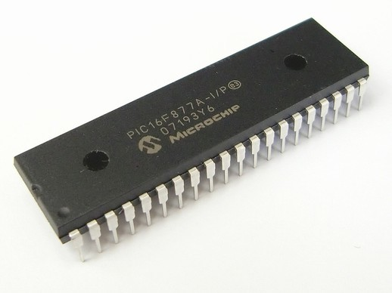
PIC16F877A Microcontroller Introduction and Features

Slide 2
PIC16F877A
The PIC microcontroller PIC16F877A is one of the most renowned microcontrollers in the industry.
This microcontroller is very convenient to use, the coding or programming of this controller is also easier.
One of the main advantages is that it can be write-erase as many times as possible because it uses FLASH memory technology.
It has a total number of 40 pins and there are 33 pins for input and output. PIC16F877A is used in many pic microcontroller projects.

Slide 3
PIN CONFIGURATION
There are 40 pins of this microcontroller IC.
It consists of two 8 bit and Capture and compare modules, serial ports, parallel ports and five input/output ports are also present in it.
It has a smaller 35 instructions set.
It can operate up to 20MHz frequency.
An EEPROM is also featured in it which makes it possible to store some of the information permanently like transmitter codes and receiver frequencies and some other related data.

Slide 4
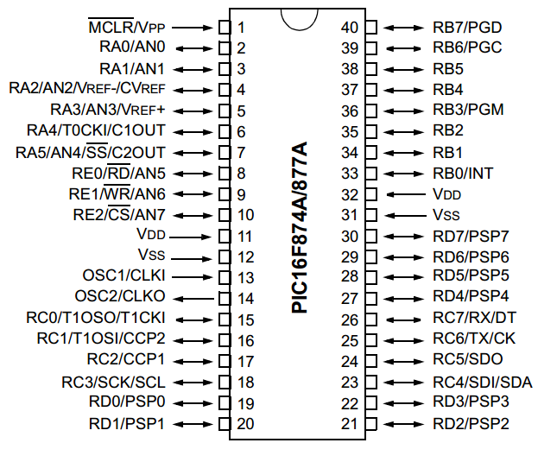

Slide 5
MEMORY ORGANIZATION
Memory of the PIC16F877 divided into 3 types of memories:
Program Memory - A memory that contains the program(which we had written), after we've burned it. As a reminder, Program Counter executes commands stored in the program memory, one after the other.
Data Memory – This is RAM memory type, which contains a special registers like SFR (Special Function Register) and GPR (General Purpose Register). The variables that we store in the Data Memory during the program are deleted after we turn of the micro.
Data EEPROM (Electrically Erasable Programmable Read-Only Memory) - A memory that allows storing the variables as a result of burning the written program.

Slide 6
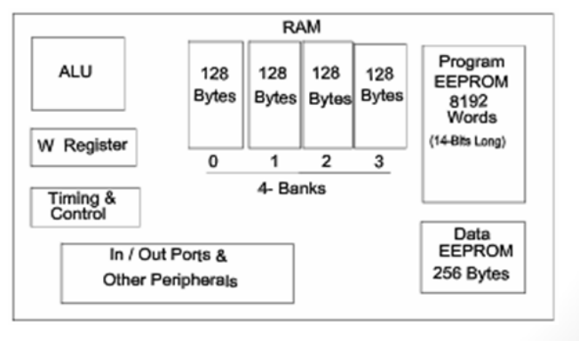
PIC16F877 Internal Block Diagram
The basic architecture of PIC16F877 consists of Program memory, file registers and RAM, ALU and CPU registers.

Slide 7
HOW TO PROGRAM THE INPUT AND OUTPUT PORTS
5 input and output ports namely PORTA, PORTB, PORTC, PORTD and PORTE which can be digital as well as analog.
There is a register named as ‘TRIS’ which controls the direction of ports. For different ports there are different registers such as TRISA, TRISB etc.
If we set a bit of the TRIS register to 0, the corresponding port bit will act as the digital output.
If we set a bit of the TRIS register to 1, the corresponding port bit will act as the digital input.

Slide 8
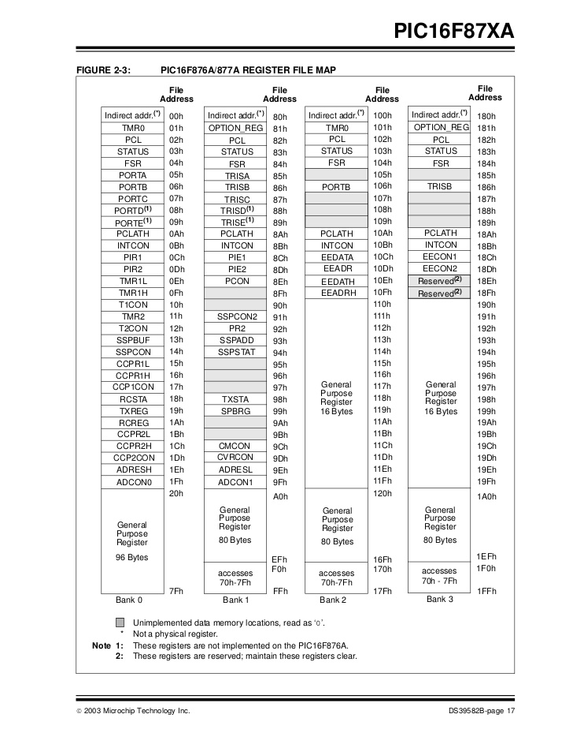
PIC16F876A/877A register file map

Slide 9
PIC16F877A Data Memory (RAM)
Memory storage for variables
Data Memory is also known as Register File and consists of two components.
General purpose register file (same as RAM).
Special purpose register file (similar to SFR in 8051).
Addresses range from 0 to 511 and partitioned into 4 banks -> each bank extends up to 7Fh (128 bytes).
The user can only access a RAM byte in a set of 4 banks and only one bank at a time. The default bank is BANK0.
To access a register that is located in another bank, one should access it inside the program. There are special registers which can be accessed from any bank, such as STATUS register.

Slide 10
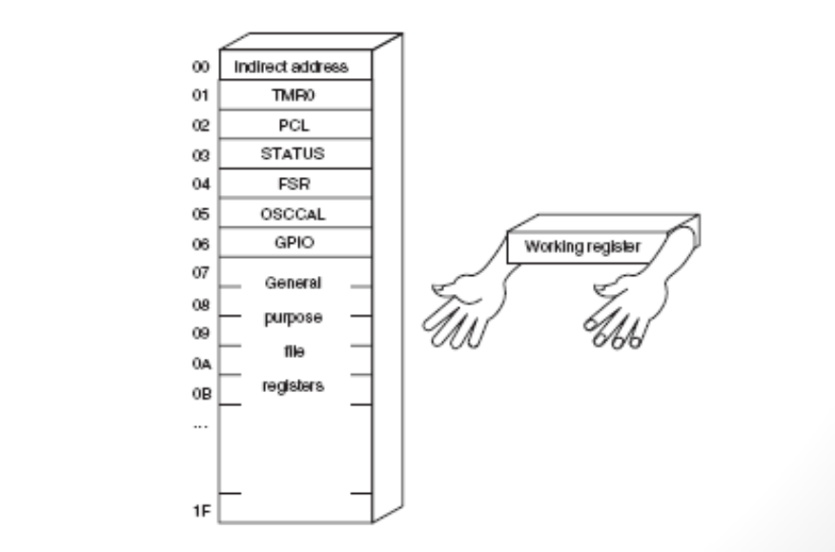
W Register
W, the working register, is used by many instructions as the source of an operand. This is similar to accumulator in 8051.
It may also serve as the destination for the result of the instruction execution. It is an 8-bit register

Slide 11
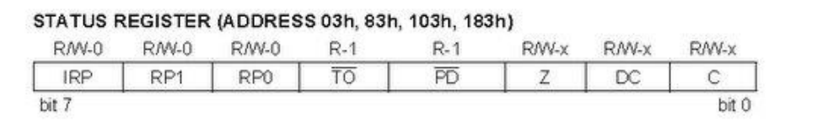

STATUS Register
Is an 8-bit register that stores the status of the processor.
In most cases, this register is used to switch between the banks (Register Bank Select), but also has other capabilities.
• IRP - Register Bank Select bit.
• RP1:RP0: - Register Bank Select bits.
• TO: Time-out bit
• PD: Power-down bit
• Z: Zero bit
• DC: Digit carry/borrow bit
• C: Carry/borrow bit
Used in conjunction with PIC’s sleep mode

Slide 12
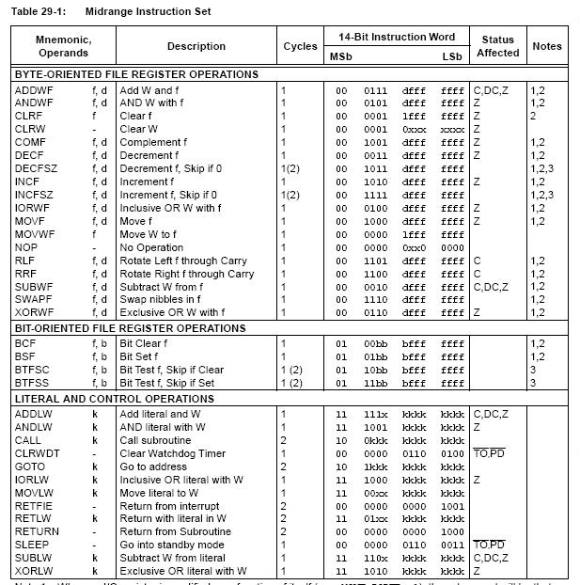
Instruction Set

Slide 13
First Code
LIST P = 16F877A
#INCLUDE "P16F877A.INC"
__config H'3F31'
ORG 0X00
;--------------------------------------------------------------------
MAIN
BSF STATUS,5
CLRF TRISD
BCF STATUS,5
GOTO MAIN
END

