Slide 1
QBI HACKATHON 2026 · UCSF MISSION BAY · MIT-LICENSED
CryoClear
The open, real-time particle-picking + junk-triage copilot for cryo-EM.
CryoFSL made few-shot picking accurate. We make picking and junk-cleaning interactive, real-time, and measurable — with a human-in-the-loop that learns live, on a single GPU.
Computer Science · picking + junk ML + UI
Hardware / Systems · GPU, MRC I/O, streaming
Chemistry · scientific story + HITL
CryoClear · open real-time cryo-EM junk-triage copilot
QBI Hackathon 2026 · UCSF · MIT | 1/12
Notes:
CryoClear is an open, real-time particle-picking and junk-triage copilot for cryo-EM that runs on a single GPU and learns from the scientist live. The novelty is the product, not a new picking model: interactive, measurable, human-in-the-loop junk removal as data streams in. Built this weekend at QBI 2026, MIT-licensed, by a CS, hardware, and chemistry team.

Slide 2
THE GAP
Auto-pickers over-pick junk. Cleaning it is manual, post-hoc, and slow.
▪ Topaz, crYOLO, CryoSegNet find particles well — but ship no junk-triage layer for ice, carbon edges, and aggregates.
▪ Scientists catch junk by eye, after the run — discard, re-tune, re-run. Hours after collection, not during.
▪ Real-time platforms (cryoSPARC Live, Warp) are powerful but closed, with simple pickers and no correctable junk model.
The opening: no open tool ships a dedicated, correctable junk-triage classifier with a sub-second human-in-the-loop refit. That product — not a new picking model — is our contribution.
CryoClear · open real-time cryo-EM junk-triage copilot
QBI Hackathon 2026 · UCSF · MIT | 2/12
Notes:
Auto-pickers like Topaz over-pick junk, and cleaning ice, carbon edges, and aggregates today is manual and post-hoc. Real-time platforms like cryoSPARC Live and Warp exist but use simple pickers and are heavy and closed. Nobody ships an open, interactive, real-time junk-triage copilot with a live human-in-the-loop learning loop, and that's the gap we fill.

Slide 3
WHAT CRYOCLEAR DOES
One modular pipeline — swap any picker, triage the junk, learn from the scientist.
MRC stream
micrographs as they arrive
Picker
blob · Topaz · CryoSegNet
Junk classifier
keep / ice / carbon / aggregate
Your correction
box-brush keep/dump · undo
Learns live
refits in <1s
Clean export
.star/.box → RELION/cryoSPARC
2D classes
proof the picks are real
Green = keep, red = junk, overlaid live. Every accept/reject updates the classifier in-session, and a live scoreboard shows how clean the stack is. The default picking + triage path is CPU-light; the GPU is used only for the optional deep pickers and the CNN.
CryoClear · open real-time cryo-EM junk-triage copilot
QBI Hackathon 2026 · UCSF · MIT | 3/12
Notes:
The flow is simple end to end: an MRC micrograph streams in, a swappable picker proposes candidate boxes, our junk classifier paints each keep or junk, the scientist corrects on the canvas, the classifier learns live, and you export a clean particle set plus 2D class averages. Every stage is a real module in the repo. This is the spine of the whole talk.

Slide 4
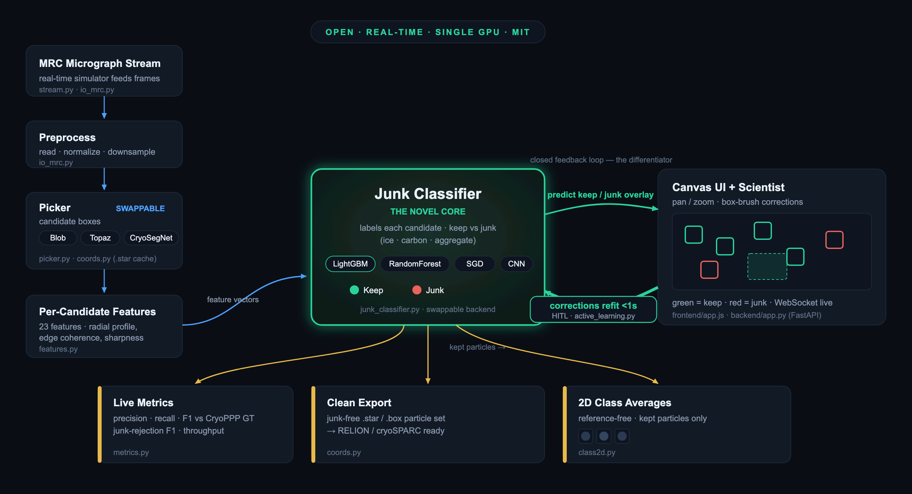
SYSTEM ARCHITECTURE
Modular by design — a swappable picker, a novel junk classifier, a live correction loop.
Forward data flow in blue · the human-in-the-loop correction loop in green · measurable outputs in gold.
CryoClear · open real-time cryo-EM junk-triage copilot
QBI Hackathon 2026 · UCSF · MIT | 4/12
Notes:
Here's the same pipeline as a system diagram, with the real module names. Three things to watch for: the picker is swappable (blob, Topaz, CryoSegNet), the junk classifier is the central novel piece, and the correction feedback loop runs from the UI back into the classifier. That feedback arrow is our differentiator.

Slide 5
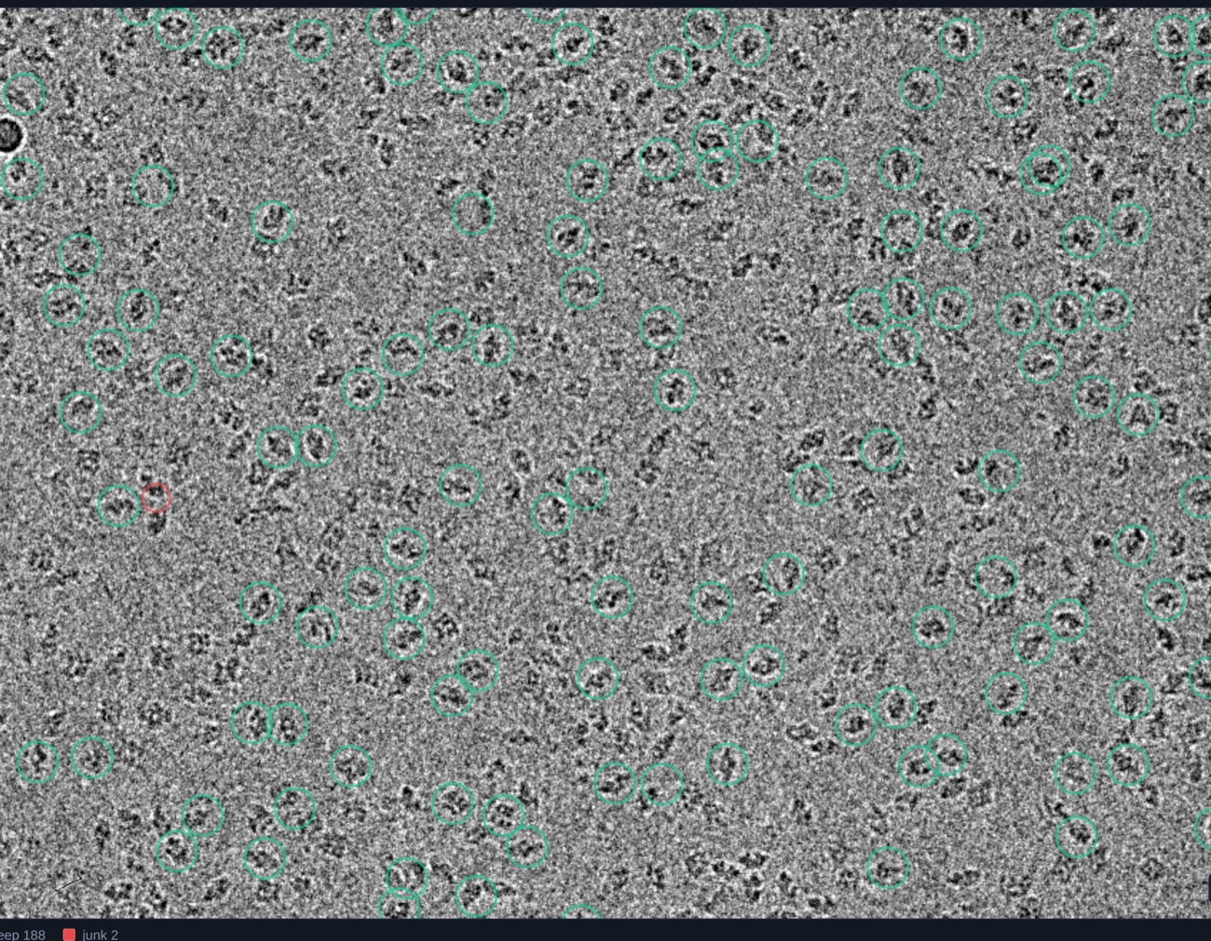
LIVE PICKING · M1
It picks particles — and tells you which ones to trust.
▪ Locally-normalised band-pass detector finds candidates across the whole field.
▪ Each candidate gets 23 intensity-normalised features (radial profile, edge coherence, sharpness).
▪ The classifier paints keep vs junk in real time.
▪ Live default is the CPU blob/DoG picker; Topaz & CryoSegNet picks are precomputed and cached as .star.
EMPIAR-10017 β-galactosidase · green = kept particle, red = flagged junk.
CryoClear · open real-time cryo-EM junk-triage copilot
QBI Hackathon 2026 · UCSF · MIT | 5/12
Notes:
A band-pass blob detector finds candidates on CPU in seconds, no GPU required for the demo path. For each candidate we compute 23 intensity-normalized features: radial profile, edge coherence, sharpness. The classifier then paints keep versus junk live on the canvas, green and red, as you watch.

Slide 6
MEASURED · LABELLED IN-SAMPLE VS HELD-OUT
Junk triage beats raw picks where it counts: a cleaner stack.
+0.09
kept-set purity vs raw picks
in-sample · 10017 · every micrograph measured
0.47 → 0.64
junk-rejection F1 (LightGBM)
held-out · richer features
Honest ceiling: on β-gal, picking-F1 after triage ≈ raw — the residual false positives are background that genuinely resembles particles, which 2D classification, not the picker, is built to resolve. The classifier's measurable value is purity and a clean kept set — every number is tagged in-sample or held-out.
27%
junk removed, recall ≈ unchanged
in-sample · at the demo threshold
0.37 → 0.38
picking F1 vs CryoPPP
held-out · the honest floor
CryoClear · open real-time cryo-EM junk-triage copilot
QBI Hackathon 2026 · UCSF · MIT | 6/12
Notes:
The kept set gets measurably purer. In-sample on EMPIAR-10017: about +0.09 purity, precision 0.36 to 0.49, and roughly 27% junk removed at the demo threshold with recall essentially unchanged. Held-out, the LightGBM junk-rejection F1 is 0.47 to 0.64 and picking F1 is 0.37 to 0.38 — the honest floor. Be clear about the ceiling: on beta-gal, picking-F1 after triage is about the same as raw, because the leftover false positives are background that genuinely resembles particles — the kind of thing 2D classification, not the picker, resolves. The value is purity and a clean kept set, and every number is tagged in-sample or held-out.

Slide 7
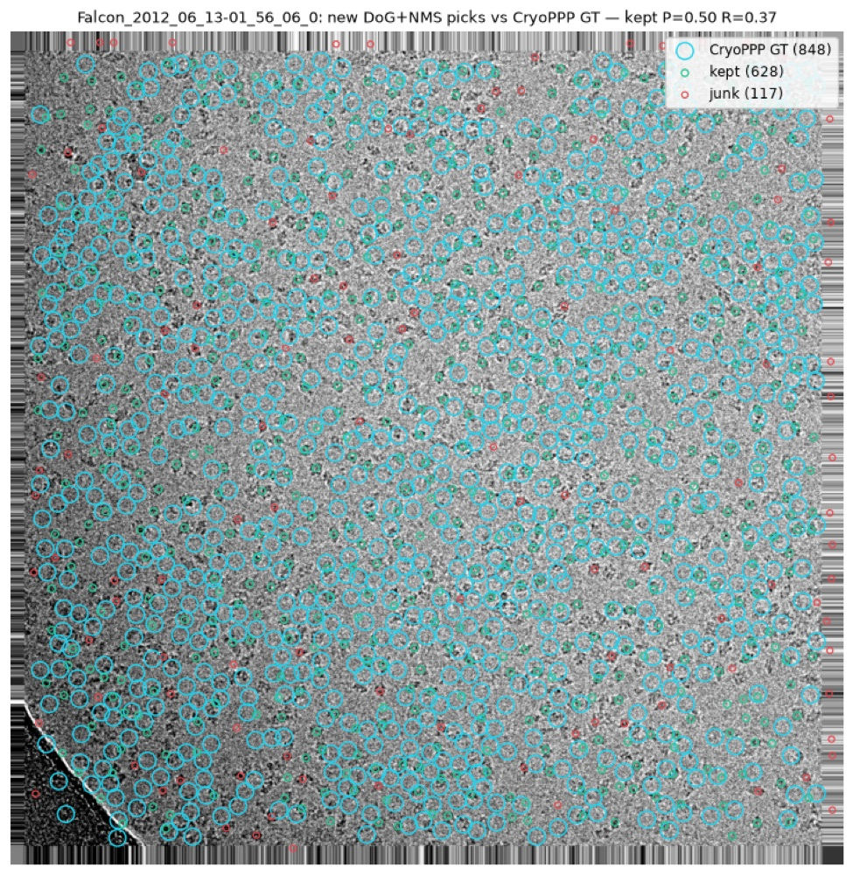
HONEST EVALUATION
Scored against expert CryoPPP ground truth.
▪ Picks matched to CryoPPP's hand-labelled particles within the particle radius.
▪ We report precision / recall / F1 per micrograph — held-out, not just in-sample.
▪ Published DL pickers reach ~0.73 F1 on their own protocols (different data & splits) — greyed context, never a head-to-head.
Candidate picks overlaid against CryoPPP ground-truth positions.
CryoClear · open real-time cryo-EM junk-triage copilot
QBI Hackathon 2026 · UCSF · MIT | 7/12
Notes:
We validate against CryoPPP ground truth on held-out micrographs, reporting precision, recall, and F1 so the numbers are reproducible, not cherry-picked. Published deep-learning pickers land around 0.73 F1, which we show purely for context, not as a head-to-head claim. Our contribution is the triage layer on top of whatever picker you choose, not beating those pickers.

Slide 8
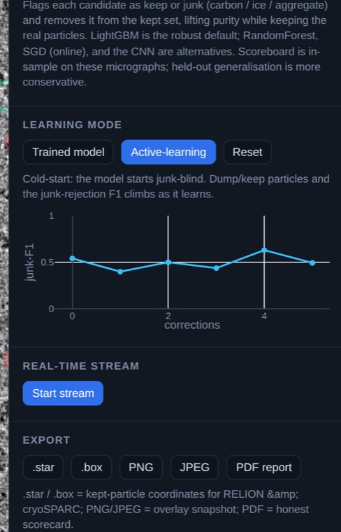
HUMAN-IN-THE-LOOP · M2
It learns from your corrections — live.
▪ Cold-start: the model begins junk-blind.
▪ Box-brush to keep or dump particles in bulk; the junk-rejection F1 climbs as it learns.
▪ Full undo / redo (Ctrl/Cmd+Z); every change flows into the export.
This is the “it learns from me” loop that batch CLI pickers don't have.
Junk-rejection F1 climbing over corrections, with one-click exports.
CryoClear · open real-time cryo-EM junk-triage copilot
QBI Hackathon 2026 · UCSF · MIT | 8/12
Notes:
The classifier cold-starts junk-blind, knowing nothing. The scientist box-brushes keep and dump corrections on the canvas, the classifier refits in under a second, and held-out junk-rejection F1 climbs as you teach it. Undo/redo is supported, and the improved model flows straight through to export. This is the human-in-the-loop loop working in real time.

Slide 9
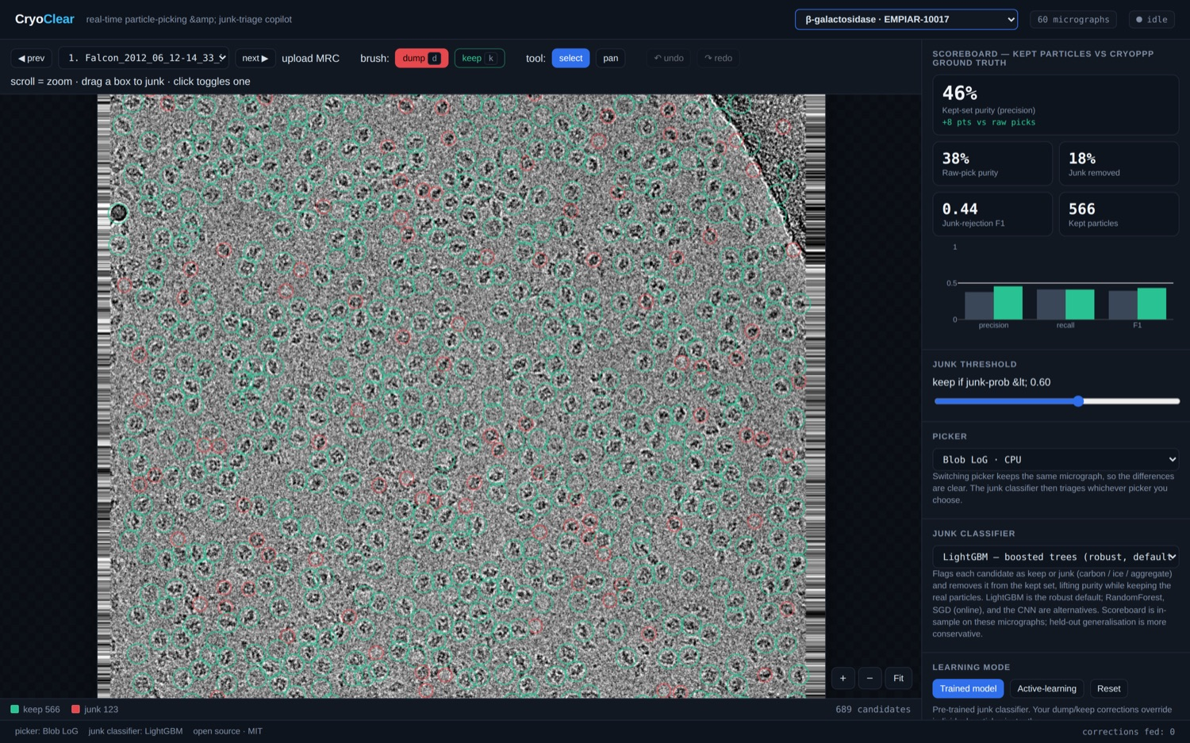
A PLATFORM, NOT A ONE-OFF
Everything is swappable and cached.
PICKERS
Blob LoG · CPU
Topaz · GPU
CryoSegNet · GPU
JUNK CLASSIFIERS
LightGBM
RandomForest
SGD · online
CNN
DATASETS
β-gal
TMV
proteasome
+ upload MRC
EXPORT
.star
.box
PNG
PDF report
The live app: canvas viewer, scoreboard, swappable picker + classifier, dataset switcher.
CryoClear · open real-time cryo-EM junk-triage copilot
QBI Hackathon 2026 · UCSF · MIT | 9/12
Notes:
Everything is modular: pickers swap between blob, Topaz, and CryoSegNet; classifiers swap between LightGBM, RandomForest, online SGD, and a CNN; datasets cover beta-gal, TMV, and proteasome, plus upload-your-own MRC. Export goes to .star, .box, PNG, and PDF, so it drops into RELION or cryoSPARC. It's a platform, not a one-off demo.

Slide 10
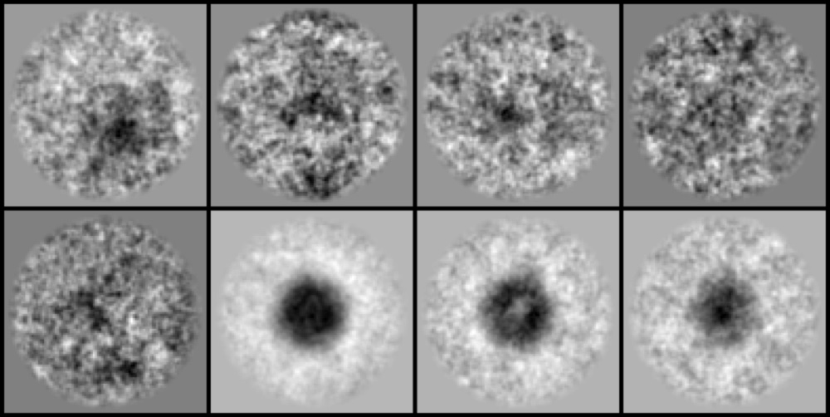
THE PROOF · M4
2D class averages — “these picks are real.”
▪ Reference-free 2D classification of the kept particles.
▪ Iterative rotational + translational alignment, then k-means clustering on band-pass crops (no CTF, no ML model).
▪ Recognisable, centred protein views emerge from the cleaned stack.
Honest: β-gal is small, low-contrast, few-view — averages won't match cryoSPARC's textbook crispness without thousands of particles + CTF. The pipeline is industry-shaped; the protein is the limit.
Class-average montage of kept β-gal particles.
CryoClear · open real-time cryo-EM junk-triage copilot
QBI Hackathon 2026 · UCSF · MIT | 10/12
Notes:
We run reference-free 2D classification on the kept particles: iterative rotational and translational alignment, then k-means clustering on band-pass crops — no CTF and no ML model. Be honest: beta-gal won't hit textbook crispness without thousands of particles and CTF correction. It's a directional proof that closes the loop from raw micrograph to interpretable averages, not a final reconstruction.

Slide 11
WHY IT SCORES
The novelty is the product — and we're honest about what it isn't.
WE BUILT
WE DO NOT CLAIM
▪ An open, real-time junk-triage copilot with a live HITL learning loop.
▪ Swappable pickers + classifiers, 7+ datasets, upload-your-own, clean export.
▪ Honest measurement against CryoPPP — held-out, in-sample labelled as such.
▪ A novel picking model or a novel ML algorithm.
▪ To beat deep-learning pickers' picking-F1 — swap one in; it's in the menu.
▪ cryoSPARC-grade 2D on a hard protein from a laptop.
Rubric fit: Impact (cleaner stacks, live) · Execution (a usable product, not a notebook) · Background variety (CS + hardware + chemistry) · Novelty (the correctable, sub-second-refit junk-triage UX nobody open-ships).
CryoClear · open real-time cryo-EM junk-triage copilot
QBI Hackathon 2026 · UCSF · MIT | 11/12
Notes:
We explicitly do not claim a novel picking model or a new ML algorithm; the picker and the classifier families are standard. The contribution is the product: interactive real-time junk triage with a live learning loop, open and measurable on a single GPU. On the rubric, that's strong on impact, execution, and novelty-as-product, with a genuinely cross-disciplinary CS, hardware, and chemistry team.

Slide 12
OPEN SOURCE · MIT · SINGLE GPU
Picking + junk-cleaning,
interactive, real-time, and measurable.
CryoClear turns post-hoc, manual junk removal into a live copilot that cleans the stack as data streams in — and proves it with honest metrics and 2D class averages.
Single GPU — core path is CPU-light
MIT-licensed, fully open
CS · Hardware · Chemistry
CryoClear · open real-time cryo-EM junk-triage copilot
QBI Hackathon 2026 · UCSF · MIT | 12/12
Notes:
CryoClear is open source under MIT, runs on a single GPU, and was built by a team spanning CS, hardware, and chemistry. We turn slow, manual, post-hoc junk cleaning into an interactive copilot that learns from the scientist live. Try it, swap in your own picker or dataset, and tell us what to clean next.

