Slide 1

The project
Christoph Hohenwarter
Universidade Federal de Sao Carlos
August – October 2010

Slide 2
Overview
TV-Anytime
  What is TV-Anytime
  Datastructure
  Example XMLs
BBC Framework
My Application
  Used technologies
  Structure
The Application

Slide 3
What is TV-Anytime?
Metadata format specification for multimedia content
Designed for local storage of metadat in a Personal Video Recorder (PVR)
Defined via xml-schemes (xsd)
Open standard
Uses MPEG7 datatyp definitions
Official ETSI standard

Slide 4
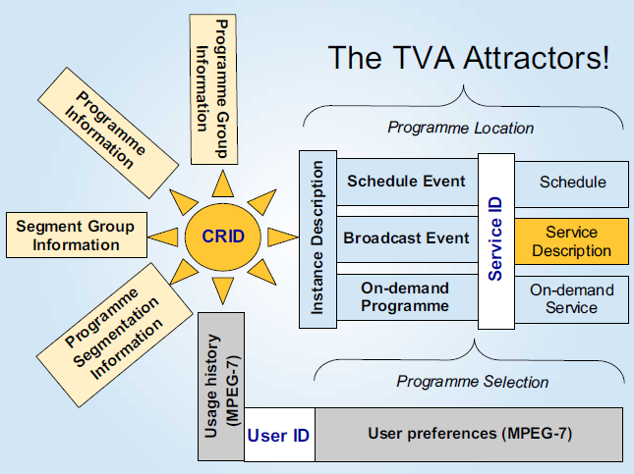
Datastructure

Slide 5
CRID - Content Reference Identifier

Slide 6
CRID - Content Reference Identifier
crid:// [DNS] / [unique identifier]
  crid://example.com/foobar

Slide 7
Programminformation
BasicDescription
  Title
  Synopsis
  Keywords
  Parential rating (MPEG-7 defined)
  Dubbed-flag
  ...

Slide 8
Programminformation
AV-Attributes
  Audio-attributes
    Encoding format (MPEG-7 classification)
    Number of Channels
  Video-attributes
    Encoding format (MPEG-7 classification)
    Resolution information, color format etc.

Slide 9
Segmentinformation
Segment location (MPEG-7 subtype)
Segment description
  Title
  Keyword
  Description
  Related Material

Slide 10
Programmlocation
Describes the scheduled place in time when the content was distributed (sent)
  Reference to the CRID
  Instance description of the content being sent => this information overrides the program information like title, synopsis etc.

Slide 11
Usage History
Describes action taken by the user
  PlayStream: Play content from input stream
  Record Record: input stream to local storage media
  Preview: View or listen to a summary of the input stream
  Pause: Pause the input stream
  FastForward: Fast forward the input stream
  Rewind: Rewind the input stream
  Mute: Turn sound off
  VolumeUp: Increase volume
Connected to a CRID

Slide 12
TV-Anytime XSD
<!-- 5.6.2 TV Anytime program information document -->
<!-- ################################################ -->
<!-- Definition of TVAMain DS -->
<!-- ################################################ -->
<element name="TVAMain" type="tva:TVAMainType"/>
<complexType name="TVAMainType">
<sequence>
<element name="CopyrightNotice" type="string" minOccurs="0"/>
<element ref=”ClassificationSchemeTable” minOccurs=”0”/>
<element ref="tva:ContentDescription" minOccurs="0"
maxOccurs="unbounded"/>
<element ref="tva:UserDescription" minOccurs="0"
maxOccurs="unbounded"/>
</sequence>
<complexType name="ProgramDescriptionType">
<sequence>
<element ref="tva:ProgramInformationTable" minOccurs="0"/>
<element ref="tva:GroupInformationTable" minOccurs="0"/>
<element ref="tva:ProgramLocationTable" minOccurs="0"/>
<element ref="tva:ServiceInformationTable" minOccurs="0"/>
<element ref="tva:CreditsInformationTable" minOccurs="0"/>
<element ref="tva:ProgramReviewTable" minOccurs="0"/>
<element ref="tva:SegmentInformationTable" minOccurs="0"/>
</sequence>
</complexType>

Slide 13
Example XML
<ContentReferencingTable xmlns='http://www.tv-anytime.org/2002/02/ContentReferencing' xmlns:xsi='http://www.w3.org/2001/XMLSchema-instance' version='1' xsi:schemaLocation='http://www.tv-anytime.org/2002/02/ContentReferencing I:\tv-anytime\schema\content_refv1.2spec(validateslocally).xsd'>
<Result CRID='crid://bbc.co.uk/302020516' status='resolved' complete='true' acquire='any'>
<LocationsResult>
<Locator>dvb://233a.1004.1200;77a4@2002-12-03T09:42:06Z/PT00H19M</Locator>
</LocationsResult>
</Result>
<Result CRID='crid://bbc.co.uk/302020517' status='resolved' complete='true' acquire='any'>
<CRIDResult>
<Crid>crid://bbc.co.uk/302020767</Crid>
<Crid>crid://bbc.co.uk/302021045</Crid>
<Crid>crid://bbc.co.uk/302022622</Crid>
<Crid>crid://bbc.co.uk/302023367</Crid>
</CRIDResult>
</Result>
.....

Slide 14
Example XML
<?xml version='1.0' encoding='ISO-8859-1'?>
<TVAMain xmlns='urn:tva:metadata:2002' xmlns:mpeg7='urn:mpeg:mpeg7:schema:2001' xmlns:xsi='http://www.w3.org/2001/XMLSchema-instance' xsi:schemaLocation='urn:tva:metadata:2002 I:\tv-anytime\Specifications\COR1_SP003v13\tva_metadata_v13.xsd'>
<!--Use of this BBC data for non-TV-Anytime purposes is strictly forbidden.-->
<ProgramDescription>
<ProgramInformationTable>
<ProgramInformation programId='crid://bbc.co.uk/3257075077'>
<BasicDescription>
<Title><![CDATA[Morning On 3]]></Title>
<Synopsis length='short'><![CDATA[Penny Gore plays Faure's Dolly Suite, Beethoven's String Trio, Op 9 No 3, Nielsen's Rhapsody Overture, Mozart's Regina coeli, Wagner's Parsifal and Mendelssohn's Elijah.]]></Synopsis>
<Synopsis length='long'><![CDATA[Presented by Penny Gore
6.10am
Faur orch. Rabaud: Dolly Suite
Orchestre de Paris
Serge Baudo (conductor)
.....

Slide 15
The BBC-framework
  Information representet:
    Content Referencing
    Credits Information
    Group Information
    Program Information
    Segment Information
    Service Information

Slide 16
BBC API

Slide 17
API Structure Example

Slide 18
Important methods of the API
  Getter
  Setter
  toXML

Slide 19
My Application
Used technologies:
  BBC TV-Anytime API
  Zkoss – Framework
  MySQL – Database
  JAX-WS - Java API for XML Web Services
Development Environment: Net Beans 6.9

Slide 20
Program Structure
WebUITVAnytime
  Webbased Userinterface (Zkoss)
TVAnytimePersistenceWS
  Webservice to store the xml-File in a database (JAX-WS)
TVAnytimeCore
  BBC – Framework
  Tools
  Databeans

Slide 21
TODO
Implement AV attributes of the Program Description
Validation
Implement Program Location Package
User authentification
Testcases

Slide 22
Questions?

Slide 23
Thanks for your attention!

