Slide 1

TV-Anytime
Christoph Hohenwarter
Universidade Federal de Sao Carlos
August 2010

Slide 2
Overview
What is TV-Anytime
History
Datastructure
  CRID - Content Reference Identifier
  Programinformation
  Segmentinformation
  Programlocation
  Usage History
TV-Anytime XSD
Example XMLs

Slide 3
What is TV-Anytime?
Metadata format specification for multimedia content
Designed for local storage of metadat in a Personal Video Recorder (PVR)
Defined via xml-schemes (xsd)
Open standard
Uses MPEG7 datatyp definitions
Official ETSI standard

Slide 4
History
Founded September 1999, Newport Beach, California
Became 2003 an official ETSI standard
  ETSI TS 102 822
tv-anytime.org Forum was closed in 2005
  Maintenance of specifications have been transferred to JTC Broadcast

Slide 5
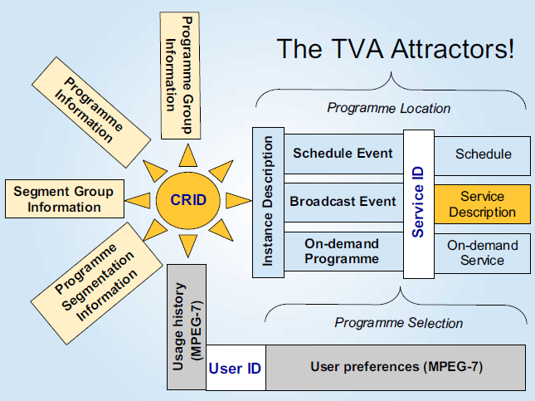
Datastructure

Slide 6
CRID - Content Reference Identifier

Slide 7
CRID - Content Reference Identifier
crid:// [DNS] / [unique identifier]
  crid://example.com/foobar

Slide 8
Programminformation
BasicDescription
  Title
  Synopsis
  Keywords
  Parential rating (MPEG-7 defined)
  Dubbed-flag
  ...

Slide 9
Programminformation
AV-Attributes
  Audio-attributes
    Encoding format (MPEG-7 classification)
    Number of Channels
  Video-attributes
    Encoding format (MPEG-7 classification)
    Resolution information, color format etc.

Slide 10
Segmentinformation
Segment location (MPEG-7 subtype)
Segment description
  Title
  Keyword
  Description
  Related Material

Slide 11
Programmlocation
Describes the scheduled place in time when the content was distributed (sent)
  Reference to the CRID
  Instance description of the content being sent => this information overrides the program information like title, synopsis etc.

Slide 12
Usage History
Describes action taken by the user
  PlayStream: Play content from input stream
  Record Record: input stream to local storage media
  Preview: View or listen to a summary of the input stream
  Pause: Pause the input stream
  FastForward: Fast forward the input stream
  Rewind: Rewind the input stream
  Mute: Turn sound off
  VolumeUp: Increase volume
Connected to a CRID

Slide 13
TV-Anytime XSD
<!-- 5.6.2 TV Anytime program information document -->
<!-- ################################################ -->
<!-- Definition of TVAMain DS -->
<!-- ################################################ -->
<element name="TVAMain" type="tva:TVAMainType"/>
<complexType name="TVAMainType">
<sequence>
<element name="CopyrightNotice" type="string" minOccurs="0"/>
<element ref=”ClassificationSchemeTable” minOccurs=”0”/>
<element ref="tva:ContentDescription" minOccurs="0"
maxOccurs="unbounded"/>
<element ref="tva:UserDescription" minOccurs="0"
maxOccurs="unbounded"/>
</sequence>
<complexType name="ProgramDescriptionType">
<sequence>
<element ref="tva:ProgramInformationTable" minOccurs="0"/>
<element ref="tva:GroupInformationTable" minOccurs="0"/>
<element ref="tva:ProgramLocationTable" minOccurs="0"/>
<element ref="tva:ServiceInformationTable" minOccurs="0"/>
<element ref="tva:CreditsInformationTable" minOccurs="0"/>
<element ref="tva:ProgramReviewTable" minOccurs="0"/>
<element ref="tva:SegmentInformationTable" minOccurs="0"/>
</sequence>
</complexType>

Slide 14
Example XML
<ContentReferencingTable xmlns='http://www.tv-anytime.org/2002/02/ContentReferencing' xmlns:xsi='http://www.w3.org/2001/XMLSchema-instance' version='1' xsi:schemaLocation='http://www.tv-anytime.org/2002/02/ContentReferencing I:\tv-anytime\schema\content_refv1.2spec(validateslocally).xsd'>
<Result CRID='crid://bbc.co.uk/302020516' status='resolved' complete='true' acquire='any'>
<LocationsResult>
<Locator>dvb://233a.1004.1200;77a4@2002-12-03T09:42:06Z/PT00H19M</Locator>
</LocationsResult>
</Result>
<Result CRID='crid://bbc.co.uk/302020517' status='resolved' complete='true' acquire='any'>
<CRIDResult>
<Crid>crid://bbc.co.uk/302020767</Crid>
<Crid>crid://bbc.co.uk/302021045</Crid>
<Crid>crid://bbc.co.uk/302022622</Crid>
<Crid>crid://bbc.co.uk/302023367</Crid>
</CRIDResult>
</Result>
.....

Slide 15
Example XML
<?xml version='1.0' encoding='ISO-8859-1'?>
<TVAMain xmlns='urn:tva:metadata:2002' xmlns:mpeg7='urn:mpeg:mpeg7:schema:2001' xmlns:xsi='http://www.w3.org/2001/XMLSchema-instance' xsi:schemaLocation='urn:tva:metadata:2002 I:\tv-anytime\Specifications\COR1_SP003v13\tva_metadata_v13.xsd'>
<!--Use of this BBC data for non-TV-Anytime purposes is strictly forbidden.-->
<ProgramDescription>
<ProgramInformationTable>
<ProgramInformation programId='crid://bbc.co.uk/3257075077'>
<BasicDescription>
<Title><![CDATA[Morning On 3]]></Title>
<Synopsis length='short'><![CDATA[Penny Gore plays Faure's Dolly Suite, Beethoven's String Trio, Op 9 No 3, Nielsen's Rhapsody Overture, Mozart's Regina coeli, Wagner's Parsifal and Mendelssohn's Elijah.]]></Synopsis>
<Synopsis length='long'><![CDATA[Presented by Penny Gore
6.10am
Faur orch. Rabaud: Dolly Suite
Orchestre de Paris
Serge Baudo (conductor)
.....

Slide 16
Repetition
TV-Anytime is an open standard defining the Metadata-description
Defined in XSD
Uses MPEG-7 datatyps
BBC opensource framework exists for accessing parts of the defined datamodell
Implementation needs still to be done

Slide 17
Questions?

Slide 18
Thanks for your attention!

