Slide 1


程序设计范式
4 – 基于对象的编程
赵钦佩（博士，副教授）
Email: qinpeizhao@tongji.edu.cn
http://sse.tongji.edu.cn/zhaoqinpei

Slide 2

4–基于对象的编程
4.1 什么基于对象的编程？
4.2 什么是类？
4.3 如何实现一个简单的类？
4.4 如何初始化和清除一个类？
4.5 什么是this指针？
4.6 如何将一个对象赋值给另外一个对象？
4.7 深拷贝和浅拷贝的区别？
4.8 怎么获取一个类的私有成员？
4.9 如何让一个类多样化？
4.10 什么是运算符重载？
4.11 如何直接对一个对象进行读和写的操作？
4.12 如何实现一个function object？
4.13 如何打造一个Iterator class?
4.14 当指针指向类的成员函数，会如何？

Slide 3

4.1 What is oop?
you should …
Understand the three pillars of Object-Oriented Programming: Inheritance, Encapsulation and Polymorphism.
Understand what an object is.
Understand object attributes, methods and events.
Understand how programmers use APIs.

Slide 4
4.1 Object-Oriented Languages
Most object-oriented languages are high-level languages.
The focus of OOP languages is not on structure, but on modeling data.
Programmers code using “blueprints” of data models called classes.
Examples of OOP languages include C++, Visual Basic.NET and Java.

Slide 5
4.1 Object Oriented Programming
Object – Unique programming entity that has methods, has attributes and can react to events.
Method – Things which an object can do; the “verbs” of objects. In code, usually can be identified by an “action” word -- Hide, Show

Slide 6
4.1 Object Oriented Programming
Attribute – Things which describe an object; the “adjectives” of objects. In code, usually can be identified by a “descriptive” word – Enabled, BackColor
Events – Forces external to an object to which that object can react. In code, usually attached to an event procedure

Slide 7
4.1 Object Oriented Programming
Class – Provides a way to create new objects based on a “meta-definition” of an object (Example: The automobile class)
Constructors – Special methods used to create new instances of a class (Example: A Honda Civic is an instance of the automobile class.)

Slide 8
4.1 OOP - Encapsulation
Incorporation into a class of data & operations in one package
Data can only be accessed through that package
“Information Hiding”

Slide 9
4.1 OOP - Inheritance
Allows programmers to create new classes based on an existing class
Methods and attributes from the parent class are inherited by the newly-created class
New methods and attributes can be created in the new class, but don’t affect the parent class’s definition

Slide 10
4.1 OOP - Polymorphism
Creating methods which describe the way to do some general function (Example: The “drive” method in the automobile class)
Polymorphic methods can adapt to specific types of objects.

Slide 11



4.2 What is a class and object?
Object
Object
Object
Object

Slide 12
4.2 What is a class and object?
User
Product
id, type, in_stock, title, description
first_name, last_name, email, password
Login Form
Job
id, type, can_be_applied_for
username, password, is_accepted

Slide 13
4.2 Attributes/ Properties
User
first_name, last_name, email, password
Attributes/ Properties

Slide 14
4.2 Attributes / Properties
Class object
is_full = false
is_empty = false

Slide 15

4.2 Attributes /Properties
mileage
Properties
37000

Slide 16

4.2 Actions/Methods
Behavior
Dog object: bark();
Actions/ Methods

Slide 17
4.2 Class & Object
Class – user defined data type
More operations, not only operators but also functions
Object – an instance or running entity of certain class
Class vs. Object
Class, a static concept; Object, a dynamic concept
One class definition, multiple object entities

Slide 18
4.2 Class & Object
class Rectangle
{
private:
int width;
int length;
public:
void set(int w, int l);
int area();
};
Objects: Instance of a class
Rectangle r1;
Rectangle r2;
Rectangle r3;
……
int a;

Slide 19
4.2 Concepts of Class
Class components
From the view of Type
Data members (Built-in, user-defined), or Attributes
Member functions (function, operator), or Methods, Behaviors
From the view of Role
Public Interface
Private Implementation
Encapsulation
Class users only access public interface, need not be aware of the internal details of implementation
No matter how dramatically the internal implementation changed, client codes need not be modified if interface is fixed
struct in C++ : Taken as a special type of class, which has no member functions, and all data members are public

Slide 20
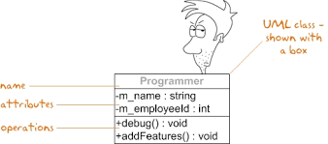
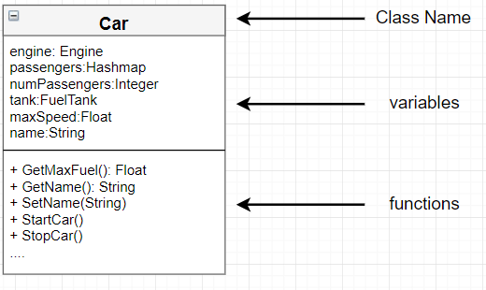
4.3 How to design a class?

Slide 21
4.3 Define a Class Type
class Rectangle
{
private:
int width;
int length;
public:
void set(int w, int l);
int area();
};
Header
class class_name
{
permission_label:
member;
permission_label:
member;
...
};
Body

Slide 22
4.3 Design our own classes
A simple start – a string stack class
An important LIFO data structure
Required operations:
Push – add an element to the stack
Pop – take an element out from the top of stack
Full – query whether the stack is full
Empty – query whether the stack is empty
Size – query the number of elements in the stack
Peek – access the element on the top of the stack, but not to pop it out

Slide 23
4.3 Class Declaration & Definition
class CStack
{
public:
bool push(const string&);
bool pop(string &);
bool peek(string &);
bool empty();
bool full();
int size() { return m_stack.size(); }
private:
vector<string> m_stack;
};
bool CStack::empty()
{ return m_stack.empty(); }
//class declaration
//{} class definition body
//access control
//member function declaration
//declaration & definition (in Class)
//access control
//data member
//never to forget the semicolon
//member function definition (out of Class)

Slide 24
4.3 Class Declaration & Definition (cont.)
Question: If class A has a pointer data member that pointing to class B, and vice versa, how to define class A and B?
Answer: Using Forward Declaration
class A;
class B;
class A{
public:
B* m_pb;
};
class B{
public:
A* m_pa;
};
A forward declaration is a declaration of an identifier (denoting an entity such as a type, a variable, a constant, or a function) for which the programmer has not yet given a complete definition.

Slide 25
4.3 Class Declaration & Definition (cont.)
Forward Declaration only telling the name to the compiler
Try your best to minimize the compilation dependencies between files
The rules is, if the class declaration could work, never to include the class definition
For pointers, references, and using objects as parameters and return value in function declaration, we only need the class declaration
CStack* pstack = 0;
void funcA(const CStack&);
CStack funcB(CStack);
We could define a real class object or use the class members, only after we know the class definition
CStack stack;
int s = stack.size();
The declaration version of <iostream> -- <iosfwd>

Slide 26
4.3 Access control
Controlling how the member functions and data members could be accessed
Public – could be accessed outside the class
Protected – could only be accessed by those classes deriving from it, or by friend classes and functions
Private – could only be accessed inner this class, or by friend classes and functions
Suggestion: Avoid exposing the data members in the public interface, Use accessing functions instead

Slide 27
4.3 Access control (cont.)
class Y
{
public:
int _m1;
int get_m2() { return _m2;}
void set_m2(int x) { _m2 = x;}
private:
int _m2;
} y;
void main()
{
y._m1++; //Not suggested! Direct access data members
y.set_m2(1); //Suggested! The data member is accessed under control
}
class X
{
public:
int mf1();
int mf2() { return mf3(); }
private:
int mf3();
} x;
void main()
{
x.mf1(); //yes
//Error! Private member can’t be accessed out of the class
x.mf3();
}

Slide 28
4.4 How to initialize and clean a class?
Construction and Destruction
Notes:
MyClass::MyClass( const MyClass& other ) : x( other.x ), c( other.c ), s( other.s ) {}
Default constructor

Slide 29
4.4 How to initialize? Constructor
Suppose we want to instantiate the Fibonacci objects in different ways
CFibonacci fib1(10); //range 10
CFibonacci fib2(8, 3); //range 8, start from the 3rd element
CFibonacci fib3(fib2); //copy of fib2
How to implement them? – Constructors
Constructors are initialization member functions that:
Having the same name as class name
No return value
Could be overloaded (Multiple constructors are supported)

Slide 30
4.4 Constructors
class CFibonacci
{
public:
CFibonacci(); //default constructor
CFibonacci(int iLen);
CFibonacci(int iLen, int iBegPos);
//… other constructors and members
};
//calling
CFibonacci f1;
CFibonacci f2( 6 );
CFibonacci f3 = 10;
CFibonacci f4( );
CFibonacci f5( 10, 3 );
//correct
//correct
//correct, same as f3(10)
//f4 will be regarded as a function
//correct

Slide 31
4.4 Constructors – Default Constructor
Default Constructor
Constructor that need not specify arguments
2 conditions:
CFibonacci::CFibonacci() //empty parameter list
{
m_iLength = 10;
m_iBegPos = 1;
m_iNext = 0;
};
Caution: Never provides these 2 types of default ctors simultaneously, it will bring ambiguity.
class CFibonacci
{
public:
CFibonacci(int iLen = 10, int iBegPos = 1); //every parameter has default value
};

Slide 32
4.4 Constructors – Default Constructor
CFibonacci::CFibonacci(int iLen = 10, int iBegPos = 1)
{
m_iLength = iLen > 0 ? iLen : 1;
m_iBegPos = iBegPos > 0 ? iBegPos : 1;
m_iNext = m_iBegPos - 1;
};
We implement a default constructor that support 3 constructing forms:
CFibonacci f1; //CFibonacci::CFibonacci(10, 1);
CFibonacci f2( 12 ); //CFibonacci::CFibonacci(12, 1);
CFibonacci f3( 8, 3 ); //CFibonacci::CFibonacci( 8, 3);

Slide 33
4.4 Constructors – Default Constructor
Discussion about Default Constructors
Default constructors – construct objects without outer information
If we never define any constructors, the compiler will generate one for us automatically
Sometimes it will generate meaningless objects
MyContact c;
To avoid such usage, we could declare a private default ctor
private: MyContact();
But without default ctors, we will have trouble in certain situations
Constructing Object Array: MyContact mc[100];
For certain template-based container class, or virtual base class
Conclusion: Be careful with default ctors; never provide them unless you find solid reasons

Slide 34
4.4 Constructors – Member Initialization List
Also we can use the method of Member Initialization List to write constructors
CFibonacci::CFibonacci(int iLen, int iBegPos)
: m_iLength(iLen > 0 ? iLen : 1),
m_iBegPos(iBegPos > 0 ? iBegPos : 1),
m_iNext(m_iBegPos – 1)
{
};
In this example, there’s no difference using these two initialization ways
But when should we use member initialization list?

Slide 35
4.4 Constructors – Member Initialization List
Use member initialization list, when the class has member class objects
To pass the arguments to the constructors of the member class objects
For better efficiency
class CFibonacci
{
private:
//…
string m_szName;
//…
};
CFibonacci::CFibonacci(int iLen, int iBegPos)
: m_szName(“Fibonacci”)
{
m_iLength = iLen > 0 ? iLen : 1;
m_iBegPos = iBegPos > 0 ? iBegPos : 1;
m_iNext = m_iBegPos - 1;
};

Slide 36
4.4 Constructors – Member Initialization List
The initialization order of the members in member initialization list, should be the same with that in class declaration
The initialization order of the class members is only dependent on its order in declaration
Why not according to the order in member initialization list? – Avoiding the cost of logging different initialization orders(for dtors), with multiple ctors’ member initialization lists
class CTriangle
{
public:
CTriangle(int lbnd, int hbnd);
private:
vector<int> m_data;
size_t m_size;
int m_lbnd, m_hbnd;
};
CTriangle::CTriangle(int lbnd, int hbnd)
: m_size(highbound – lowbound + 1),
m_lbnd(lowbound), m_hbnd(highbound),
m_data(m_size)
{
};
//the vector could not be initialized as our expectation

Slide 37
4.4 How to clear up? Destructor
Opposed to constructor, destructor is a user-provided member function that is called automatically at the end of the lifetime of an object, to release its assigned resources
Destructor name is fixed – ~ClassName()
No return value, no parameters; so it can’t be overloaded – Only one destructor per class
Destructor is not necessary – A good C++ programmer should know the time when a destructor is needed

Slide 38
4.4 Destructor
Example: a double matrix that requests memory from the free store
{
CMatrix Mat(4, 4);
//constructor is automatically called
//16 double mem is allocated from heap
//…
//end of its scope, destructor is called
//automatically, 16 double are released
}
class CMatrix
{
public:
CMatrix(int Row, int Col)
: m_iRow(Row), m_iCol(Col)
{
m_pdMat = new double[row * col];
}
~CMatrix()
{ delete [] m_pdMat; }
private:
int m_iRow, m_iCol;
double* m_pdMat;
};

Slide 39
4.5 What is this pointer?
Every object in C++ has access to its own address through an important pointer called this pointer.
The this pointer is an implicit parameter to all member functions.
Therefore, inside a member function, this may be used to refer to the invoking object.
Friend functions do not have a this pointer, because friends are not members of a class. Only member functions have a this pointer.

Slide 40
4.5 this pointer
this pointer
We could access(address) data members in member functions, but how could we address the whole object (especially as a return value)?
this pointer is such a reserved pointer for member functions to address their affiliating object
Compiler automatically but implicitly adds this pointer to every member function’s parameter list
CFibonacci& CFibonacci::copy(const CFibonacci& rhs )
{
if (this != &rhs)
{ m_iLength = rhs.m_iLength;
m_iBegPos = rhs.m_iBegPos;
m_iNext = rhs.m_iBegPos - 1; //reset
}
return *this;
}

Slide 41
4.6 How to assign object to object?
Default Memberwise Initialization/Copy
Copy Constructor
Copy Assignment

Slide 42
4.6 Default Memberwise Initialization/Copy
Suppose we construct the objects in these ways
CFibonacci f1(8);
CFibonacci f2(f1); //constructor
CFibonacci f3; … ; f3 = f1; //assignment
They will work, because the m_iLength, m_iBegPos, m_iNext, m_szName in f2 and f3 will be copied from f1 orderly.
This is called Default Memberwise Initialization /Copy, a bitcopy from an existing object in essence
But does it work all the times? Imagine these examples…

Slide 43
4.6 Default Memberwise Initialization/Copy
Previous double matrix class
{
CMatrix mat(4, 4); //constructor called
{
CMatrix mat2 = mat;
//default memberwise initialization used here, so mat2.m_pdMat == mat2.m_pdMat
//end of mat2’s scope, so its destructor is called, thus the mem from heap is released
}
//end of mat’s scope, so its destructor is called, but what to release?
};
If there are pointers or references in class, bitcopy will make pointers in different objects point to same memory area, which may cause problems in using and destructing

Slide 44
4.6 Default Memberwise Initialization/Copy
Another example
class CRef
{
public:
CRef() { s_iObjectCnt++; }
static void print(const string &str = “”)
{
cout << str << “: Object Count = ”;
cout << s_iObjectCnt << endl; }
~Cref()
{ s_iObjectCnt--;
print(“~Cref()”); }
private:
static int s_iObjectCnt;
};
int CRef::s_iObjectCnt = 0;
CRef cp(CRef X)
{
X.print(“X arguments inside cp()”);
return X;
}

Slide 45
4.6 Default Memberwise Initialization/Copy
//Calling
int main()
{
CRef r;
CRef::print(“after construction of r”);
CRef r2 = cp(r);
CRef::print(“after calling of cp”);
}
//Output
after construction of r: Object Count =
X arguments inside cp(): Object Count =
~CRef(): Object Count =
after calling of cp: Object Count =
~CRef(): Object Count =
~CRef(): Object Count =
1
1
0
0
-1
-2
If there are static members in class, the bitcopy form of the default memberwise initialization/copy may also lead potential problems.

Slide 46
4.6 Default Memberwise Initialization/Copy
In previous cases which we create a new object from an existing object, we need to ask the compiler not to use bitcopy, and provide our method instead to create objects
Solutions
Copy Constructor
Copy Assignment

Slide 47
4.6 Copy Constructor
A Constructor that like the form of X(const X&), is called copy constructor
CMatrix::CMatrix(const CMatrix& rhs )
: m_iRow(rhs.m_iRow),
m_iCol(rhs.m_iCol)
{
int num = m_iRow * m_iCol;
//another copy of the matrix
m_pdMat = new double [num];
for (int i=0; i<num;i++)
m_pdMat[i] = rhs.m_pdMat[i];
}
CRef::CRef(const CRef& rhs )
{
s_iObjectCnt++;
print(“CRef(const CRef&)”);
}

Slide 48
4.6 Copy Constructor
2 situations that we must provide copy constructor while designing class
Default memberwise initialization is not appropriate for the class – very often
Pointer or reference members
Static members related to construction or destruction or both
Prevent passing by value of the class object – seldom
Declare it as private access control without definition, is enough
System will generate error message when we use like this:
funcA(classB b);

Slide 49
4.6 Copy Assignment
We overload the assignment operator(=) to replace the default memberwise copy in certain cases, say:
CMatrix mat2;
mat2 = mat;
CMatrix& CMatrix::operator=(const CMatrix& rhs )
{
if (this != &rhs)
{
m_iRow = rhs.m_iRow;
m_iCol = rhs.m_iCol;
int num = m_iRow * m_iCol;
delete [] m_pdMat;
m_pdMat = new double [num];
for (int i=0; i<num;i++)
m_pdMat[i] = rhs.m_pdMat[i];
}
return *this;
}
If you provided the copy constructor, it is recommended that you also provide the copy assignment

Slide 50
4.6 Discussion about operator=
operator= should return the reference of *this
It will be OK for a built-in type:
int w, x, y, z; w = x = y = z = 0;
It should also be OK for a user-defined type, for the same semantic meaning in operator=
string w, x, y, z; w = x = y = z = “Hi”;
Because of the right-associative, re-write it in in-order form
w = (x = (y = (z = “Hi”))); →
w.operator=(x.operator=(y.operator=(z.operator=(“Hi”))));
That means the operator= should accept the type of its return value as its own parameter
C& C::operator=(const C&);

Slide 51
4.6 Discussion about operator=
Check the self-assignment in operator=
Not only for efficiency
But also for correctness and safety, example
class string
{
public:
string(const char* value);
~string();
string& operator=(const string& rhs);
private:
char* data;
}
string& string::operator=(const string& rhs)
{
delete [] data;
data = new char[strlen(rhs.data)+1];
strcpy(data, rhs.data);
return *this;
}

Slide 52
4.6 Discussion about operator=
Check the self-assignment in operator=
Not only for efficiency
But also for correctness and safety, example
class string
{public:
string(const char* value);
~string();
string& operator=(const string& rhs);
private:
char* data;
}
string s=“Hi”;
s = s;
//although stupid, but is valid
string& string::operator=(const string& rhs)
{
delete [] data;
data = new char[strlen(rhs.data)+1];
strcpy(data, rhs.data);
return *this;
}

Slide 53
4.6 Discussion about operator=
Check the self-assignment in operator=
Not only for efficiency
But also for correctness and safety, example
string s=“Hi”;
s = s; //although stupid, but is valid
There is the problem that this->data and rhs.data are the same pointer, …
Add a check for self at the beginning
if (this != &rhs) {…} / if (*this == rhs)

Slide 54
4.7 Difference? shallow and deep copy
Shallow copy: Some members of the copy may reference the same objects as the original.
Deep copy: All members of the original are cloned (recursively, if necessary). There are no shared objects.

Slide 55
4.7 shallow and deep copy
Primitive data type: name and value are stored in memory stack, e.g., a = 1;
Stack
name | val
a | 1
Now when b = a;
Stack
name | val
a | 1
b | 1

Slide 56
4.7 shallow and deep copy
reference data type: name in stack and value in heap, and a reference in stack to the value in heap.
Stack
name | val
a | heap add#1
Heap
val
[0,1,2,3,4]
Stack
name | val
a | heap add#1
b | heap add#1
Heap
val
[0,1,2,3,4]
[1,1,2,3,4]
Shallow copy
Notes:
【浅拷贝】在多个对象指向一块空间的时候，释放一个空间会导致其他对象所使用的空间也被释放了，再次释放便会出现错误

Slide 57
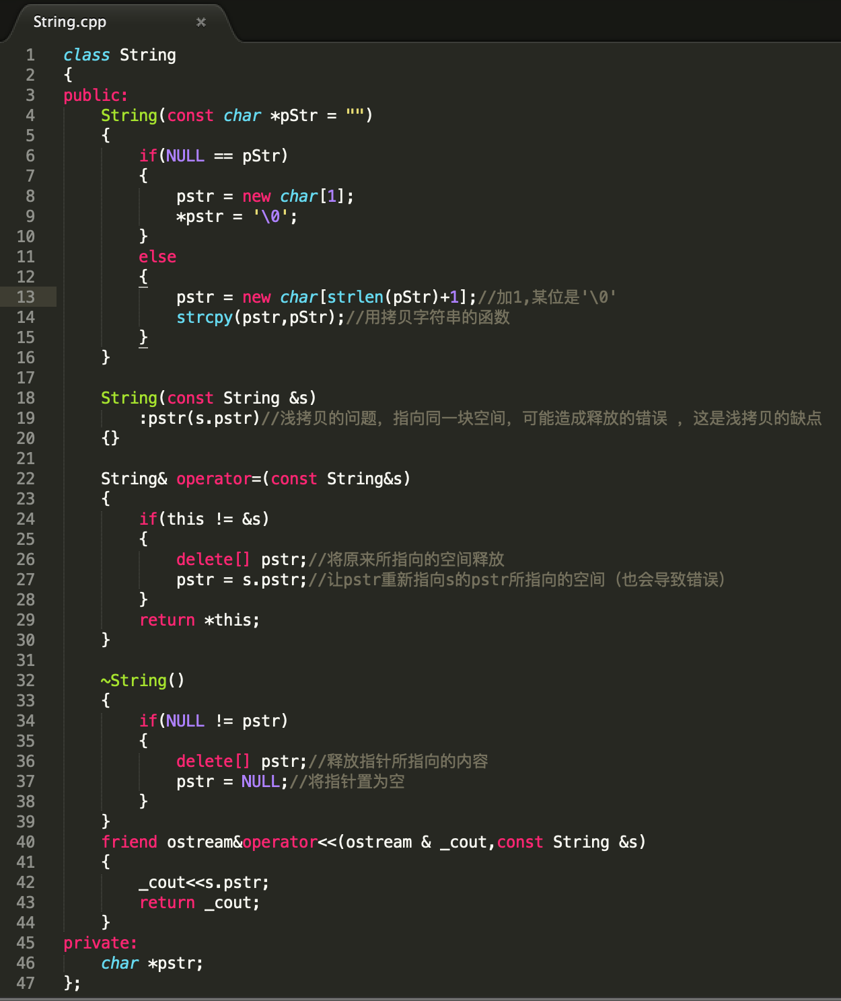
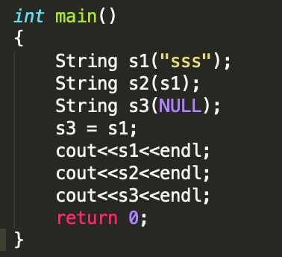
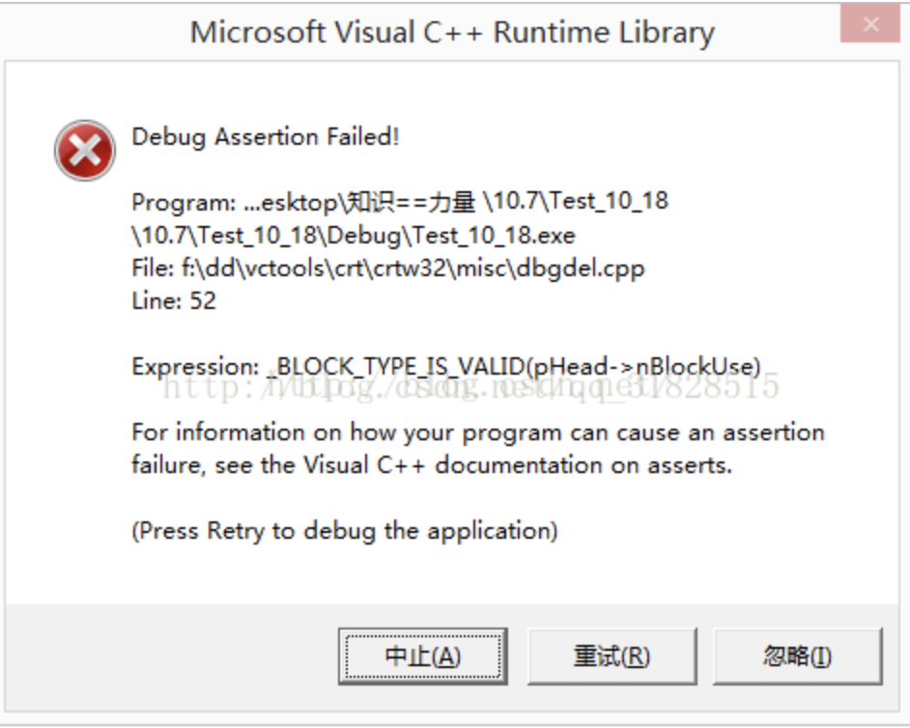
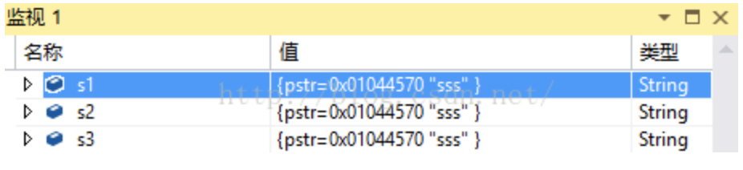
Notes:
【浅拷贝】在多个对象指向一块空间的时候，释放一个空间会导致其他对象所使用的空间也被释放了，再次释放便会出现错误

Slide 58
4.7 shallow and deep copy
reference data type: name in stack and value in heap, and a reference in stack to the value in heap.
Stack
name | val
a | heap add#1
Heap
val
[0,1,2,3,4]
Stack
name | val
a | heap add#1
b | heap add#1
Heap
val
[0,1,2,3,4]
[0,1,2,3,4]
Deep copy

Slide 59
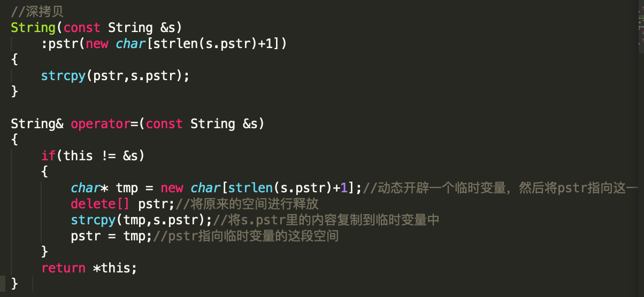
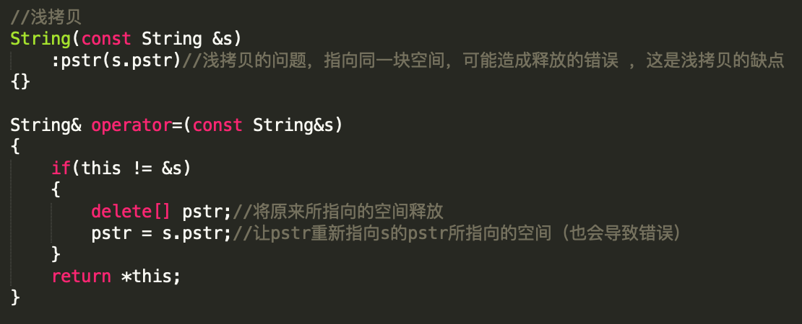
Notes:
【浅拷贝】在多个对象指向一块空间的时候，释放一个空间会导致其他对象所使用的空间也被释放了，再次释放便会出现错误

Slide 60
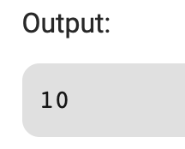
4.8 How to access a private member?
#include<iostream>
using namespace std;
class Test {
private:
int data;
public:
Test() { data = 0; }
int getData() { return data; }
};
int main() {
Test t;
int* ptr = (int*)&t;
*ptr = 10;
cout << t.getData();
return 0;
}
Encapsulation? Security?
Notes:
https://www.geeksforgeeks.org/can-access-private-data-members-class-without-using-member-friend-function/

Slide 61
4.8 friend class
A friend class can access private and protected members of other class in which it is declared as friend.
It is sometimes useful to allow a particular class to access private members of other class.
class Node
{
private:
int key;
Node *next;
/* Other members of Node Class */
……
friend class LinkedList;
// Now class LinkedList can access private members of Node
};

Slide 62
4.8 friend function
A non-member function can access the private and protected members of a class if it is declared a friend of that class.
#include <iostream>
using namespace std;
class Rectangle
{
int width, height;
public:
Rectangle() {}
Rectangle (int x, int y) : width(x), height(y) {}
int area() {return width * height;}
friend Rectangle duplicate (const Rectangle&);
};
Rectangle duplicate (const Rectangle& param) {
Rectangle res;
res.width = param.width*2;
res.height = param.height*2;
return res;
}

Slide 63
4.9 How to make the class versatile?
Member functions are the functions, which have their declaration inside the class definition and works on the data members of the class.
inline member functions
static member functions
const and mutable

Slide 64
4.9 member functions
Can be defined within the class definition or separately using scope resolution operator (::) outside the class.
Similar to accessing a data member in the class, we can access the public member functions through the class object using the dot operator (.).
class Box
{
public:
double length; // Length of a box
double breadth; // Breadth of a box
double height; // Height of a box
double getVolume(void)
{ return length * breadth * height; }
};
//Create an object
Box myBox;
//Call member function
//for the object
myBox.getVolume();
double Box::getVolume(void)
{
return length * breadth * height;
}

Slide 65
4.9 Inline member functions
Implicit inline member function
Member functions defined in the class body, automatically regarded as inline functions, e.g., CStack::size()
:: – class scope resolution operator
Explicit inline member function
Member functions if defined outside the class body, ‘inline’ should be manually specified, e.g.,
inline bool CStack::empty() {
return m_stack.empty(); }
Definitions of both types inline functions should be placed in the head file, for better visibility

Slide 66
4.9 Static Class Member – Data Members
Another example: the fibonacci number sequence class
The sequence is fixed, so every object of the class maintain a copy is needless.
Every instance uses only a range of elements in the sequence, related status information are:
Beginning position – start point in the original sequence
Length – range size of current object
Next Element – current position
How to define the class?

Slide 67
4.9 Static Class Member – Data Members
class CFibonacci
{
public:
//we define interface later
private:
int m_iBegPos;
int m_iLength;
int m_iNext;
static vector<int> s_elems; //declaration
};
CFibonacci::s_elems
fib1
fib3
fib2
m_iBeginPos
m_iLength
m_iNext
m_iBeginPos
m_iLength
m_iNext
m_iBeginPos
m_iLength
m_iNext

Slide 68
4.9 Static Class Member – Data Members
Static data members
Only one entity among all objects of this class
All objects share the static data members and access them
Should be defined and initialized outside the class
vector<int> CFibonacci::s_elems;
//definition and intialized as an empty vector, like global variables
//class scope is needed, but keyword ”static” is no more needed
int Cfibonacci::s_iDefaultPos = 8; //definition and initialized
const objects could be done in the class
{ //Other parts
private:
static const int s_iBuffSize = 1024; //Compiler dependent
int m_Buffer[s_iBuffSize];
}

Slide 69
4.9 Static Class Member – Data Members
Suppose we need to implement a member function is_elem() to check whether an element is in the Fibonacci sequence
It will be only related to the s_elems vector
If a member function never access any non-static data members, it is then independent with any object instances, we could declare it as a static member function

Slide 70
4.9 Static Class Member – Data Members
class CFibonacci
{
public:
static bool is_elem(int); //declaration
//…
};
bool CFibonacci::is_elem(int iValue) //definition, class scope is needed, but “static” is not
{
if ((! s_elems.size()) || (s_elems[s_elems.size()-1] < iValue))
gen_elems_to_value(iValue); //another static member function
vector<int>::iterator found_it, end_it = s_elems.end();
found_it = find(s_elems.begin(), end_it, iValue);
return found_it != end_it;
}

Slide 71
4.9 Static Class Member – Data Members
Benefit – We could directly call these functions, without instantiating any objects
cout << iVal
<< (fIsElem ? “ is ” : “ is not”)
<< “a element of the sequence.”
<< endl << “Try another? (Y/N)”;
cin >> ch;
if (‘N’==ch || ‘n’==ch)
fContinue = false;
}
}
//…
#include “Fibonacci.h”
int main()
{
char ch;
bool fContinue = true;
int iVal;
while (fContinue)
{
cout << “Enter Value: ”;
cin >> iVal;
bool fIsElem = CFibonacci::is_elem(iVal);
Remember: only member functions that never access non-static data members could be declared static

Slide 72
4.9 const member function
If a class is declared as a parameter of const reference in a function, could we use all its member functions?
int sum(const CFibonacci&); //may change m_iNext
As it declared as const, we can invoke only const member functions which telling the compiler they won’t modify the object (may be compiler-dependent)

Slide 73
4.9 const member function
How to declare and define const member functions?
class CFibonacci
{
public:
int length() const { return m_iLength; };
int beg_pos() const;
//…
};
int CFibonacci::beg_pos() const
{
return m_iBegPos;
};
Add const after the parameter list
If member function defined outside the class body, const should also be added
Compiler will check the const member functions, to ensure they actually don’t modify the object

Slide 74
4.9 const member function
Consider this function:
ClassA& ClassA::val() const { return *this; };
Although the function is const, it returns a class reference and exposes the class, which leads the risk of object modification
Solution:
const ClassA& ClassA::val() const { return *this; };

Slide 75
4.9 const member function
Member functions could be overloaded according to const, thus we could provide the const version and non-const version of functions
const ClassA& ClassA::val() const { return m_val; };
ClassA& ClassA::val() { return m_val; };
Compiler will choose the correspondent version according to the constness of objects
void funcB(const ClassA* pca, ClassA& rca)
{
pca->val(); //will call the const version of val()
rca.val(); //will call the non-const version of val()
}

Slide 76
4.9 Mutable
From another viewpoint, once the sequence initialized, m_iNext is only a status iterator, its change will not influence the sequence’s constness
So another solution: declared the m_iNext as mutable
Declare a data member as mutable, to tell the compiler that its change will not violate the constness of the object it belongs to; thus it could be modified in a const member function or via const class reference

Slide 77
4.9 Mutable
class CFibonacci
{
public:
void next_reset() const
{ m_iNext = m_iBegPos – 1; };
bool next(int& iValue) const
{
if (m_iNext < m_iBegPos+m_iLength—1)
{
iValue = s_elems[m_iNext++];
return true;
}
return false;
}
//…
private:
mutable int m_iNext;
//…
};
int sum(const CFibonacci& fib)
{
if (! fib.length())
return 0;
fib.next_reset();
int val, sum = 0;
while (fib.next(val))
sum += val;
return sum;
}

Slide 78
4.10 What is operator overloading?
Changing the definition of an operator so it can be applied on the objects of a class is called operator overloading.
To overload an operator, we need to write a function for the operator we are overloading.

Slide 79
4.10 Operator overloading
Overloading an operator
Write function definition as normal
Function name is keyword operator followed by the symbol for the operator being overloaded
operator+ used to overload the addition operator (+)
Using operators
To use an operator on a class object it must be overloaded unless the assignment operator(=)or the address operator(&)
Assignment operator by default performs memberwise assignment
Address operator (&) by default returns the address of an object

Slide 80
4.10 Operator Overloading
Rules for operator overloading:
Not to introduce new operators
Not to change the semantic meaning, always considering the int
Operand number could not be changed, binary ops could not be overloaded as unary
Precedence could not be changed
Ops for non-class type could not be overloaded (re-defined); For non-member definition style, at least one parameter should be class type.
//non-member style
inline int operator*(const CFibonacci_Iterator& rhs) const {
rhs.check_integrity();
//access private function, need other access control
return CFibonacci::s_elems[ m_iIdx ] ;
}

Slide 81
4.10 Operator Overloading
Rules for operator overloading: (cont.)
Operators could not be overloaded:
. .* :: ?: new delete sizeof typeid
static_cast dynamic_cast const_cast reinterpret_cast
Operators not suggested to overload:
&& || ,
Operators could be overloaded:
operator new operator delete operator [] new operator [] delete
+ - * / % ^ & | ~ ! = < > += -= *= /= %= ^=
&= != << >> <<= >>= == != <= >= ++ -- ->* ->
() []

Slide 82
4.11 How to read and write an object?
Suppose we need to input and output the object like this:
cout << fib1 << endl;
cin >> fib1;
The object is not of built-in type, how could we reach it?
Overload the << and >>

Slide 83
4.11 Overload the iostream operators
ostream& operator<<(ostream& os, const CFibonacci& rhs )
{
os << “( ” << rhs.beg_pos() << “, ” << rhs.length() << “ )”;
rhs.display(rhs.length(), rhs.beg_pos(), os);
return os;
}
Output: ( 3, 6 )2 3 5 8 13 21
istream& operator>>(istream& is, CFibonacci& rhs )
{
char ch1, ch2;
int bp, len;
//suppose the input format is: (3,6)
cin >> ch1 >> bp >> ch2 >> len;
rhs.beg_pos(bp);
rhs.length(len);
rhs.next_reset;
return is;
}

Slide 84
4.11 Overload the iostream operators
For the << and >> operators overloading, it suggested to use the non-member form
Or it will have the strange usage
class X
{
ostream& operator<<(ostream&);
istream& operator>>(istream&);
} a, b;
b << a << cout; //b.operator<<(a.operator<<(cout));
b >> a >> cin; //b.operator>>(a.operator>>(cin));
Notes:
怪在哪里？常规我们是cout<< a<<b;的顺序

Slide 85
4.12 How to implement a function object?
Function object – a class providing function call operator
class LessThan
{
public:
LessThan(int val) : m_iBaseVal(val);
int read_base() const { return m_iBaseVal; }
void change_base(int val) { m_iBaseVal = val; }
bool operator()(int value) const
{ return value < m_iBaseVal; } //function call operator
private:
int m_iBaseVal;
}

Slide 86
4.12 Implement a function object
Usage
int count_less_than(const vector<int>& vec, int iBase)
{
LessThan lt(iBase);
int count = 0;
for (int i = 0; i < vec.size(); i++)
//lt(vec[ i ]) will be converted to lt.operator(vec[ i ])
if ( lt(vec[ i ]) )
count++; //by the compiler automatically
return count;
}

Slide 87
4.13 How to build an Iterator class
Suppose we need provide the following ways of using for our Fibonacci sequence class, quite similar with a standard container class
CFibonacci fib(10);
CFibonacci::iterator it = fib.begin(),
end_it = fib.end();
while (it != end_it)
{
cout << *it << endl;
it++;
}

Slide 88
4.13 Implement an Iterator class – Operators Overloading
iterator should be a nested class of CFibonacci
Some operators, such as !=, ==, *, ++, should be overloaded in the iterator class
class CFibonacci_Iterator
{
public:
CFibonacci_Iterator(int idx) : m_iIdx(idx - 1) {};
bool operator= =(const CFibonacci_Iterator&) const;
bool operator!=(const CFibonacci_Iterator&) const;
int operator*() const;
CFibonacci_Iterator& operator++(); //prefix version
const CFibonacci_Iterator operator++( int ); //postfix version
private:
void check_integrity(); //to avoid exceed the limit
int m_iIdx; //index the static s_elems
}

Slide 89
4.13 Implement an Iterator class – Operators Overloading
inline bool CFibonacci_Iterator ::operator==(const CFibonacci_Iterator& rhs) const
{ return m_iIdx == rhs.m_iIdx; }
inline bool CFibonacci_Iterator ::operator!=(const CFibonacci_Iterator& rhs) const
{ return !(*this == rhs); } //use previous overloaded ==
inline int CFibonacci_Iterator::operator*() const //member style
{ check_integrity();
return CFibonacci::s_elems[ m_iIdx ] ; }
CFibonacci_Iterator& operator++(); //++it
{ ++m_iIdx;
check_integrity();
return *this; }
const CFibonacci_Iterator operator++(int); //it++, int is required by C++, to distinguish from the prefix version, a 0 is generated automatically
{ CFibonacci_Iterator old = *this;
++(*this); //use previous prefix ++ to eliminate future bugs
return old; } //from stand-alone modifications
Notes:
i++ 先算后加
++i 先加后算

Slide 90
4.13 Implement an Iterator class – Operators Overloading
The return value of prefix version of ++ is a class reference
“Increment and fetch” in semantic meaning
The return value of postfix version should be a const object
“Fetch and increment” in semantic meaning
To prevent such usage: it++++;
For most operators and functions, use pass-by-value if an object must be returned
Few exceptions: op++(), op[]() (writing version)
it++++; //for integer, it’s invalid; it’s better so for iterator
(it.operator++(0)).operator++(0);
const iterator operator++(int) //a const object as the return value, could stop
//the second invoke,because the op++ is a non-const
//member function

Slide 91
4.13 Implement an Iterator class – Nested Types
Then, Modify the CFibonacci to provide the begin() and end() functions
#include “CFibonacci_Iterator.h”
class CFibonacci
{
public:
//to make the class name CFibonacci_Iterator
//be transparent to the users, use the abstract form
typedef CFibonacci_Iterator iterator;
CFibonacci_Iterator begin() const
{ return CFibonacci_Iterator(m_iBegPos); }
CFibonacci_Iterator end() const
{ return CFibonacci_Iterator(m_iBegPos + m_iLength); }
//…
};

Slide 92
4.13 Implement an Iterator class – Friend
For the operator *, it will access the private data members like s_elems in CFibonacci class, how could it be?
Declaring it as friend will make it have the same access privilege as class member functions
Or we could declare the whole class as friend
class CFibonacci
{
//this function have same privilege as CFibonacci’s member function
friend int CFibonacci_Iterator:: operator*() const;
}
class CFibonacci
{
friend class CFibonacci_Iterator; //all its member functions have privilege
}

Slide 93
4.13 Implement an Iterator class – Friend
Friend declaration could appear in any place inside of the class, and will not be influenced by the access control
Define friend for performance consideration, tradeoff between efficiency and encapsulation
Direct accessing private members
Avoiding the cost of public manipulating interface

Slide 94
4.14 What happens when pointer to class members?
Suppose we need to have different classes to support Fibonacci, Pell, Lucas, Pentagonal, Square and Triangular, how to implement a general class to support the six sequences?
int main(){
num_sequence ns;
const int pos = 8;
for(int ix = 1; ix < num_sequence::num_of_sequence(); ++ix)
{
ns.set_sequence( num_sequence::ns_type(ix) );
int elem_val = ns.elem( pos );
display(cout, ns, pos, elem_val);
}
}

Slide 95
4.14 Pointers to class member functions
Definition
void (num_sequence::*pm) (int) = 0;
//simplified way
typedef void (num_sequence::*PtrType) (int);
PtrType pm = 0;
class num_sequence{
public:
typedef void (num_sequence::*PtrType) (int);
// pmf can point to any of the following functions
void fibonacci( int );
void pell( int );
void lucas( int );
void triangular( int );
void square( int );
//...
private:
PtrType pmf; };

Slide 96
4.14 Pointers to class member functions
Definition
void (num_sequence::*pm) (int) = 0;
//simplified way
typedef void (num_sequence::*PtrType) (int);
PtrType pm = 0;
Assignment
pm = &num_sequence::fibonacci;
Usage
num_sequence ns;
num_sequence *pns = &ns;
(ns.*pm)(pos);
(pns->*pm)(pos);
.* (->*) -- pointer to member selection operator

